Slide 1
Report from the EIC Project
Jim Yeck
EIC Project Director
EIC Users Group Meeting
July 24, 2024

Slide 2
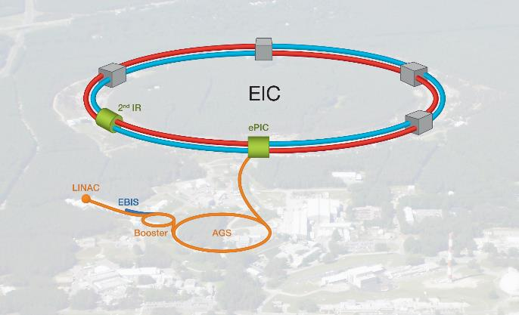
Outline
Introduction
EIC Requirements
Recent Highlights
Design Overview
Critical Decisions and Milestones
Funding and Schedule Update
Planning for CD-3B & CD-2
Organization
Accelerator Collaboration
Summary

Slide 3
Facility Requirements
EIC Facility Performance Goals
High Luminosity: L= 10³³ – 10³⁴cm⁻²sec⁻¹, 10 – 100 fb⁻¹/year
Highly Polarized Beams: 70%
Large Center of Mass Energy Range: E_{cm} = 20 – 140 GeV
Large Ion Species Range: protons – Uranium
Large Detector Acceptance and Good Background Conditions
Accommodate a Second Interaction Region (IR)
Conceptual design scope and expected performance satisfy the U.S. Nuclear Science Advisory Committee (NSAC) Long Range Plan (2015 & 2023) and the requirements endorsed by the U.S. National Academy of Sciences (2018).

Slide 4
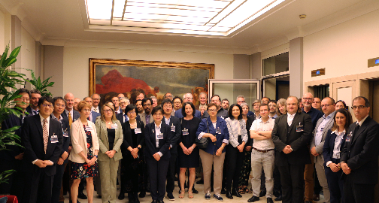
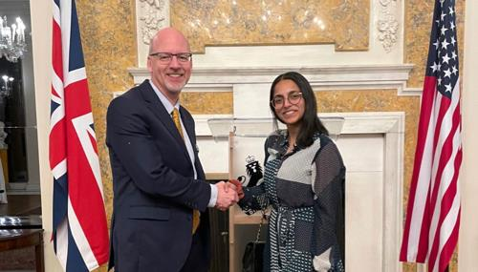
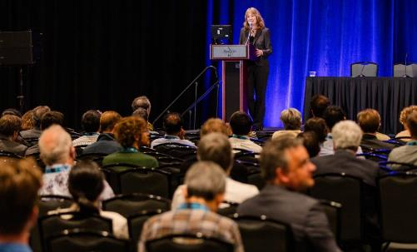
Progress on In-Kind Contributions
In-kind contribution goals are 30% of the Detector and 5% of the Accelerator
EIC Resource Review Board Meeting Held at INFN in May
Strong international participation including: Canada, Czech Republic, France, India, Israel, Italy, Japan, South Korea, United Kingdom, and Taiwan.
EIC Accelerator Collaboration Kick-Off Meeting at IPAC’24
Over 150 participants attended and expressed interest in contributing to the global EIC effort.
UK announced £58 million for the EIC project in March. IKC also developing with Canada, France, and Italy. Statements of Interest signed by the DOE and French agencies.

Slide 5
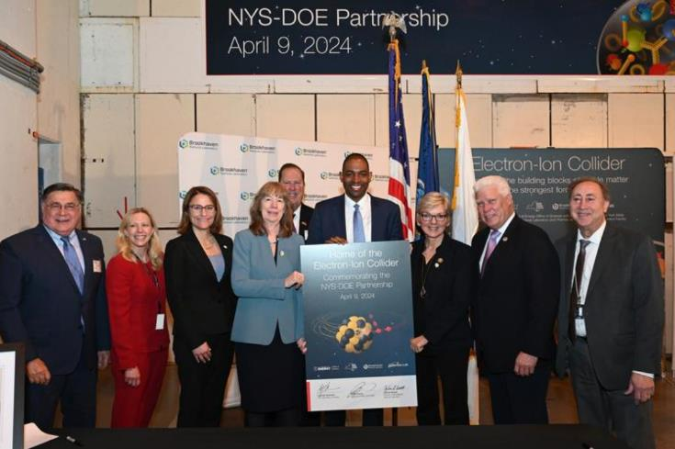
NYS $100M Grant
History of NYS Grant Disbursement
NYS agreed to contribute $100M should
EIC be sited at BNL
ESD Board approval July 2021
SPP proposal submitted to BHSO in September 2023
SPP proposal was approved by SC-1in January 2024
EIC was assigned NYS ESD Project No. 134,346 and Compliance Manager Jordan Kaplan
NYS Grant approved for $100M
Received first $100k installment Tuesday, March 26th
Began charging labor hours to NYS scope in April
NYS DOE Partnership Ceremony held on April 9^{th .} View video here.
“The Electron-Ion Collider is a quintessential lab project, opening new vistas for scientific discovery, and in the process hiring hundreds of Long Island union workers to build the collider. I am grateful to Governor Hochul along with Senators Schumer and Gillibrand for their leadership on this game-changing initiative.”
-United States Secretary of Energy Jennifer Granholm

Slide 6
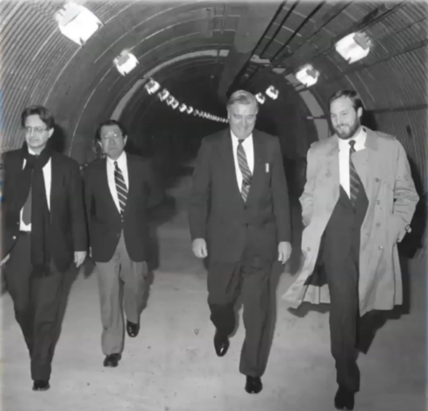
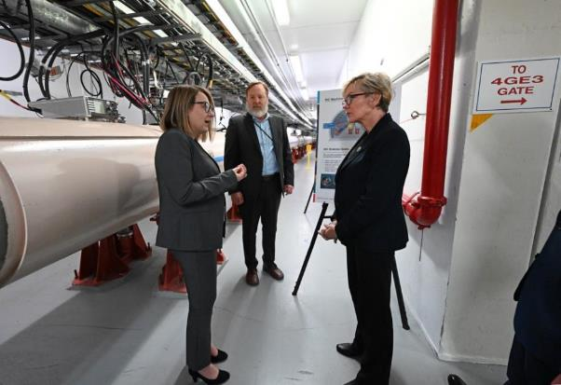
AGS → RHIC → EIC
DOE Secretary of Energy Visit February 1991
DOE Secretary of Energy Visit
April 2024
Leveraging existing infrastructure to deliver a new facility
Enabling the next generation of professionals

Slide 7
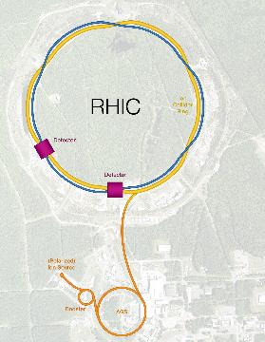
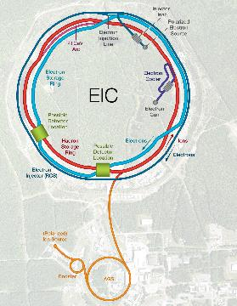
EIC Design Overview
Hadron Storage Ring (RHIC Rings) 40-275 GeV
Superconducting magnets (existing)
1160 bunches, 1A beam current (3x RHIC)
Bright vertical beam emittance 1.5 nm (“flat beams”)
Cooling at collisions (coherent electron cooling)
Electron Storage Ring 5–18 GeV
High beam current, 2.5 A, 9 MW S.R. power, S.C. RF
Swap-out injection of polarized bunches
Electron rapid cycling synchrotron, 1Hz, 3 -> 18 GeV
Spin transparent due to high quasi-periodicity
SCRF injection linac (3 GeV)
High luminosity Interaction Region(s)
Superconducting final focus magnets
25 mrad crossing angle with crab cavities
Spin Rotators (longitudinal spin)
Forward hadron instrumentation

Slide 8
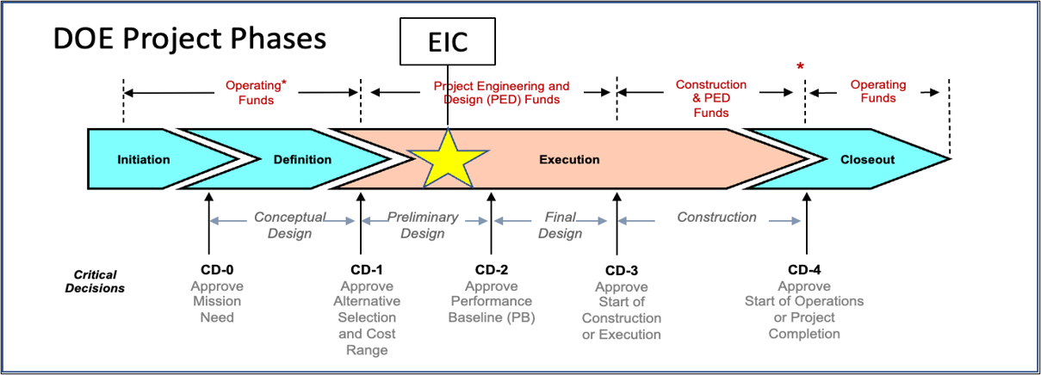
DOE EIC Critical Decision Milestones
2019
2021
CD-2, Performance Baseline, and
CD-3, Construction Start, End of 2025✽
CD-4 = 2034
CD-3A, Long Lead Procurement, approved March 2024. Excellent use of IRA funding.
CD-3B, Long Lead Procurement, approval planned for March 2025.
CD-2, Project Performance Baseline, requires a DOE approved annual funding profile.
✽ FY25 and FY26 funding will impact CD-2 and CD-3 milestone dates.
Notes:
CD-2, Project Performance Baseline, requires an annual funding profile.

Slide 9
EIC Project Funding Plans
Cumulative Project Funding to Date ($490M)
DOE = $390 M, including $138M Inflation Reduction Act.
New York State = $100 M.
FY2025 Funding TBD
EIC Plan: $150M
DOE Request: $113M
House: $128M
Senate: TBD
FY2026 Funding TBD
RHIC operations concludes end of 2025.
EIC project transitions to construction.
Reduced RHIC operations funding maintains the injector complex and the removal/repurposing of equipment.
Assumed Peak Annual Funding
$300M per year
EIC Ops Operations
Starting w/Electron Injector
RHIC Ops Concludes
Annual Funding Plan Prior to FY25 PBR ($M)
FY20 | FY21 | FY22 | FY23 | FY24 | FY25 | FY26 | FY27 | FY28 | FY29 | FY30 | FY31 | FY32 | FY33 | FY34 | Total
11 | 30 | 183 | 70 | 98 | 150 | 300 | 300 | 300 | 300 | 300 | 254 | 222 | 165 | 120 | 2,803

Slide 10
Project Planning Update
The EIC project is preparing plans for completing the design, construction, and commissioning of the EIC facility. Plans must satisfy the DOE approved mission need, and be based on realistic assessments of technical readiness, cost, schedule, and risk.
There are three primary project planning goals/constraints:
Annual EIC project funding requirements should not exceed $300M per year,
Total Project Cost less than $3B, and,
Deliver science within ten years after RHIC shuts down.
The annual funding limitation may require the phased delivery of the accelerator, which is more than 85% of the DOE funded project scope. It is possible to start the science program in less than ten years with electron-ion collisions at the conclusion of the first phase. The second phase would complete the scope required to achieve the DOE approved mission need. The two phases would overlap.

Slide 11
Project Planning Update (2)
The plan to phase the delivery of the EIC project, i.e., two phases, is consistent with the DOE Order 413.3B, Program and Project Management for the Acquisition of Capital Assets, and the DOE Critical Decision process. The current implementation of the DOE Order for large, complex projects uses subprojects. The two EIC project phases would result the following subprojects:
EIC Early Science Subproject [Accelerator Phase I and Detector Phase I]; and,
EIC Full Capability Subproject [Accelerator Phase II and Detector Phase II].
The priority would remain to secure DOE approvals of CD-2, Performance Baseline, and CD-3, Construction Start, in the time frame that RHIC operations concludes. The actual timing is dependent on funding. A realistic goal is DOE CD-2/3 approval for the EIC Early Science Subproject by the end of 2025.
A Project Strategy Meeting is planned for August 21 to further define construction plans.

Slide 12
Near Term Project Planning Dates
Milestone | Date | Milestone | Date
Advisory Board Meeting | Jan 25, 2024 | Machine Advisory Committee | Sep 16-18, 2024
Infrastructure Construction Advisory Committee | Jan 30-31, 2024 | Infrastructure Construction Advisory Committee | Oct 3-4, 2024
Project Advisory Board Meeting | Feb 29, 2024
DOE CD-3A ESAAB Approval (A) | Mar 25, 2024 | CD-3B and Status Director’s Review | Oct 22-24, 2024
Virtual Machine Advisory Meeting | Apr 15 & 17, 2024 | EIC Advisory Board | Oct TBD, 2024
Advisory Board Meeting | Apr 19, 2024 | Resource Review Board Meeting | Nov 12-13, 2024
Resource Review Board Meeting | May 6-7, 2024 | DOE CD-3B and Status OPA Review | Jan 7-9, 2025
SC Magnet Steering Group Kickoff (bi-weekly mtgs.) | May 17, 2024 | DOE CD-3B ESAAB Approval | Mar 2025
Detector Advisory Committee Meeting | June 21, 2024
Advisory Board Meeting | Aug 2, 2024 | DOE CD-2/3 OPA Review and ICR | TBD 2025
Project Advisory Committee Meeting | Aug 21, 2024 | RHIC Operations Concludes | Oct 2025
Detector Advisory Committee Meeting | Sep TBD 2024 | DOE CD-2/3 ESAAB Approval | TBD 2025

Slide 13
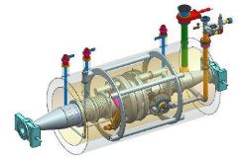
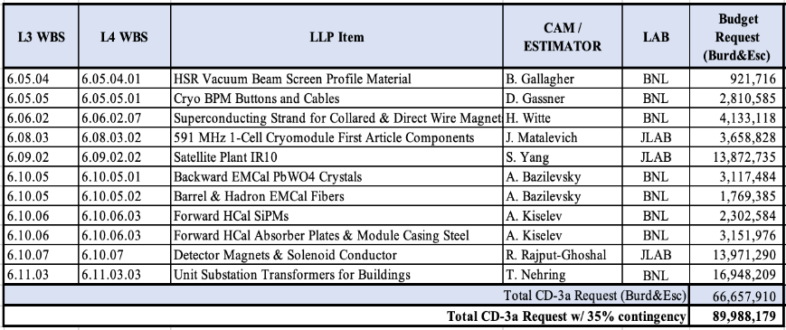
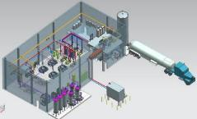
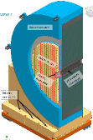
CD-3A, Long-Lead Procurement (LLP)
The EIC project is approved to execute ~$90M in LLPs. IRA funds will support ~$60M.
CD-3B LLP items are being prepared and prioritized.
Prominent items include normal conducting magnets for the Rapid Cycling Synchrotron (RCS) and for the Electron Storage Ring (ESR).

Slide 14
BNL/JLab Partnership
EICUG, ePIC Collaboration, and Accelerator Collaboration Input and Advice
Technical & Management Advice
International Governance
BROOKHAVEN NATIONAL LABORATORY
J. Hewett
Laboratory Director
J. Hill A. Emrick
Deputy Director for Science Deputy Director for
& Technology Operations
BOARDS
EIC ADVISORY BOARD S. Henderson (JLAB) L. Merminga (FNAL)
D. Bettoni (INFN) F. Sabatie (IRFU-Saclay)
M. Grasso (IN2P3) N. Smith (TRIUMF)
P. Kearns (ANL) M. Thomson (STFC)
M. Lamont (CERN) M. Witherell (LBNL)
RESOURCE REVIEW BOARD A. Deshpande (BNL) D. Bettoni (INFN)
D. Dean (JLAB) Funding Agencies
ELECTRON-ION COLLIDER PROJECT
J. Yeck
PROJECT DIRECTOR
A. Petrone
CHIEF OF STAFF
EIC PROJECT MANAGER L. Lari
TECHNICAL DIRECTOR S. Nagaitsev
ASSOCIATE PROJECT MANAGER J. Fast (JLAB)
CO-ASSOCIATE DIRECTOR EXPERIMENTAL PGM R. Ent (JLAB)
CO-ASSOCIATE DIRECTOR EXPERIMENTAL PGM E. Aschenauer
SENIOR ADVISOR F. Willeke
Associate Director for ACC. IntL. Partnerships A. Seryi (JLAB)
Environmental, Safety and Health C. Schaefer
W. Rainey (JLAB)
EIC SCIENCE & TECHNOLOGY
User Group Steering Committee M. Radici (INFN)
O. Hen (MIT)
ePIC Collaboration J. Lajoie (ORNL)
S. Dalla Torre (INFN)
EIC ACCELERATOR COLLABORATION C. Welsch (Liverpool) A. Seryi (JLAB)
ADVISORY COMMITTEES
Project T. Glasmacher (MSU), Chair
Machine T. Raubenheimer (SLAC), Chair
Detector E. Kinney (UC), Chair
Infrastructure Construction M. Fallier (BNL Retired), Chair
STEERING GROUP
Superconducting Magnets G. Apollinari (FNAL), Chair
Technical support & Integration
K. Smith
DEPUTY TECHNICAL DIRECTOR K. Smith
CHIEF ENGINEER J. Tuozzolo
Chief Systems Engineer T. Russo
Associate PROJECT Engineer K. Wilson (JLAB)
PROJECT OFFICE & IN-KIND SUPPORT
L. Lari
TJNAF PROJECT SUPPORT J. Fast (JLAB)
PROJECT CONTROLS P. Kessler (JLAB)
PROCUREMENT M. Laney (JLAB)
PROJECT SUPPORT C. Lavelle
PROJECT CONTROLS K. Krug
BUSINESS OPERATIONS H. Turbush
PROCUREMENT K. Kirkendall (Interim)
RISK MANAGER I. Sourikova
ADMIN SUPPORT SERVICES C. Hoffman
QUALITY ASSURANCE & CONFIG. MGMT C. Porretto/J. Harris (JLAB)
In-Kind Contributions SUPPORT P. Berrutti/ J. Fast (JLAB)
Accelerator development & R&D
M. Blaskiewicz
L2 Manager
T. Satogata (JLAB)
Deputy L2 Manager
Electron Injector
V. Ranjbar
L2 Manager
TBD
Deputy L2 Manager
Electron Storage Ring
C. Montag
L2 Manager
S. Philip (JLAB)
Deputy L2 Manager
Hadron Ring
V. Ptitsyn
L2 Manager
C. Liu
Deputy L2 Manager
Interaction Regions & Detector Interface
A. Drees
L2 Manager
W. Wahl (Interim)
Deputy L2 Manager
Accelerator Support Systems
J. Tuozzolo
L2 Manager
TBD
Deputy L2 Manager
RF Systems
Z. Conway (JLAB)
L2 Manager
P. Berrutti (Interim)
Deputy L2 Manager
Cryogenics
B. Shell (JLAB)
L2 Manager
R. Than
Deputy L2 Manager
EIC Detector
R. Ent (JLAB)
L2 Manager
E. Aschenauer
Deputy L2 Manager
Infrastructure
C. Folz
L2 Manager
D. Nassar
Deputy L2 Manager
Pre-Operations
A. Blednykh
L2 Manager
T. Satogata (JLAB)
Deputy L2 Manager

Slide 15
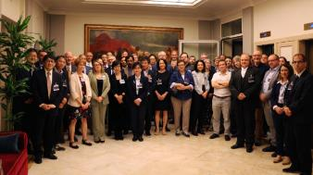
EIC Boards, Committees, and Steering Group
Advisory Board (AB) – Advice to the BNL Director on the construction of the EIC accelerator facility. Meets ~ 3 times per year. Chaired by JLab Director.
EIC Resource Review Board (RRB) – Oversight of the EIC Experimental Program. Meets ~ 2 times per year. Chaired by the BNL/JLab and International Partner.
Project Advisory Committee (PAC) – Advice to the BNL Director on the delivery of the EIC Project and organized by the Project Director. Meets 2-3 times per year.
EIC RRB Meeting
May 6-7, 2024
Machine Advisory Committee (MAC) – Provides advice on EIC accelerator science and technology. The MAC reports to the EIC Project Director and is organized by the EIC Technical Director. Meets 2-3 times per year.
Detector Advisory Committee (DAC) – Provides advice on detector science and technology. The DAC reports to the EIC Project Director and organized by the EIC Co-Associate Directors for the EIC Experimental Program. Meets 2-3 times per year.
Infrastructure Construction Advisory Committee (ICAC) – Provides advice on infrastructure plans. The ICAC reports to the EIC Project Director and organized by EIC Infrastructure Division Director. Technical experts with rotating terms. Meets 2-3 times per year.
SC Magnet Steering Group (MSG) – Charged to guide the development of an EIC SC Magnet Design, Production, and Testing Plan. The MSG reports to the EIC Project Director. Meets at least monthly over the next 2 years.

Slide 16
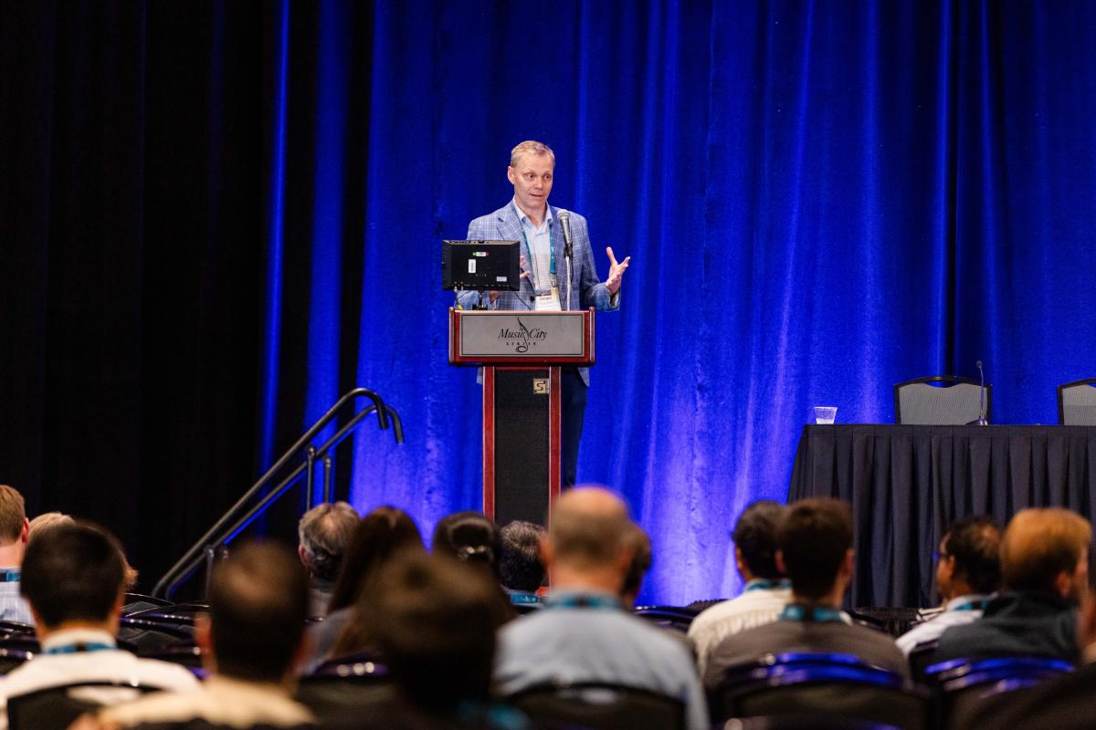
EIC Accelerator Collaboration
The EIC Accelerator Collaboration will enhance the developments of the evolution, upgrades, and the ultimate performance of the EIC facility.
150 accelerator experts joined the Kick-Off Meeting at the International Particle Accelerator Conference (IPAC) ’24 in May 2024 in Nashville.
Co-Chairs: Andrei Seryi (Jefferson Lab) and Carsten Welsch (Liverpool, UK)
Collaborative topical working groups formed:
Beam-Beam
Polarization
Working Groups are coordinated by leaders who are appointed by Co-Chairs of the Accelerator Collaboration in coordination with EIC Project Technical Director Sergei Nagaitsev.
EIC Technical Director Sergei Nagaitsev presenting at IPAC’24

Slide 17
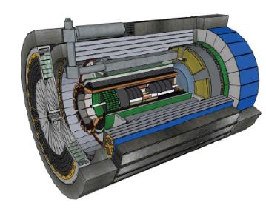
Summary
EIC is a unique, high-energy, high-luminosity, polarized beam collider that will be one of the most challenging and exciting accelerator complexes ever built -- only new collider in the next decades.
DOE approved CD-3A and supports the preparation CD-3B for additional procurements.
Strong support in the scientific community and increasing international engagement. Partners participated in preparing the EIC governance model and engaging in the project.
The 2024 priorities include:
Execution of the CD-3A baseline and contracts;
Preparing the CD-3B procurements and baseline for DOE approval;
Preliminary design, and final design for CD-3B items;
Review of all project dependencies (accelerator, detector, host lab); and,
Preparation of the technical, cost, schedule, and performance baseline (CD-2).

