Slide 1

Status of the ePIC
Collaboration
J. Lajoie, S. Dalla Torre
July 24, 2024

Slide 2

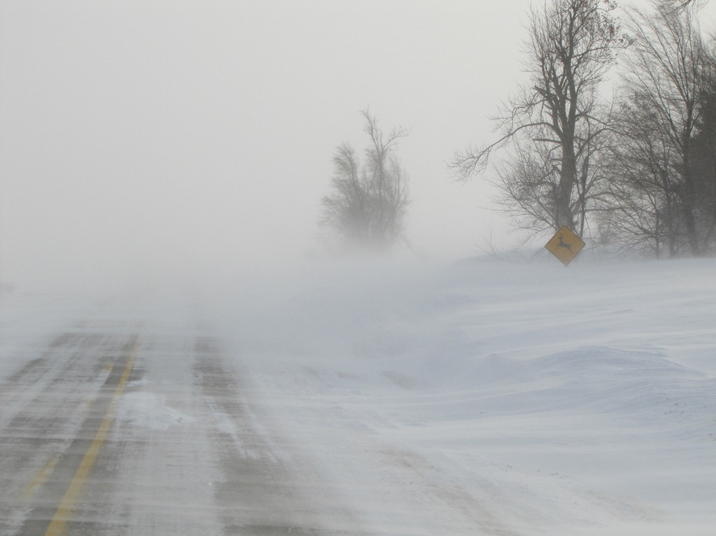
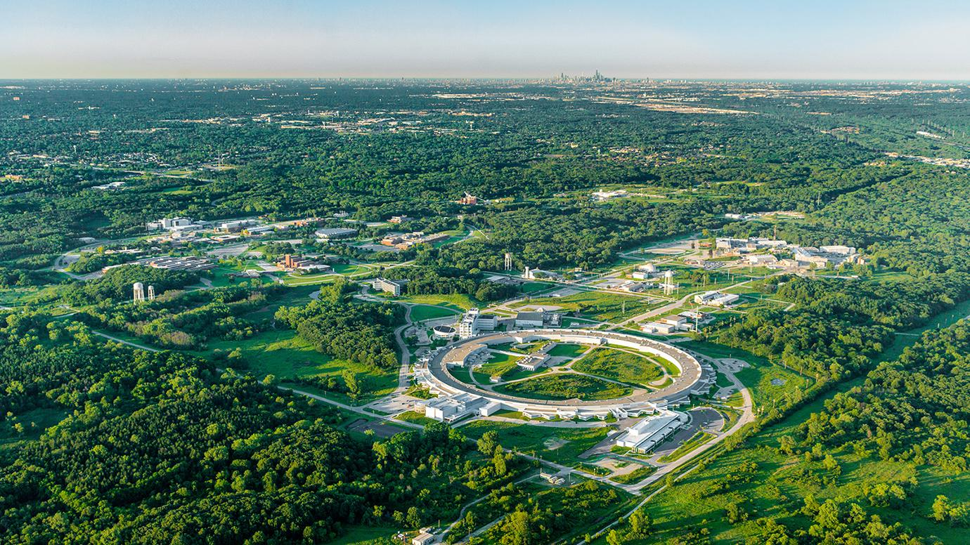
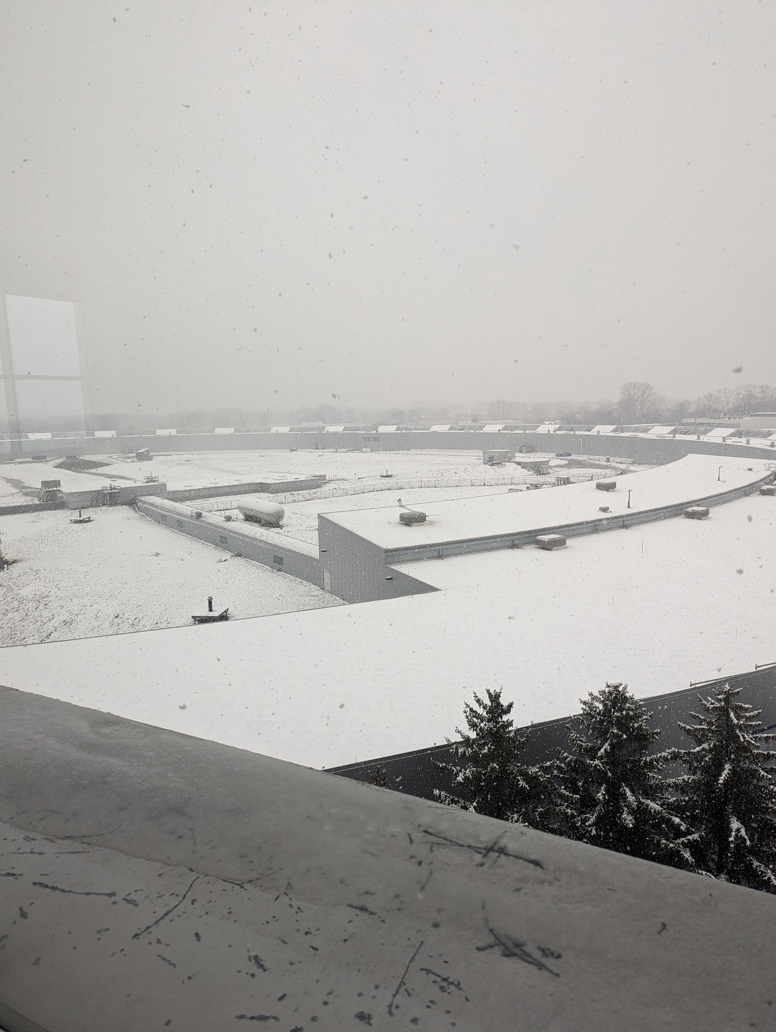

Welcome to Argonne!
Thanks to our hosts for this wonderful venue and support!

Slide 3

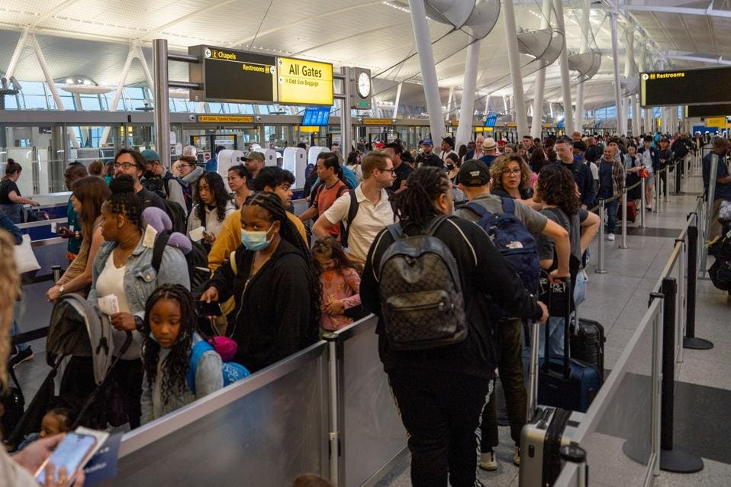
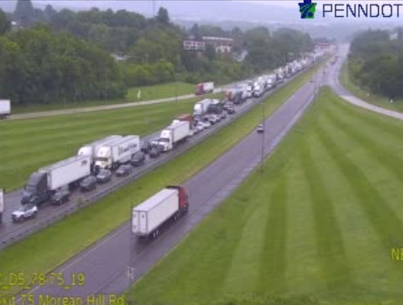
Welcome to Lehigh!
Lehigh University
Bethlehem, PA
July 22-27
Jointly organized with the EICUG
ePIC Meeting
July 24-27th
https://indico.bnl.gov/event/20727/

Slide 4
From there to here 2024…
10 General Meetings
22 TIC Meetings
100’s of DSC and WG Mtgs
Test beams, etc.
3rd EIC-Asia Workshop
Jan 29-31st
4th EIC-Asia Workshop
July 1-5th
Argonne Collab. Mtg. Jan 2024
BIC Workshop
May 14-17th
Lehigh Collab. Mtg. July 2024
hpDIRC Annual Meeting
May 16-22nd
ePIC Software and Computing Meeting
@ CERN– Apr 22-26th
INFN ePIC Meeting
June 27-28th
2024
2025
ePIC/EIC Det. R&D Day
March 25th
PDR: Integration, Installation
and Infrastructure
July 15th
PDR2: IR Integration and Auxiliary Detectors – Feb 12th
PDR2: Electronics & DAQ
FDR for VTRx+/lpGBT
(poss. CD-3B scope)
June 10-11th
PDR1: Tracking Detectors
March 20-21st
FDR: Magnet Power Supply
(poss. CD-3B scope)
May 28th
8th Detector Advisory Committee
June 21st

Slide 5
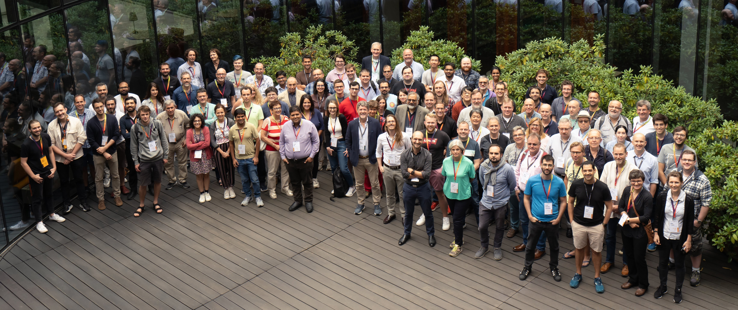
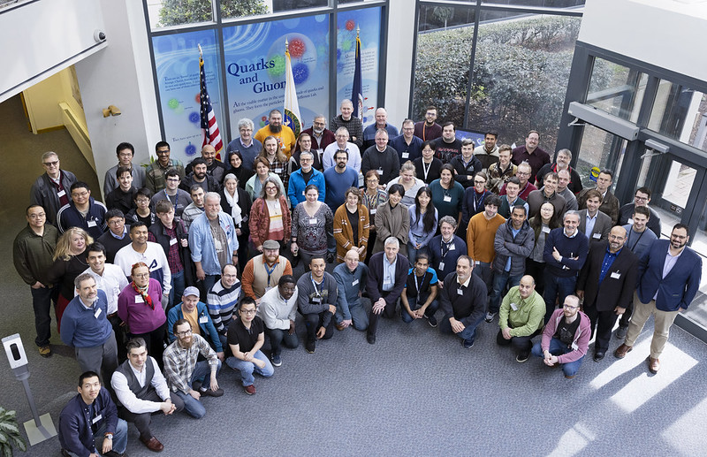
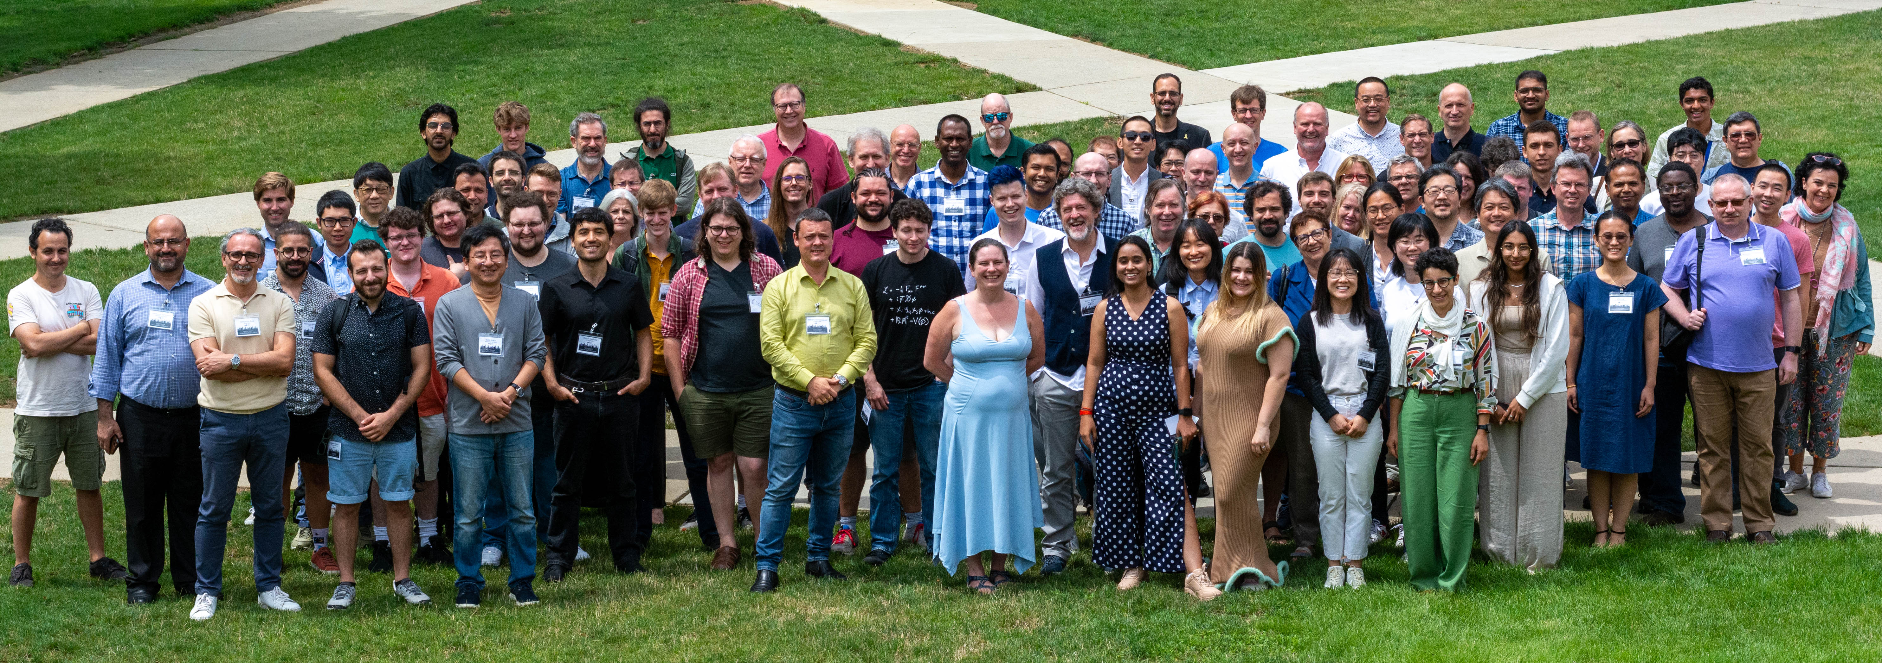
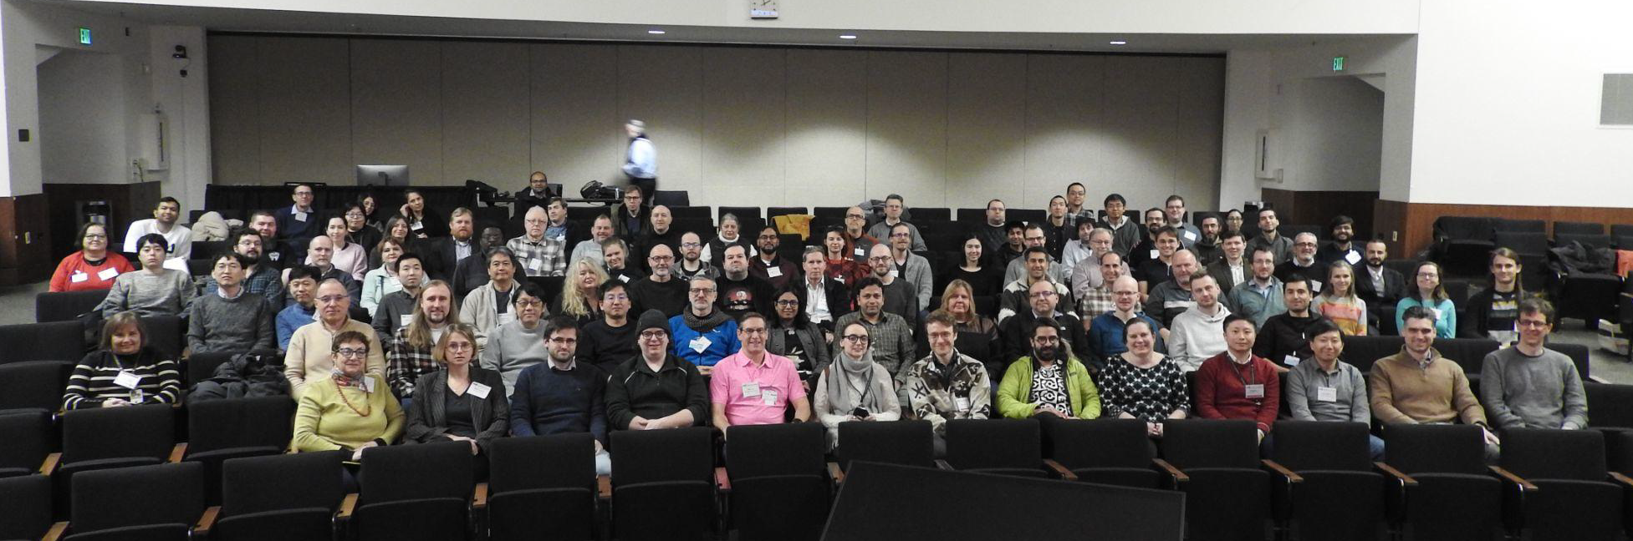
The Collaboration
Warsaw, July 2023
JLab, Jan. 2023
ANL,
Jan. 2024
ePIC is a community of scientists dedicated to realizing the EIC science mission.
The ePIC Collaboration is as unique as the ePIC detector.
EICUG/ePIC Meeting – Lehigh, July 2024

Slide 6
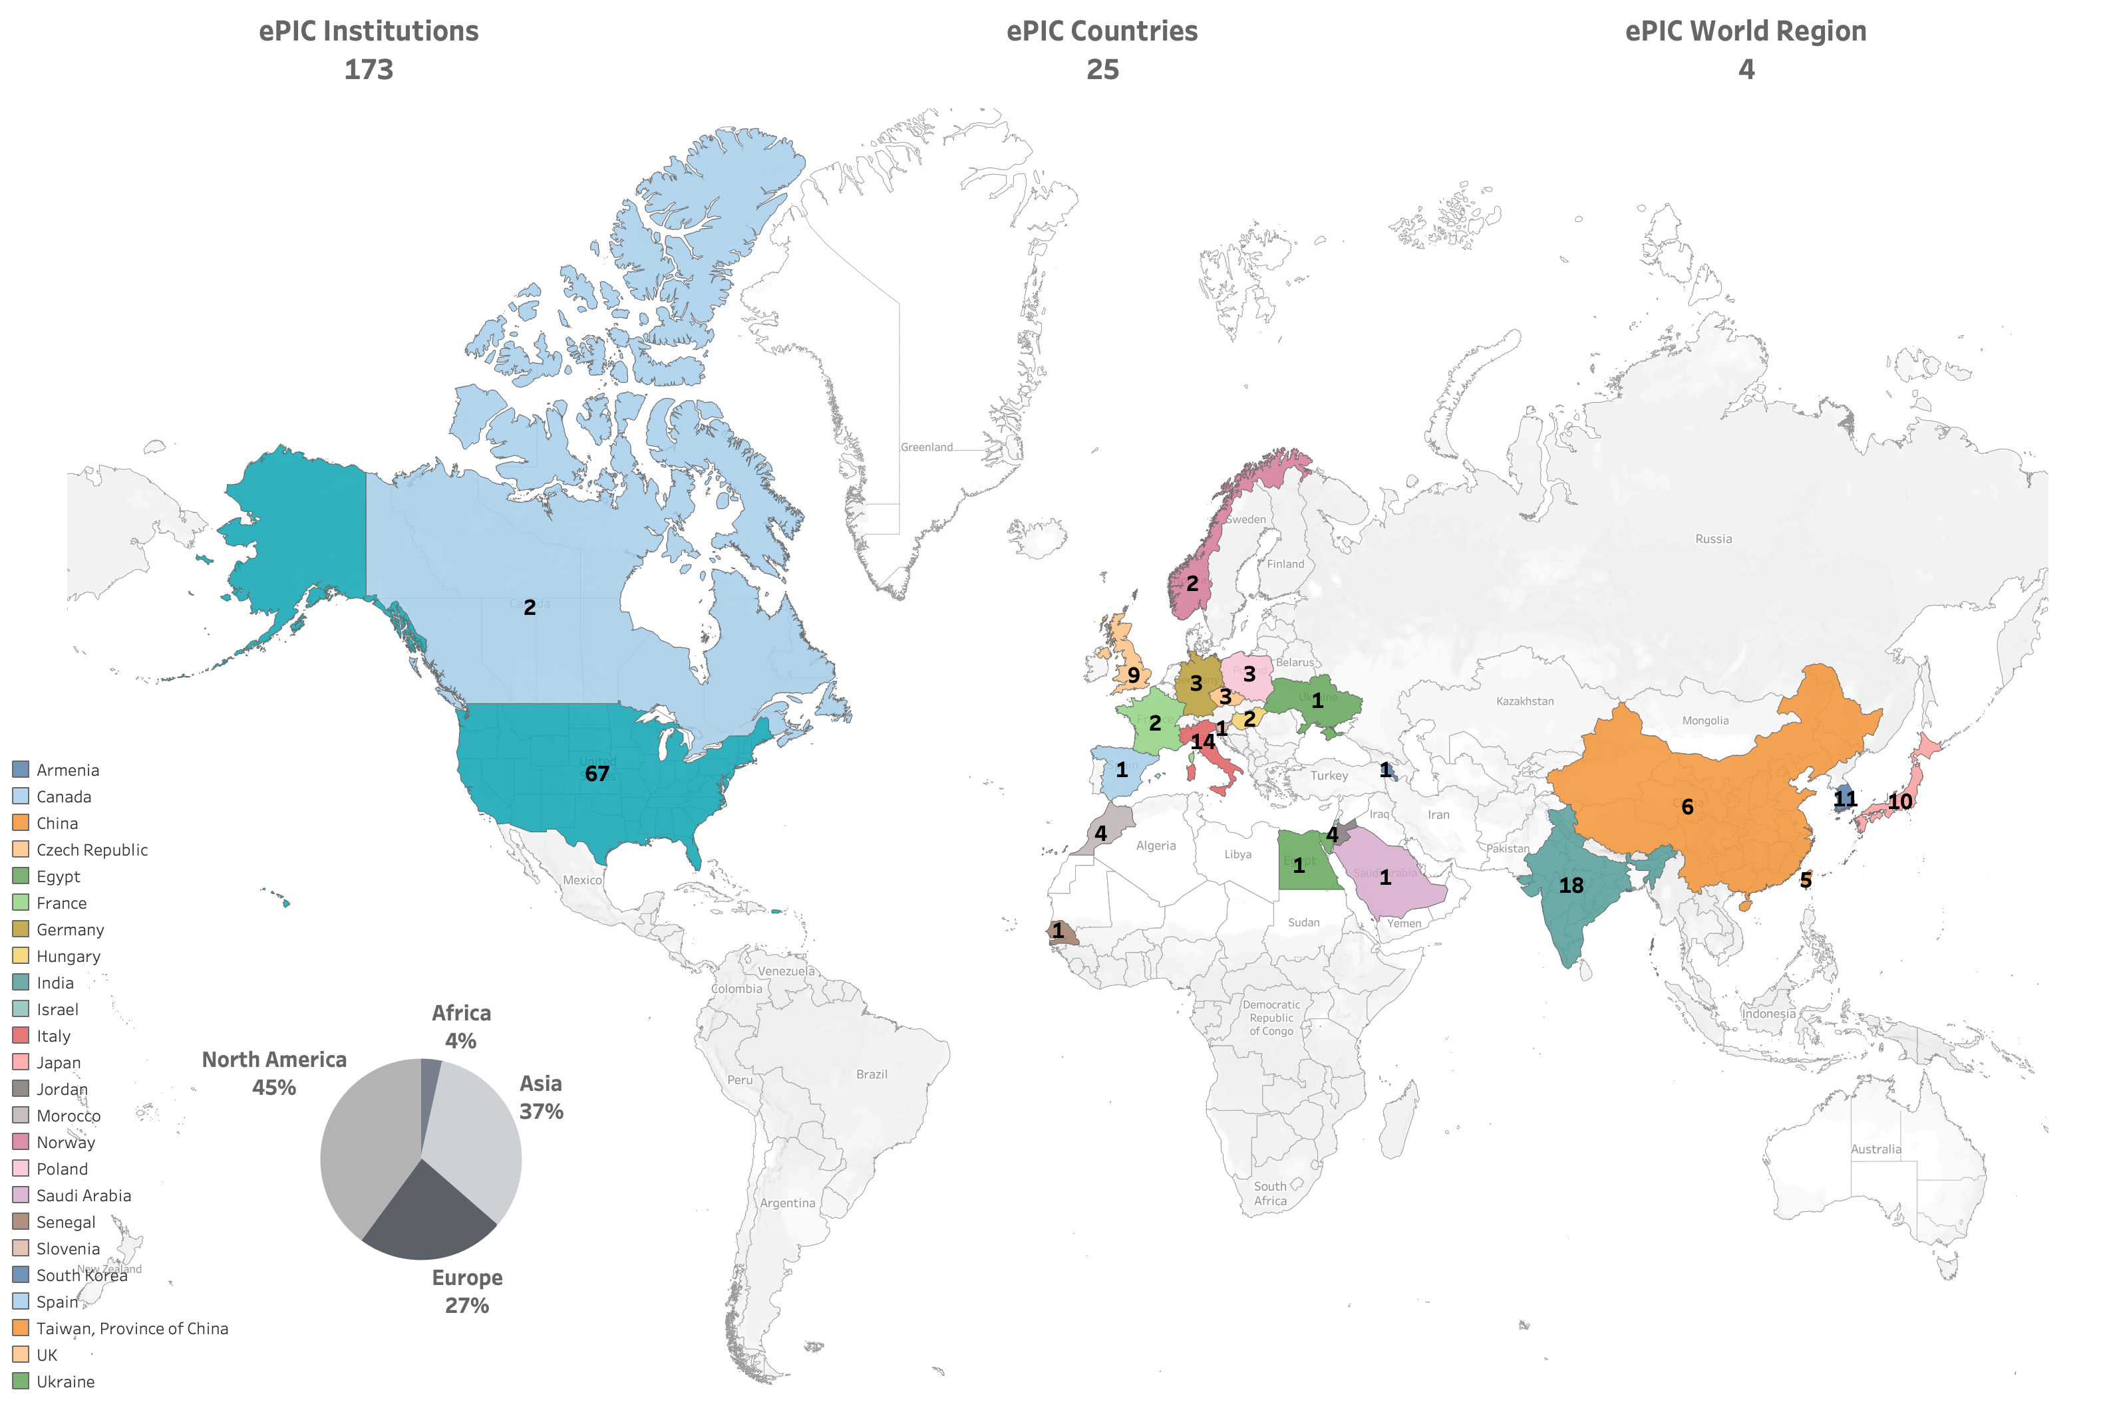












By the numbers…
New Institutions Joining ePIC in 2024:
Univ. of Texas at Austin
Univ. Mohammed V in Rabat
Univ. Ibn Tofail in Kénitra
Univ. Mohammed
Premier in Oujda
Univ. Mohammed VI
in Bengurir
Kent State Univ.
Laboratoire
Leprince-Ringuet (LLR)
American University
in Cairo
Central University
of Haryana
Indian Institute of
Technology Mandi
ePIC Initiated in
July 2022
Currently:
>850 collaborators (from 2024 Institutional Survey)
>650 members
active in ePIC activities
Two new petitions to join ePIC at Thursday’s CC Meeting:
University of Petroleum and Energy Studies (India)
Tohoku University (Japan)

Slide 7
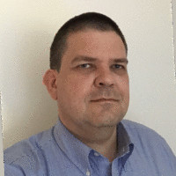
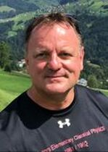
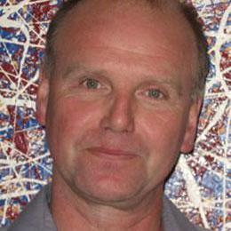
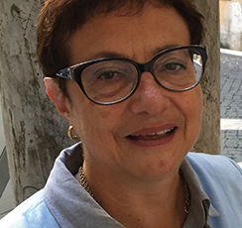
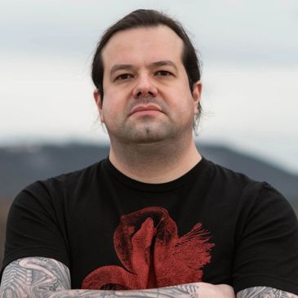
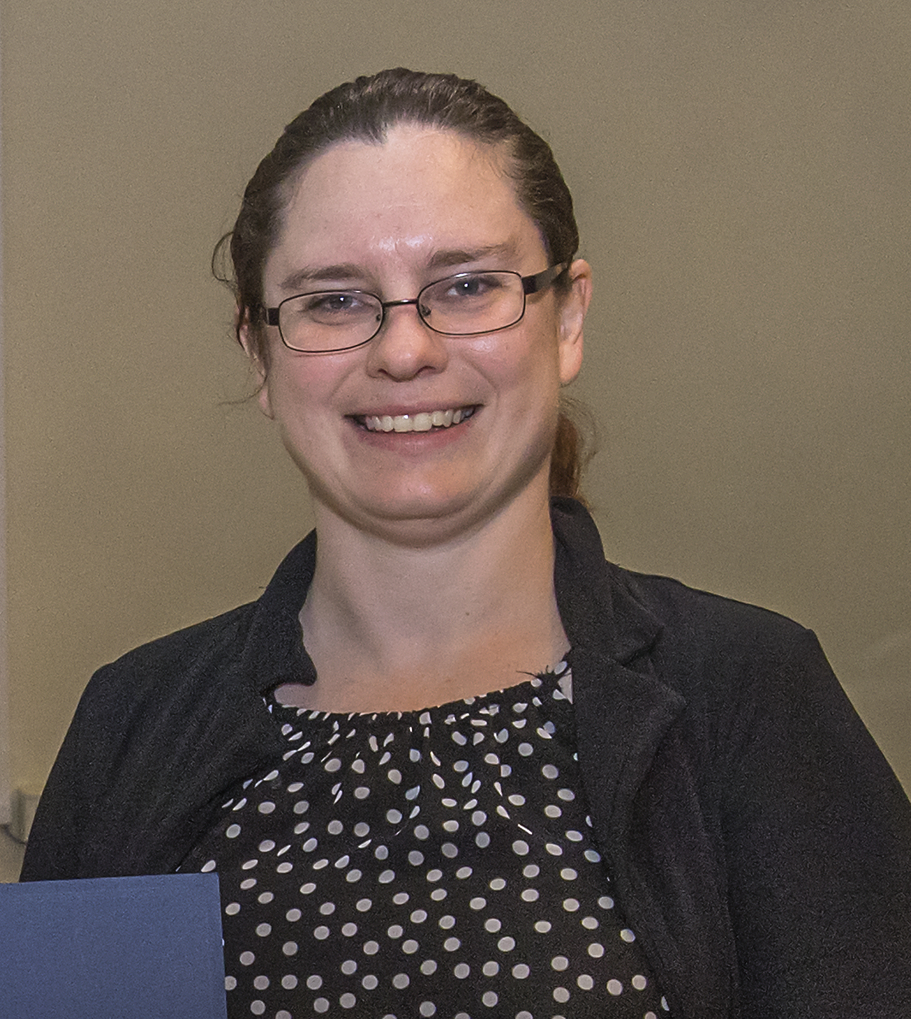
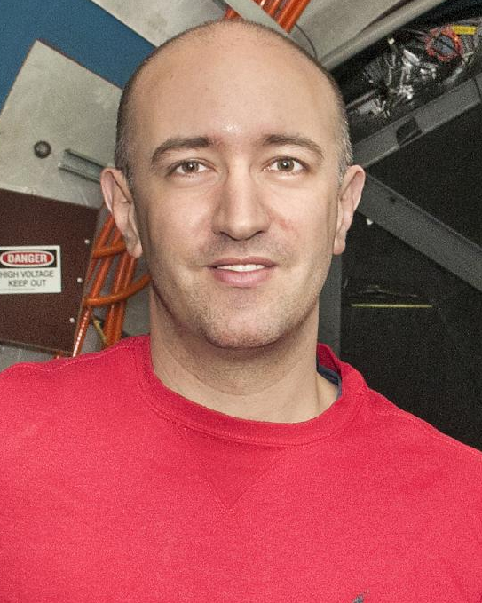
ePIC Collaboration Structure
Collaboration Council
Institutional Representatives
Spokesperson’s Office
Spokesperson (SP)
Deputies
EIC Project
Executive Board
Ernst Sichtermann: Past Chair
Bernd Surrow: Chair
Thomas Ullrich: Vice-Chair
Standing Committees
DE&I
Conferences and Talks
Membership
Elections
Publications
Ad-Hoc Committees
Technical Coordinator (TC)
Software and Computing Coordinator (SCC)
Analysis Coordinator
(AC)
Technical Coordinator (Acting)
• Silvia Dalla Torre (INFN)
Deputy TC’s:
Prakhar Garg (Yale)
Oskar Hartbrich (ORNL)
Matt Posik (Temple)
SCC Coordinator
• Markus Diefenthaler (JLab)
Dmitry Kalinkin
(Kentucky, Deputy SCC for Development)
Torre Wenaus
(BNL, Deputy SCC for Infrastructure)
Wouter Deconinck
(U. Manitoba, Deputy SCC for Operations)
Analysis Co-Coordinators
• Rosi Reed (Lehigh Univ.)
• Salvatore Fazio (Univ. Calabria)
Blue: New since last year

Slide 8
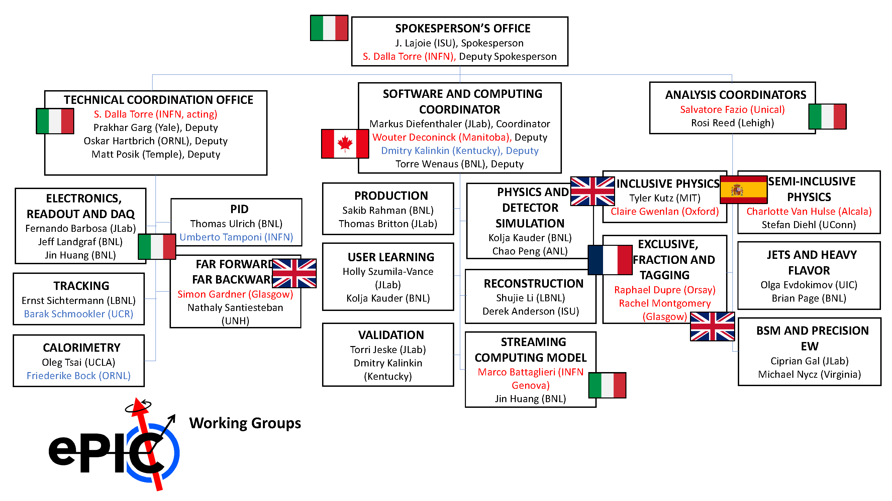
ePIC Working Group Structure
Red: International
Blue: New since last year
New PWG and SCC Conveners will be recommended to the CC in Thursday’s meeting.

Slide 9
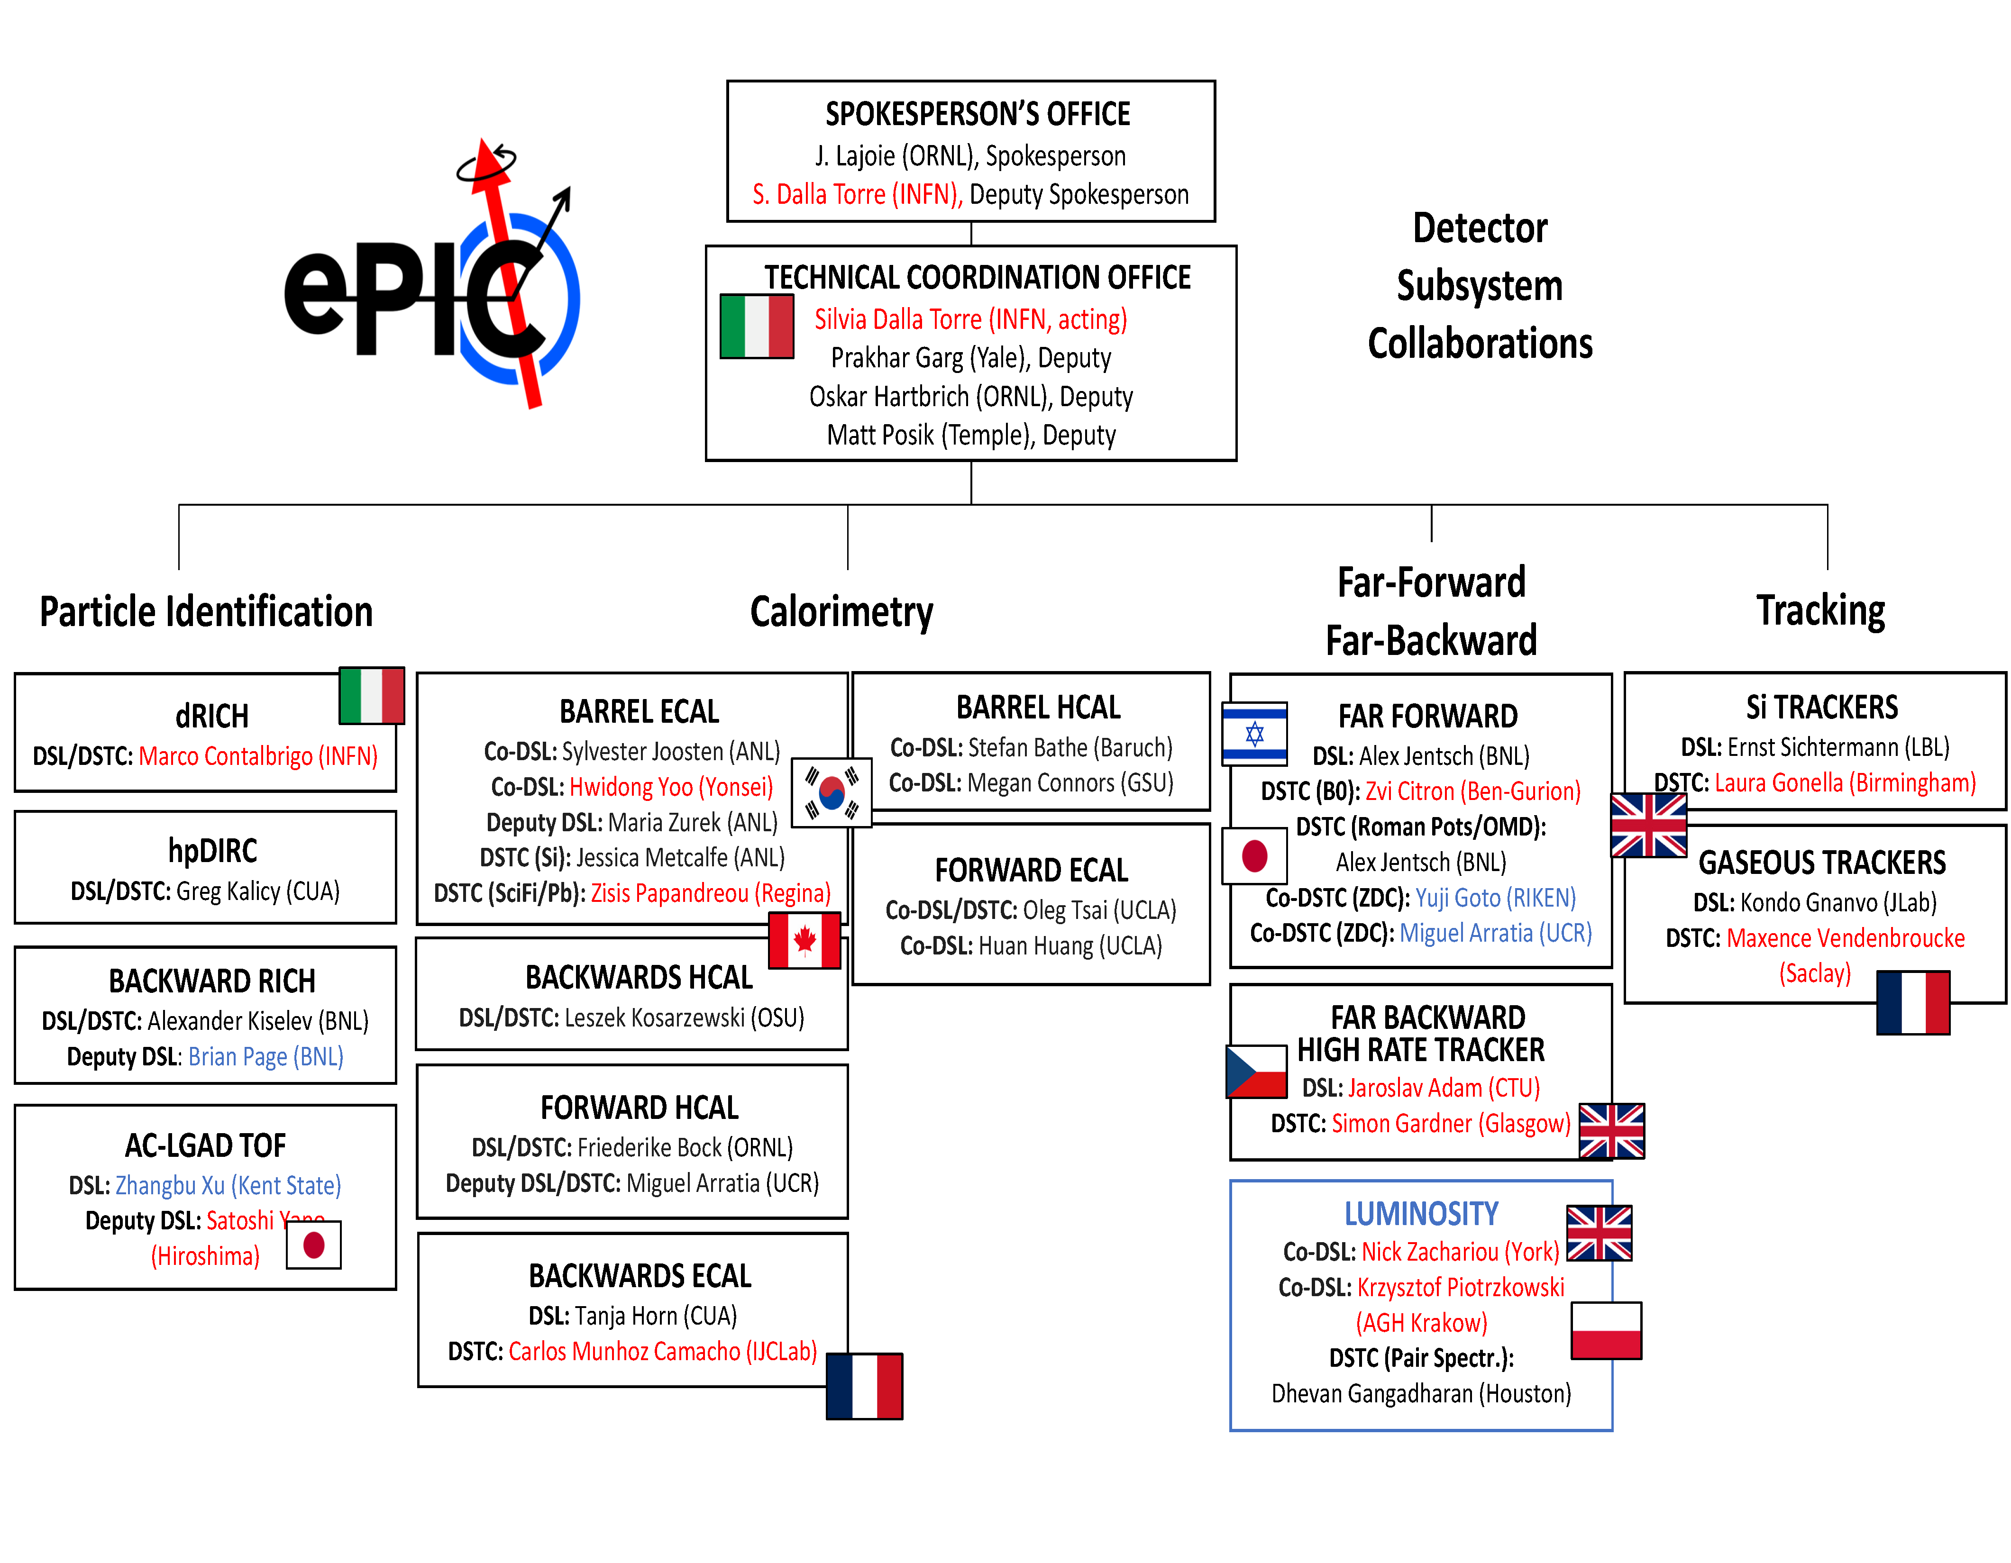
ePIC DSC Structure
Red: International
Blue: New since last year

Slide 10






ePIC Committees
DE&I Committee:
Chair: Megan Connors (GSU)
Vice-Chair: Christine Nattrass (UTK)
Francesco Bossù (CEA-Saclay), Wouter Deconinck (University of Manitoba), Narbe Kalantarians (Virginia Union University) , Iris Ponce Pinto (Yale University) , Maya Shimomura (Nara Women’s University) , Allison Zec (University of New Hampshire)
Collaboration Council
Institutional Representatives
Conferences and Talks:
Chair: Maria Zurek (ANL)
Vice-Chair: Brian Page (BNL)
Barbara Jacak (Berkeley), Daniel Brandenburg (OSU), Dmitry Kalinkin (Kentucky), Nick Zachariou (York), Xuan Li (LANL), Nicola Rubini (Bologna), Wouter Deconinck (Manitoba)
Standing Committees
DE&I
Conferences and Talks
Membership
Elections
Publications
Ad-Hoc Committees
Membership Committee:
Chair: Peter Steinberg (BNL)
Vice-Chair: Pietro Anontioli (INFN-Bologna)
Friederike Bock (ORNL), Helen Caines (Yale), Doug Higinbotham (JLab), Bedhangas Moharty (NISER), Silvia Niccolai (IJCLAB), Marzia Rosati (ISU)
Elections Committee:
Chair: Helen Caines (Yale)
Vice-Chair: Ken Barish (UCR)
Past-Chair: John Arrington (LBNL)
Maria Stefaniak (OSU), Domenico Elia (INFN)
All ePIC Standing Committees now formed and at work.
Voting underway to ratify ePIC Membership policy.
Drafting of Conf. and Talks, Code of Conduct, and Publication Policy underway.
Reports in Thursday’s CC Meeting.
Publications Committee:
Chair: Rene Bellwied (U. Houston)
Vice –Chair: Annalisa Mastroserio (INFN Bari)
Lokesh Kumar (Panjab U.), Michela Chiosso (Torino), Prithwish Tribedy (BNL), Markus Diefenthaler (JLab), Sevil Salur (Rutgers),
ex-officio w. Conferences and Talks Committee:
Daniel Brandenburg (OSU)

Slide 11


TDR/Publication Timeline
Executing the plan from the Jan. 2024 Collaboration Meeting:
This Collaboration Meeting is an opportunity to take stock of the progress we have made and make plans for the remainder of the year and the Jan 2025 CD-3B review.
process design phase
structuring the
effort
draft ePIC pre-TDR
ePIC pre-TDR (CD-2)
writing
(TDR/notes)
Preparing papers for
publication
Mid Jan.24
Mid Mar.24
End Oct. 24
Late 2024
Early 2025
Silvia’s talk today/Thurs – many thanks to Doug Higinbotham, Anil Panta, and Rolf!
Putting the tools in place:
Overleaf/Github for TDR
Zenodo.org selected as document database solution
Discussed in June 14th GM

Slide 12

The Three Pillars of ePIC
Technical Coordination
  Develop technical design of ePIC
  Support the ePIC TDR contributions
  Facilitate technical communication with the EIC project
Software & Computing Coordination
  Software and simulation productions for TDR and beyond.
  Onboarding via landing page and targeted tutorials.
  Development of ePIC Streaming Computing Model.
Analysis Coordination
  Organizing physics “benchmark” plots for the TDR
  Sets priorities for reconstruction development in
  conjunction with Software and Computing
Silvia Dalla Torre
Prakhar Garg
Oskar Hartbrich
Matt Posik
See TC report immediately following this talk.
Markus Diefenthaler
Wouter Deconinck
Dmitry Kalinkin
Torre Wenaus
See SCC report in Saturday’s plenary session.
Rosi Reed
Salvatore Fazio
See AC report in Saturday’s plenary session.

Slide 13



Collaborative Tools Development
Ad-Hoc Committee working to put together the tools we will need to support the collaboration:
  Mattermost and GitHub already in use
  Overleaf available for TDR effort
  Zenodo.org selected as document database solution
  Website under development
    ePIC has a page under the EIC Project BNL site
    Push to develop both public and collaboration sections
  Working on collaboration database solution
    Based on BNL developed “phone book” for EICUG/sPHENIX
Federated Login
Identity
User Request
Login
ePIC Collaboration Database
Authorization

Slide 14
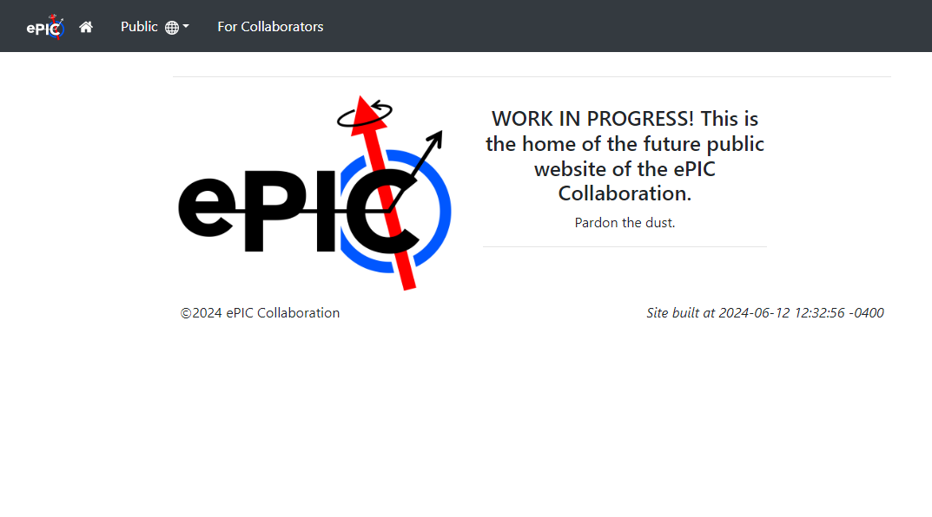
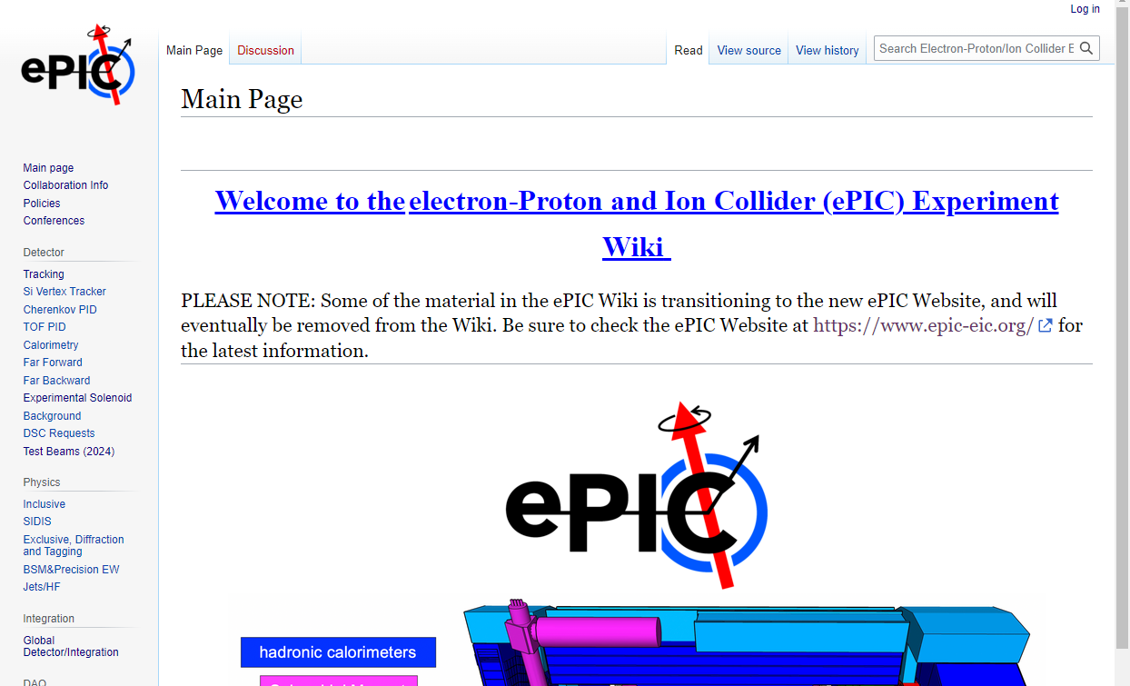
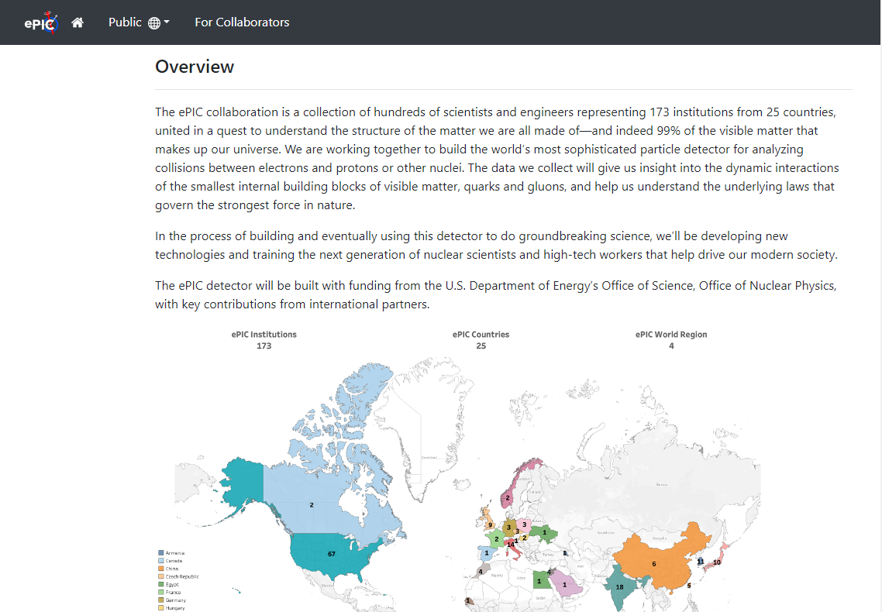
ePIC Website Progress
https://www.epic-eic.org/

Slide 15
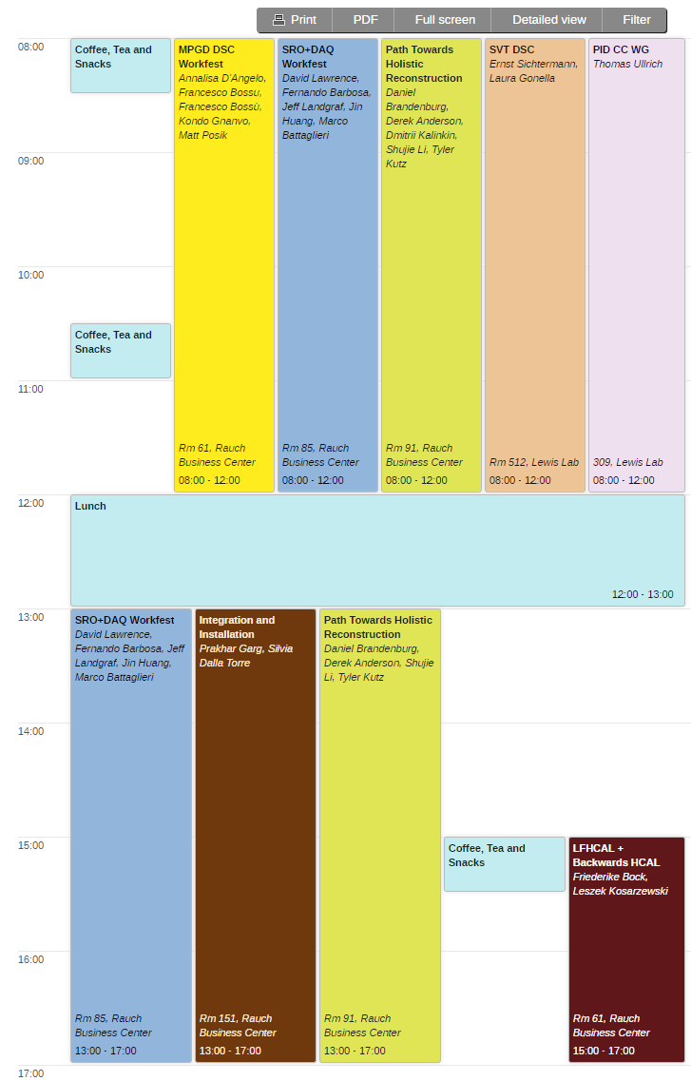
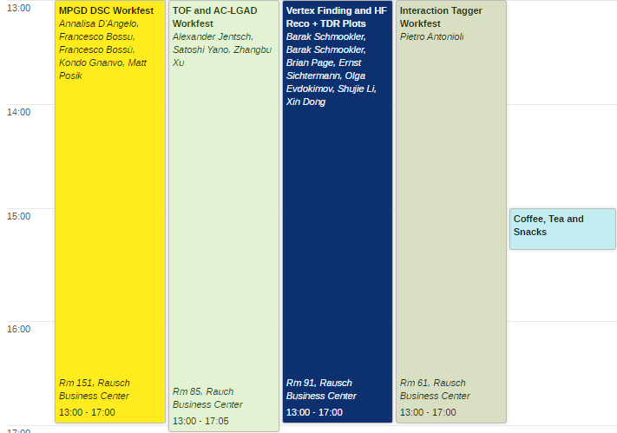
This Collaboration Meeting…
Workfests!
Parallel session with summaries and strategy Sat. July 27th
Friday, July 26th
Thursday, July 25th

Slide 16
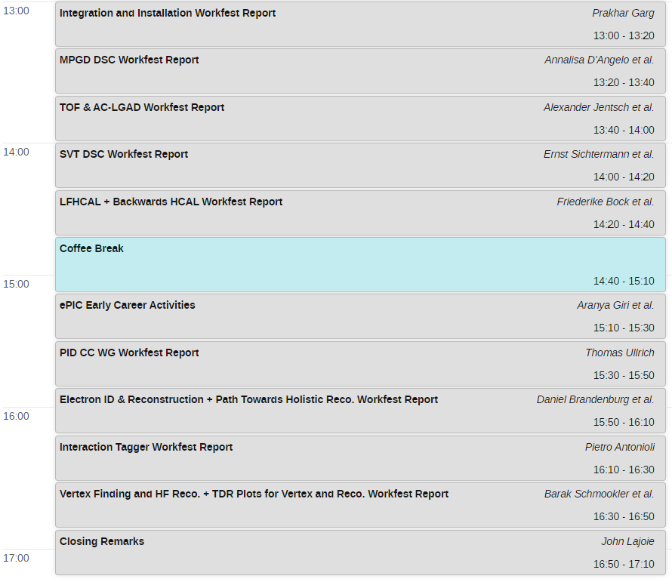
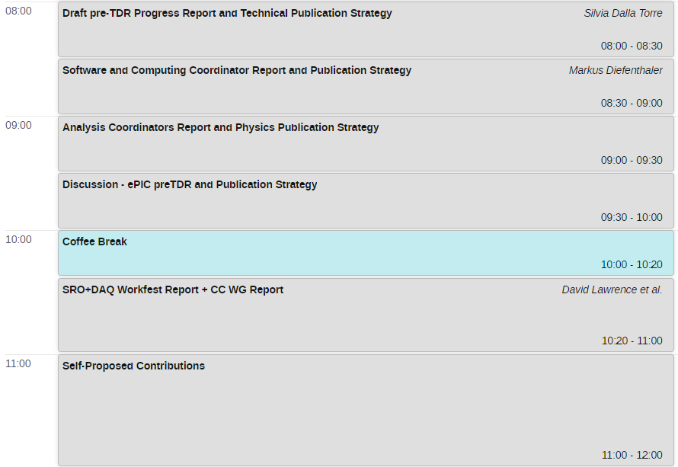
Saturday Plenary Session

Slide 17
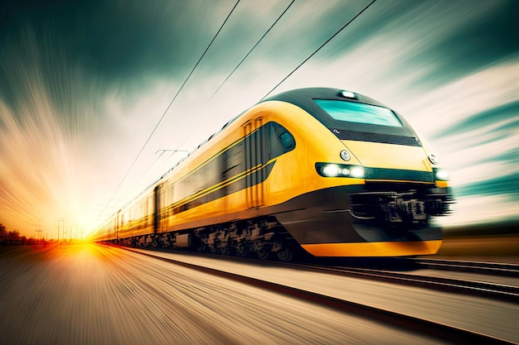

From there to here 2024…to 2025
10 General Meetings
22 TIC Meetings
100’s of DSC and WG Mtgs
Test beams, etc.
EIC Strategy Mtg
August 21st
… and a whole lot more MEETINGS!
3rd EIC-Asia Workshop
Jan 29-31st
ePIC draft pre-TDR sections complete
December 2024
4th EIC-Asia Workshop
July 1-5th
Argonne Collab. Mtg. Jan 2024
BIC Workshop
May 14-17th
Lehigh Collab. Mtg. July 2024
Frascati Collab. Mtg. Jan 2025
hpDIRC Annual Meeting
May 16-22nd
PDR2: PID Detectors
Summer/Fall 2024
ePIC Software and
Computing Review
Sept. 26-27th
ePIC Software and Computing Meeting
@ CERN– Apr 22-26th
INFN ePIC Meeting
June 27-28th
2024
2025
ePIC/EIC Det. R&D Day
March 25th
PDR: Integration, Installation
and Infrastructure
July 15th
FDR: Magnet Flux Return Steel
(poss. CD-3B scope)
Sept. 2024
PDR2: IR Integration and Auxiliary Detectors – Feb 12th
PDR2: Electronics & DAQ
FDR for VTRx+/lpGBT
(poss. CD-3B scope)
June 10-11th
PDR1: Tracking Detectors
March 20-21st
9th Detector Advisory
Committee
Sept. (TBD)
FDR: Magnet Power Supply
(poss. CD-3B scope)
May 28th
Backward & Forward EM Calorimetry, Barrel & Forward HCAL, Fall 2024
Barrel EMCal, Fall 2024
EIC Project CD-3B Review
January 7-9th, 2025
8th Detector Advisory Committee
June 21st

Slide 18
Challenges
The ePIC Collaboration needs to continue to engage more of its membership in ePIC activities.
The ePIC Collaboration needs to engage more of the NP community both in the US and internationally.
The availability of EIC research support for university and lab groups is a major concern
  Will continue to work with the EICUG to communicate this to funding agencies

Slide 19
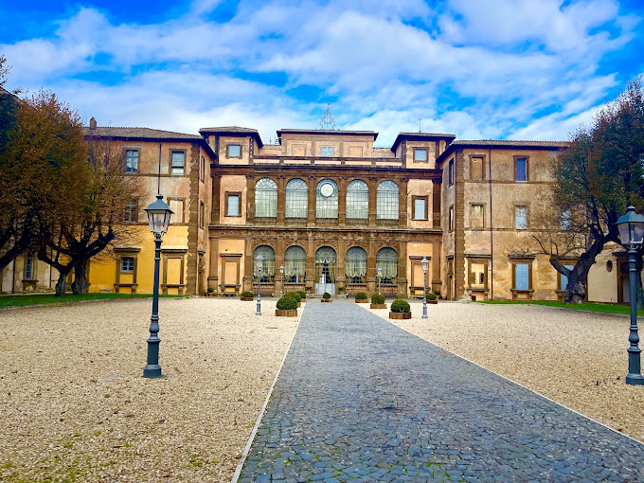
Jan 2025 Collaboration Meeting
?
University of Rome Tor Vergata & INFN
  January 20-24th, 2025
  Via Frascati (Roman Hills)

Slide 20



Stickers!
Once again, many thanks to Oskar Hartbrich!

Slide 21
Summary
The ePIC Collaboration is strong and growing!
  Mechanisms of collaboration are in place and being exercised
  Establishing policies and procedures
  Building the tools to support the collaboration
  Working with the EIC Project to realize ePIC
ePIC is up to the challenges ahead:
  Completing the technical design and TDR
  Publishing first papers:
    ePIC Design
    Physics Performance
    Software and Computing Model

Slide 22


Slide 23
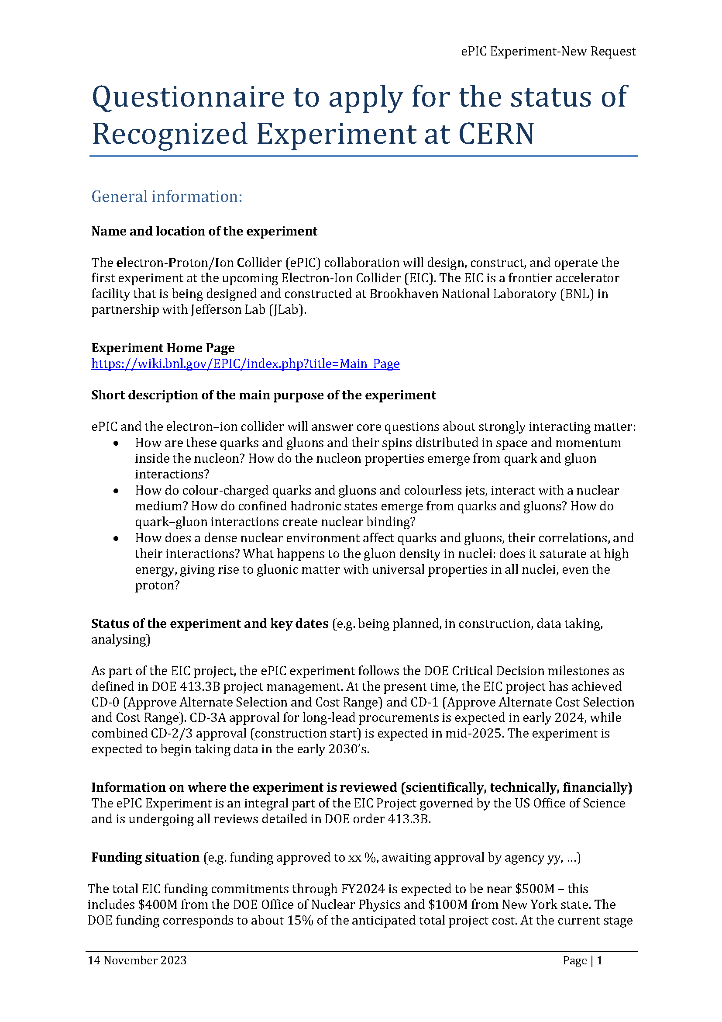
CERN Recognized Experiment
ePIC Application for CERN Recognized Experiment:
  ePIC leadership has submitted an application to become a CERN Recognized Experiment
  Strong synergies between CERN and EIC
  Important for access to CERN resources (test beams, …)
  Increase visibility in the European community
ePIC presentation to CERN Recognized Experiments Committee (REC) Feb 8th
Research Board confirmed the positive REC recommendation at CERN Council Meeting March 21-22nd
Working with Helge Meinhard on next steps

Slide 24
ePIC Resources
Public Website - https://www.bnl.gov/eic/epic.php
Mailing Lists – https://lists.bnl.gov/mailman/listinfo
Indico Agenda - https://indico.bnl.gov/category/402/
  ePIC Software and Computing: https://indico.bnl.gov/category/435/
Wiki - https://wiki.bnl.gov/EPIC
ePIC Software Training:
  Landing Page: https://eic.github.io/documentation/landingpage.html
  Tutorials: https://eic.github.io/documentation/tutorials.html
Mattermost: https://chat.epic-eic.org
ePIC Zenodo Community: https://zenodo.org/communities/epic

Slide 25
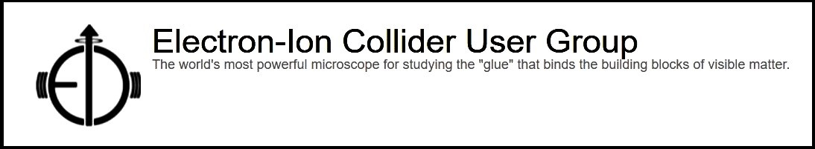

EICUG Membership
The EICUG is a vital organization to promote the interests of the EIC community!
  Without the EICUG we would never have gotten far enough to form ePIC!
Please register your institution!
Check with your EICUG IB representative to get registered as a member
https://www.eicug.org/content/join.html

Slide 26
Workfest/Parallel Session Organizers
MPGD DSC:
  K. Gnanvo, F. Bossu, A. D’Angelo, M. Posik
TOF and AC-LGAD:
  Zhangbu Xu, Satoshi Yano and Alex Jentsch
SRO + DAQ
  Jeff, Marco, David, Fernando, Jin
Integration and Installation:
  TC Office (Prakhar Garg)
Electron ID & Reconstruction +
Path Towards Holistic Reco.
  Daniel Brandenburg, Tyler Kutz, Derek Anderson, Dmitry Kalinkin, Shujie Li, Umberto Tamponi
Vertex Finding and HF Reco.+ TDR Plots for Vertex and Reco.
  Xin Dong, Olga Evdokimov, Brian Page, S. Li, B. Schmookler, E. Sichtermann
SVT DSC:
  E. Sichtermann
PID CC WG:
  Thomas Ullrich, Umberto Tamponi
LFHCAL + Backwards HCAL/Hackathon
  F. Bock, L. Kosarzewski

Slide 27
Analysis Coordination in ePIC
Analysis Coordination is responsible for the simulations that demonstrate the ability of ePIC to do EIC science
  A critical part of the TDR development process
  Organizing physics “benchmark” plots for the TDR
  Sets priorities for reconstruction development in conjunction with Software and Computing
DRAFT pre-TDR Plots In Development

