Slide 1
Central Detector Integration and Installation
Dan Cacace, Josh Harvey & Nathaniel Speece-Moyer
Contributions from Rahul Sharma & Roland Wimmer
ePIC Collaboration Meeting, Integration and Installation
July 15th, 2024

Slide 2
Overall Integration
Central Barrel
Backward End Cap
Forward End Cap
Front Magnets
Rear Magnets

Slide 3
Envelope Drawing

Slide 4
Endcap Supports and Components
Forward Endcap (FE)
11’x7’x25’, 200ton
Backward Endcap (BE)
11’x5.5’x25’, 130ton
Description
EMCal
HCal
HCal, EMCal and Lepton are end cap detectors
Seismic restraints attach the end caps to the central barrel
Anchor bolts tie down the end caps when the central barrel isn’t available
Hydraulic rams push the end caps on Hilman rollers
Hydraulic jacks lift the detector for alignment
Pole tip and flux return minimize the fringe field and balance the magnetic forces
Pole Tip
Lepton
Seismic Restraints
Seismic Restraints
Flux Return
Flux Return
Hydraulic Rams
Hydraulic Rams
Hydraulic Jacks
Hydraulic Jacks
Hilman Rollers
Anchor Bolts
Anchor Bolts
Hilman Rollers

Slide 5
Endcap Supports and Components
Forward Endcap (FE) – Base
Backward Endcap (BE) – Base
Hilman Rollers
Hydraulic Jacks
Four 200 ton Hilman rollers, with cam followers (not shown)
Four 250 ton 2” stroke Enerpac hydraulic locknut jacks
Shim between the rollers and base, leaving the endcaps on the rollers
Jacks could be removable and reused for all endcaps

Slide 6
Endcap installation and Choreography
The maximum extent of the positions needed for installation, integration and maintenance
Making all options viable gives us significant flexibility
Allows for beam pipe bake-out, inner detector removal and
Platforms need to be trimmed to allow endcaps to move past them
Need to work on services layout for endcap and central barrel detector to make sure they can pass each other smoothly without damage

Slide 7
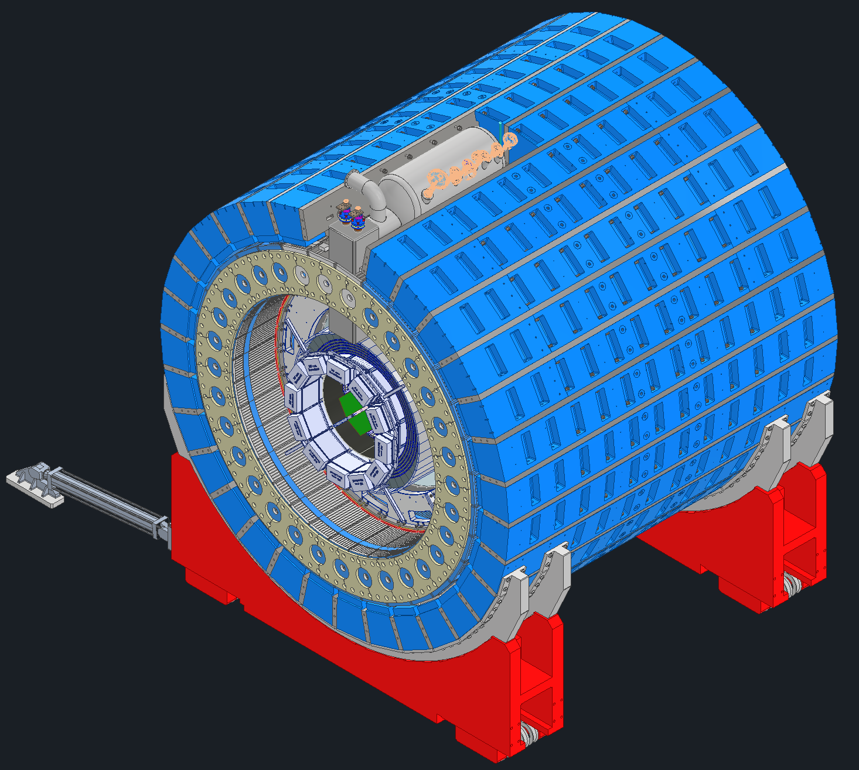
Cradle and flux return bar overview
We plan to reuse the cradle assembly and flux return bars from the STAR detector, located at BNL.
Cost and time savings by reusing steel.
Will reuse all 30 STAR flux return bars and get two new half-length flux return bars fabricated.
The EIC detector diameter is different than the STAR detector diameter. We want to maintain a continuous ring without air gaps, so we need to design and fabricate spacers to go between each flux return bar.
31 full length spacer bars and one half-length spacer bar.
We plan to maintain the same material specs for the spacers as for the flux return bars unless cost or timing are prohibitive.
The outer HCAL will be reused from sPHENIX and will attach to the flux return bars.
HCAL sectors will require a new mounting method – more on this later.
Flux return bars, along with the entire detector, to be rotated 8 milliradians (0.458 degrees) to align with the lepton beam.
Will be taken up by cradle design - more on this later.
ePIC Collaboration Meeting, Integration and Installation
Dan Cacace, Josh Harvey & Nathaniel Speece-Moyer

Slide 8
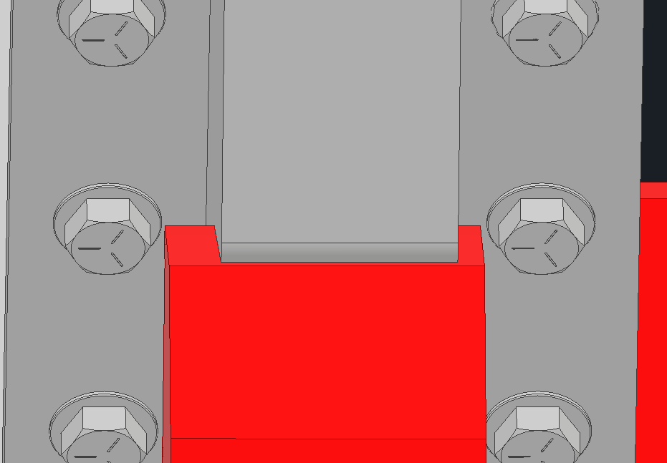
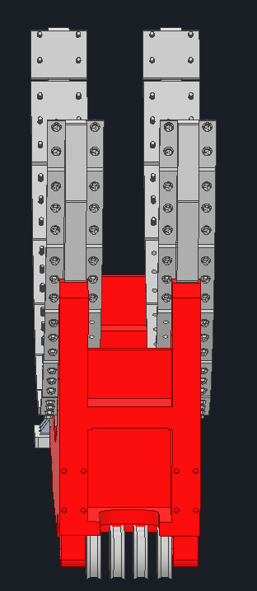
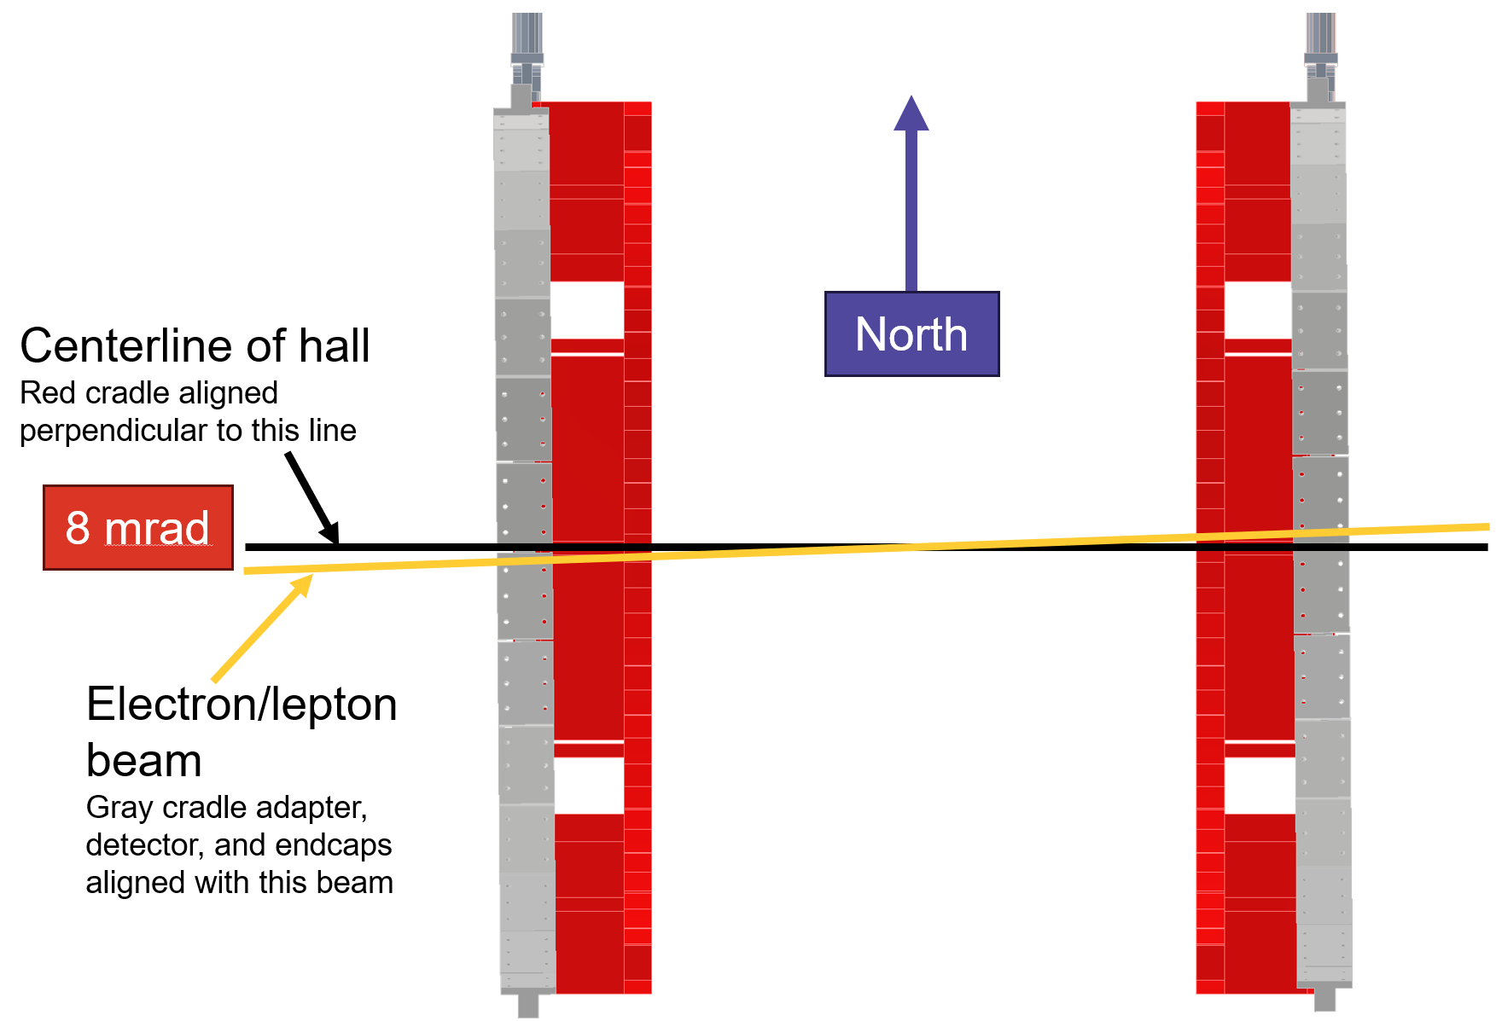
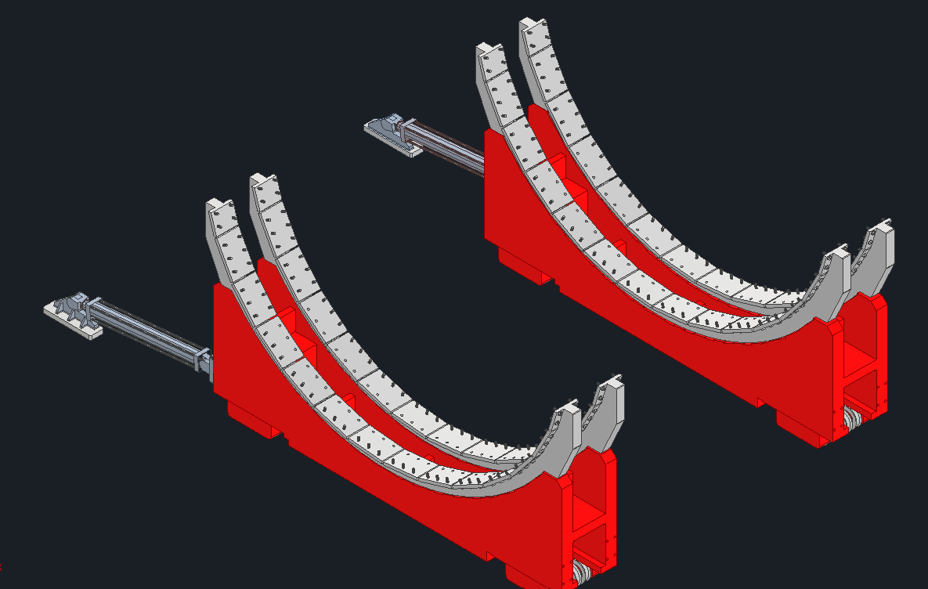
Flux Return and HCal Support, Cradle to Adapters Connection
Adapters will be welded to the cradles.
8 mrad rotation between bottom of adapters and cradle.
The rotation causes an approximately ± 2 in shift from one end of the cradles to the other.
Having the rotation built into the adapters allows for the bolt pattern on the flux return bars to be consistent from bar to bar.
+2 in
-2 in
ePIC Collaboration Meeting, Integration and Installation
Dan Cacace, Josh Harvey & Nathaniel Speece-Moyer

Slide 9
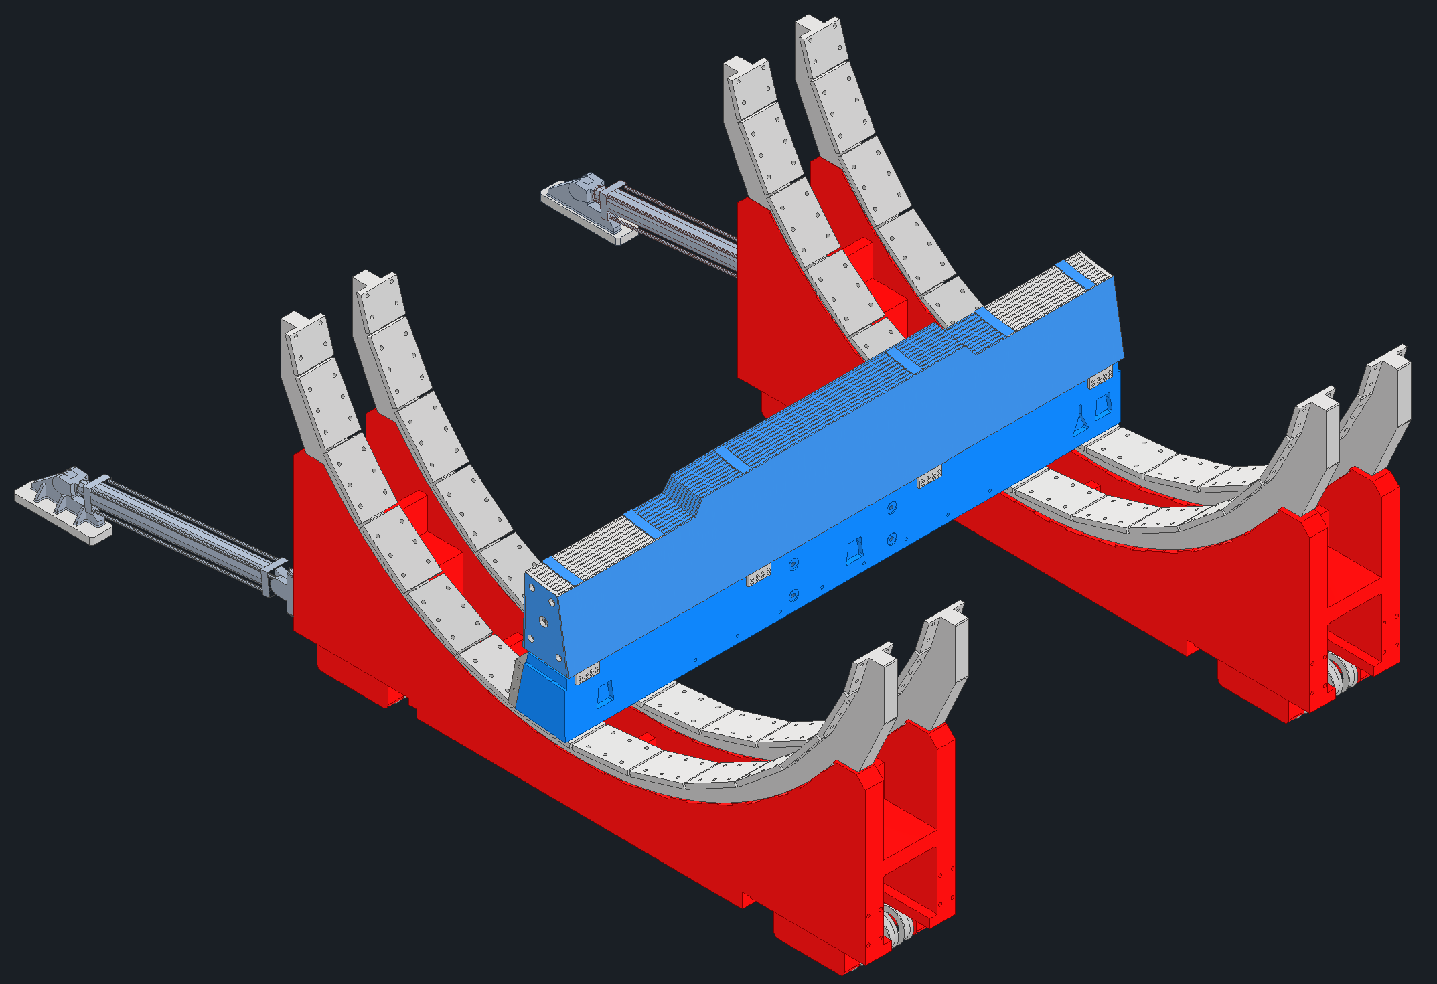
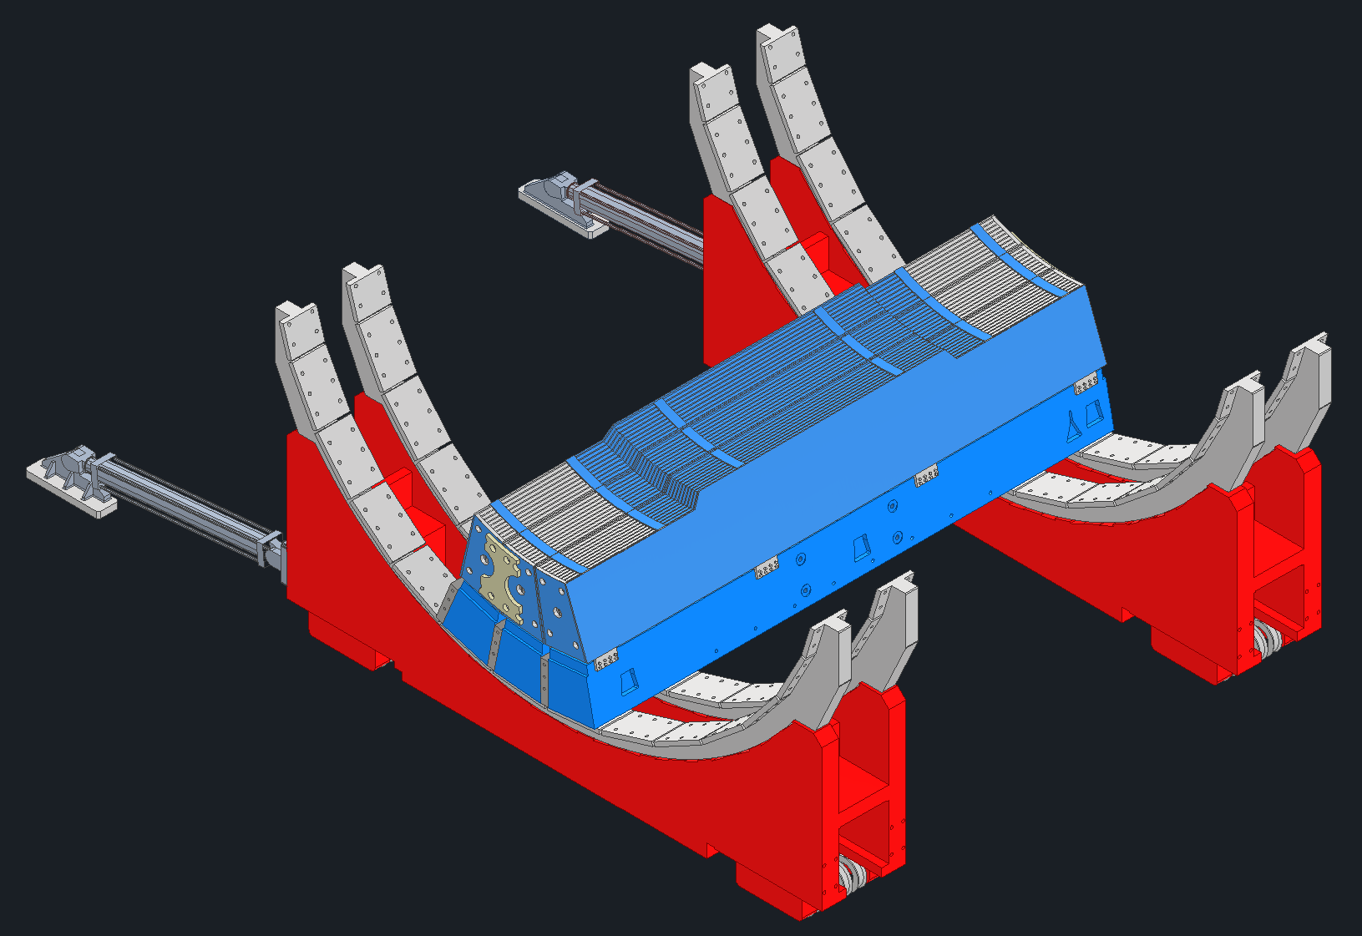
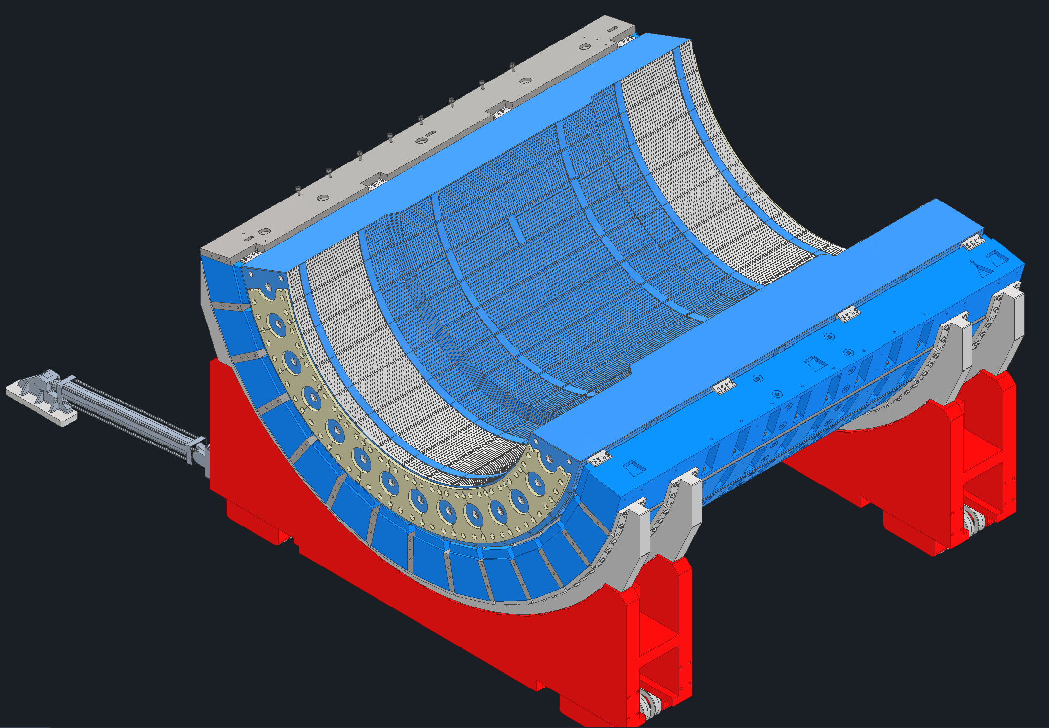
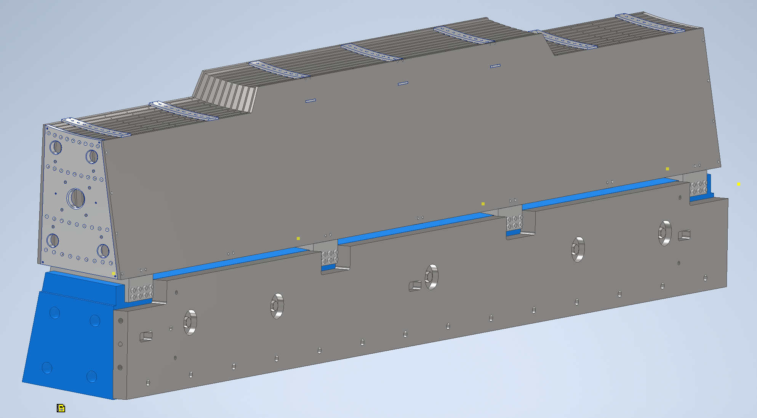
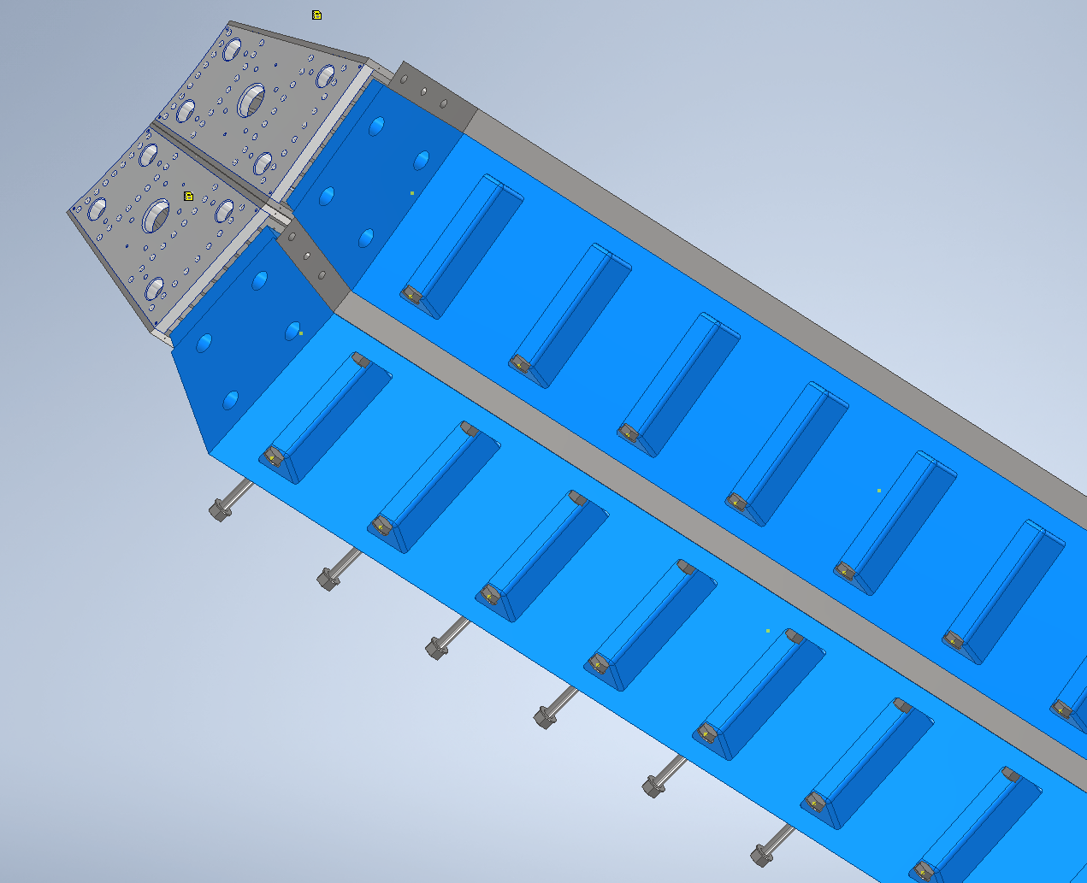
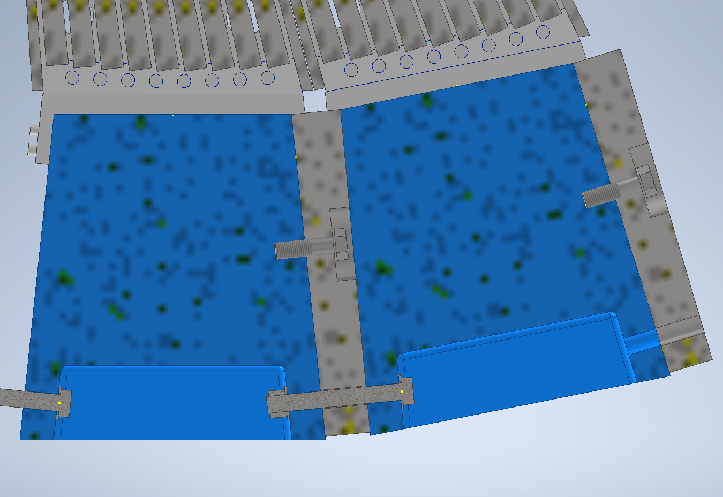
Flux Return and HCal Installation
We will build up one subassembly at a time consisting of a flux return bar, flux return bar spacer, and HCAL sector up to the 3 and 9 o’clock positions. After the 3 and 9 o’clock positions, the flux return bars + spacer subassemblies will be separate from the HCAL sectors.
Each subassembly will then be added to the larger assembly.
Possibly use SPHENIX HCAL Lift-Rotate plate design from sPHENIX to rotate each assembly during installation.
Start from bottom center of the cradle, work upward, and shim as needed.
Bolts between bars tightened with hydraulic tensioners. Bolts to cradle tightened with hydraulic torque wrenches.
At top of HCAL ring and flux return bar ring, use a hydraulic spreader to allow final bar(s) to be installed.
ePIC Collaboration Meeting, Integration and Installation
Dan Cacace, Josh Harvey & Nathaniel Speece-Moyer

Slide 10
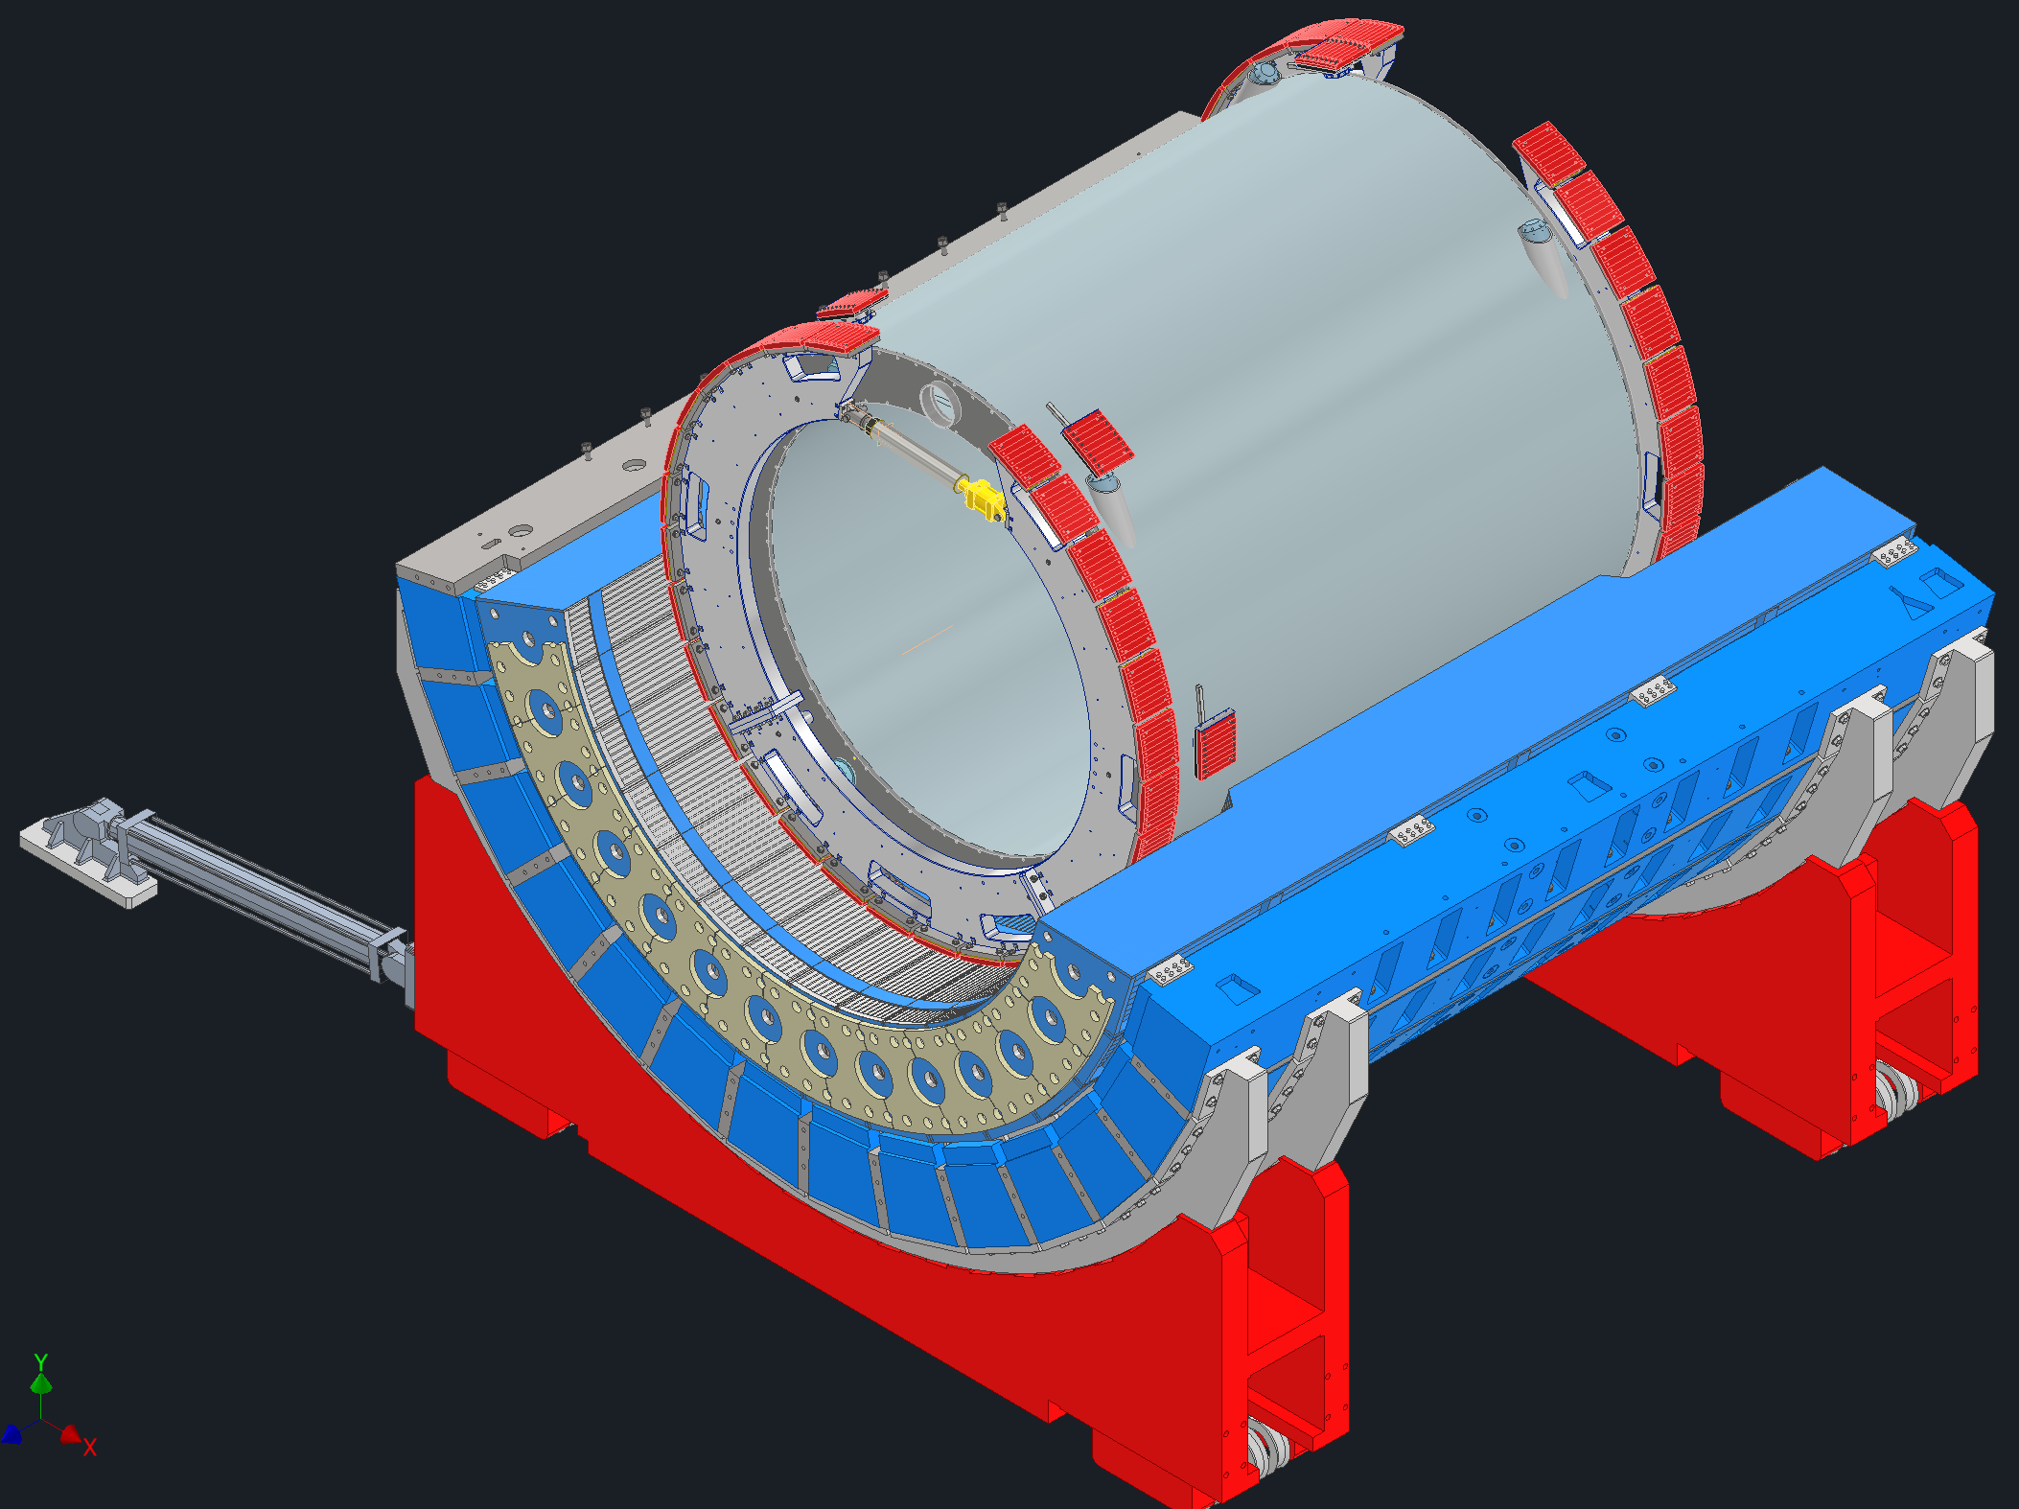
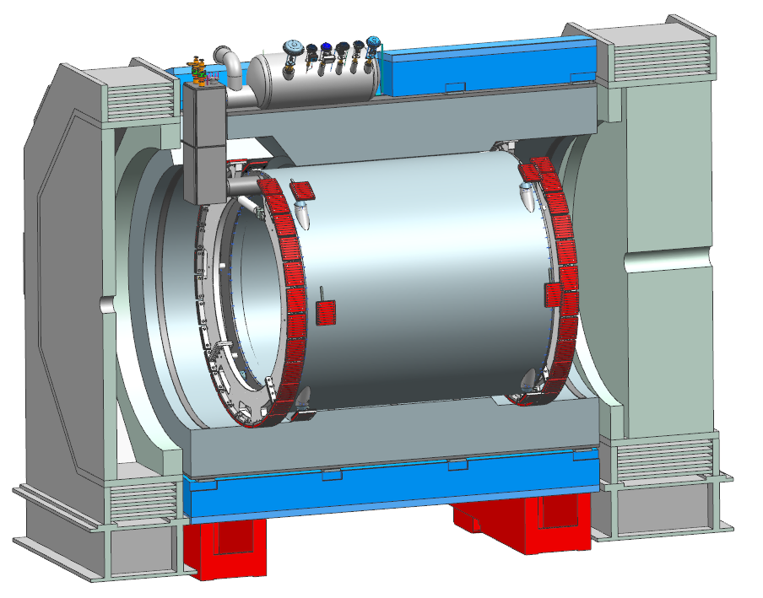
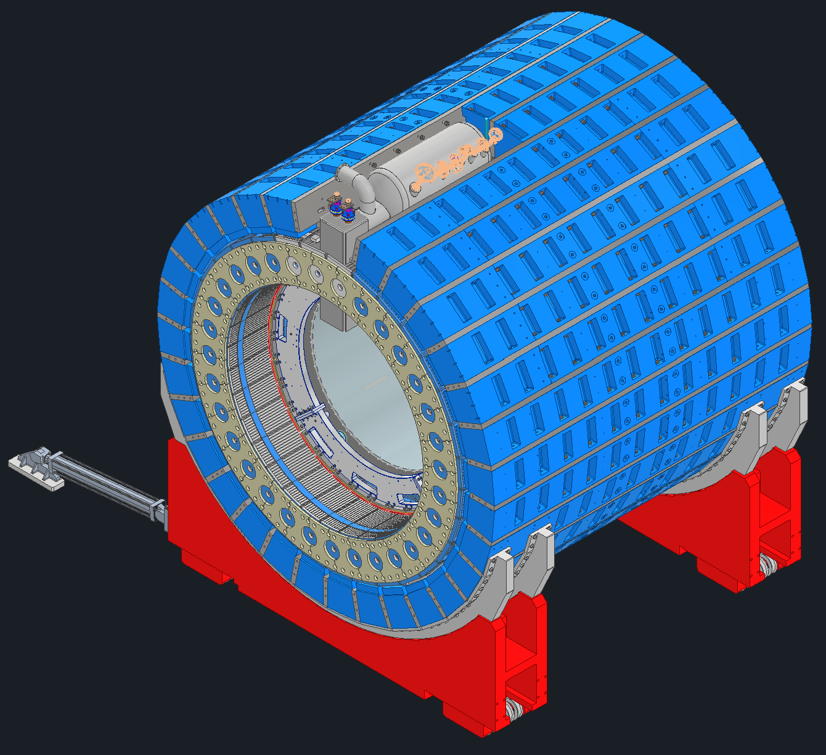
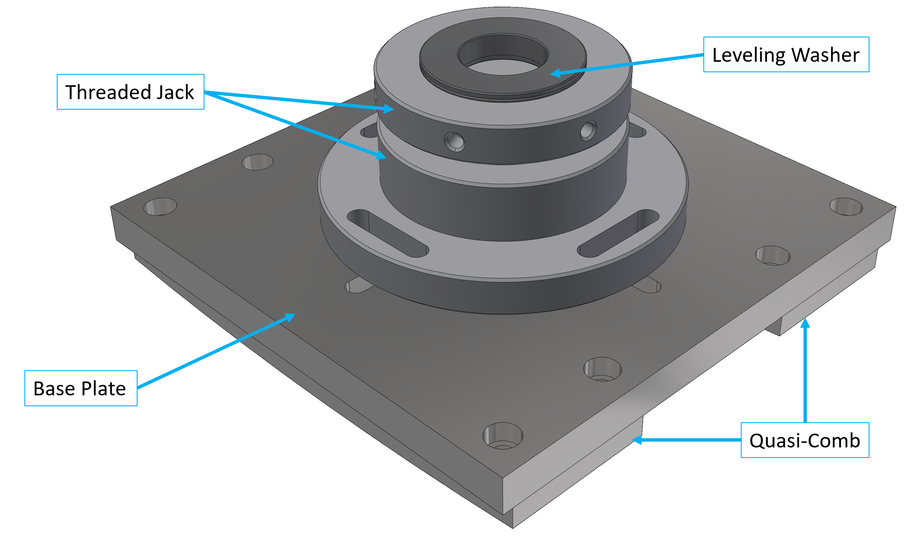
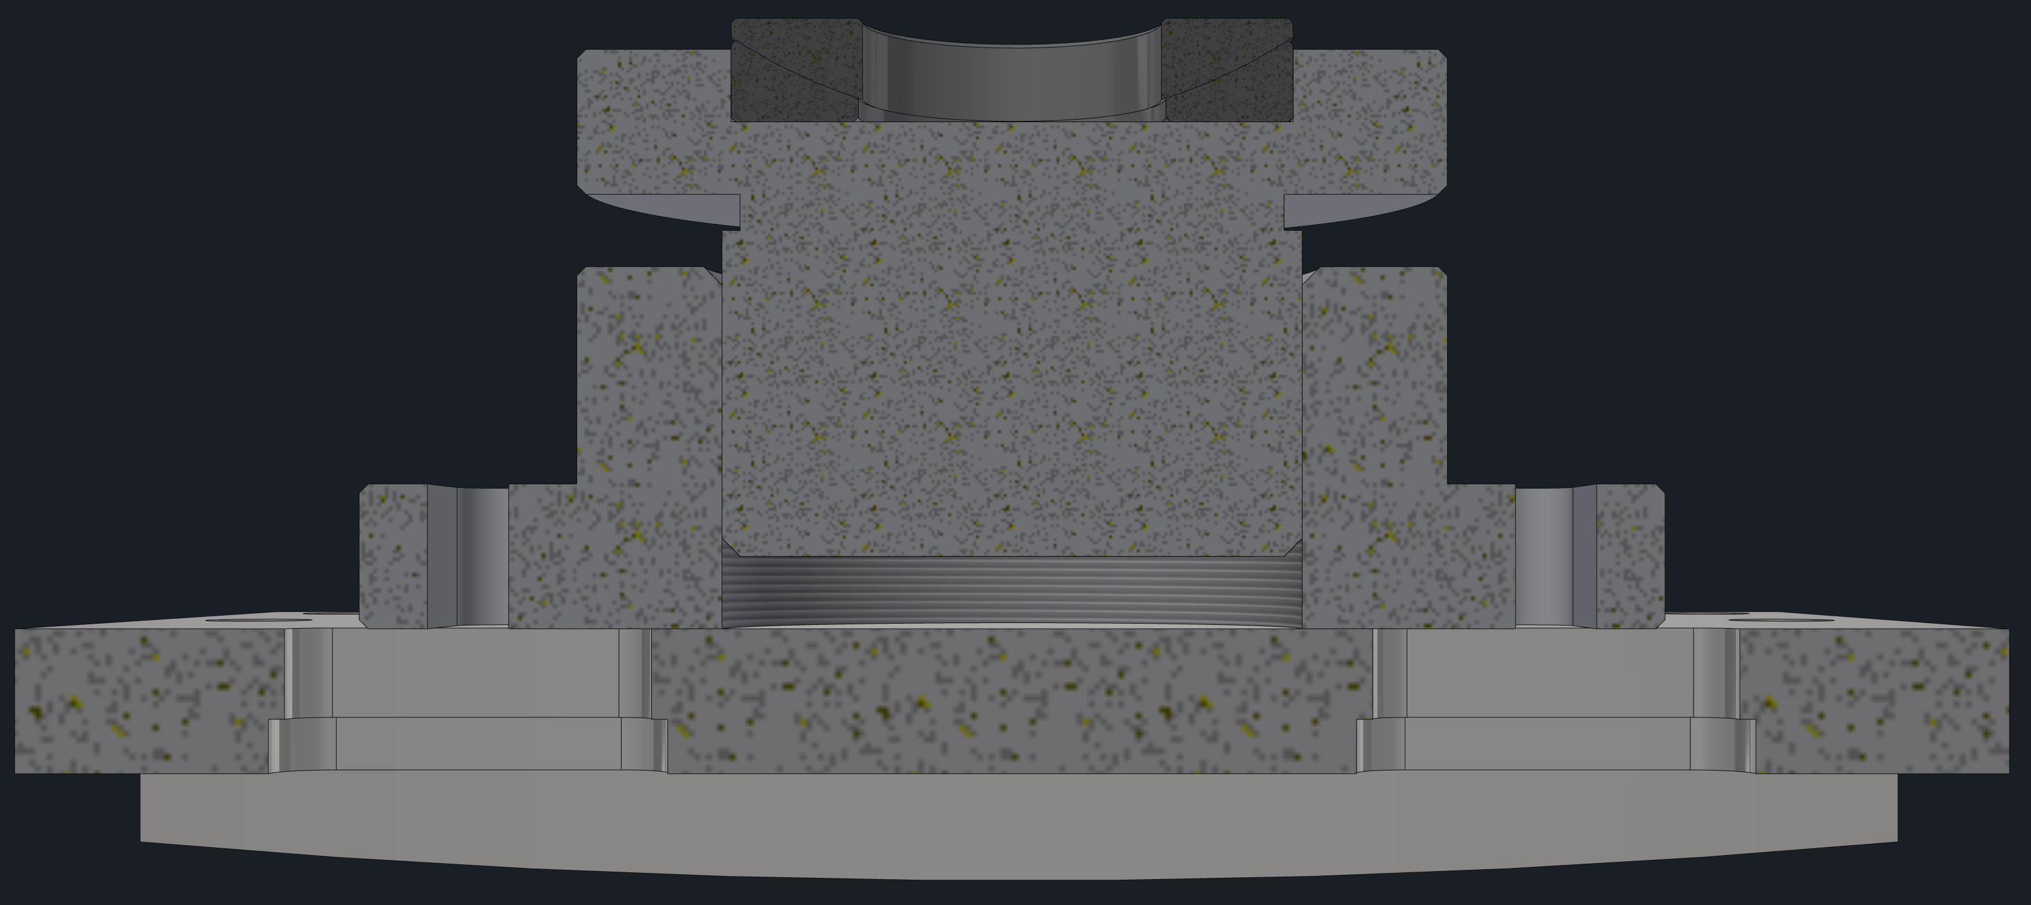
Magnet Support
Phase Separator
HCAL Barrel
Steel
Hadron Barrel
Chimney
Steel
Lepton Barrel
HCAL Hadron
Magnet Assembly
Lepton
Steel Plate
Hadron
Steel Plate
Support Ring
(Existing)
Screw Jacks
(Existing)
Existing Cradle

Slide 11
Magnet installation

Slide 12
Barrel EMCal Support
EMCal supported off of existing HCal support rings
Additional support added in between support rings and EMCal to take up radial gap
Leveling wedge jacks and shimming used to adjust EMCal position
Need to extend EMCal strongback on forward side to reach support rings
HCal
Support Ring
EMCal Support
Wedge Jacks
EMCal
EMCal Support

Slide 13
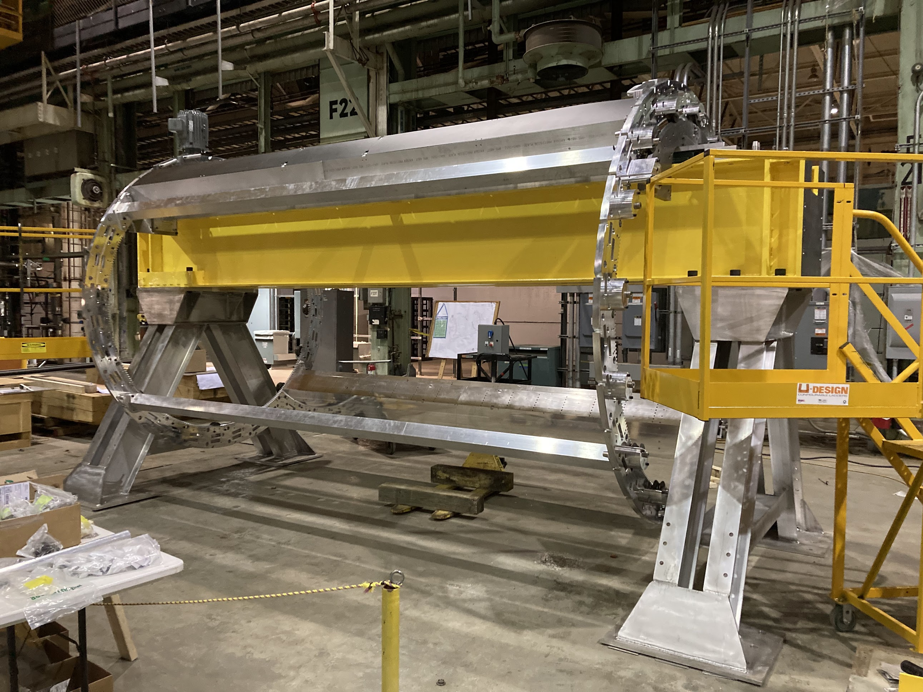
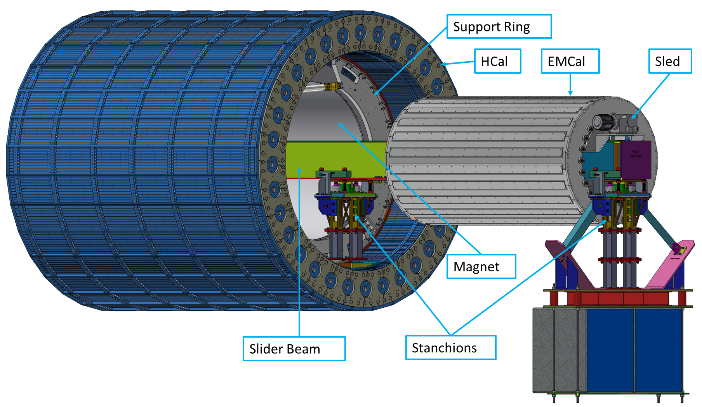
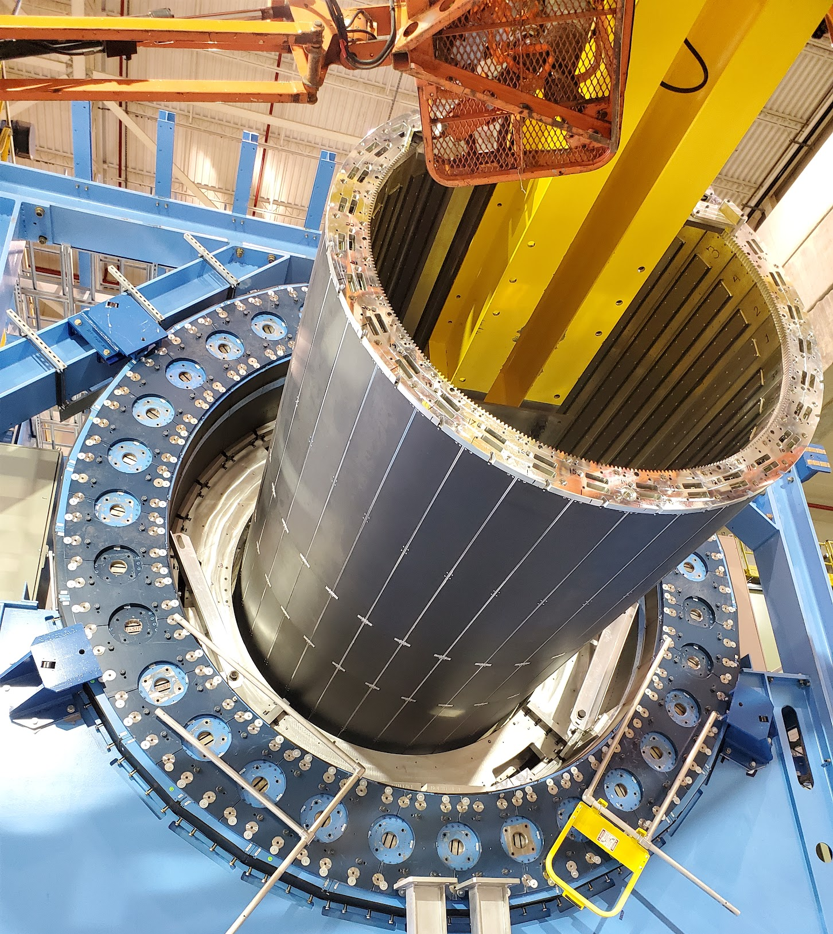
Barrel EMCal Installation
Use existing installation tooling from sPHENIX that was used to install inner HCAL
Assemble barrel EMCal on sled, A-frames and section of I-beam
I-beam is inserted into the HCal and supported on stanchions
Barrel EMCal is rolled in via the sled on the I-beam
Barrel EMCal is attached to the support rings
I-beam and stanchions are removed
ePIC Collaboration Meeting, Integration and Installation
Dan Cacace, Josh Harvey & Nathaniel Speece-Moyer

Slide 14
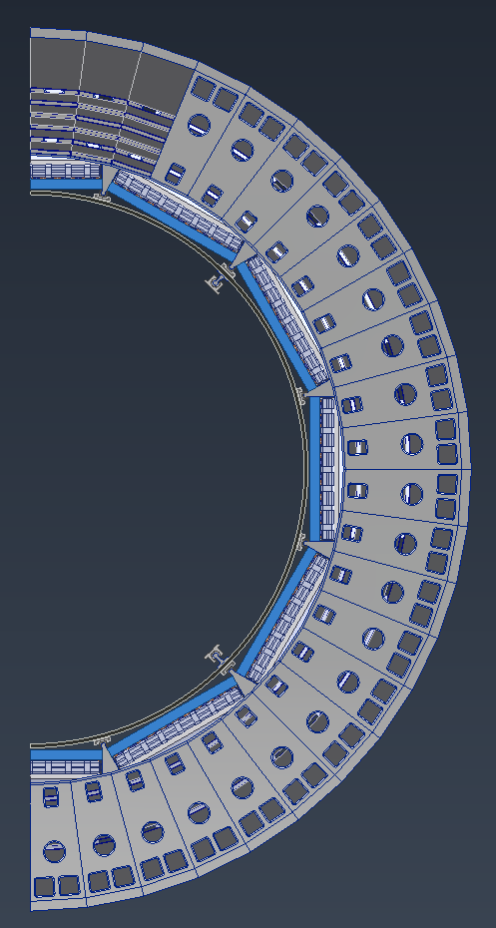
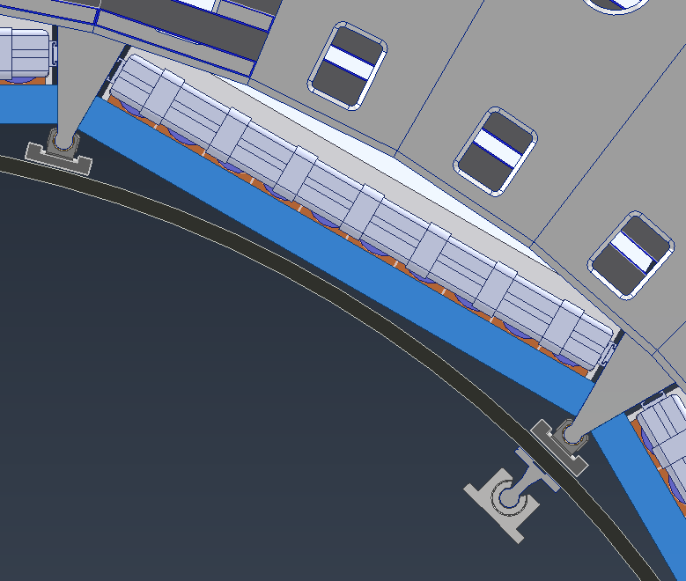
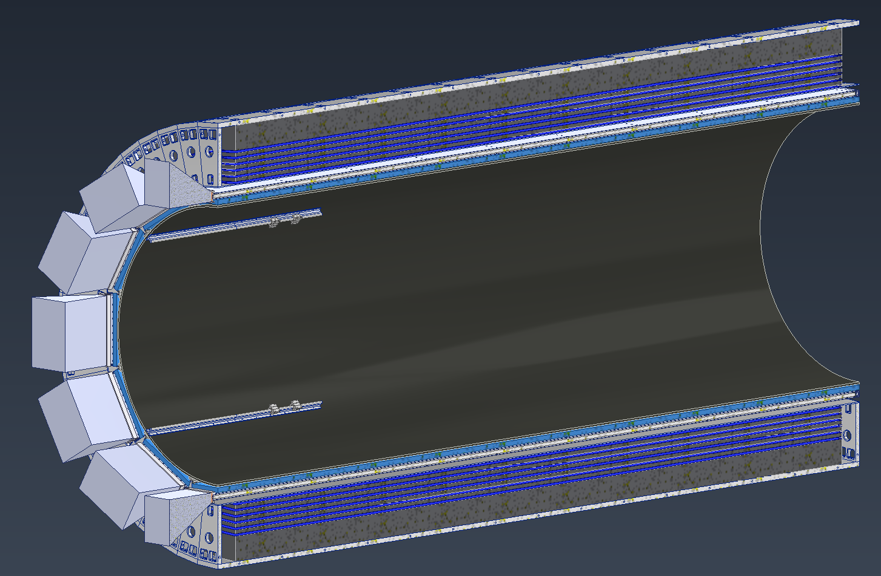
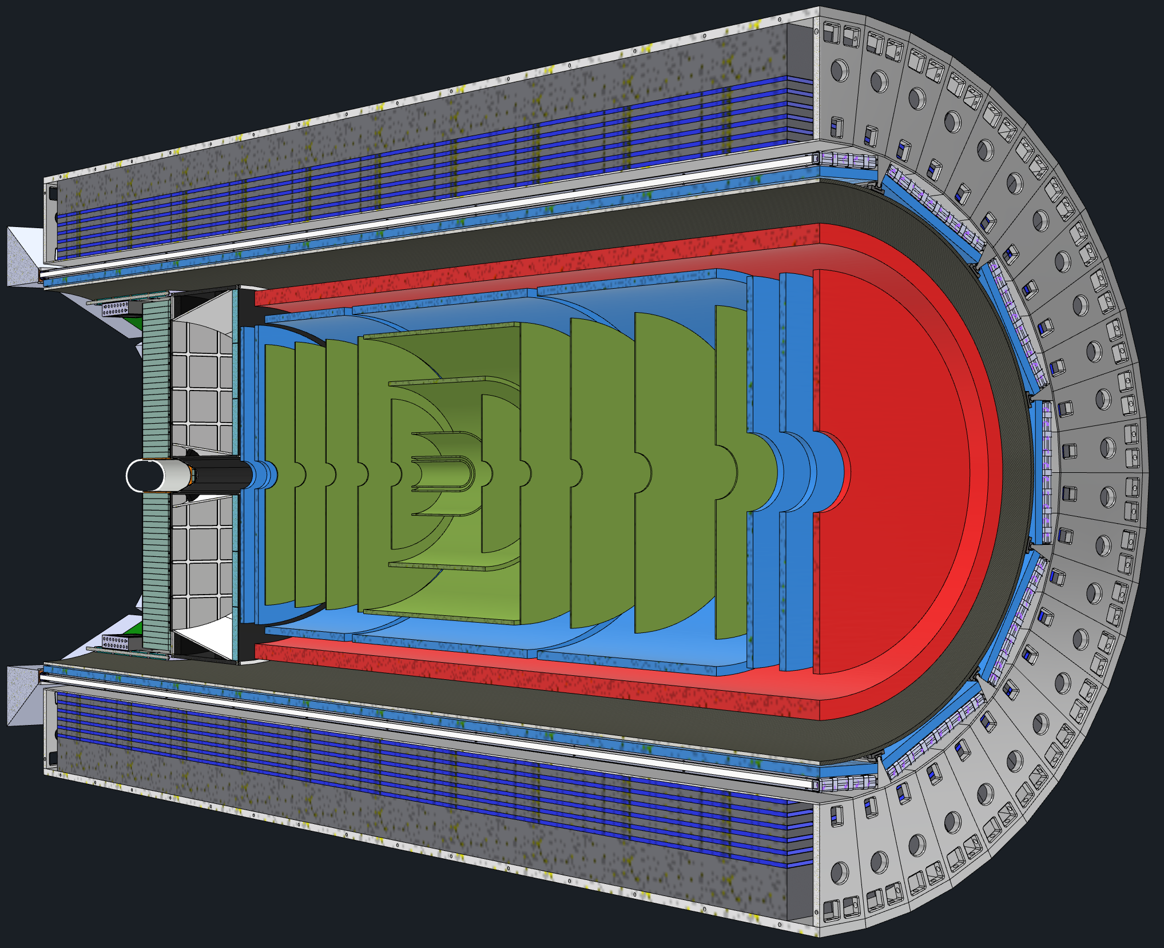
DIRC and oMPGD Support
Use barrel EMCAL for support of inner detectors
Outer MPGDs and DIRC will be nested in the area between rails.
A carbon fiber support structure attached to the barrel EMCal will support all the inner detectors
Separate Rails will be used for EEEMCal and pfRICH installation
Gaps between the EEEMCal and the carbon fiber cylinder will allow for inner services to be brought out
DIRC
oMPGD
CF Support Structure
Rails to Support Inner Detectors
Barrel EMCAL
ePIC Collaboration Meeting, Integration and Installation
Dan Cacace, Josh Harvey & Nathaniel Speece-Moyer

Slide 15
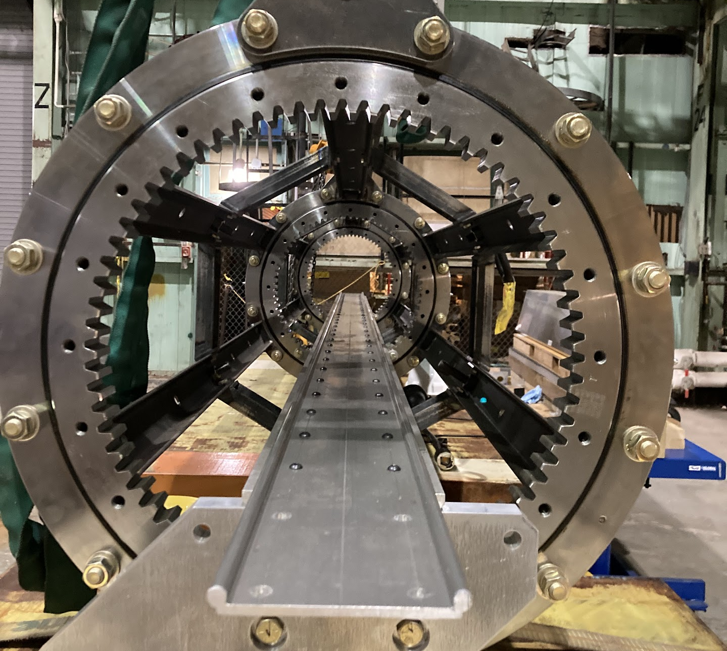
DIRC and oMPGD Installation
Use existing installation tooling from sPHENIX that was used to install EMCal
Tooling can rotate around axis parallel to Z
Tooling has rails that allow for detectors to slide on and off of
Detectors pulled in from far side

Slide 16
TOF, iMPGD and SVT Support – Conceptual
Rails support the carbon fiber cylinder which holds the TOF, iMPGD, SVT and BP
Load transferred to barrel EMCal
Alignment mechanisms need to be designed and incorporated
Is there sufficient clearance for adjustment/alignment?
Rails

Slide 17
TOF, iMPGD and SVT Installation – Conceptual
The TOF, inner MPGD, SVT and BP will be assembled together prior to installation
Will be installed as one unit on rails supported from the EMCal
Lifting tooling needs to be designed
EMCal
Rails
Caron Fiber cylinder with
TOF, iMPGD, SVT

Slide 18
pfRICH and EEEMCal Support – Conceptual
Rails support the EEEMCal and pfRICH
Potentially supported through the carbon fiber cylinder or cut outs will be made around them
Load transferred to barrel EMCal
Services need to be very well routed
Alignment mechanisms need to be designed and incorporated
EEEMCal
pfRICH
Rails

Slide 19
pfRICH and EEEMCal Installation – Conceptual
Might be advantageous to use a box structure for EEEMCal and pfRICH shipping, handling and installation
Attach box structure to beams bridging gap between HCal Sectors
Need extension rails and a means of interfacing them for transition and installation
Detectors could be installed together or separately

Slide 20
dRICH Support – Conceptual
Assuming the back plate of the dRICH is bulk carbon fiber, can be extended
Create tabs that can be attached to HCal, once attached, cantilevered off Hcal
May need to add additional support in Z
Minimizes space needed between dRICH OD and HCal ID.

Slide 21
dRICH Installation – Conceptual
Might be advantageous to use a temporary strongback for dRICH shipping, handling and installation
External stanchions bolted to floor and rails mounted to stanchions and HCal
C-fixture used to pick up and move dRICH over CG
More complex if dRICH is split
Services need to be very well routed

Slide 22
Questions?

