Slide 1
Far-Detector Integration and Installation
Jonathan Smith (JLAB), Ron Lassiter (JLAB)
2024 Electron-Ion Collider User Group
July 25th, 2024

Slide 2
Outline
CAD model synchronization
Far-Forward, Sector 5
Zero Degree Calorimeter (ZDC)
Roman Pots/Off-Momentum
B0 Magnet Detectors
B0 Magnet Sub-Components
Far-Backward, Sector 6
Lumi Calorimeter & Detectors
Low Q2 Tagger Tables

Slide 3
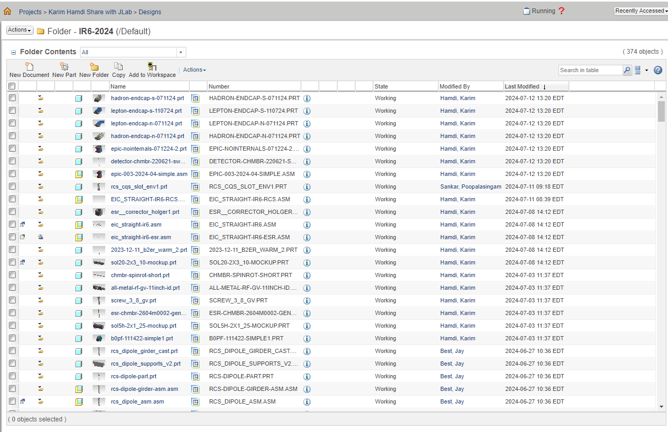
CAD Model Synchronization
CAD Programs Used:
PTC CREO
Siemens NX12 / NX2306
AutoDesk Inventor
SolidWorks
SketchUp

Slide 4
CAD Model Synchronization
JLab uploads the step file into Project Link to be extracted by BNL
BNL Updates the Lattice to reflect latest
CAD
JLab develops further updates to
the CAD and exports the STEP file
BNL uploads the Lattice into ProjectLink
JLab extracts the Lattice Update and imports the file into NX.

Slide 5
CAD Model Synchronization
BNL CREO Lattice Export:
JLAB NX12 Import:

Slide 6
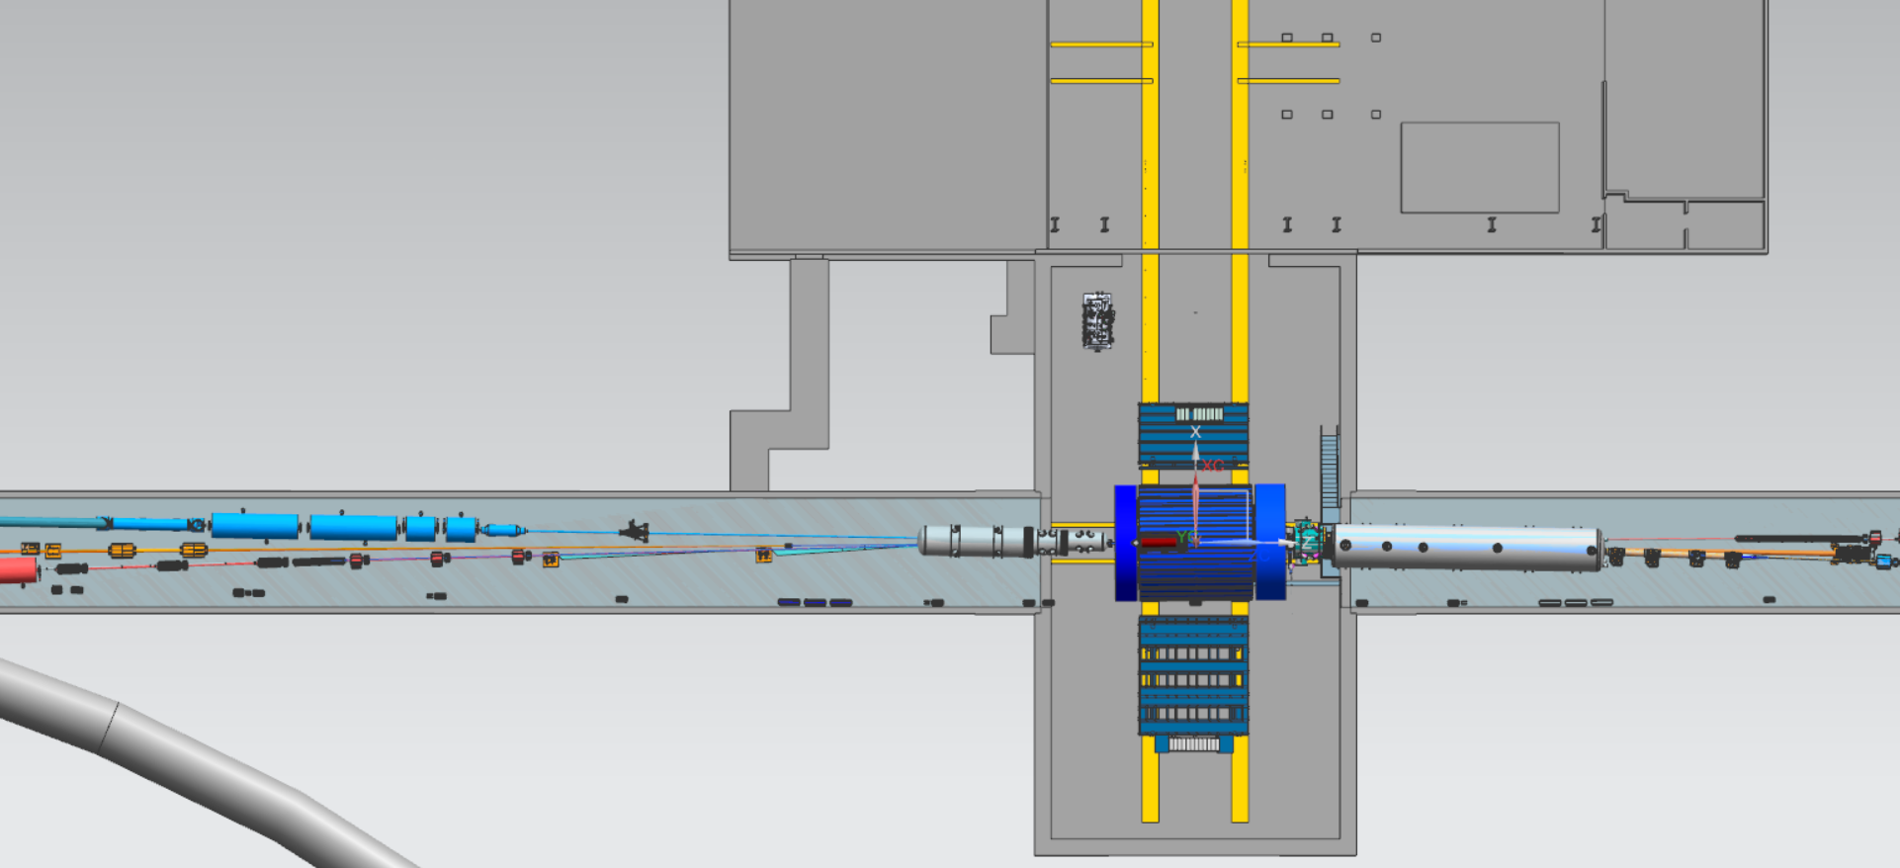
Far-Forward and Far-Backward
Far-Backward, Sector 6
Far-Forward, Sector 5

Slide 7
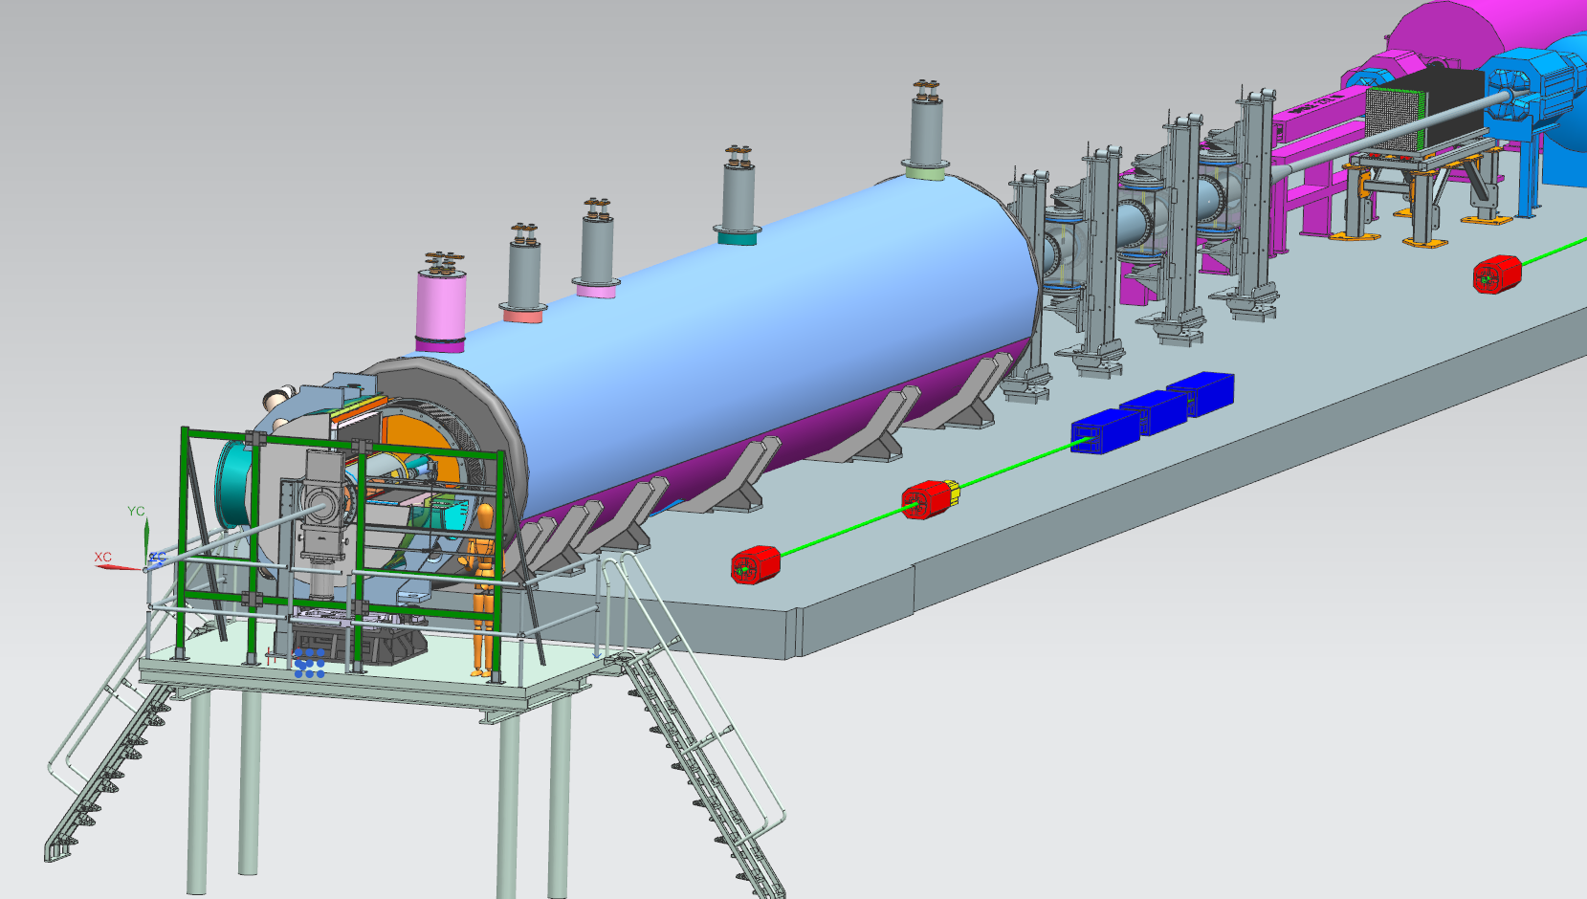
Far-Forward Region, Region 5
B0 Detector
Zero-Degree
Off Moment // Roman Pots

Slide 8
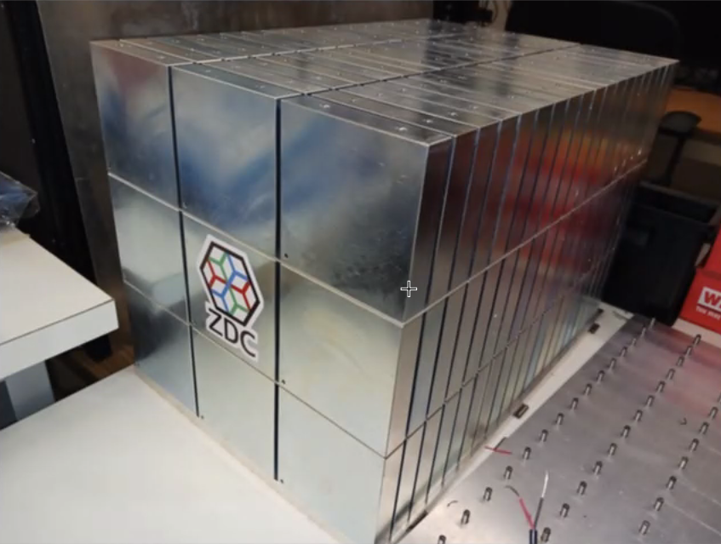
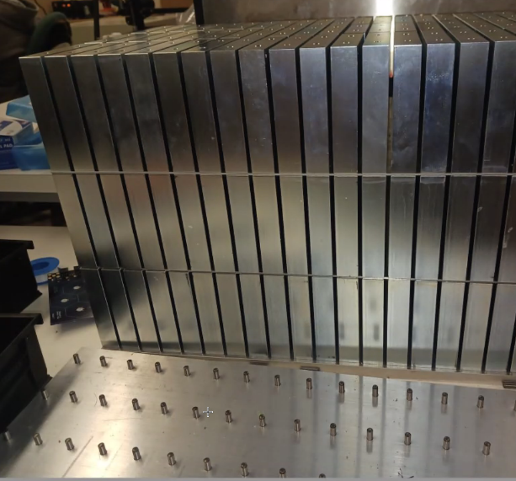
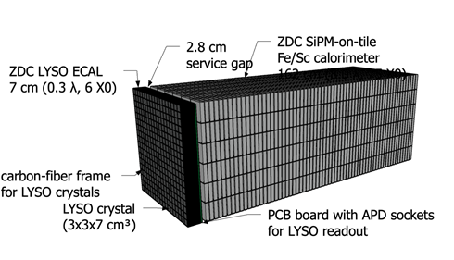
Zero Degree Calorimeter (ZDC)
Lead Tungston or LYSO Crystal (3x3x7 cm^3)
Carbon-Fiber Frame for Crystals(?)
ZDC SiPM-on-tile Fe/Sc Hydronic Calorimeter
>4,000kgs

Slide 9
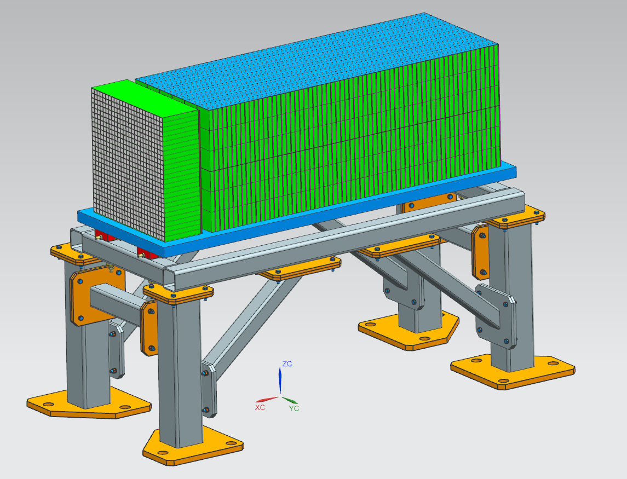
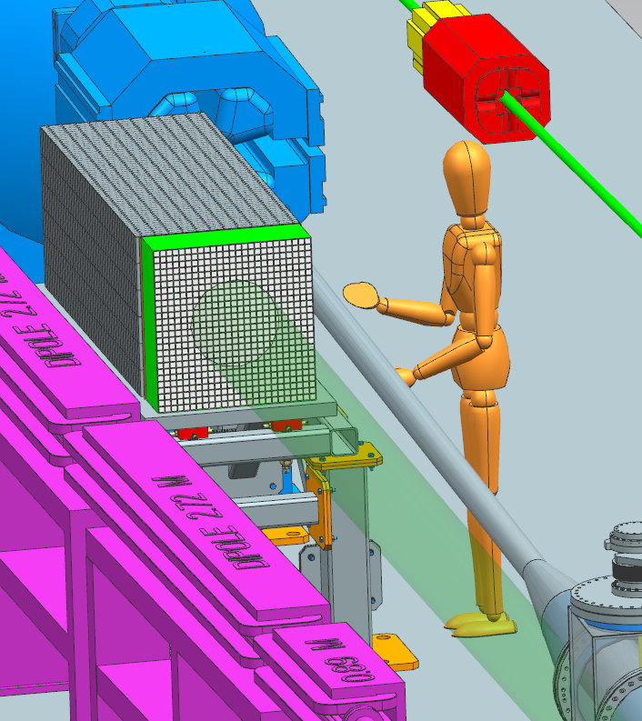
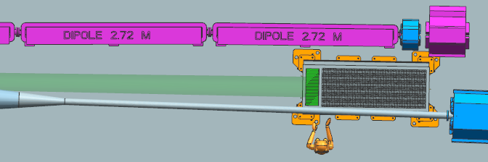
Zero Degree Calorimeter (ZDC)
Design Consideration:
Support for >4,000kgs
Removal/Re-Install for Maintenance

Slide 10
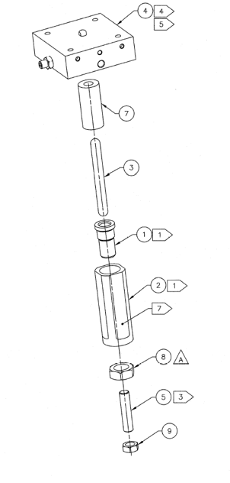
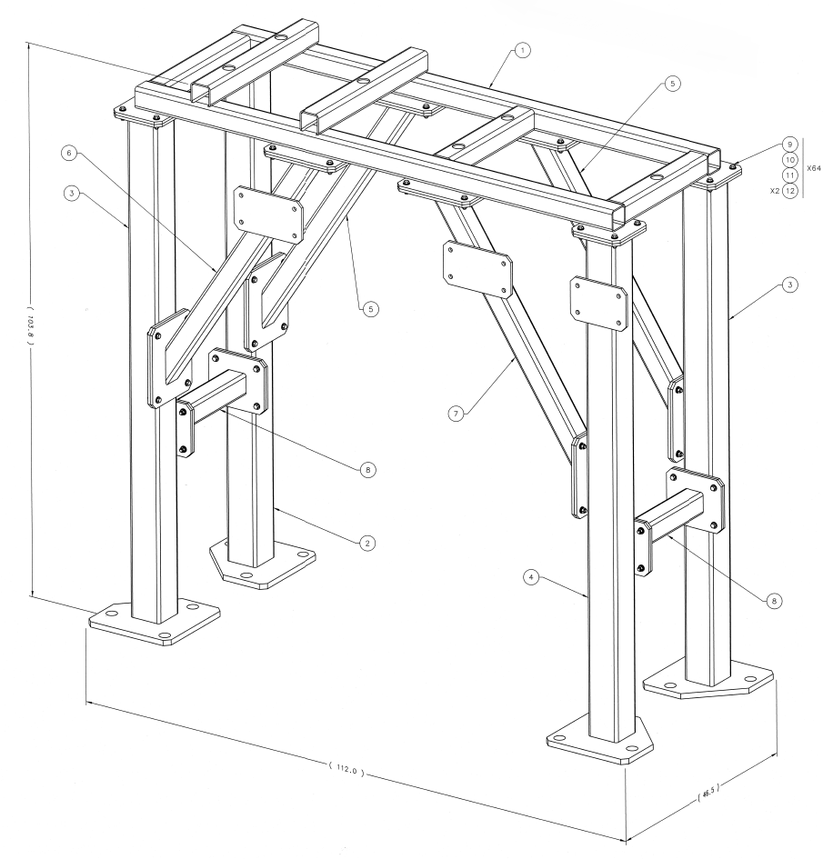
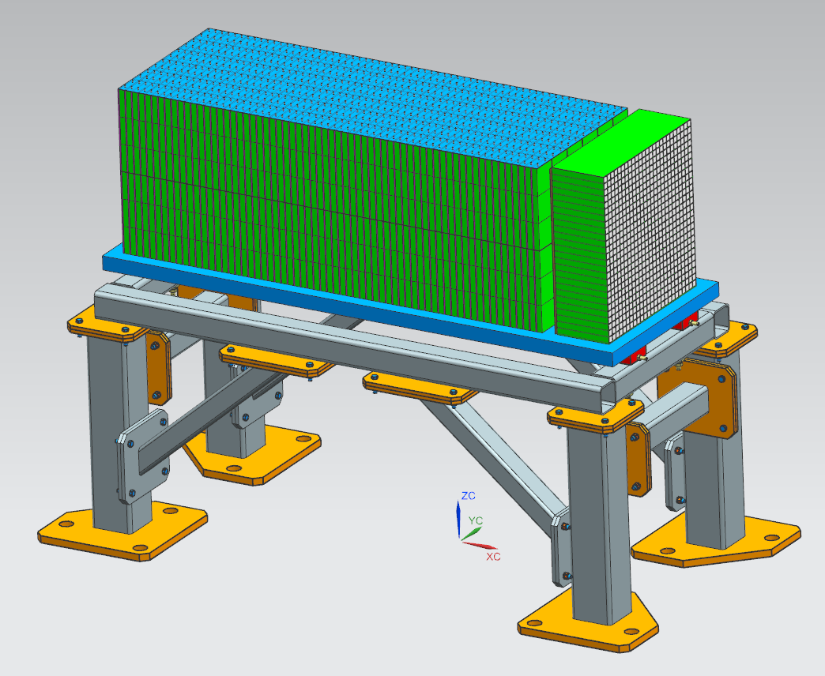
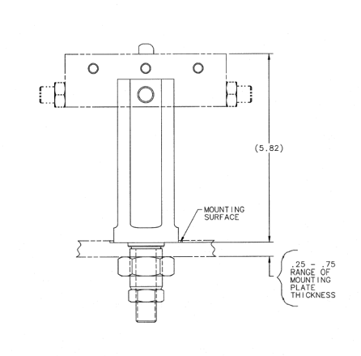
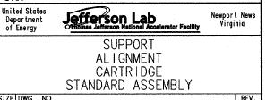
Zero-Degree Calorimeter

Slide 11
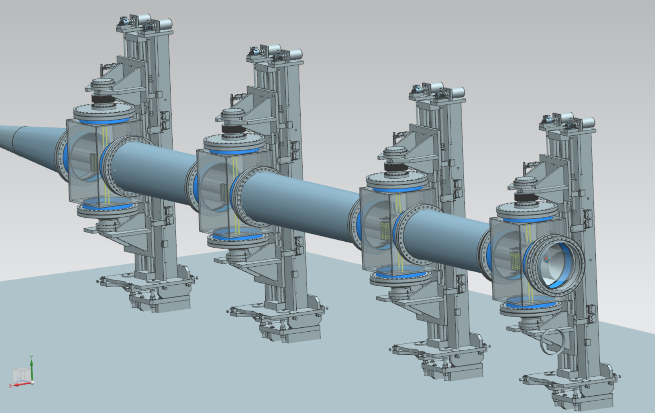
Off-Moment & Roman Pot Detectors
This design is out of date based on a layout BNL STAR Roman Pot system
Not optimized for accelerator, impedance too high

Slide 12
Off-Moment & Roman Pot Detectors
Roman Pots
OMD
Credit: Alex Jentsch, BNL

Slide 13
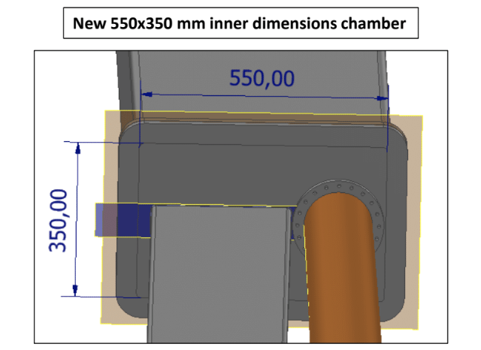
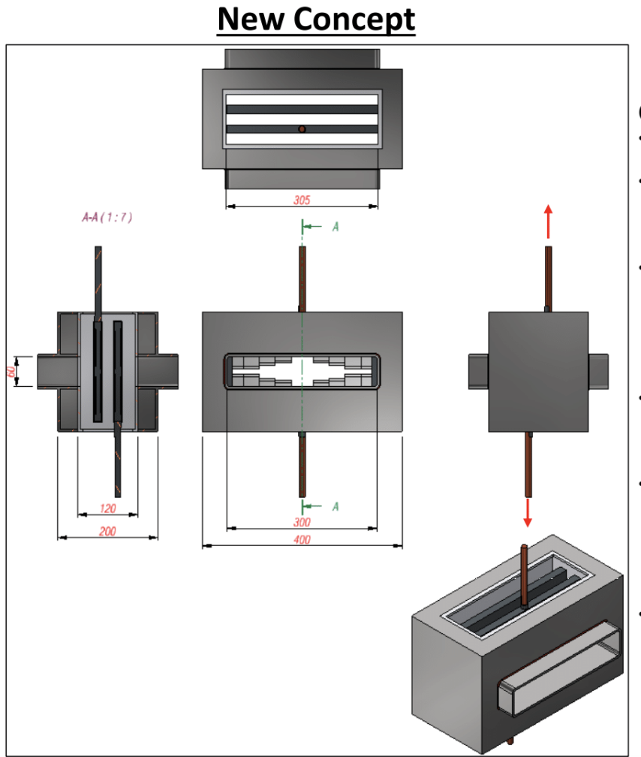
Off-Moment & Roman Pot Detectors
Transition region from larger beam pipe containing OMD to smaller pipe containing RP (left) and exit window for neutrals (right).
Credit: Alex Jentsch, BNL

Slide 14
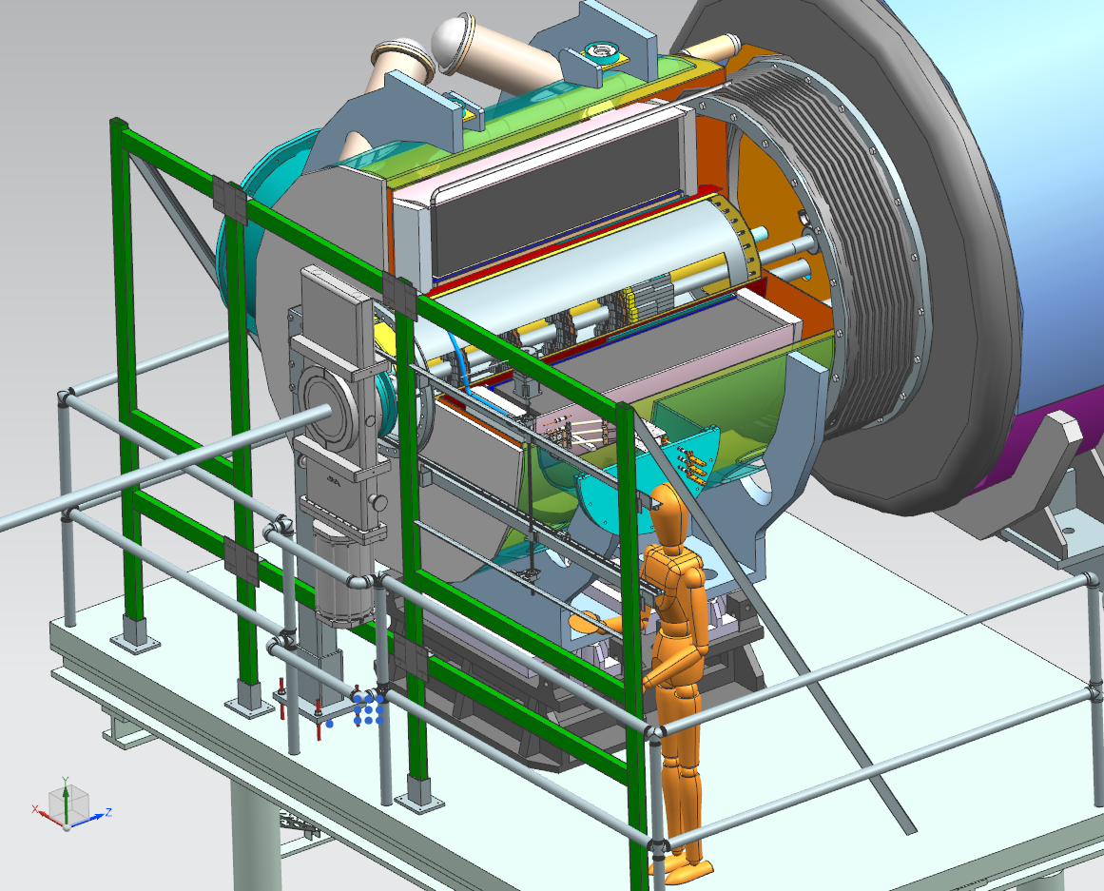
B0 Magnet Detector
Counter-Lever Support
Removable Detector Track/Roller Support Frame
Detector Layers
Calorimeter
Install/Removal Sequence
Known Challenges…
3D Print Mock-up

Slide 15
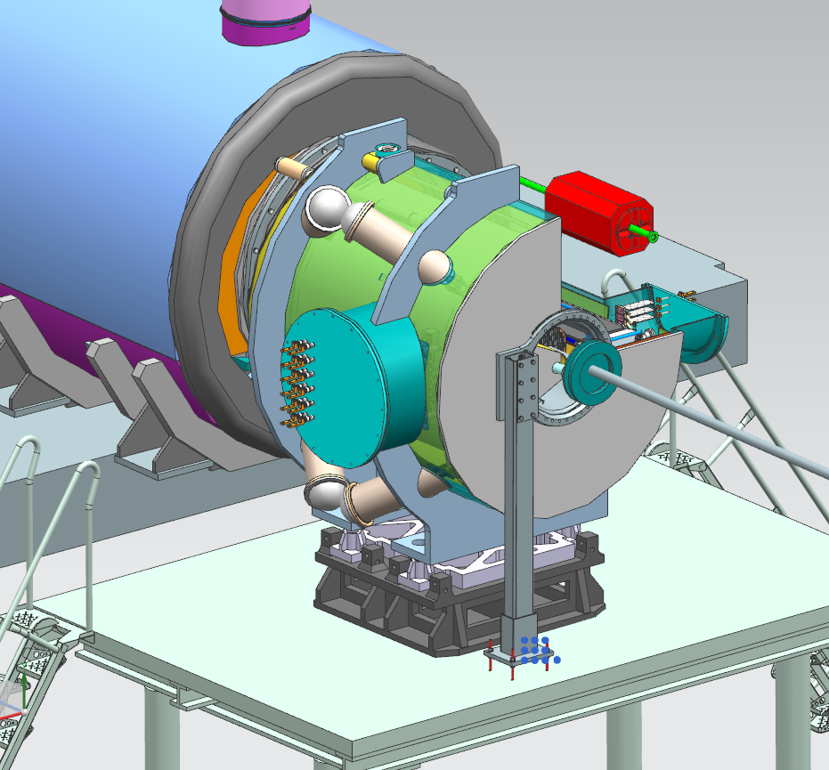
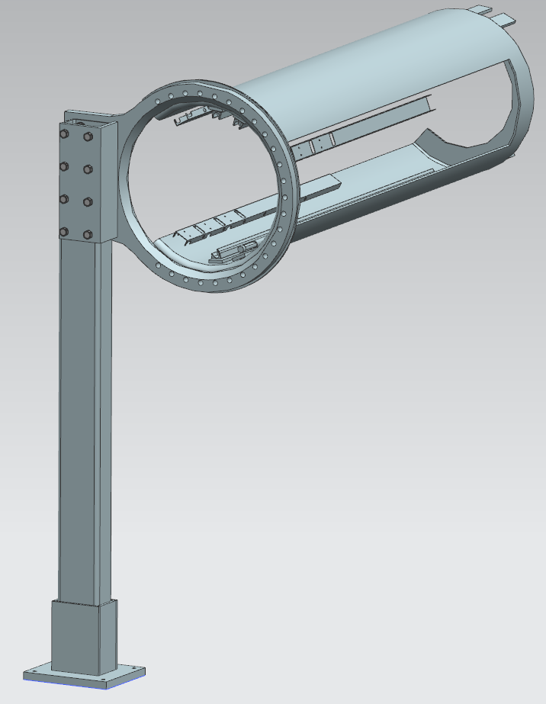
B0 Magnet Detector

Slide 16
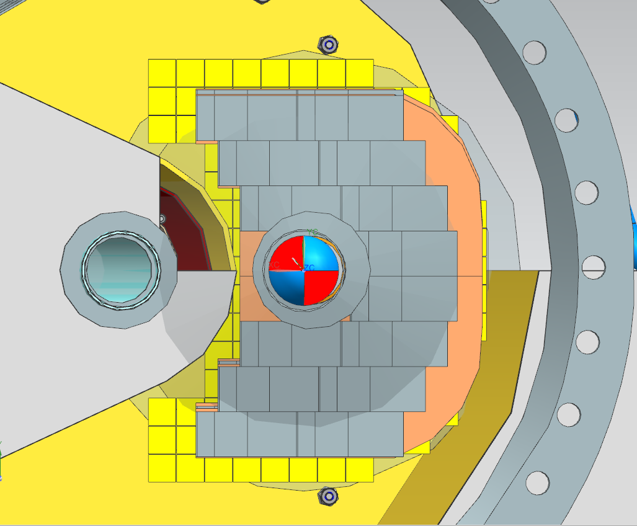
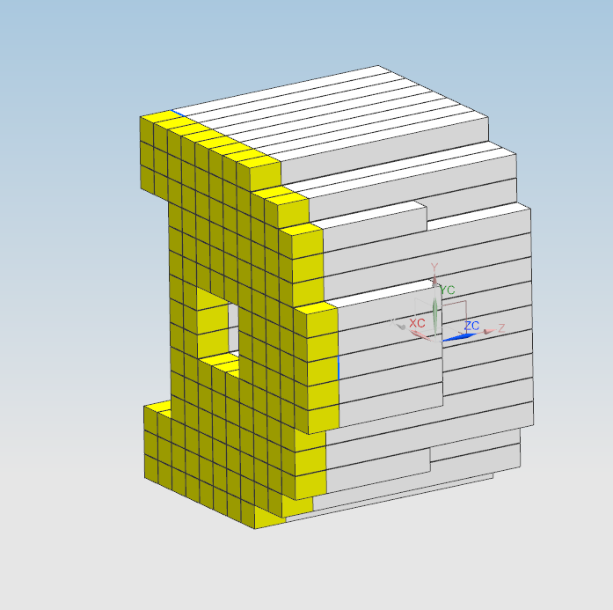
B0 Magnet Detector
Design Requirements
Detector Layers must be removable via the front
Provide full coverage for 20mrad from IP to downstream
20cm spacing between detector layers
Calorimeter is 693cm from IP, with nearest detector 1cm in front
Calorimeter utilizing 20cm crystals (Note: 10cm crystals used nearest cryostat, circled RED)
Support Structure will need to hold approximately 200lbs (Calorimeter) from the furthest point.

Slide 17
B0 Magnet Detector

Slide 18
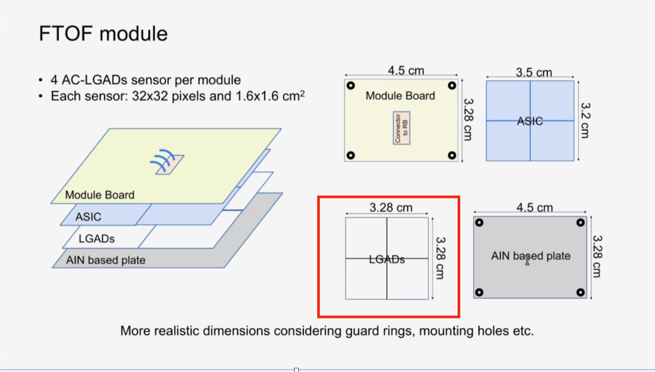
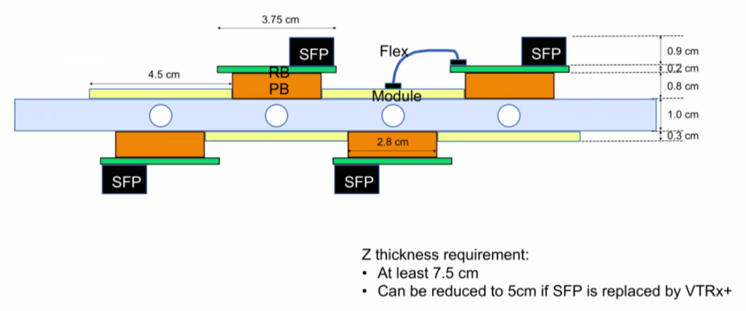
B0 Magnet Detector
Note: Cooling is currently unknown at this time

Slide 19
B0 Magnet Detector

Slide 20
B0 Future Design Development
Further development of detector layers and calorimeter maintenance/removal rail system.
Pending R&D detector updates for heating/cooling requirements.
Ongoing discussions with accelerator, magnet, and vacuum that will likely have impact future design.
Potential for a removable access platform
Currently 3D printing a prototype for Track/Roller detector removal/install system

Slide 21
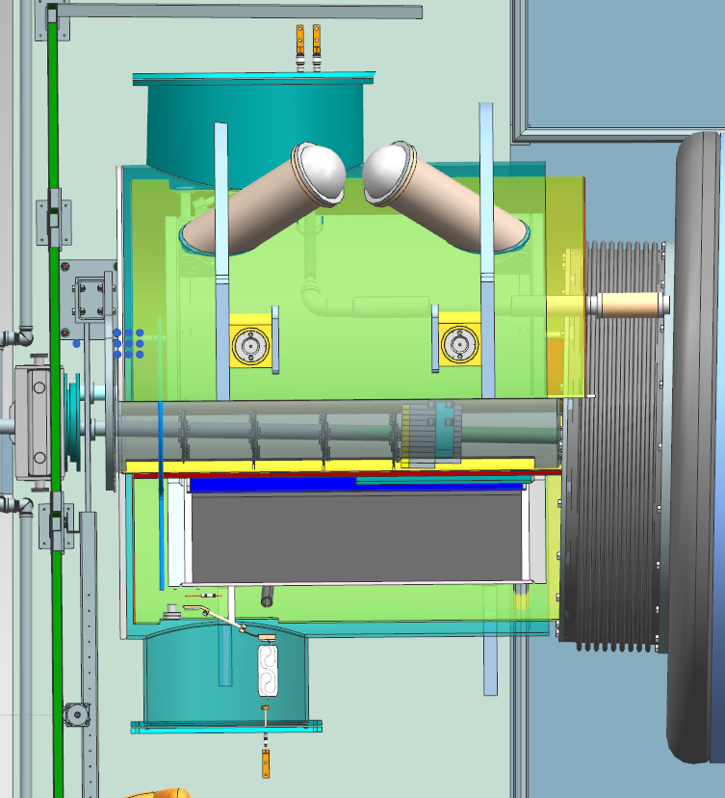
B0 Challenges
No access in the rear, very limited access in front
Anticipating a bellows around electron beampipe in front access
Unable to remove Calorimeter for maintenance.
Calorimeter will need to be installed prior to placing B0 Magnet in beamline.
Space limitations for electronics and cooling lines.

Slide 22
Far-Backward Region, Sector 6
Far-Backward, Sector 6

Slide 23
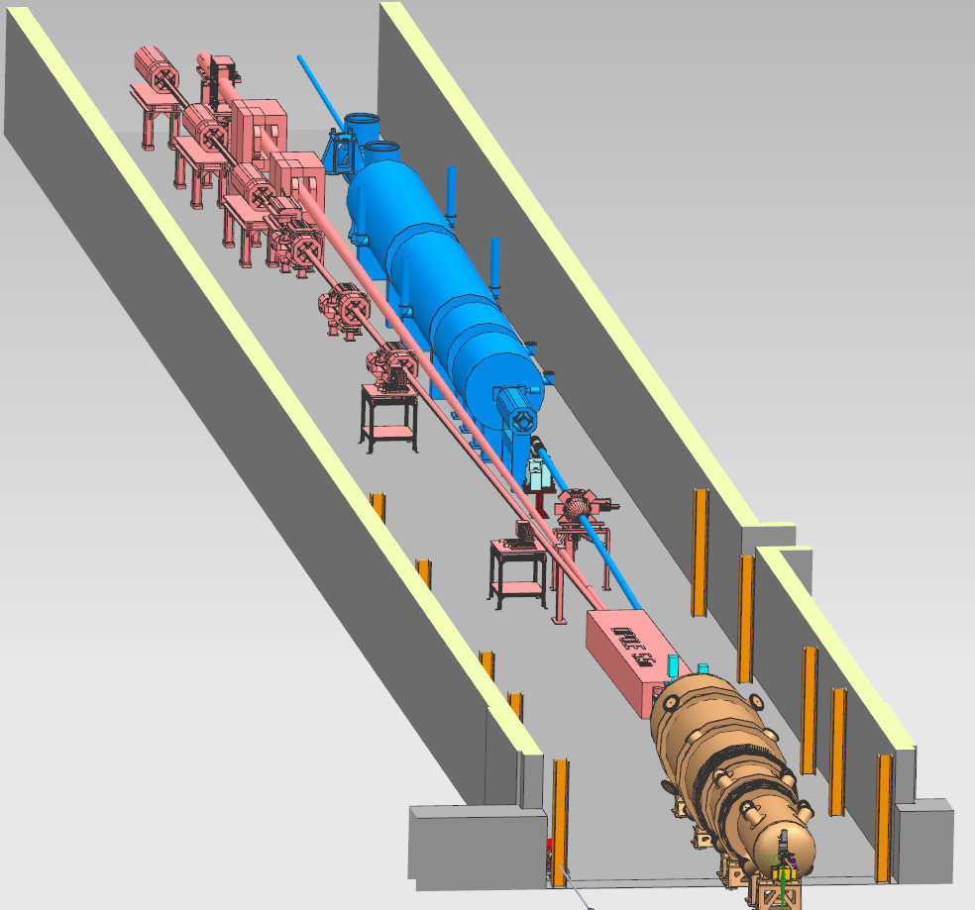
Far-Backward Region, Region 6
Lumi Detectors
Electron Detectors

Slide 24
Far-Backward Region, Region 6
FAR-BACKWARD REGION AS OF FEBRUARY 2024
FAR-BACKWARD REGION AS OF JULY 2024
PUT UPDATED LAYOUT HERE

Slide 25
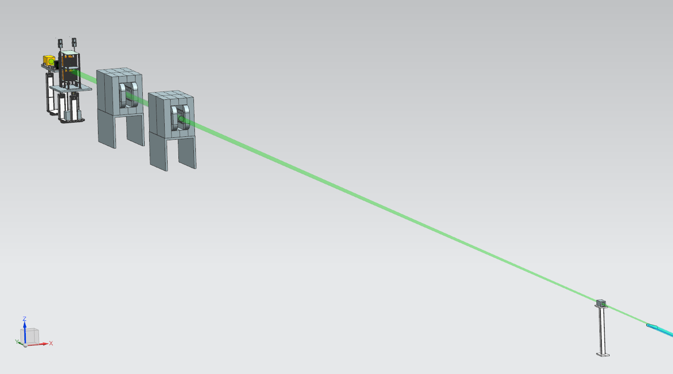
Lumi Detectors and Calorimeters Arrangement
High/Low Lumiseparation Calorimeters
Sweeper & Analyzer Dipole
Pair Spectrometer Detectors & Calorimeters
Exit Window
Collimator

Slide 26
Lumi Pair Spectrometer Detectors and Calorimeters
Currently utilizing 80/20 Supports for Photon and Spectrometer Detector Layers
Similar to B0 Detectors, we are using Forward TOF Detectors
Using (2) separate drive screws for individual vertical movement on each layer
Top layer will move +10cm, Bottom layer will move -10cm from Lumi
Credit: Dhevan Gangadharan & Nick Zachariou

Slide 27
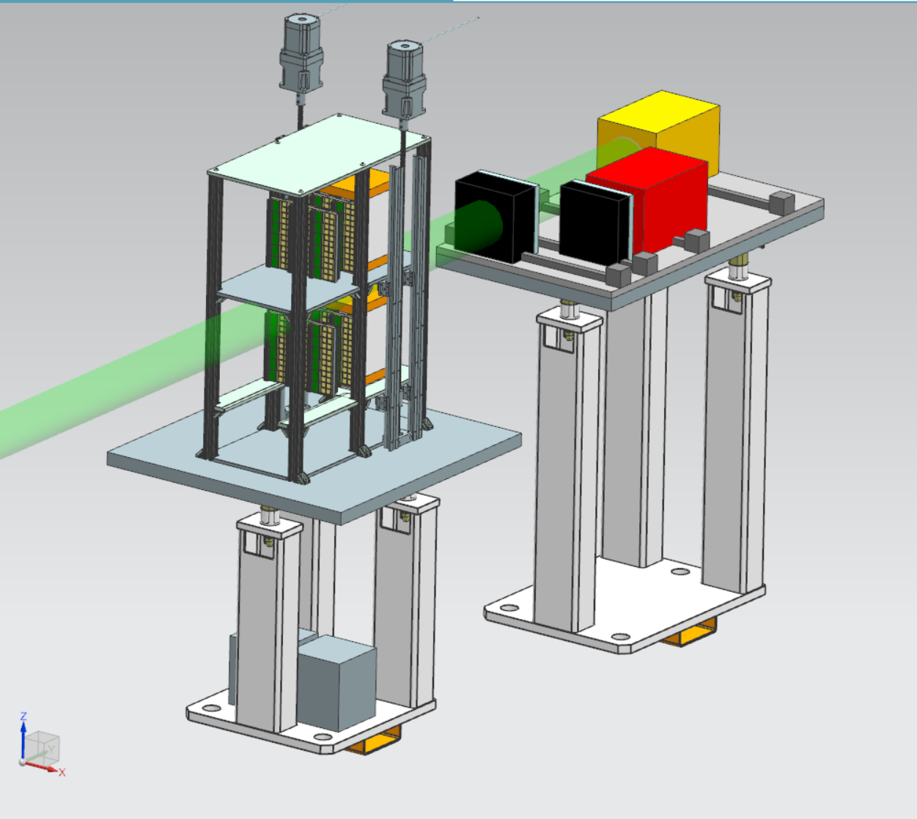
Lumi Spectrometer Detectors and Calorimeters
Future Design Development
Removing existing pedestal support to be replaced by a Table
Supports for detector layers
Updating 80/20 Frame to support linear rails

Slide 28
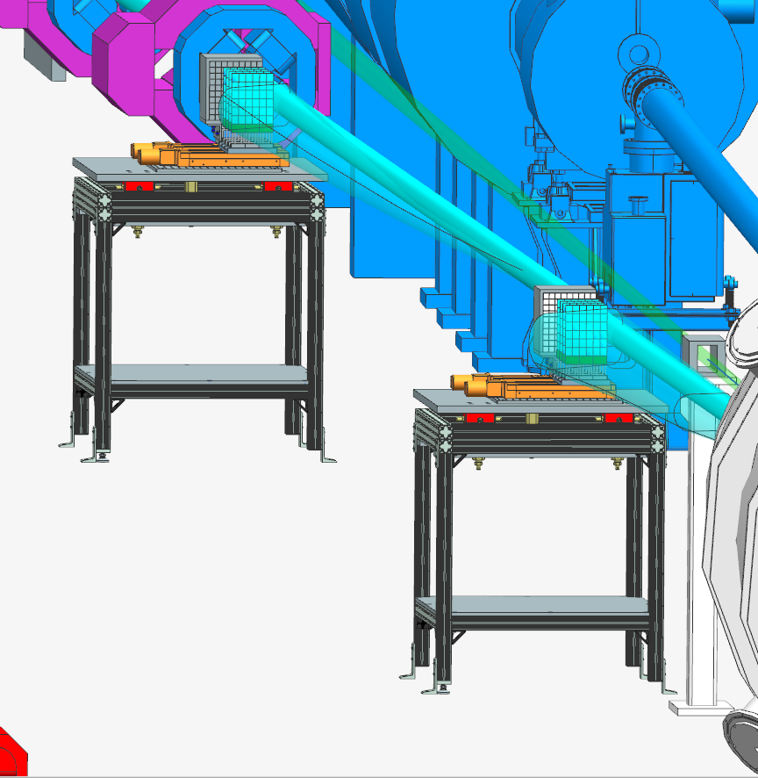
Low Q2 Tagger Stations 1 & 2

Slide 29
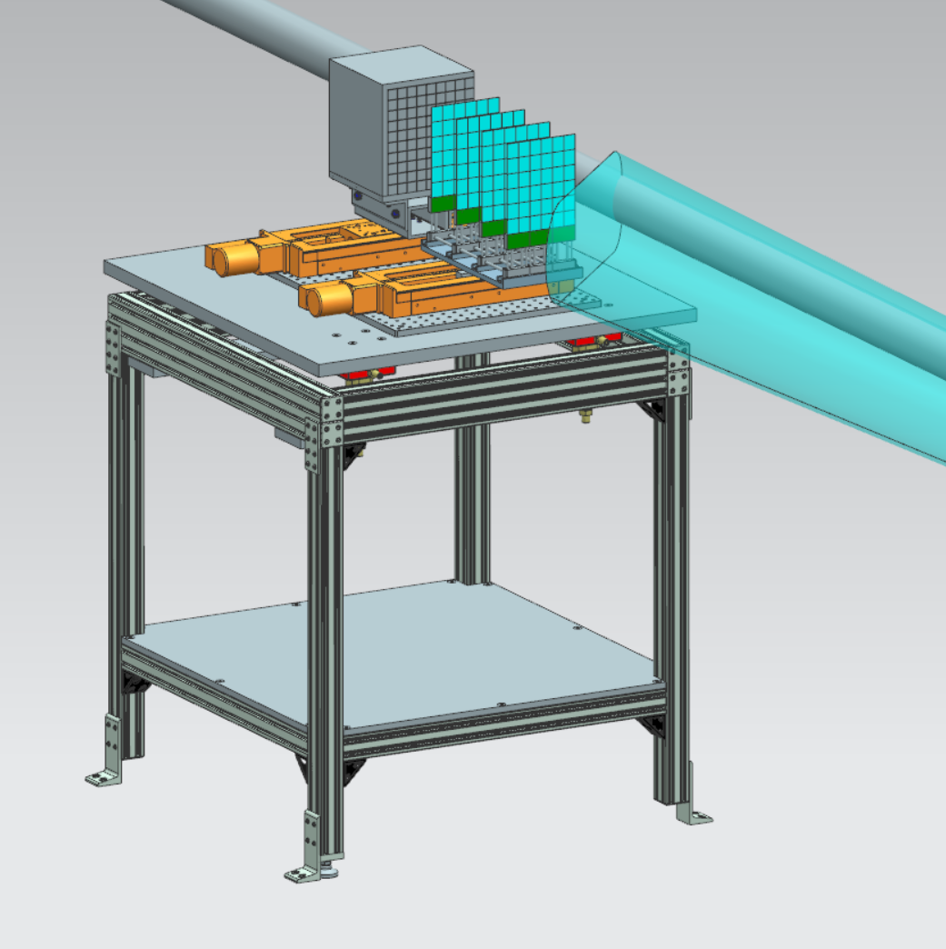
Low Q2 Tagger Stations 1 & 2
Utilizing an adjustable motor for both calorimeters and detector layers in way of electron line
Constructing an 80/20 Support Table with adjustable legs for leveling
Using alignment cartridges to adjust the yaw, pitch, and roll as necessary.
Credit: Ken Livingston & Simon Gardner, UK

Slide 30
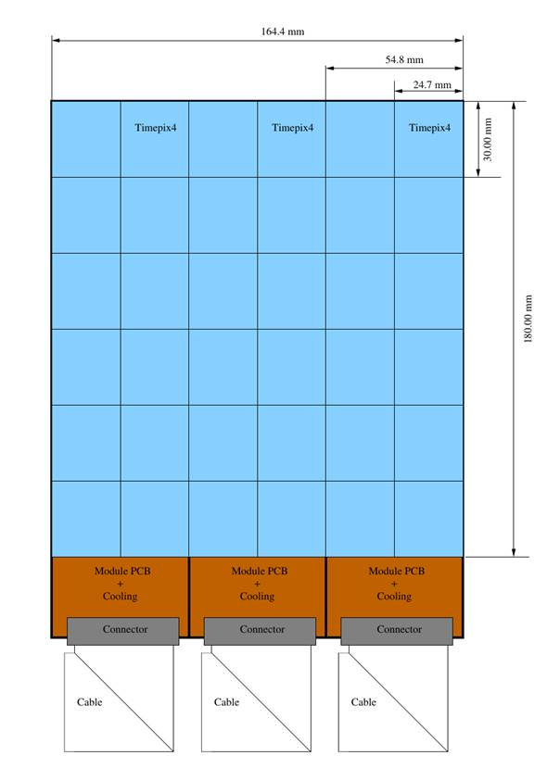
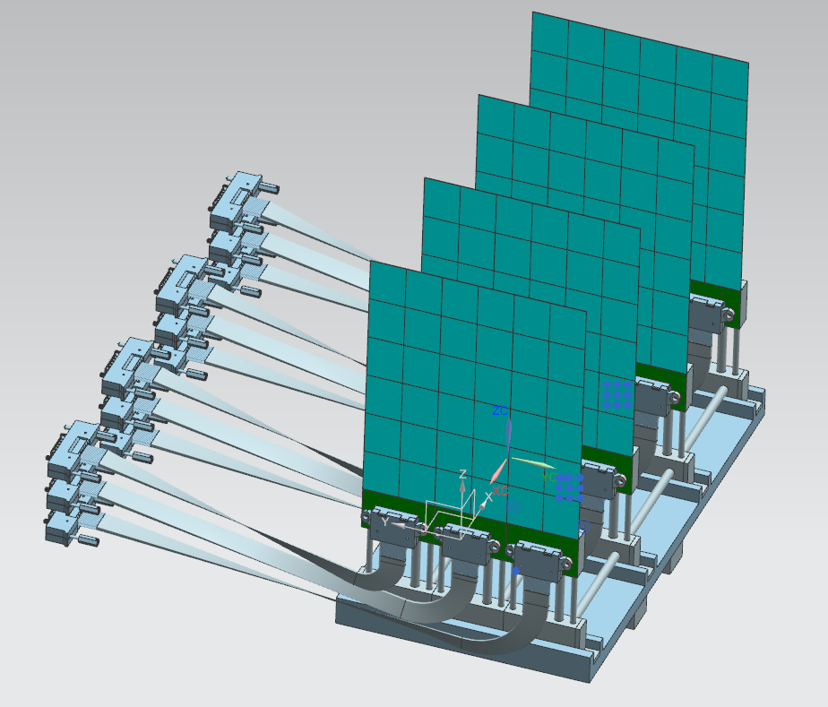
Low Q2 Tagger Requirement / Timepix4
Credit: Ken Livingston & Simon Gardner

Slide 31
Low Q2 Tagger Stations 1 & 2
Future Design Development
Rearrangement may be necessary due to recent B2ER dipole update
Both exit windows will be modified based on the outcome of synchrotron simulation radiation

