Slide 1
Routing & Services
Roland Wimmer (BNL)
Contributions from everyone
ePIC Collaboration Meeting
July 25th, 2024

Slide 2
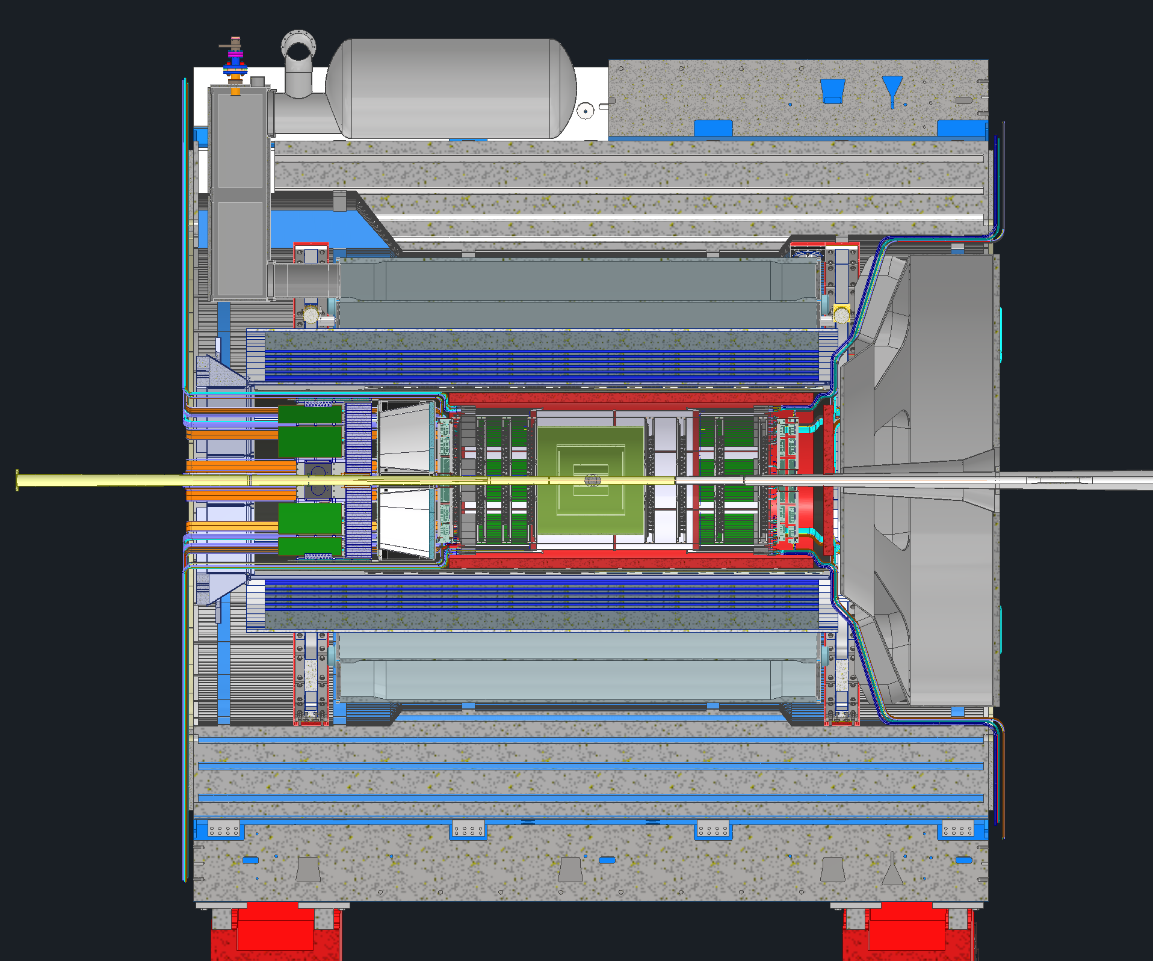
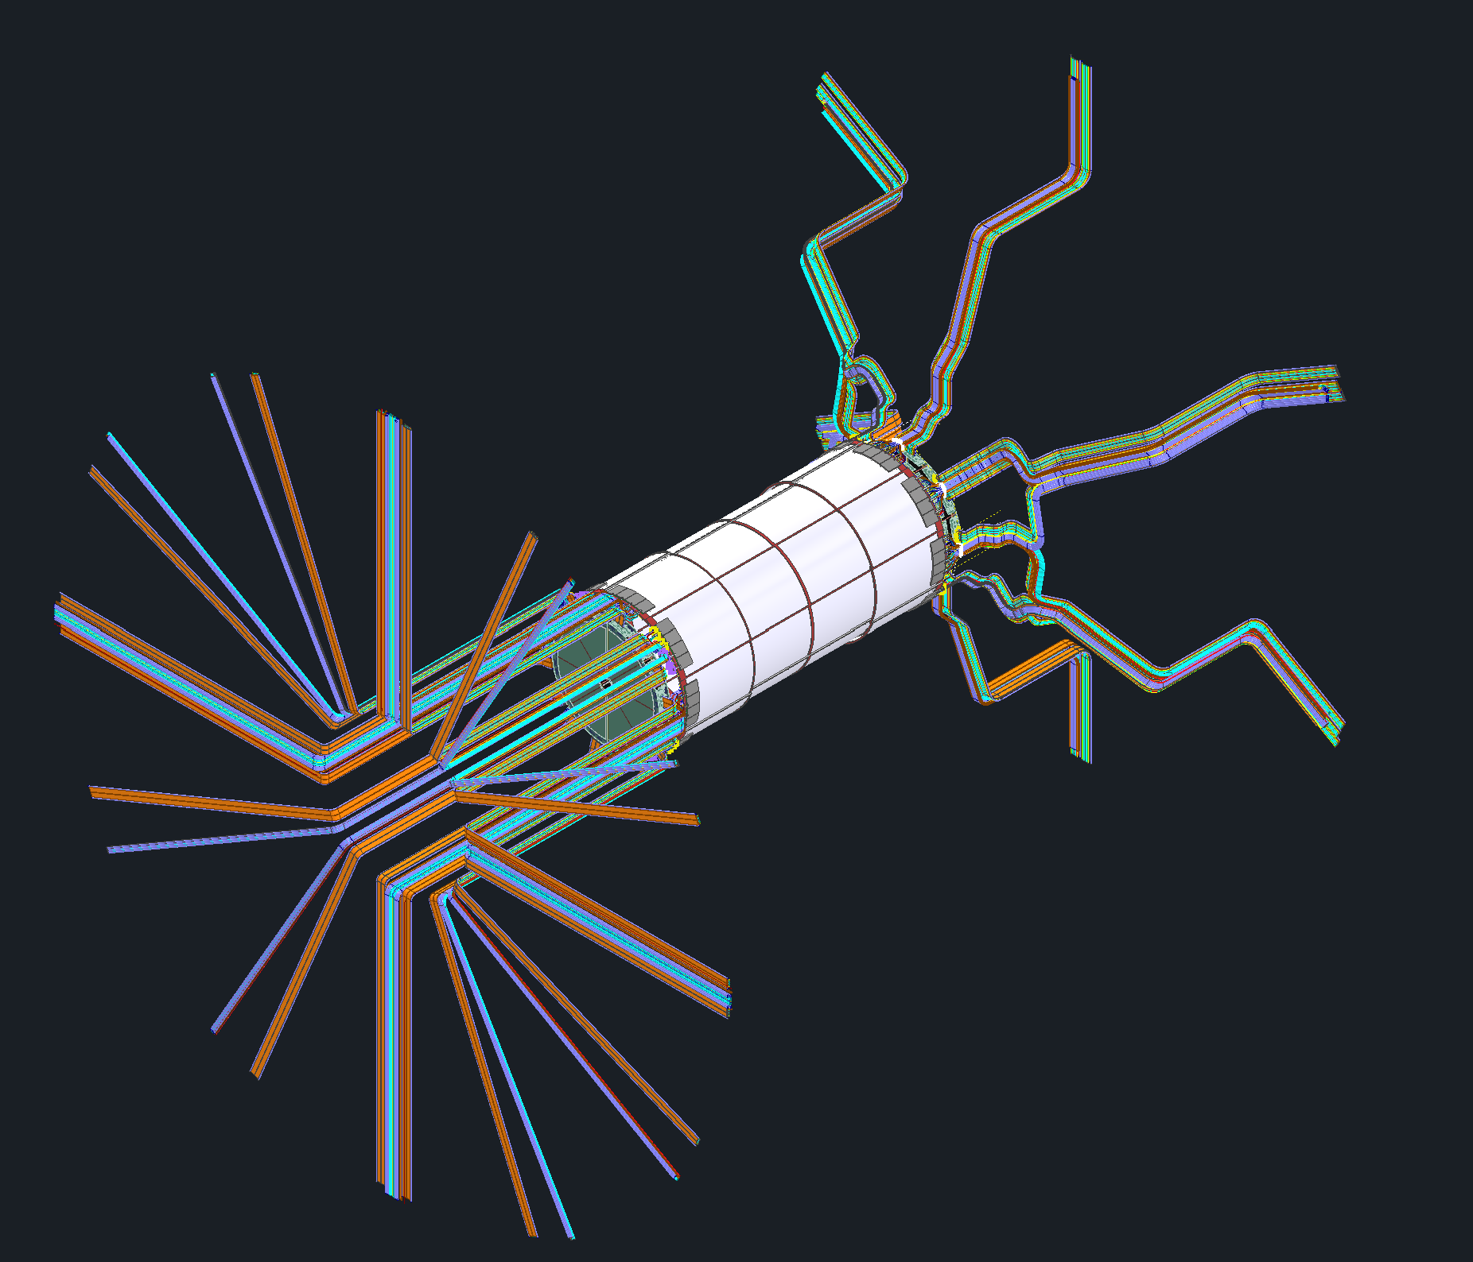
Outline
Recent updates
Updates needed from subgroups
Current available spaces
RDOs
Moving forward

Slide 3
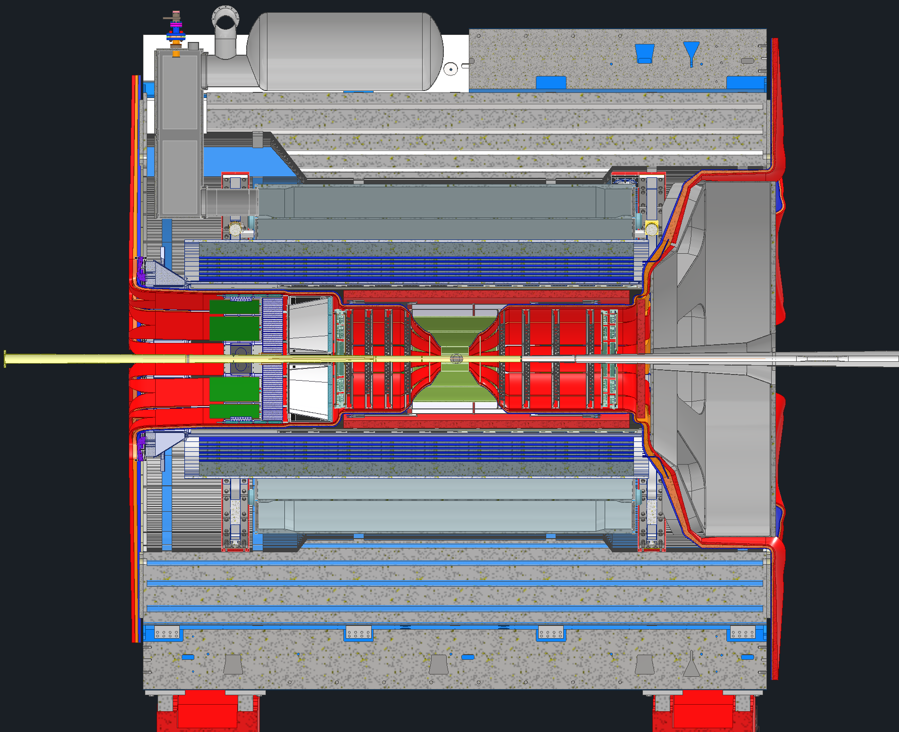
Recent Updates
Working on converting the volume services model to an actual services model
Only Inner MPGD Barrel and Disks so far

Slide 4
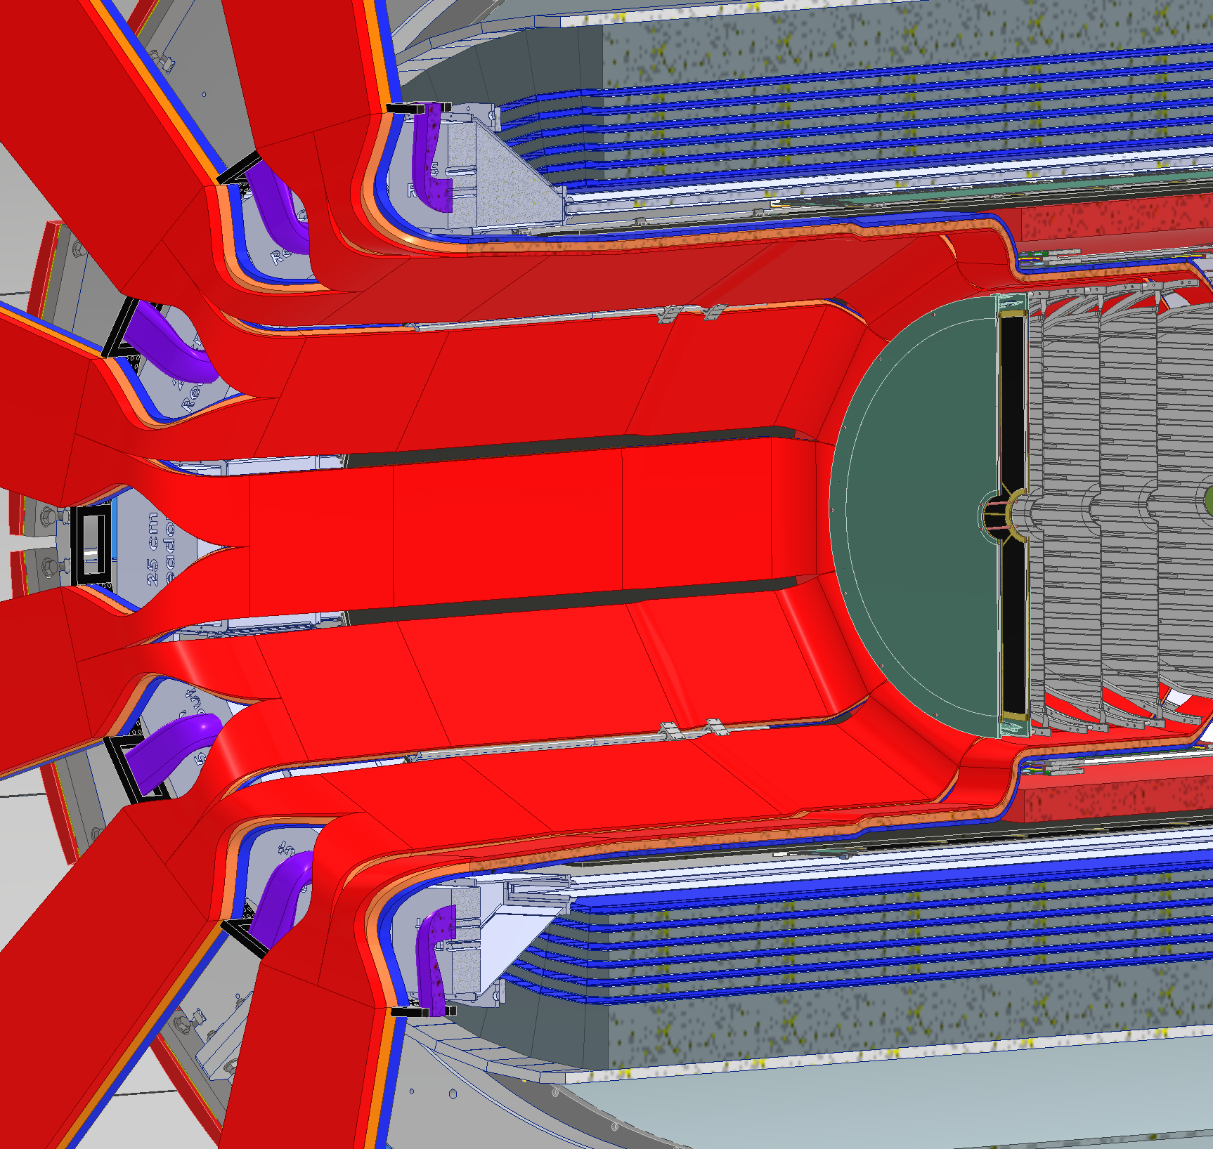
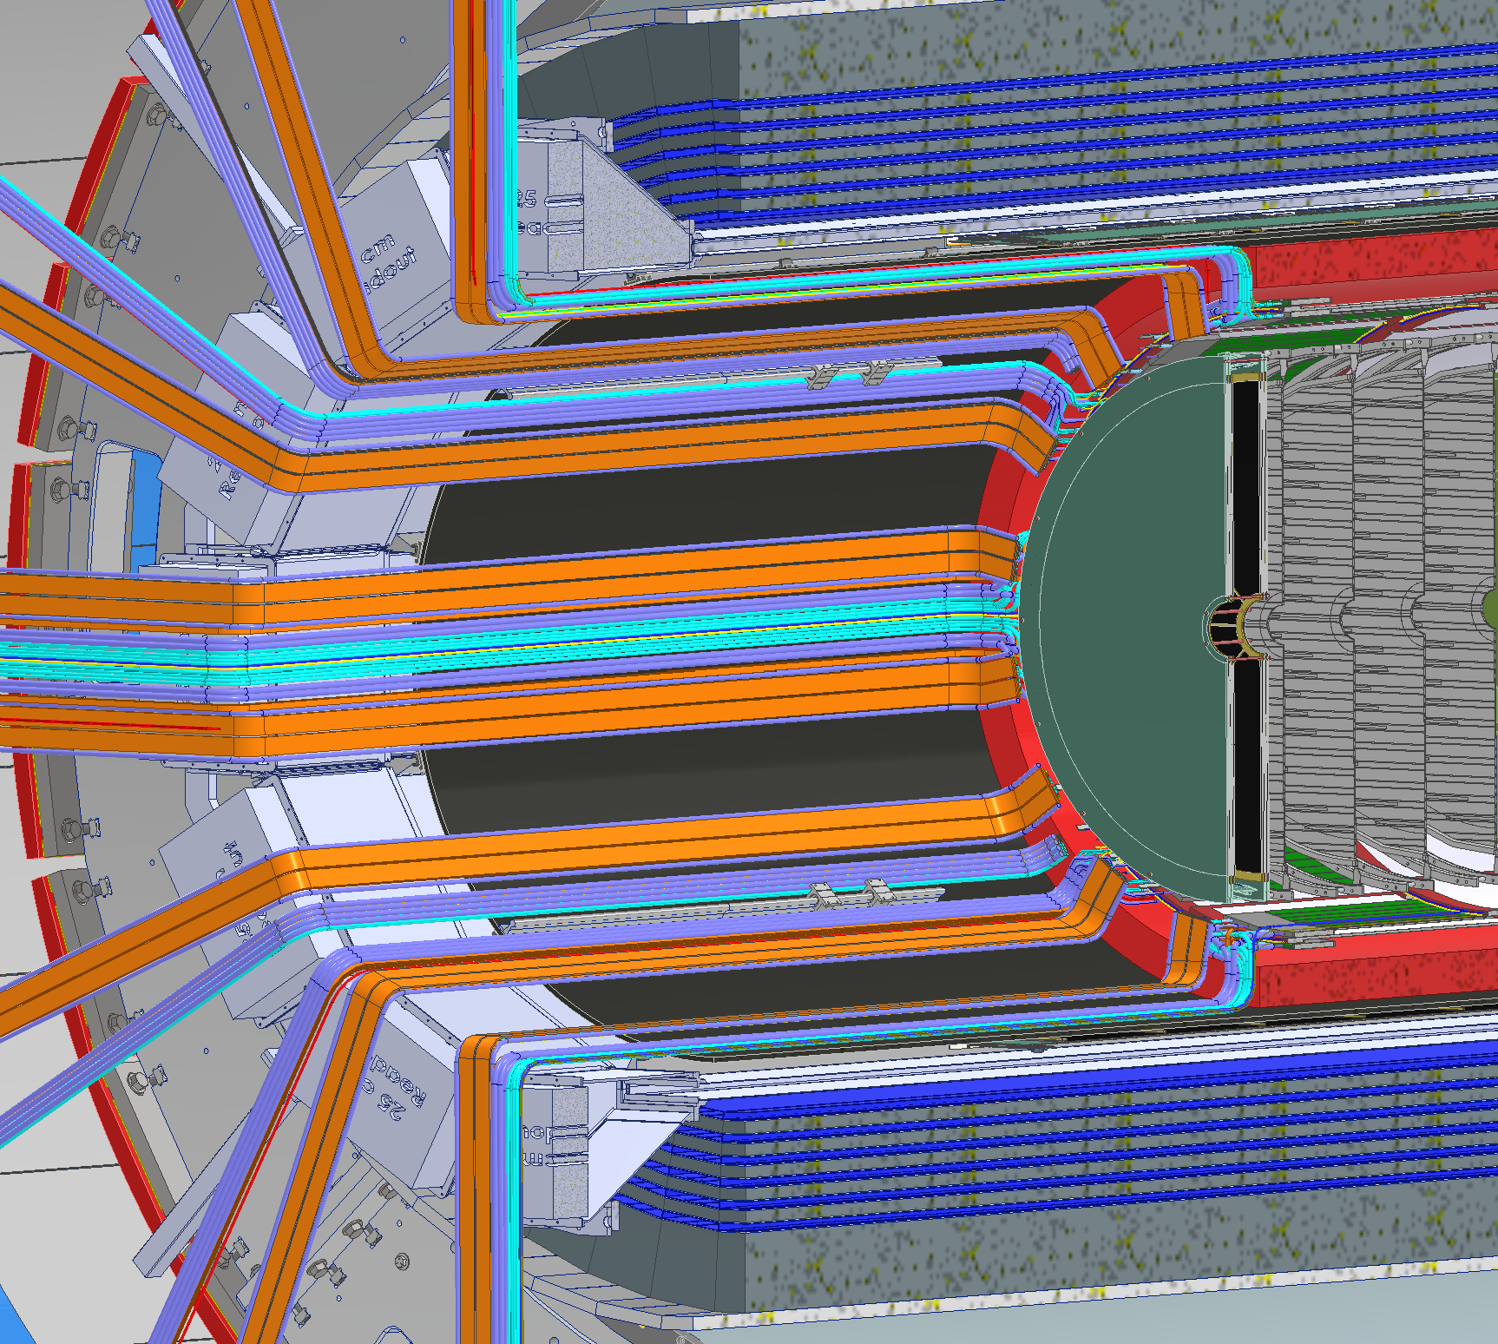
Recent Updates

Slide 5
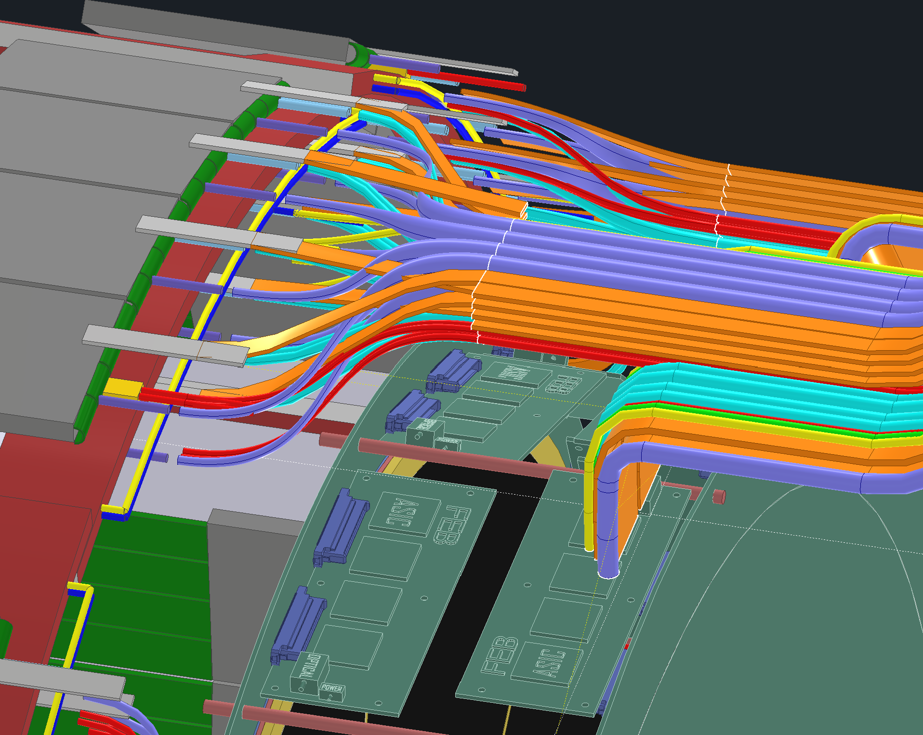
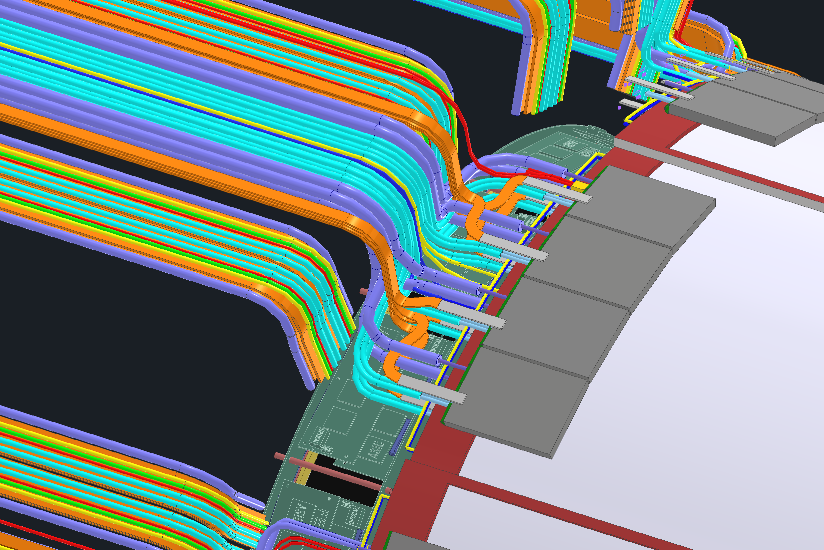
Modeling Updates
Certain groups are starting to give models that have various ports or cable leads to indicate where the services will be coming out of their detectors and boards

Slide 6
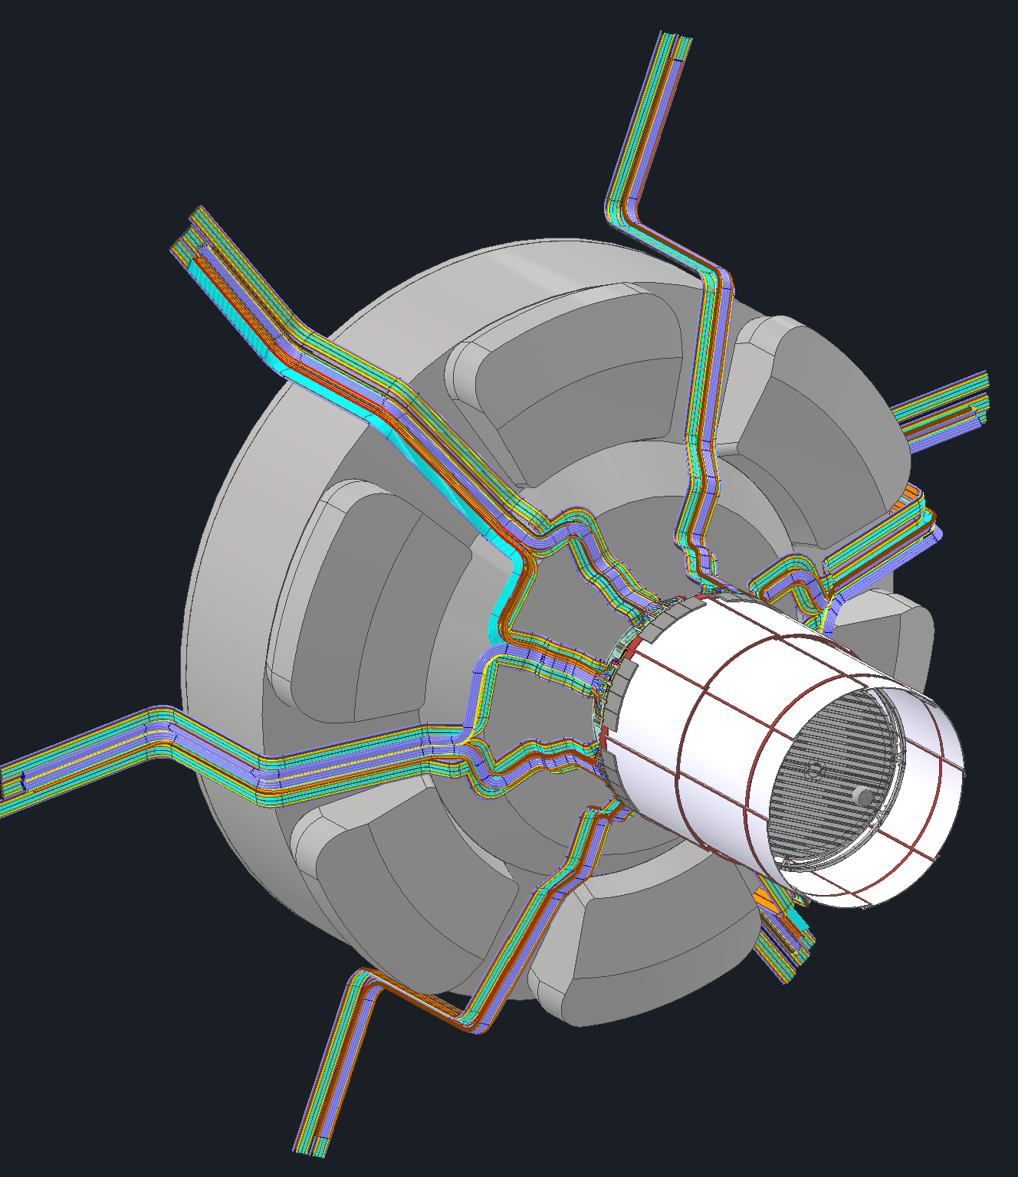
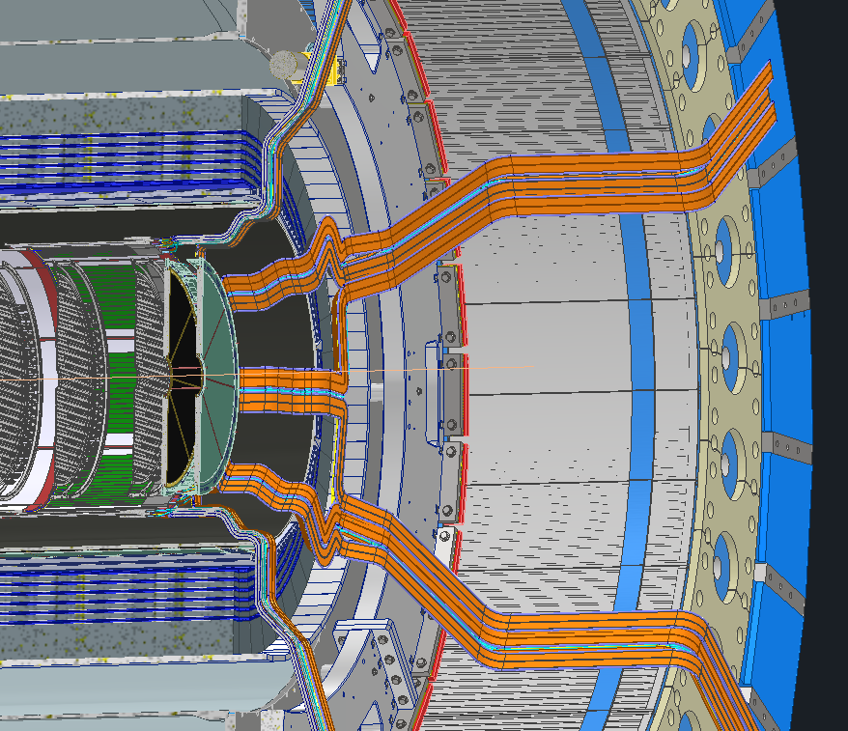
Updates

Slide 7
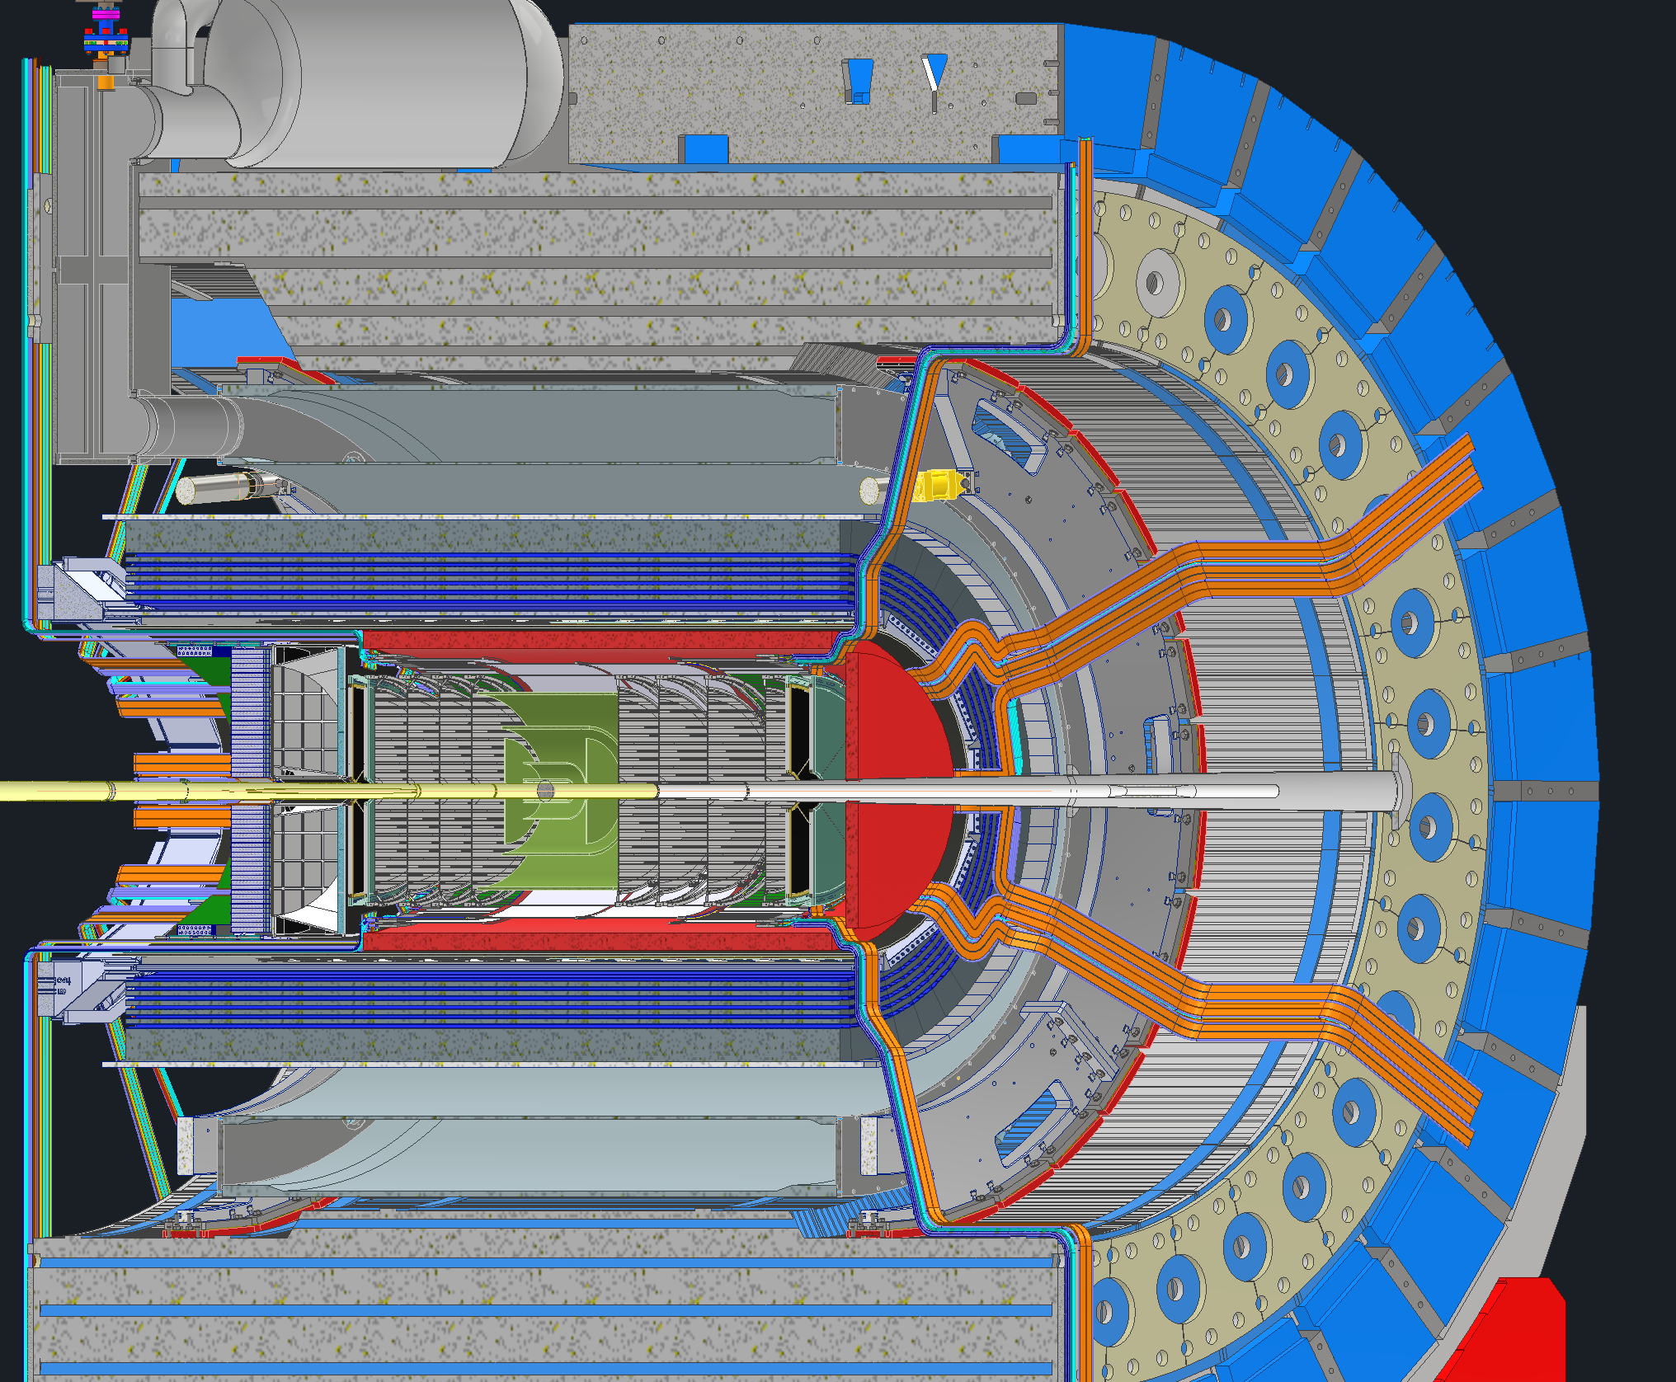
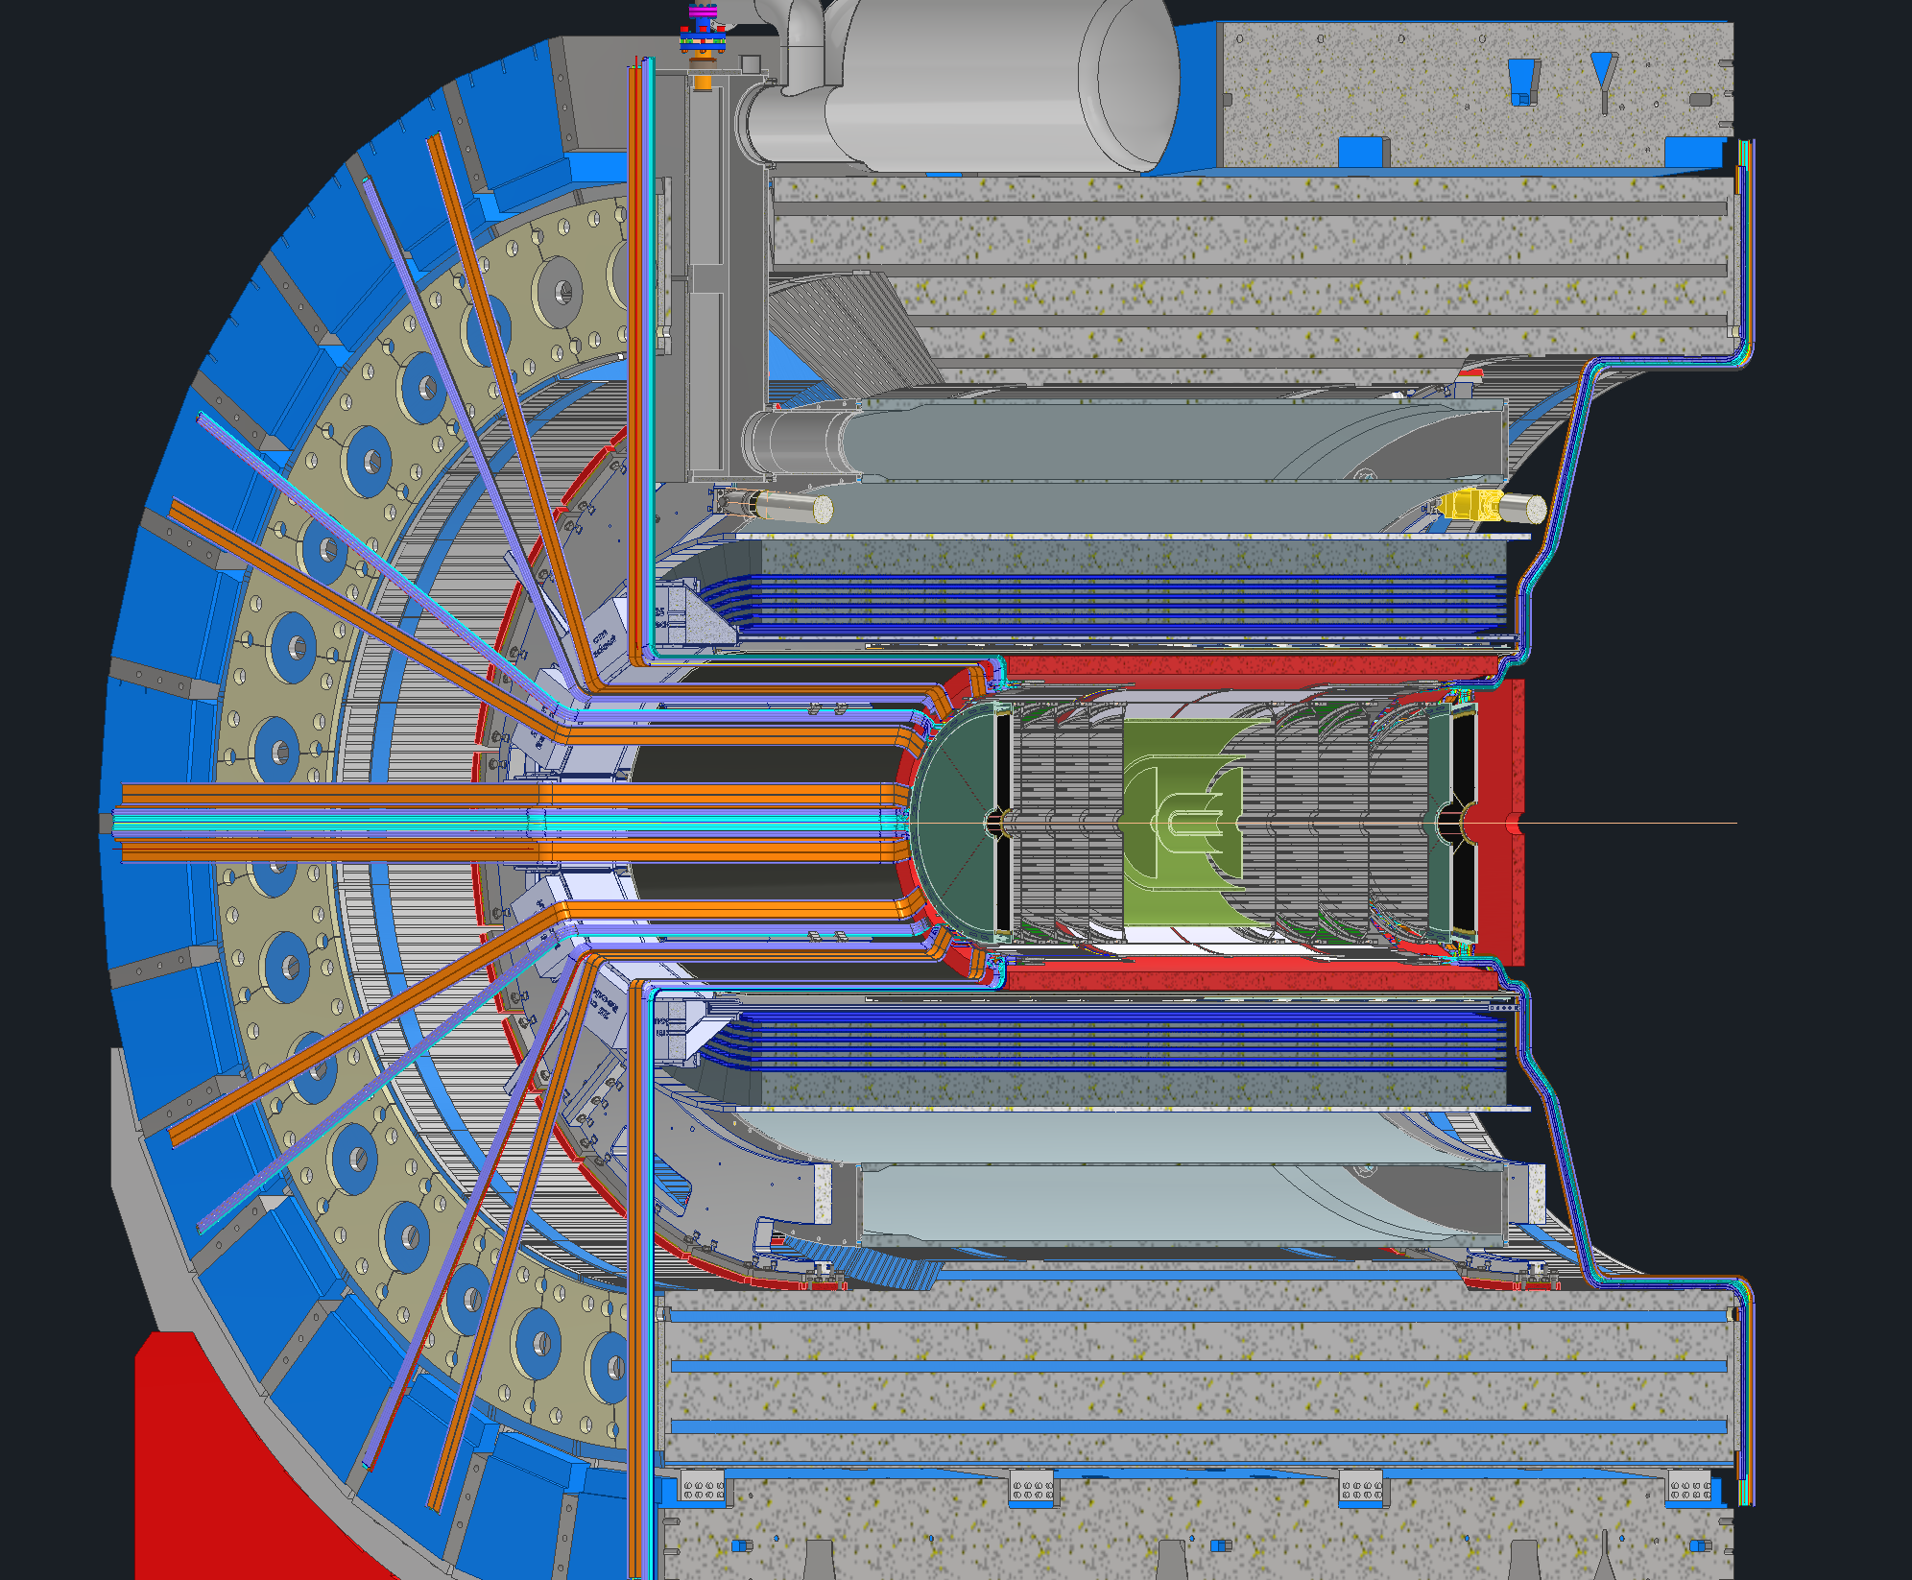
Updates

Slide 8
Available Space
Example shown below of the available space estimates
The services from each detector are broken down into 2 sides, Lepton and Hadron
Find the total cross-sectional area for each service for each detector
Add 50% to that number because the services wont stack nicely
Add an additional 50% for miscellaneous spacing needs (cable trays, raceways, bend radii, etc.)
Total it all up

Slide 9
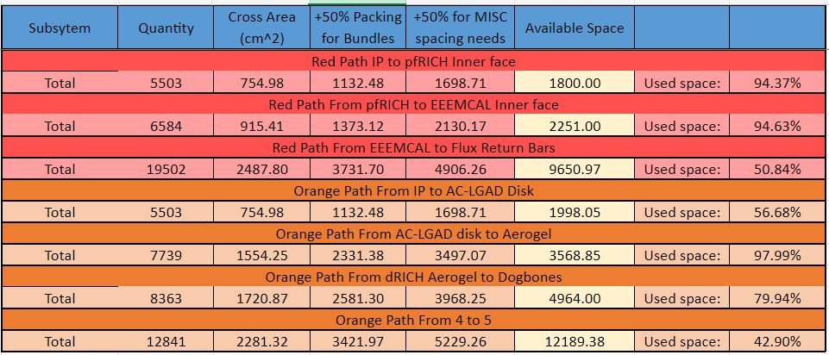
Available space
Several locations of high concern

Slide 10
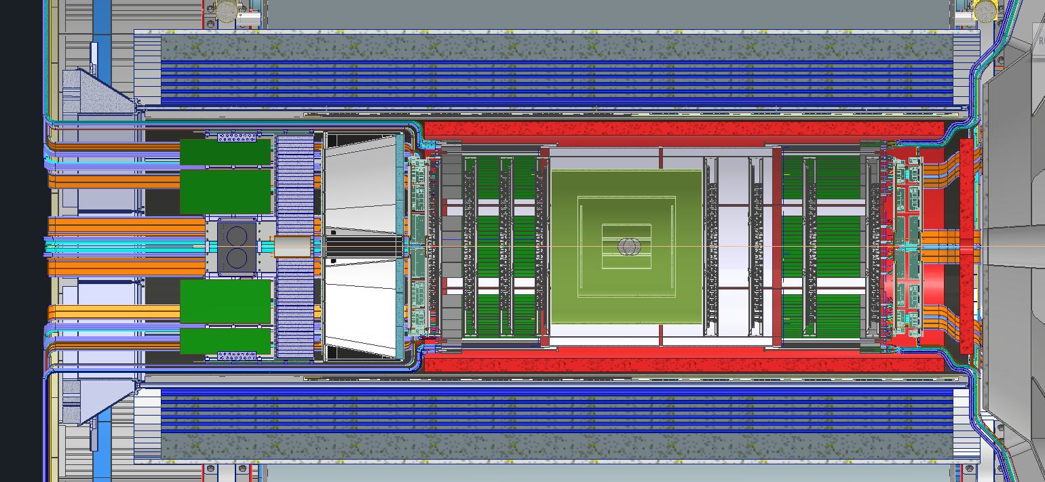
Available space
95%
94%
98%

Slide 11
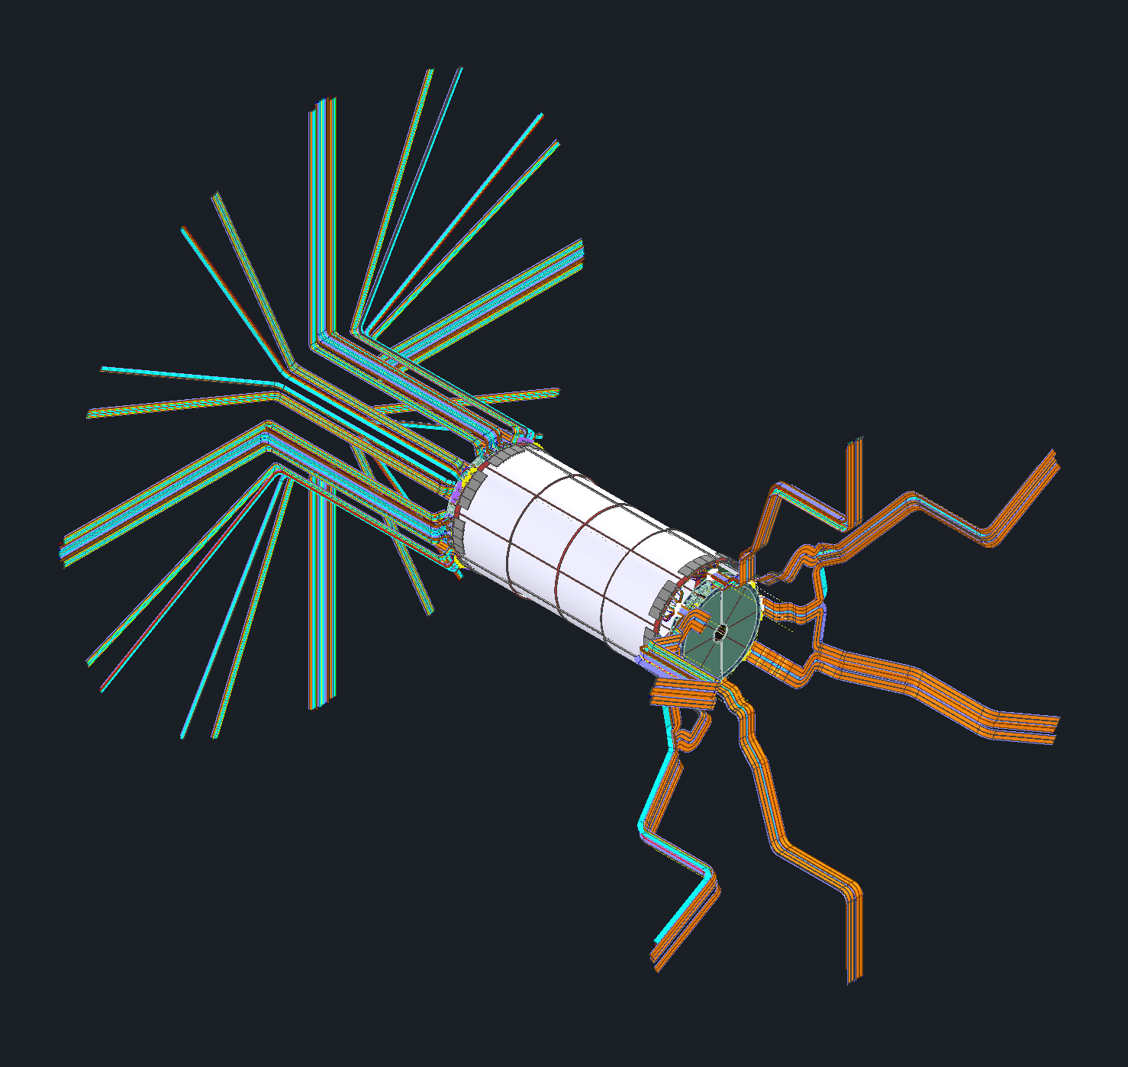
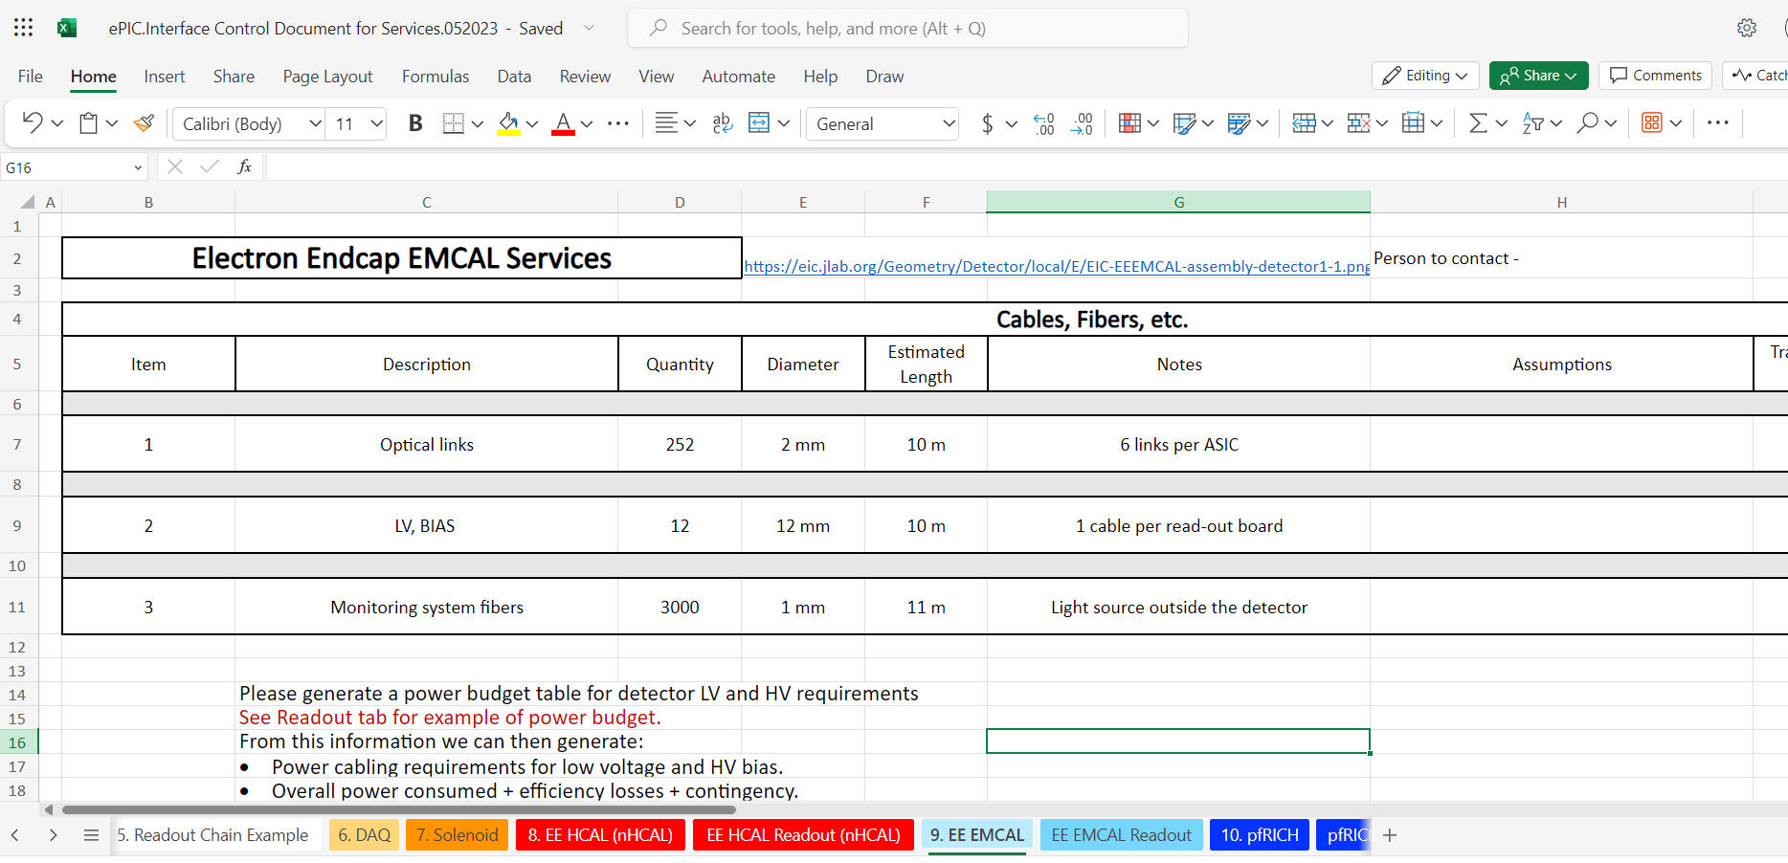
Update Me!
ePIC.Interface Control Document for Services.052023.xlsx
Please go through and update the values for your detectors
Quantities / Diameters / Cooling & Gas needs / Power estimates / etc.
Adding your level of confidence in these numbers to the descriptions would be very helpful
As we get further along accommodations for any necessary changes become harder to make
Space is a commodity and were already running out!
If you don’t have access request it

Slide 12
Channels & RDOs
Below is the summary of channel counts from the EE group
Detector​ Group​ | Channels​ |  |  |  |  | RDO​
 | MAPS​ | AC-LGAD​ | SiPM/PMT​ | MPGD​ | HRPPD/​ MCP-PMT​
Tracking (MAPS)​ | 16B​ | ​ | ​ | ​ | ​ | 183​
Tracking (MPGD)​ | ​ | ​ | ​ | 164k​ | ​ | 160​
Calorimeters​ | 500M​ | ​ | 100k​ | ​ | ​ | 510​
Far Forward​ | ​ | 1.5M​ | 10k(+201k*)​ | ​ | ​ | 80(+218)​
Far Backward​ | 66M​ | 128k​ | 4k​ | ​ | ​ | 60​
PID (TOF)​ | ​ | 6.1M​ | ​ | ​ | ​ | 500​
PID Cherenkov​ | ​ | ​ | 318k​ | ​ | 143k​ | 1283​
TOTAL​ | 16.6B​ | 7.7M​ | 432k(+201k)​ | 164k​ | 143k​ | 2816(+218)​

Slide 13
RDO Placements
*Distances are from IP*
Option 1 - RDOs are placed on the outside of the barrel for both the lepton and hadron sides.
Hadron ~7.2m
Lepton ~7.5m
Option 2 - RDOs are placed on the outside of the barrel EMCAL for both the lepton and hadron sides.
Hadron ~2.7m
Lepton ~4.6m
Option 3 - RDOs are placed on the outside of the barrel EMCAL for hadron side and inside the DIRC on the Lepton side.
Hadron ~2.7m
Lepton ~2.8m
RDOs
RDOs
RDOs
RDOs
RDOs

Slide 14
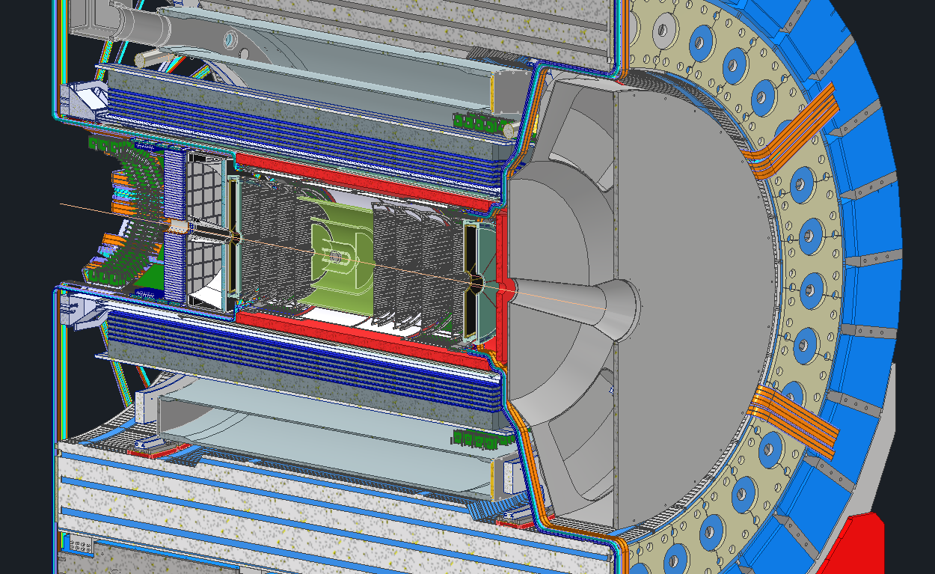
RDO Mockup
Approximately 250 RDOs shown on each side
Depending upon cable length restrictions certain detectors’ RDOs may be further away due to space constraints

Slide 15
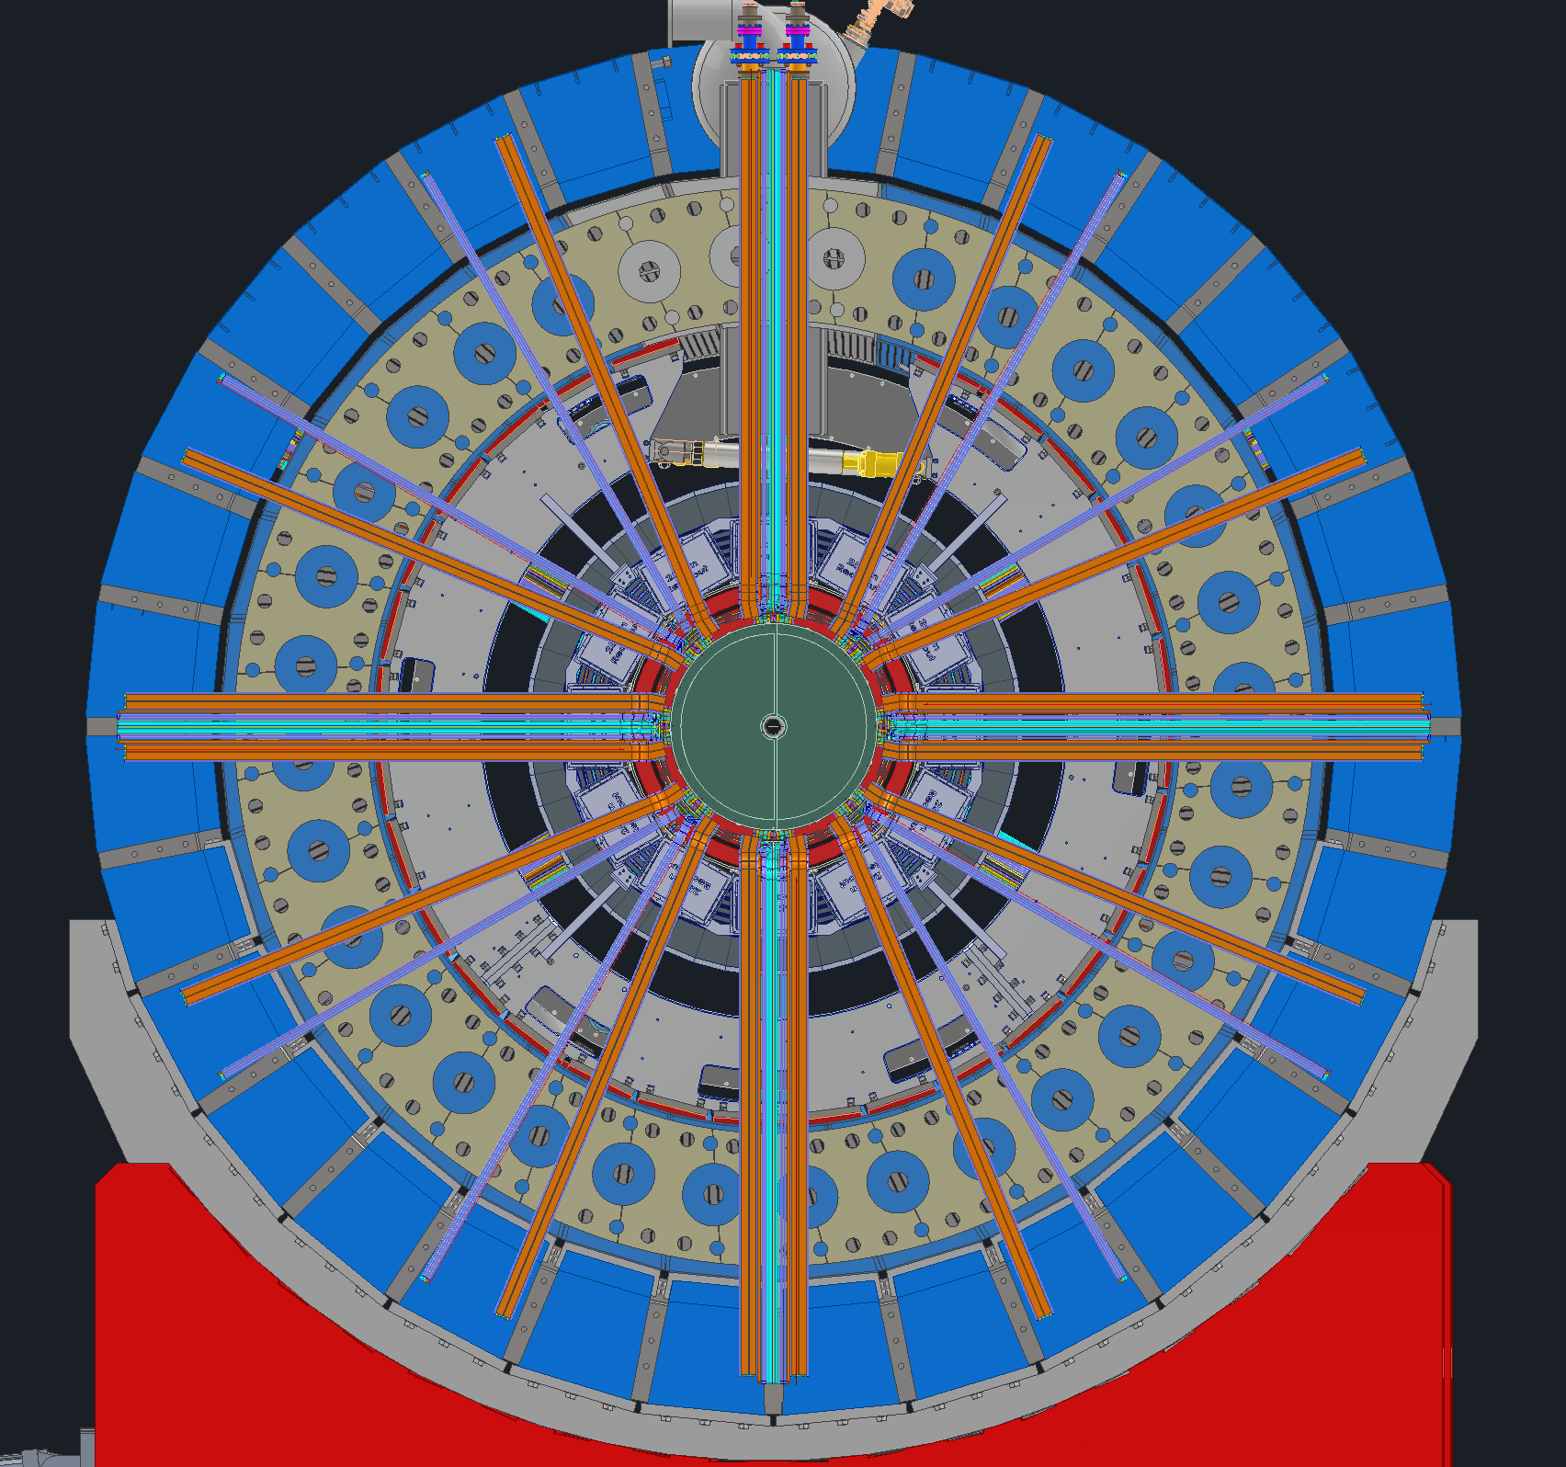
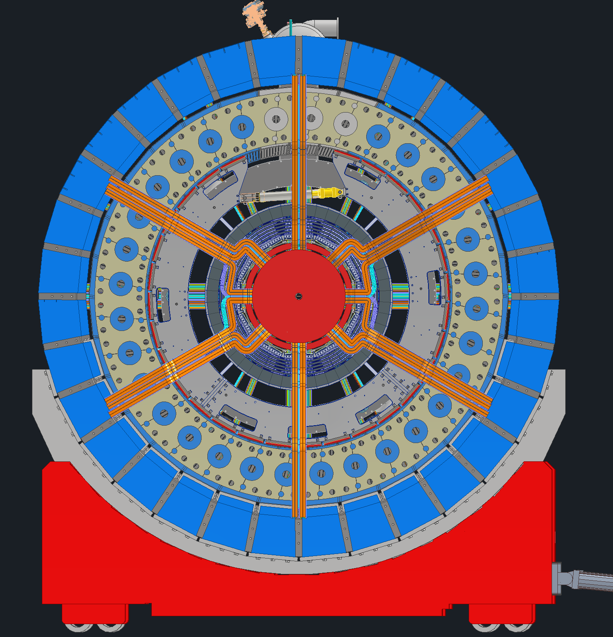
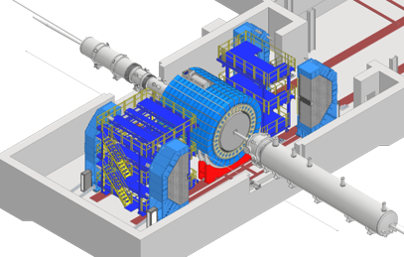
Items being looked into
Placements of remaining assorted electronics (RDOs, DC to DC converters, etc.)
Cooling & gas manifolds, panels and locations
Cable support systems inside the detector and how everything will integrate with installation
dRICH being spilt in half will have an impact on how services are routed
Services coming from the Lepton endcap may interfere with services coming from the barrel when the endcaps are slid in the hall
Future updates from subgroups

Slide 16
Questions?
Please update the ICD!
ePIC.Interface Control Document for Services.052023.xlsx

Slide 19
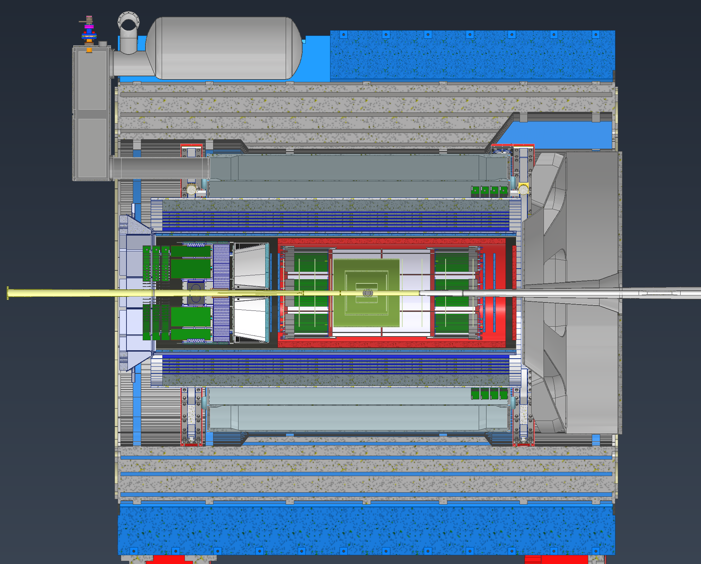
Option 1-
RDOs are placed on the outside of the barrel for both the lepton and hadron sides.
Hadron would be 6.5m +10% for contingency, so ~7.2m
Lepton would be 6.8m +10% for contingency, so ~7.5m
For all the numbers I list the distances are from the Inner MPGDs since I believe they are the worst case. If we need RDOs for the inner Silicon we must add to 0.5m the numbers.
RDOs
RDOs
~7.5m Silicon ~7m MPGD
~7m Silicon ~6.5m MPGD

Slide 20
Option 2-
RDOs are placed on the outside of the barrel EMCAL for both the lepton and hadron sides. This option potentially creates issues for the Hadron side as getting access to the RDOs may be difficult. Also routing of the cables in this area will be a nightmare. On the Lepton side we have much more space since we are not limited by the dRICH.
Hadron would be 2.4m +10% for contingency, so ~2.7m
Lepton would be 4.2m +10% for contingency, so ~4.6m
RDOs
RDOs

Slide 21
Option 3-
RDOs are placed on the outside of the barrel EMCAL for hadron side and inside the DIRC on the Lepton side. This option has the shortest distances, but I don’t think its possible. It has the same issues on the Hadron side but also additional issues on the lepton side. The EEEMCAL and pfRICH will be slid into and out of the detector here, so anytime we need to service them or another detector inside of them we’ll have to disconnect every RDO in this area and remove them. The cabling in this area would also be extremely messy.
Hadron would be 2.4m +10% for contingency, so ~2.7m
Lepton would be 2.5m +10% for contingency, so ~2.8m
RDOs
RDOs

Slide 22
