Slide 1
Joint EICUG/ePIC Collaboration Meeting
July 25, 2024
Barrel EMCAL Engineering Update

Slide 2
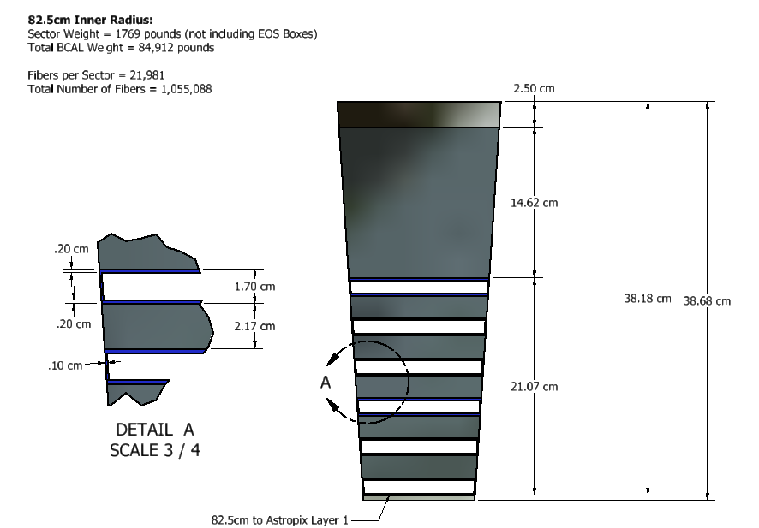
BIC Sector, End View:

Slide 3
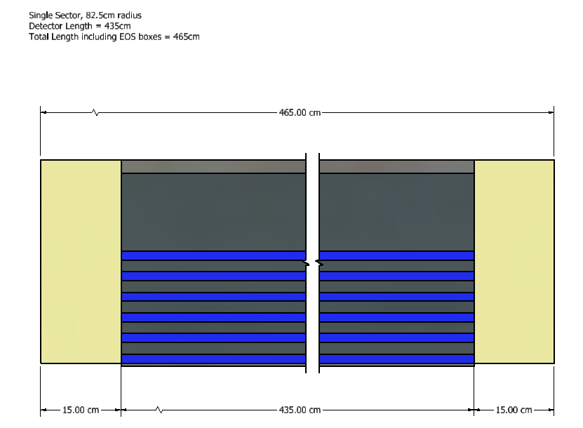
BIC Length:

Slide 4
“Recent” Change Summary:
Needed more space for end-of-sector boxes
Originally allocated 10cm
Increased to 15cm to accommodate light guides and connectors
Distance to dRICH has to be unchanged (hard requirement)
Reduced active length of the detector from 440cm to 435cm to maintain service gap
Detector was out-of-phase with the DIRC
We have 48 sectors, DIRC has 12 segments
We had a single “cap-stone” sector, which made us 3.75 degrees out of alignment with the DIRC
Rotated barrel 3.75 degrees to put edge of sector on vertical plane which restores alignment
Unclear how/if this will impact installation

Slide 5
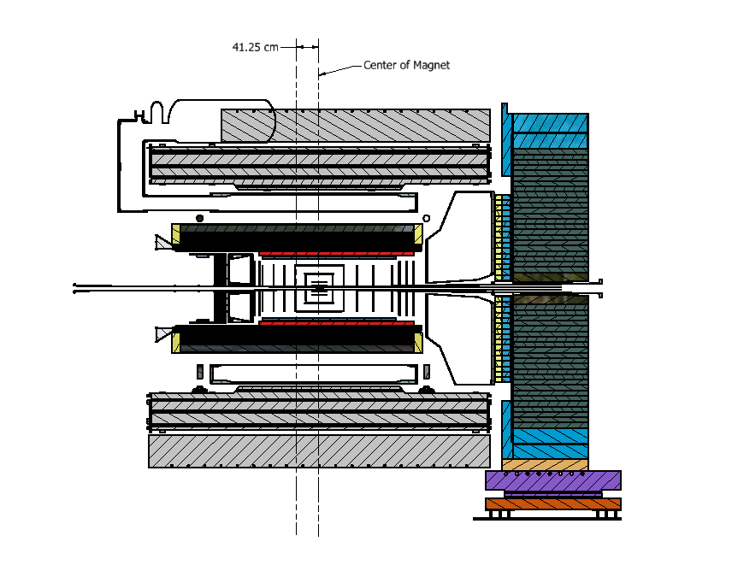
BIC Placement in Global Model:
Facing North
West (-Z)
East (+Z)
Interference
w/DIRC
6.75cm gap to
DRICH

Slide 6
DIRC Interference:
4.74cm

Slide 7
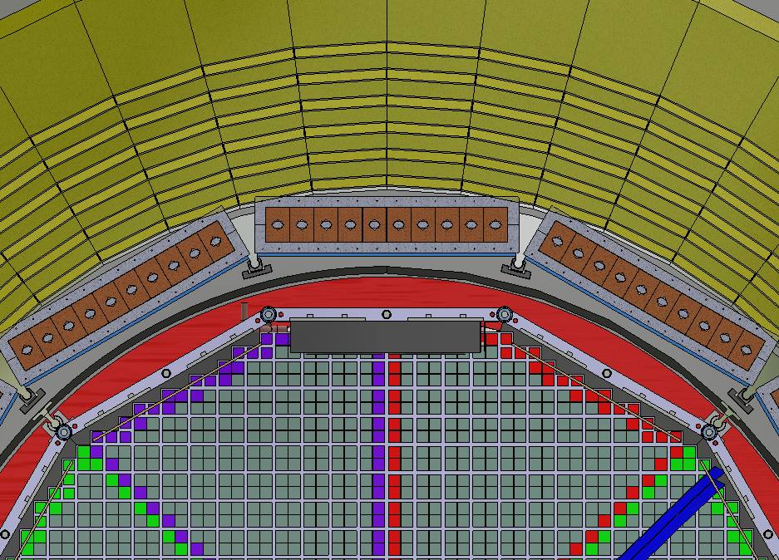
Dirc Interference, Astropix Access:
New orientation in phase w/DIRC
DIRC Lenses block inner Astropix
Support Tube for
Inner Detectors

Slide 8
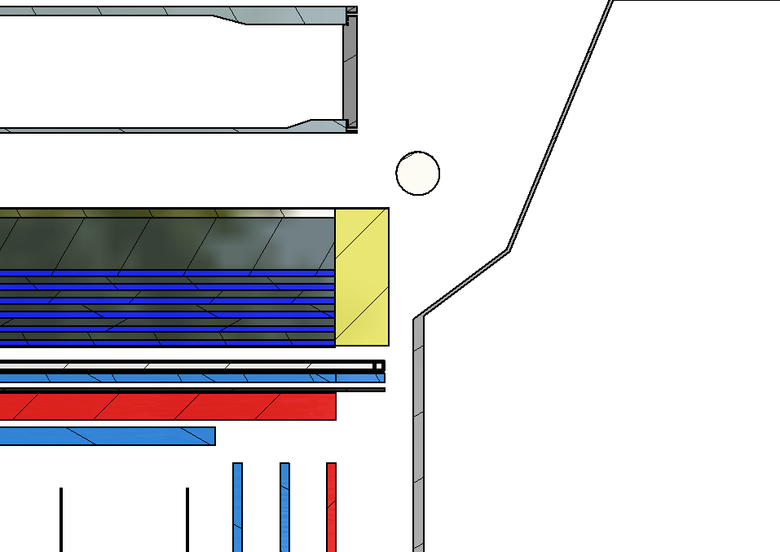
DRICH End:
6.75cm gap to DRICH
ESB’s extend 1.25cm beyond DIRC Bar

Slide 9
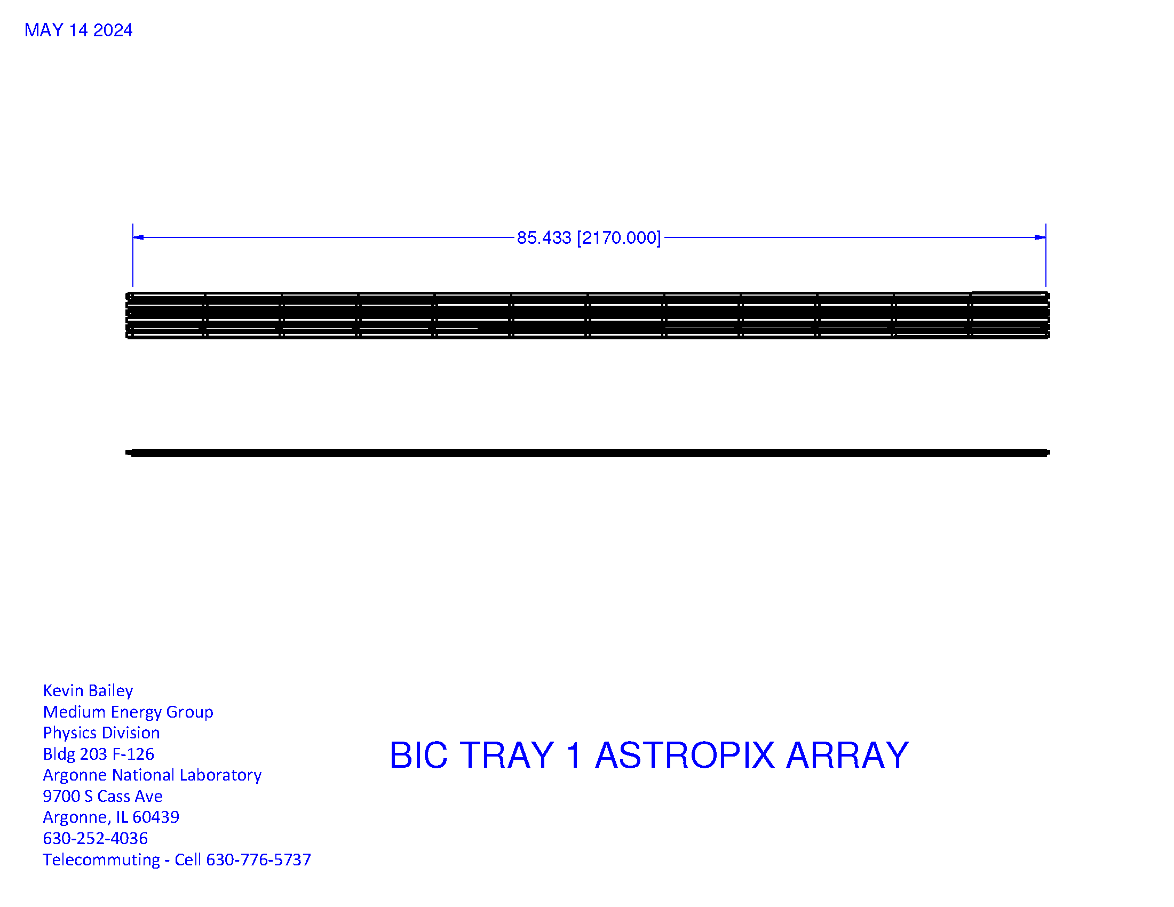
ASTROPIX Tray

Slide 10
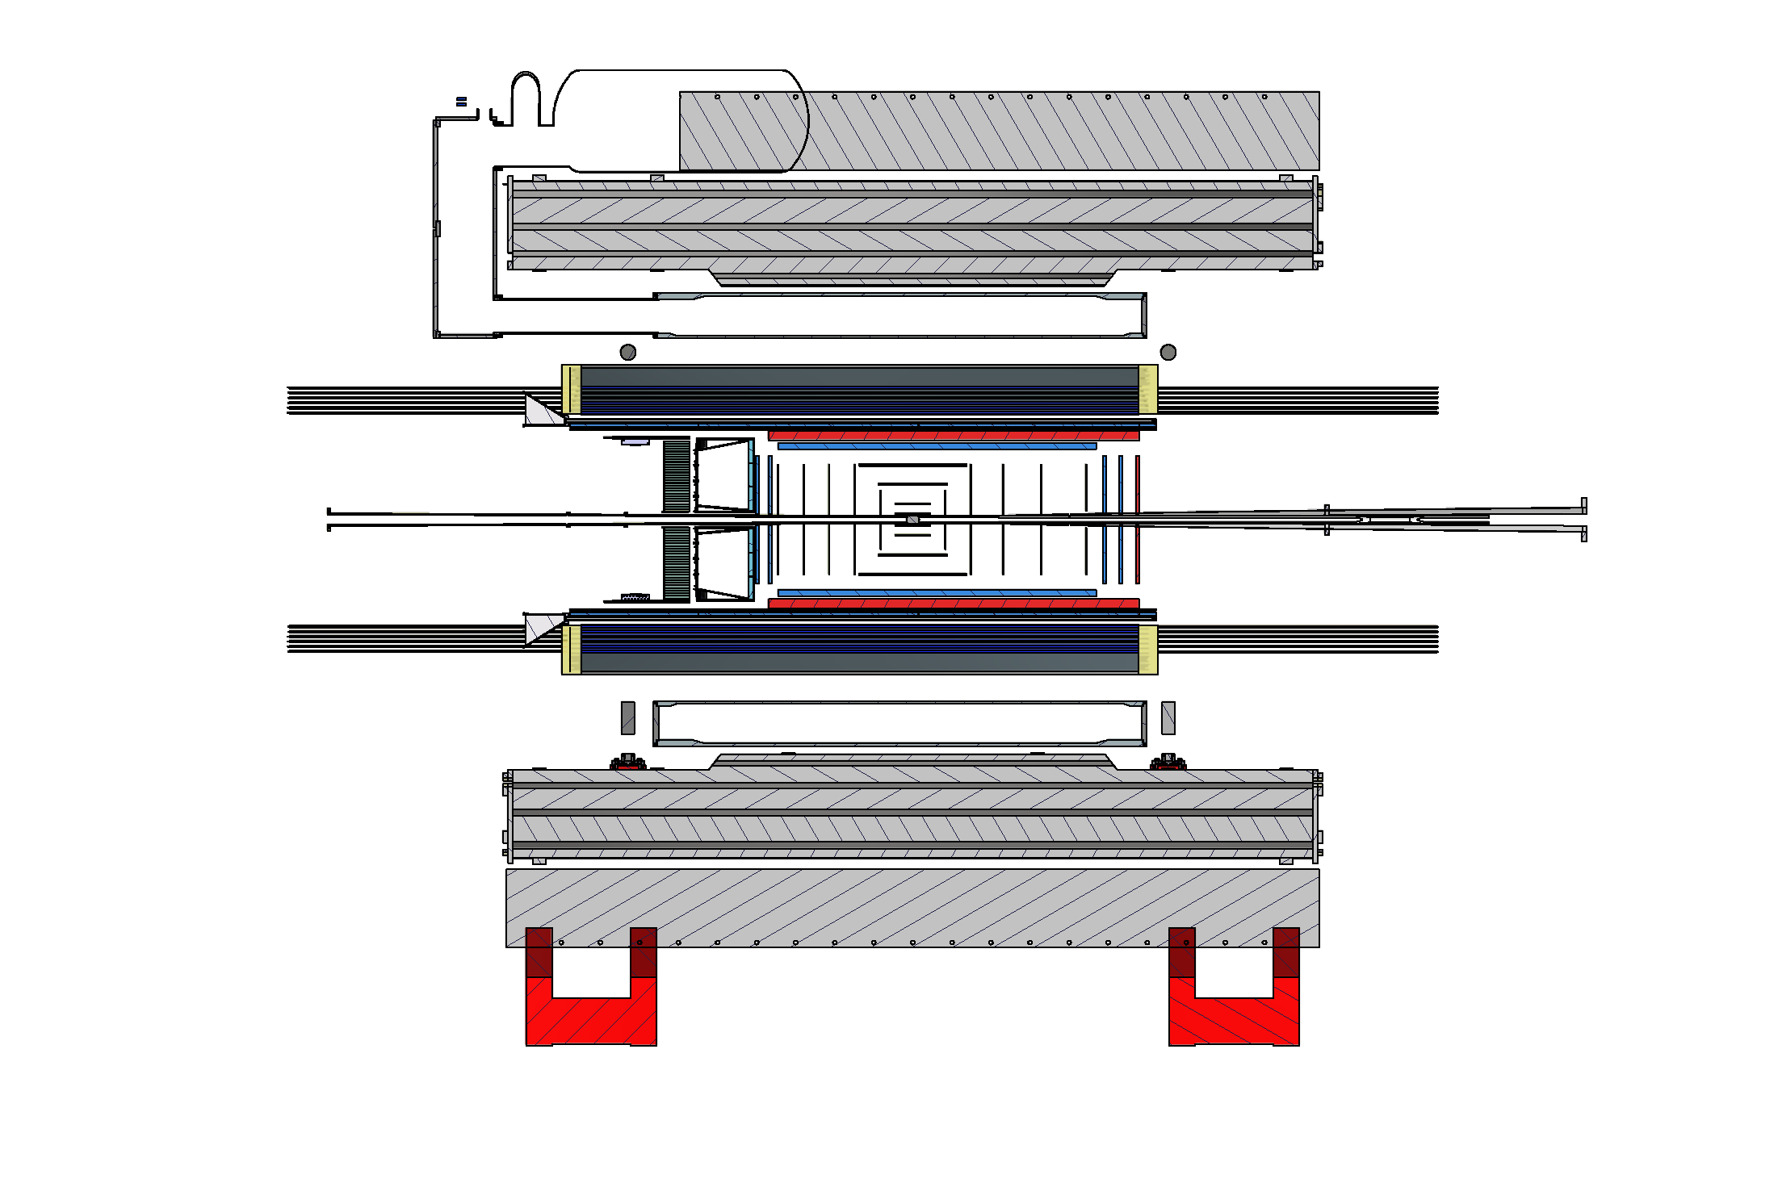
ASTROPIX Installation

Slide 11
Barrel Construction/Installation
Unpack sectors and attach light guides
Assemble sectors (with light guides) next to solenoid (on dRICH side)
Slide assembled barrel into position and connect to support rings
Insert AstroPix into drawers,
Trays are half-length, each sector has 2 trays back-to-back
Prefer installation (and servicing) from both ends
Assemble end-of-sector boxes at both ends of each sector

Slide 12
Next Steps:
Finalize engineering interface documents
Resolve interference with DIRC and overlap with lenses?
Incorporate interface with support rings into sector design
Design AstroPix installation/maintenance fixtures
Clarify support scheme for inner detectors and evaluate impact on AstroPix installation/maintenance
Our Requirements:
Ability to access and replace end-of-sector boxes on each end of the detector
Access to AstroPix staves, preferably from both sides (this impacts tray design and installation tooling)

