Slide 1
Joint Electronics and DAQ / SRO workfest
Introduction to Workfest
DAQ Protocols
Electronics and DAQ WG Conveners:
Fernando Barbosa, Jin Huang, Jeff Landgraf
SRO conveners
Marco Battaglieri, Jin Huang, Jeff Landgraf
(Markus Diefenthaler, Torre Wenaus, David Lawrence)

Slide 2
Workfest Introduction
The guiding principle of this workfest is discuss how the Electronics, DAQ, and the SRO WGs are going to interact with the DSCs and the software WGs during the detector development phase of the project
Make the design of the Electronics/DAQ and Software more specific
Evaluate the needs that the DSCs have from the Electronics/DAQ and SRO groups
Common Solutions
Hardware / Expertise
Specifications / Joint discussion and development of specifications
Evaluate how to handle immediate detector prototyping needs with the need to develop towards the final streaming system with final ASICs
Evaluate what sort of tests, or mock data challenges can be done to demonstrate the streaming concepts
Reconstruction & Event selection
Time synchronization
Automatic calibration

Slide 3
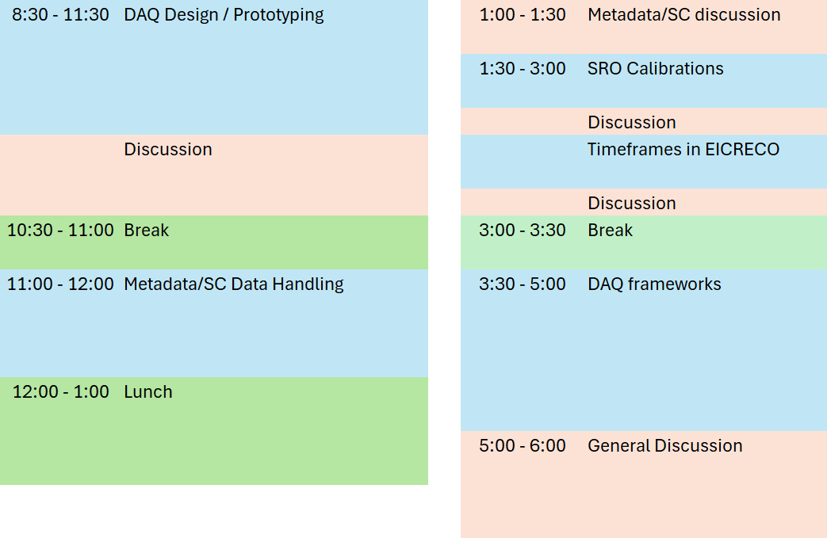
Schedule
Morning
Afternoon
Some Late Schedule Changes https://indico.bnl.gov/event/20727/sessions/7431/#20240725
Note Metadata/SC discussion doesn’t match indico page
In some cases discussion is interspersed, in others it is separated… Don’t worry about the schedule though, the point of all talks is to foster discussion!

Slide 4
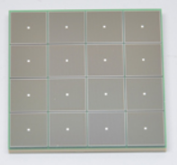
DAQ / SRO Protocols
Global Timing Unit (GTU)
-Interfaces to Collider, Run Control & DAM
-Config & Control
-Clock & Timing
Echelon 1
(BNL)
On Detector
SMT BGA
Echelon 0
Echelon 1
(JLAB)
Name
Sensor
Adapter
Front End Board
(FEB)
Readout Board
(RDO)
Data Aggregation Module (DAM)
Computing
FEB/RDO
(Fiber Protocol)
ePIC DAQ protocol
Echelon 0
Protocol
SRO protocol

Slide 5
DAQ / SRO Protocols
Firmware variations by ASIC
Some Hardware variations
Need to clear up groups responsible, clarify corresponding P6 activities for each flavor of board and which flavor of firmware
Discuss ASIC interfaces next “monthly” status update
Global Timing Unit (GTU)
-Interfaces to Collider, Run Control & DAM
-Config & Control
-Clock & Timing
Echelon 1
(BNL)
Count | Firmware | Hardware Design | Unit Testing at BNL?
620 | TOF (EICROC) | TOF | Yes
1240 | dRICH (ALCOR) | INFN | No
510 | Calorimeters (CALOROC) | (as per tof) | Yes
160 | MPGDs (SALSA) | (as per tof) | Yes
32 | Low Q2 (Timepix) | spyder4? | No
100 | Discrete | (as per tof) | Yes
160 | MAPS | Detector side fiber interface | Yes
340 | Astropix | NASA | Yes
100 channels FLASH | Direct Photon | JLAB
On Detector
SMT BGA
Echelon 0
Echelon 1
(JLAB)
Name
Sensor
Adapter
Front End Board
(FEB)
Readout Board
(RDO)
Data Aggregation Module (DAM)
Computing
FEB/RDO
(Fiber Protocol)
ePIC DAQ protocol
Echelon 0
Protocol
SRO protocol

Slide 6
DAQ / SRO Protocols
Global Timing Unit (GTU)
-Interfaces to Collider, Run Control & DAM
-Config & Control
-Clock & Timing
Echelon 1
(BNL)
On Detector
Subject of most of this talk
Link to Draft Document
https://brookhavenlab.sharepoint.com/:f:/s/EICPublicSharingDocs/Eo2ZtIxpVIZIguncUBUJmtIB10gn_fHJ0dIAJHb0WusJAA?e=OypaSe
Mattermost Channel
https://chat.epic-eic.org/main/channels/daq----gtudamrdo-fiber-protocol-discussion
SMT BGA
Echelon 0
Echelon 1
(JLAB)
Name
Sensor
Adapter
Front End Board
(FEB)
Readout Board
(RDO)
Data Aggregation Module (DAM)
Computing
FEB/RDO
(Fiber Protocol)
ePIC DAQ protocol
Echelon 0
Protocol
SRO protocol

Slide 7
DAQ / SRO Protocols
Data file’s are:
Timeframes are continuous and ordered within file
Timeframes contain all detector information
Some data is attached to a physical run period
Some data is continuously generated
Global Timing Unit (GTU)
-Interfaces to Collider, Run Control & DAM
-Config & Control
-Clock & Timing
Echelon 1
(BNL)
On Detector
SMT BGA
Echelon 0
FBDC
Scaler
Layer 2
Echelon 1
(BNL)
FBDC
Echelon 1
(JLAB)
Name
Sensor
Adapter
Front End Board
(FEB)
Readout Board
(RDO)
Data Aggregation Module (DAM)
Computing
FBDC
FBDC
Layer 2
Layer 3
FBDC
Layer 2
Layer 3
(Fiber Protocol)
ePIC DAQ protocol
FEB/RDO
Layer 2
Echelon 1
(JLAB)
FBDC
Layer 3
( . . . )
( . . . )
( . . . )
Echelon 0
Protocol
FBDC
Layer 2
Layer 3
Unit
TF(DAM)
TF
File:
SRO protocol
Route(TF%N)
Route((TF/Nfile)%N)

Slide 8
DAQ / SRO Protocols
Data file’s are:
Timeframes are continuous and ordered
Timeframes contain all detector information
Some data is attached to a physical run period
Some data is continuously generated
Global Timing Unit (GTU)
-Interfaces to Collider, Run Control & DAM
-Config & Control
-Clock & Timing
Echelon 1
(BNL)
On Detector
SMT BGA
(Or… Echelon 1)
Echelon 0
FBDC
Scaler
Layer 2
Echelon 1
(BNL)
FBDC
Echelon 1
(JLAB)
Name
Sensor
Adapter
Front End Board
(FEB)
Readout Board
(RDO)
Data Aggregation Module (DAM)
Computing
FBDC
FBDC
Layer 2
Layer 3
FBDC
Layer 2
Layer 3
(Fiber Protocol)
ePIC DAQ protocol
FEB/RDO
Layer 2
Echelon 1
(JLAB)
FBDC
Layer 3
( . . . )
( . . . )
( . . . )
Echelon 0
Protocol
FBDC
Layer 2
Layer 3
Unit:
TF
File: (ordered contiguous TF)
SRO protocol
TF(DAM)

Slide 9
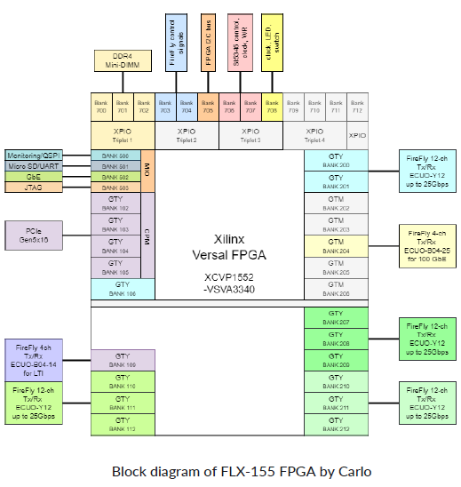
Fiber Protocol (ePIC DAQ protocol)
Fiber Links between GTU/RDO/DAM/FBDC
RDO – 48 GTYP transceivers (up to 32.65gbps)
expect 14gbps firefly (25 is possible)
8gbps 8b10b -> 64bits synced to BCO
FBDC – PCIe Gen5 (16 GTYP transceivers)
WORLD – 100GbE (GTM transceivers)
GTU – 4 GTYP transceivers (up to 32.65gbps)
expect 14gbps firefly (25 is possible)
encoding? Synced to BCO but not 8b/10b?
- up to 80 bits x 3 links?
- fourth link used for dedicated timing

Slide 10
GTU Fanout Scheme
Distribute copies of GTU signals to O(140) DAM boards to be forwarded to RDO. These signals should reach RDO boards with fixed latency (Assume 64 bits / BX)
Distribute copies of a dedicated clock to O(140) DAM boards
Independently address (some) commands to up to 32 detectors/groups of detectors
Receive in the GTU at least N bits of Flow Control / Time Frame Status information from O(140) DAM boards. (N = up to 64)
Receive in the GTU at least N bits of information constructed for triggering from a specific selection of DAM boards TBD (N = up to 160)
GTU is going to be complex:
Define a group to discuss the hardware details & options
Project does have PED engineering defined for this, but we should consider options? Tree of FELIX boards?

Slide 11
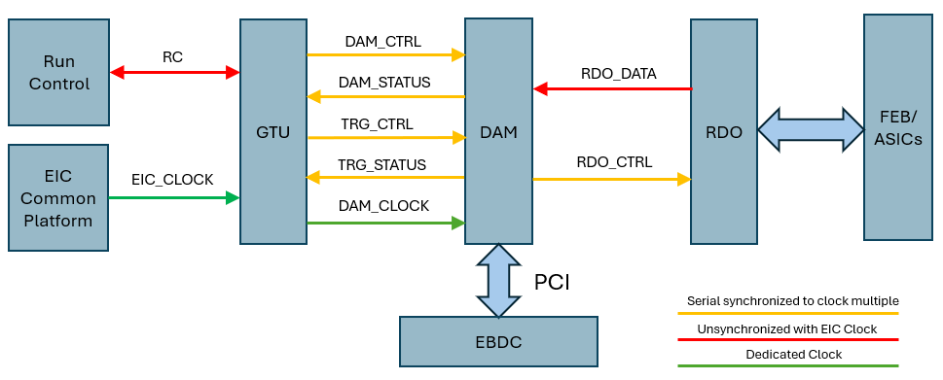
Communication Channels
DAM_CTRL = 64 bits. Copied to all DAM (or all DAM for single detector) Forwarded to RDO_CTRL
DAM_STATUS = 20(64) bits DAM information copied back to GTU.
Timeframe handling, Error conditions, Dam responses (e.g. returning control after config)
TRG_CTRL = 20(160) bits Send trigger commands (to selected DAM boards)
TRG_STATUS = 160 bits Return summary information (from selected DAM boards)
RDO_CTRL = 64 bits Clock + RDO commands
RDO_DATA RDO headers + ASIC + SC data

Slide 12
Feature Implementation
Bunch definition
BCO itself:
64 bit BCO
Time frames maximum 16 bits
BCO verification (require verification at least every timeframe)
Periodic full specification
Checksum-like verification of bits over many bunchcrossings (7 bit scheme?)
Beam Info (REV_TIC x 2, BUNCH_FILLED x2), Sent every bunch
Resync (issued by RDO or by GTU)
Time Frame Handling
Start frame Synchronous command
Time frame identification
High order bits of BCO?
Re-usable identifier (token)

Slide 13
Feature Implementation (continued)
RDO and DAM Data Processing Flags.
Identify periods when unprocessed data should be kept
Firmware, Run Control Configuration & Resets
Likely these involve giving control to the DAM boards and selecting appropriate data to be loaded via run control or slow controls. But need command to indicate to DAM board to take over, and for the DAM boards to relinquish control when they are finished.
Fast configuration
We have had discussions of potential configuration during a run
Could involve calibration control, error mitigation and recovery. Possibly to be handled by standard configuration scheme, but if so need to indicate when certain components are disabled for timeframe building and coherency
Triggering
Firing hardware actions / activities (e.g. laser or pulser system, requests to read slow controls information, or to write out unzero-suppressed for a short time to calculate pedestals)
Firmware trigger as needed by dRICH / low Q2 taggers

Slide 14
Feature Implementation (Continued)
Flow control
Sense ASIC overflow/truncation
RDO overflow/truncation
DAM overflow/truncation
Prevention strategy
Sense truncation and apply deadtimes?
Force deadtime before truncation occurs?
We don’t need perfection in avoiding overflow, but we must clearly sense, mark, and minimize overflow situations!
Data link
Will consist of multiplexed headers, ASIC data, & SC data.
Define headers
Provide link between BCO and ASIC clock based time measurements

Slide 15
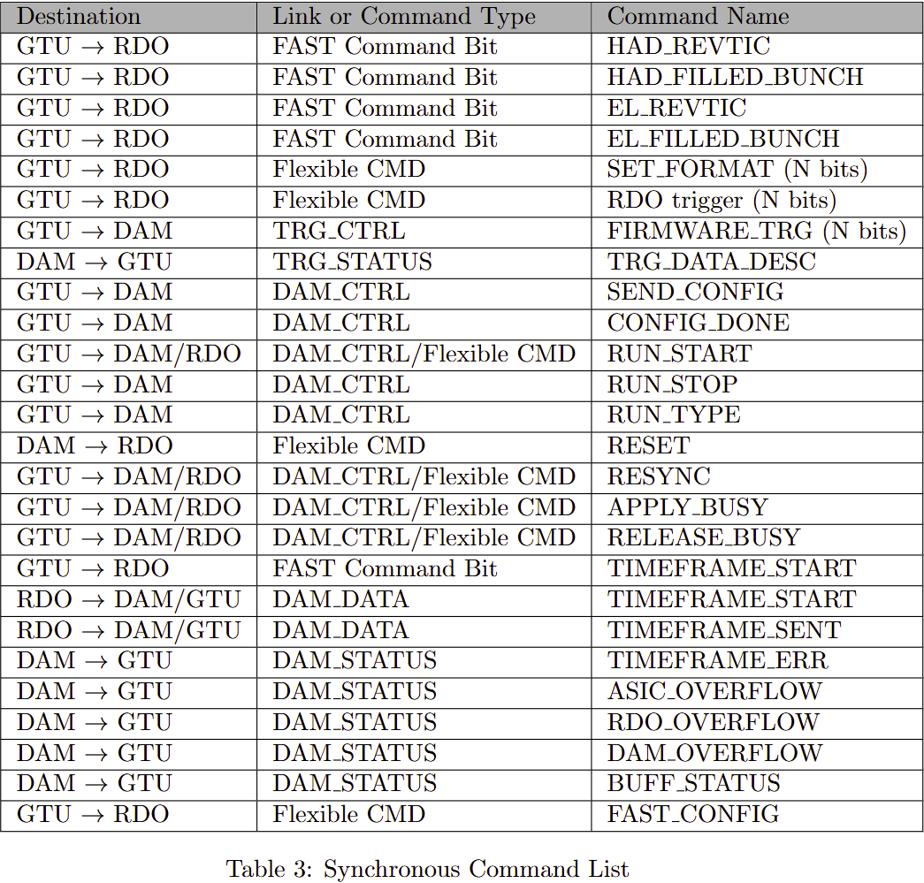
Synchronous Command Structure
Started to think about the kinds of define commands to implement these features.
Proposed command structure
This needs significant iteration!

Slide 16
Example: (dRICH tag based on external detector)
Given the requirement for a backup triggered readout for RICH, it is necessary to carefully define the physics trigger rate, trigger conditions, and trigger latency in order to facilitate design of the RICH front-end.
ePIC depends upon a flexible scheme in which sufficient bandwidth is available for data to the dRICH DAM in the worst case. (> 4x safety). The selecting detectors (ex FWD HCAL) generate information characterizing beam in O(10us). The decision is made by the GTU and returned to DAM boards with fixed latency. The maximum latency is orders of magnitudes less than available buffering in DAM board memory. A hardware trigger is supported by the GTU but uses the same dRICH buffering scheme and delays as the firmware trigger option.
FWD HCAL RDO
FWD HCAL RDO
FWD HCAL RDO
FWD HCAL RDO
FWD HCAL RDO
FWD HCAL RDO
FWD HCAL RDO
dRICH
RDO
RDO_DATA
48
48
48
48
48
48
FWD HCAL DAM
dRICH DAM
FWD HCAL DAM
dRICH DAM
Activitiy | Notes
Data Arrives at DAMs | <=10us from Bunch Crossing
Data Evaluation in HCAL DAMs | 100ns
TRG_STATUS to GTU | Data transmitted to GTU after fixed delay from source crossing O(10us)
Trigger Evaluation on GTU | Fixed Latency O(100ns)
Keep/Drop Bit to (dRICH) DAMs | Fixed Latency O(40ns)
Drop data / forward data | Drop/Forward after fixed time O(11us)
DAM Buffer | 16GB
Buffer Time available | 2.6 seconds
FWD HCAL DAM
dRICH DAM
TRG_STATUS
64 bits
Bunch Data
Fixed delay O(10us)
DAM_CTRL
3
(Keep/Drop
Bunch bit)
30
GTU
Fixed delay O(10us)
Hardware Trigger Option
Ex: Hcal generates trigger
dRICH is triggered

Slide 17
Example: (dRICH tag based on external detector)
Selection criteria : count of hits in fwd hcal > N
Fwd HCAL State machine:
GTU State machine
Nhits/BX: Circular Buffer ~1000 deep (10us)
Rcv from TRG_STATUS (each BX)
Sum Fwd HCAL hits from TRG_STATUS
Each BX:
Send Nhits/BX[curr – 10us] via TRG_STATUS
Zero Nhits/BX[curr-10us]
Each BX:
Send accept via TRG_CTRL if hits [curr – 10] > Threshold, release otherwise
RCV via RDO_DATA :
1. Evaluate hits count & associated BX
2. Add hit count to Nhits/BX[Associated BX]
dRICH DAM State machine
RCV via RDO_DATA:
Store Data indexed by associated BX
The state machines are simple, but one must evaluate
Simultaneous usage of communication pathway resources
Edge conditions
Flexibility
RCV via TRG_CTRL (each BX)
If accept, forward BX info to FBDC
If abort, drop BX info

Slide 18
Example: (dRICH tag based on hardware input)
Flexibility (Hardware Trigger Added)
GTU State machine
Each BX
Store interaction tagger Bit
Minor
Change
Each BX:
Send accept via TRG_CTRL if tagger bit set, release otherwise
FWD HCAL RDO
FWD HCAL RDO
FWD HCAL RDO
dRICH
RDO
48
48
48
dRICH DAM State machine
dRICH DAM
Interaction
Tagger
dRICH DAM
RCV via RDO_DATA:
Store Data indexed by associated BX
dRICH DAM
DAM_CTRL
No
Change
(Keep/Drop
Bunch bit)
30
RCV via TRG_CTRL (each BX)
If accept, forward BX info to FBDC
If abort, drop BX info
GTU
Fixed delay O(10us)
Hardware Trigger Option

Slide 19
Example: (dRICH tag based on dRICH analysis)
Flexibility (dRICH local Analysis) (See Alessandro Lonardo’s talk in interaction tagger session)
40 RDO
8 X-DAM
dRICH DAM State machine
RCV via RDO_DATA:
Store Data indexed by associated BX
ePIC Handling
RDO
Apeiron
No
Change
Versal FPGA
RCV via TRG_CTRL (each BX)
If accept, forward BX info to FBDC
If abort, drop BX info
Accept / Abort
RCV via RDO_DATA:
Complex Multi-FPGA ML implementation with deterministic time
Send abort/accept via TRG_STATUS to GTU
GTU State machine
Rcv from TRG_STATUS (each BX)
Store accept/abort from TRG_STATUS
New
Minor
Change
Each BX:
Send accept via TRG_CTRL any accept, release otherwise

Slide 20
Questions / Discussion

