Slide 1
Streaming DAQ Development at JLab and Ideas for EIC DAQ Prototyping
SRO+DAQ Workfest
ePIC Collaboration Meeting - Lehigh University
July 25th 2024
David Abbott
FEDAQ Group
Jefferson Lab

Slide 2
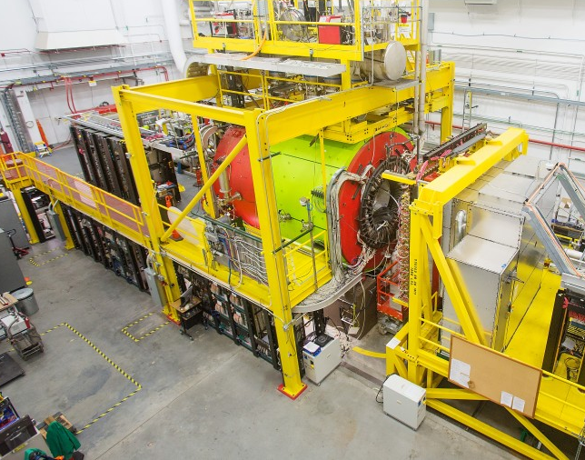
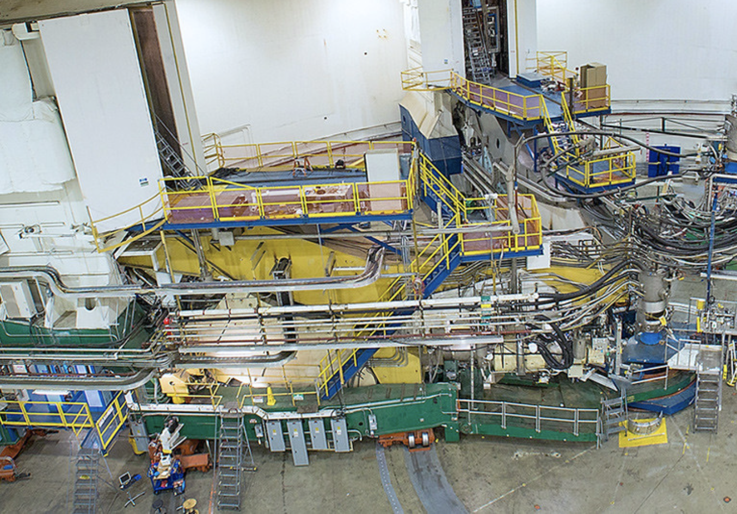
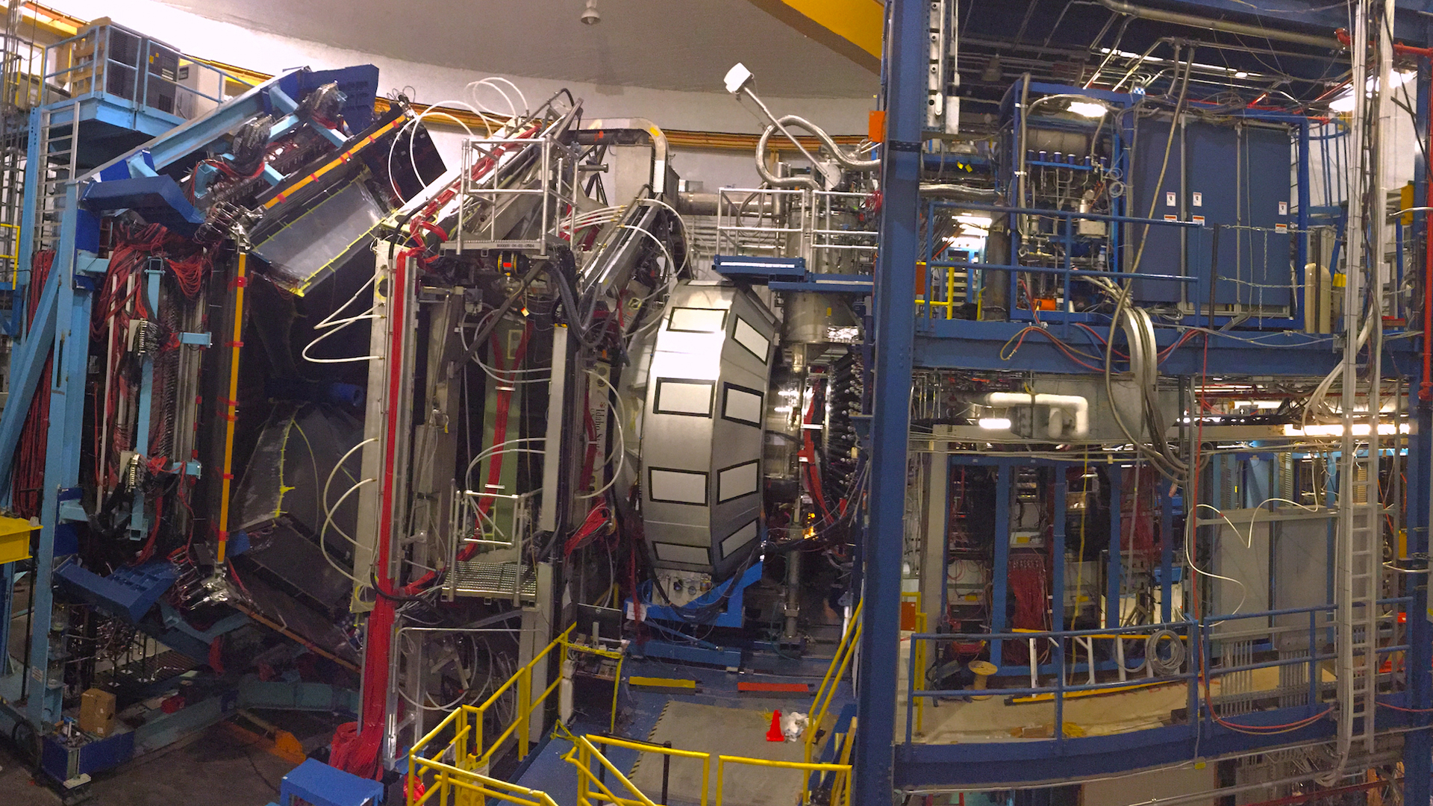
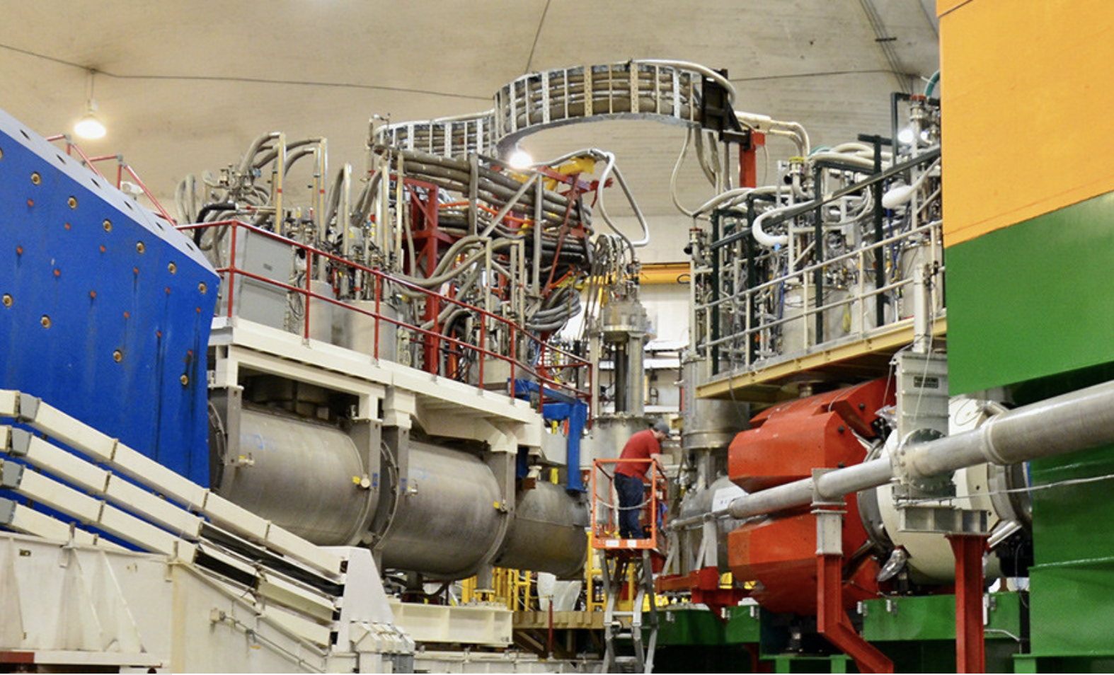
Data Acquisition at Jefferson Lab
At JLab we have 4 Experimental Halls, all running with different detectors - and physics focus.
Of course all are having increased demands for the DAQ.
The Fast Electronics/DAQ (FEDAQ) support group provides custom electronics, as well as firmware and software libraries and tools for all experiments.
Our current goals are to support both the traditional Triggered model along with the Streaming Model within one integrated DAQ framework.
Leverage existing hardware to implement Streaming
Add support for new electronics
Try to keep it as seamless and user friendly as possible
D
A
B
C

Slide 3
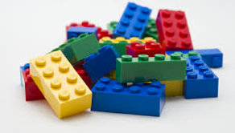
CODA – CEBAF Online Data Acquisition
What is CODA (also see coda.jlab.org)
Software toolkit for implementing data acquisition systems.
Hardware/Electronics
Custom electronics , FPGAs, ASICs, TDCs and ADCs.
Support for commercial hardware.
Software includes :
Interfaces with electronics (libraries/drivers).
Readout Front End and Data Formating (ROC)
Inter-process communication - Control and Data (cMsg)
Manage data streams (DC, PEB, SEB, PAG, SAG)
Give users access to data for analysis and monitoring (ET System)
Write data to files (EVIO, ER)
Manage and control the data acquisition system (AFECS)
CODA is modular. Build a single crate DAQ or a full Experimental Hall system

Slide 4
The CODA Data Acquisition (software) Toolkit
The ROC is software responsible for collecting data from front-end hardware and sending it to the next stage.
AFECS
COOL
Database
GUI
ROC – Readout Controller
EMU – Event Management Unit
ET – Event Transport (Shared memory)
AFECS – Agent Framework Experiment
Control System (JAVA)
Platform
ROC
Trigger/Clock
VTP
TI
CPU
SD
VXS
File
ROC
TI
EMU
(Event Builder)
ET
EMU
(Event Recorder)
CPU
File
VME
ROC
User
PCIe TI

Slide 5
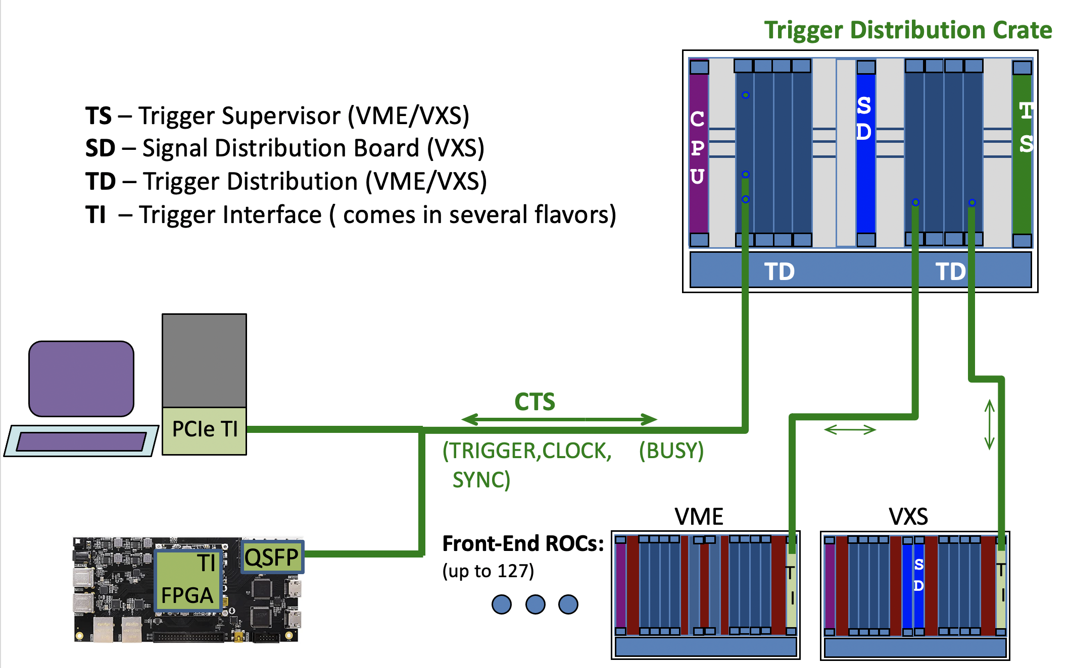
JLAB Clock and Trigger Distribution System
For large DAQ systems with many front-ends (ROCs)
The TI board can be used as a TS for small (up to 9) front-ends

Slide 6
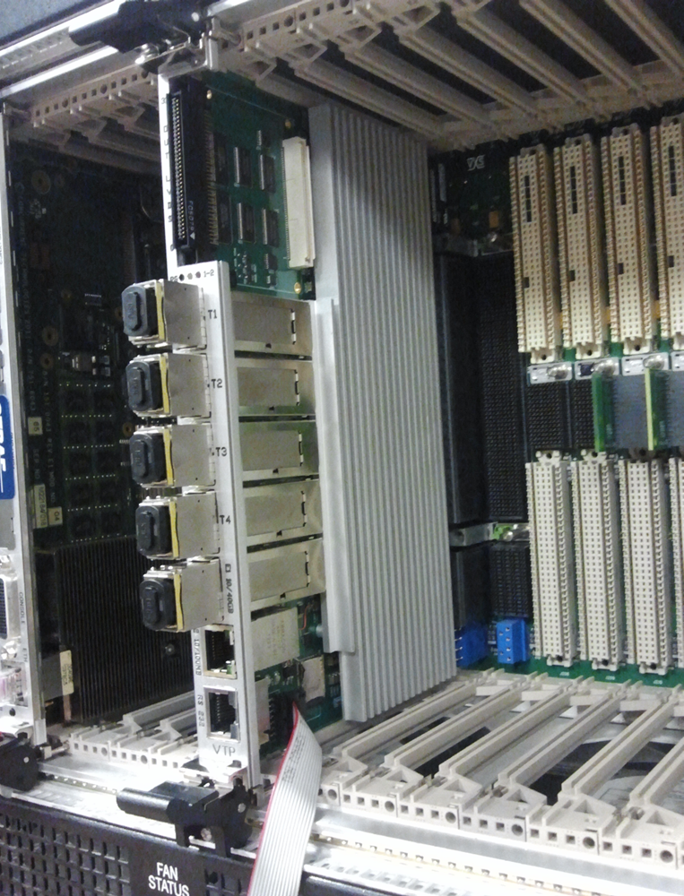
VXS Standard (VITA 41)
JLab standardized on this technology for the 12GeV Upgrade
- Originally used for the L1 trigger data path
Dual Star – switched serial backplane (along with original VME)
Up to 20Gb (4 lanes) from each Payload to the 2 Switch slots (A, B)
Up to 18 Payload slots are available
Easy distribution of Trigger, Sync and low jitter clock to all modules in the crate.
A B
VXS Trigger Processor (VTP)
Relieve the ROC of all of the “Readout” tasks and implement them in the FPGAs.
Triggered or Streaming readout from All payload modules in parallel
This requires the payload modules to have some intelligence/programmability and serial link capability (e.g. FPGA-based).
The Software ROC now is primarily responsible only for Configure, Control and Monitoring the VTP-Based DAQ.

Slide 7
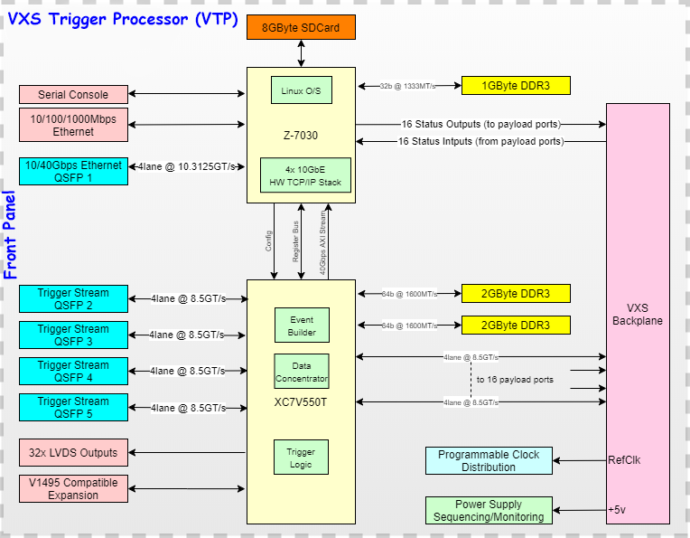
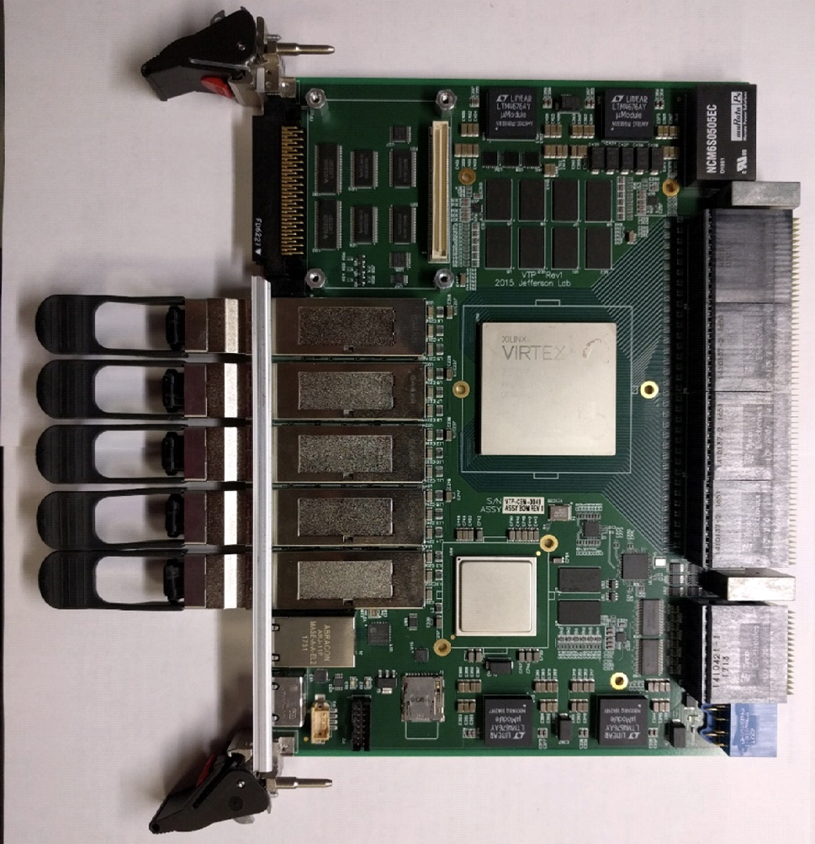
JLAB – VTP Board
Linux OS on the Zync-7030 SoC
(2-core ARM 7L , 1GB DDR3)
10/40Gbps Ethernet option
(runs the CODA ROC)
Xilinx Virtex 7 FPGA
Serial Lanes from both the VXS backplane and the Front panel
4GB DDR3 RAM
Four
10Gbps
Ethernet
16 Payload
Ports
64 total
serial lanes
FADC
FADC
FADC
FADC
16 total lanes
for external
serial links
FADC
FADC
V7
FADC
FADC
Z7

Slide 8
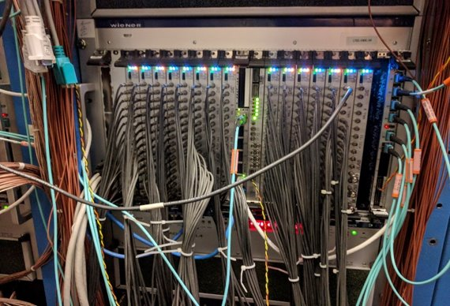
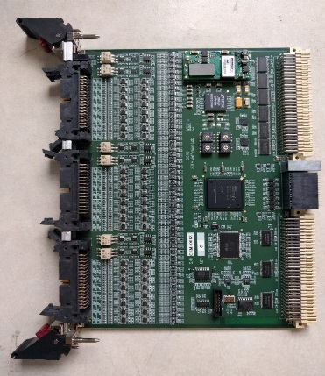
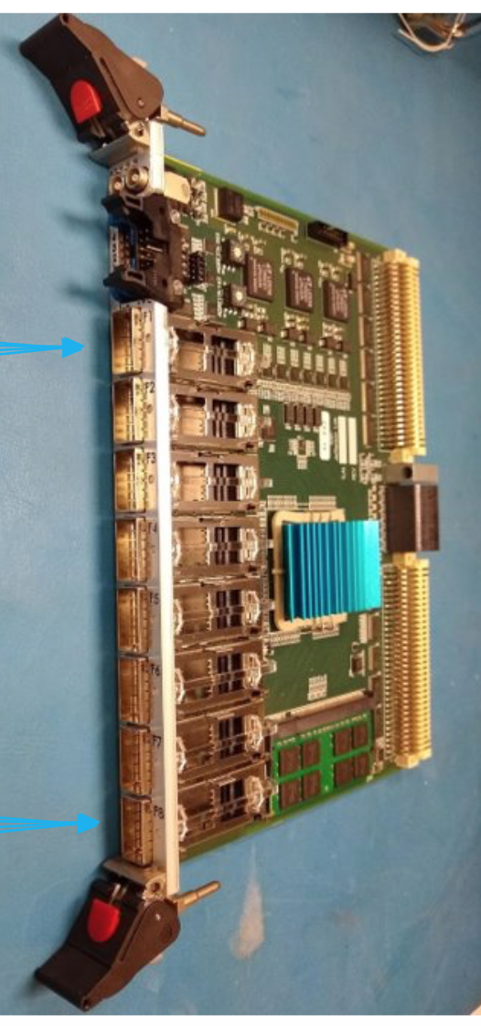
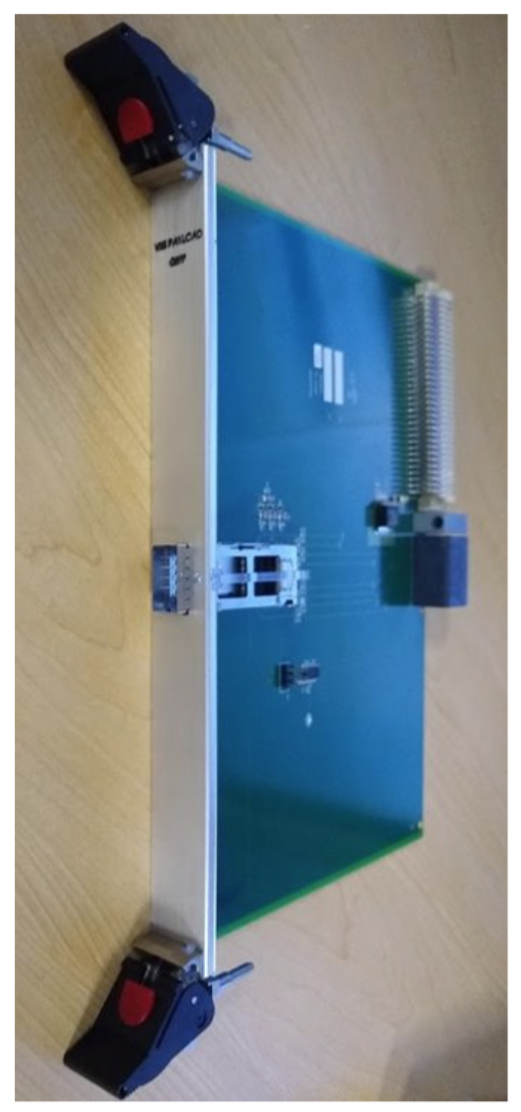
Flexible Platform
In addition to supporting all the older VME electronics, we have developed a number of custom boards that take advantage of the VXS backplane.
Streaming Model tests grew out of the original purpose of VXS for the trigger data path.
250 MHz FADC
16 Channels
12 bits
JLab workhorse in all current experiments
Drift Chamber Readout Board (DCRB)
96 Channel TDC
boards
Used to readout Hall B/CLAS12 drift chambers
Subsystem Processor (SSP)
FPGA board
8 QSFP Inputs (32 links)
QSFP->VXS adapter card
Simple direct serial link
access to the VTP for
External custom
Front-end electronics
Supports 4 separate bidirectional links

Slide 9
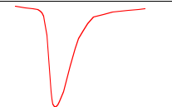
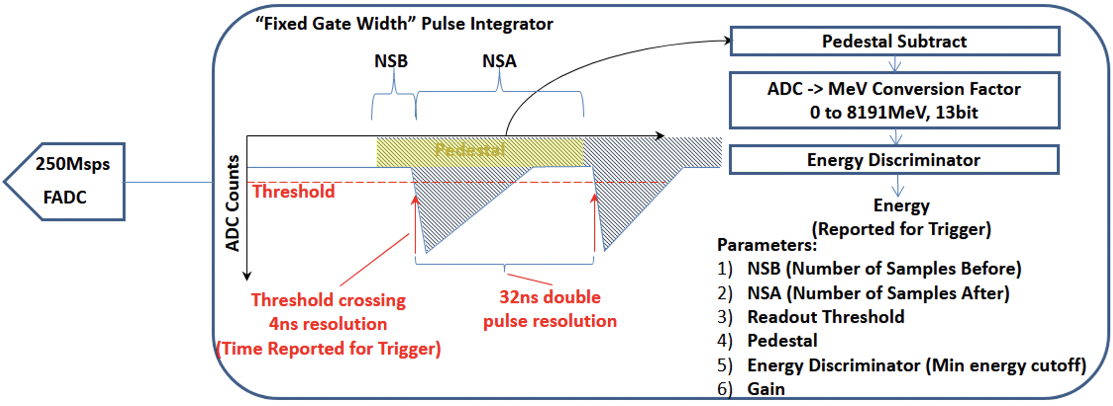
JLAB FADC – Streaming
A 250 MHz FADC generates a 12 bit sample every 4ns. That’s 3 Gb/s for one channel. A 16 channel module is 48 Gb/s. That is over twice the available VXS bandwidth. But we don’t need ALL the samples.
Within the FPGA we keep only the data around a Region of Interest (ROI) from each channel, along with a fine time stamp (4ns ticks) in each time slice window (65µs). Then we do some pulse processing for each hit.
Readout Time Frame
(65µs)
TF1
TF2
TF3
TF4
ROI
ROI
ROI
ROI
Chan 1
.
.
.
TH
TH
TH
TH
Fine
Time Stamp (4ns)
0
16383
ROI
ROI
ROI
Chan 16
TH
TH
TH
FPGA Pulse Processing (one 32 bit word/hit)
1 hit/32ns (double hit resolution)
- Pedestal subtracted
- Integrated Charge(13bit)
- Timestamp (14bit – 65µs)
- 8Gpbs/Module rate to the VTP

Slide 10
VTP - Frame Builder
Globally “Sync” from the JLAB Clock/Trigger distribution system is used to start and stop all the streams at their source (FADC Boards)
Locally, PPs stream hits to a VTP DRAM buffer. The Frame Builders (V7 FPGA) have a frame output “fifo”
A Frame builder will only aggregate hits into a ROC frame if the fifo is not full. Otherwise the frame is dropped.
Built ROC frames at the Zync will always get sent (eventually).
Up to 4 independent network streams can be defined. Each PP maps to a specific output stream.
Limited Zync resources only provide 2 high performance TCP connections (or 4 UDP streams)
FADC Boards
DRAM
4 x Frame
Builder
Zync
PP 1
BUF 1
1
TCP/UDP
EMU
(Stream
Aggregator)
2
TCP/UDP
VXS
3
UDP
4
UDP
PP 16
BUF 16
V7
VTP

Slide 11
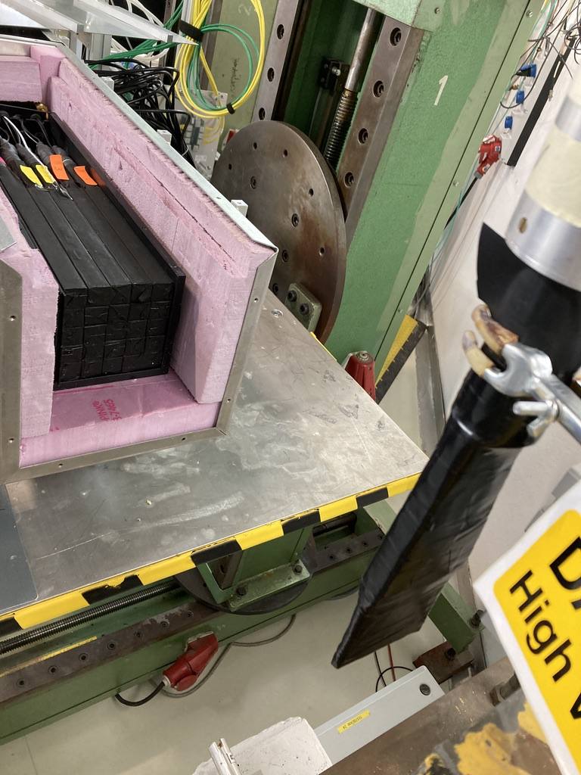
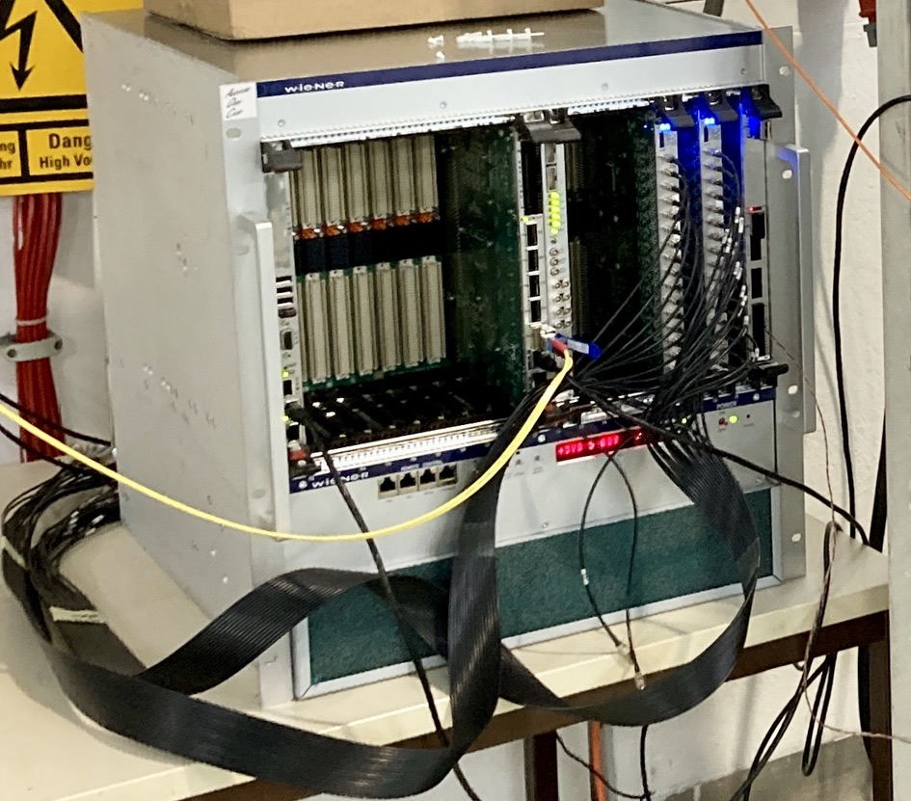
Simple Hybrid DAQ System
phototube
Lead glass
JLAB 250MHz FADC board has the ability to support simultaneous Triggered and Streaming readout
This system Streamed integrated hits while Triggered data were the full waveforms for the ROI
DISC
e-
scintillator
Two ROCs are defined for the DAQ System
VME_ROC
Runs on the CPU
Reads out Triggered data
VTP_ROC
Configures and manages the stream data
TI
SD
Trigger
CPU
VTP
VXS Crate
FADCs
EMU
(Stream
Aggregator)
File
10Gbps
EMU
(Event Builder)
File
1Gbps
PC/Server

Slide 12
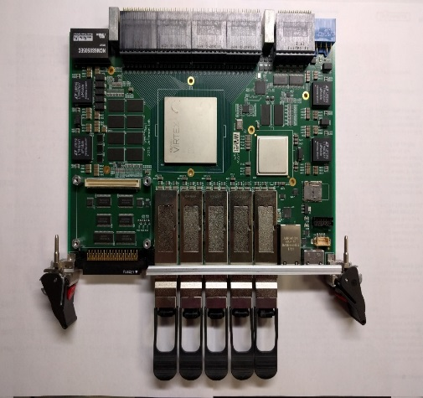
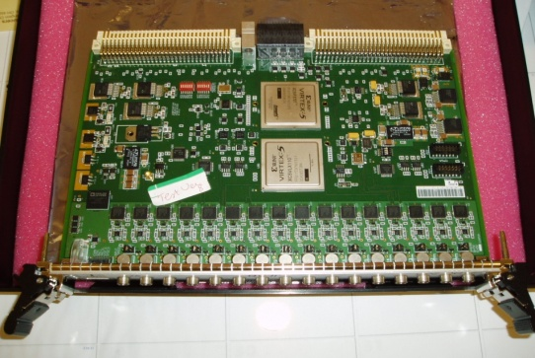
VTP Streaming Readout Testing in CLAS/Hall B – with recent DCRB support
Front-end Crates
DCRB
VTP
DC Hits
(32ns Timeslices)
Ethernet Routers
Computing & Storage
New Firmware
Drift Chamber
Fibers: 4x 10Gbps Ethernet Links from each VTP
VXS Backplane
10Gbps per Slot
FADC250
FTCAL
FTHODO
ECAL
PCAL
FTOF CTOF
CND
HTCC
Existing Firmware
FADC Pulses
(4ns Timestamp & integrated Charge)
FADC250 streaming support (pulse charge & time) already supported
DCRB streaming support added for CLAS12 beam tests (2 sectors -> 6 crates)
First streaming test in CLAS12 with calorimeters, Cherenkov, and Drift Chambers for large triggerless DAQ

Slide 13
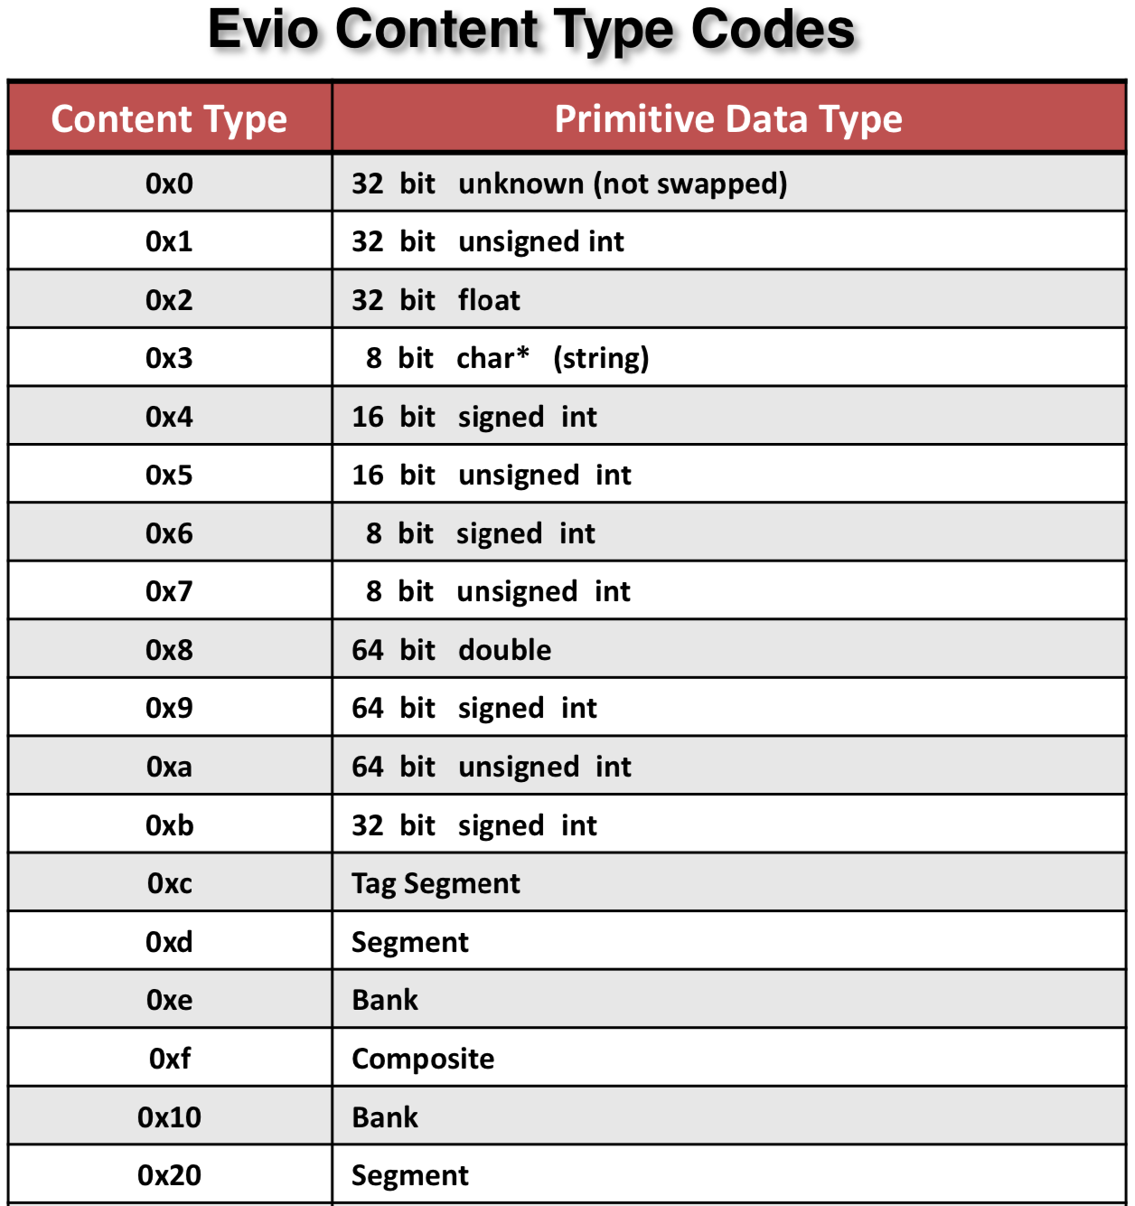
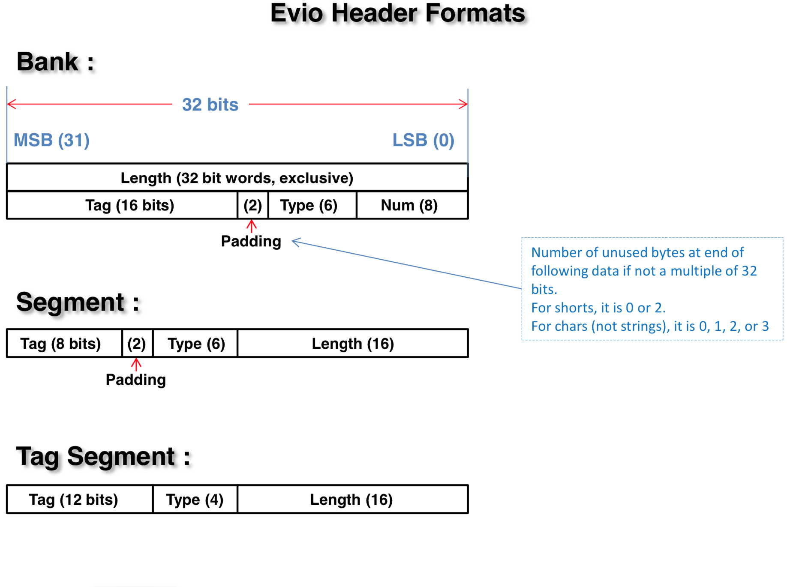
EVIO Primitive Data Structures
EVIO data formats are based on 32 bit words

Slide 14
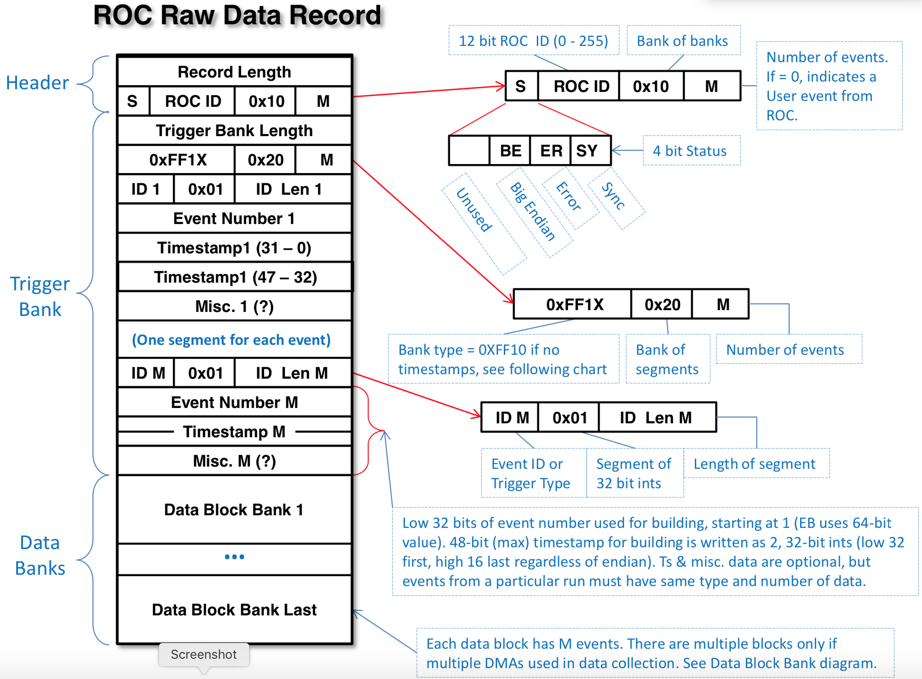
Example Data Structure – Triggered Readout
Note that Banks can contain Banks or Segments which can further encapsulate information for the User.
Lengths in the headers facilitate finding the start of the next bank or segment.
For purposes of transporting or archiving these bank structures we wrap them up within another header called an EVIO Block header (8 Words).

Slide 15
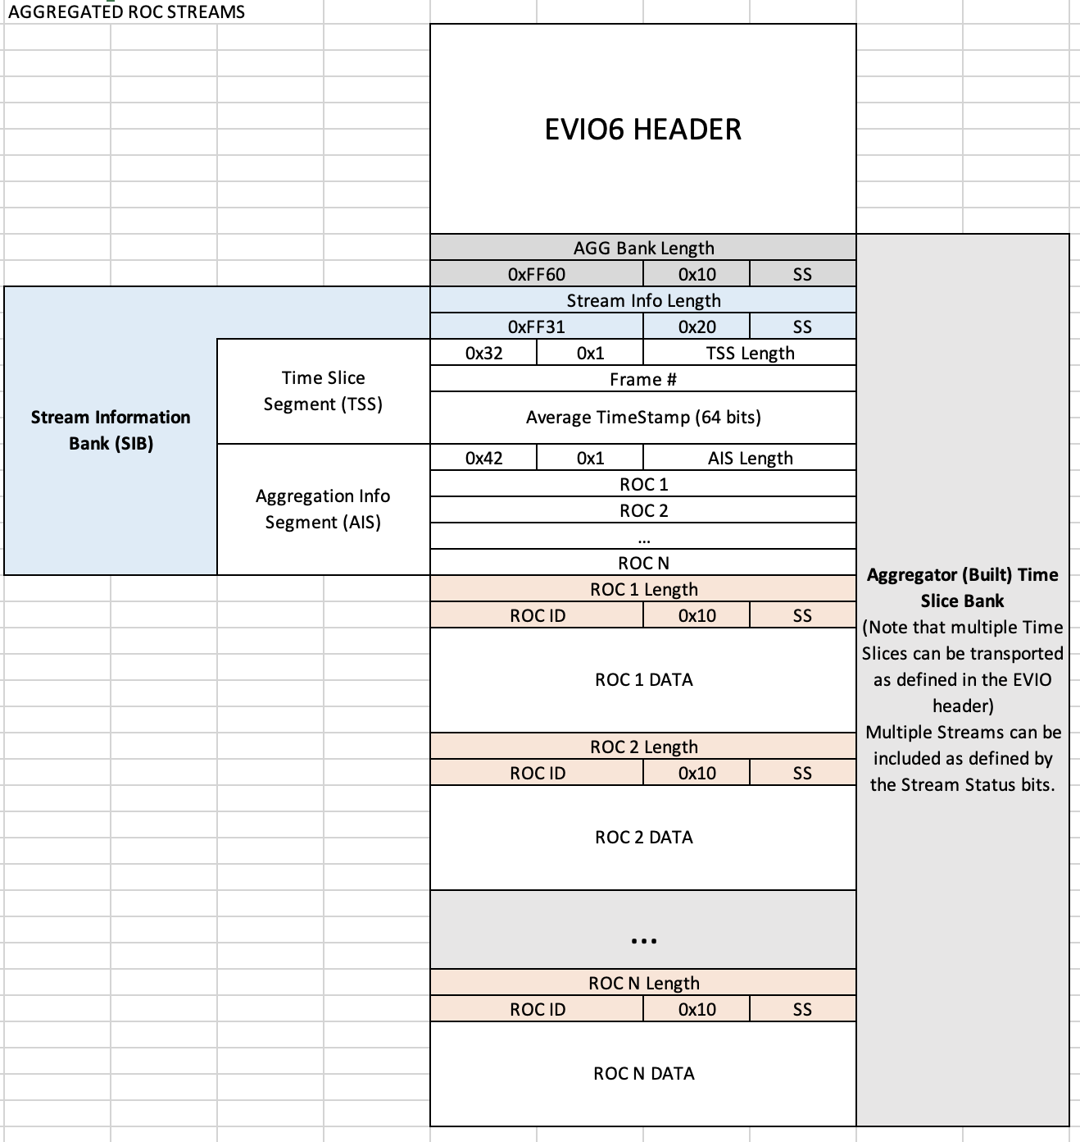
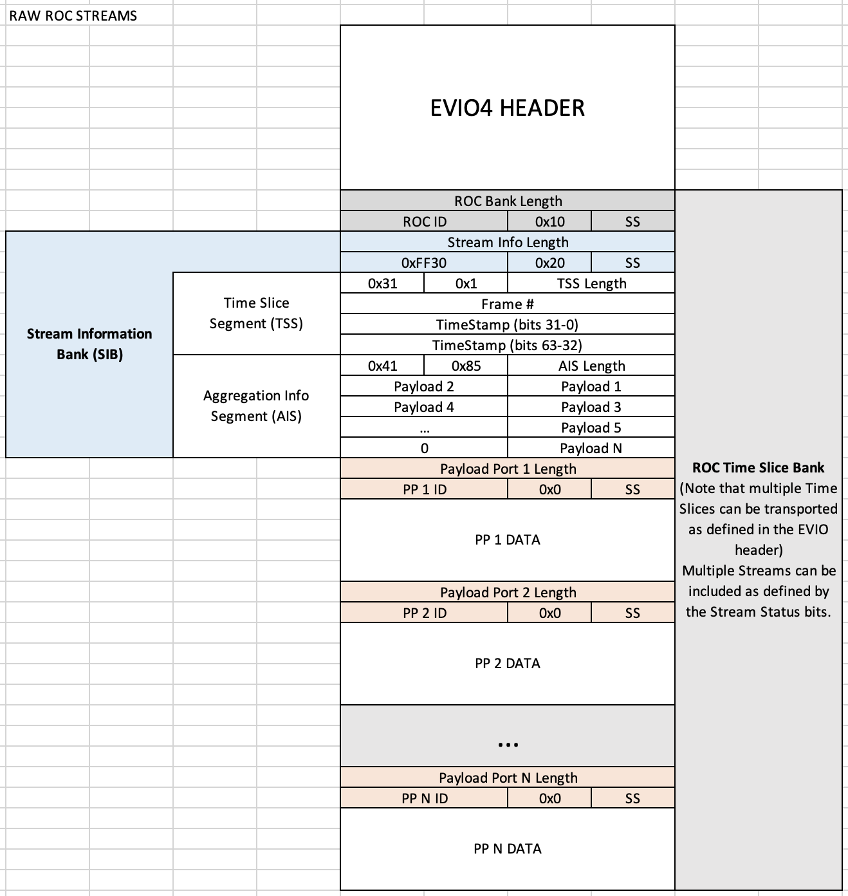
Example Data Structures – Streaming Readout
Streaming Data Structure is analogous to existing Triggered Data
Aggregation just appends Streams and updates a new SIB

Slide 16
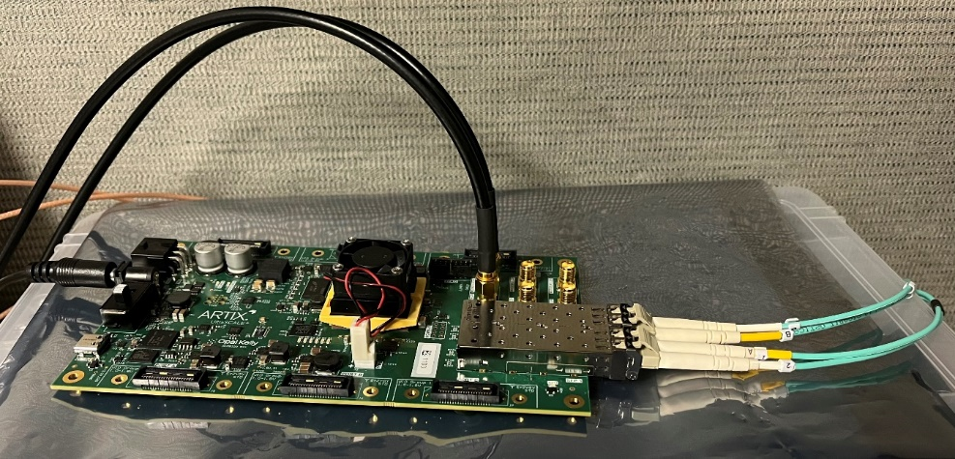
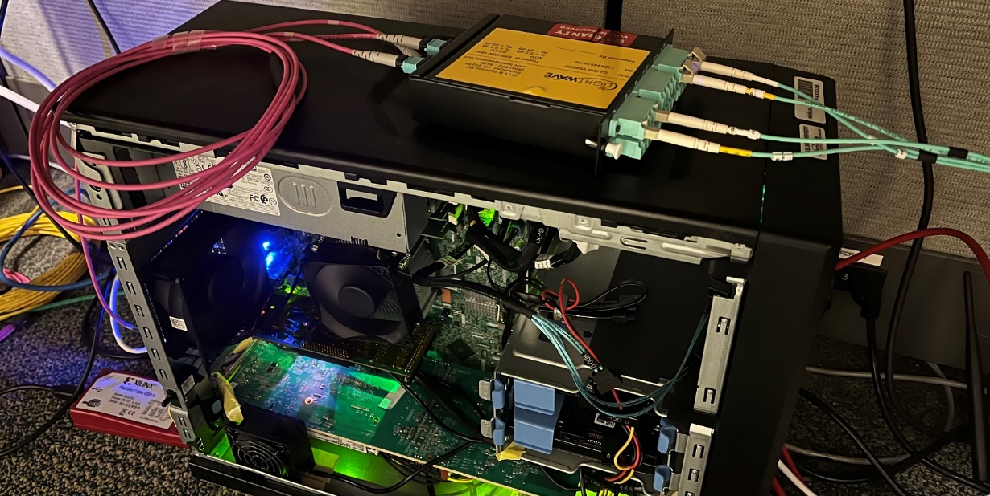
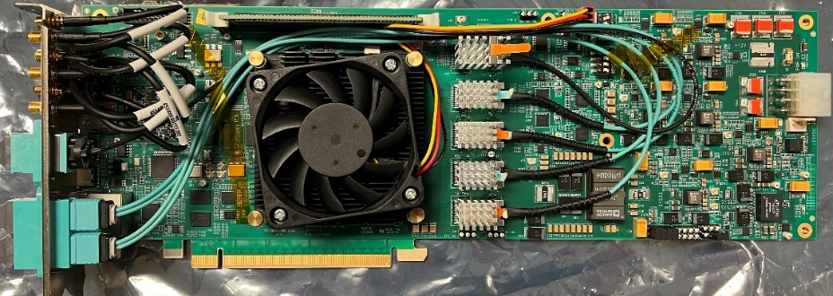
DAQ/Computing Activity in 2024
Finishing timing studies
Define clock/command distribution protocol
Jitter and phase drift – (measured ~3ps at RDO)
Refine requirements for the GTU
(scale of the distribution, interface to DAM)
Finalize requirements for FELIX development to define EIC DAM Board.
Collaborating with ATLAS OMEGA group at BNL
Currently using FLX-182 engineering article in tests
Refine expected RDO counts and flavors for all detector sub-systems and
Required interfaces with FEB electronics (ASICS, VTRX+, FADC).
Better estimates of backgrounds and data volumes.
All for development of the TDR and the CD2 baseline.
XEM8320,
Artix Ultrascale+
(RDO)
FLX 182 board
Used for timing studies and
DAM firmware/software development

Slide 17
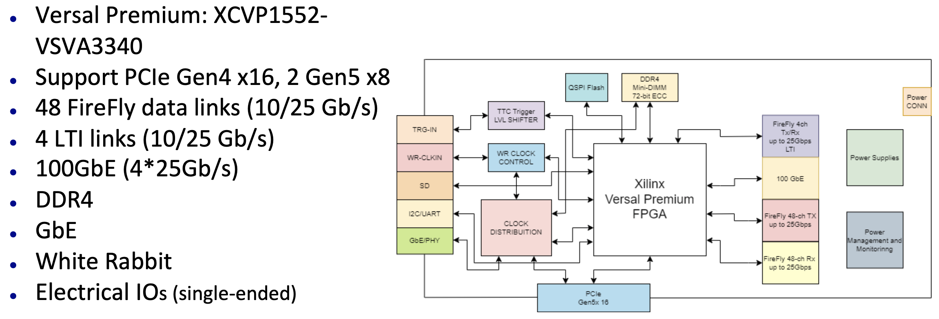
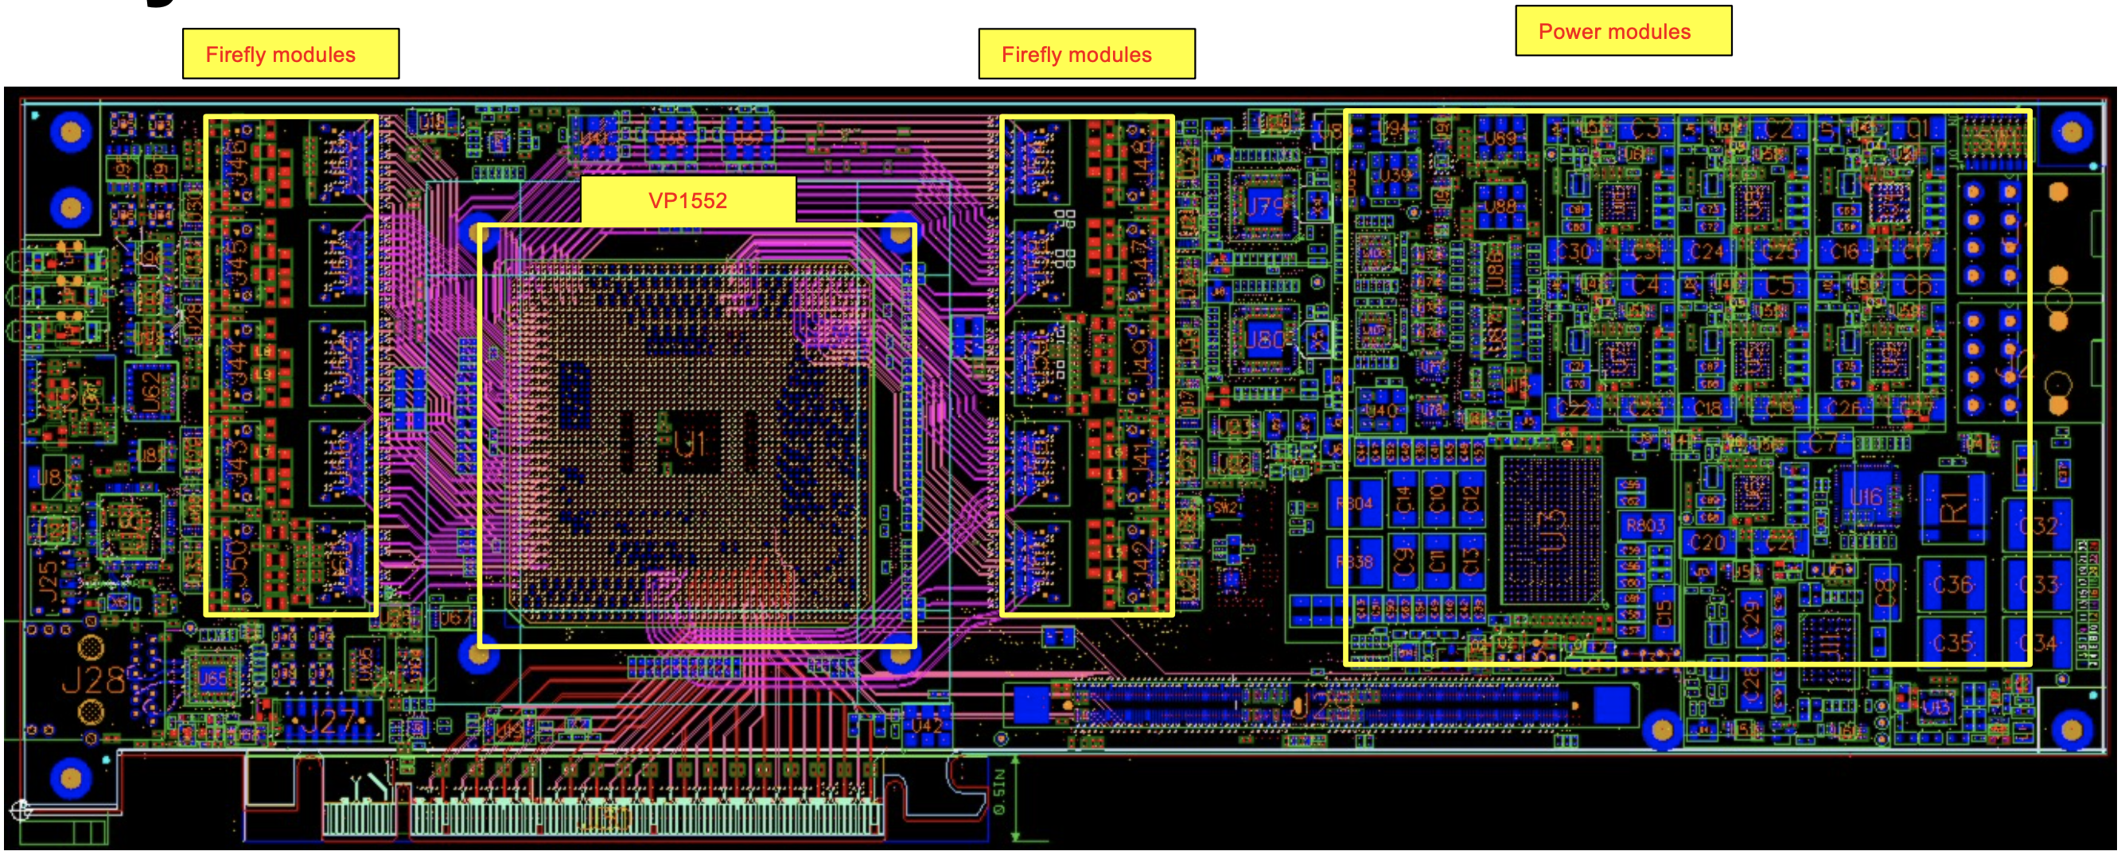
FELIX Updates – FLX 155
FELIX hardware for future ATLAS experiments at HL-LHC is being developed at BNL (Omega Group)
Long term support is insured. Development timelines are compatible with EIC.
Latest (FLX-155) design review completed by ATLAS and AMD
This revision should be the final engineering article
It has been sent out for fabrication. PCBs available this month.
First 4 populated boards expected by late August/early September
We expect to receive at least one board by the end of this year
Note: 4 fiber LTI Link supports receiving either reconstructed or a direct clock
Versal FPGA is a SoC (Dual Core ARM). The FELIX board can operate either standalone or in a Server

Slide 18
Supporting FELIX Hardware at JLAB
FELIX: FLX 182 (we have 2 boards)
Versal Ultrascale+ FPGA (SoC, ROC)
FPGA: Xilinx Versal Prime XCVM1802
PCIe Gen4 x16
24 Firefly links
JLAB
Clock/Trig
RDO
Detector
RDO
24
RDO
Data
24
RDO
Control/Clock
PCIe
Implement a protocol based
on the proposed EIC Link
DAQ Server
CODA
EMU
DRAM
Questions:
What can we use for RDOs?
Is there a potential “cheap” commercial option for the DAM that could be used for prototyping?

Slide 19
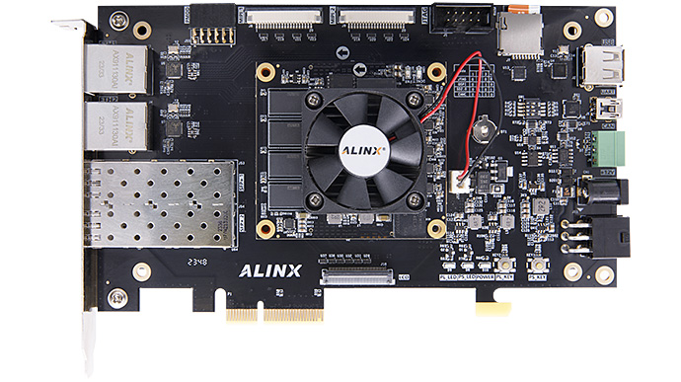
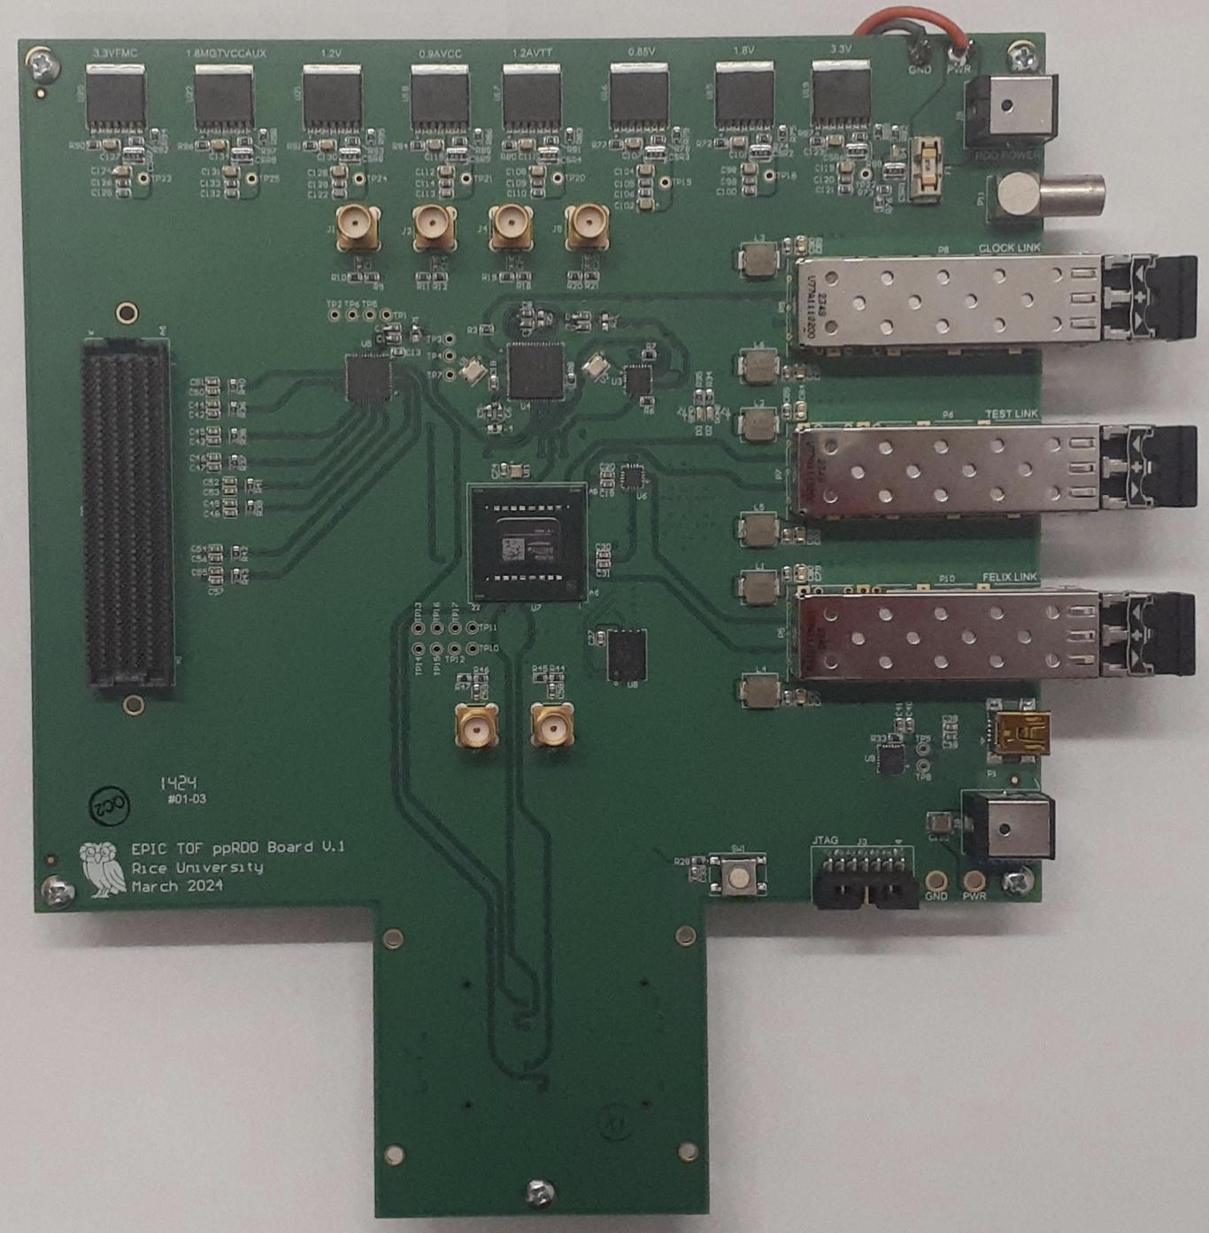
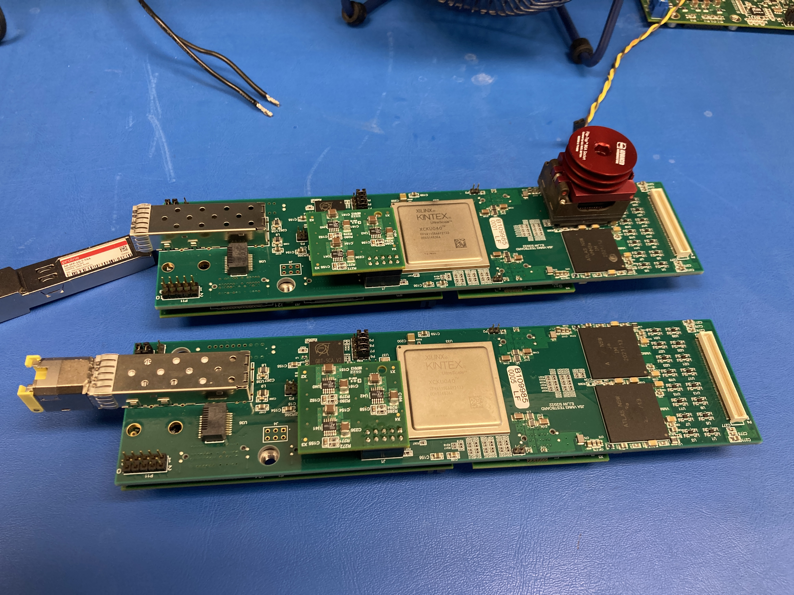
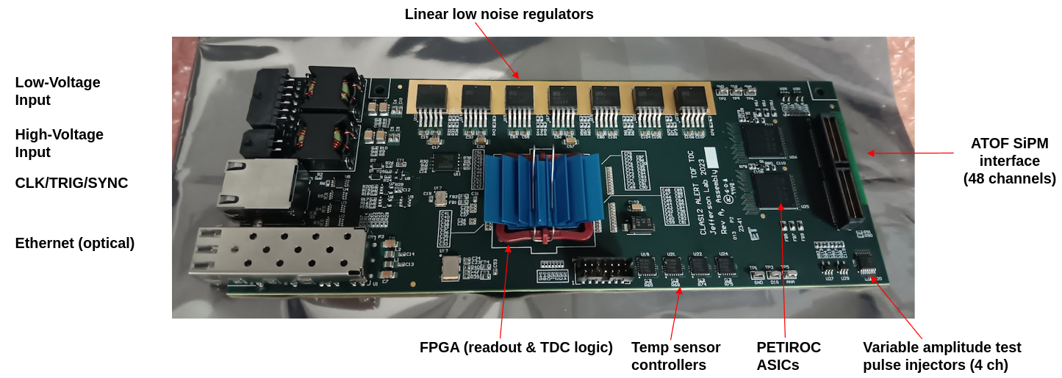
Pre-Prototyping EIC DAQ at JLAB
VMM ASICs + Artix Ultrascale+
EIC PP-RDO
ALINX VD100 ($800)
Versal SoM (dual core ARM)
2x SFP+ (12.5Gps)
2x 1Gb Ethernet
4GB DRAM
156MHz on board clock

Slide 20
What’s Next?
The VXS platform works for JLAB for the near term, but how do these solutions evolve for future experiments, and in particular the Streaming model.
Introduce the DAM/RDO architecture to our DAQ development with FELIX and other viable commercial options.
Implement a DAM/RDO clock distribution and communication protocol that is consistent with the EIC proposal.
This will initially be a useful testbed for the overall performance of the clock reconstruction and phase synchronization.
RDO
SoC
ROC
RDO
ethernet
Server
RDO
FPGA
PCIe
Server
RDO

Slide 21
Backup Slides

Slide 22
FADCs - Triggered vs Streaming
Triggered Mode
Streaming Mode
ROI
ROI
ROI
External
Trigger
(timestamp)
Time Slice
(Frame #
& timestamp)
ROI
ROI
ROI
TH
TH
TH
0
511 (Sample #)
TH
TH
TH
PTW (0-2µs)
PL (0-8µs)
0
Fine time stamp (4 ns)
N ( Max Sample #)
PL: Programmed Lookback
PTW: Time window
Data we get on a trigger:
- FADC waveform values for the ROI
- Threshold Sample # (hit time)
- Trigger absolute time stamp
1 Frame = N Clocks (up to 16bits, currently 65536 ns)
Data we get for a Frame:
- Pedestal subtracted sums over an ROI for every hit over threshold
- Threshold sample # fine time stamp for each hit
- Frame # and absolute time stamp for the frame
ROC Data Format
Length (words)
ROC Data Format
Length (words)
Tag
DT
M
Tag
DT
SS
Trigger Bank
Trigger #
timestamp
Stream Info Bank
Frame #
timestamp
Data Banks
Data Banks

Slide 23
Readout Controller (ROC)
OS: Linux
ARCH: Intel, Arm
The CODA ROC is a software application that has multiple options for the User to implement custom code or hardware for their specific needs.
User
Libs
DMA
Lib
VME
Lib
DL Lib
PCI
ROC
Interactive shell (Tcl)
$ <cmd>
USB
Process Thread
Trigger Thread
FIFO
User
FIFO
User
User
ROL2
FIFO
ROL1
to Trigger Processor
Buffer
Pool
Buffer
Pool
Modules
DMA
Pool
VME
VXS
Buffer Pool
Control
Remex
Output Thread
to EMU, ET
stdout or File
cMsg
External Trigger/Clock

Slide 24
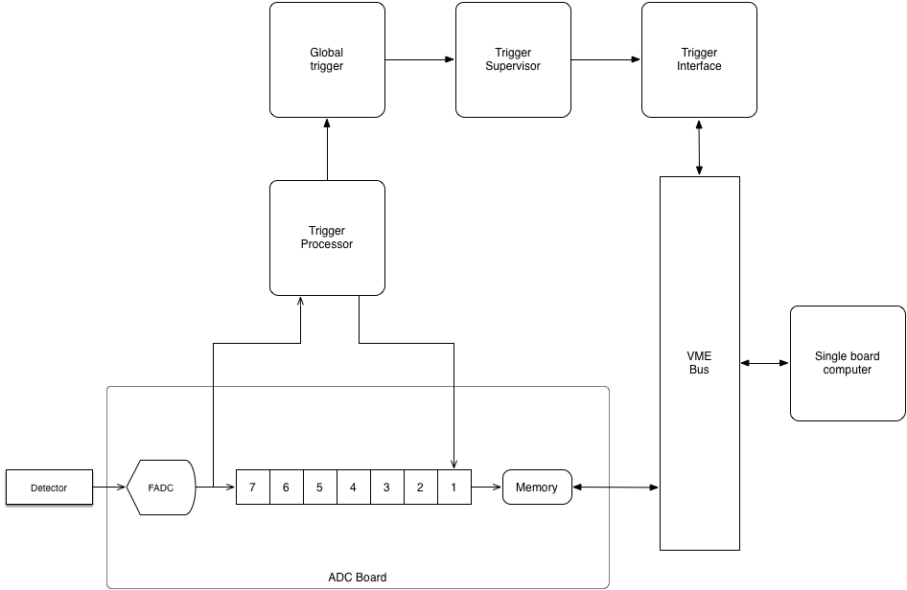
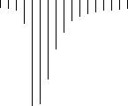
Example – The GlueX trigger
Each ADC sends signals to a crate level trigger processor over VXS serial bus.
And stores the signal locally in memory
Each CRATE Trigger processor sends signal to a global trigger for all crates over fiber optic cable.
Global trigger tells trigger supervisor (TS) which events are good.
The TS tells Trigger Interface (TI) board in each crate.
The TI signals the CPU to read out crate and provides information about which trigger the data belongs to.
VXS
FIBER
Cable
Fiber
VXS
VXS
8µs
Trigger
Copy data from
all ADCs in the crate
To the CPU
Look back some # clocks

Slide 25
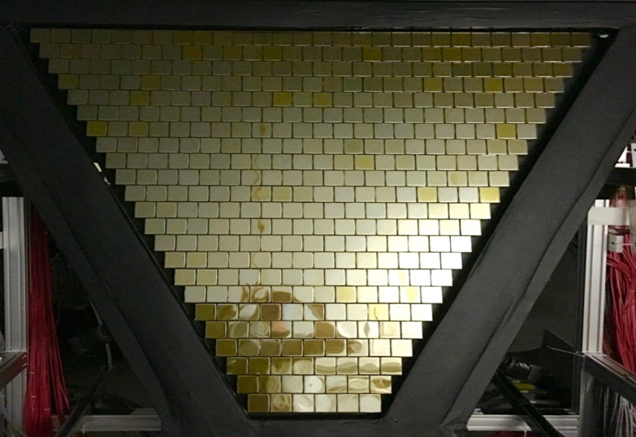
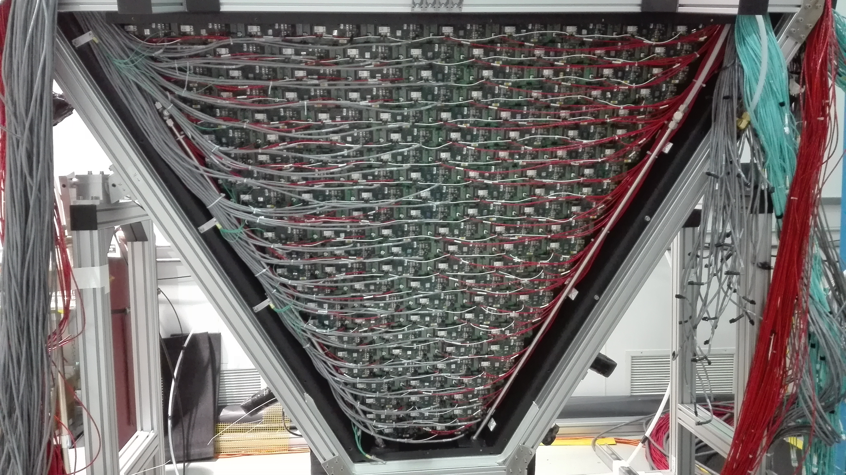
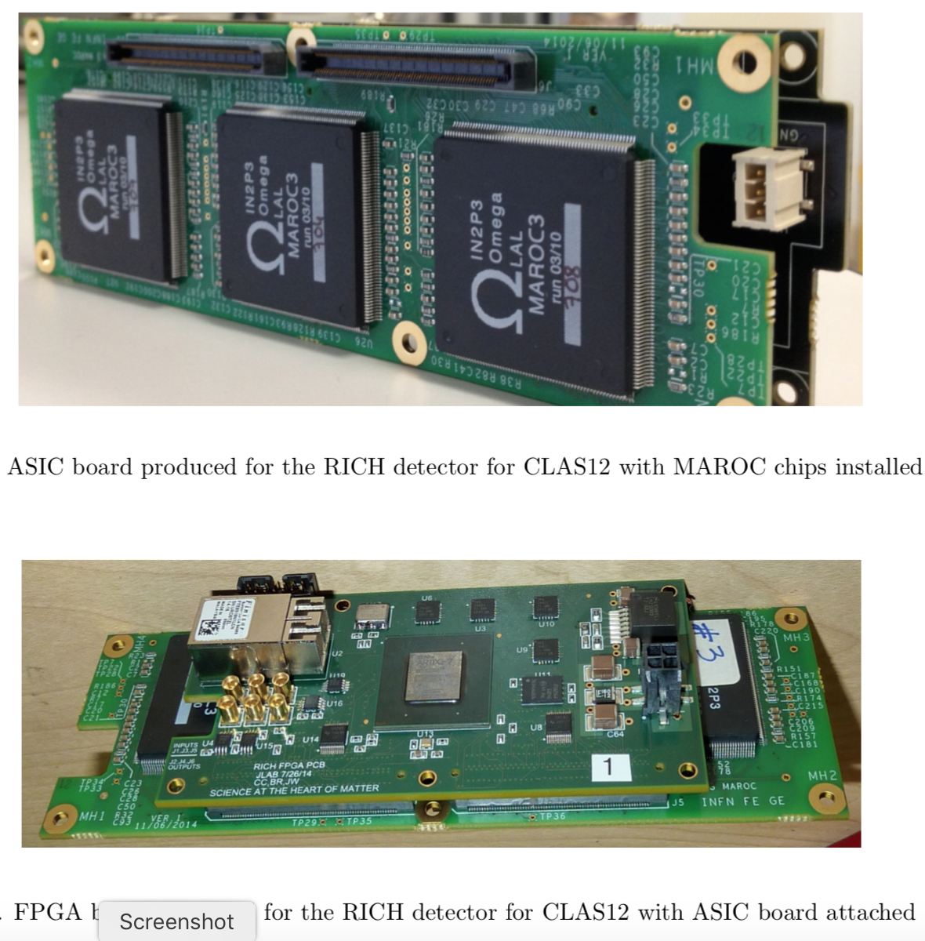
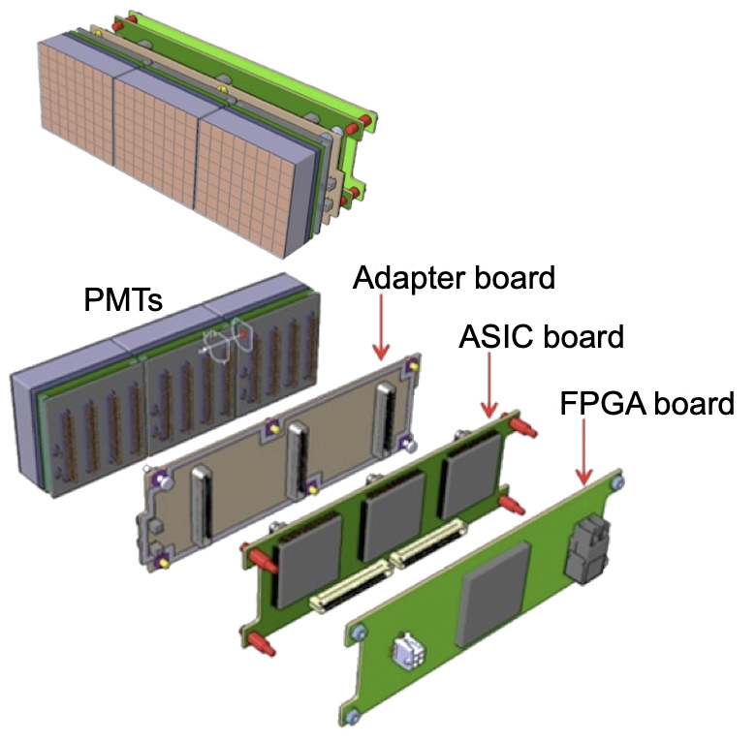
HALL B RICH Detector - Readout
138 Readout Boards (Tiles)
(Blue fiber cables)
MAPMT Sensors (25024 Channels)
5 SSP FPGA boards aggregate the fibers
In a single VXS crate

Slide 26
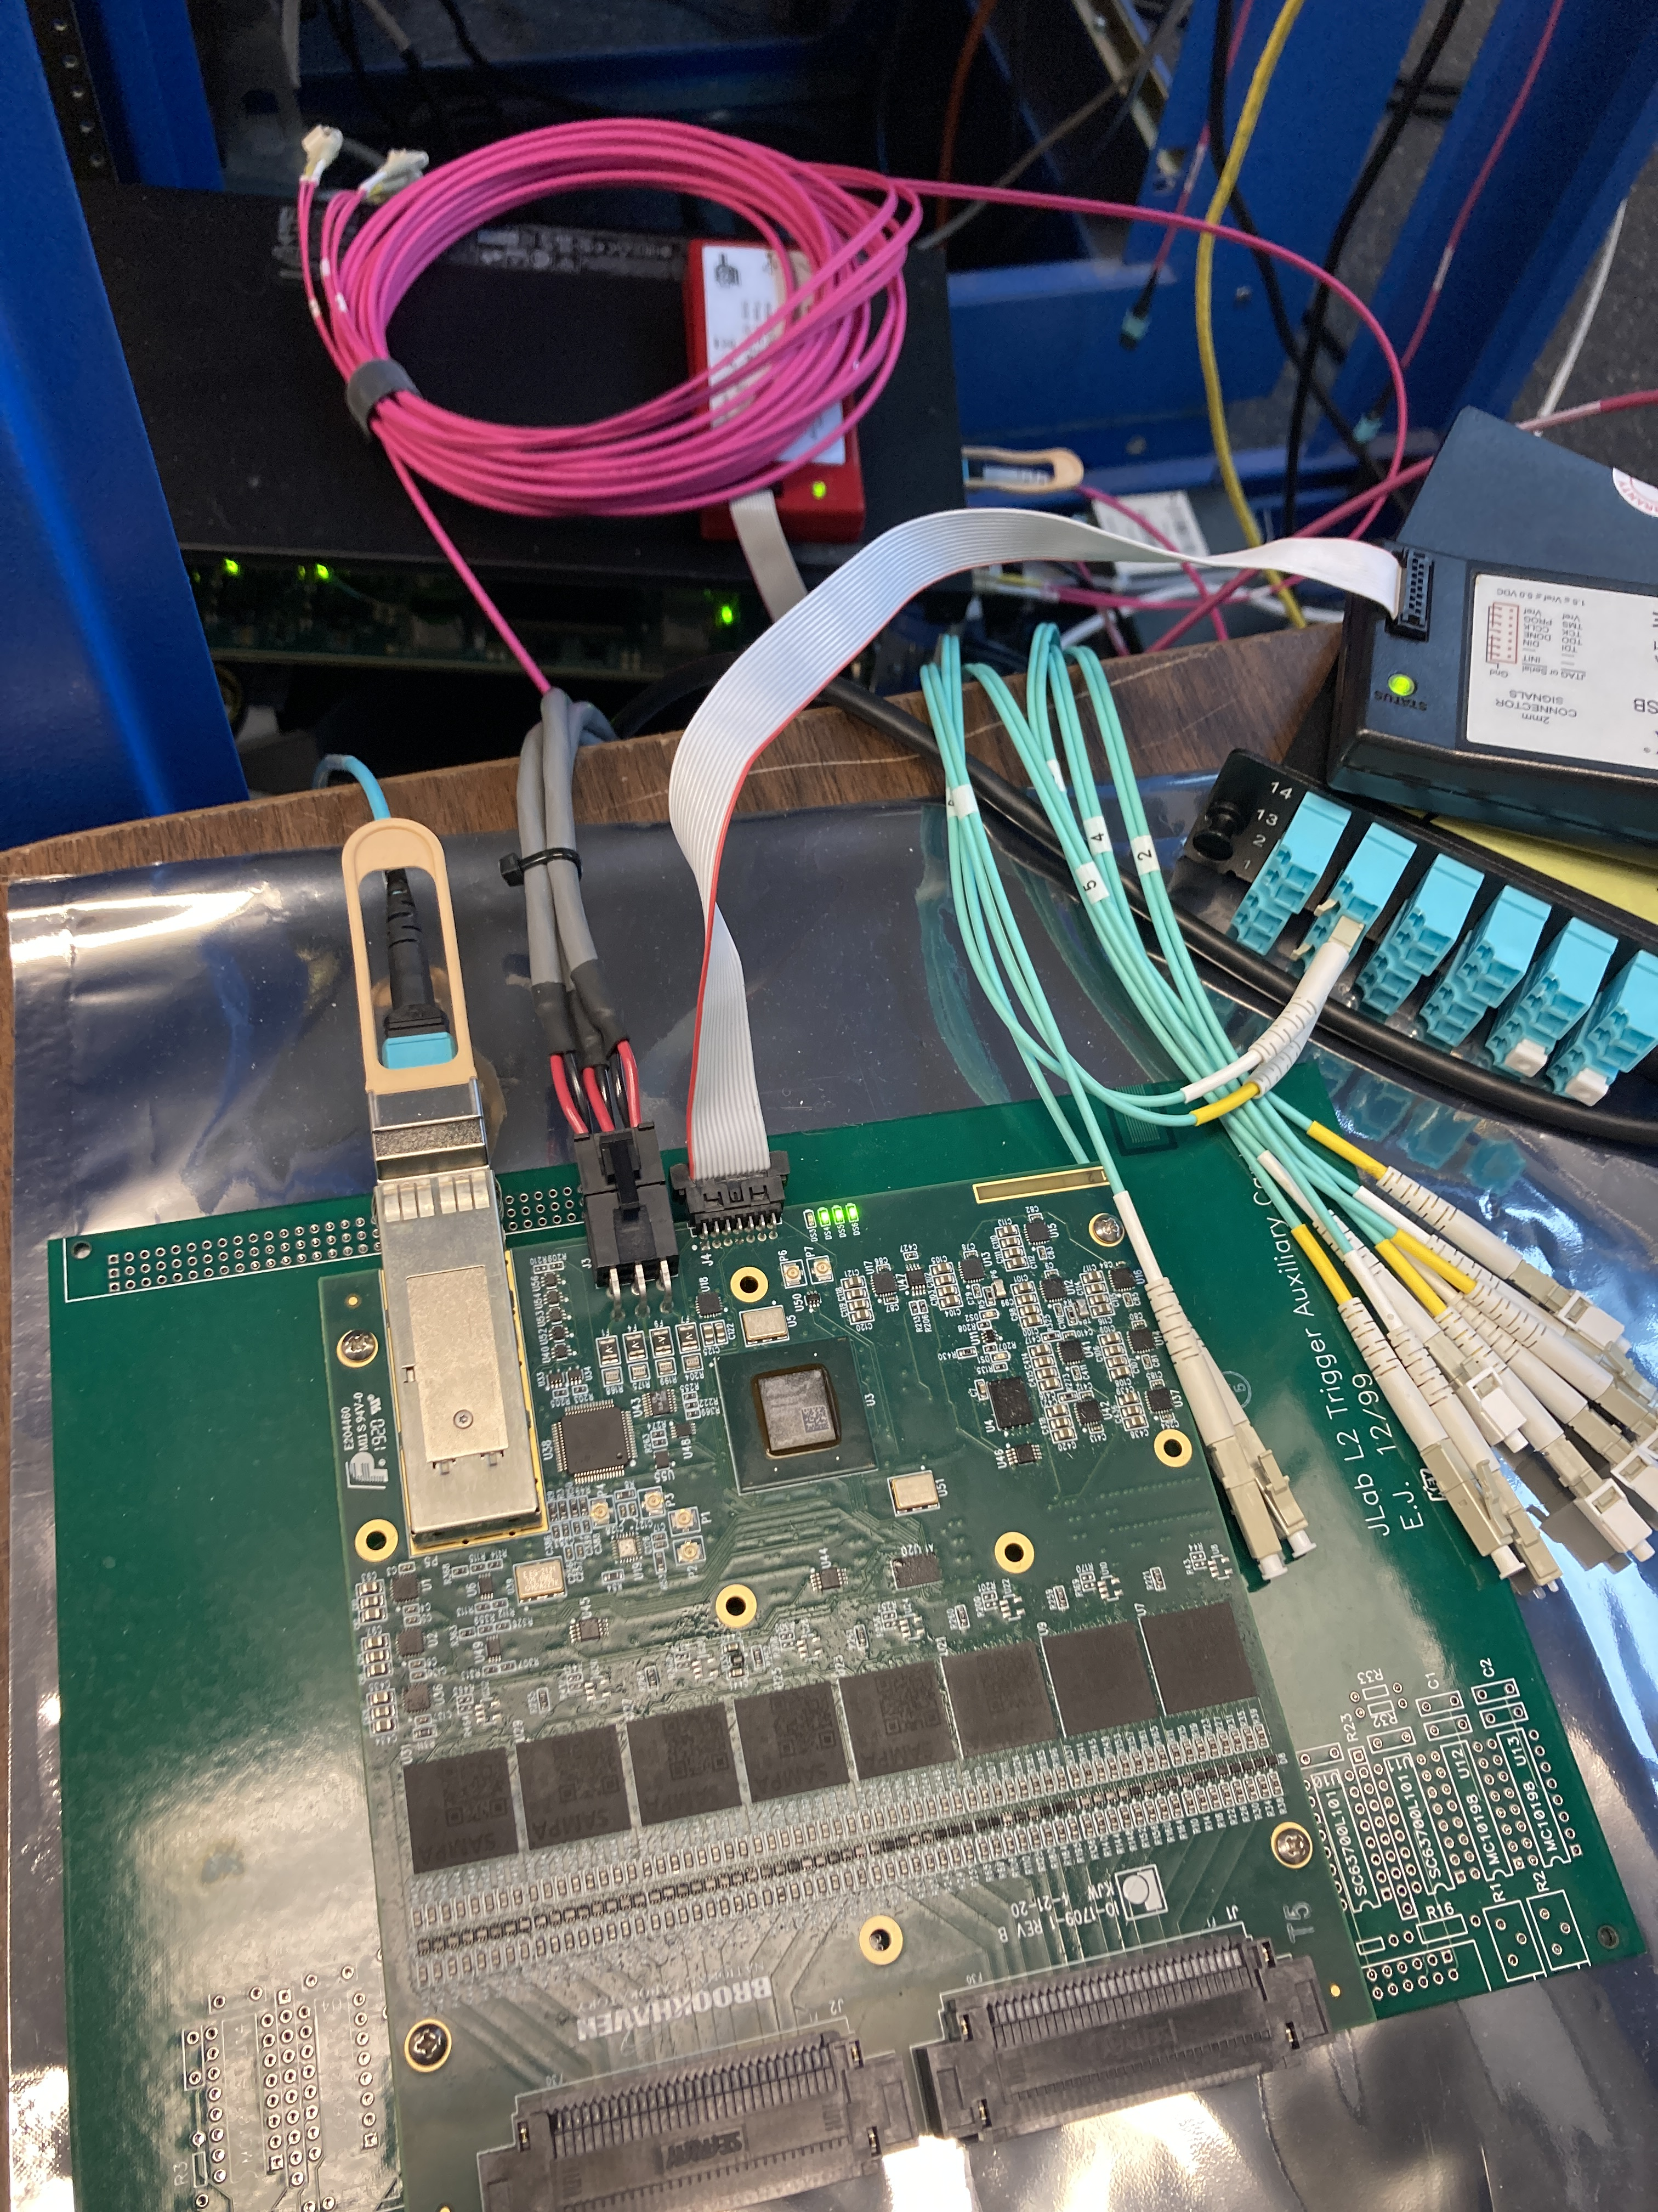
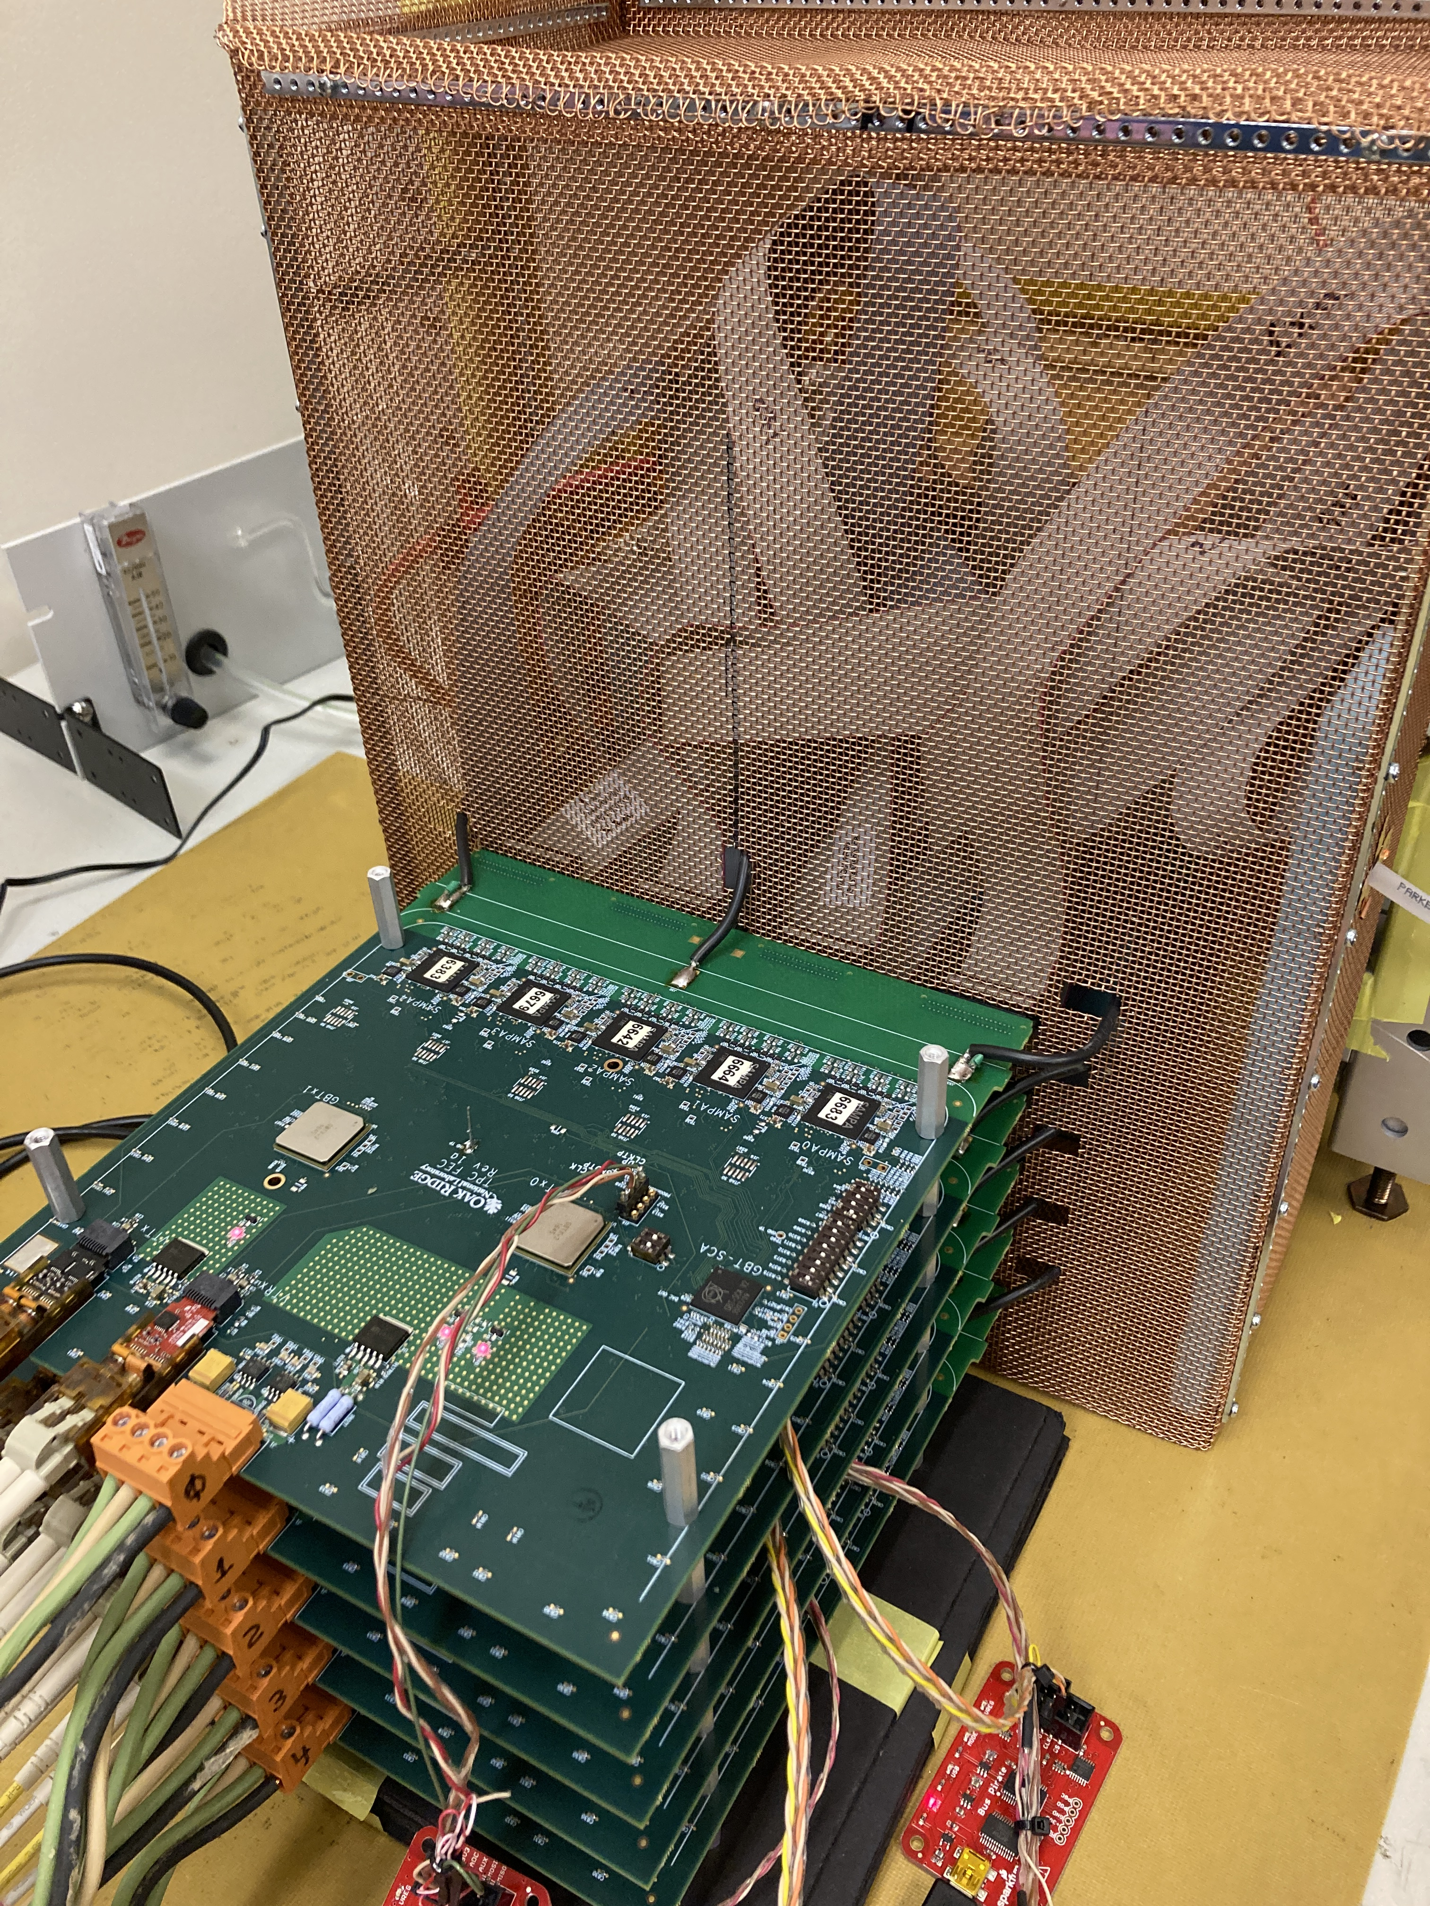
New Detectors - New Electronics - ASIC Front-End Examples
VMM3 ASICs
64 Channel
10bit/6bit ADC
GEM readout
GEM Detector
FPGA
MAROC3 ASICs
64 channel
Fast ”trigger” bits
MAPMT/SiPM readout
Optional 8/10/12bit ADC
sPHENIX @BNL
FPGA
GBT ASICs
SAMPA ASICs
SAMPA ASICs
32 channel
10 bit (10Mhz) ADC
Optional DSP
This FEE card was originally designed for the ALICE TPC
(High radiation environment)
FPGA Daughter card
with 1Gb Ethernet port

Slide 27
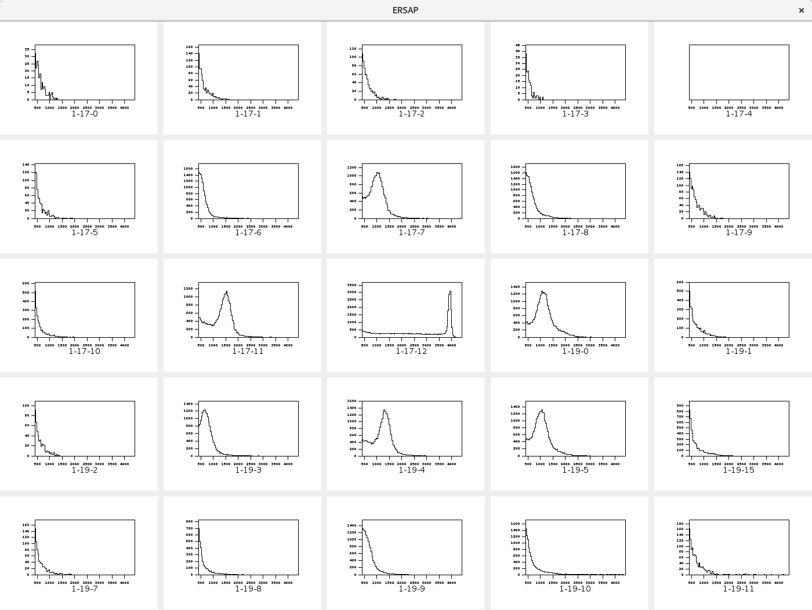
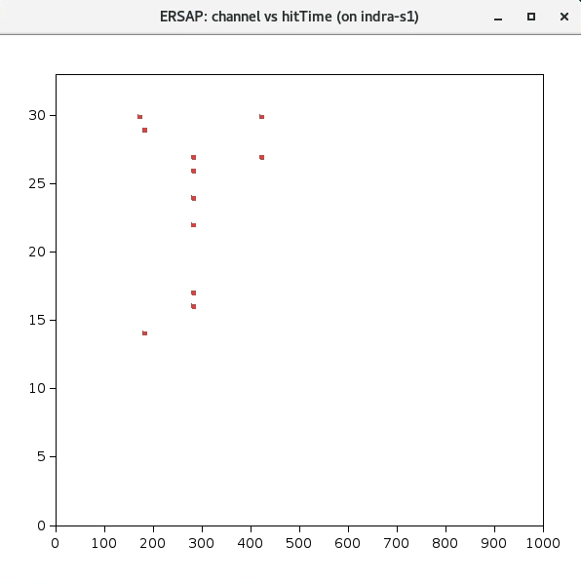
Beam Tests
Calorimeter spectra – Streaming Data
(Electron beam centered on the central crystal)
Time Slice Frame containing a Trigger
FADC Channel
Can look for “triggers” in software
Time

