Slide 1
Slow Control/Metadata Handling for the JLab GlueX Experiment
SRO+DAQ Workfest
ePIC Collaboration Meeting - Lehigh University
July 25th 2024
David Abbott/David Lawrence
Jefferson Lab

Slide 2
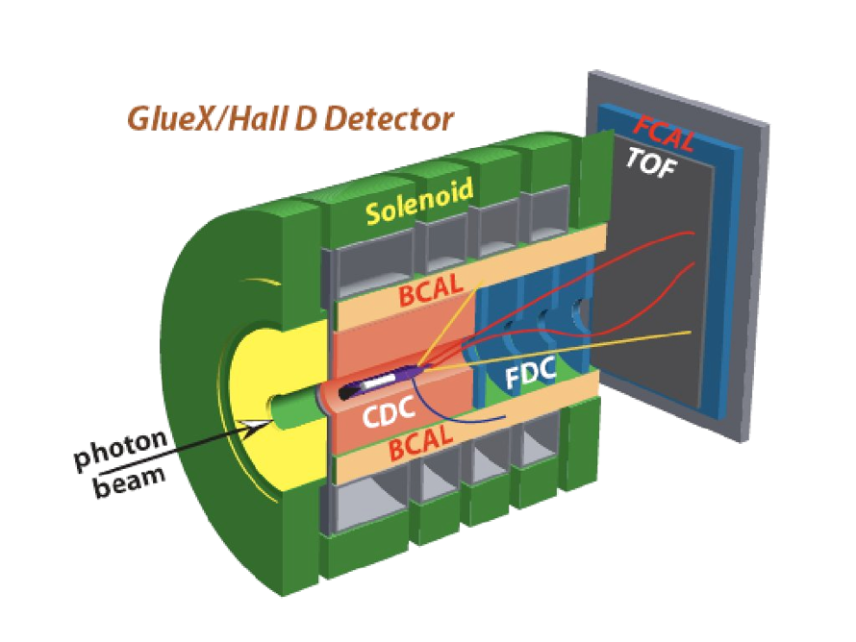
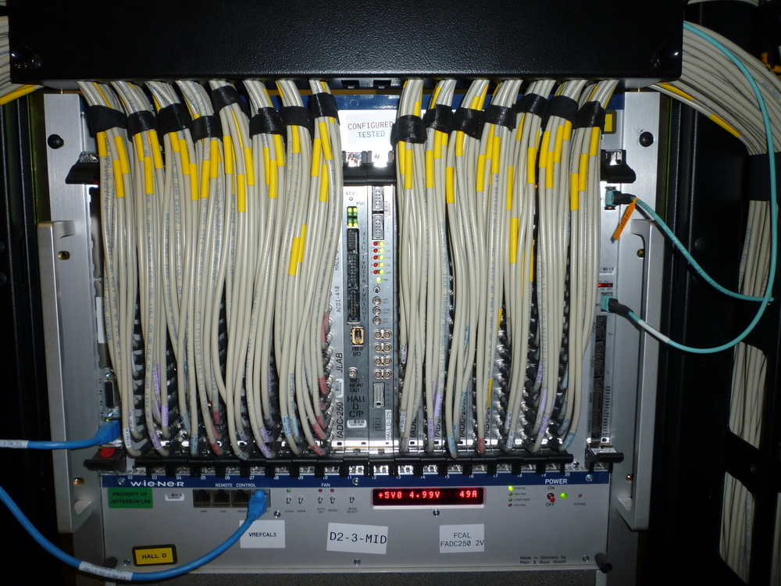
GlueX Experiment
Trigger rates ~90kHz
Data rates 1-1.5 GB/s to disk
8 Detector Subsystems
Most Front-End digitizers are VME/VXS crate based readout
50+ crates

Slide 3
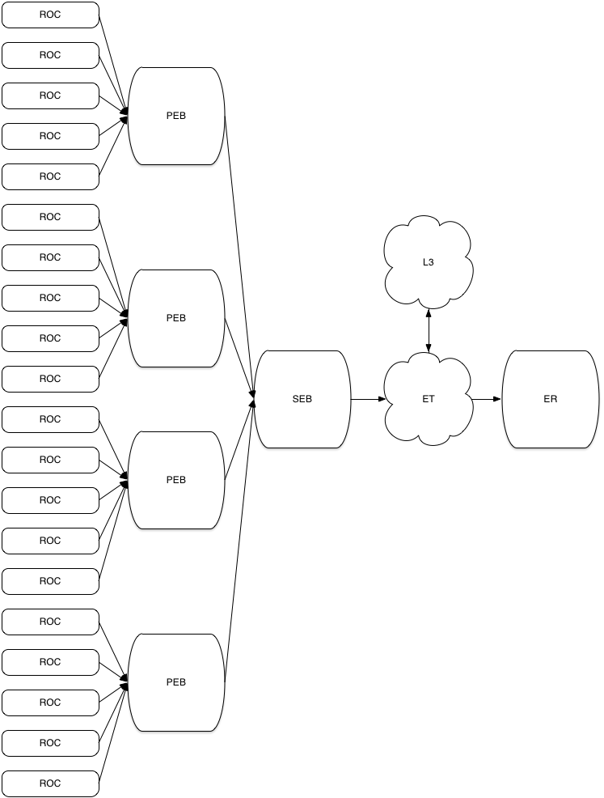
DAQ Architecture
Crate based front end digitizers.
Configured and readout by a software component (ROC)
Clock and trigger distribution system
Synchronizes and distributes clock and trigger to all front-ends
2 Software Event Building stages
Shared memory (ET) for User access to data stream
Event Recorder writes files
~20GB per/file
Two Data Paths for User/Slow control information to Files.
Direct from the ROCs
Inserted by User processes via ET
User
File

Slide 4
Module Configuration
FEB modules are configured using text configuration files at the beginning of each run (every ~2-4 hours).
Configuration values are read back from FEBs and written to data stream as special BOR events before any physics events
Event Recorder process keeps copy of BOR event and writes it to beginning of each raw data file of run so that it can be processed independently
Configuration files are archived as tarball next to raw data in permanent storage for redundancy

Slide 5
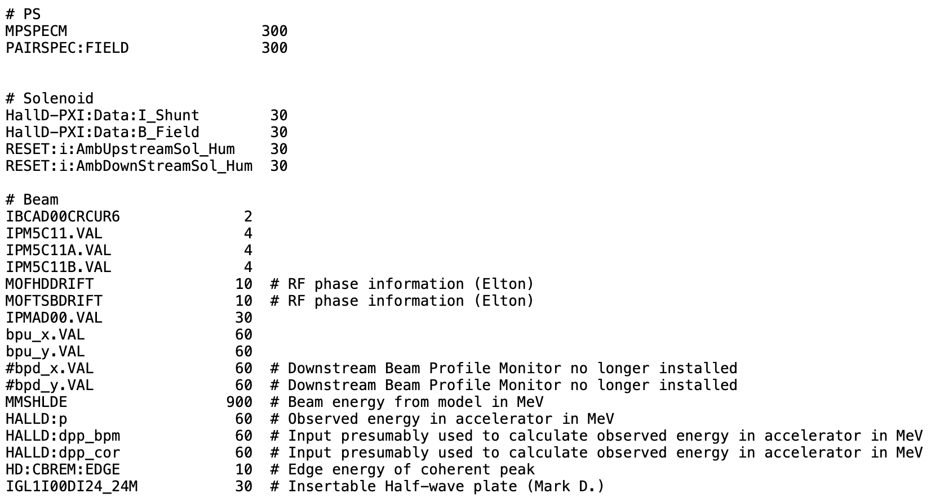
Slow Controls (EPICS)
EPICS values are archived in multiple ways:
DB archive maintained by accelerator. Same archive used for both accelerator and selected experiment SC values.
Written to data stream as special EPICS events. Must be handled carefully as “barrier” events when used in processing offline data!
Select values written to Conditions Database
Very select values written to special logbook entries to summarize run conditions
example epics2et configuration file
value is number of seconds between writes to data stream
key is EPICS PV name

Slide 6
GlueX Example
Special process launched on nearby compute node at beginning of run to gather BOR records from all front end crates and package them into BOR event that is inserted into beginning of event stream
Special process launched on nearby compute node at beginning of run to gather EPICS records periodically during the run and package them into EPICS events that are inserted into event stream
BOR
epics2et
FEB
FEB
Event Builder
ET
storage
FEB
Each raw data file will contain all run-time information needed for offline processing
(excluding field maps and calib. constants)
monitoring
FEB
Online monitoring sees a small fraction of the events and is not guaranteed to see any of the special event types.

