Slide 1
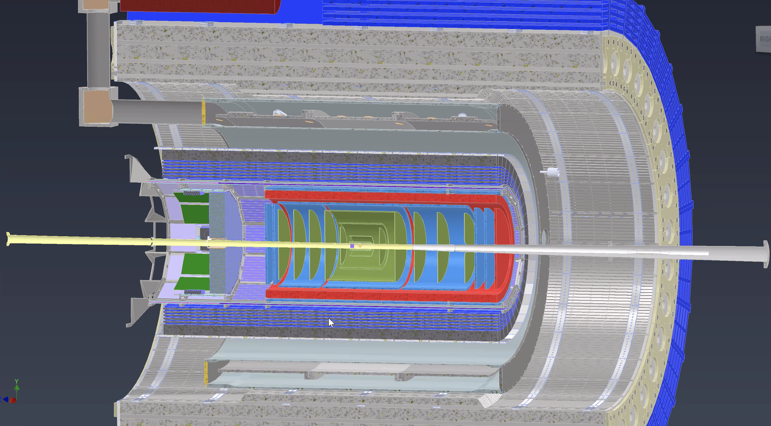
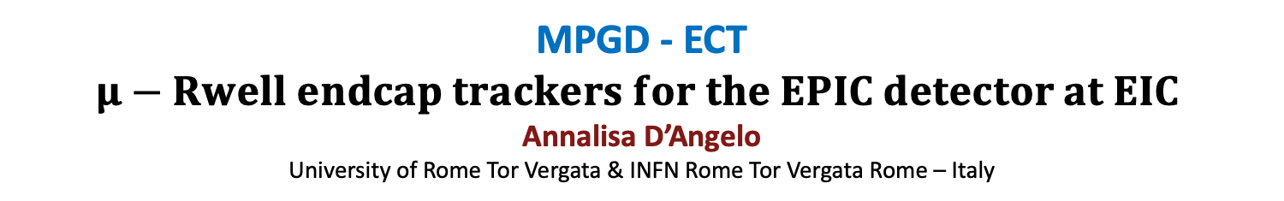
MPGD - ECT
$μ−$ $Rwell endcap trackers for the EPIC detector at EIC$
Annalisa D’Angelo
University of Rome Tor Vergata & INFN Rome Tor Vergata Rome – Italy

Slide 2
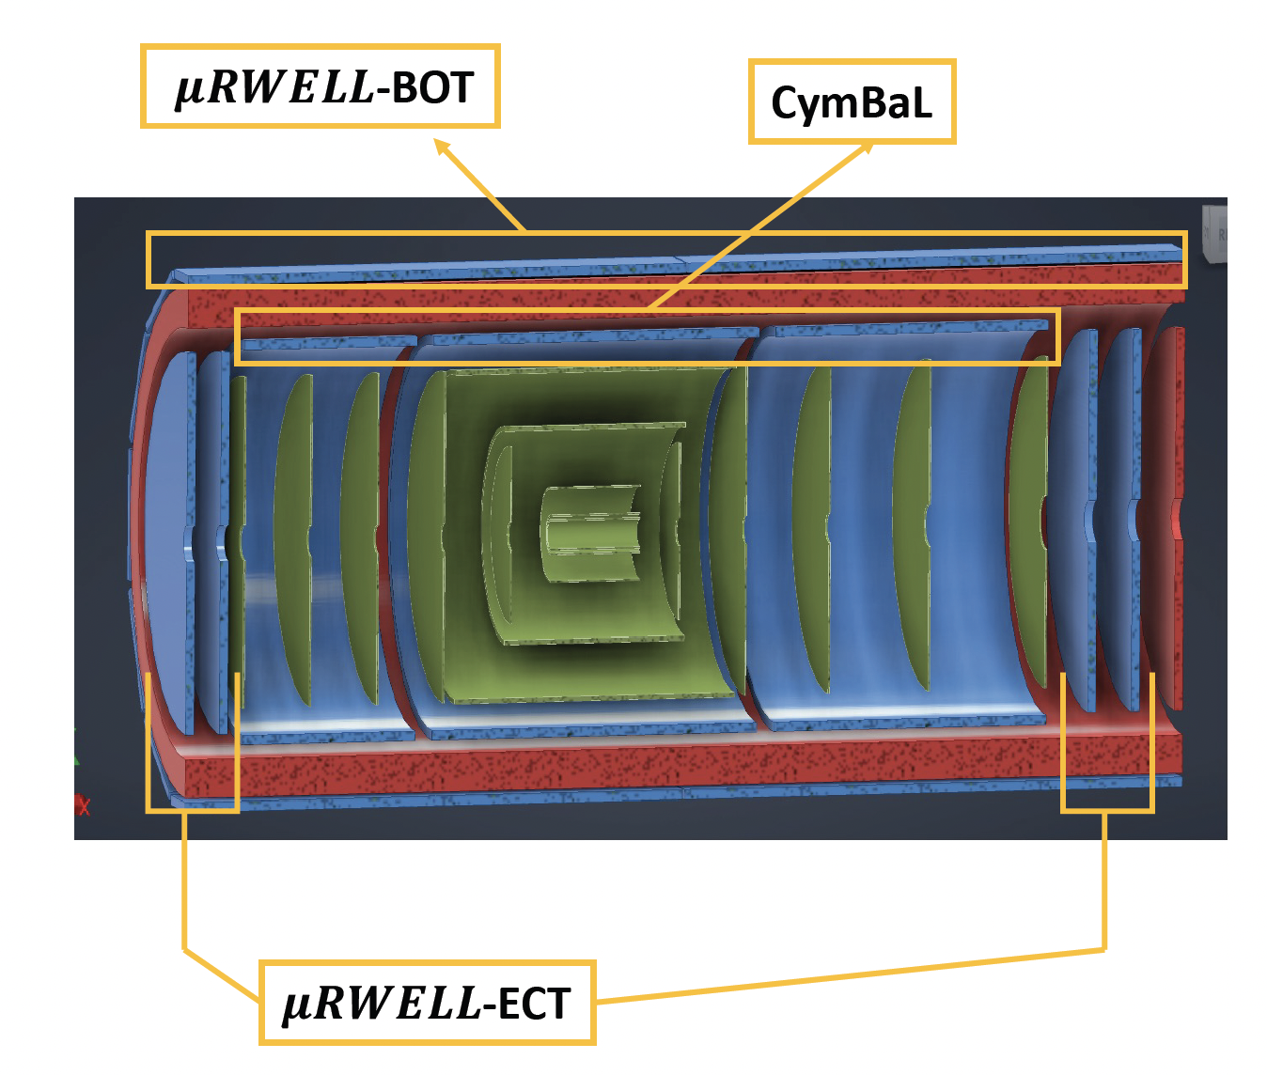
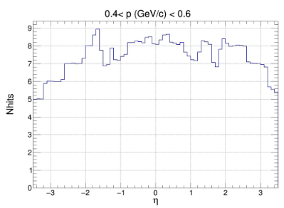


Scope of the MPGD endcaps in ePIC detector tracking
Adding two MPGD Endcap Tracking (ECT) disks both in the hadronic and in the leptonic regions increased the number of hits in the |η| > 2 region to improve pattern recognition.
-3.61$<η<−1.72$
Present Configuration
1.99$<η<$3.44
Present ePIC tracker geometry
ePIC Collboration Meeting- July 25 2024 – Annalisa D’Angelo
2

Slide 3

Technical Performance Requirements
Time resolution 10 ns or less to provide tracking timing
  Fast rise time ~ 20 $÷$ 50 ns
  Peaking time 50 ns
  Sampling faster than 50 MHz
Low material budget
  1-2 % X₀ - it will be the minimum compatible with the chosen technology
Spatial resolution: 150 $μ$m or better
  <150 $μ$m intrinsic spatial resolution for perpendicular tracks
  Technological optimizations to retain 150 $μ$m resolution for inclined/curved tracks
High Efficiency
  Single detector efficiency ~ 96 –97 % $→$ 92 –94 % combined efficiency for two disks
ePIC Collboration Meeting- July 25 2024 – Annalisa D’Angelo
3

Slide 4
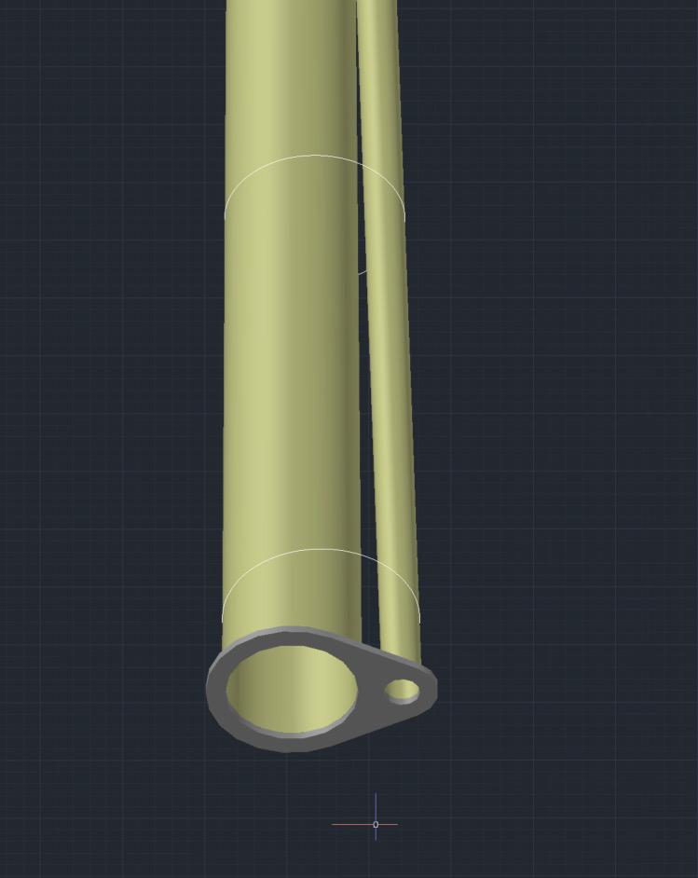
Detector Geometry: Envelope and Active Regions
MPGD Disk | Max Z Pos (cm) | Disk Outer Radius (cm) | Outer Active Reg. radius (cm) | Calculated Beam pipes radii (mm) | Offset (mm) | Disk Inner Radius (cm) | Inner Active Reg. radius (cm)
HD MPGD 2 | 163.5 | 50 | 45 | 55.8 | 22.5 | 9 | 10.5
HD MPGD 1 | 150.5 | 50 | 45 | 53.1 | 19.9 | 9 | 10.5
LD MPGD 1 | -112.5 | 50 | 45 | 37.7 | -3.1 | 4.5 | 6.0
LD MPGD 2 | -122.5 | 50 | 45 | 39.2 | -3.4 | 4.5 | 6.0
Two couples of disks: Lepton/Hadron Disks
The geometric envelope should include the electronics front-end boards
50 cm external radius/45 cm active region radius – including 5cm outer ring for services.
Different internal hole dimensions due to divergent beam pipes: 4.5 cm (LD)/9 cm(HD)
Calculated
Radii
1m
ePIC Collboration Meeting- July 25 2024 – Annalisa D’Angelo
4

Slide 5
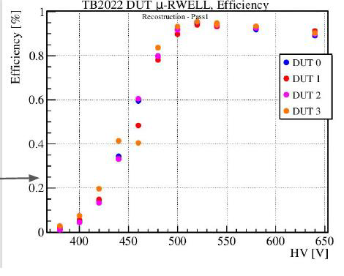
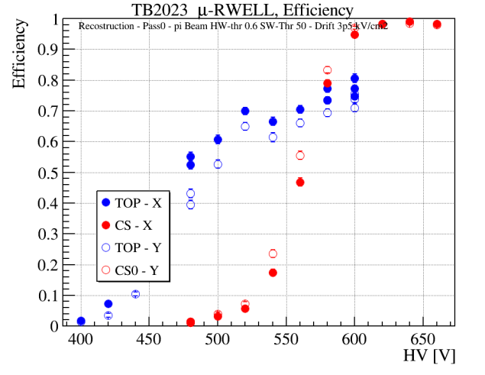
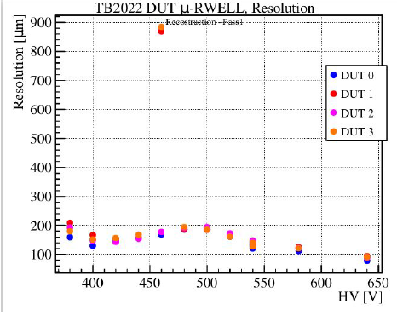
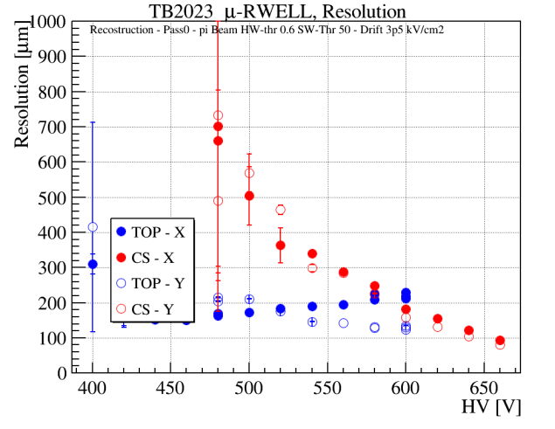
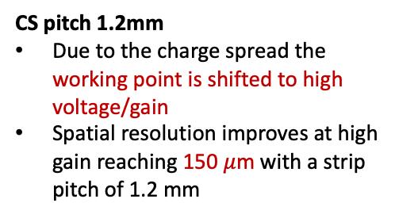
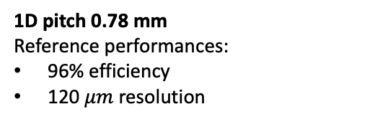
MPGD Technology - 2-D Tracking layout tests
CS & TOP
1D pitch 0.78 mm
Reference performances:
96% efficiency
120 $μm$ resolution
CS pitch 1.2mm
Due to the charge spread the working point is shifted to high voltage/gain
Spatial resolution improves at high gain reaching 150 $μ$m with a strip pitch of 1.2 mm
2x1D
CS & TOP
Top-r/out pitch 0.78 mm
low-voltage/gain operation but low efficiency level (80%) due to the geometrical dead zone on the segmented amplification stage
2x1D
October 2022 test beam
June 2023 test beam
ePIC Collboration Meeting- July 25 2024 – Annalisa D’Angelo
5

Slide 6
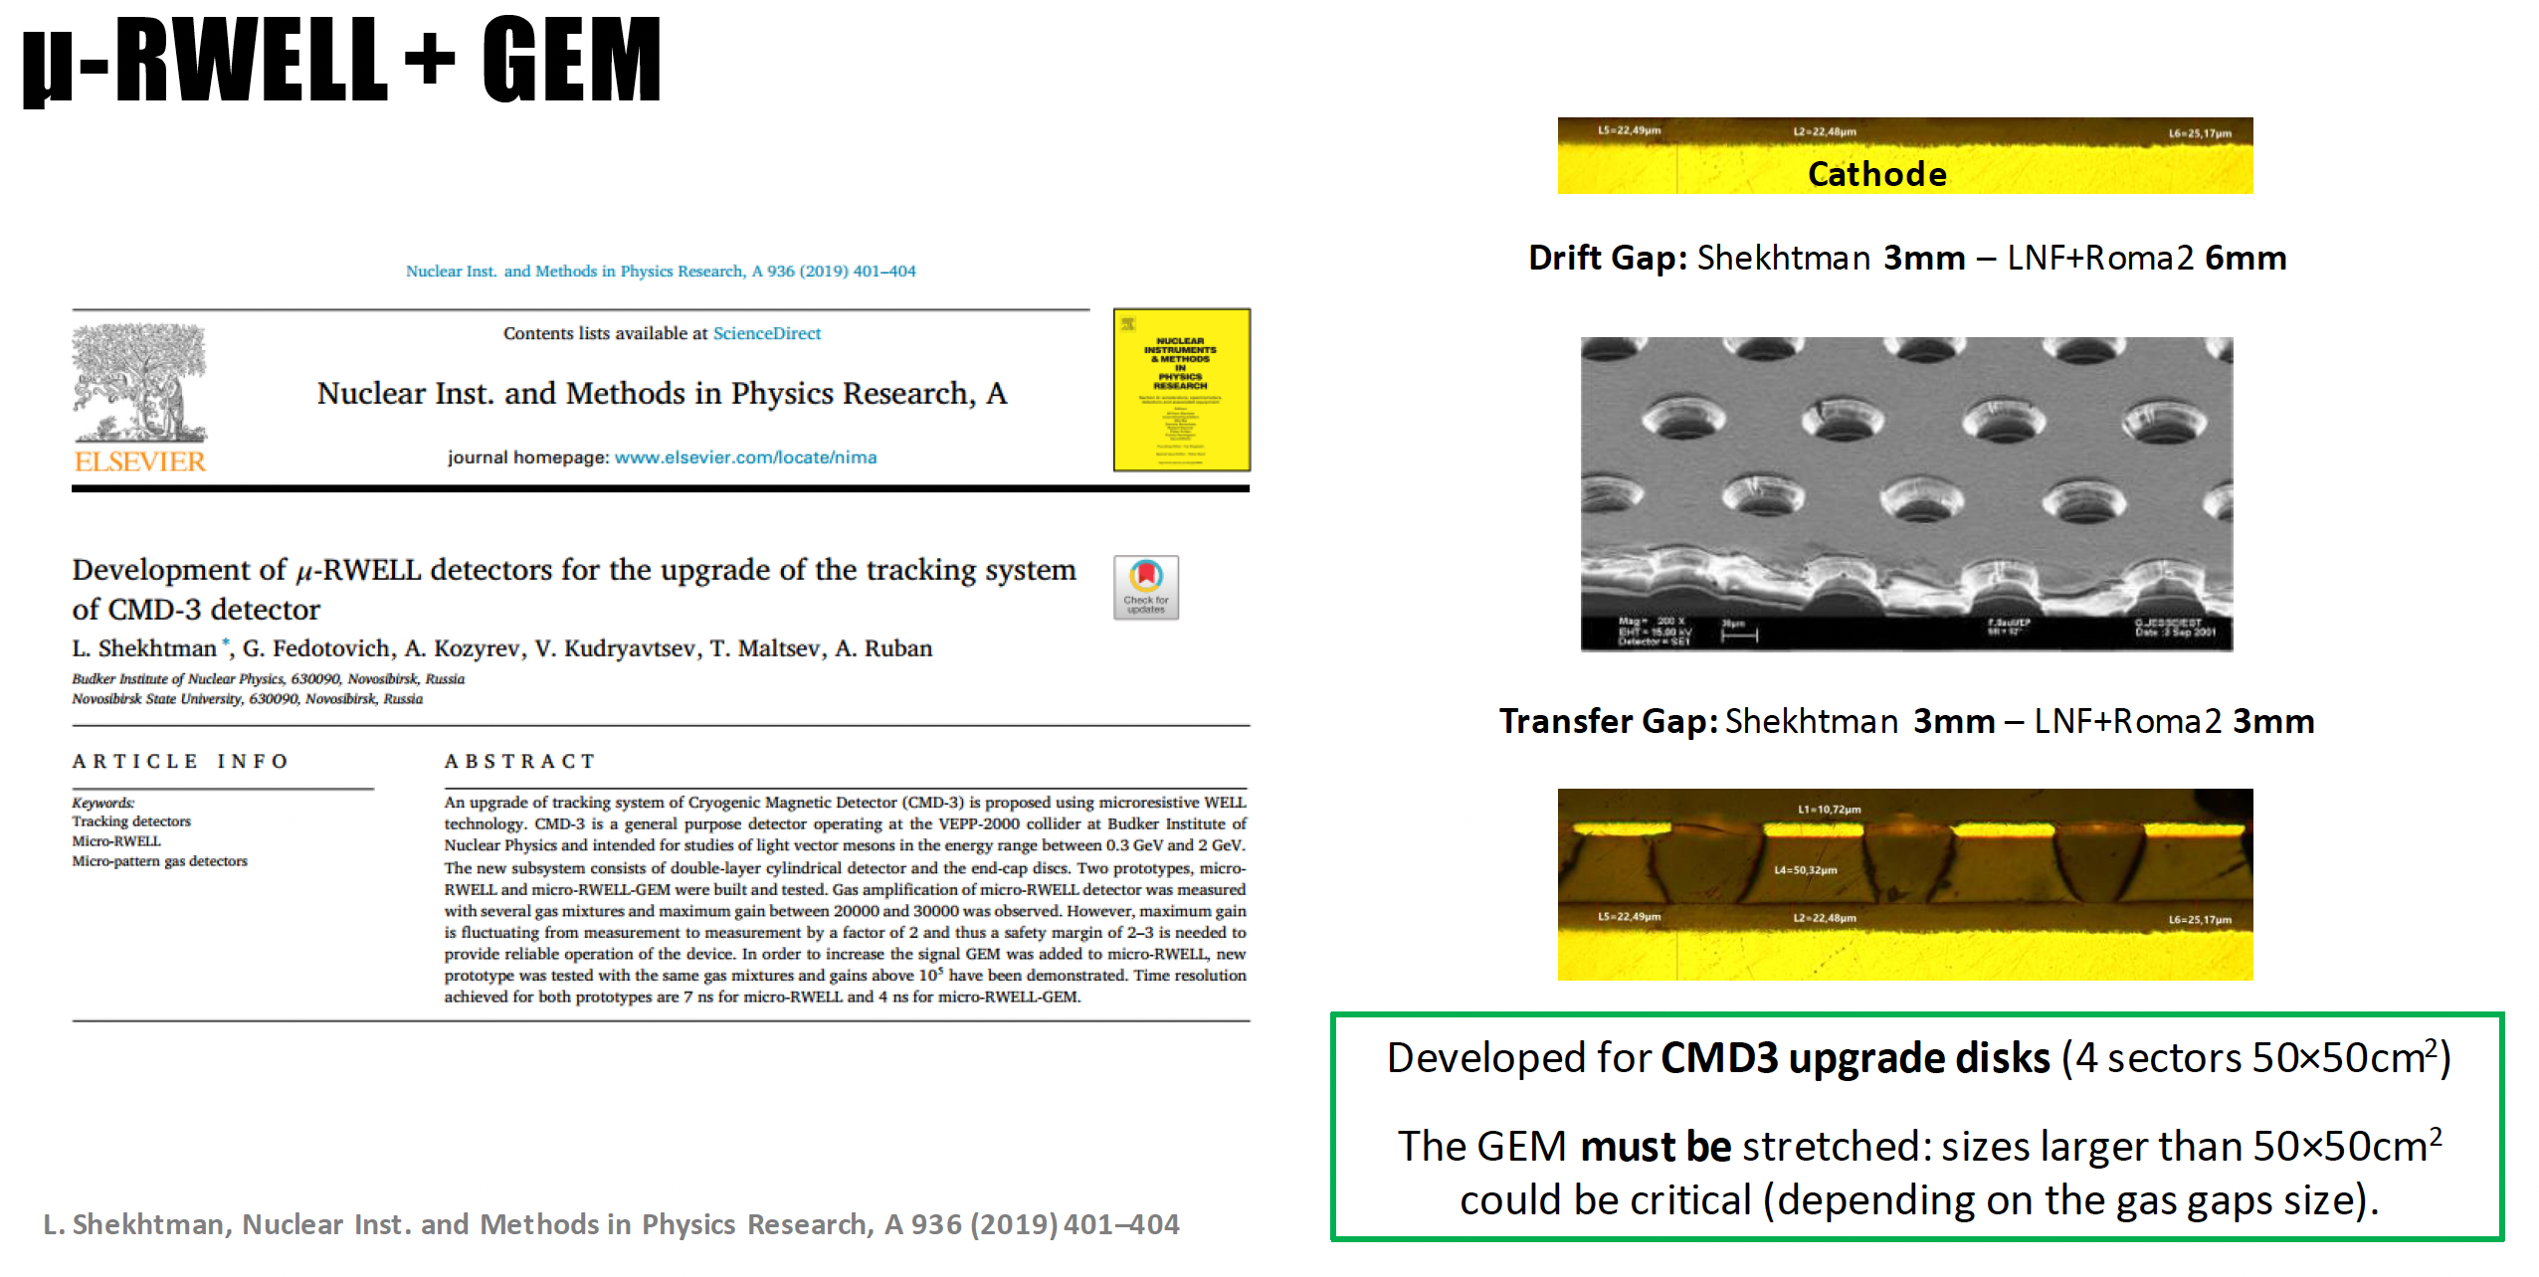
ePIC Collboration Meeting- July 25 2024 – Annalisa D’Angelo
6

Slide 7
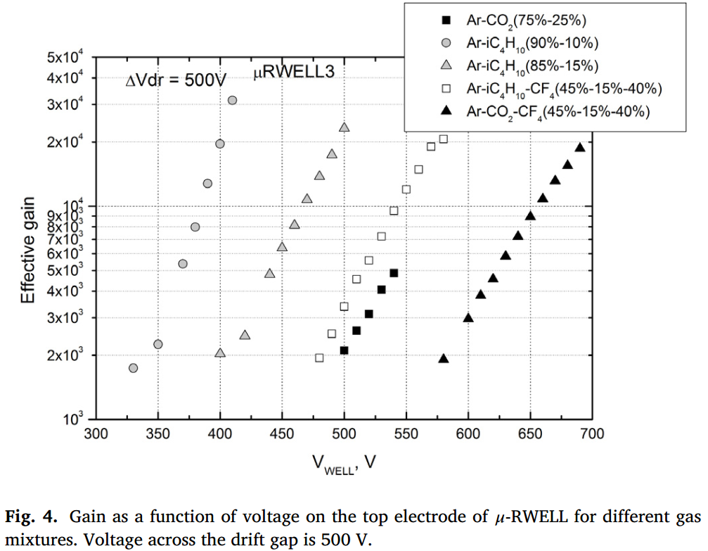
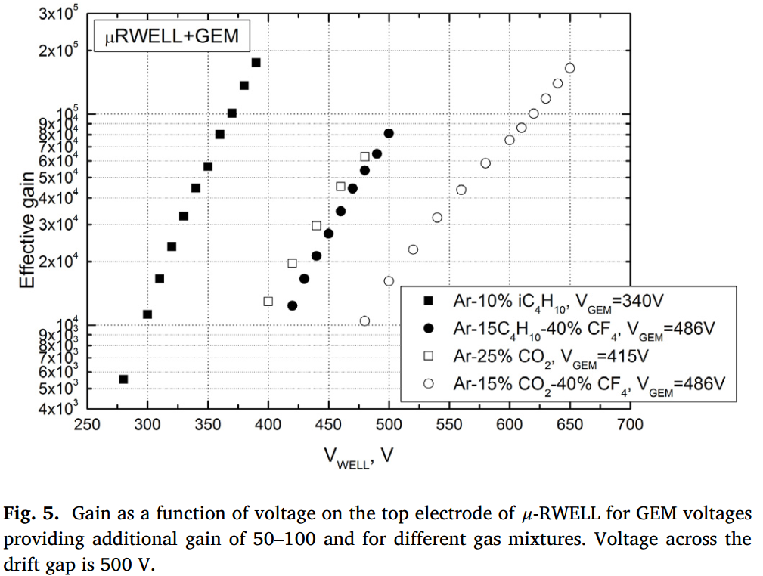
μ-RWELL + GEM – Gain
L. Shekhtman, Nuclear Inst. and Methods in Physics Research, A 936 (2019) 401–404
μ-RWELL + GEM
μ-RWELL
G~60000
G~2000
ePIC Collboration Meeting- July 25 2024 – Annalisa D’Angelo
7

Slide 8
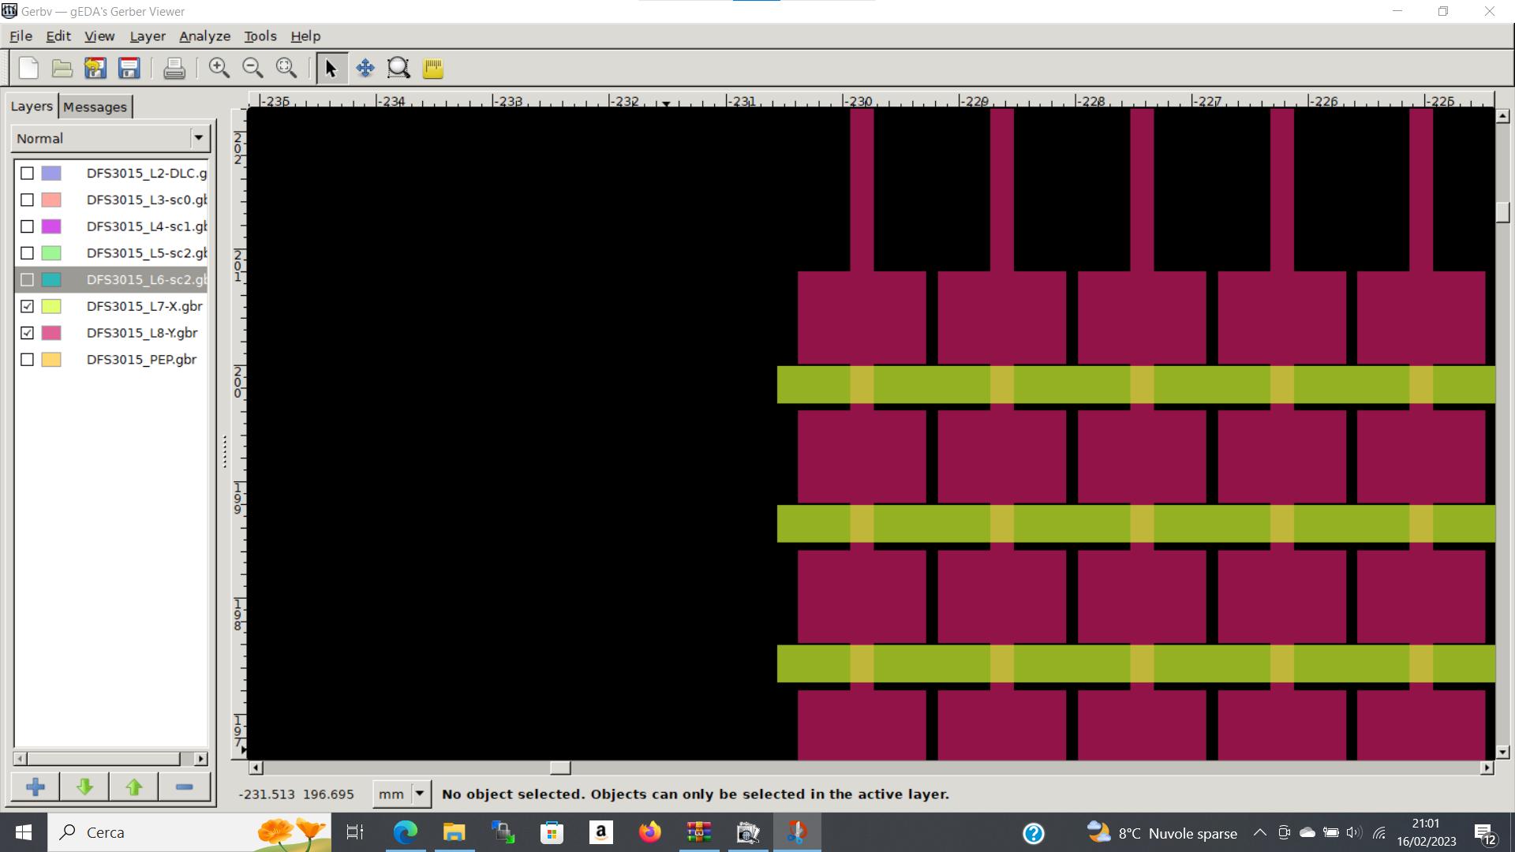
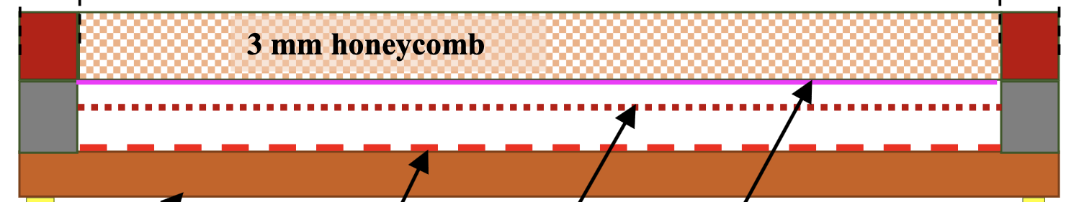


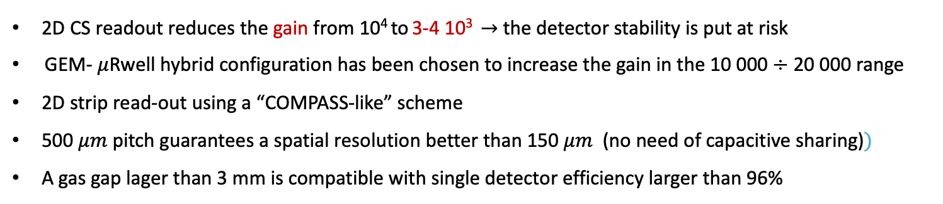
Detector Technology Choices: GEM+$μ$Rwell
GEM - $μ$Rwell Technology
3/6 mm gas gap
2/3 mm transfer gap
PCB read-out
$μ−$Rwell
GEM
cathode
2D CS readout reduces the gain from 10⁴ to 3-4 10³ $→$ the detector stability is put at risk
GEM- $μ$Rwell hybrid configuration has been chosen to increase the gain in the 10 000 $÷$ 20 000 range
2D strip read-out using a “COMPASS-like” scheme
500 $μm$ pitch guarantees a spatial resolution better than 150 $μm$ (no need of capacitive sharing)$⁡)$
A gas gap lager than 3 mm is compatible with single detector efficiency larger than 96%
ePIC Collboration Meeting- July 25 2024 – Annalisa D’Angelo
8

Slide 9
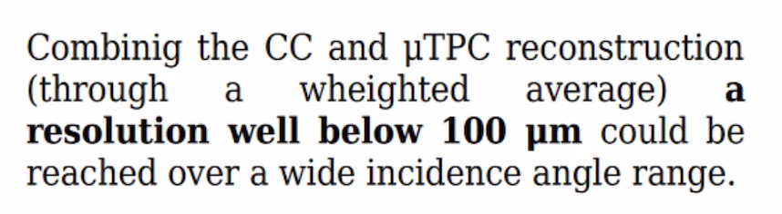
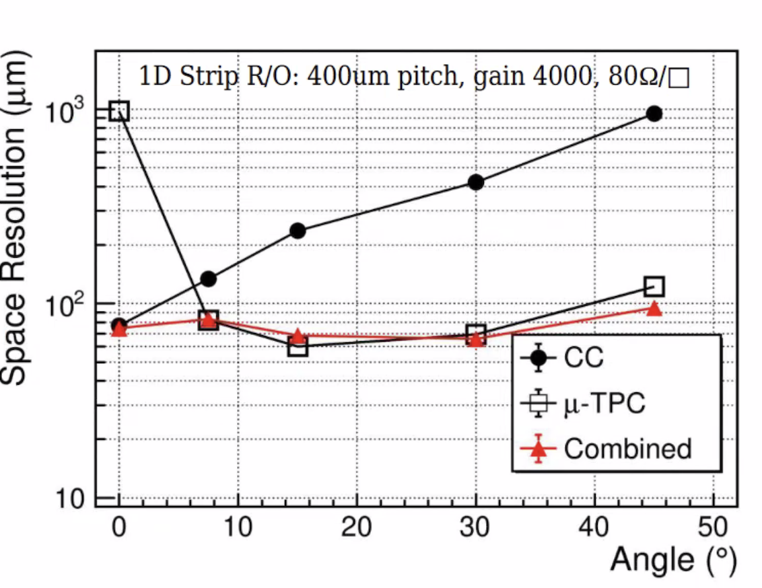
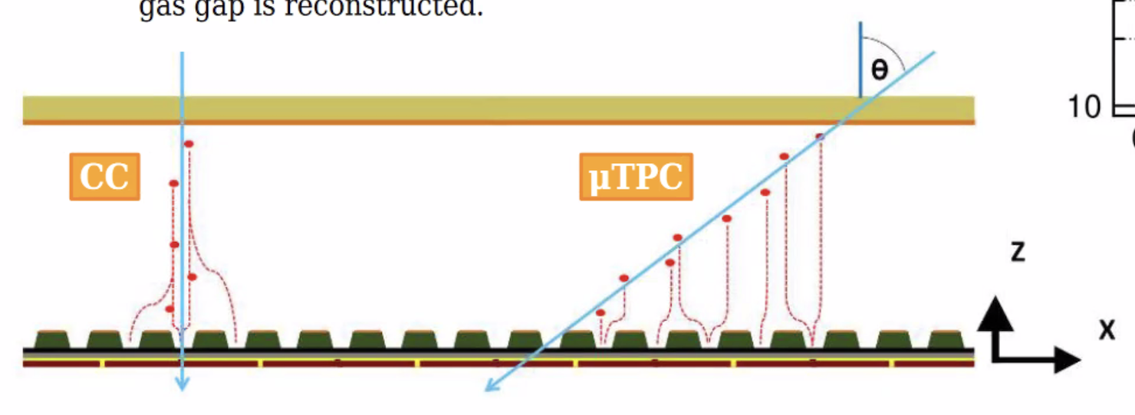

Detector Technology Choices: GEM+$μ$Rwell+ $μ$ TPC
GEM - $μ$Rwell Technology
3/6 mm gas gap
2/3 mm transfer gap
PCB read-out
$μ−$Rwell
GEM
cathode
CC= Charge Centroid
Next test beam Oct/Nov 2024
ePIC Collboration Meeting- July 25 2024 – Annalisa D’Angelo
9

Slide 10
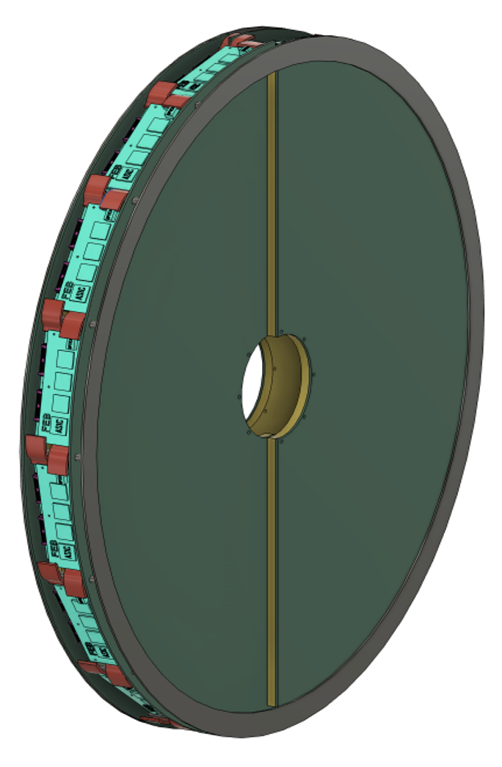
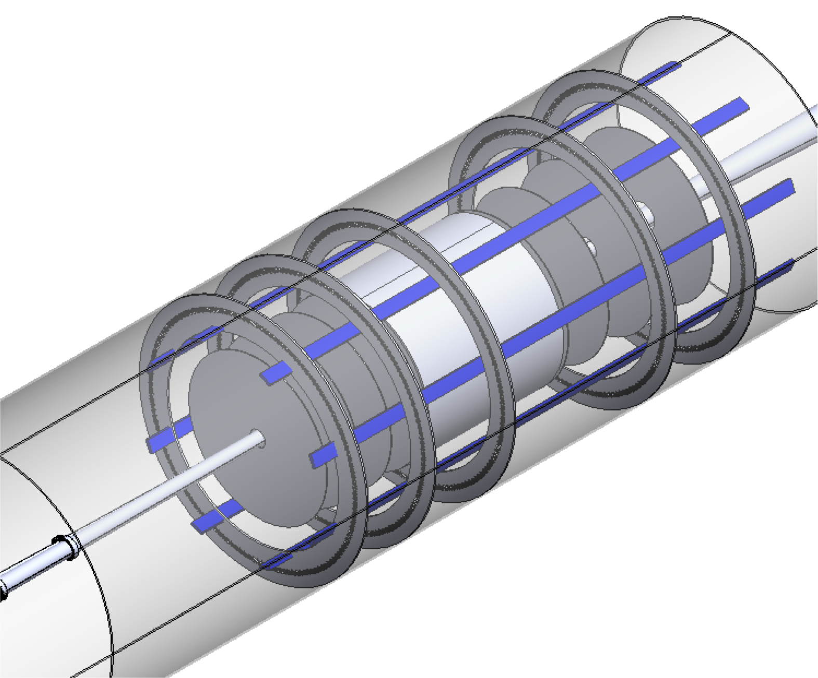
Endcap Detectors Integration in ePIC
The assigned envelope will include the detectors and the FEB electronics.
The disks will be attached together and to the support frame under design.
ePIC Collboration Meeting- July 25 2024 – Annalisa D’Angelo
10

Slide 11
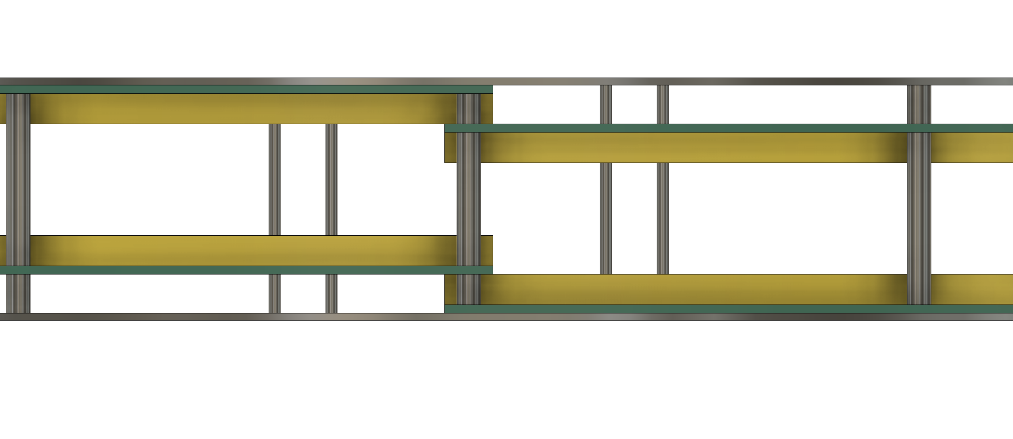
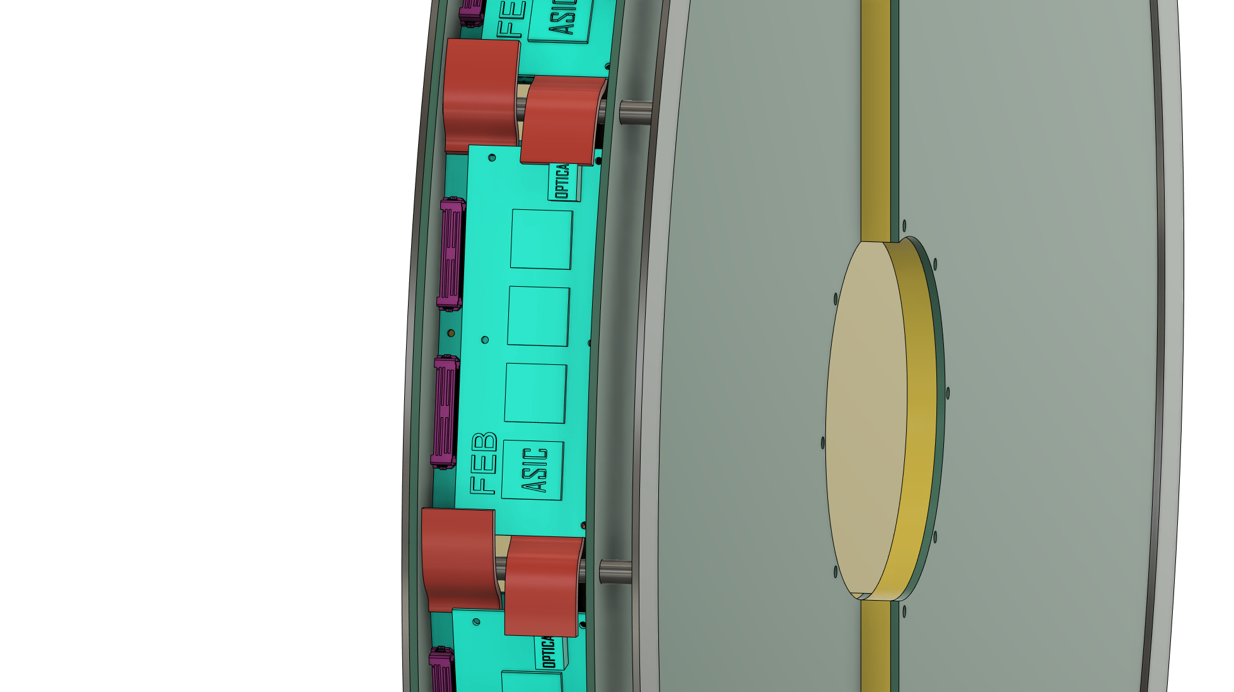
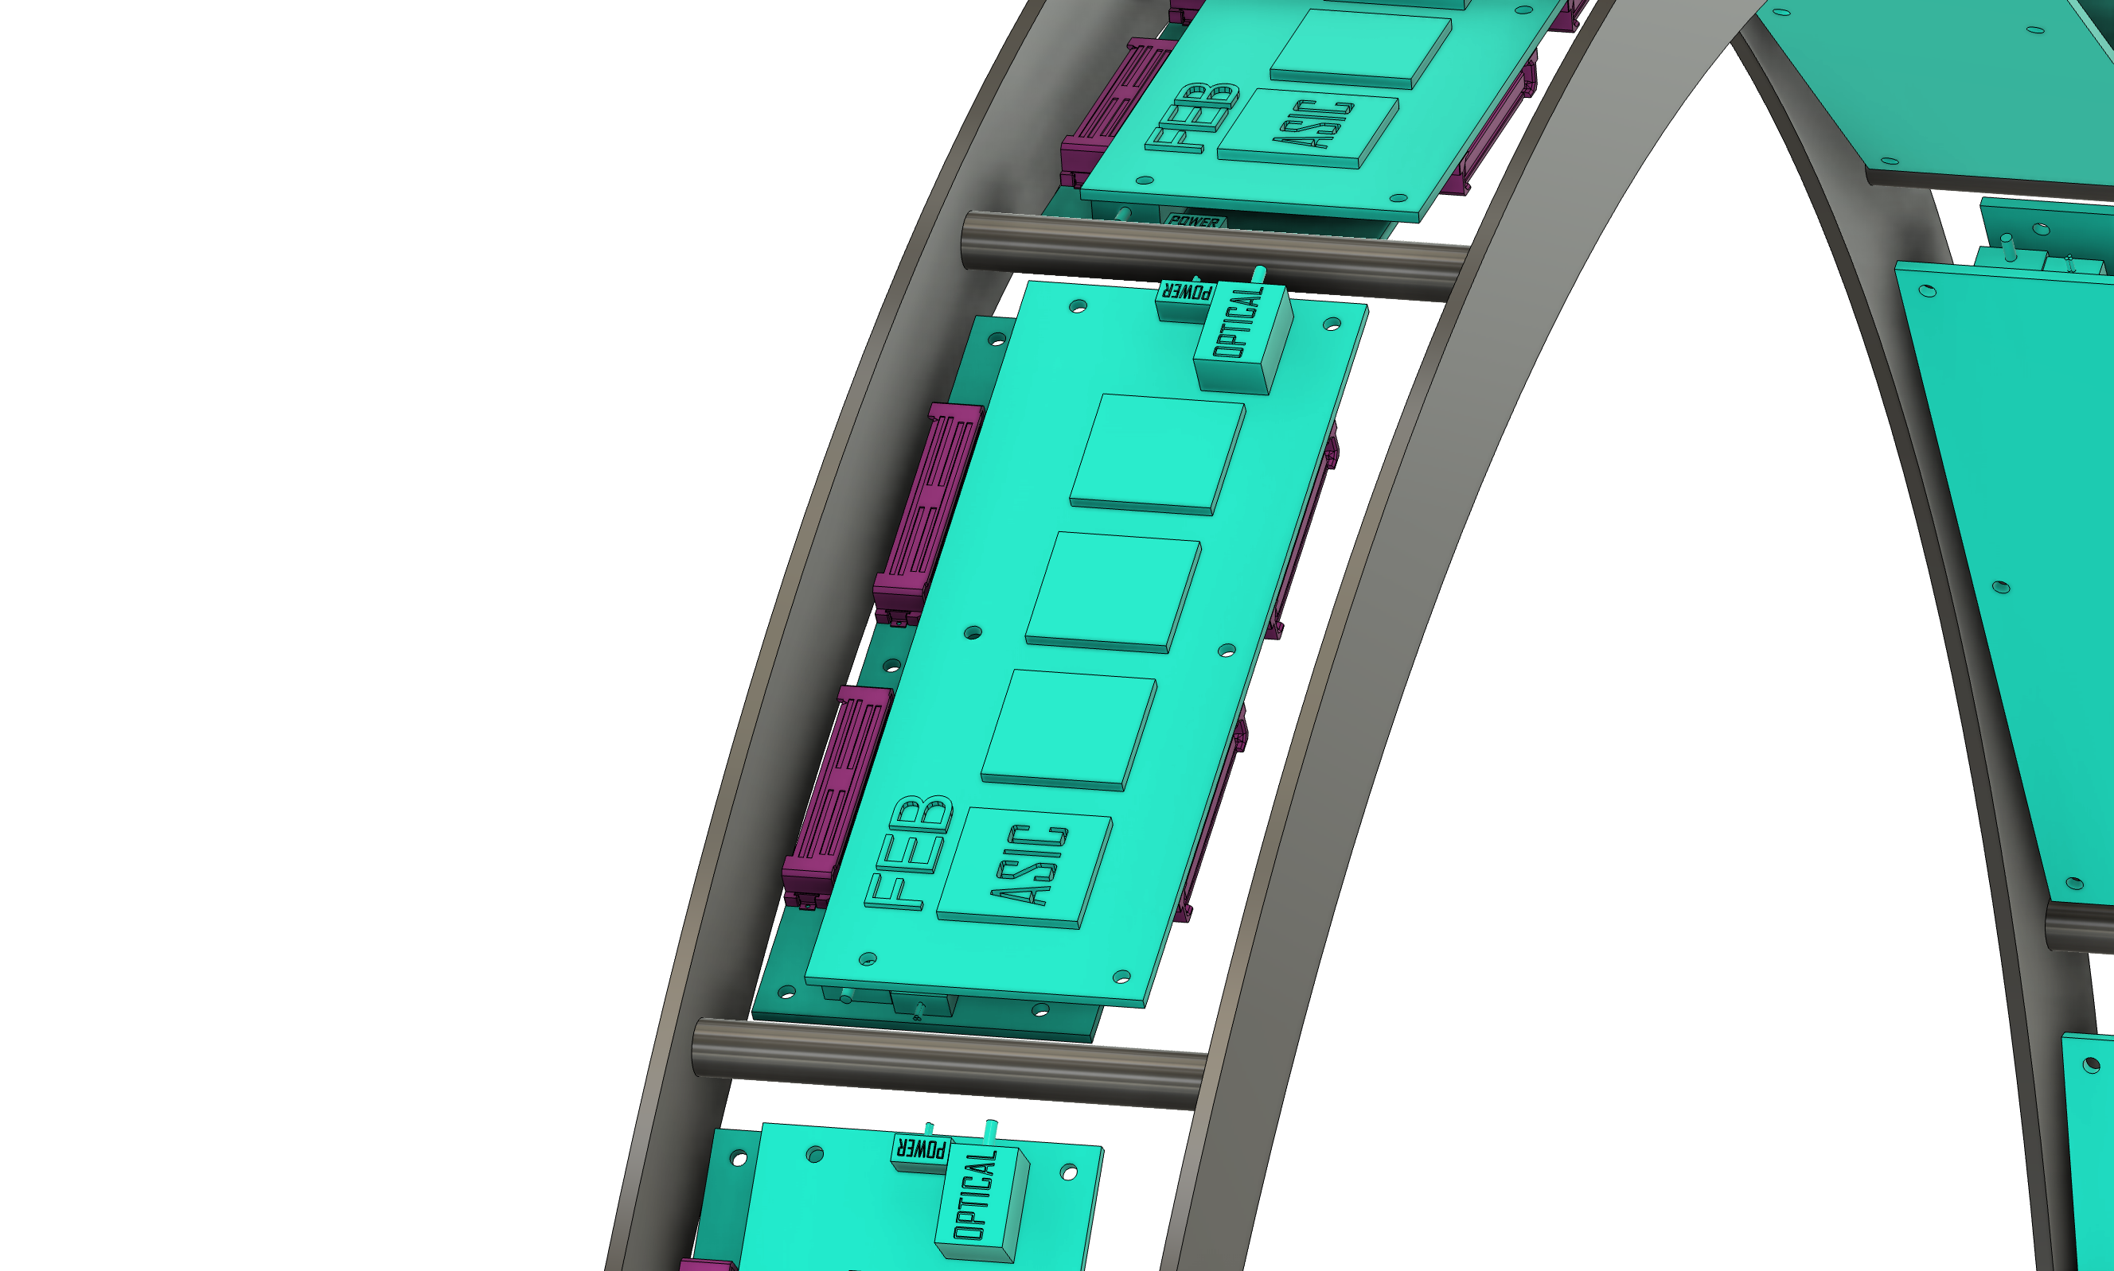
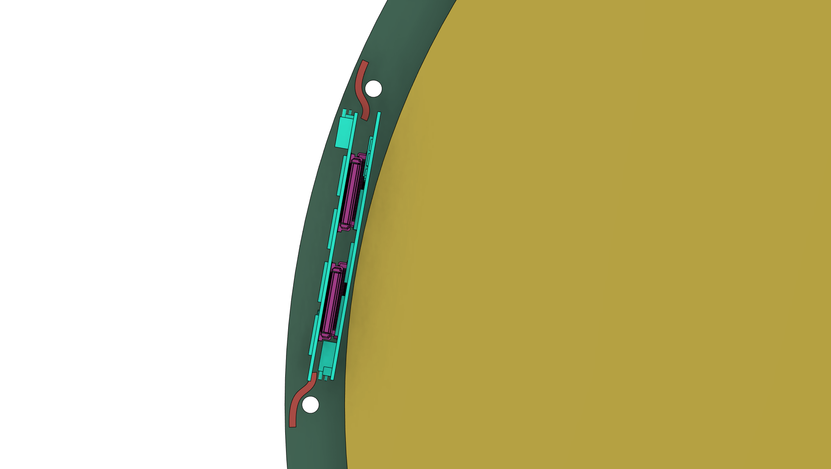
Endcap Detectors Mechanical design in progress
Longitudinal stack
.
FEB mounting
Mechanical
Support
Connectors
ePIC Collboration Meeting- July 25 2024 – Annalisa D’Angelo
11

Slide 12
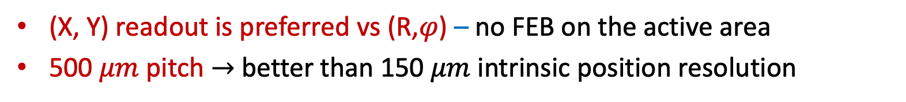
Detector Technology Choices: (X,Y) vs (R,$φ$) read-out
(X, Y) read-out geometry
PROs | CONs
The strip length does not vary much along the active area | Alignment is critical
All readout FE hybrids may be located outside the active area | Routes to read-out connectors must be accurately studied
(X, Y) readout is preferred vs (R,$φ$) – no FEB on the active area
500 $μm$ pitch $→$ better than 150 $μm$ intrinsic position resolution
Strips routing details is being studied
ePIC Collboration Meeting- July 25 2024 – Annalisa D’Angelo
12

Slide 13

Detector Technology Choices: Detector sectors overlap
1000 mm
1000 mm
$\left|η\right|$>1.99
525 mm
525 mm
ePIC Collboration Meeting- July 25 2024 – Annalisa D’Angelo
13

Slide 14
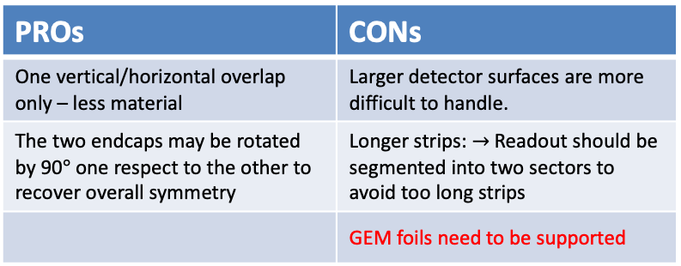
ePIC Endcaps – open options
52.5 cm
52.5 cm
      2 semi-circles
100 cm
4 Quadrants
52.5 cm
PROs | CONs
Smaller dimensions are easier to handle | Two vertical and horizontal overlapping regions – more material budget
Each endcap is intrinsically symmetric | We need to study how to attach two quadrants in a semi-circle
Strips length are shorter
GEM foils easier to stretch
PROs | CONs
One vertical/horizontal overlap only – less material | Larger detector surfaces are more difficult to handle.
The two endcaps may be rotated by 90$°$ one respect to the other to recover overall symmetry | Longer strips: $→$Readout should be segmented into two sectors to avoid too long strips
 | GEM foils need to be supported
ePIC Collboration Meeting- July 25 2024 – Annalisa D’Angelo
14

Slide 15
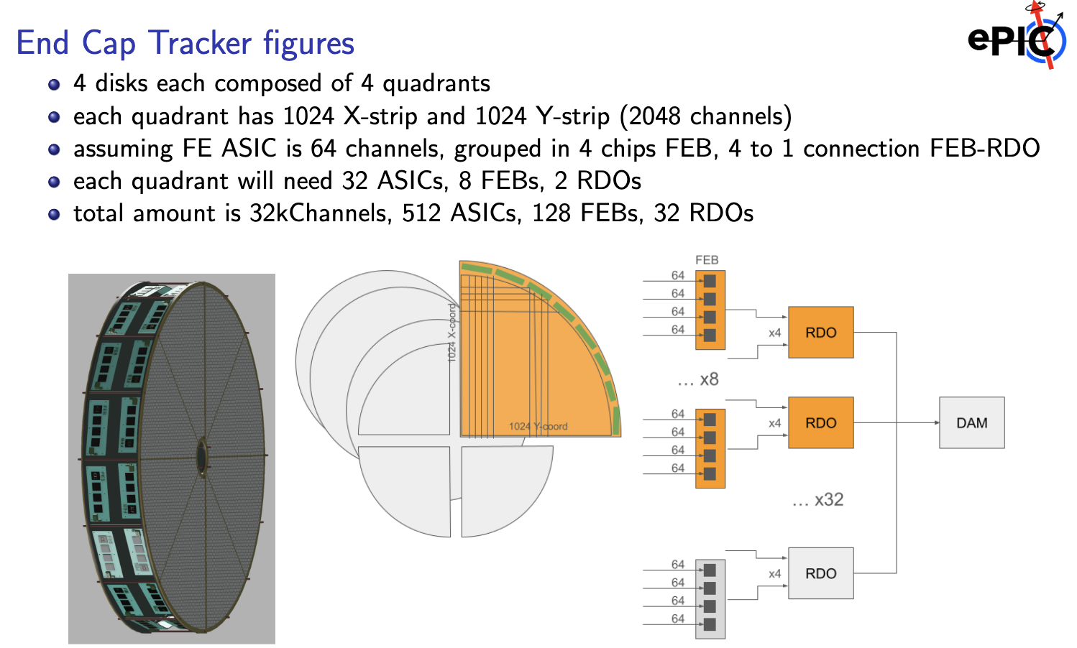
FEB – RDO – DAQ electronics
ePIC Collboration Meeting- July 25 2024 – Annalisa D’Angelo
15

Slide 16
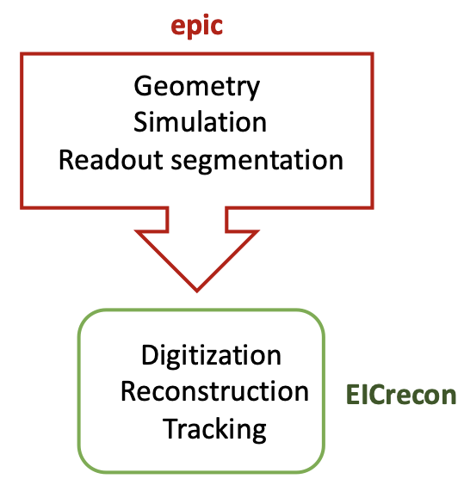
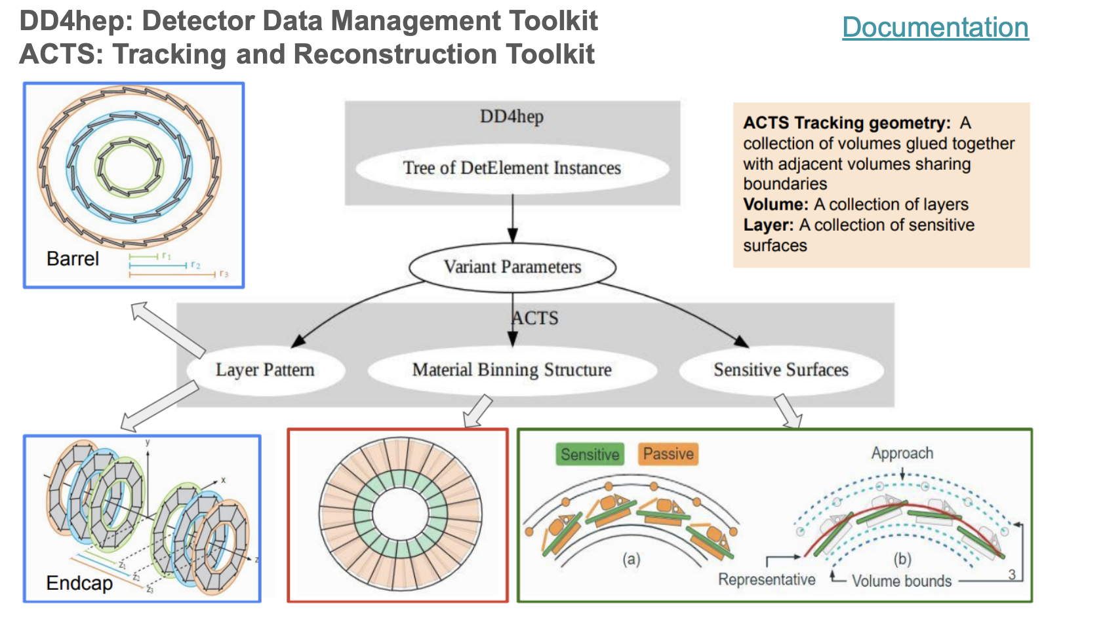
MPGD in ePIC Simulation
ePIC geometry is based on DD4HEP
ACTS is a toolkit for charge particle track reconstruction in hep experiments
All digitization and reconstruction is done in EICrecon based on JANA
By Mariangela Bondi’
ePIC Collboration Meeting- July 25 2024 – Annalisa D’Angelo
16

Slide 17
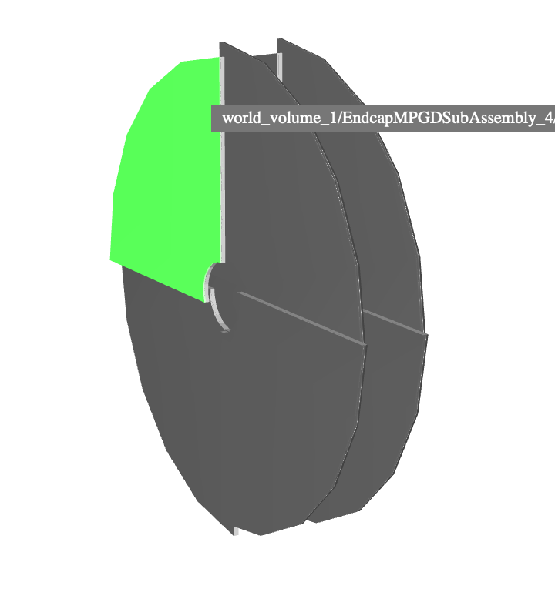
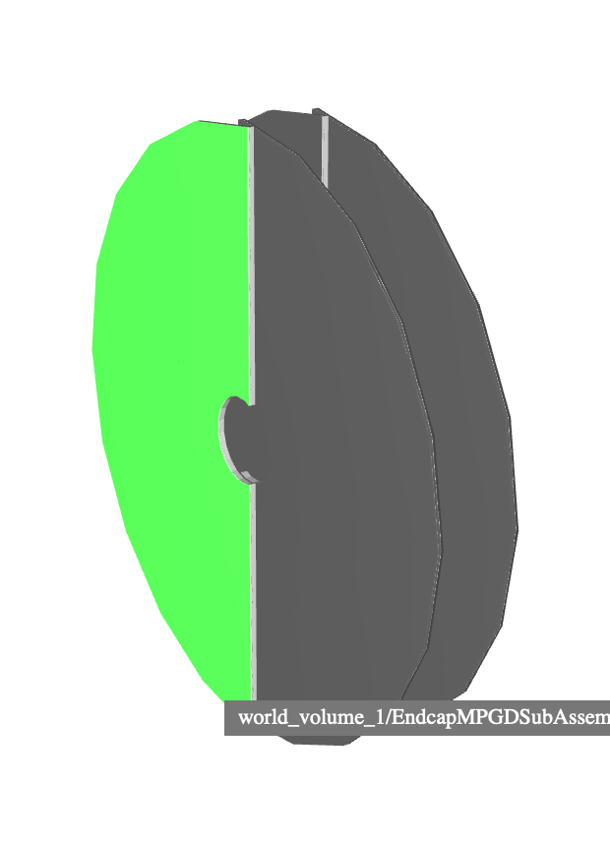
MC simulation of EndCap MPGD Disks geometry
1 configuration
Pairs of disk in electron and hadron endcaps based on uRWell technology
2 configuration under development:
  1 configuration : 4 quarters
  2 configuration: 2 semi-ellipses
Currently disk made of subtracted solid
  No overlaps ✅
  DD4hep-ACTS conversions fail ❌
    Disk approximation with trapezoid: working in progress
2 configuration
By Mariangela Bondi’
ePIC Collboration Meeting- July 25 2024 – Annalisa D’Angelo
17

Slide 18
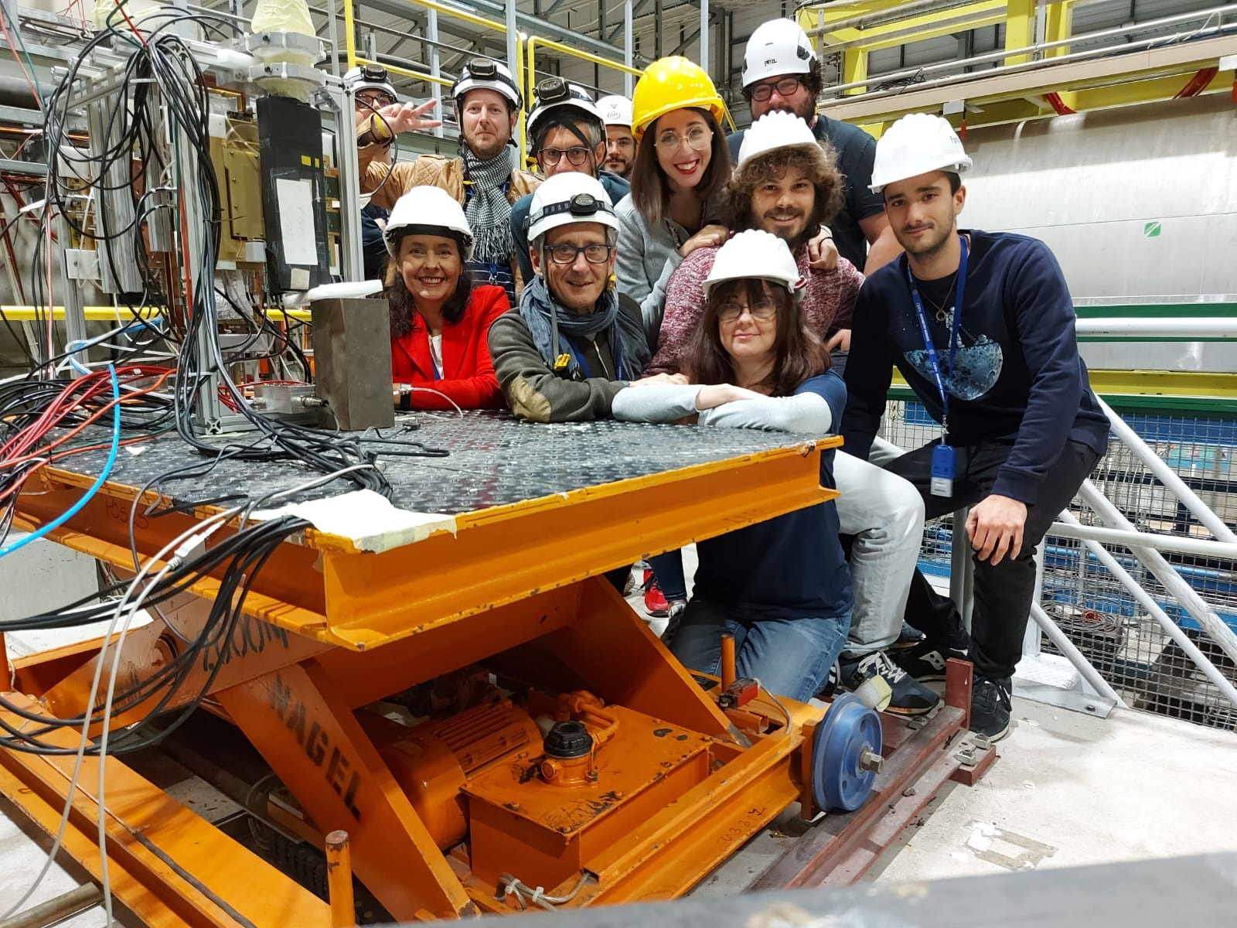

Involved Institutions & Workforce
INFN Workforce:
Roma Tor Vergata – Also member of the DRD-1 WP1
Coordinator: A. D’Angelo,
Detector Hardware and QA: E. Sidoretti (PhD) A. Fantini, L. Lanza, Post Doc
Simulation & Reconstruction: L. Lanza, A. Fantini, R. Di Salvo
FEB Electronics: R. Ammendola
Genova
FEB Electronics: Paolo Musico, M. Battaglieri (streaming ro)
Catania
Simulation & Reconstruction: Mariagela Bondi’
INFN coordinates the GEM-$μ$Rwell MPGD ECT – for both the Hadron and Lepton Disks
INFN will provide the Hadron Disks and related electronics as In-kind contributions
Temple U. (Bernd Surrow , Matt Posik, ….) are interested taking the responsibility of the Lepton Disks.
The is being performed in close connection with:
the group of Gianni Bencivenni @ INFN LNF and with the JLab detector group (Kondo Gnanvo, Seung Joon Lee)
ePIC Collboration Meeting- July 25 2024 – Annalisa D’Angelo
18

Slide 19
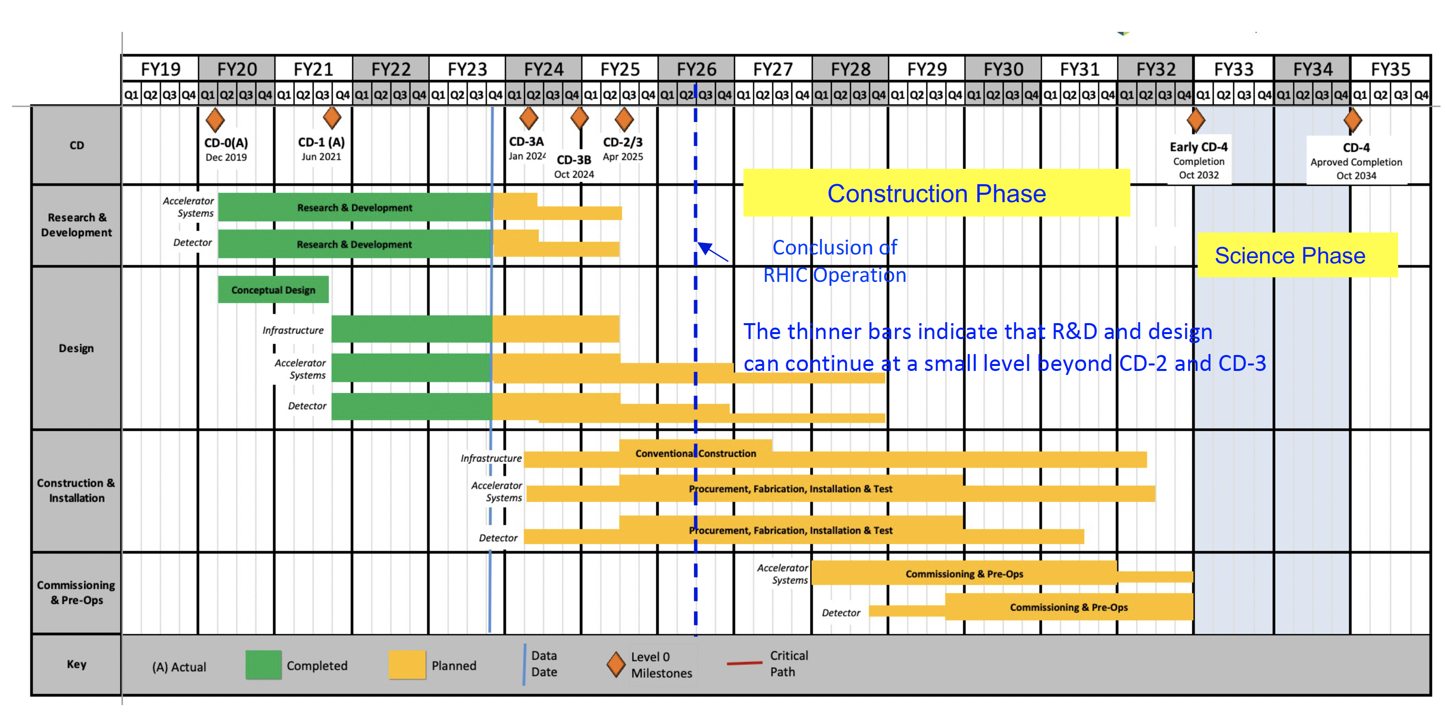
Fabrication and Assembly Plans
Design by end of 2024
2025 - 2026 Engineering Test Article and Pre-Production
2027 - 2029 production & QA
2030 Commissioning & Installation
MPGD Timeline |  |  | DURATION (years)
START DATE | END DATE | DESCRIPTION
3/1/24 | 12/31/24 | Detectors Overall Design | <1
1/1/25 | 12/31/26 | Pre - Production | 2
1/1/27 | 31/12/29 | Production & QA | 3
1/1/30 | 6/1/30 | Commissioning & Installation | 0.5
ePIC Collboration Meeting- July 25 2024 – Annalisa D’Angelo
19

Slide 20
On-going activities
ePIC Collboration Meeting- July 25 2024 – Annalisa D’Angelo
20

Slide 21
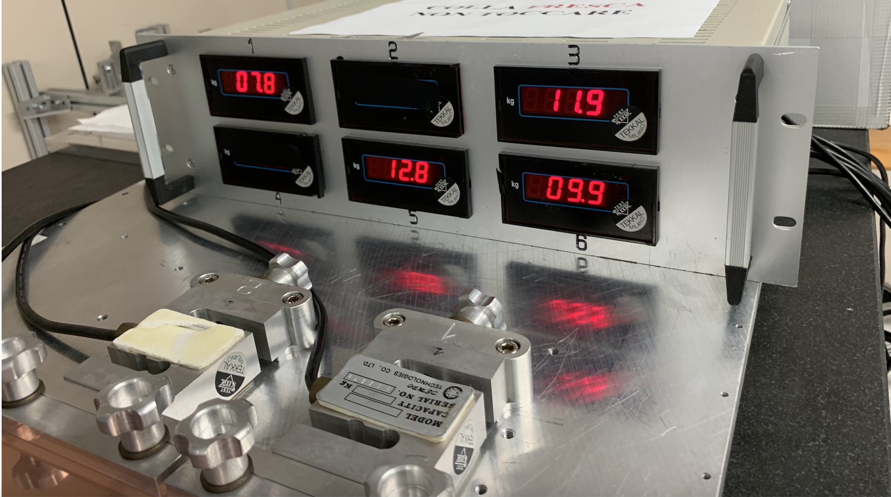
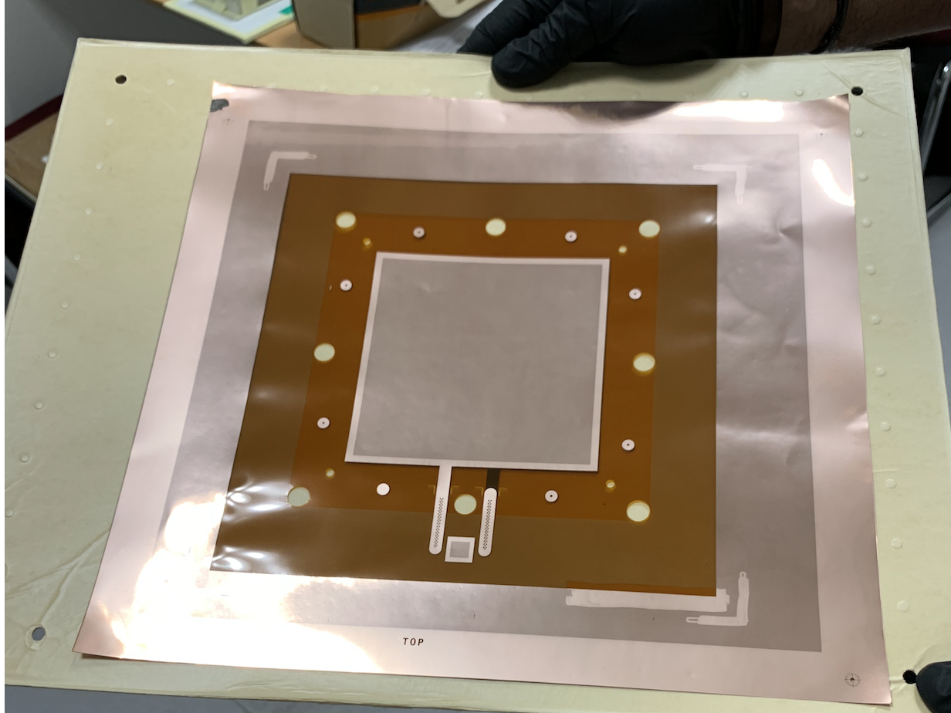
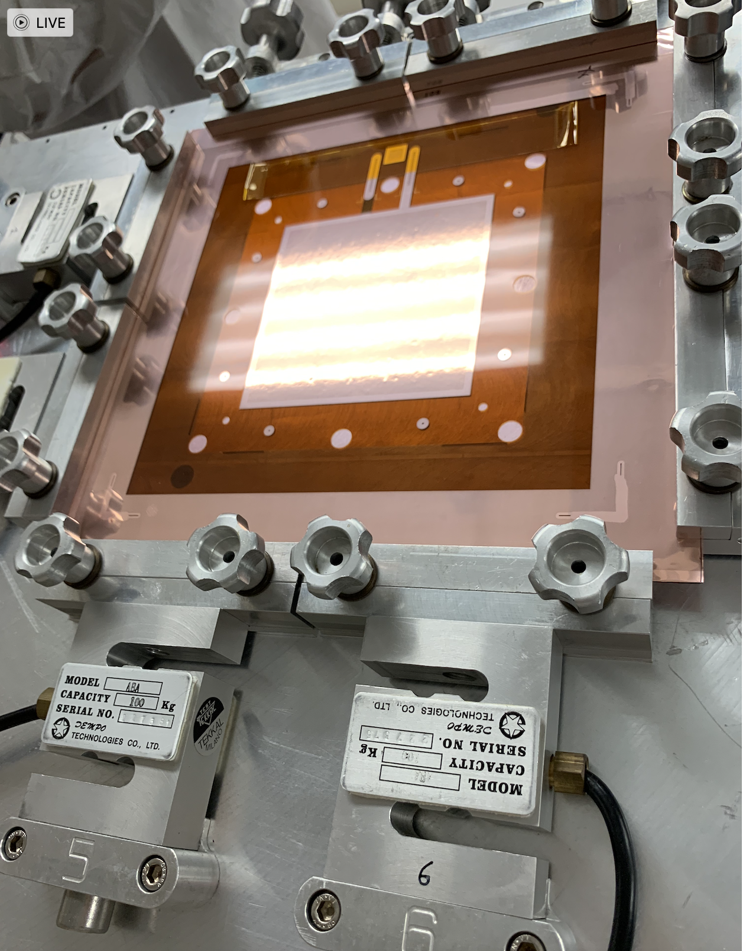
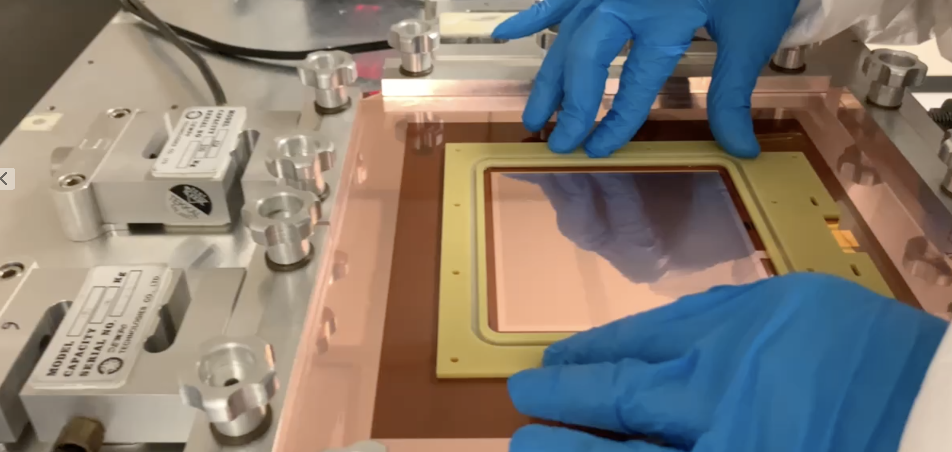
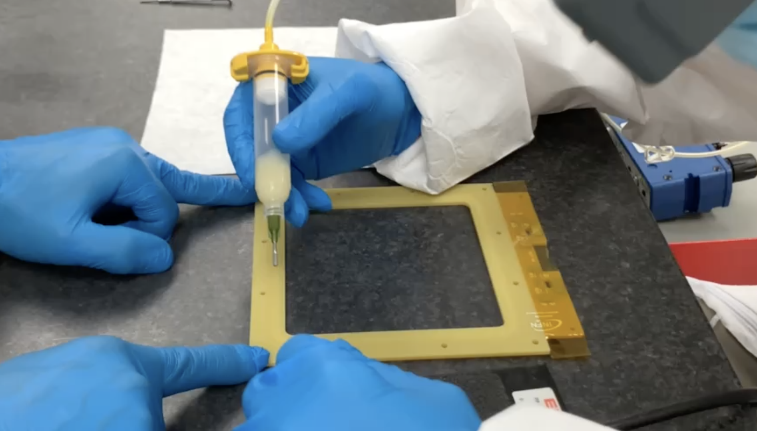
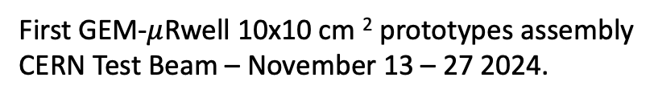
First 10x10 cm² GEM-$μ$Rwell prototype – synergies with JLAB12
First GEM-$μ$Rwell 10x10 cm ² prototypes assembly
CERN Test Beam – November 13 – 27 2024.
GEM tension measurement
GEM foil
Glue on peek frame
GEM stretching
Frame assembling
ePIC Collboration Meeting- July 25 2024 – Annalisa D’Angelo
21

Slide 22
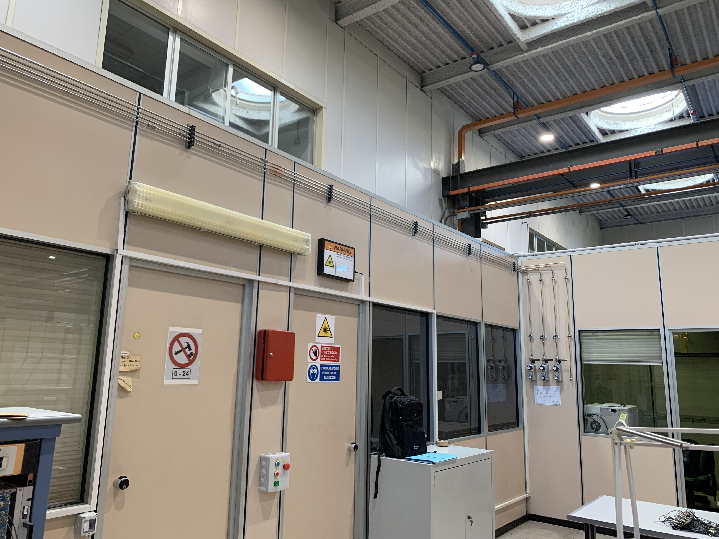
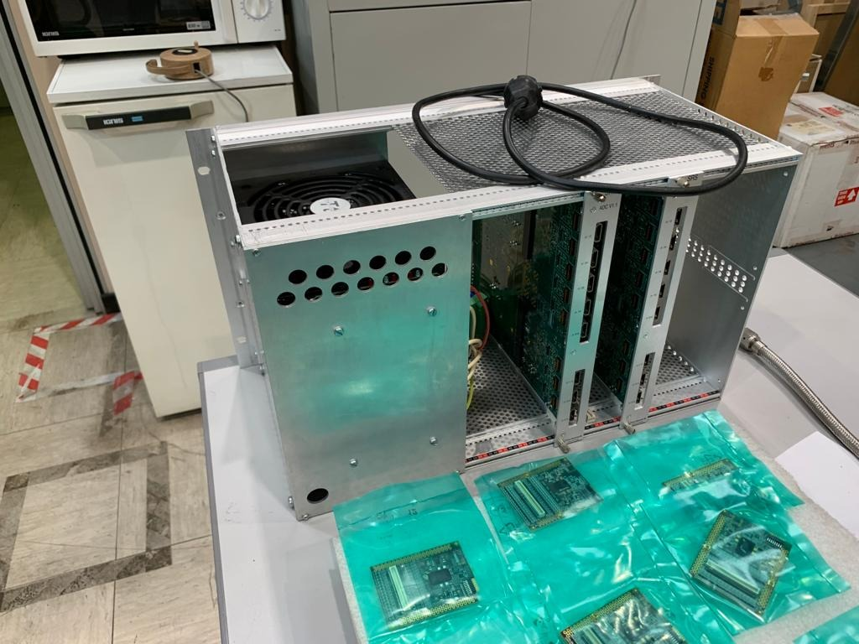
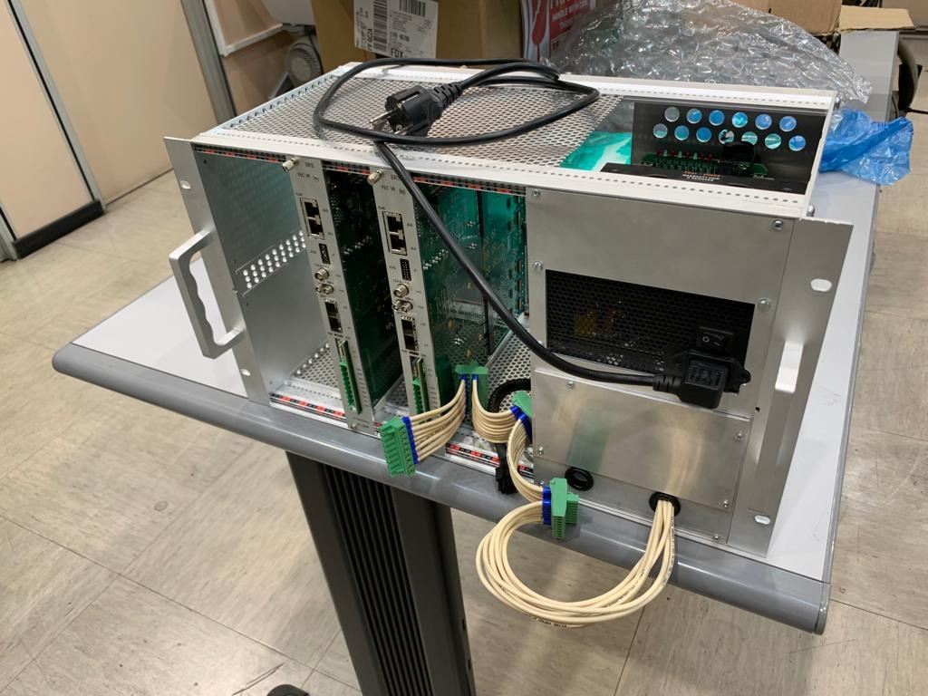
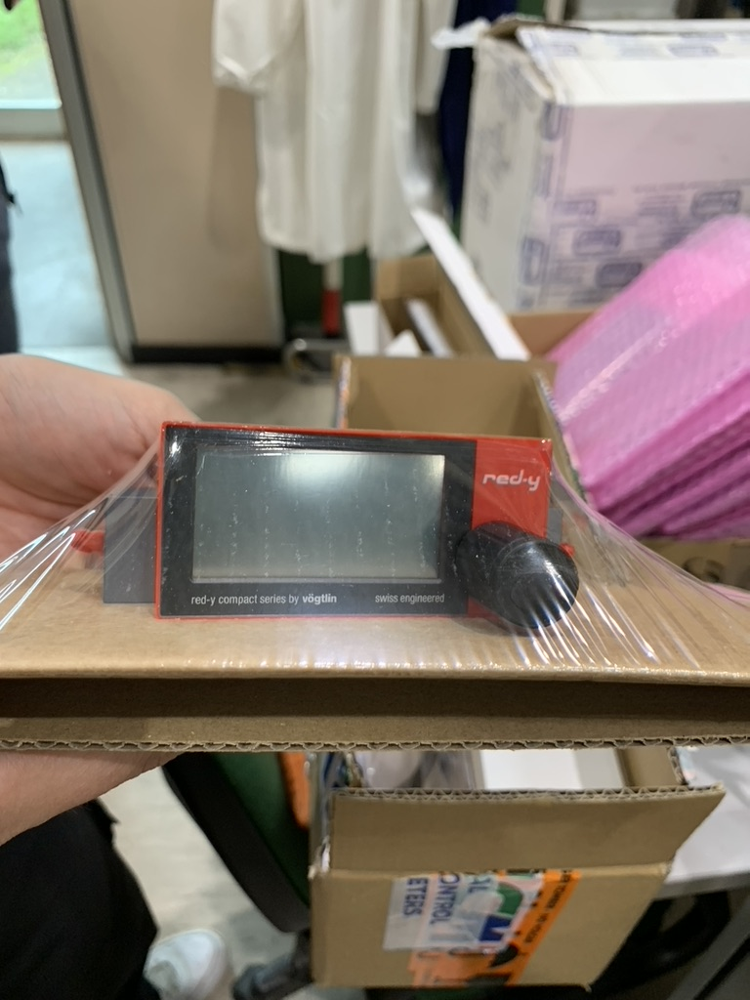
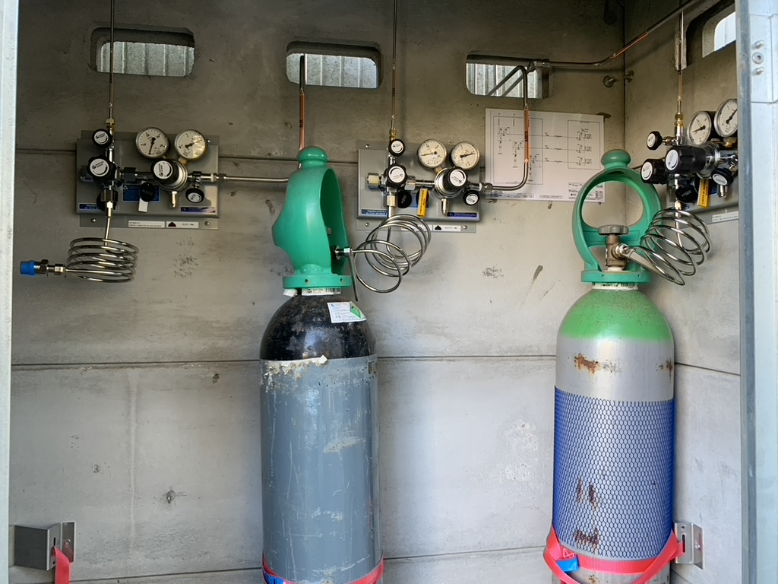
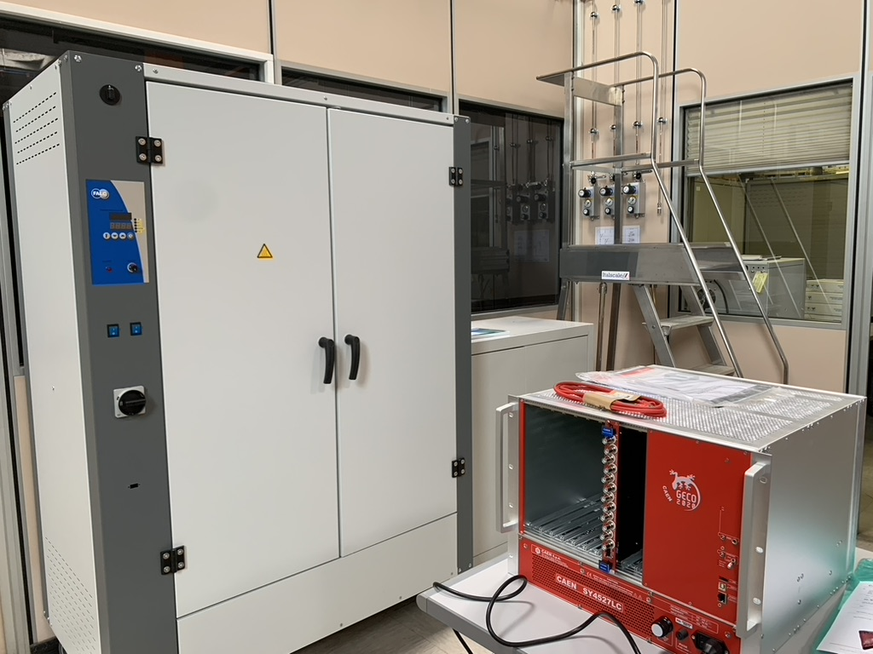
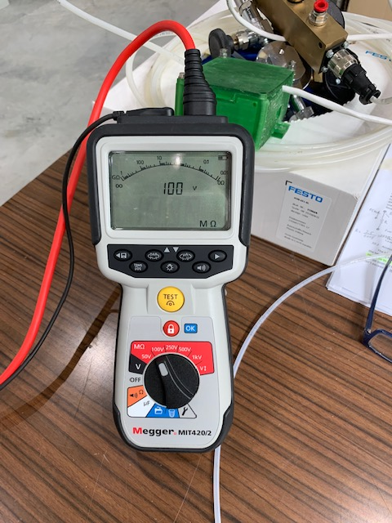
Infrastructures – synergies with JLAB12
The gas distribution system has been installed
Flow controller
for gas mixtures
APV25 based SRS DAQ
The oven and the
CAEN HV supply are available
GEM layer for 50x50 cm² Large area detector with Capacitive sharing
X-Ray gun and shielding
GEM stretcher components
The gas mixture
(Ar /CO₂/CF₄45%/15%/40%) and N2 bottles are available
Megger Tester
Megger Tester
ePIC Collboration Meeting- July 25 2024 – Annalisa D’Angelo
22

Slide 23




Infrastructures and Tests – synergies with JLAB12
Test of Large Area Prototype steps @ LNF: CS - 40x46 cm ²
Data analysis is ongoing
HV filter on
Conditioning In the Oven
X-Ray characterization
Cosmic-rays Data Acquisition
ePIC Collboration Meeting- July 25 2024 – Annalisa D’Angelo
23

Slide 24

Prototypes Tests – synergies with JLAB12
Test of Large Area Prototype steps @ LNF: CS - 40x46 cm ²
Data analysis is ongoing
First results confirm
that maximum gain is
~ 6000
ePIC Collboration Meeting- July 25 2024 – Annalisa D’Angelo
24

Slide 25
INFN- Workforce
Catania
Researchers | Position | FTE
Mariangela Bondì | Tecnologo | 10%
Roma Tor Vergata
Researchers | Position | FTE
Annalisa D’Angelo | P.O. | 50%
Lucilla Lanza | RTDb | 30%
Roberto Amendola | Tecnologo | 20%
Alessia Fantini | Ric. Univ. | 30%
Rachele Di Salvo | I Ric. INFN | 10%
Bruno Benkel * | Assegnista Tec. | 100%
Gaetano Salina | Dir. Ricerca INFN | 20%
Karolina Armonaite | Assegn. altro ente | 20%
Totale FTE |  | 2.8
Genova
Researchers | Position | FTE
Marco Battaglieri | INFN DR | 10%
Synergic JLAB12 techs
Giovanni Nobili | Coll. Tecnico E.R. INFN | 50%
Daniele Pecchi | Associazione Tecnica – UToV | 30%
Enzo Reali | Incarico di Coll. Tecnica– UToV | 30%
Enrico Maria Tusi | Incarico di Coll. Tecnica – UToV | 30%
1.4 FTE
* A new experienced post-doc has been selected (DOE- PED2024)
ePIC Collboration Meeting- July 25 2024 – Annalisa D’Angelo
25

Slide 26
Thank you
ePIC Collboration Meeting- July 25 2024 – Annalisa D’Angelo
26

Slide 27

Outline
Scope of the MPGD endcap trackers in the EPIC detector$.$
  Pseudo-rapidity coverage: effective $η$ranges
Technical performance requirements
  Detector Geometry: Envelope and Active Regions
  Integration of MPGD endcap trackers in the ePIC detector
  Detector technology
  2D – readout challenges and test beam results
  Hybrid GEM-$μ$Rwell technology & $μ$TPC readout
  (X,Y) readout – 500 $μ$m pitch
  INFN Involvement
  Fabrication and Assembly Plans
  Timeline
  Workforce
Financial Plan and Requests to INFN
ePIC Collboration Meeting- July 25 2024 – Annalisa D’Angelo
27

Slide 28

2025 ePIC $μ$Rwell Activity
Coordinate the MPGD endcap tracking project
Complete the analysis of GEM-$μ$Rwell 10x10 cm² test beam data:
  characterization of detector gain, efficiency and position resolution
Study the detector response to bend/inclined tracks:
  analysis of $μTPC$mode in 2D
Design and procure the first large area Engineering Test Articles
Implement an emulator of the SALSA chip response to the GEM-$μ$Rwell detector
Contribute to the TDR
Organize the January 2025 ePIC General Meeting at Villa Mondragone
ePIC Referee Meeting- July 16 2024 – Annalisa D’Angelo
28

Slide 29


Scope of the MPGD endcaps in ePIC detector tracking
In May 2023, MC simulations showed that the tracking configuration in the endcap regions of the ePIC detector, which will experience the highest backgrounds in the experiment, would not provide enough hit points in the |η| > 2 region for good pattern recognition.
ePIC tracker geometry before June 2023
ePIC Referee Meeting- July 16 2024 – Annalisa D’Angelo
29
ePIC tracker geometry before June 2023

Slide 30


More on Technical Performance Requirements
Rate Capability
  Not critical ~ 1 kHz/cm² or less
Radiation Hardness
  Not critical for the detectors
  Important for FEBs and RDO electronics boards
Temperature Stability
  Not critical for the detector performances
  Detector calibration should consider gas pressure variations
Electronics power consumption and cooling
  SALSA ASIC consumption ~ 15 mW/channel at 1.2V $→$ 60 W/disk
  Air vs liquid cooling is under study at Saclay
ePIC Collboration Meeting- July 25 2024 – Annalisa D’Angelo
30

Slide 31


Detector Technology Choices μ-RWELL
1
-2400V
Ar:CO2:CF4 45:15:40
-600V
2
The μ-RWELL is a Resistive MPGD detector (Micro Pattern Gas Detector)
The device is composed of two elements:
drift/cathode PCB defining the gas gap ($5μm Cu$ layer on the bottom side)
μ-RWELL_PCB (detector core) Multilayer circuit: W$ell Pattered Polyimide⊕$ resistive film $⊕$ readout PCB
Standard Gas mixture: Ar:CO₂:CF₄ 45:15:40 mixture ( it also works with Ar:CO₂ «green» mixture )
1
2
ePIC giornate nazionali - June 28 2024 – Annalisa D’Angelo
31

Slide 32

Detector Technology Choices μ-RWELL
The core is the μ-RWELL_PCB, realized by coupling three different elements:
-2400V
Ar:CO2:CF4 45:15:40
1
-600V
2
3
a WELL patterned kapton foil acting as amplification stage (GEM-like)
1
a resistive DLC layer (Diamond-Like-Carbon)
for discharge suppression with
surface resistivity ~ 50÷100 MΩ/□
Applying a suitable voltage between the top Cu-layer and the DLC the WELL acts as a multiplication channel for the ionization produced in the conversion/drift gas gap.
2
3
a standard readout PCB
ePIC Referee Meeting- July 16 2024 – Annalisa D’Angelo
32

Slide 33

June 2023 test beam
June 2023 test beam
October 2022 test beam
1200 μm pitch
300 μm vs 1000 μm strips width
10 x 10 cm² active surface
83 channels
“Compass-like” strip configuration
Capacitive sharing
780 μm pitch
300 μm width
10 x 10 cm² active surface
128 channels
X –strips Top read-out
Y – strips standard read-out
780 mm pitch
300 mm width
10 x 10 cm² active surface
128 channels
ePIC Referee Meeting- July 16 2024 – Annalisa D’Angelo
33

Slide 34



FEB – RDO – DAQ electronics
FEB is based on new SALSA chip designed and produced by the Saclay/San Paulo group for all MPGD detectors
Specific FEB form factor must be designed to fit each detector requirements
Roberto Ammendola
Paolo Musico
ePIC Referee Meeting- July 16 2024 – Annalisa D’Angelo
34

Slide 35

INFN Involvement timeline
August 2023: Interest of INFN groups to contribute to the MPGD trackers
1 year time to make the final decision about the INFN responsibility of the endcap construction
Joined DRD-1 and eRD108 communities
December 2023: Direct contact with ePIC management (Rolf Ent)
ePIC/DOE management agreed that INFN takes the leadership of MPGD ECT
eRD108 $→$ PED project: 30 k$ from DOE to provide a design by the end of 2024.
March 2024: Incremental Design and Safety Review (PDR)
Detector technical choices and project design communicated to the management
Very positive feedback
May 2024: MPGD ECT working group reinforced
Interest expressed by Paolo Musico (INFN GE) and local RM TV digital electronic group to contribute to the FEB design
Interest expressed by Temple University to contribute to the Lepton Disks construction
Support from the local INFN Director: electronics workshop and clean room
ePIC Referee Meeting- July 16 2024 – Annalisa D’Angelo
35

Slide 36

FEB – RDO – DAQ electronics
ePIC Referee Meeting- July 16 2024 – Annalisa D’Angelo
36

Slide 37

FEB – RDO – DAQ electronics
ePIC Referee Meeting- July 16 2024 – Annalisa D’Angelo
37

Slide 38

FEB – RDO – DAQ electronics
ePIC Referee Meeting- July 16 2024 – Annalisa D’Angelo
38

Slide 39



The μ-RWELL (Micro Resistive Well Detector)
The μ-RWELL is a Resistive MPGD detector (Micro Pattern Gas Detector)
Used Gas : Ar:CO₂:CF₄ 45:15:40 mixture ( it also works with Ar:CO₂ «green» mixture )
The device is composed of two elements:
• drift/cathode PCB defining the gas gap ($5μm Cu$ layer on the bottom side)
• μ-RWELL_PCB (detector core)
Multilayer circuit: W$ell Pattered Polyimide⊕$ resistive film $⊕$ readout PCB
Amplification stage: $→$ 50 μm thick Kapton (Apical®) foil
With a 5 μm Cu layer on the top side
Resistive stage: $→$ DLC (Diamond-Like-Carbon) film sputtered on the bottom side of the polyimide foil
Surface resistivity: $ρ=10÷100 MΩ/\text{□}$
the resistivity is function of DLC thickness
The resistive layer strongly suppresses the transition from streamer to spark
=> Allows to achieve large gains (> 10⁴), without affecting the capability to operate under high particle fluxes
G. Bencivenni et al.; 2015_JINST_10_P02008
ePIC giornate nazionali - June 28 2024 – Annalisa D’Angelo
39
Notes:
TetraFluoromethane CF4
It is composed of 2elements: a drift/cathode standard PCB and the μ-RWELL_PCB. The space between the two elements defines the thickness of the gas gap where the ionization occurs (3/6 mm); the cathode establishes the electron field to make the free electrons drift towards the μ-RWELL_PCB, the core of the detector.
The micro-RWELL_PCB, realized by means of standard photo-lithography technology, is composed of three different elements: a well matrix patterned kapton (Apical®) foil acting as amplification element of the detector; a
resistive layer ( = 10-100Mohm/cm2. ) realized with a Diamond-Like-Carbon (DLC) film sputtered on the bottom side of the kapton foil, as discharge limitation stage; a standard PCB, segmented as strip, pixel or pad electrodes, for readout purposes

Slide 40


The μ-RWELL principle of operation
The “WELL” acts as a multiplication channel for the ionization produced in the gas of the drift gap
The charge induced on the resistive layer is spread with a time constant:
𝜏 ~ 𝜌 x c
[M.S. Dixit et al., NIMA 566 (2006) 281]:
Strips/
𝜌 $→$the DLC surface resistivity
c $→$ the capacitance (per unit area), depending on the distance between the DLC and the readout plane
𝐶 = 𝜀₀×𝜀_{𝑟}×$\frac{S}{t}$ =120 𝑝𝐹×𝐿(𝑚) − 𝑤=0.2 𝑚𝑚, 𝑝=0.4 𝑚𝑚 strip read-out
The resistive stage ensures the quenching of the spark amplitude
As a drawback, the capability to stand high particle fluxes is reduced, but appropriate grounding schemes of the resistive layer solves this problem
ePIC giornate nazionali - June 28 2024 – Annalisa D’Angelo
40
Notes:
.Applying a suitable voltage between the copper layer and the DLC, the well acts as a multiplication channel for the ionization produced inthe drift gas gap.
The streamer created inside the amplification volume , inducing a large current flowing into the resistive leyer, generate a localized drop of the amplifying voltage with an effective quenching of the moltiplication process in the gas.=> this process strongly suppress the discharge amplitude allows to operate at large gains with a single amplification stage.
This time 𝜏 strongly affects the rate capability of the detector because of a local charging-up. In case of discharge this effect lowers the amplification field then stopping its propagation but at the same time switching off that part of the detector. The resistivity of the DLC is then a crucial point: a large resistivity makes the detector safer but increases the earlier mentioned 𝜏 then worsening the rate capability of the detector; a low resistivity plays an exactly complementary role: larger rate capability but lower discharge quenching power.

Slide 41


The μ-RWELL Technology
Studies have been focused on the DLC grounding layout to increase the rate capability while maintaining a safe resistivity => The solution is to reduce as much as possible the current path towards the ground connection introducing a high density “grounding network” on the resistive stage of the detector
PEP – Patterning-Etching-plating
The micro-RWELL layouts for high particle rate, G.Bencivenni et al., 2019-JINST-14-P05014
The active area is discontinued by grooves that uncover the DLC; then a copper plating, carefully separated from the copper in the active sectors, is disposed to connect the DLC to the ground.
A small dead zone on the amplification stage must be introduced for high stability operation
ePIC giornate nazionali - June 28 2024 – Annalisa D’Angelo
41
Notes:
.Applying a suitable voltage between the copper layer and the DLC, the well acts as a multiplication channel for the ionization produced inthe drift gas gap.
The streamer created inside the amplification volume , inducing a large current flowing into the resistive leyer, generate a localized drop of the amplifying voltage with an effective quenching of the moltiplication process in the gas.=> this process strongly suppress the discharge amplitude allows to operate at large gains with a single amplification stage.
This time 𝜏 strongly affects the rate capability of the detector because of a local charging-up. In case of discharge this effect lowers the amplification field then stopping its propagation but at the same time switching off that part of the detector. The resistivity of the DLC is then a crucial point: a large resistivity makes the detector safer but increases the earlier mentioned 𝜏 then worsening the rate capability of the detector; a low resistivity plays an exactly complementary role: larger rate capability but lower discharge quenching power.

Slide 42





The μ-RWELL Technology
Charge Centroid reconstruction method
The track position is determined as a weighted average of fired strips
GOOD FOR ORTHOGONAL TRACKS
$$x_{hit}=\frac{\sum{x_{i}·q_{i}}}{Q_{tot}}$$
FOR INCLINED TRACKS &/or HIGH B FIELD
the Charge Centroid method gives a very broad spatial distribution on the anode-strip plane.
$$μTPC reconstruction$$
The spatial resolution is strongly dependent on the impinging angle of the track $→$A non-uniform resolution in the solid angle covered by the apparatus $→$ Large systematical errors.
ePIC giornate nazionali - June 28 2024 – Annalisa D’Angelo
42
Notes:
.Applying a suitable voltage between the copper layer and the DLC, the well acts as a multiplication channel for the ionization produced inthe drift gas gap.
The streamer created inside the amplification volume , inducing a large current flowing into the resistive leyer, generate a localized drop of the amplifying voltage with an effective quenching of the moltiplication process in the gas.=> this process strongly suppress the discharge amplitude allows to operate at large gains with a single amplification stage.
This time 𝜏 strongly affects the rate capability of the detector because of a local charging-up. In case of discharge this effect lowers the amplification field then stopping its propagation but at the same time switching off that part of the detector. The resistivity of the DLC is then a crucial point: a large resistivity makes the detector safer but increases the earlier mentioned 𝜏 then worsening the rate capability of the detector; a low resistivity plays an exactly complementary role: larger rate capability but lower discharge quenching power.

Slide 43


      2D Readout Scheme
2D – readout: step by step approach
The first prototype was a set of 2x1D detectors each having the following specs, rotated by 90 degrees:
780 μm pitch
300 μm width
10 x 10 cm² active surface
128 channels
5 – 19 October 2022
Test Beam: SPS North Area H8
ePIC giornate nazionali - June 28 2024 – Annalisa D’Angelo
43

Slide 44











      2D Readout Scheme
2D – readout: 780 μm pitch-300 μm width - 10 x 10 cm² active surface
$$Δx$$
$$Δx$$
$$x (mm)$$
$$x (mm)$$
Increasing the pitch read-out the resolution is strongly affected by the number of strips among which the charge is distributed
$$Δx (mm)$$
3 strips
$$Δx (mm)$$
4 strips
ePIC giornate nazionali - June 28 2024 – Annalisa D’Angelo
44

Slide 45

      2D Readout Scheme
2D – readout: step by step approach
2x1D detectors.
The 2022/2023 tests show that the optimal pitch to obtain 100 $μm$ resolution is the following:
400 μm pitch
300 μm width
ePIC giornate nazionali - June 28 2024 – Annalisa D’Angelo
45

Slide 46


1D - Rho e pitch scan
Fixed surface resistivity: ~ 40 MΩ/□
R/O pitch scan
Resistivity scan
Fixed strip pitch (0.4 mm) and width (0.15 mm)
Increase the R/O pitch
=
As expected: reduction of the space resolution.
No effects in this resistivity range.
→ DLC resistivity uniformity is not a crucial parameter for space resolution
In collaboration with G. Cibinetto, R. Farinelli, L. Lavezzi, M. Gramigna, P. Giacomelli, E. De Lucia, D. Domenci, A. D’angelo, M. Bondi, M. Scodeggio, I. Garzia, M. Melindi

Slide 47

      2D Readout Scheme
2D – readout: step by step approach
The second prototype reads the 2-nd coordinate on the “top” copper layer
Same readout geometry as in the bottom:
780 μm pitch
300 μm width
10 x 10 cm² active surface
128 channels
The effect charge collection on the «top»
layer is the object of investigation.
ePIC giornate nazionali - June 28 2024 – Annalisa D’Angelo
47
Notes:
The basic concept of capacitive-sharing readout structures is composed of a vertical stack of Transfer layers; each layer consists of 5 μm copper (Cu) pads deposited on 50 μm polyimide (Kapton) foils, in this prototipe the pad sizes are: f 200 μm x¡200 μm, 400 μm x¡400 μm, 800 μm x 800 μm for the three transfer layers
respectively. he stack of several such layers can be viewed, in a simple approximation, as a set capacitors in series along the vertical direction as a way to simply describe how charge are transferred from one layer to another.
For n layers, the number of readout pads or strips along one axis of the readout plane, connected to the front end electronics is only a fraction 1/n of the number of pads along the same axis of the first transfer layer collecting the incoming signal from the MPGD amplification structure. In essence, the pad size of this first transfer layer (layer1) defines the spatial resolution performance of the readout plane and the pad size of readout layer (layer𝑛) defines the total number of electronic channels required to read out the detector plane

Slide 48




      2D Readout Scheme
2D – readout: step by step approach
The third prototype reads both coordinates on the bottom in “COMPASS-like” strips configuration with capacity sharing read-out:
1200 μm pitch
300 μm vs 1000 μm strips width
10 x 10 cm² active surface
83 channels
0.3 mm
0.6 mm
1.2 mm
300 $μm$
1000 $μm$
1.2 mm
ePIC giornate nazionali - June 28 2024 – Annalisa D’Angelo
48
Notes:
The basic concept of capacitive-sharing readout structures is composed of a vertical stack of Transfer layers; each layer consists of 5 μm copper (Cu) pads deposited on 50 μm polyimide (Kapton) foils, in this prototipe the pad sizes are: f 200 μm x¡200 μm, 400 μm x¡400 μm, 800 μm x 800 μm for the three transfer layers
respectively. he stack of several such layers can be viewed, in a simple approximation, as a set capacitors in series along the vertical direction as a way to simply describe how charge are transferred from one layer to another.
For n layers, the number of readout pads or strips along one axis of the readout plane, connected to the front end electronics is only a fraction 1/n of the number of pads along the same axis of the first transfer layer collecting the incoming signal from the MPGD amplification structure. In essence, the pad size of this first transfer layer (layer1) defines the spatial resolution performance of the readout plane and the pad size of readout layer (layer𝑛) defines the total number of electronic channels required to read out the detector plane

Slide 49

Preliminary results from June test beam
Efficiency
Preliminary Results
CS readout reaches a plateau at higher HV values than standard readout scheme.
TOP readout is not yet at plateau at 600 V
(HV was chosen not to to be raised to higher values)
ePIC giornate nazionali - June 28 2024 – Annalisa D’Angelo
49

Slide 50


Preliminary results from June test beam
Resolution
Preliminary Results
CS readout reaches 100 $μm$ resolution at highest HV values (starting from 1200 $μm$ pitch)
TOP readout resolution is fixed at 250-300 $μm$
(pitch is 780 $μm$)
ePIC giornate nazionali - June 28 2024 – Annalisa D’Angelo
50

Slide 51


Preliminary results from June test beam
Cluster Size
Preliminary Results
CS readout Cluster Size is not lower than 2.5 strips and increases to 4 at higher HV.
higher cluster size $→$ better resolution
TOP readout cluster size is fixed at 1.3
Bottom readout cluster size increases from 1.5 to 2.3 with HV
ePIC giornate nazionali - June 28 2024 – Annalisa D’Angelo
51

Slide 52


On-going Activities
TEST BEAM at CERN SPS North Area H8:
16 - 30 October 2024
$$π/μ$$
Reference
Tracker - OUT
Reference
Tracker - IN
10x10 cm²
Capacity Sharing
2D readout
Photo taken during 5 – 19 October 2022 test beam
ePIC giornate nazionali - June 28 2024 – Annalisa D’Angelo
52

Slide 53



First Large Area Detector prototype
A first large area 40 x 46 cm ² detector has been delivered to Roma Tor Vergata and is being characterized in collaboration with the LNF group lead by Gianni Bencivenni
1200 $μm pitch$
300 $μm vs 1000μm$strips
6 mm gas gap
ePIC giornate nazionali - June 28 2024 – Annalisa D’Angelo
53

Slide 54








      The μ-RWELL Developments: High-rate capability and improved grounding scheme
Studies have been focused on the DLC grounding layout to increase the rate capability while maintaining a safe resistivity => The solution is to reduce as much as possible the current path towards the ground connection introducing a high density “grounding network” on the resistive stage of the detector
2015
2017
2018
2020
time
R&D on low-rate layout
R&D on high-rate layout (grounding network also in the active area)
SRL_Single-Resistive-Layer
DRL-DoubleResistive Layer
SG –Silver Grid
PEP-Patterning-Etching-plating
the DLC grounding is provided all around the active area.
Two DLC layers connected by a matrix of conductive vias and grounded by a further matrix of vias to the readout electrodes
a SRL with a 2-D grounding conductive strip lines realized on the DLC layer.
the grounding grid of the DLC is patterned by etching a groove in the base material from the top
$$detection efficiency:$$
$\frac{G}{G_{0}}\sim 1 up to 35 kHz/cm^{2}$
$\frac{G}{G_{0}}>0.90 up to 3MHz/$ $cm^{2}$
$\frac{G}{G_{0}}>0.90 up to 20MHz/$ $cm^{2}$
$\frac{G}{G_{0}}>0.90 up to 20MHz/$ $cm^{2}$
ePIC giornate nazionali - June 28 2024 – Annalisa D’Angelo
Notes:
Studies have been focused on the DLC grounding layout with the purpose to increase the rate capability while maintaining a safe
resistivity. In the first layout the DLC grounding is provided all around the active area.
To increase the rate capability of the detector it was introduced a grounding network also in the active area
First evolution is the Double Resistive Layer (DRL) where a second resistive layer has been introduced. The two layers are interleaved by a gluing film, 50 μm
thin, and connected by a matrix of metalized vias. The same scheme applies between the second layer and the readout plane. The last plane provides the final grounding to the whole resistive stage.
This version is the first where a particular attention has been paid to the minimum distance between the grounding
node and the amplification channels (DOCA standing for Distance Of Closest Approach). Although this prototype exhibited a rate capability up to 10 MHz/cm2, its
manufacturing is quite complex and not reliable for a technological transfer to industry
To meet this request a second version of the detector has been built : the Silver Grid (SG). The grounding network is created with copper strips realized by photolitography below the DLC: the base material is indeed a stack of copper, kapton, DLC and copper again. To increase the DOCA a dead area is present above the grounding strips. The alignment of these dead areas with the strip can be difficult in particular
when going toward large area devices.
This issue suggested a different procedure to obtain the grounding of the DLC => GPEP – Groove-Patterning-Etching-plating

Slide 55


The CLAS12 DC TRACKING UPGRADE
Two MPGD detector technologies have been discussed, triple-GEM and μ-RWELL
μ-RWELL technology is new, only small prototypes have been tested:
$→$ will require extensive R&D.
μ-RWELL detector is best suited for CLAS12:
– low material budget, easy to build, less support structures in the active volume of the detector.
Large area triple-GEM detectors have been used in experiments (PRad, SBS, …).
F. Sauli, Nucl. Instr. and Meth. A386 (1997) 531
G. Bencivenni et al.; 2015_JINST_10_P02008
ePIC giornate nazionali - June 28 2024 – Annalisa D’Angelo
55

Slide 56

The High-Rate solution: PEP
PoS(ICHEP2022)339
Rate capability measured with 5.9 keV X-rays with Double Layer μ-RWELL (DRL) and with PEP
NB: a photon flux around 1 MHz/cm², which corresponds to a m.i.p. rate of 3 MHz/cm².
ePIC giornate nazionali - June 28 2024 – Annalisa D’Angelo
Notes:
The prototypes have been all characterized under high intensity X-ray Philips 2217/20 gun. The detectors have been flushed with Ar:CO2:CF4 45:15:40. In this mixture the 5.9 keV X-rays
produce a ionization about 3 times larger than the one given by a m.i.p. in the 6 mm thick gas gap. The plots in fig. 4 show that for a Double Resistive Layer (left) the ratio of the measured gain to
the nominal one drops down to 90% for a photon flux around 1 MHz/cm2, which corresponds to a m.i.p. rate of 3 MHz/cm2. The PEP (right) shows a relative gain drop of 10% at flux 7 times larger,
according to the extrapolation of the fitting function since such flux is out of the range of our gun. The measurements have been performed with different collimators with the purpose to compare the
detector response as a function of the irradiated area. As expected the larger the irradiated area the worse is the rate capability with a saturation effect due to the fact that in PEP the sector width is 1
cm and larger collimators do not affect any longer the behaviour of the single sector.

Slide 57





      The μ-RWELL Development for Large Area Detectors : $Spatial resolution →μ$TPC reconstruction
A possible solution : $μTPC reconstruction$
The electrons created by the ionizing particle drift towards the amplification region
In the μTPC mode from the knowledge of the drift time and the measurement of the arrival time of electrons, the track segment in the gas gap is reconstructed
The fit of the analog signal gives the arrival time of drifting electrons.
By the knowledge of the drift velocity, the 3D trajectory of th ionizing particle in the drift gap is reconstructed.
drift field $E_{D} = 1 kV/cm$
Integrated charge as a function of the
sampling time
Example of a track reconstruction using the TPC algorithm.
Comparison of the CC and $μTPC$ reconstruction algorithms in function of the impinging angle
ePIC giornate nazionali - June 28 2024 – Annalisa D’Angelo
57
Notes:
The idea developed for the ATLAS MicroMegas of the New Small Wheels [10, 11], and also implemented on the BESIII cylindrical GEM [12, 13], is to reconstruct a track segment inside the detector conversion gap rather than a single hit exploiting the analog readout of the signals.
$μ$TPC0=> a readout approach that combines measurement of the arrival time of electrons and the amplitude of the signals on the strips
The fired strips represent the projection of the track on the readout and each center is the x coordinate of the corresponding ionization.
These hits are recorded at different times tk , depending on the distance of the ionization electrons from the readout plane. Applying the simple formula
zk = v_drift * (tk-t0) the z position of the k-th cluster can be computed.

Slide 58

The μ-RWELL – High Rate scheme
To overcome the intrinsic rate limitation of the Single Resistive layout: introduction of an high density “grounding network”.
Ground
Ground
Low Rate
High Rate
Low Rate
spot size
A sort of tiling with
smaller low rate schemes.
Single Resistive Layout (SRL)

Slide 59



Spot Effect for SRL – Manufacturer plot
10x10 cm²
From the mathematical model:
1. detectors with same size but different resistivity exhibit a rate capability scaling as the inverse of their resistivity:
2. for the SRL, increasing the active area from 10×10 cm² to 50×50 cm² the rate capability should go down to few kHz/cm²
3. thus using a DLC ground sectoring every 10/20/30 cm, detectors could achieve rate capability up to 100kHz/cm² (with X-ray)
× 1/3
× 1/3
50x50 cm²
Different primary ionization ⇒
Rate Cap.m.i.p. = 3×Rate Cap.X-ray

Slide 60




The PEP-dot μ-RWELL
DLC-GND pitch [mm] | Dead Zone [mm] | GND width [mm] | Insulation gap [mm] | DOCA [mm]
9 | 1.1 (2%) | 0.6 | 0.25 | 0.7
The most recent high rate layout
  Patterning–Etching–Plating
The DLC ground connection is established by creating metalized vias from the top Cu layer through the DLC, down to the pad-readout of the PCB
The dead zone is ~2%

Slide 61






PEP-dot – results
Overall efficiency
Outside PEP dot
HV=620
G=6000
THR = 6.5fC
σt=6.7ns
5.9keV
X-rays
150 GeV
μ beam

