Slide 1

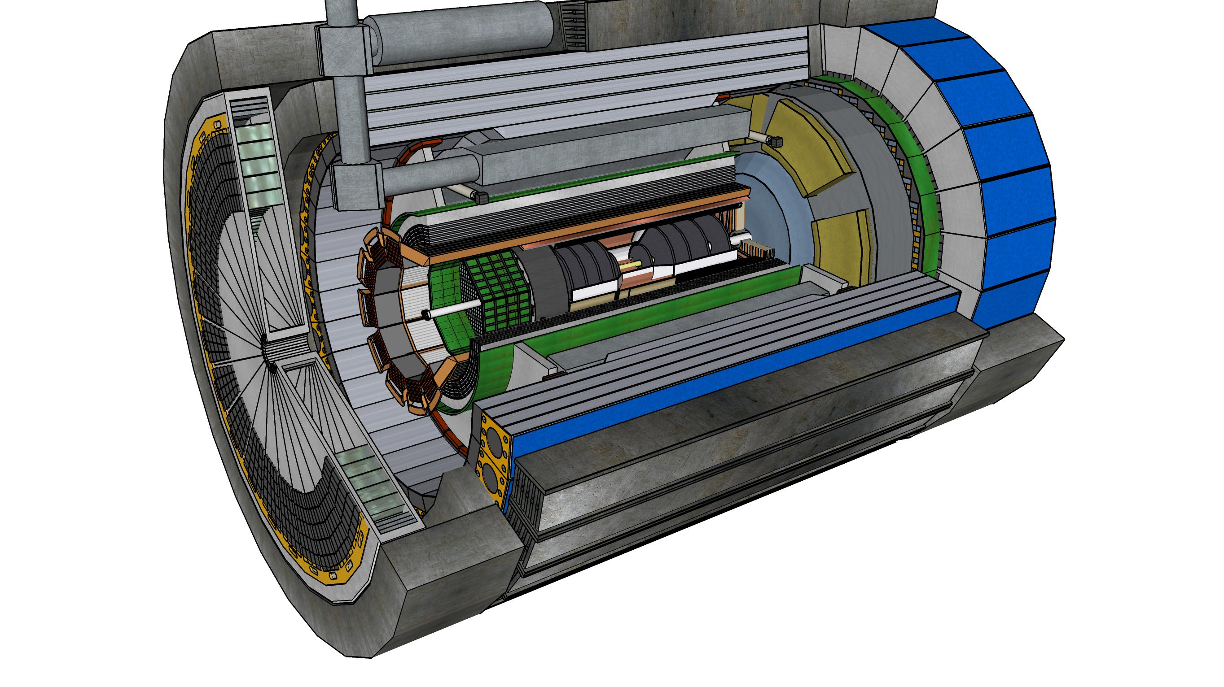
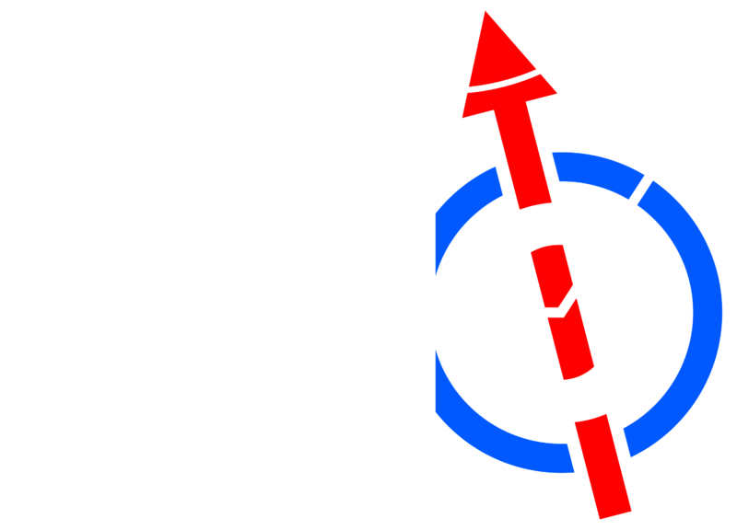


MPGD
Engineering Design and Integration Update
(BOT and ECT)
Seung Joon Lee (JLab)
Summer 2024 Joint EICUG/ePIC Collaboration Meeting
(Jul 22 – 27, 2024)

Slide 2
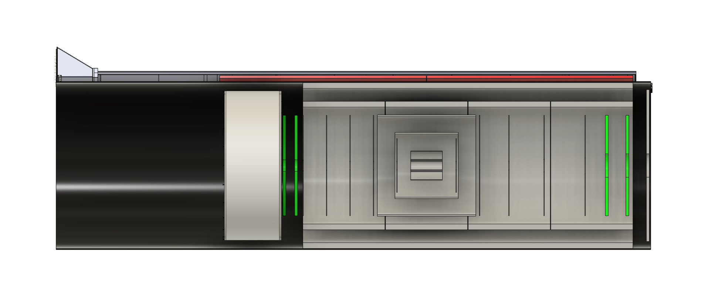
MPGD Detectors
DIRC
Barrel Outer Tracker
(μRwell)
CyMBaL
(MicroMegas)
CF Tube
Electron EndCap
(μRwell)
Hadron EndCap
(μRwell)

Slide 3
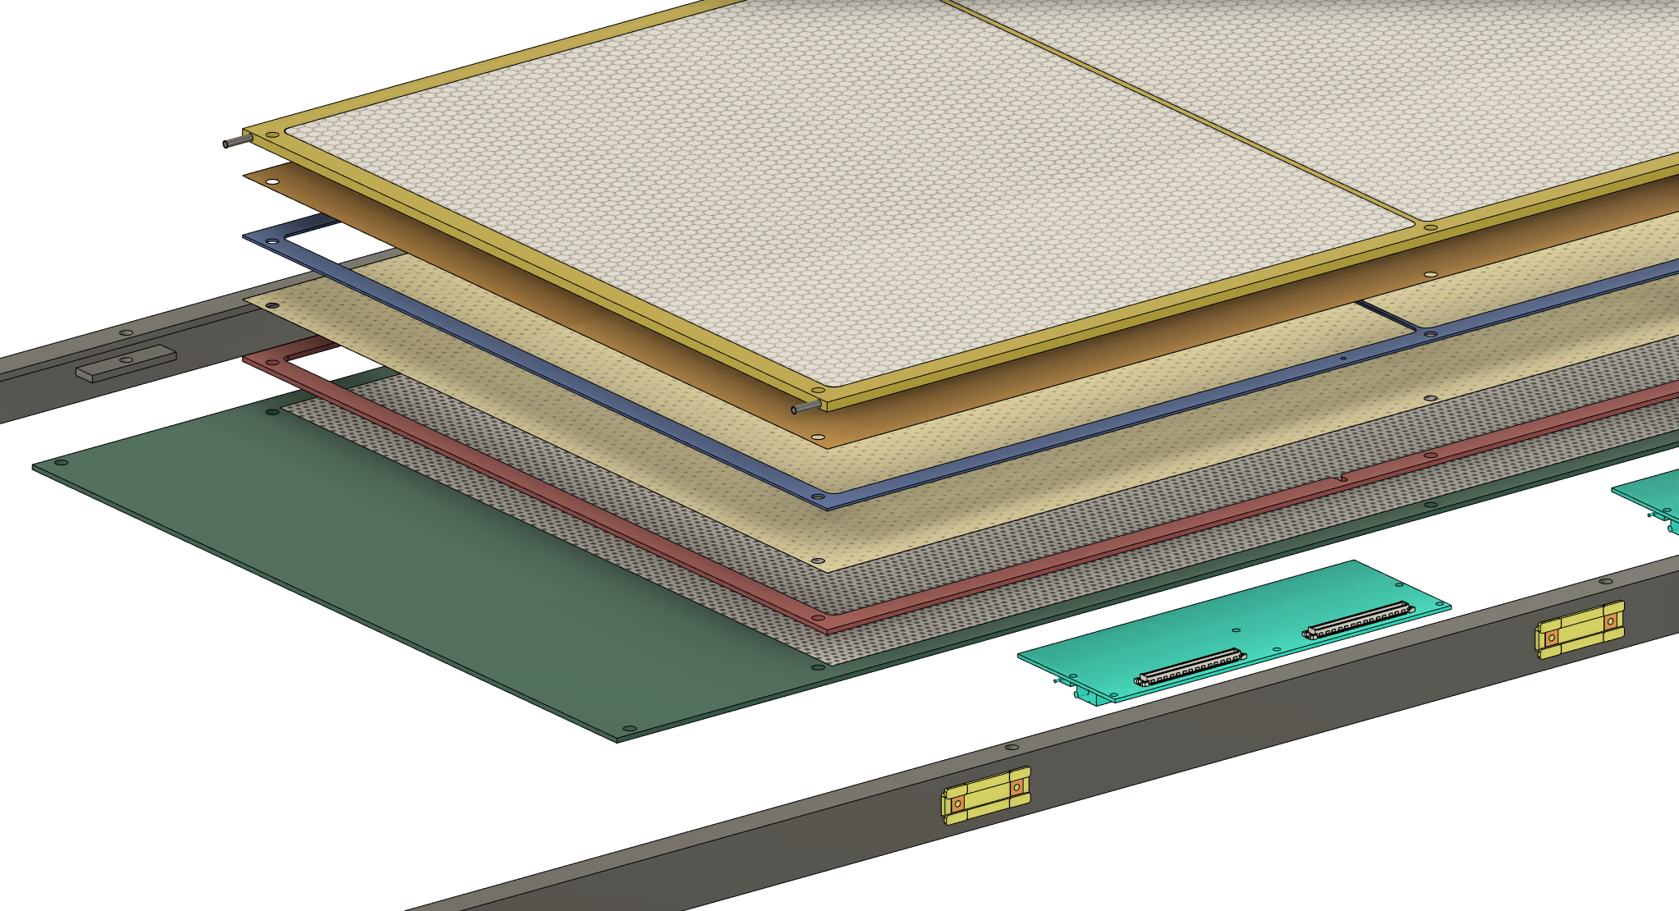
BOT structure
Honeycomb layer
Drift foil
Drift frame
GEM foil
Induction frame
uRWELL + PCB
Service area
FEB

Slide 4
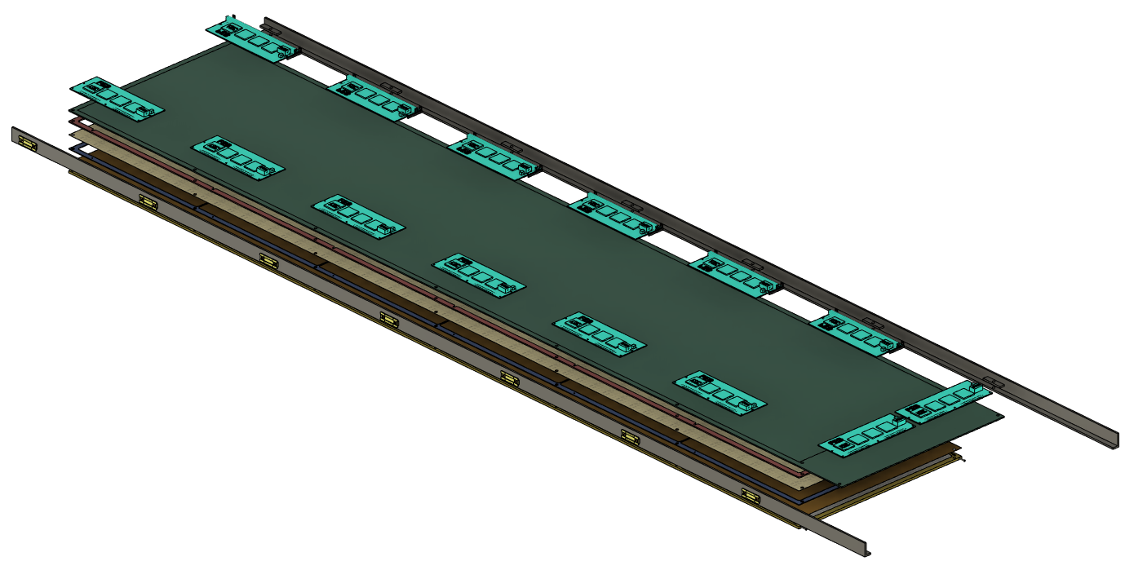
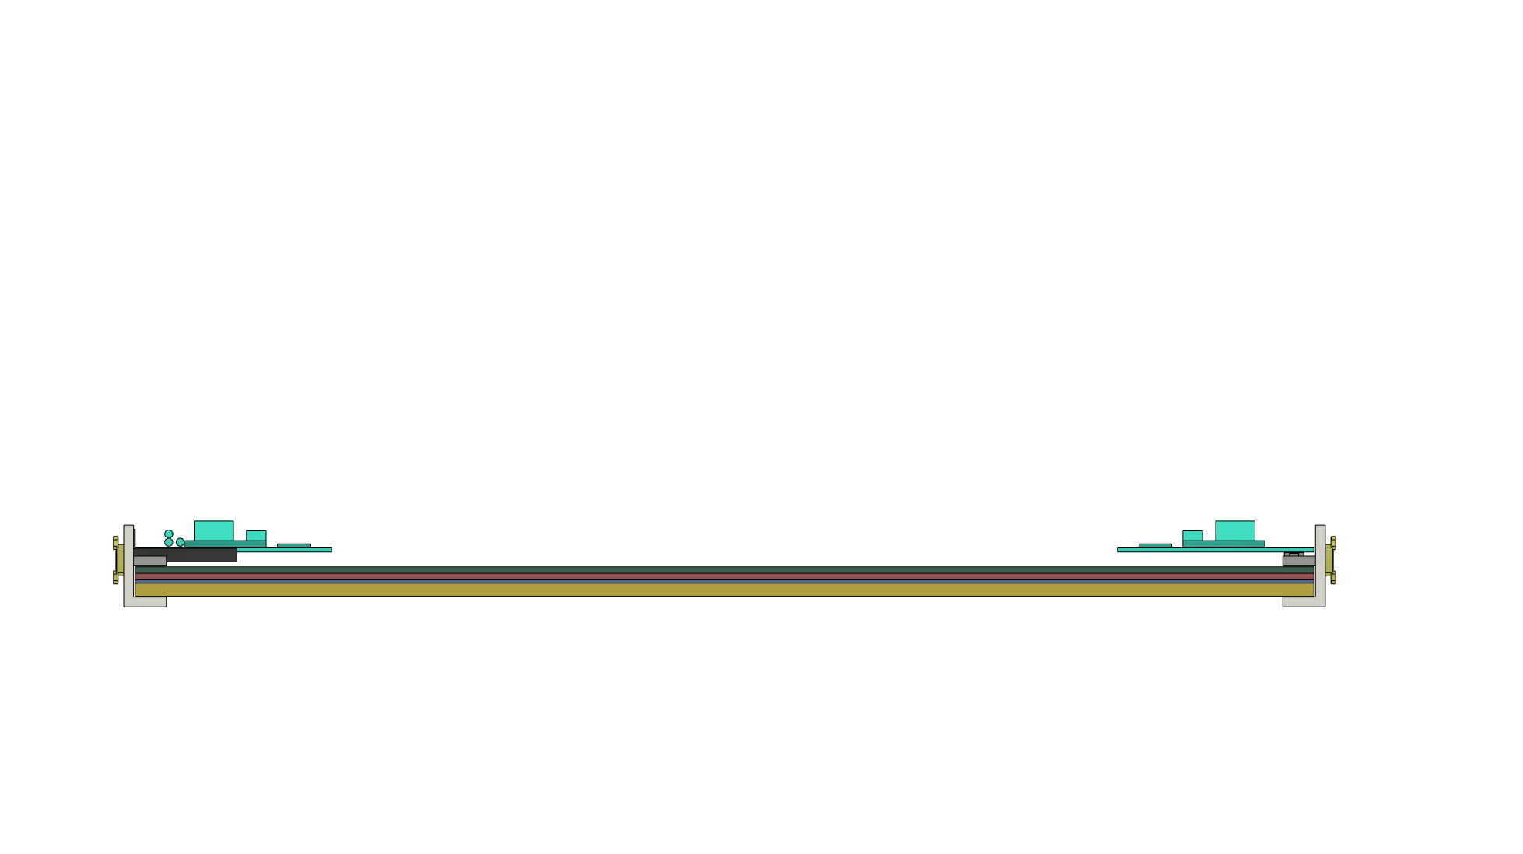
Detector Structure
Dimension: 180 cm x 38 cm x 2.5 cm
F
B2B connector
Service area
FEB
MPGD chamber
FEB support bracket

Slide 5
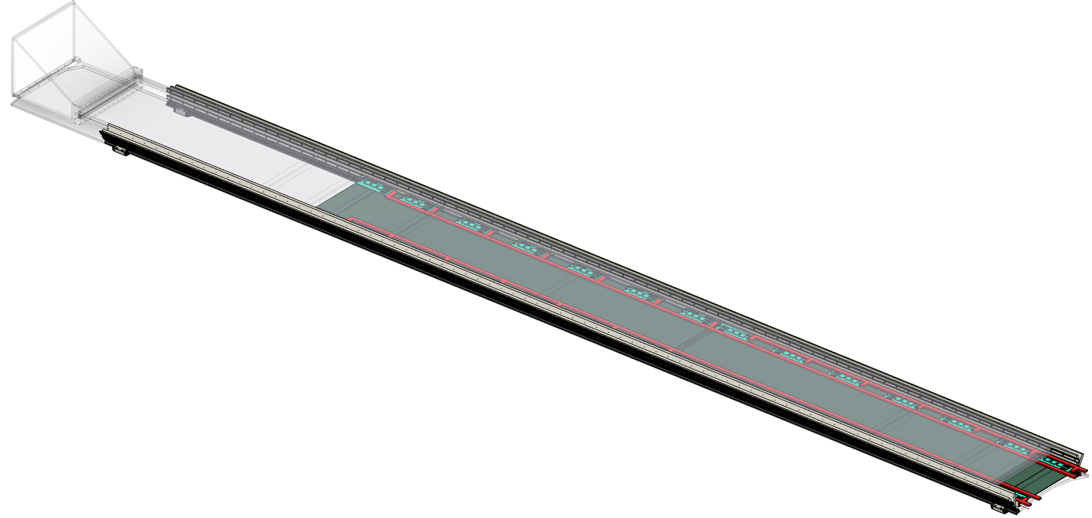
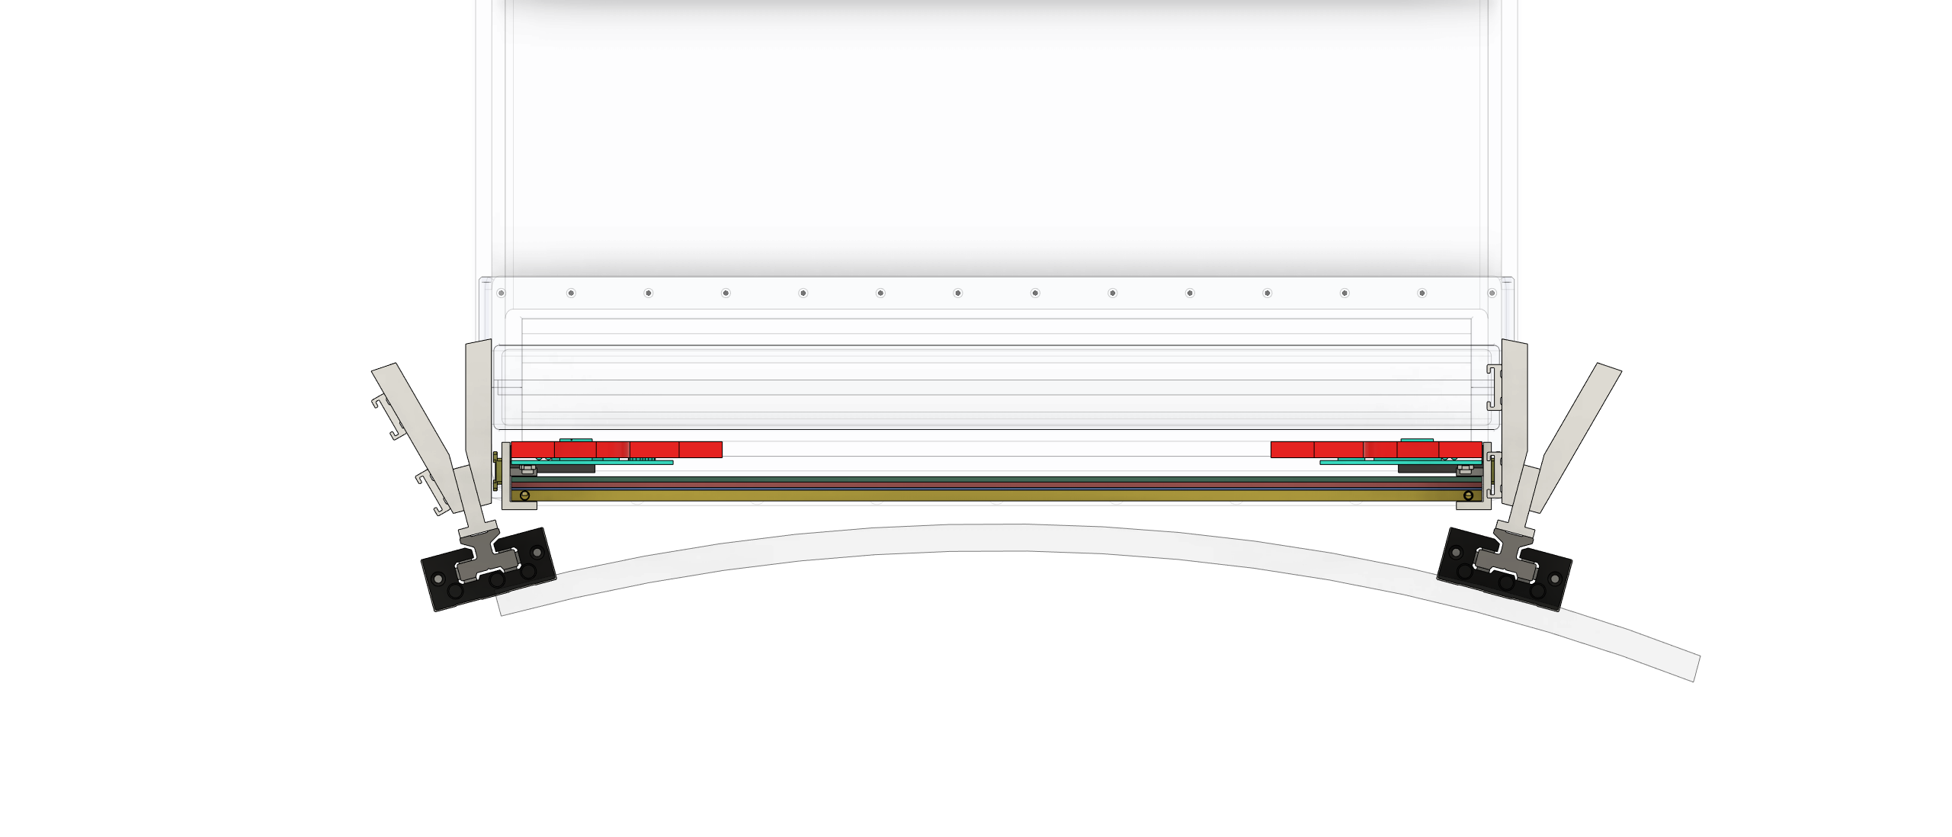
Service Line (BOT)
Service line
Installation
dRICH have to be moved out 4 meters to remove BOT
Or Remove DIRC
Removal
& Service

Slide 6
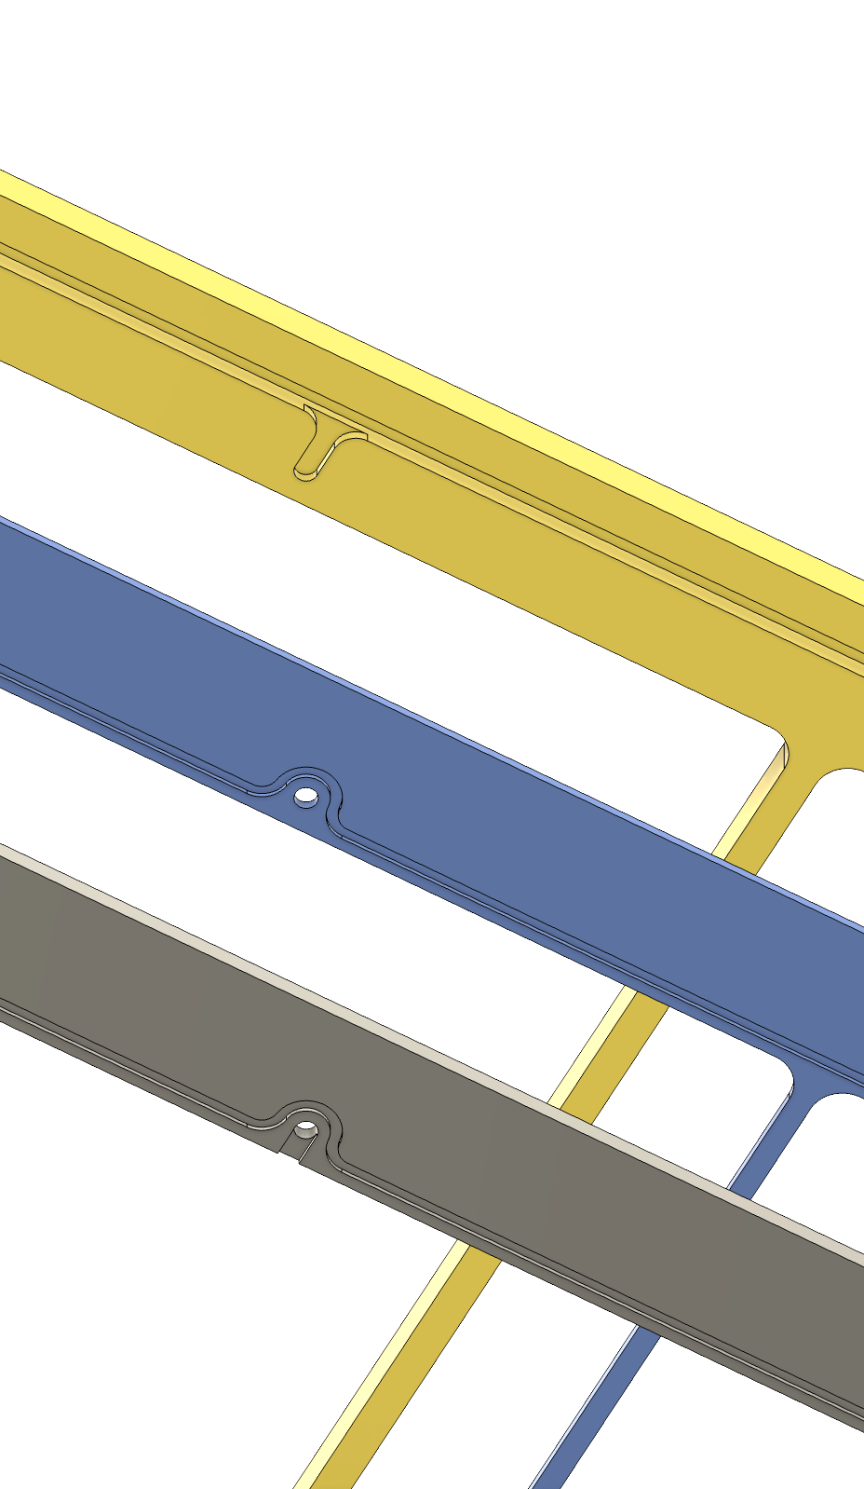
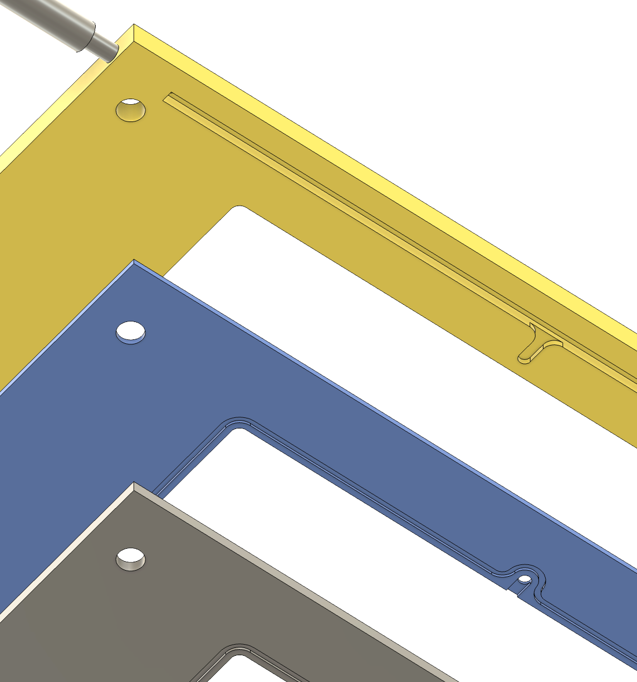
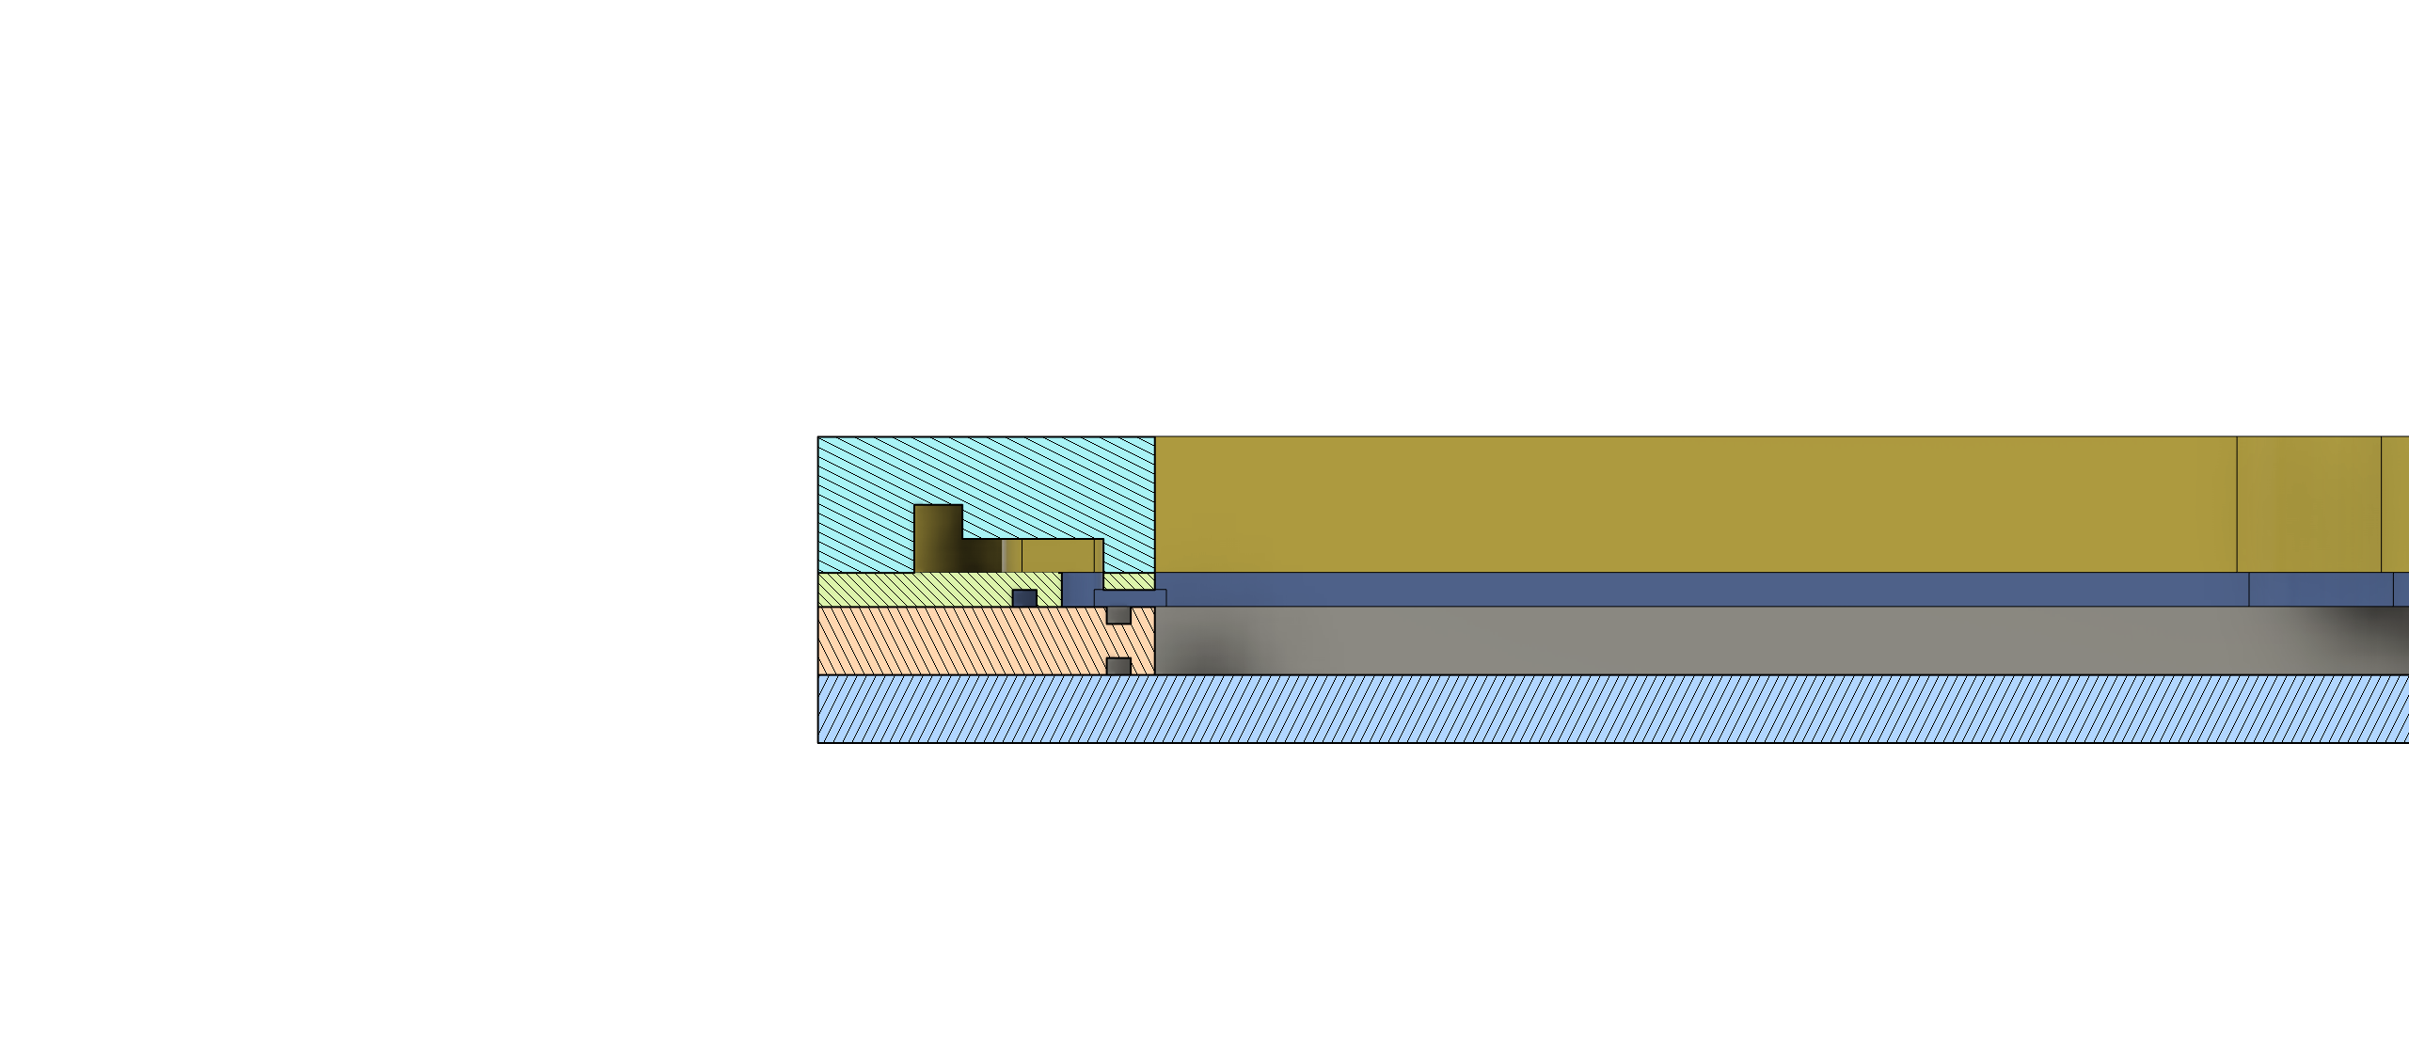
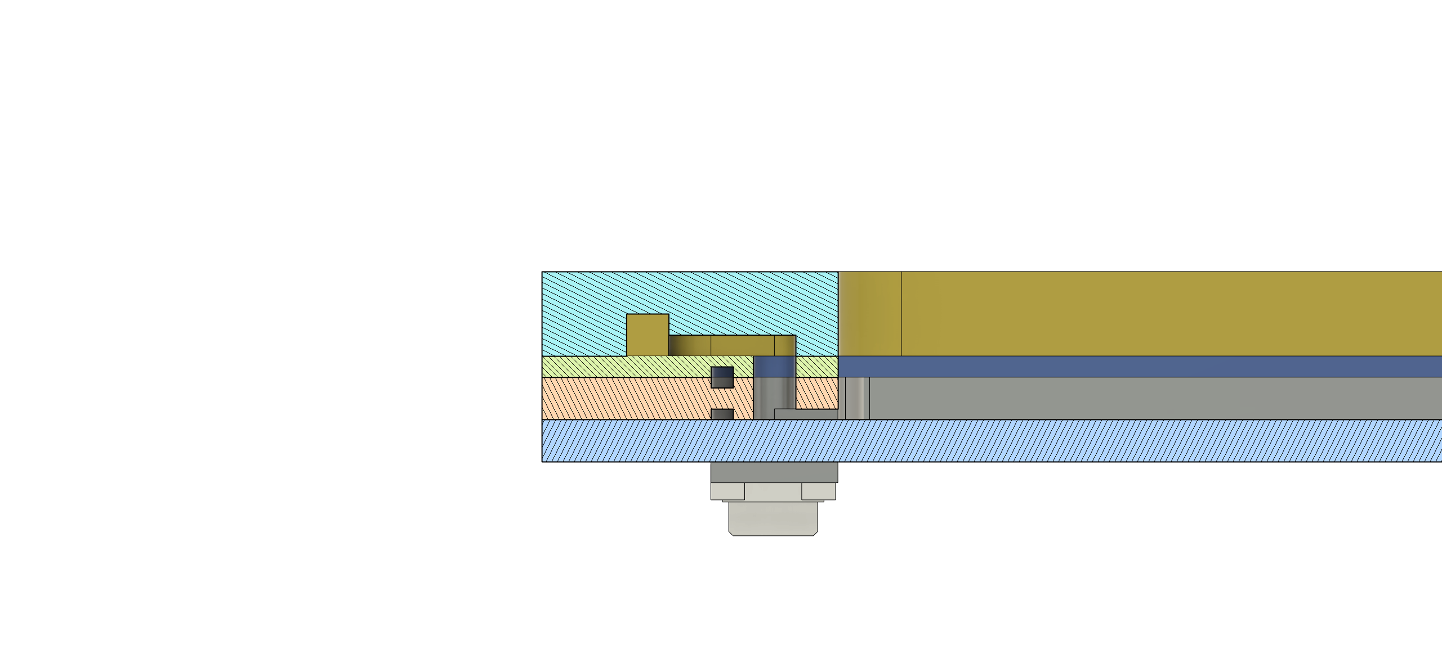
MPGD chamber - Gas line
Mainstream channel
Drift frame
Glue stopper
Induction frame

Slide 7
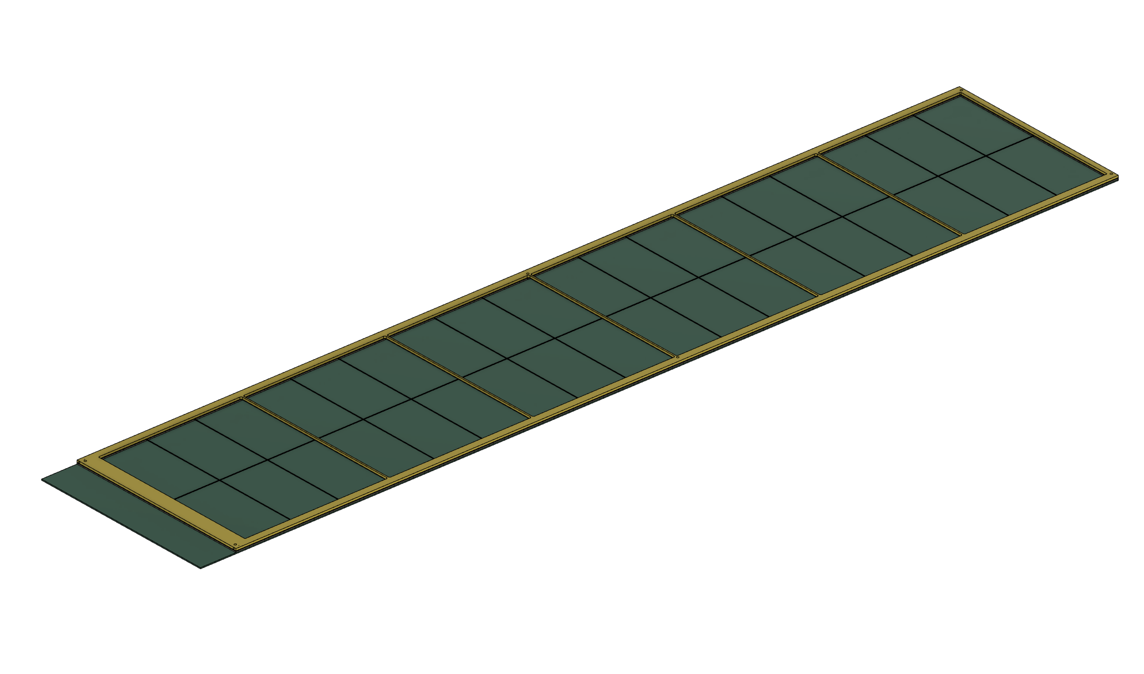
MPGD chamber - Gas line
GEM foil
More Gas inlet/outlet can be added if required
Gas - inlet
Cross flow for maximum diffusion
Gas - outlet

Slide 8
End Cap tracker (ECT)
DIRC
Barrel Outer Tracker
(μRwell)
CyMBaL
(MicroMegas)
CF Tube
Electron EndCap
(μRwell)
Hadron EndCap
(μRwell)

Slide 9
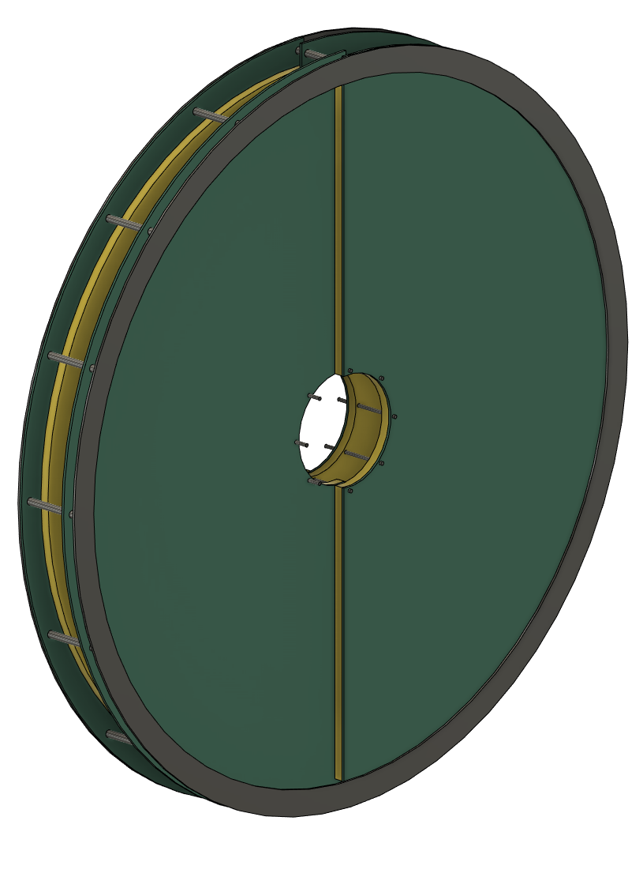
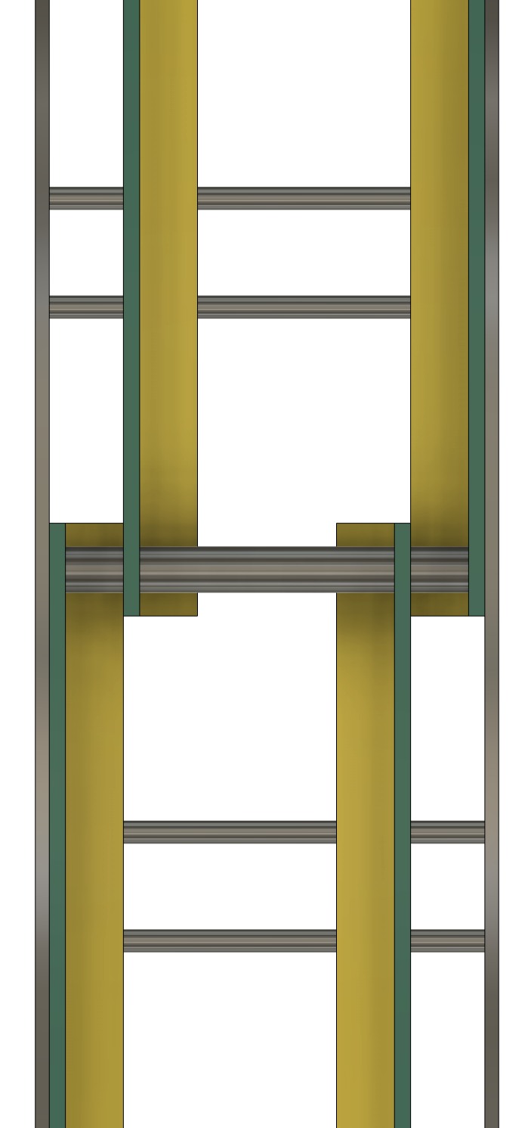
Current Design of ECT (E-ECT)
MPGD Detector
Support frame
Active Area Overlap (10 mm)
4x Half disc
Support Frame
10 cm
6 cm for FEB (µTPC), 8 cm for (thin gap Hybrid)

Slide 10
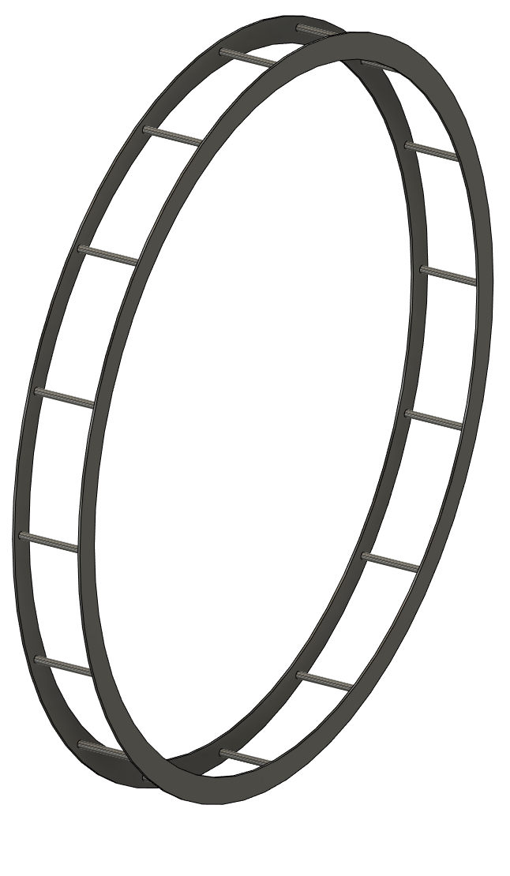
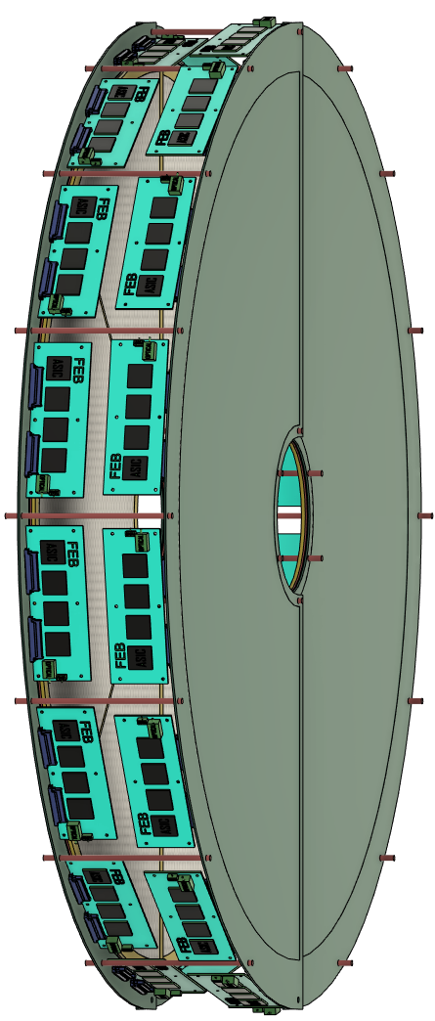
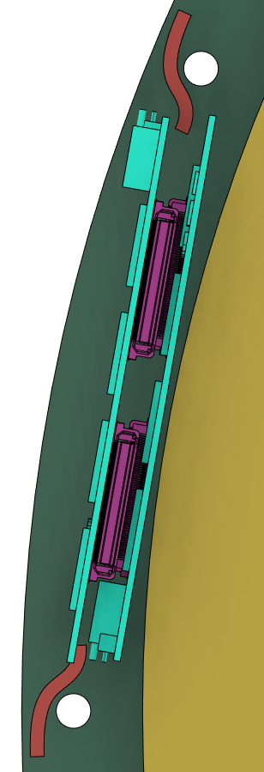
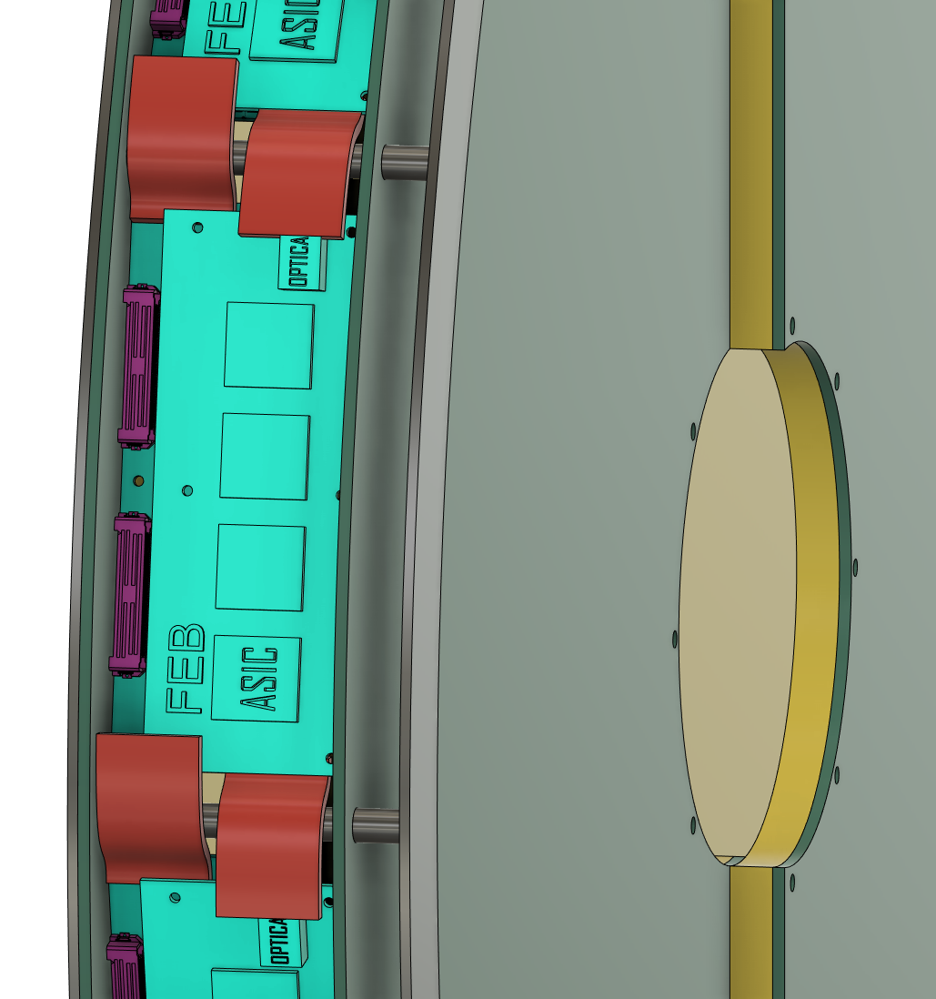
FEB and Service
This part will be supported (not designed yet)
Double rim support structure
15+ cm for HD-ECT
24~30 FEBs required for µTPC (0.5 mm pitch)
16 FEBs for thin gap hybrid (1 mm pitch)
How many FEBs can we put around the disc?
Front view without front disc
Service line

Slide 11
Summary
BOT
- 1st engineering design of chamber is completed.
- Service plan of BOT requires discussion with DIRC/dRICH
ECT
- Double rim support structure was design to support ECT discs and FEBs also to be integrated into the IB rail.
- Spacing between two discs for E-ECT is a key for placing multiple FEBs

Slide 12
Backup

Slide 13
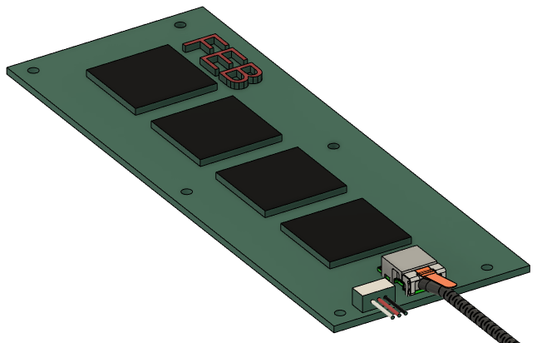
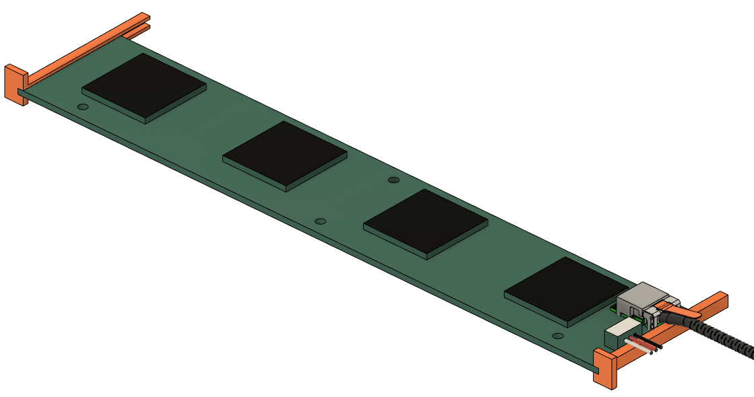
FEB comparison (BOT)
Side Rail
Side Rail
Initial design of FEB
Run service line close to the side rail
Bracket to support FEB
New design of FEB (same area)
Long and narrow, close to the side rail
Run the 1st service line close to the side rail
Run the 2nd service line on the bracket
Bracket to support FEB and Service line

Slide 14
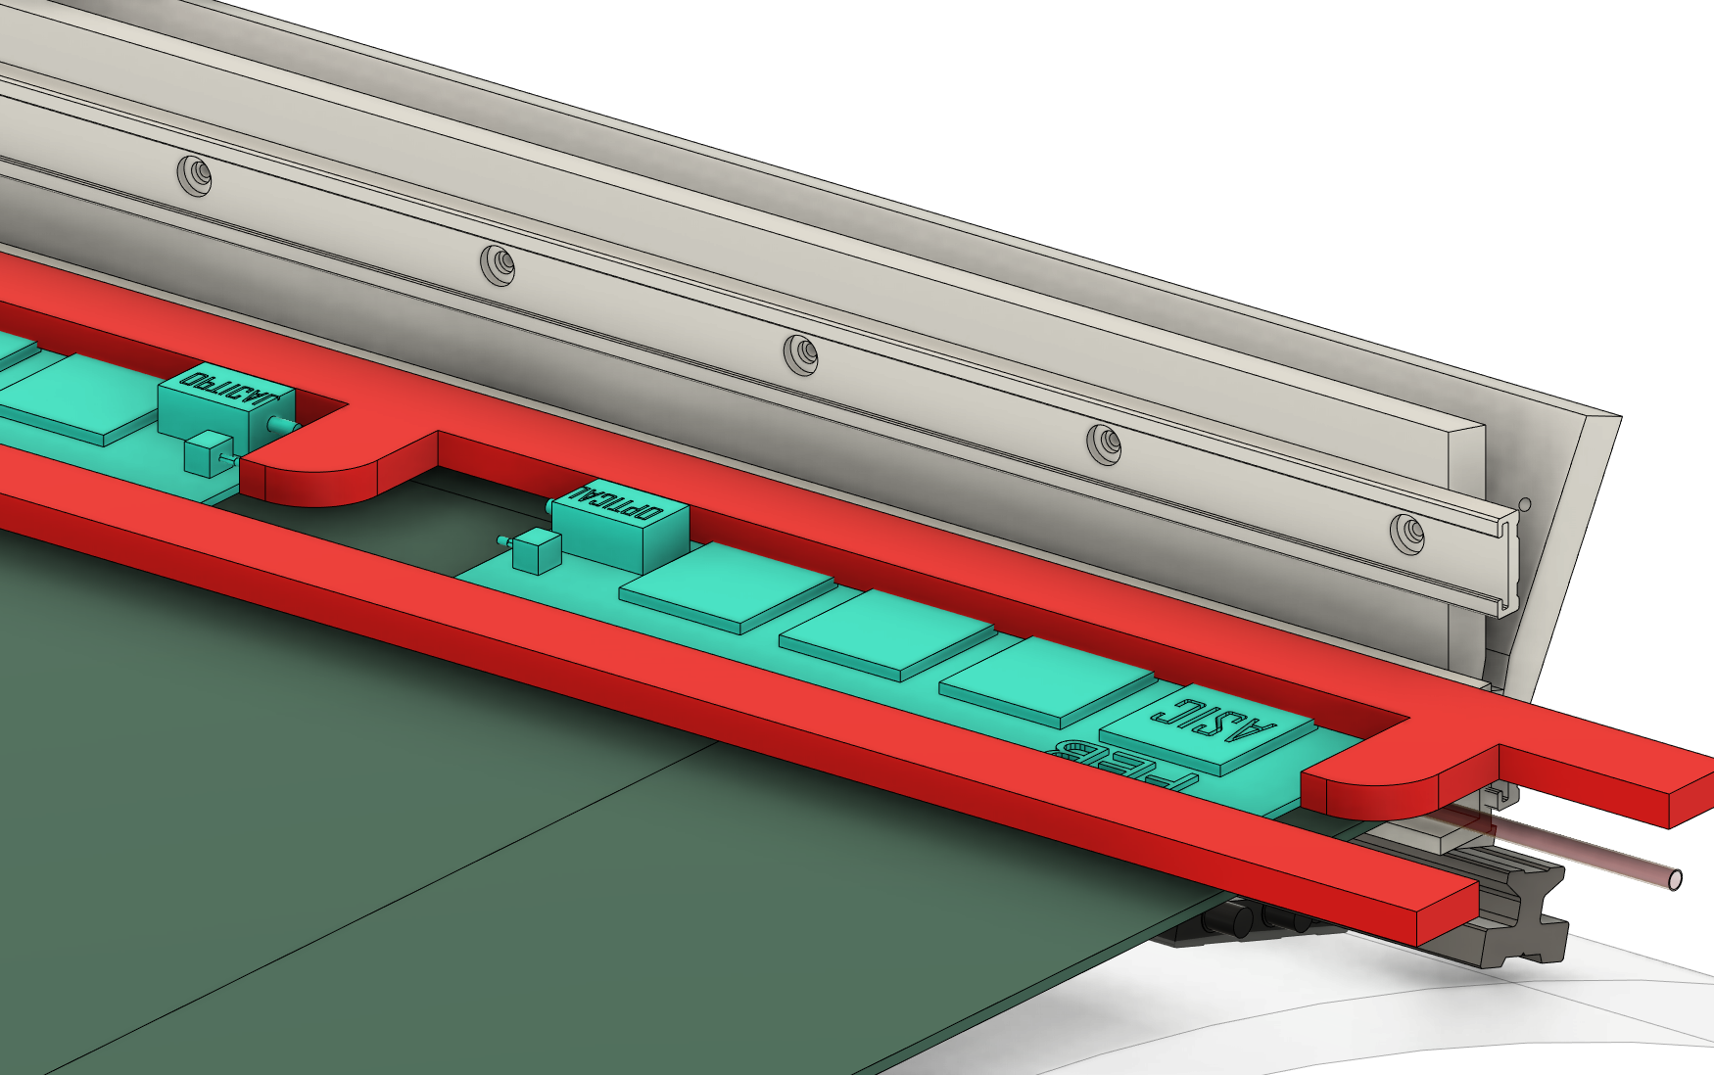
Service Line (BOT)
Service line was doubled on the east side detector
Not enough space for the 2nd service line on the side wall
Extra support structure is required to support weight of 2nd service line
Realistic service line requirement is needed.

Slide 15
Half disc – full length
Strip pitch = 0.5 mm
Max strip length = 900 mm
Direction | # of Channel
Vertical | 1800
Horizontal | 920
Total (Half circle) | 2720
Total (Full circle) | 5440
FEB (256ch) | 22
460 mm
900 mm

Slide 16
Half disc – half length (similar with quarter disc)
Strip pitch = 0.5 mm
Max strip length = 460 mm
Direction | # of Channel
Vertical | 1800
Horizontal | 1840
Total (Half circle) | 3640
Total (Full circle) | 7280
FEB (256ch) | 30
460 mm
450 mm

Slide 17
Half disc – half length
Strip pitch = 0.5 mm
Max strip length = 640 mm
Direction | # of Channel
+45 degree | 1540
- 45 degree | 1540
Total (Half circle) | 3080
Total (Full circle) | 6160
FEB (256ch) | 24
640 mm
450 mm

Slide 18
Half disc – no uTPC
Strip pitch = 1 mm
Max strip length = 460 mm
Direction | # of Channel
Vertical | 900
Horizontal | 920
Total (Half circle) | 1820
Total (Full circle) | 3640
FEB (256ch) | 16
460 mm
450 mm

