Slide 1
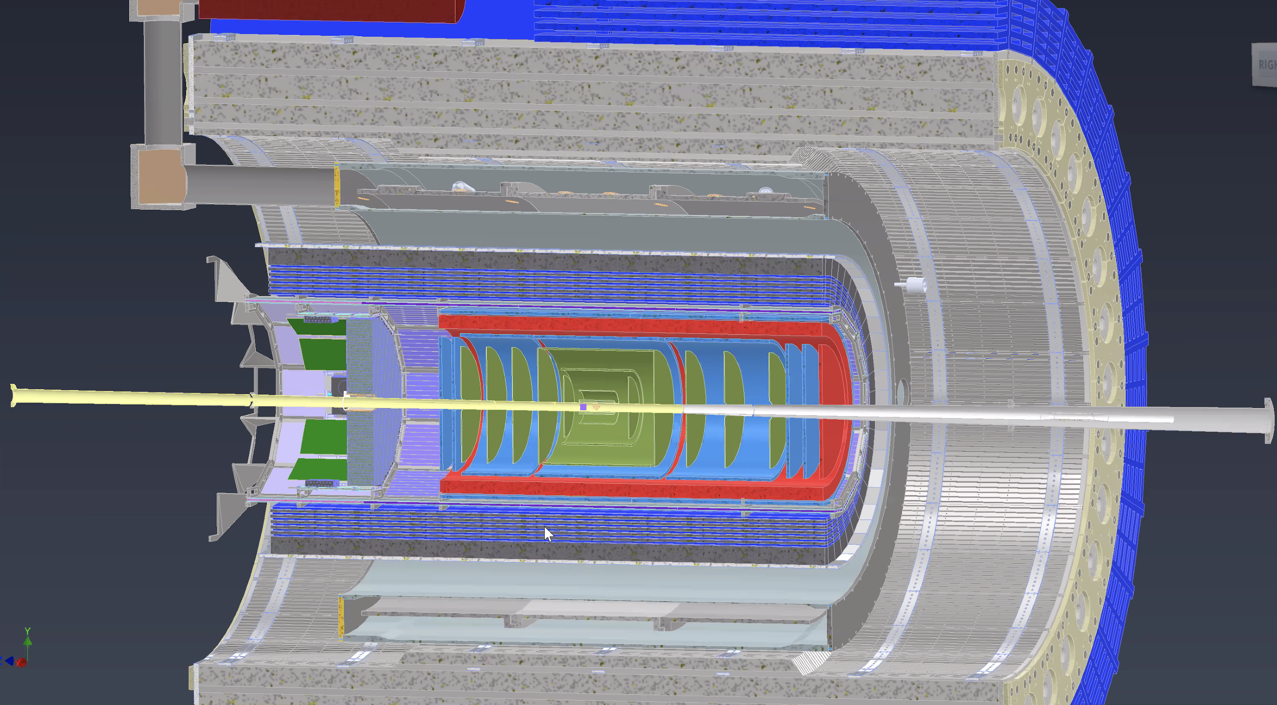
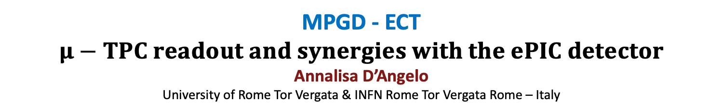
MPGD - ECT
$μ−$ $TPC readout and synergies with the ePIC detector$
Annalisa D’Angelo
University of Rome Tor Vergata & INFN Rome Tor Vergata Rome – Italy

Slide 2
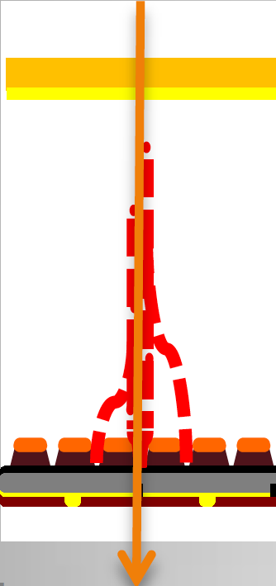
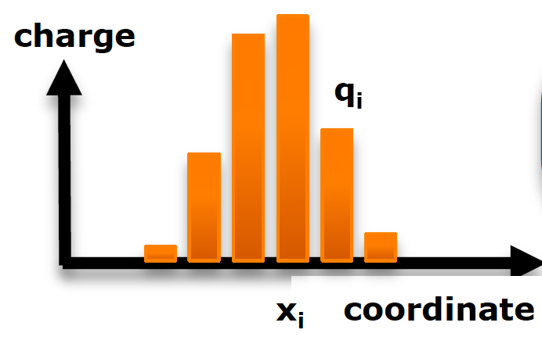
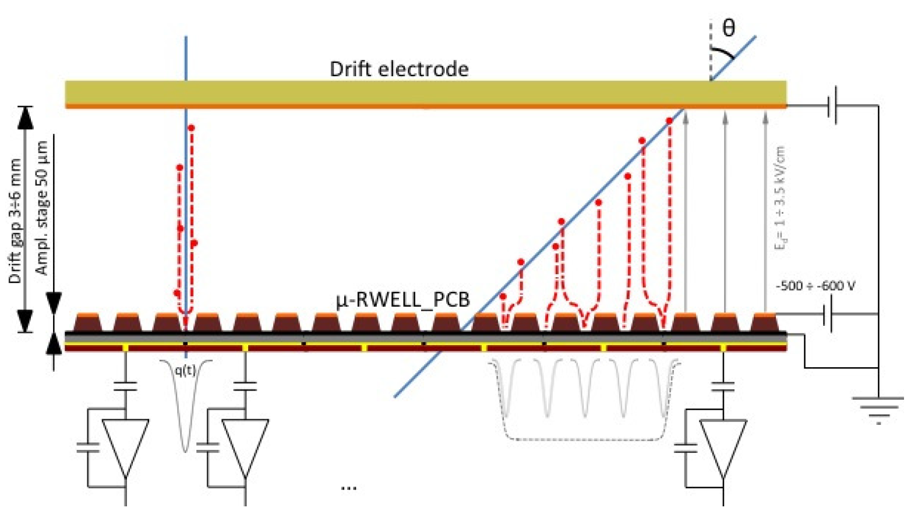

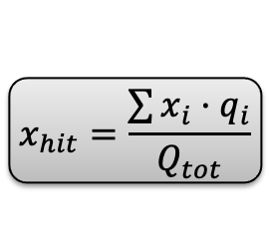
μ-RWELL Position Resolution
Charge Centroid reconstruction method
The track position is determined as a weighted average of fired strips
GOOD FOR ORTHOGONAL TRACKS
$$x_{hit}=\frac{\sum{x_{i}·q_{i}}}{Q_{tot}}$$
FOR INCLINED TRACKS &/or HIGH B FIELD
the Charge Centroid method gives a very broad spatial distribution on the anode-strip plane.
$$μTPC reconstruction$$
The spatial resolution is strongly dependent on the impinging angle of the track $→$A non-uniform resolution in the solid angle covered by the apparatus $→$ Large systematical errors.
ePIC Collaboration Meeting July 26 2024 – Annalisa D’Angelo
2
Notes:
.Applying a suitable voltage between the copper layer and the DLC, the well acts as a multiplication channel for the ionization produced inthe drift gas gap.
The streamer created inside the amplification volume , inducing a large current flowing into the resistive leyer, generate a localized drop of the amplifying voltage with an effective quenching of the moltiplication process in the gas.=> this process strongly suppress the discharge amplitude allows to operate at large gains with a single amplification stage.
This time 𝜏 strongly affects the rate capability of the detector because of a local charging-up. In case of discharge this effect lowers the amplification field then stopping its propagation but at the same time switching off that part of the detector. The resistivity of the DLC is then a crucial point: a large resistivity makes the detector safer but increases the earlier mentioned 𝜏 then worsening the rate capability of the detector; a low resistivity plays an exactly complementary role: larger rate capability but lower discharge quenching power.

Slide 3
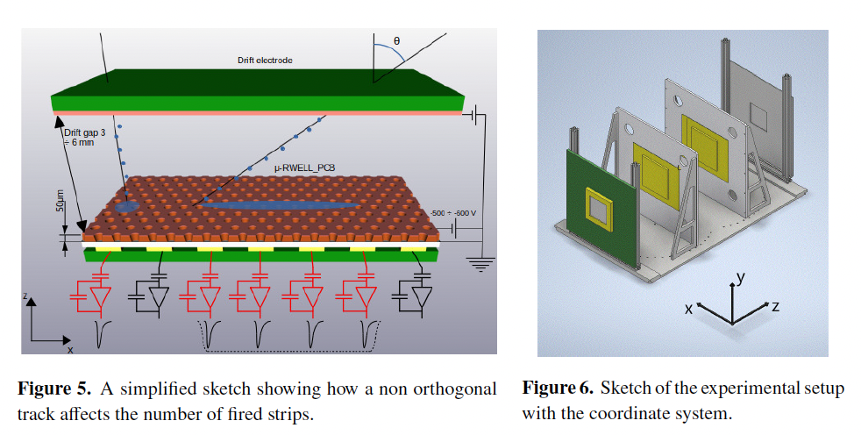

      The μ-RWELL Development for Large Area Detectors : $Spatial resolution →μ$TPC reconstruction
A possible solution : $μTPC reconstruction$
The electrons created by the ionizing particle drift towards the amplification region
In the μTPC mode from the knowledge of the drift time and the measurement of the arrival time of electrons, the track segment in the gas gap is reconstructed
The fit of the digitized charge signal as a function of the sampling time gives the arrival time of drifting electrons.
By the knowledge of the drift velocity, the 2D trajectory of the ionizing particle in the drift gap is reconstructed.
G. Bencivenni et al 2021 JINST 16 P08036
ePIC Collaboration Meeting July 26 2024 – Annalisa D’Angelo
3
Notes:
The idea developed for the ATLAS MicroMegas of the New Small Wheels [10, 11], and also implemented on the BESIII cylindrical GEM [12, 13], is to reconstruct a track segment inside the detector conversion gap rather than a single hit exploiting the analog readout of the signals.
$μ$TPC0=> a readout approach that combines measurement of the arrival time of electrons and the amplitude of the signals on the strips
The fired strips represent the projection of the track on the readout and each center is the x coordinate of the corresponding ionization.
These hits are recorded at different times tk , depending on the distance of the ionization electrons from the readout plane. Applying the simple formula
zk = v_drift * (tk-t0) the z position of the k-th cluster can be computed.

Slide 4
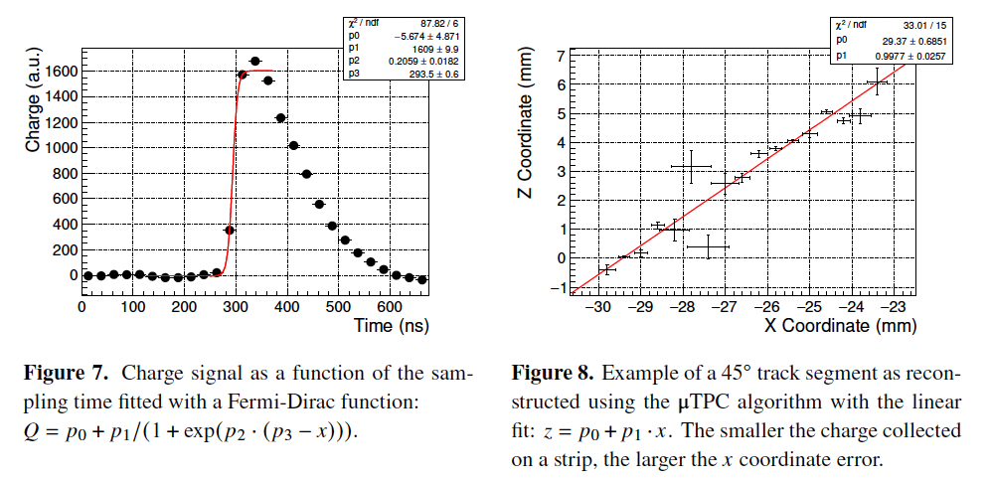
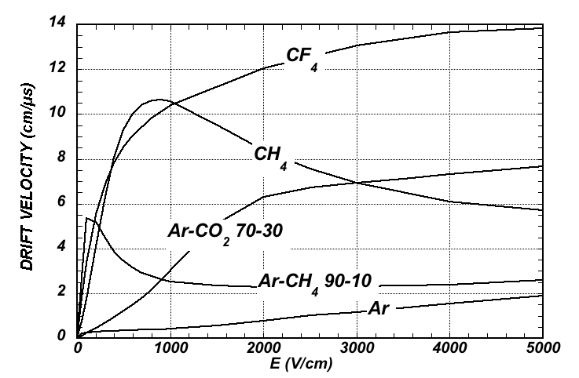
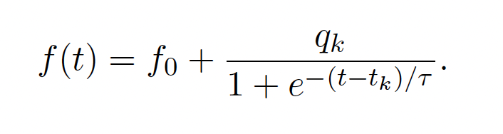
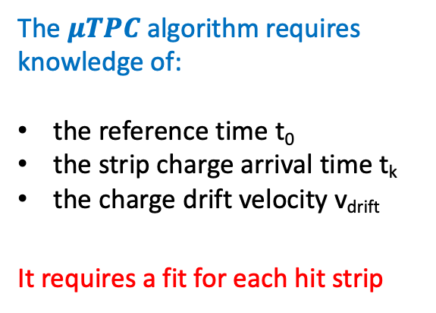
      The μ-RWELL Development for Large Area Detectors : $Spatial resolution →μ$TPC reconstruction
The $μTPC$ reconstruction algorithm: $z_{k}=v_{drift}∙\left(t_{k}−t_{0}\right)$
The $μTPC$ algorithm requires knowledge of:
the reference time t₀
the strip charge arrival time t_{k}
the charge drift velocity v_{drift}
It requires a fit for each hit strip
t_{k}
Electron drift velocity of different gasses, as a function of the applied electric field
PDG
G. Bencivenni et al 2021 JINST 16 P08036
ePIC Collaboration Meeting July 26 2024 – Annalisa D’Angelo
4
Notes:
The idea developed for the ATLAS MicroMegas of the New Small Wheels [10, 11], and also implemented on the BESIII cylindrical GEM [12, 13], is to reconstruct a track segment inside the detector conversion gap rather than a single hit exploiting the analog readout of the signals.
$μ$TPC0=> a readout approach that combines measurement of the arrival time of electrons and the amplitude of the signals on the strips
The fired strips represent the projection of the track on the readout and each center is the x coordinate of the corresponding ionization.
These hits are recorded at different times tk , depending on the distance of the ionization electrons from the readout plane. Applying the simple formula
zk = v_drift * (tk-t0) the z position of the k-th cluster can be computed.

Slide 5
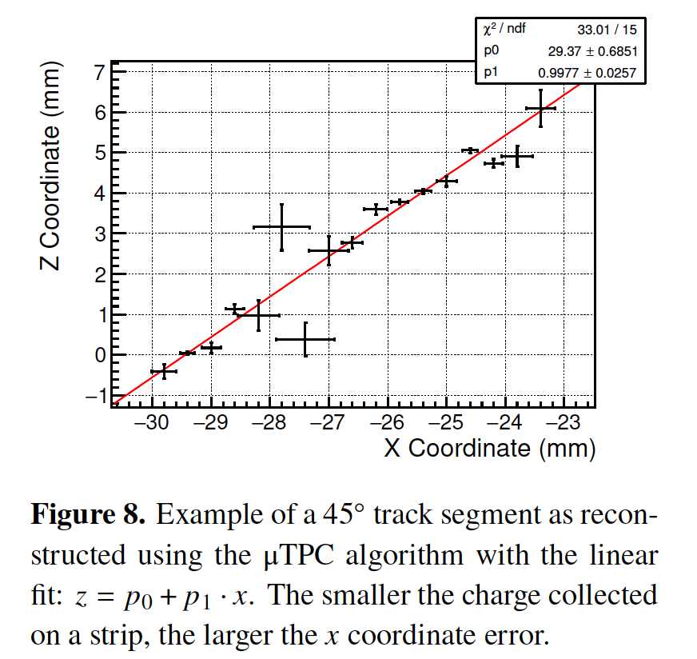
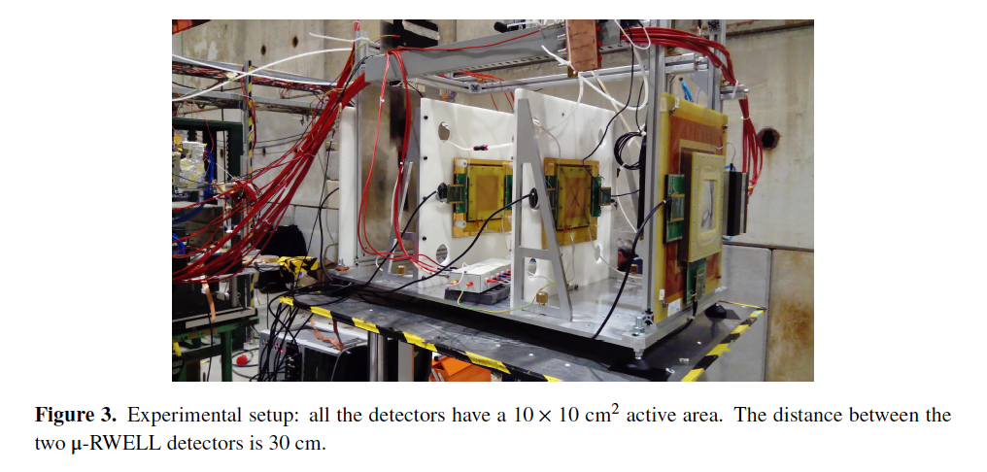
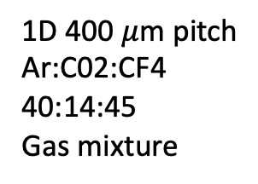
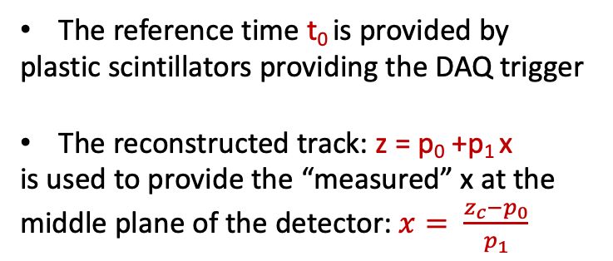
Tests performed on 1D $μ−$Rwell prototypes
1D 400 $μ$m pitch
Ar:C02:CF4
40:14:45
Gas mixture
Z_{c}=3 mm
X
The reference time t₀ is provided by
plastic scintillators providing the DAQ trigger
The reconstructed track: z = p₀ +p₁ x
is used to provide the “measured” x at the middle plane of the detector: $x= \frac{z_{c}−p_{0}}{p_{1}}$
G. Bencivenni et al 2021 JINST 16 P08036
ePIC Collaboration Meeting July 26 2024 – Annalisa D’Angelo
5

Slide 6
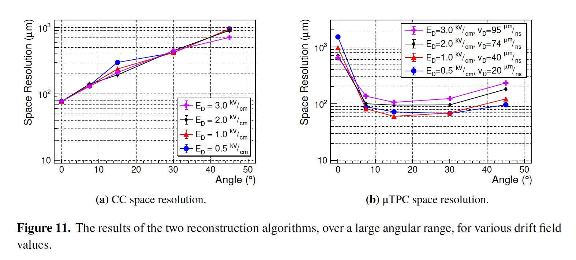
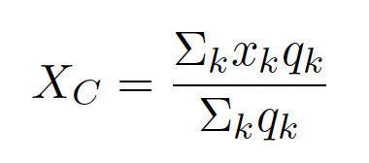
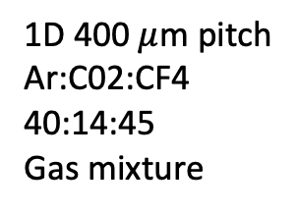
Tests performed on 1D $μ−$Rwell prototypes
1D 400 $μ$m pitch
Ar:C02:CF4
40:14:45
Gas mixture
G. Bencivenni et al 2021 JINST 16 P08036
ePIC Collaboration Meeting July 26 2024 – Annalisa D’Angelo
6

Slide 7
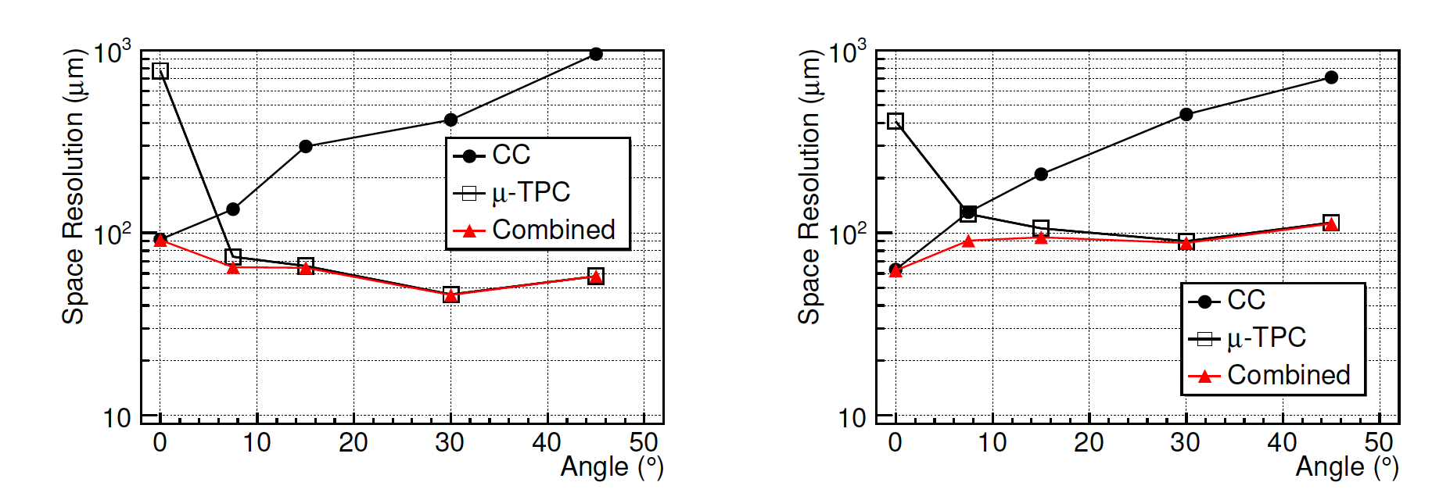
Tests performed on 1D $μ−$Rwell prototypes
1D 400 $μ$m pitch Ar:C02:CF4 40:14:45 Gas mixture
E=0.5 KV/cm
E=3 KV/cm
Combined results of 1D space resolution from charge centroid (CC) and $μ$-TPC algorithms
ePIC Collboration Meeting- July 25 2024 – Annalisa D’Angelo
7

Slide 8
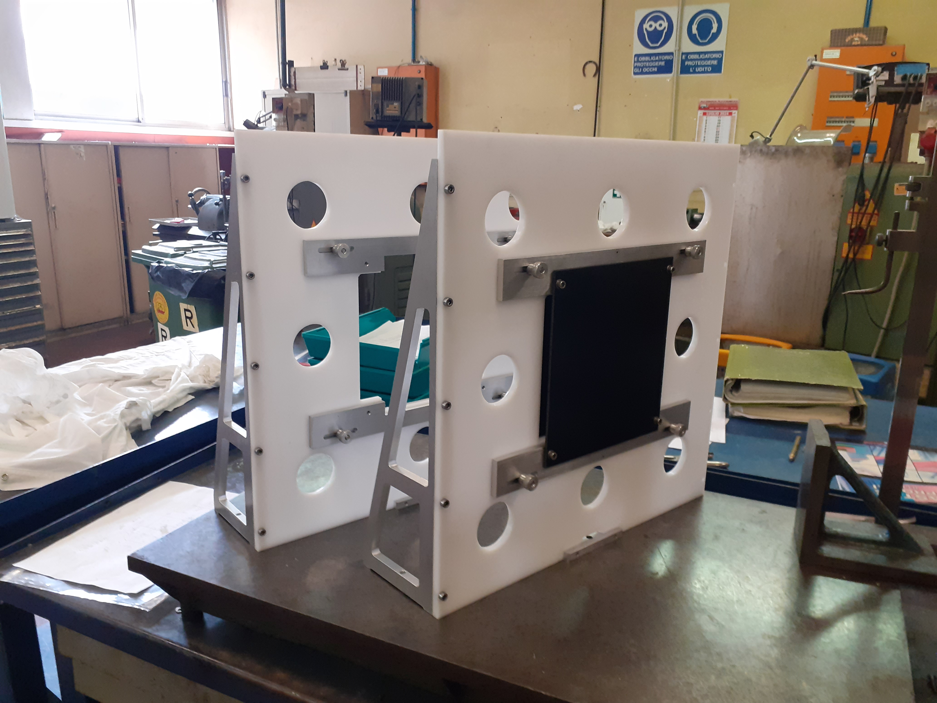
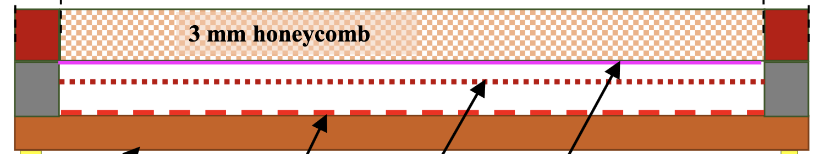
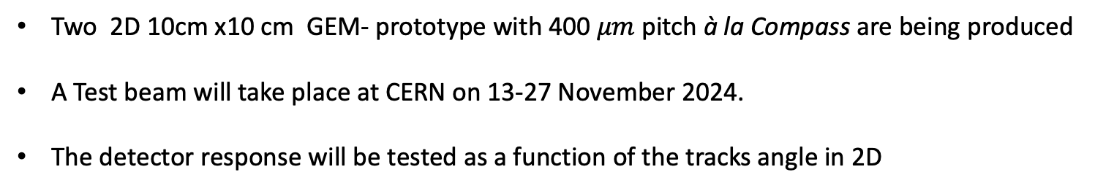


Future test on 2D GEM+$μ$Rwell+ $μ$ TPC
2D GEM - $μ$Rwell Technology
3/6 mm gas gap
2/3 mm transfer gap
PCB read-out
$μ−$Rwell
GEM
cathode
New detector holders
Two 2D 10cm x10 cm GEM- prototype with 400 $μm$ pitch à la Compass are being produced
A Test beam will take place at CERN on 13-27 November 2024.
The detector response will be tested as a function of the tracks angle in 2D
ePIC Collaboration Meeting July 26 2024 – Annalisa D’Angelo
8

Slide 9
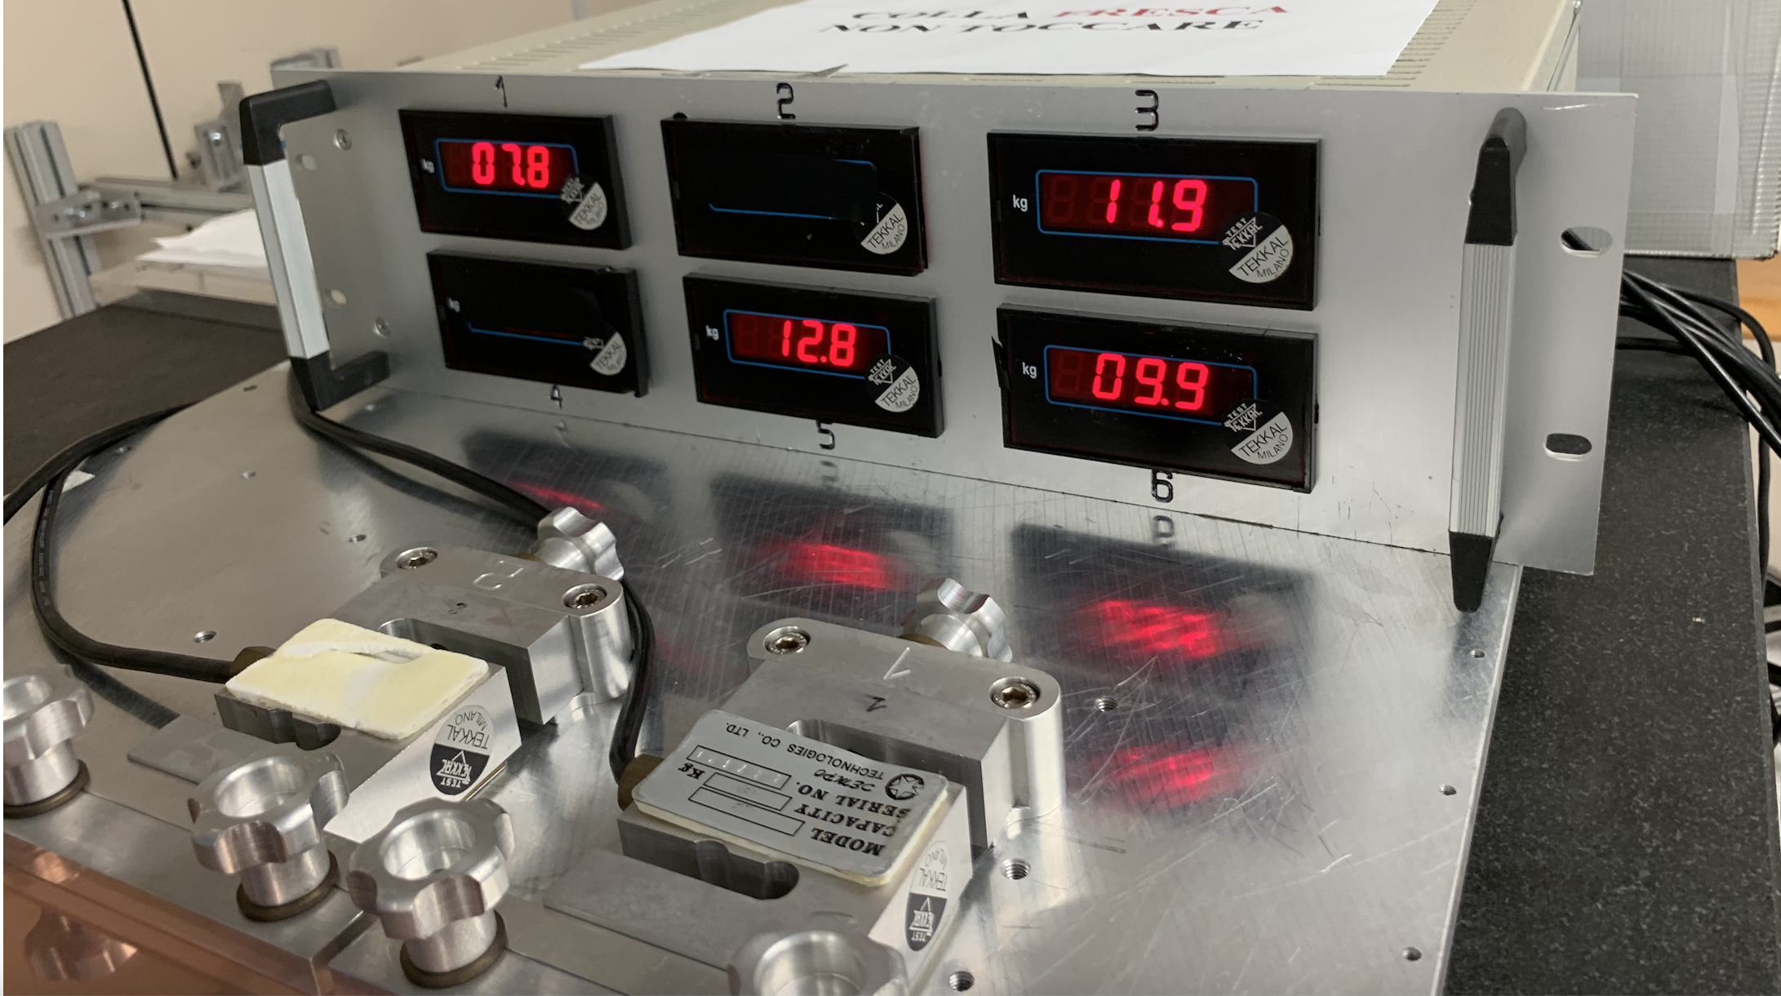
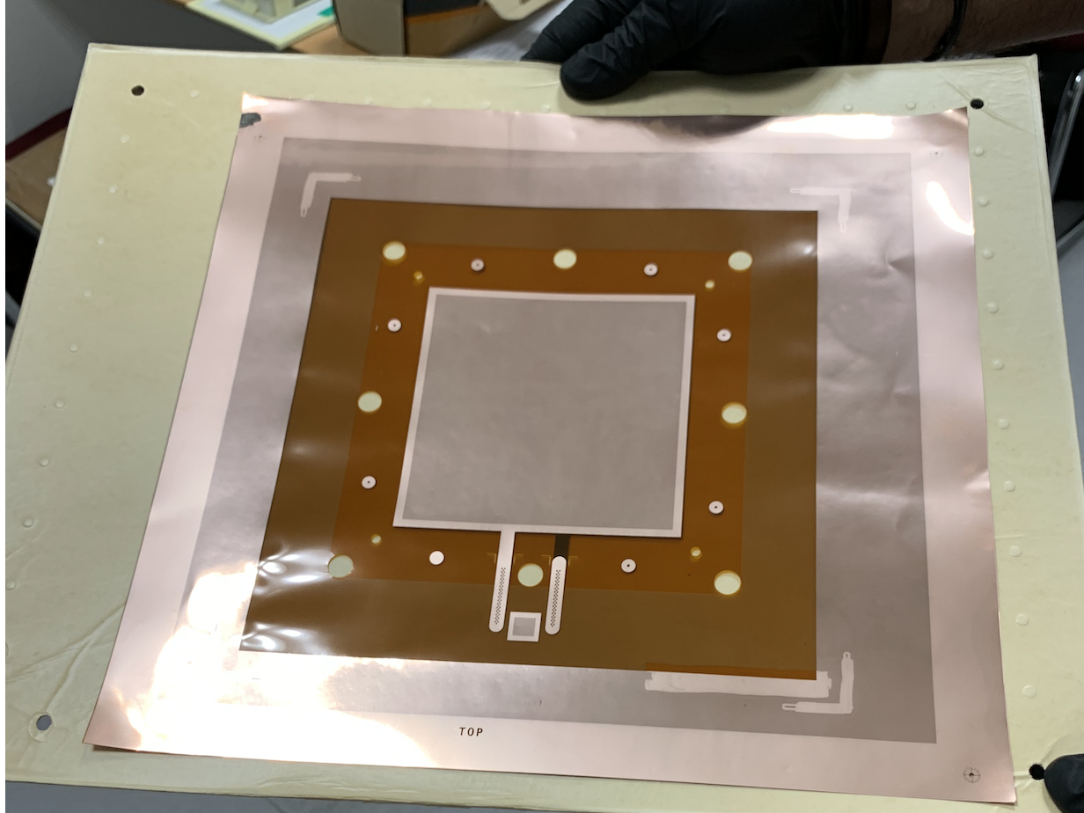
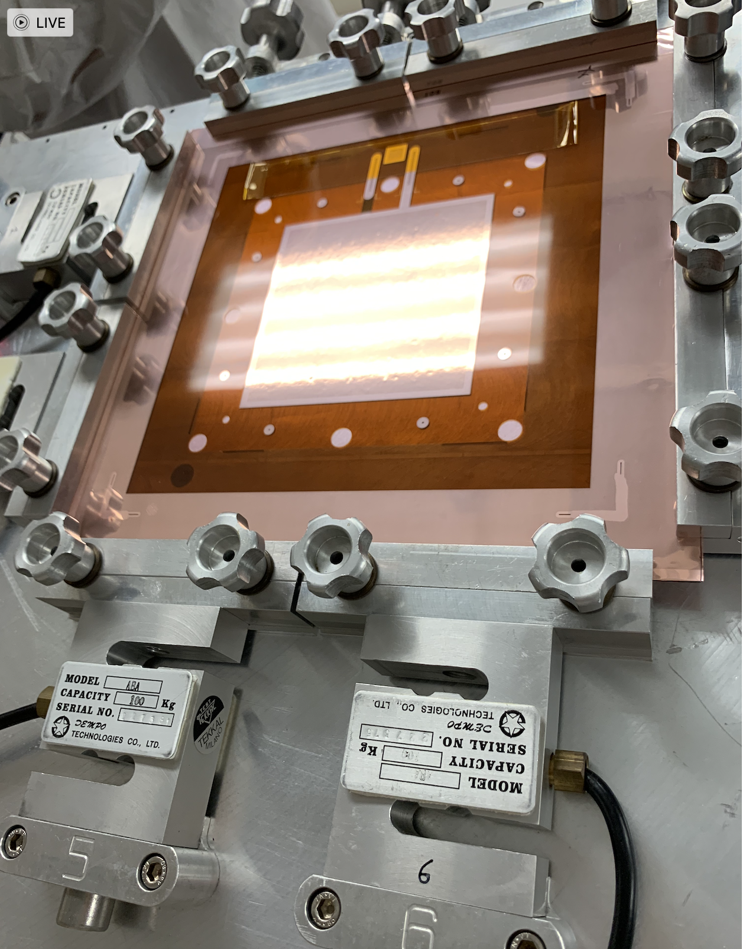
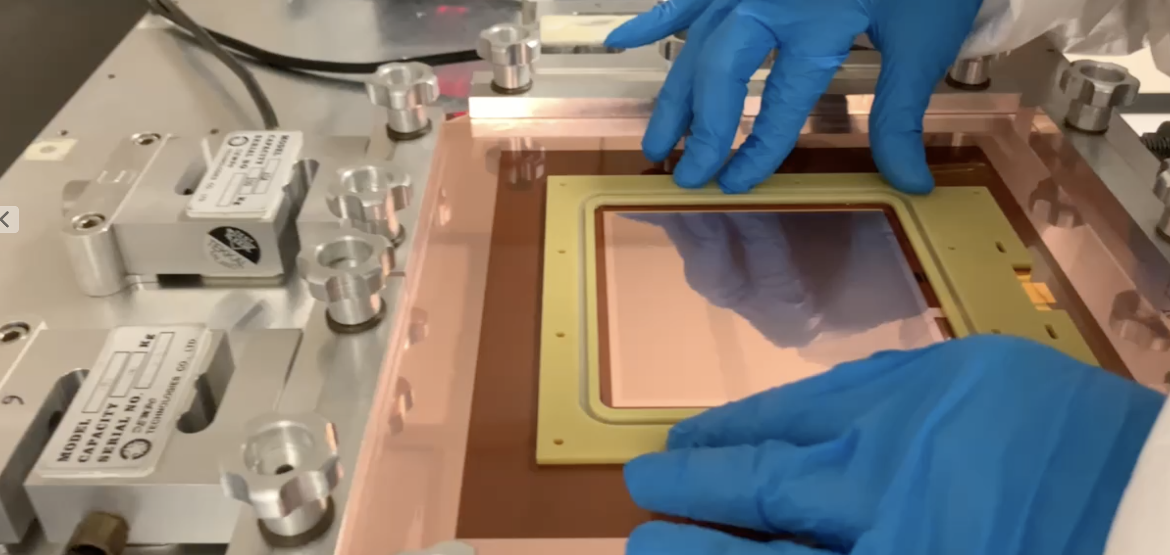
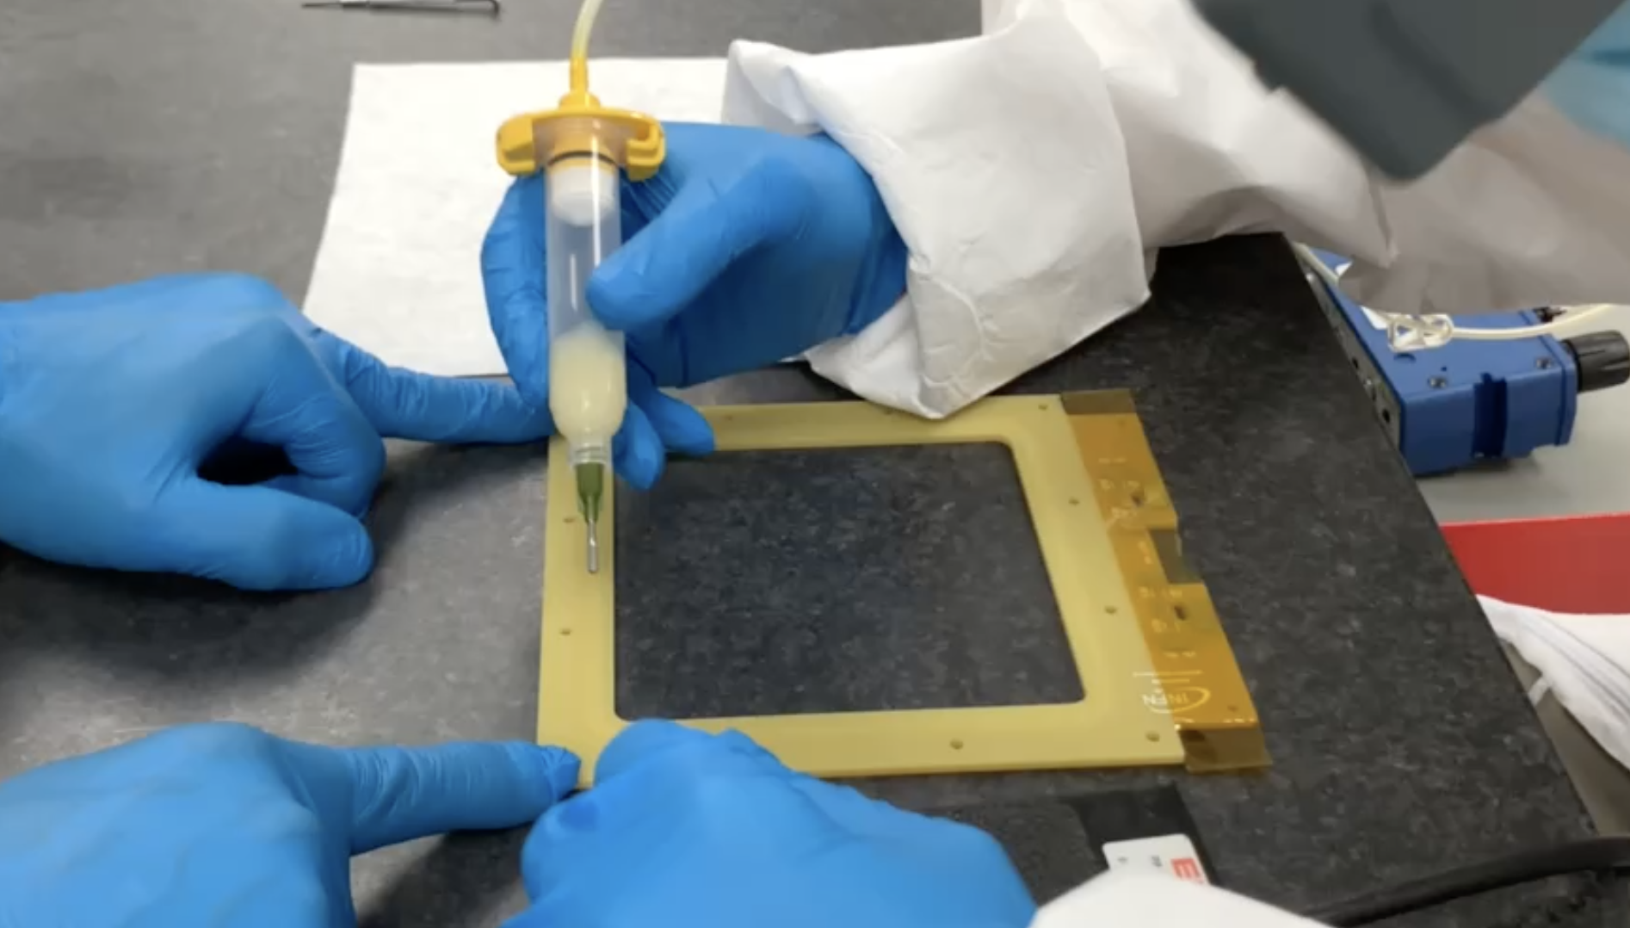

2D 10x10 cm² GEM-$μ$Rwell prototype assembly
GEM-$μ$Rwell 10x10 cm ² prototypes assembly
GEM tension measurement
GEM foil
Glue on peek frame
GEM stretching
Frame assembling
ePIC Collaboration Meeting July 26 2024 – Annalisa D’Angelo
9

Slide 10
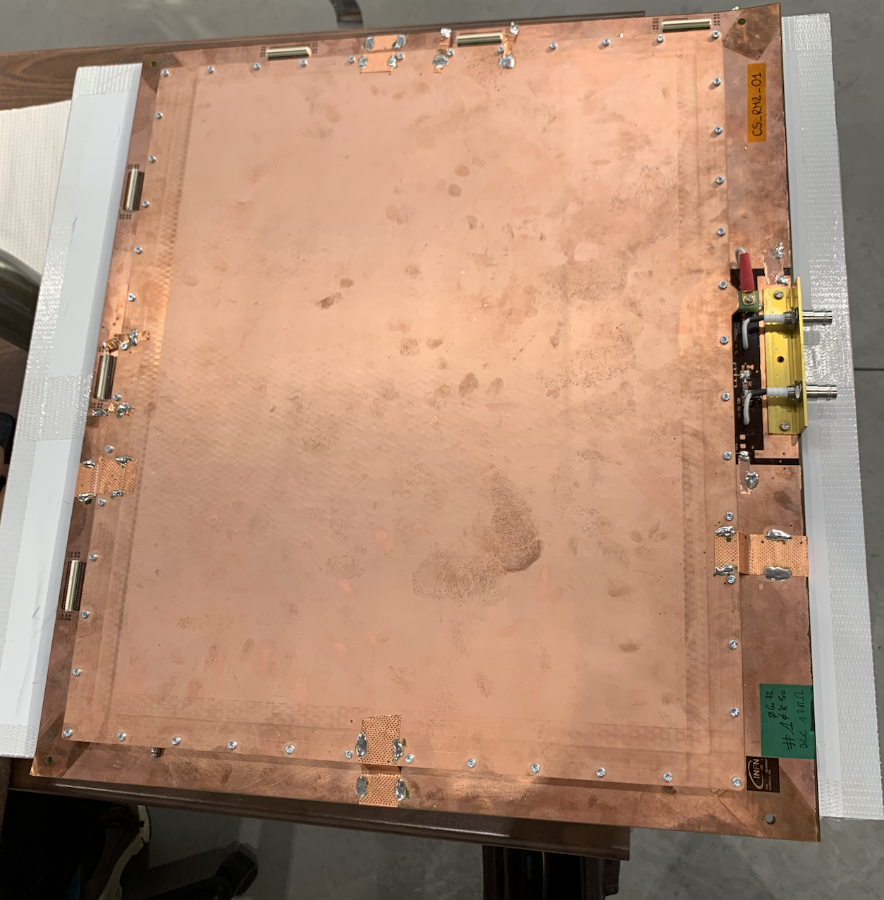
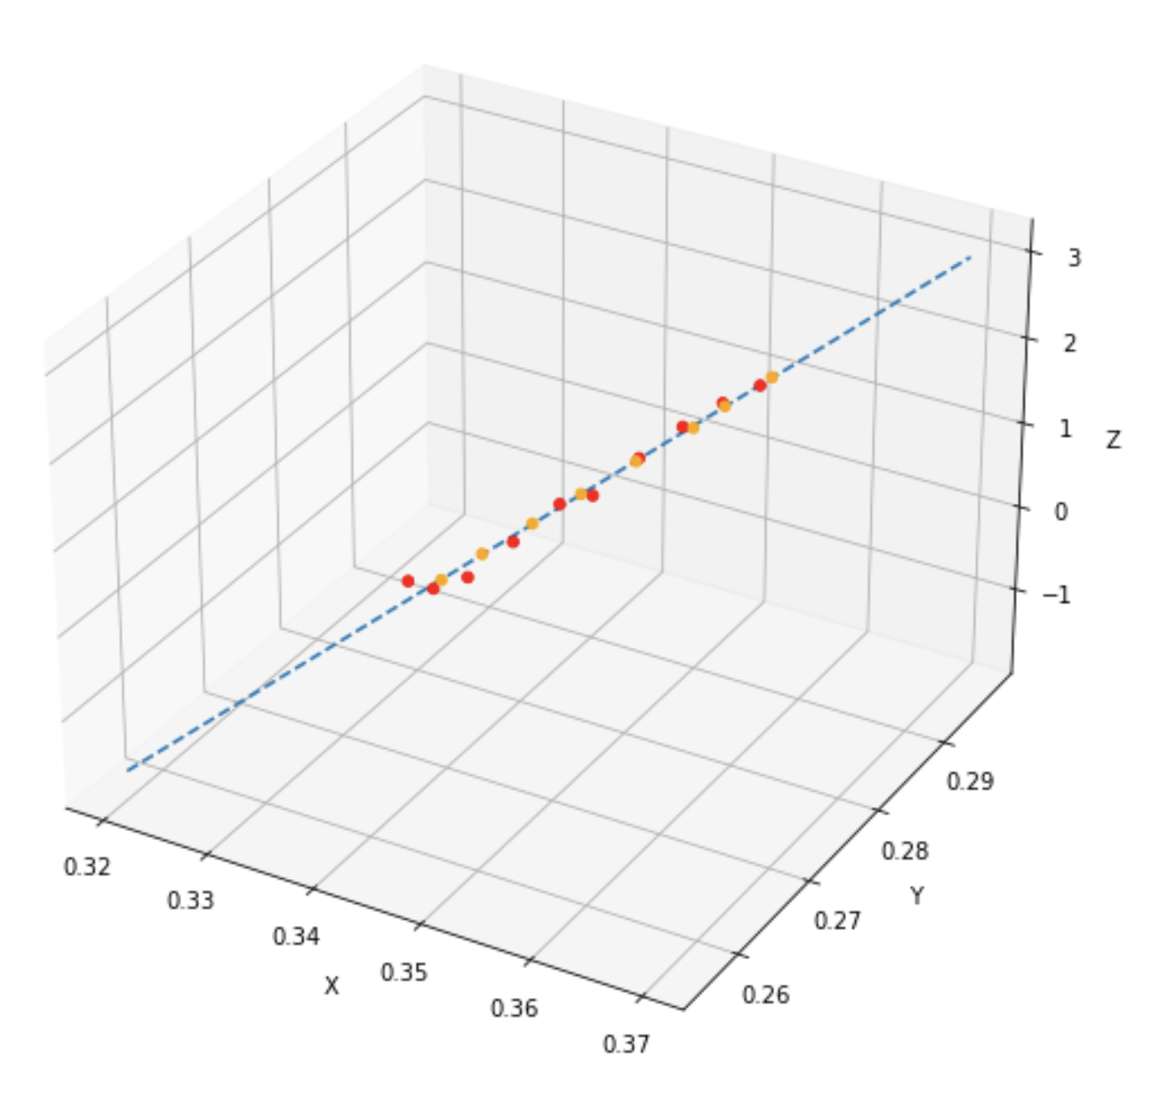
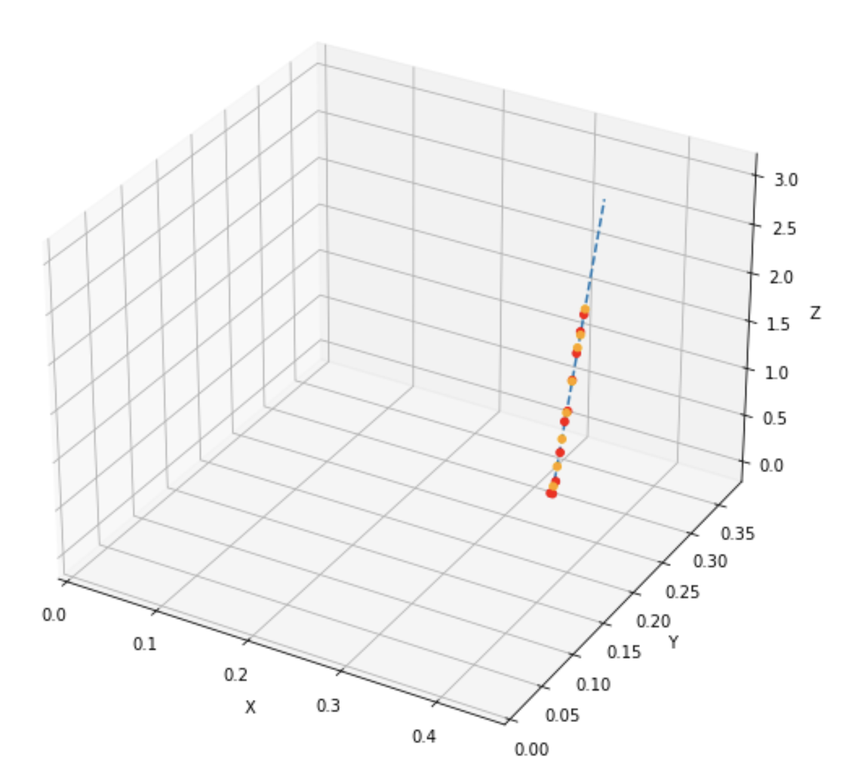
2D 46x38 cm² Large Area $μ$Rwell prototype with capacitive Sharing
By Carlo Gustavino
Ar:CO2 70:30
590 V
30 mm drift gas gap
First tests on large gas gap
With capacitive sharing show good 3D track reconstruction
ePIC Collaboration Meeting July 26 2024 – Annalisa D’Angelo
10

Slide 11
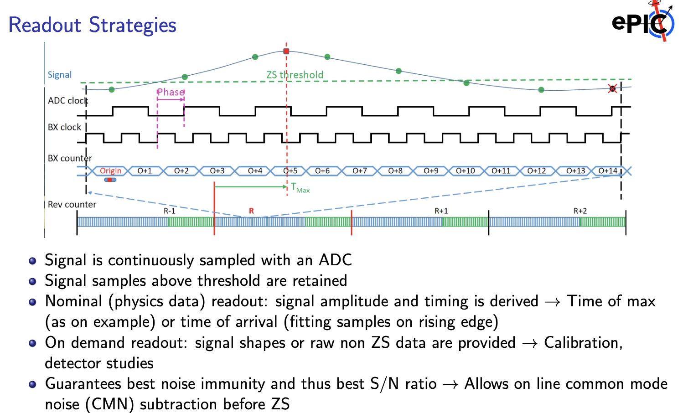
Requirements to the DAQ electronics
Start time t₀
Charge sampling at 50 MHz
Number of sampling larger than the maximum drift time
Precise t_{k} determination in the data stream: rise-time fit not the time of the maximum collected charge
ePIC Collaboration Meeting July 26 2024 – Annalisa D’Angelo
11

Slide 12

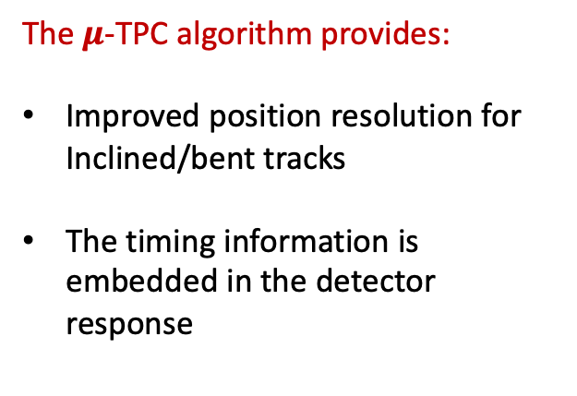
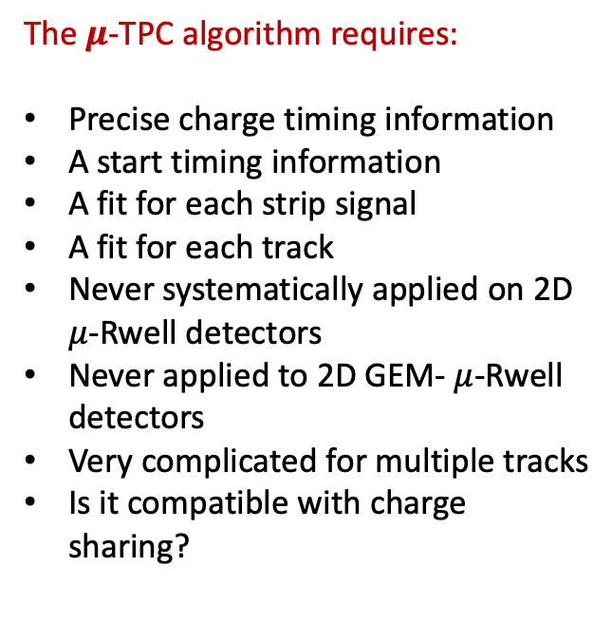
$μ$-TPC PROs and Cons
CONs
PROs
The $μ$-TPC algorithm requires:
Precise charge timing information
A start timing information
A fit for each strip signal
A fit for each track
Never systematically applied on 2D $μ$-Rwell detectors
Never applied to 2D GEM- $μ$-Rwell detectors
Very complicated for multiple tracks
Is it compatible with charge sharing?
The $μ$-TPC algorithm provides:
Improved position resolution for Inclined/bent tracks
The timing information is embedded in the detector response
ePIC Collaboration Meeting July 26 2024 – Annalisa D’Angelo
12

