Slide 1



Progress on SVT IB global mechanics design
Rosario Turrisi
Gustav Johann Grunewald
View of Bethlehem and South Mountain
ca. 1867

Slide 2
ePIC Padova
Activity planned in 2025
  Design and construction of SVT-IB global mechanic support
  Test and characterization of MAPS sensors (synergy with ALICE/ITS3, NA60+)
  Set up the 2nd production center of half barrels (under discussion)
Very welcome additional funding (DoE, eRD113):
  One PhD co-funded with Padova University (C. Pantouvakis)
  This year ~20 k€ funded, probably dedicated to critical instrumentation for sensor testing (not personnel)
The team:
  Two silicon sensors expert physicists (P. Giubilato, S. Mattiazzo)
  One post-doc, three phd students (also in other projects, ~1.5 FTE total)
  Two engineers (M. Benettoni, P. Rebesan)
  One CAD designer (M. Turcato)
  Workshops support in 2025 (mildly adjustable to needs)
    two person-months from mechanical workshop
    two person-months from electronics workshop

Slide 3
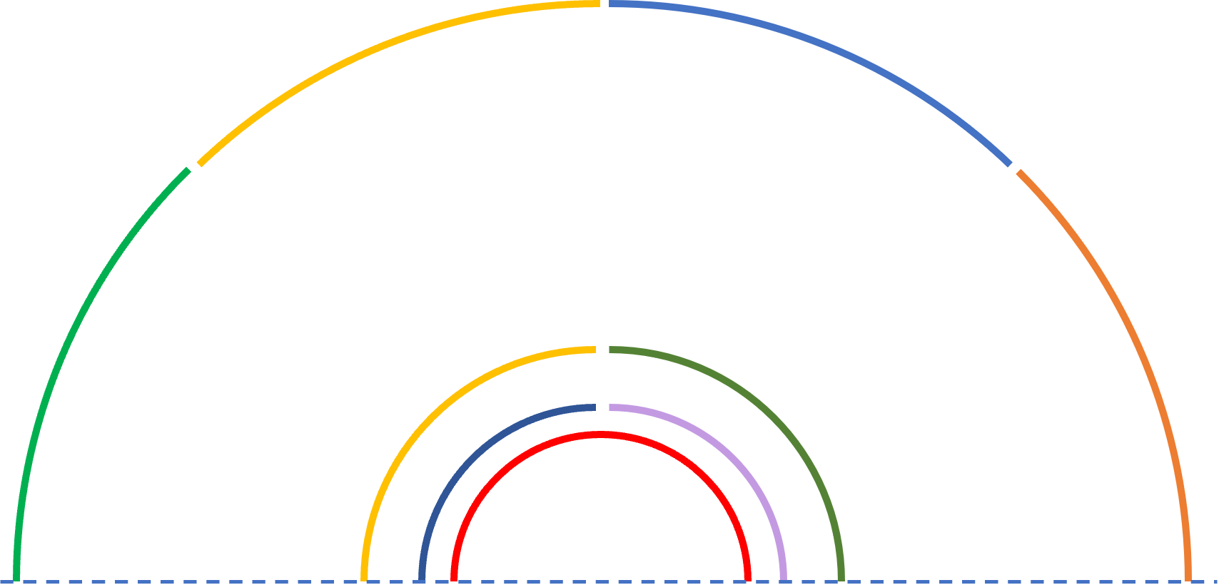
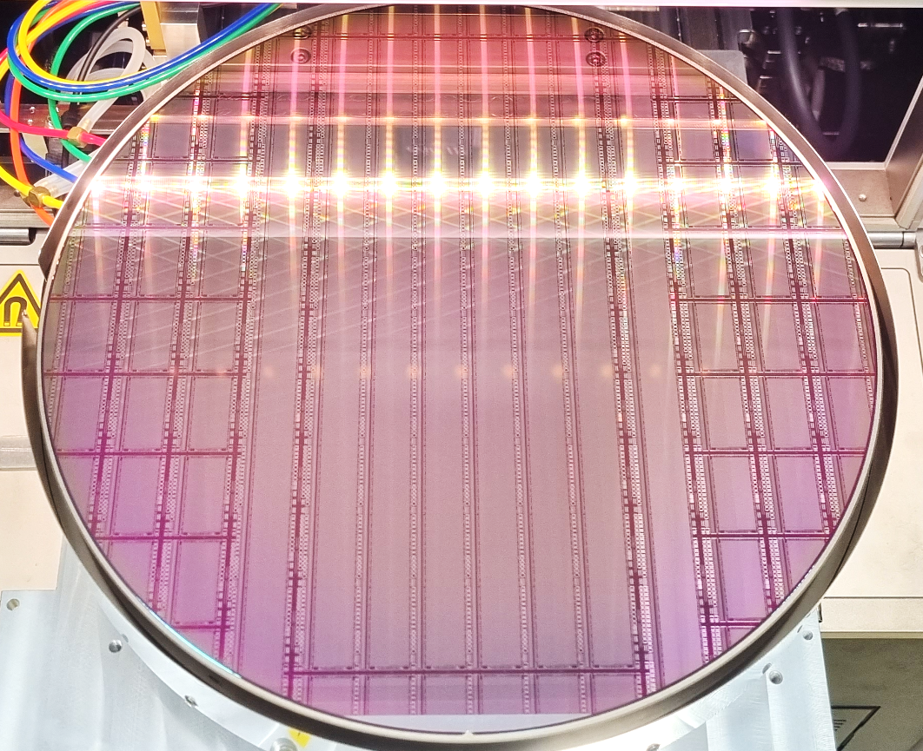
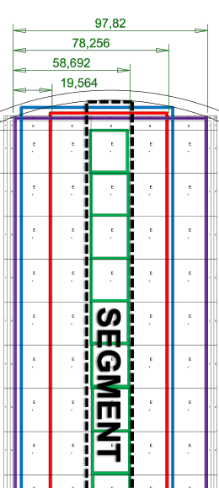
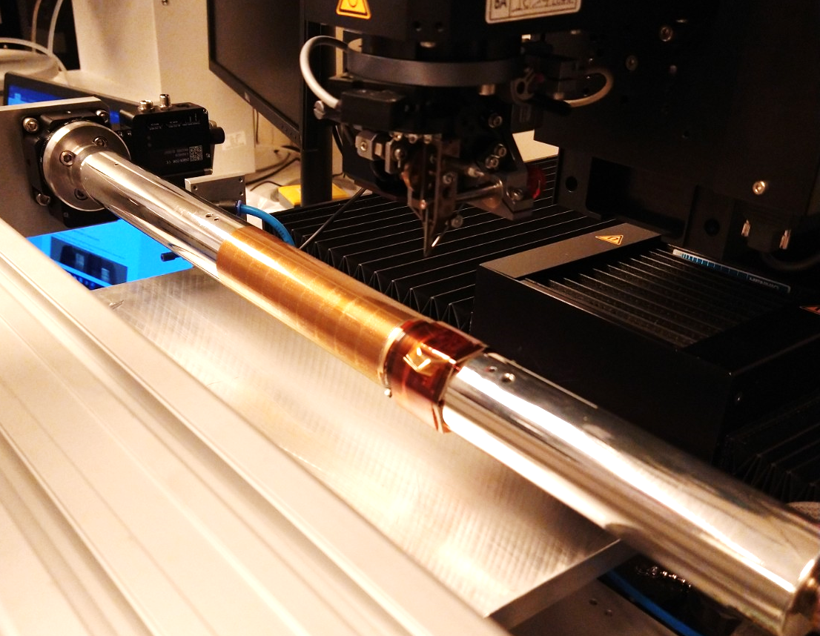
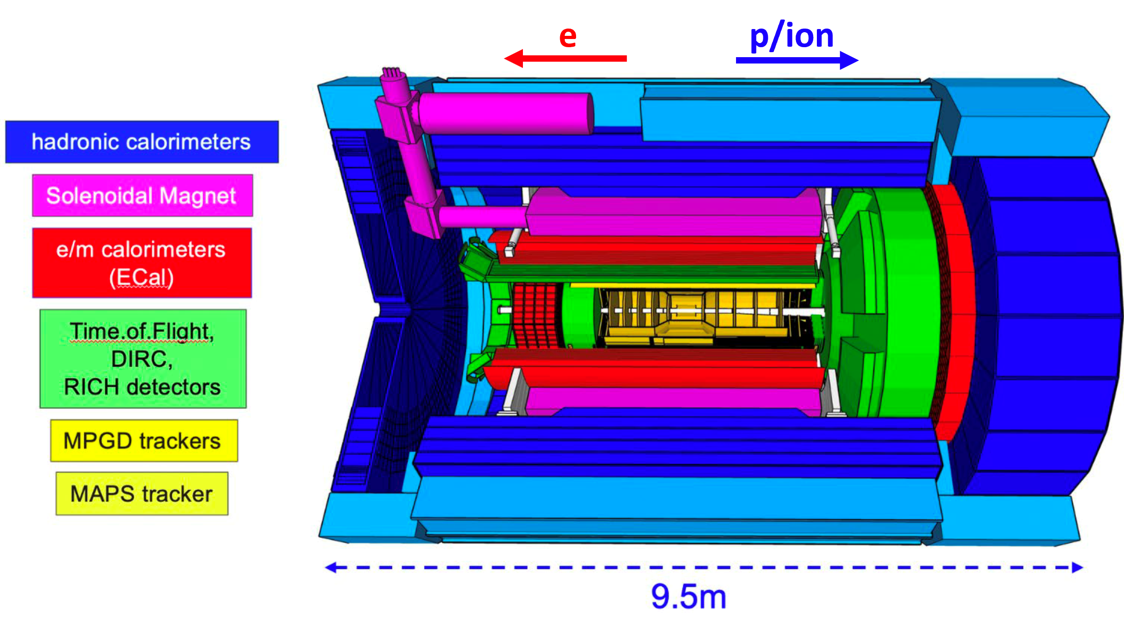
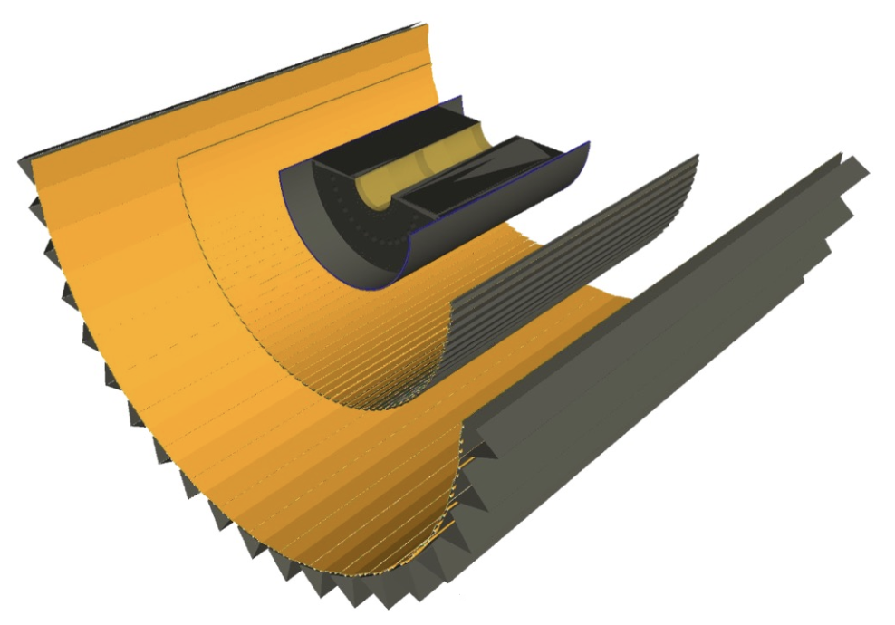
Generalities about SVT
high precision tracking
hermeticity
high position resolution sensors
low mass
From DIS to exclusive process
low power
From ALICE/ITS3 development
65 nm TPSCo technology with bent silicon sensors!
L2 (4 x sensors) r = 125 mm
L1 (2x sensors) r = 50 mm
L0 (2x sensors) r = 37.5 mm
beam pipe r = 31.75 mm
inner layers (3)
Thinned down to 50 μm
Pitch 21 × 23 μm
40 mW/cm² power dissipation ( ~800mW/ cm² in the LEC)
0.05% X /X₀ (just the sensor)
~ 3.3 g Si/sensor

Slide 4
General thoughts about global support
Assembly procedure drives the design of the support
Need to have as low as possible X, at least in the e-side
Preliminary design with best-guess quotes (from G. Viehauser)
OB/IB supports are two separated objects
Just a reminder about properties one wants to find in the materials of the support/services (probably not exhaustive):
  low X₀
  hydrophobic
  insulating
  thermal and chemical stability
  chemically not ‘’dangerous’’ (e.g. no fluorine)
  no flammability (and at least highly self-extinguishing)
carbon fiber composites
carbon foams
kapton (and maybe other polymides)
not all properties are always satisfied…but can work on this
e.g. CF is hygroscopic…and conductive at high frequency!
but can be treated with parylene coating…

Slide 5

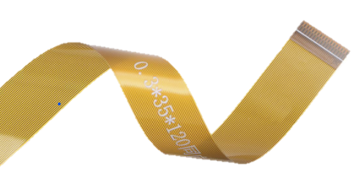
Starting points for services
FPC’s ITS3-inspired, but with mandatory differences, to be updated along the way…
now 250*20*0.75 mm
Cooling: a first guess on air distribution on the layers
e-side
cables or FPC’s?
we tried with the first hypothesis as a placeholder, to figure out the possible routing – one cable per phase/ground, 1 mm ∅
?
h-side
‘’local mechanics’’

Slide 6
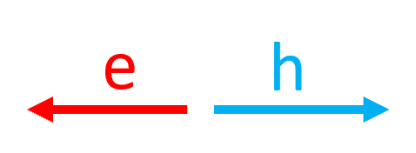
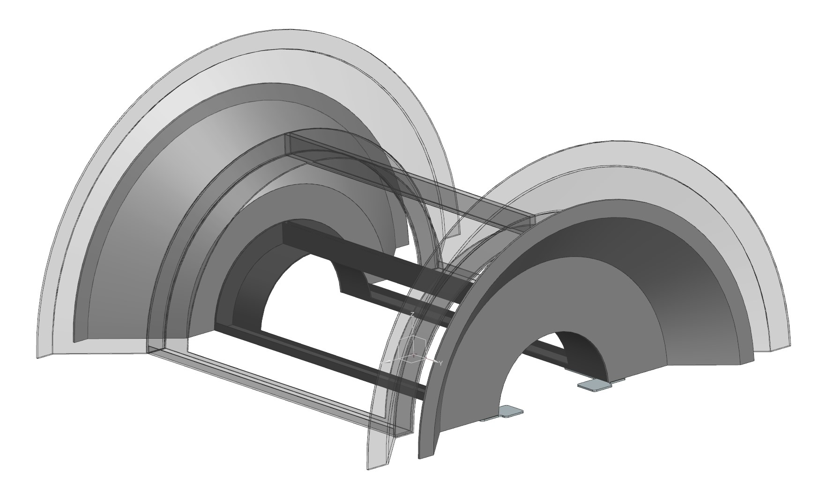
SVT IB global support design
Updated radii from ITS3 TDR sensor size
+ 0.5 mm spacing between sensors
L0 → r = 37.5 mm
L1 → r = 50 mm
L2 → r = 125 mm
IB half barrel support
Material of the support: likely, carbon fiber composite (CFC)
Symmetric design e-h side, but for cables routing
Half-cones to support IB and connect to OB
Frames to support the sensors (on their local mechanics)
Light-material wall (kapton or other polymide) to protect L2 while minimizing X/X₀ in the sensitive area
CAD by M. Turcato

Slide 7
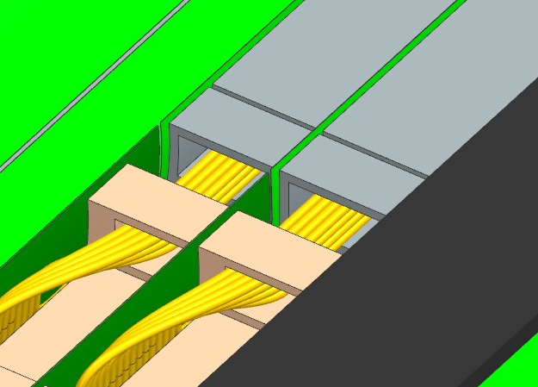
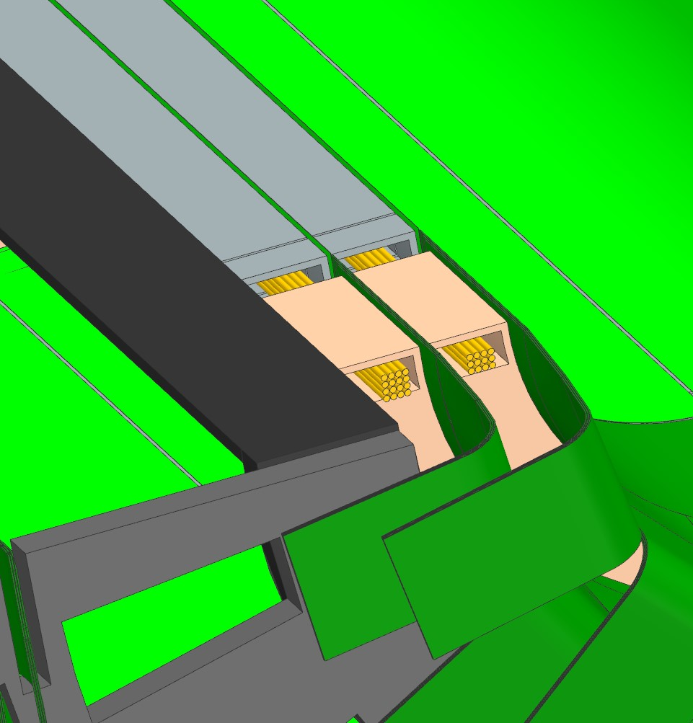
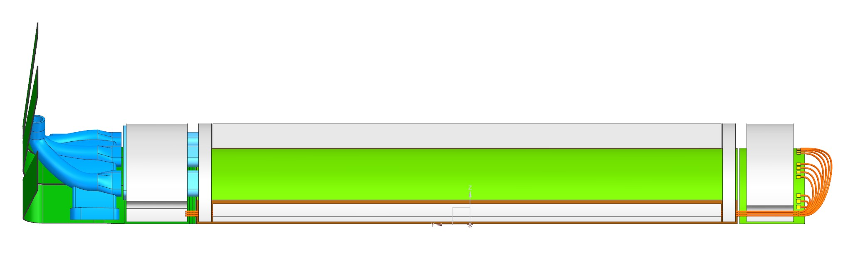
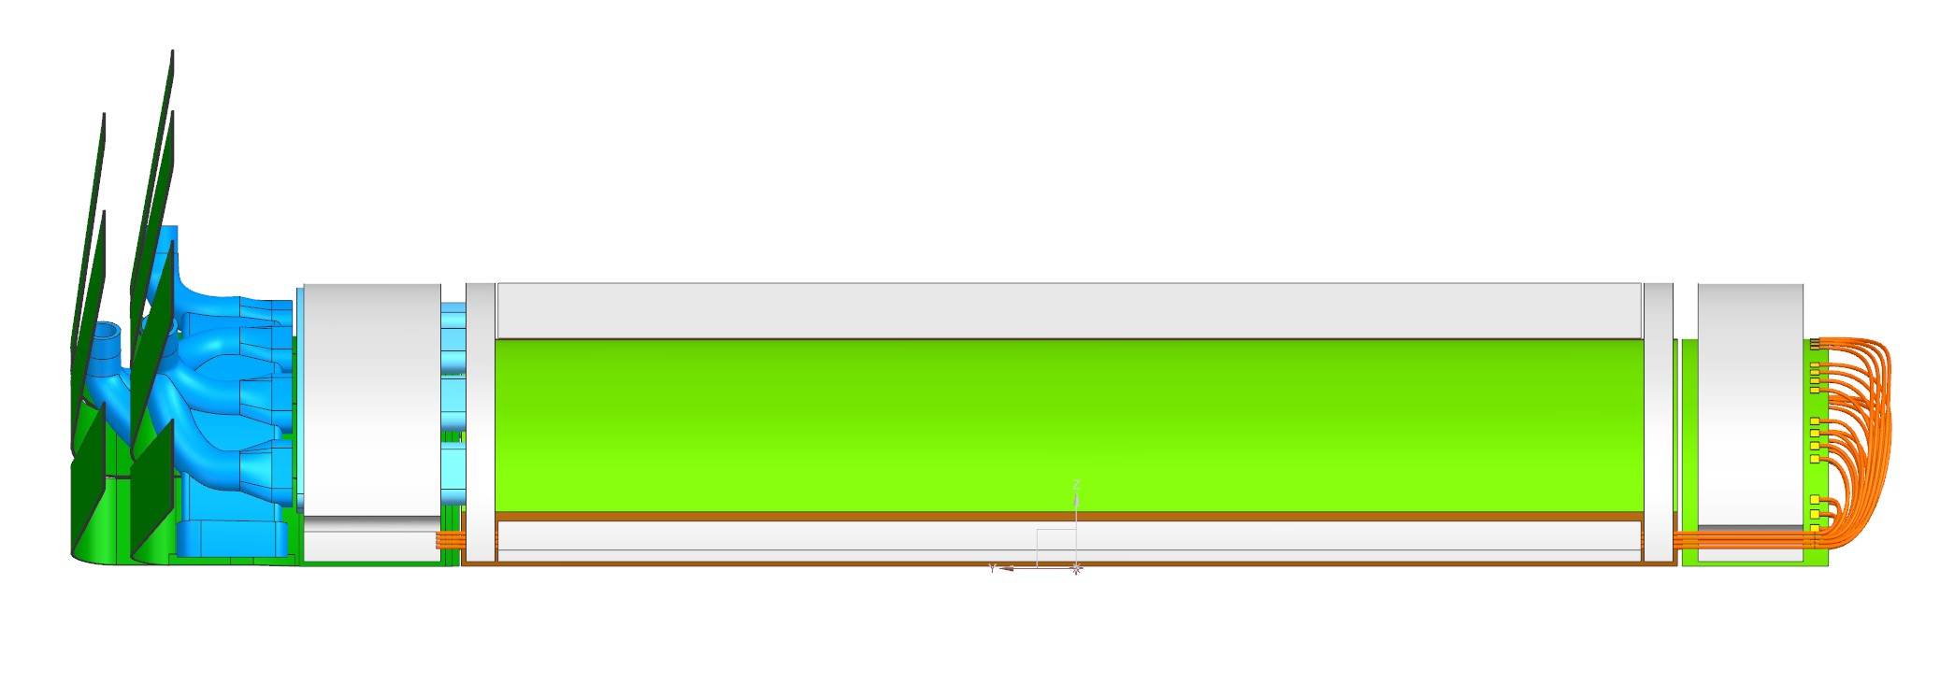
L0-L1 local mechanics
FPC’s 250 × 20 × 0.75mm
cables ∅ 1mm
L0+L1 with local support structures
WARNING: here cable trays are supposed in CFC instead of carbon foam → to be defined!
Carbon foam ‘’rib’’, positioned on the facing borders of the two sensors
Air collectors are ‘’manyfold’’: one input 3-4 outlets L0-L1 resp.

Slide 8
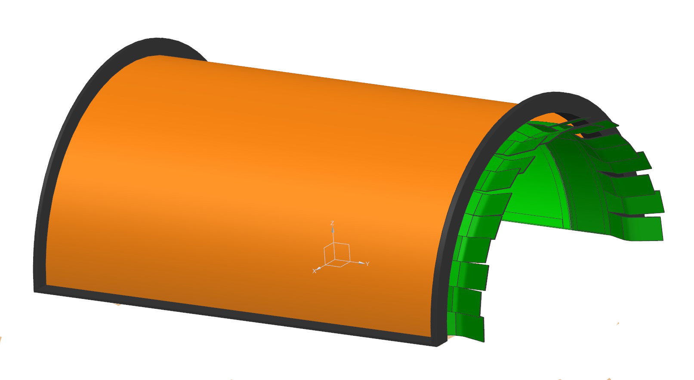
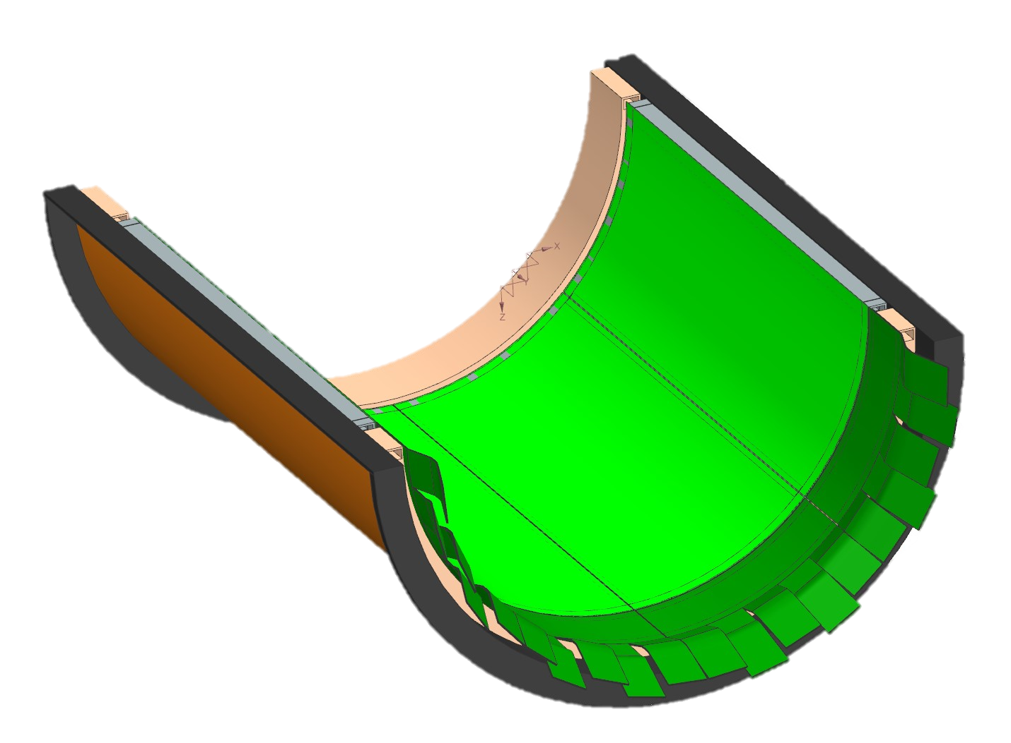
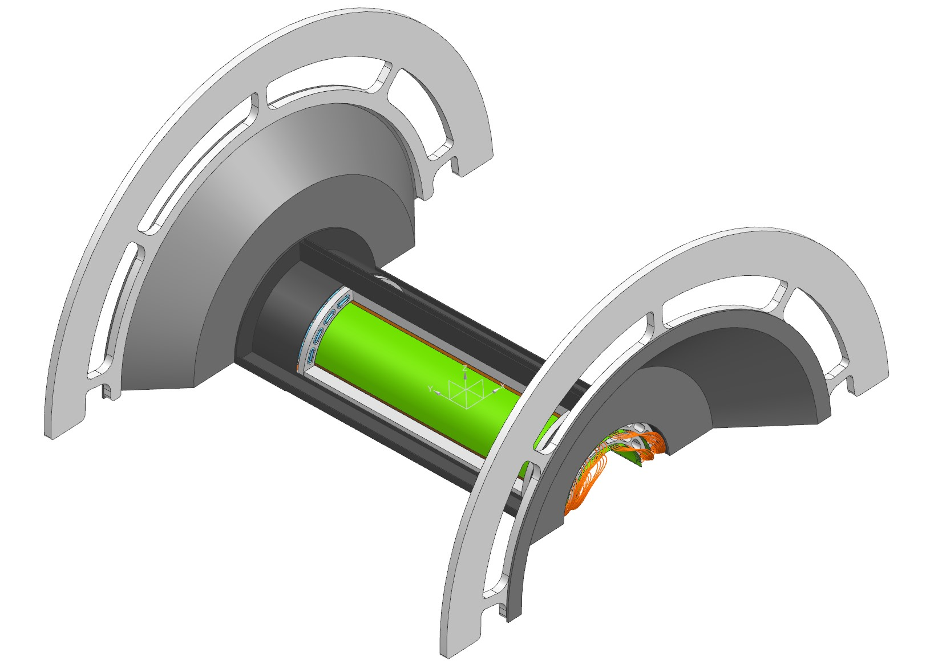
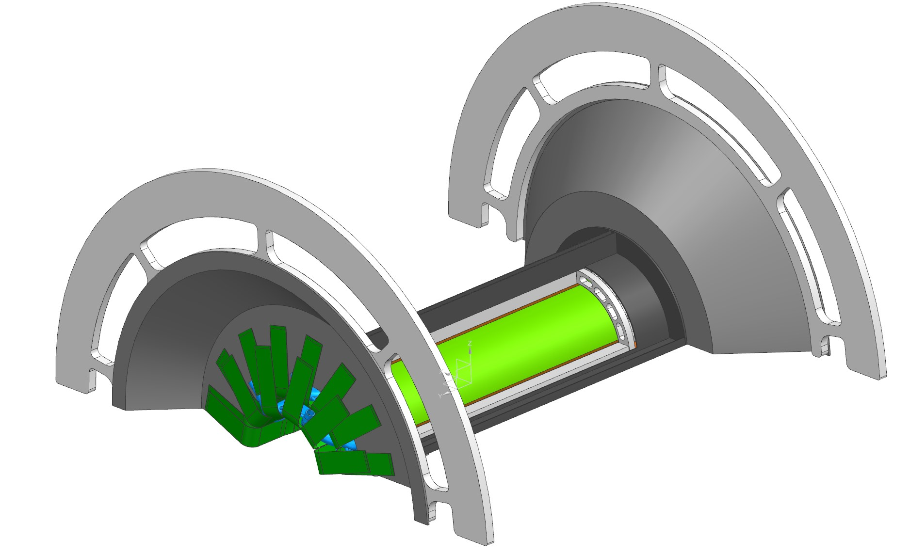
SVT IB mechanical support L0+L1, L2
L2 on its frame (current guess - details to be discussed with MIT)
L0+L1 on global support
Kapton
Frame (CFC) to support the sensors
Frame to hold the half-rings and longerons supporting the sensors
L0+L1 on global support

Slide 9
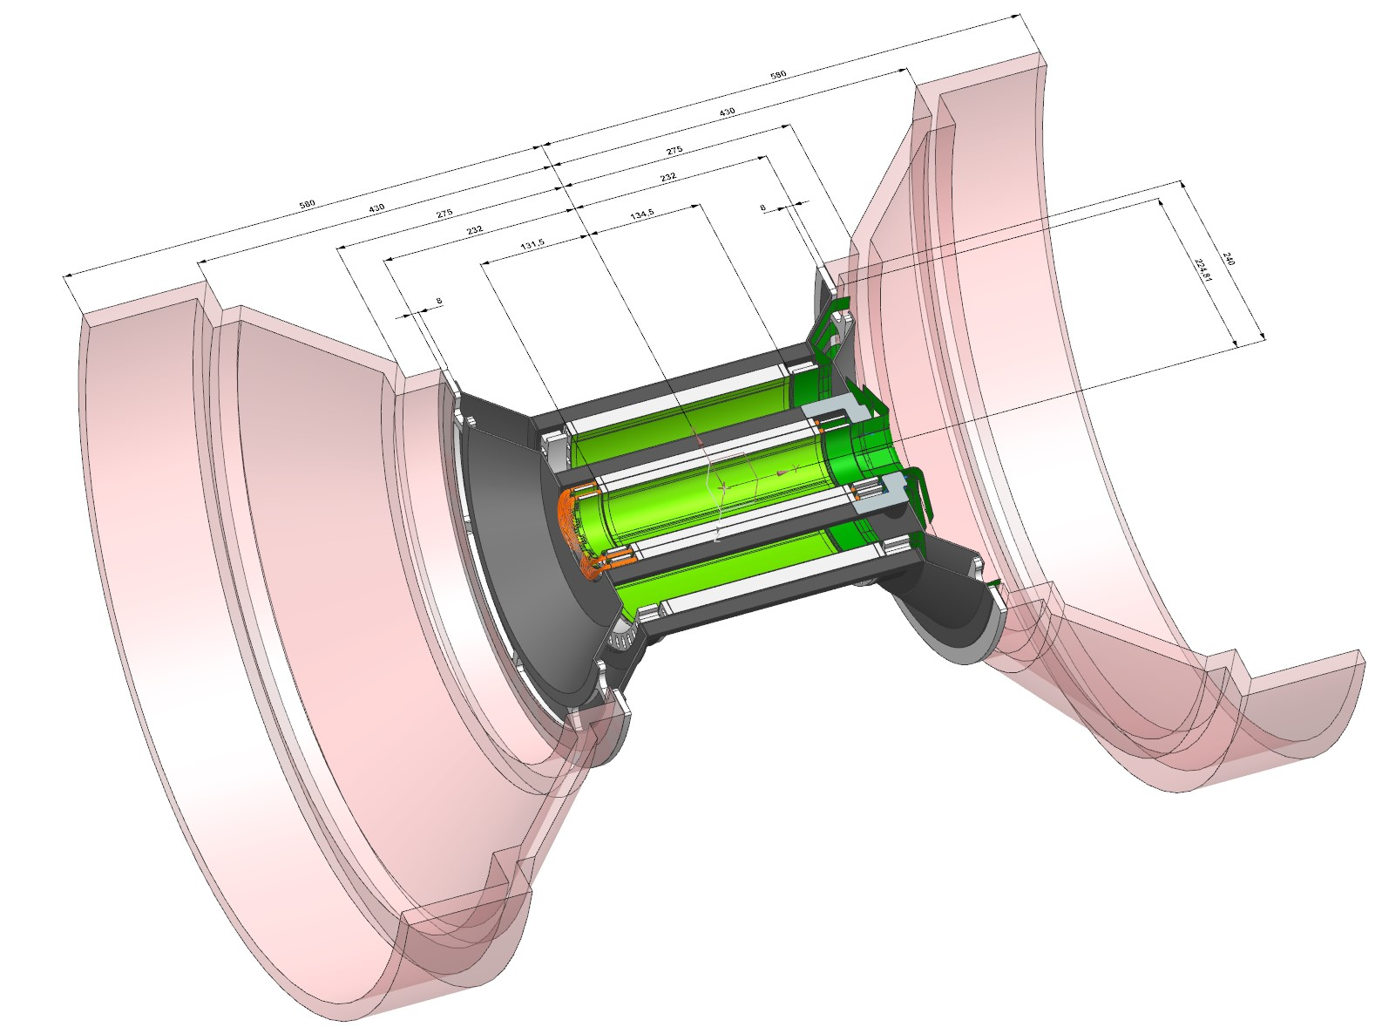
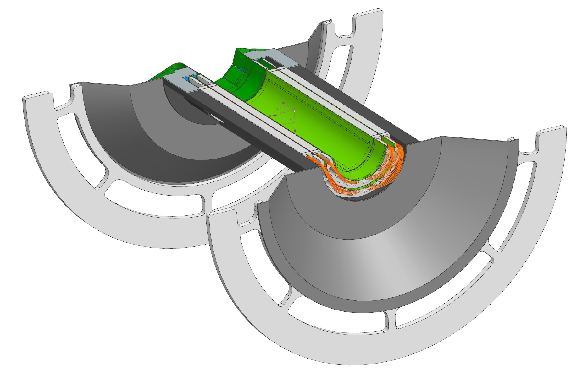
SVT IB connection to OB
The ‘’first’’ sketch (slide 4) expanded here in 3D
→ just for a first guess of the connection IB-OB
L0+L1 on the global support with the flange for L2 support and OB connection

Slide 10
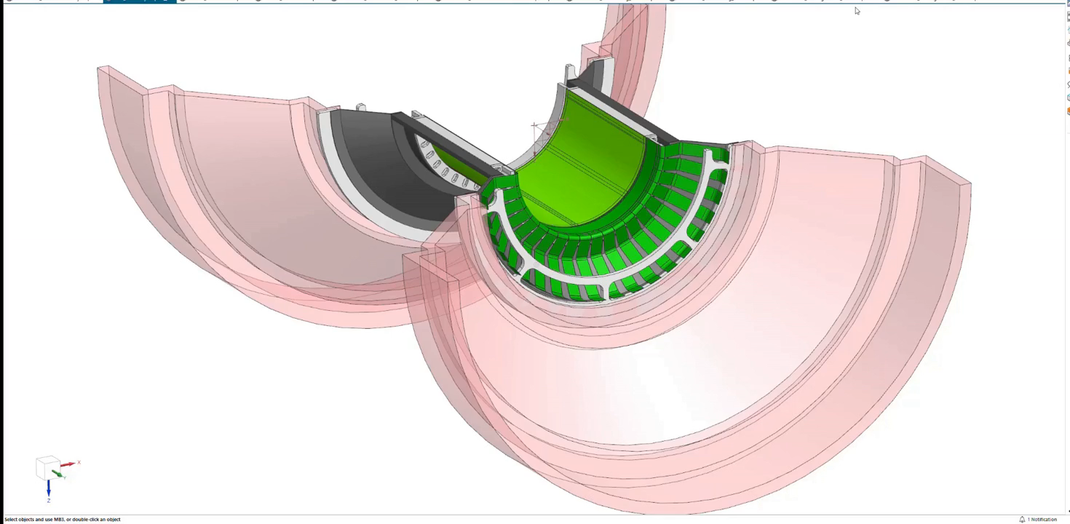

Slide 11
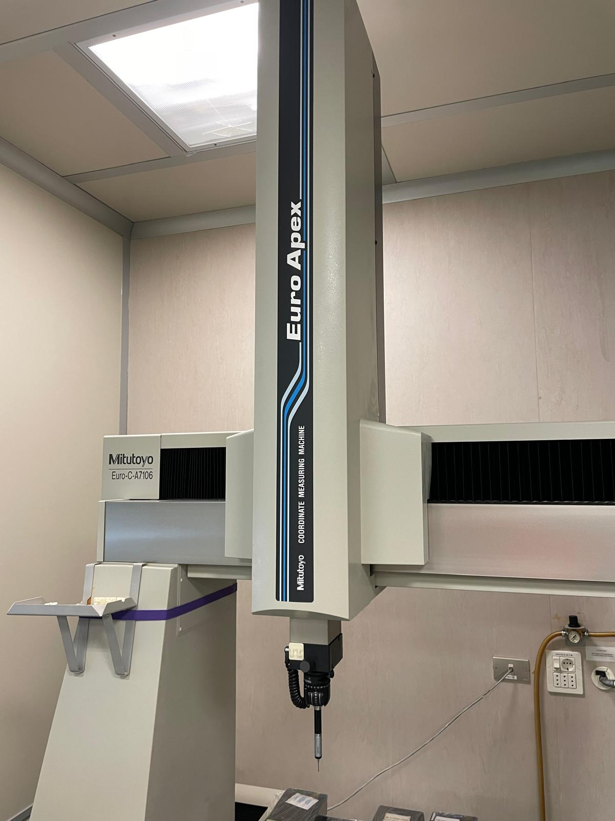
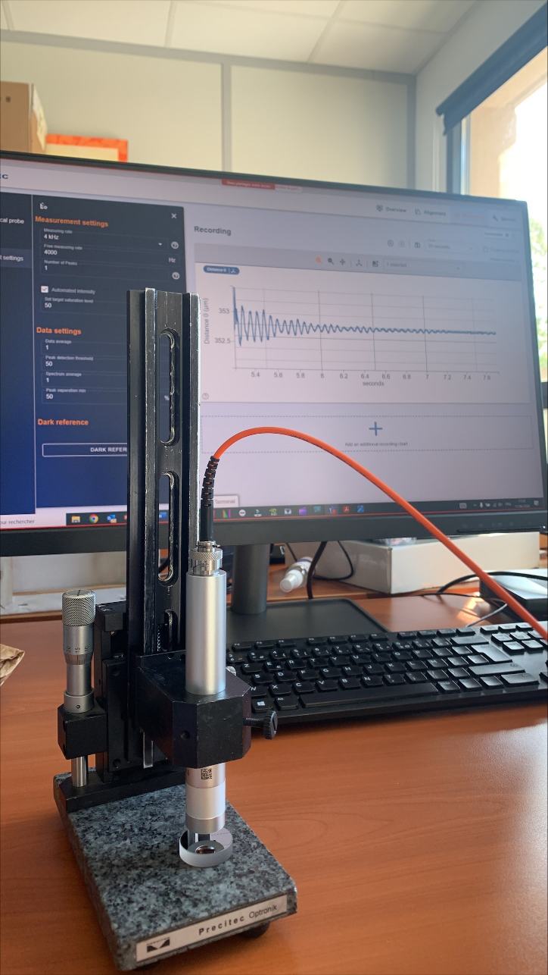
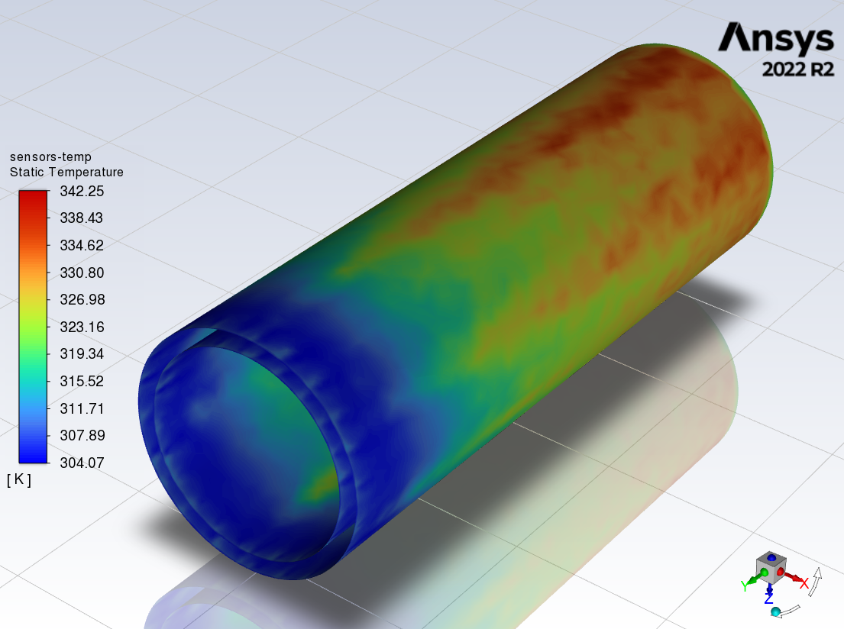
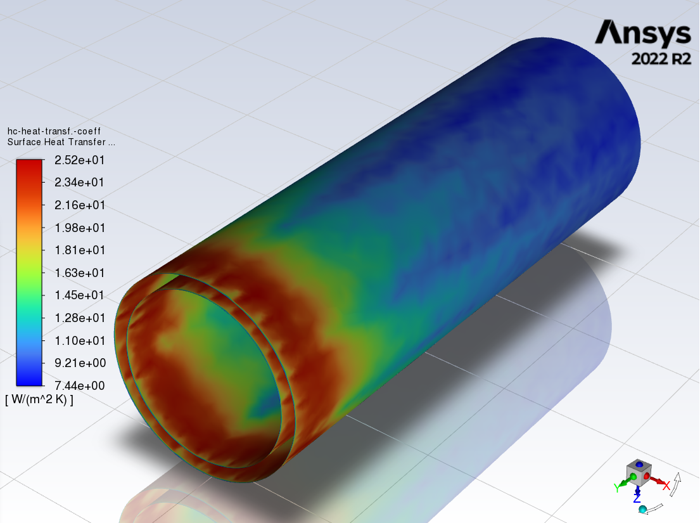
Test it
Mitutoyo Euro C-A7106
700 mm bore, 0.05 μm step
  Mock-ups at increasing level of detail will be produced
    First is coming after the summer break, 3D printed with common PVC wire
    Test assembly procedure, alternatives for routing of services, etc.
    Updating the design while details come in (FPC’s, cooling…)
  Mechanical precision
    Prototypes and final supports will undergo a mechanical survey with Mitutoyo measuring machine
    On the same bench (for best mechanical stability) a vibrational test can be performed with a position measurement tool (confocal chromatic sensor), looking for air flow-induced vibrations
  Material budget test
    C. Bonini (PhD student) in charge of CAD->GEANT4 translation will provide material budget maps (developed a working procedure, already tested)
  FEA thermal analysis
    started to have in-house reference for mechanical model refinement after verification on mock-up with heaters and comparison with FEA analyses from other teams
PRECITEC CHRocodile mini
4 kHz/10kHz sampling, axial resolution <=400 nm (to be procured)
L0+L1 40 mW/cm2, 15 m/s (!) air
flow between L0-L1 (12.5 mm gap)
T in/out hec in/out →
DISCLAIMER: ouput from a quick look
at a ‘’default parameters’’ run (few minutes)
F.e. check of permanence of turbulent regime,
effect of distance between layers, etc.

Slide 12
Summary - activities and plans
  CAD model of global IB support development
    need tight contact with MIT for L2 integration
  Production of mock-ups for various tests, mainly assembly and integration procedures
    First 3D print after summer break and definition of a few details, for a ‘’first-guess’’ assembly test
  Mechanical precision survey, vibrational tests FEA thermal
    Tools available, in progress
  Procedure developed for CAD → GEANT4 translation (two PhD students) to cross-check material choices with thickness maps
  Position, size of RDO cards, FPC’s design, size of connectors will help a lot for the routing/support of services (both cables and cooling)

Slide 13


Slide 14
Backups

Slide 15
Sensor testing/characterization
  MAPS development ''ALICE/ITS3-driven'. Testing and characterization activities - complete overlap with NA60+ and ePIC.
  Staff and students with experience in pre-post bending, pre-post irradiation (participation also to test-beam e.g. at FNAL) tests
  Tests on APTS (Analogic Pixel Test Structures) produced in the MLR1 (Multiple Layer Reticle 1) run for ITS3, containing some variants of MAPS for design definition, First submission in 65nm technology to TPSCo
  Testing system development for new ''stitched' structures still in progress
  2025: Sensor test preparation for next engineering run
FLAT/BENT comparison – ⁵⁵Fe spectrum
FLAT
LONG EDGE
SHORT EDGE
LONG EDGE
DAQ board
Proximity board
Carrier board
APTS chips sensors test
electronic chain

Slide 16
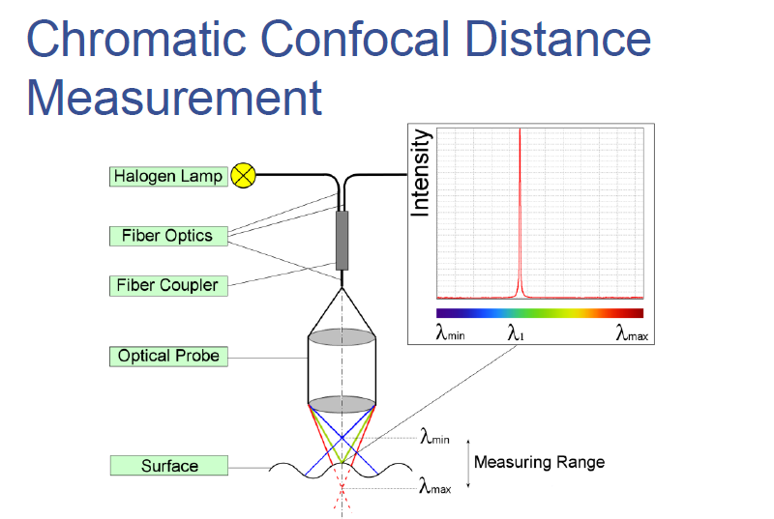
Confocal chromatic sensor principle

Slide 17
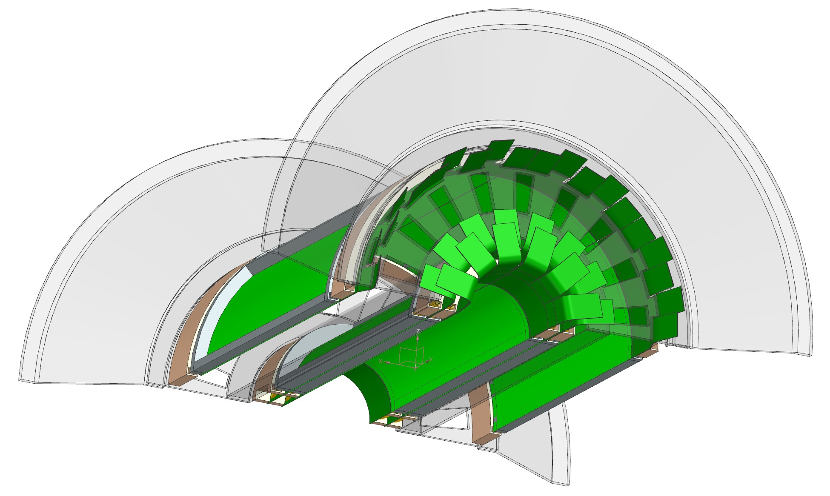
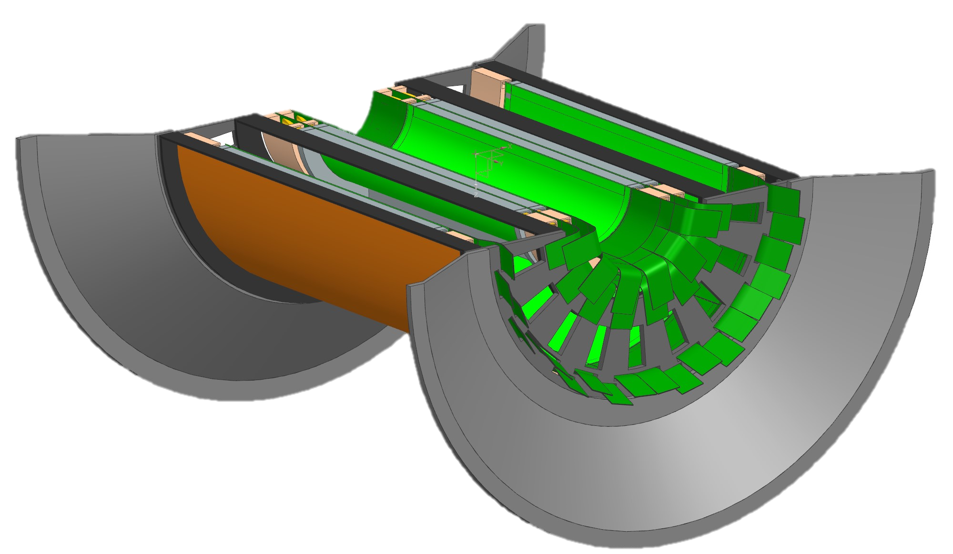
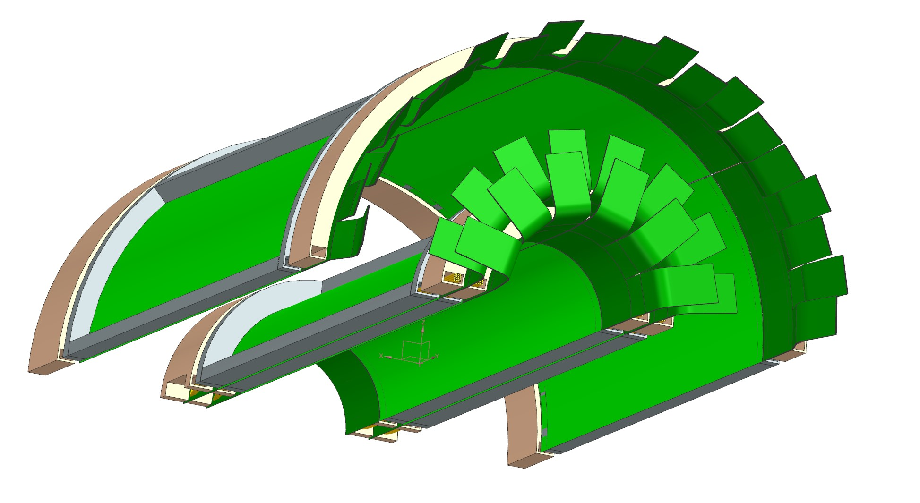
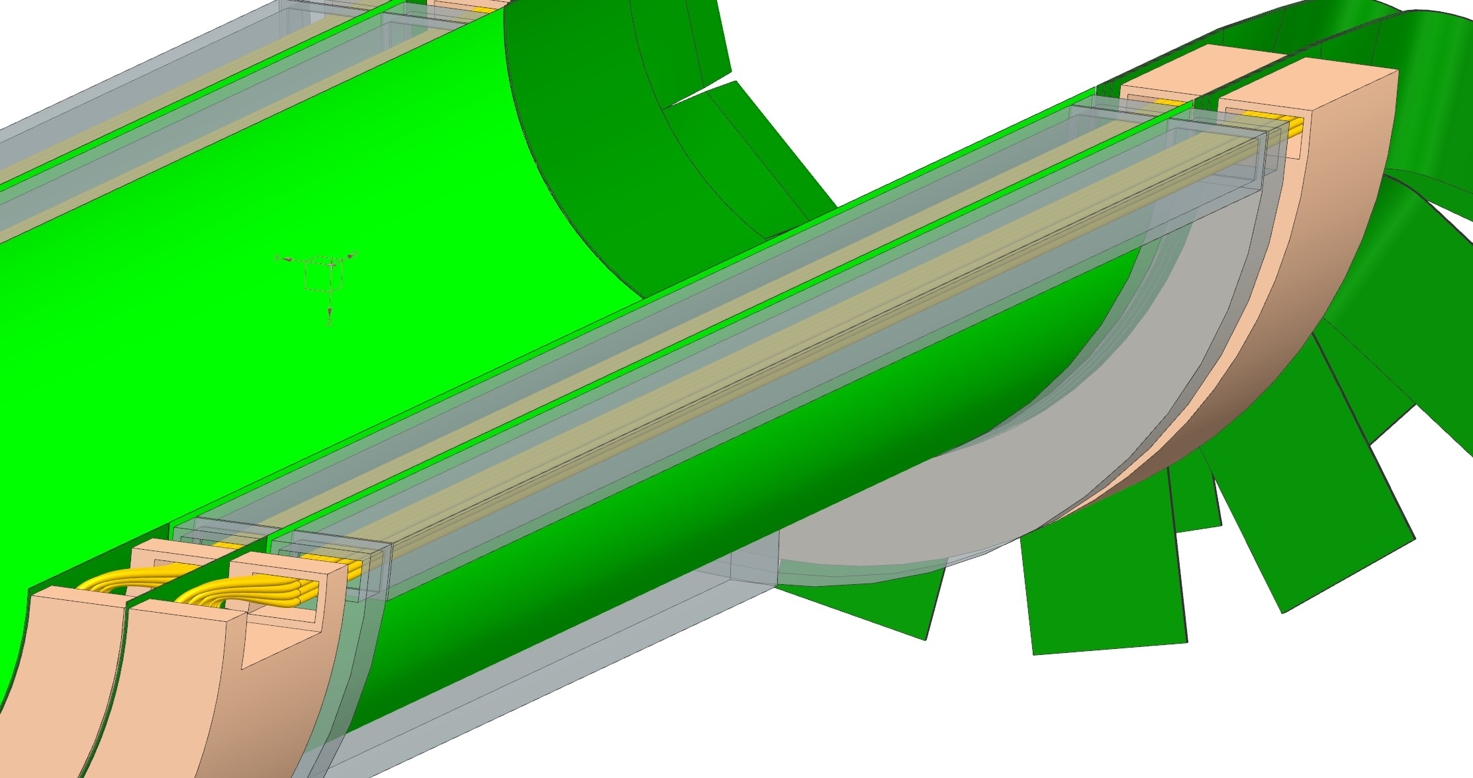
SVT IB half barrel assembled – previous model
Final mechanical assembly (cooling is missing):
CAD by M. Turcato

