Slide 1
ITS3 mechanics and cooling
Slides from Aitor Amatriain at the Forum on Tracking Detector Mechanics 2023 (https://indico.cern.ch/event/1228295/contributions/5390941/attachments/2657320/4602244/FTM_Amatriain_20230601.pptx)

Slide 14
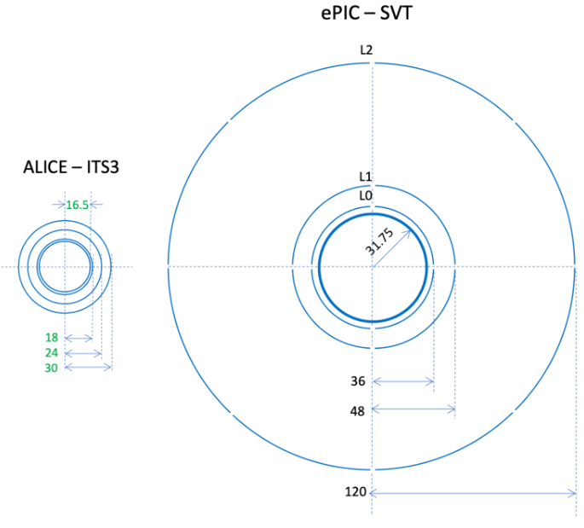
Comparison ITS3 - ePIC
Significant radius difference already for inner layers
Length is similar
In particular, L2 has a much larger radius
For outer layers length and radius are different
Also, mounting a large number of sensors onto a large foam cylinder seems challenging (yield etc.)
But maybe we could segment the cylinder…

Slide 15
LBNL foam cooling studies

