Slide 1
Introduction

Slide 2
Goals of the meeting
Purpose:
Come up with an (or a small number of) idea(s) what the ePIC SVT outer layer mechanics could look like
Agree on a distribution of tasks
Target:
Primarily: SVT outer barrel layers (L3 & L4)
Including global supports, service management and cooling – this is likely to be the UK deliverable
But, if there are good ideas for inner layers or disks, or implications from the outer layer design for these parts we can bring these to the collaboration as well

Slide 3
Some context
Still many unknowns in the project (see later)
The EIC project needs to progress according to the DOE Project Path through a series of Critical Decision (CD) Milestones. Delaying CDs is not an option for a DOE project.
This means that the EIC project needs to demonstrate already now a level of detector technological readiness that is beyond where DSC are in term of R&D.
Situation was created by funding delays & lack of critical mass to start R&D in earnest (affects many sub-detectors),
As such, project engineers work on best “guesstimates” provided by the DSC
Project engineers have shown a tendency to re-use previous technological solutions rather than looking at more recent developments
This is being remedied now – with the formation of the ePIC SVT collaboration…
More institutes have joined! Meaning more people to do work and more experts that can help steer detector choices towards innovative, (beyond) state-of-the-art solutions
Project has been divided into WP and WP leaders - most relevant here: WP4 Layers and disks, Nikki Apadula (LBNL) and Georg Viehhauser (Oxford)
In the process of finalizing a Work Breakdown Structure (WBS)
Next step is collection of system requirements and specifications
This clearly is necessary for any progress on the mechanics and service management
However, as will be discussed, there are central system specs that will only be finalised well after the mechanics and service designs are required for CD reviews
Our solutions will have to provide flexibility to accommodate these changes
At the same time, the project knows their current integration scenarios will need updating

Slide 4
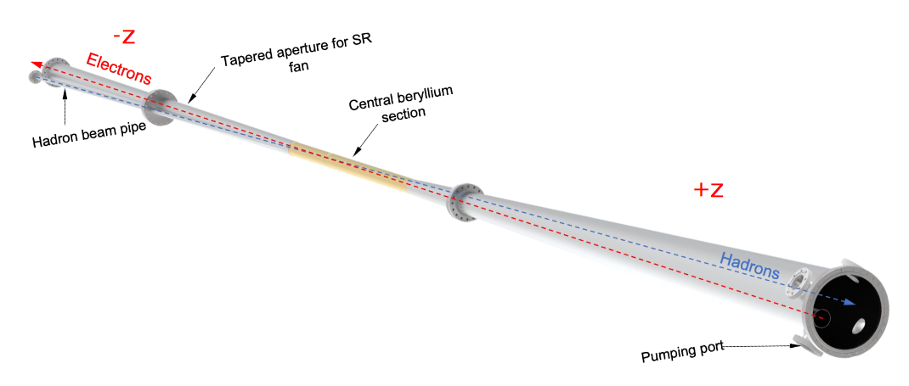
Knowns
Basic layout
This will be a MAPS detector
ALICE ITS3 wafer-scale sensor for IB
EIC Large Area Sensor (LAS) design derived from ALICE ITS3 sensors for OB/EE/HE
We have no control over specs and timeline
For further discussion of current size and considerations see James’ talk
Material requirements:
Material per layer L0‒L2: 0.05% X₀,
Material per layer L3: 0.25% X₀,
Material per layer L4: 0.55% X₀,
Material per disk: 0.24% X₀
Another consideration:
Lower material is wanted on the electron-going side (-z in the ePIC coordinate system
Momentum transfer measured primarily from the scattered electron, so we need to measure that scattered electron as well as possible.
The beam pipe is flared
$→$ At least the inner layers and disks
need too be designed so that they can be split
That does not require a split of the outer layers, but it might facilitate integration (we become more independent of actual integration sequence)

Slide 5
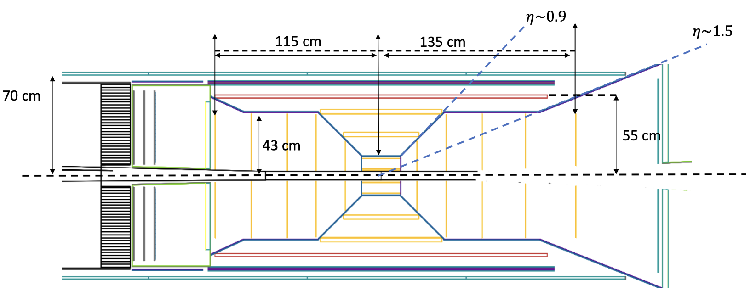
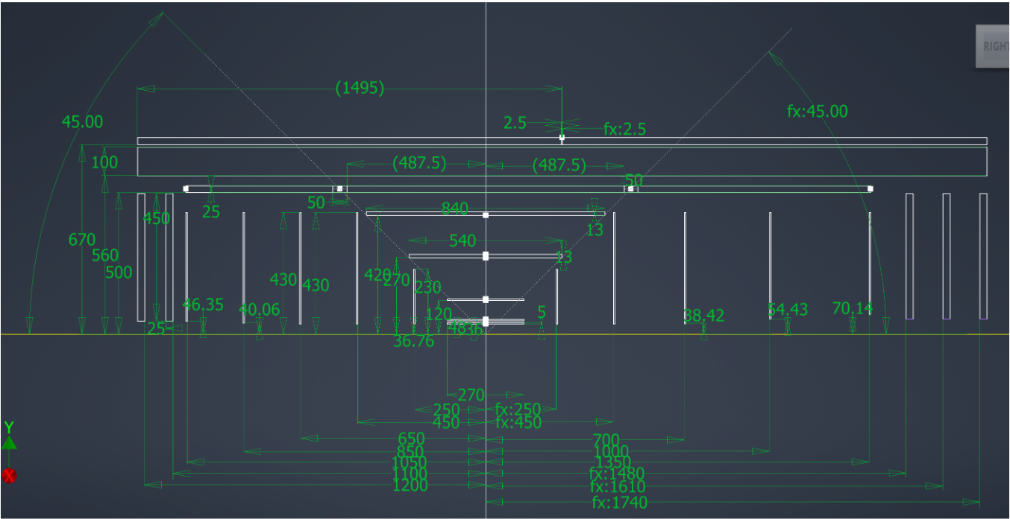
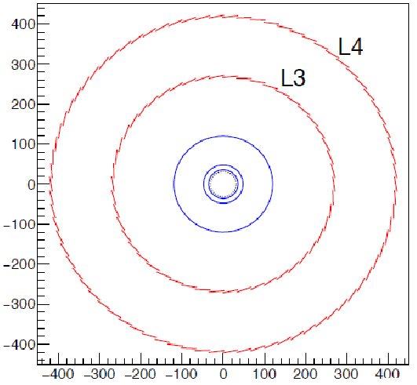
Layout
Inner layers (L0-L2) wants to follow the ITS3 design with bent sensors (see later)
Outer layers probably staves
SVT in yellow
Other tracking systems: MPGD and LGADs

Slide 6
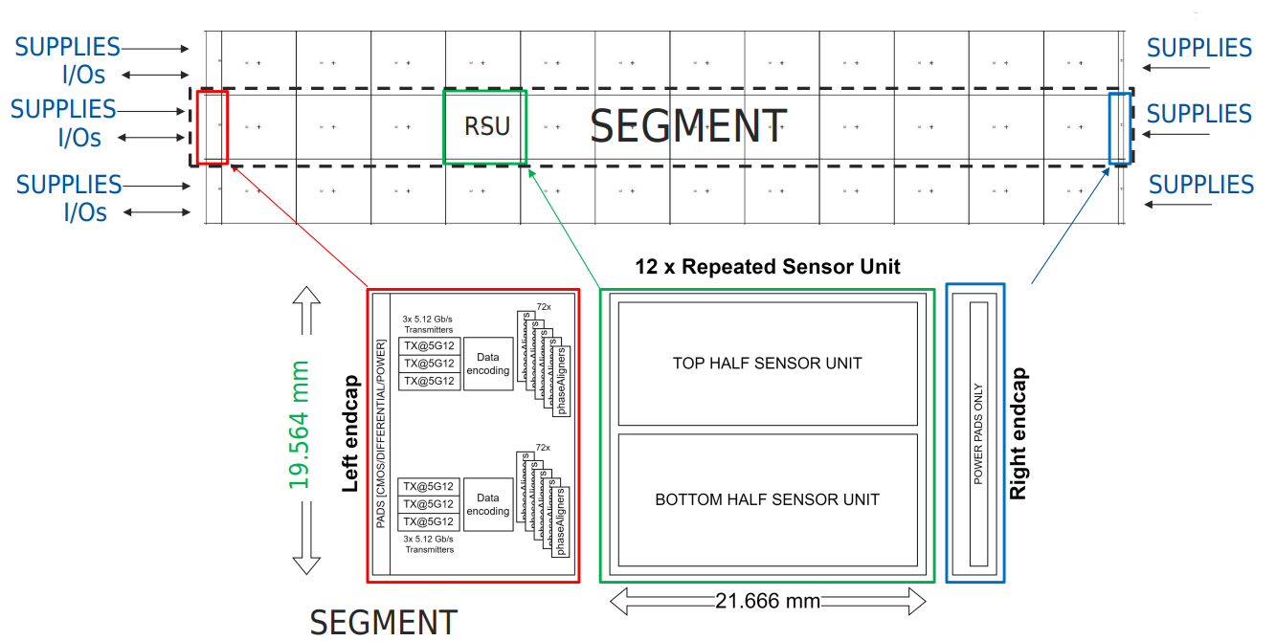
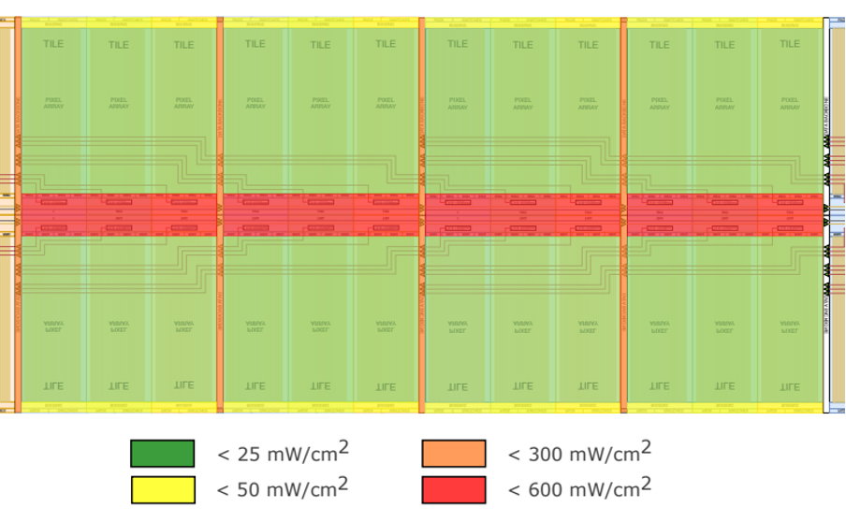
Sensor
RSU size: 19.564 mm (w) × 21.666 mm (l)
Endcap size: 4.5 mm (L), 1.5 mm (R)
Sensor thickness
Inner layers 20-40 μm
Outer layers 50 μm
Power density
RSUs are connected by “stitching”
Currently considered for outer layers: a Large Area Sensor (LAS) comprised of 5 or 6 RSUs, and only left endcap
Power density in the left endcap: 900 - 1200 mW/cm²

Slide 7
FPC
More on this later, but here just to introduce:
Sensors will be connected to Flexible Printed Circuit (FPC)
Length of the FPC < 50 cm, width not known
Connected to readout board - RDO (ALICE calls this the detector service board – DSB)
RDO will contain significant power sources, so will need (liquid/evaporative?) cooling – exact power not yet known
RDO design and size not known
Data from DSB likely by optical fibre
Cables for power
Readout scheme for ePIC still under discussion (see Laura’s talk)
ALICE readout scheme

Slide 8
Cooling
Radiation damage is not an issue, so no need for going cold
Operational temperature is room temperature, no temperature cycling
Power for SVT estimated about 5kW
Ideally we want to use gas cooling, at least for the inner layers
See talk on ITS3 design on how this could be done
Air flow through foam
LBNL is investigating this actively
Probably worth looking into also for outer layers (even power density might be higher in outer layers)
It is conceivable that there will be areas with high power densities that require fluid cooling
The project baseline is liquid cooling based on previous experience
Currently investigating sub-atmospheric water
Evaporative cooling a possible alternative (would reduce material and service volume)
If we use gas-cooling:
Where is the heat sink (do we need to bring in the gas from the outside, do we exchange heat locally)?
How do we move the gas (Pressure set externally, or local fan system)?

Slide 9
Summary and timeline
Main unknowns
Number of RSUs per sensor is converging to 5 to 6, but might change when yield is known
If we rely on stitching (baseline, for alternative see more on this in discussion on flex circuits), this will depend on yield
$→$ mechanics design needs to be flexible
FPC design and connections
Cooling technology
Timeline
TDR by end of 2024
By then we need technology choices and a demonstration that all ingredients to deliver them work

