Slide 1
Some ideas

Slide 2
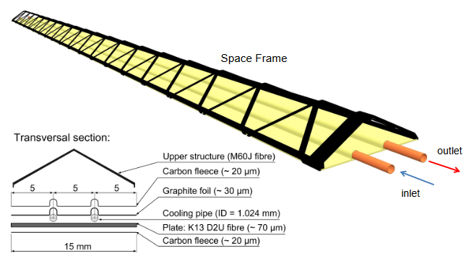
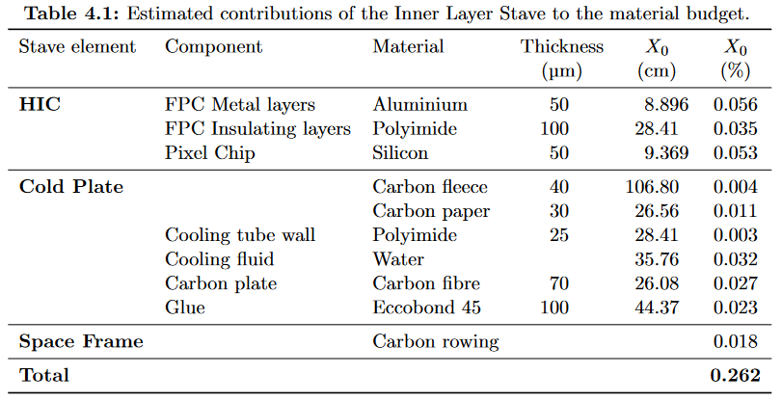
Truss structure
ALICE ITS2
This design was used to define the ePIC SVT performance parameters for the outer layers
I can’t see how this will work with gas cooling
But then, it seems to work well (low material) with liquid cooling
Length: 270 mm
B Abelev et al and (The ALICE Collaboration) 2014 J. Phys. G: Nucl. Part. Phys. 41 087002

Slide 3
Concept for a foam-based stave
Silicon: 0.05%X₀ for 50 μm thickness
FPC: For example ITS2 ~0.09%X₀
Use a foam core
For shear strength and to conduct air and heat
Other means to maintain shear strength (ribs etc.) probably more material
RVC (Al or SiC?)
Typical density about 3% of bulk material
Radiation length for SiC foam is > 3000 mm
$→$0.17% X₀ for 5 mm thickness (this is probably overly conservative…)
Enclose to guide air flow
Enclosing layer of Kapton foil
Radiation length for Kapton is ~300 mm
$→$ 10⁻²% X₀ for 25 μm
Bending stiffness from single layer of UHM fibre (K13C2U?)
Ultra-thin plies (other fibres) down to 30 μm
Such thin plies need very careful handling (using handling tools, elevated temperatures during lay-up, etc.) because they are likely to split
Also, sharp corners are difficult
Radiation length ~250 mm
$→$ 3×10⁻²% X₀ for 70 μm

Slide 4
Conceptual sketches
End view
Consisting of two half shells
Possibly could co-cure the sandwich
CF coverage could be optimised
Side view of foam core
Top shell has complementary castellations
FPC can run underneath castellations
x scale : y scale = 10:1
What would be needed next:
Verify mechanical performance with FEA
Optimise choice of foam (how low a density can we get? What is the radiation length?)
Detail joint of half shells (how do we make this gas-tight) – maybe angular Kapton strip with runny epoxy
Detail FPC underneath castellation
Is the air flow enough, or do we need to embed cooling pipes into the foam?

Slide 5
Stiffness issues
Stiffness of staves might not be sufficient to work over a ~ 800 mm span
Several options:
Intermediate support rings
If needed for L3 this would introduce additional
material before L4
Link adjacent staves
Stiffness would now be defined by the huge moment of inertia of the complete cylinder
Effectively it means that it is defined by the buckling stiffness
And that’s probably dominated by the distance between links
Could be (floating) support rings as above, or something more local
End rings
Staves

Slide 6
Solution 3: Staves under tension
Outer support cylinder
Staves
Tensioning elements could be Kevlar filaments
Want something that has high strength, but moderate modulus
Possibly also include springs to maintain tension at defined level
End rings
This could be a solution for L3 (in that case L4 would be the support cylinder, but buckling of L4 would need to be prevented…)

