Slide 1
Toward a global analysis of GPDs through GUMP
Xiangdong Ji
U. Maryland
Guo, Ji, Shiells, JHEP 09 (2022) 215
Guo, Ji, Santiago, Shiells, Yang, JHEP 05 (2023) 150
G. Santiago et al, to be published
RBRC Workshop: Workshop on Generalized Parton Distributions for Nucleon Tomography in the EIC Era, Jan. 17-19, 2024

Slide 2
Outline
GPDs, variables , analyticity, and difficulty with global analysis
PDF moment parametrization & GPD conformal moments
Parametrizing conformal moments and test fitting
An example of global analysis
Conclusion

Slide 3
GPDs, variables, analyticity, and difficult with global analysis

Slide 4
Generalized parton distributions
GPDs interpolate two well-know bound state properties:
Form Factors (since 1950’s)
Parton Distribution Functions (since 1970’s)
  Introduced first in 1994 by D. Muller et al, for its interesting UV evolution properties.
  D. Muller et al, Fortsch.Phys. 42 (1994) 101-141
  Independently introduced in 1996 for its connection with gravitational form factors
  X. Ji, PRL 78 (1997) 610-613

Slide 5


GPD Variables: $F(x, ξ, t, μ^{2})$
Maximally symmetric choice
  $x (−1<x<1)$: reducing to parton x in the forward limit
  $ξ (0<ξ<1)$: skewnewss
  $t \left(0>t>−∞\right):$ momentum transfer squared

Slide 6
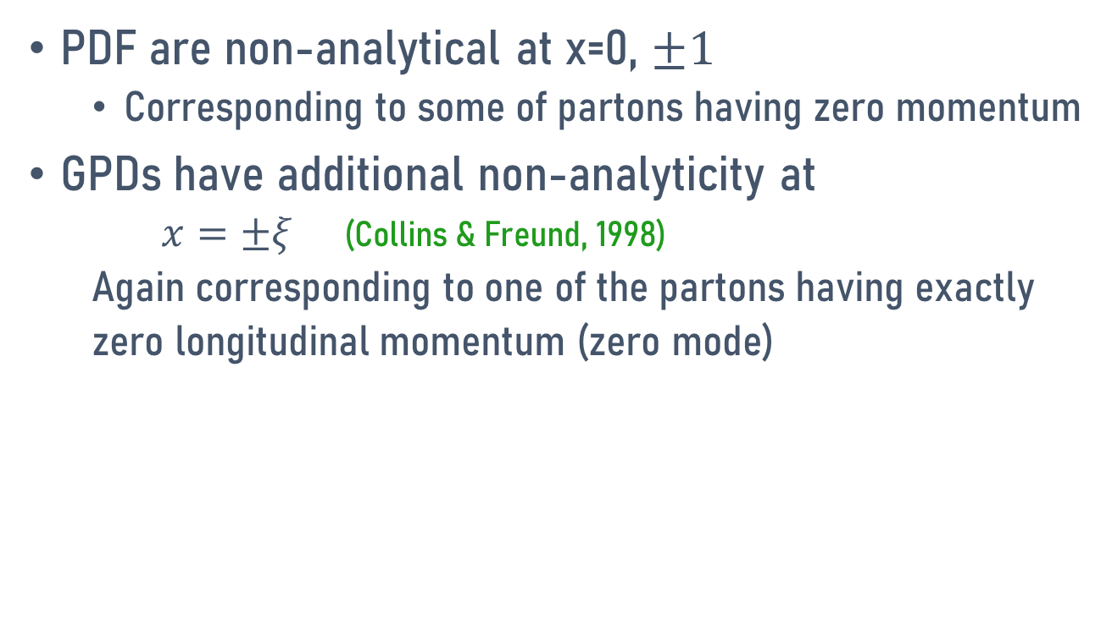
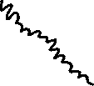
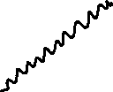
GPD Non-analyticity
PDF are non-analytical at x=0, $±1$
  Corresponding to some of partons having zero momentum
GPDs have additional non-analyticity at
  $x=±ξ$ (Collins & Freund, 1998)
  Again corresponding to one of the partons having exactly
  zero longitudinal momentum (zero mode)

Slide 7
Difficult for GPD global analysis
Too many variables!
Difficult to make a general parametrization without introducing too many parameters.
Experimental constraints are limited.
  Well-know hard-exclusive processes, such as DVCS etc , only constraint some moments (Compton Form Factors), but no x dependence.
  Meson productions such as DVMP have not been tested convingly in pQCD region.
  DDVCS etc imposes exceptional experimental challenges
Lattice calculations are essential (large-momentum effective theory, 2013)

Slide 8
PDF moment parametrization & GPD from conformal moments

Slide 9
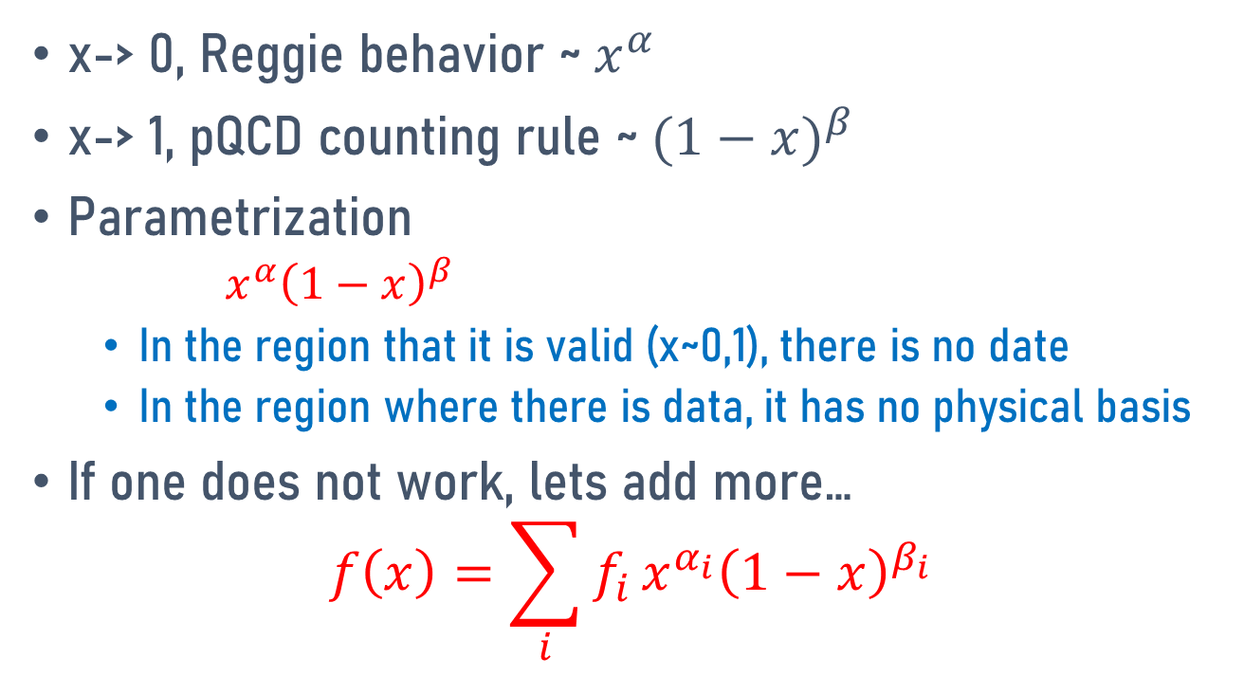
Standard parametrizations of PDFs (0<x<1)
x-> 0, Reggie behavior ~$x^{α}$
x-> 1, pQCD counting rule ~${(1−x)}^{β}$
Parametrization
  $x^{α}{\left(1−x\right)}^{β}$
  In the region that it is valid (x~0,1), there is no date
  In the region where there is data, it has no physical basis
If one does not work, lets add more…
$${f\left(x\right)=\sum_{i}{f_{i}}x}^{α_{i}}{\left(1−x\right)}^{β_{i}}$$

Slide 10
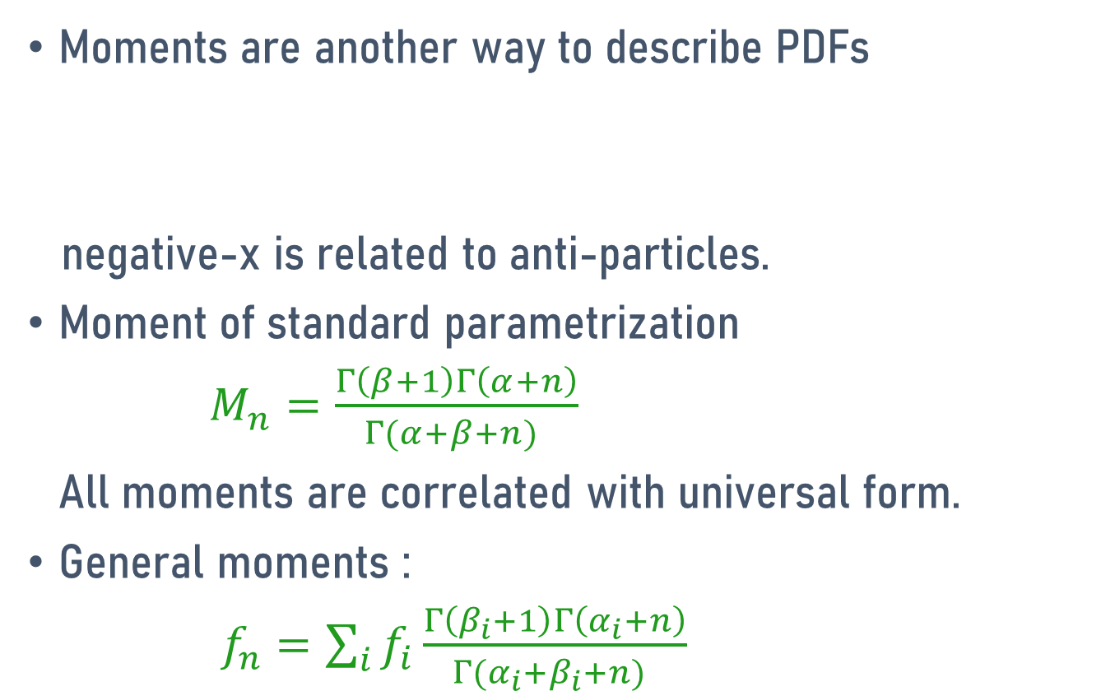
Moments
Moments are another way to describe PDFs
negative-x is related to anti-particles.
Moment of standard parametrization
$M_{n}=\frac{Γ\left(β+1\right)Γ\left(α+n\right)}{Γ(α+β+n) }$
All moments are correlated with universal form.
General moments :
$f_{n}=\sum_{i}{f_{i}\frac{Γ\left(β_{i}+1\right)Γ\left(α_{i}+n\right)}{Γ(α_{i}+β_{i}+n) }}$

Slide 11
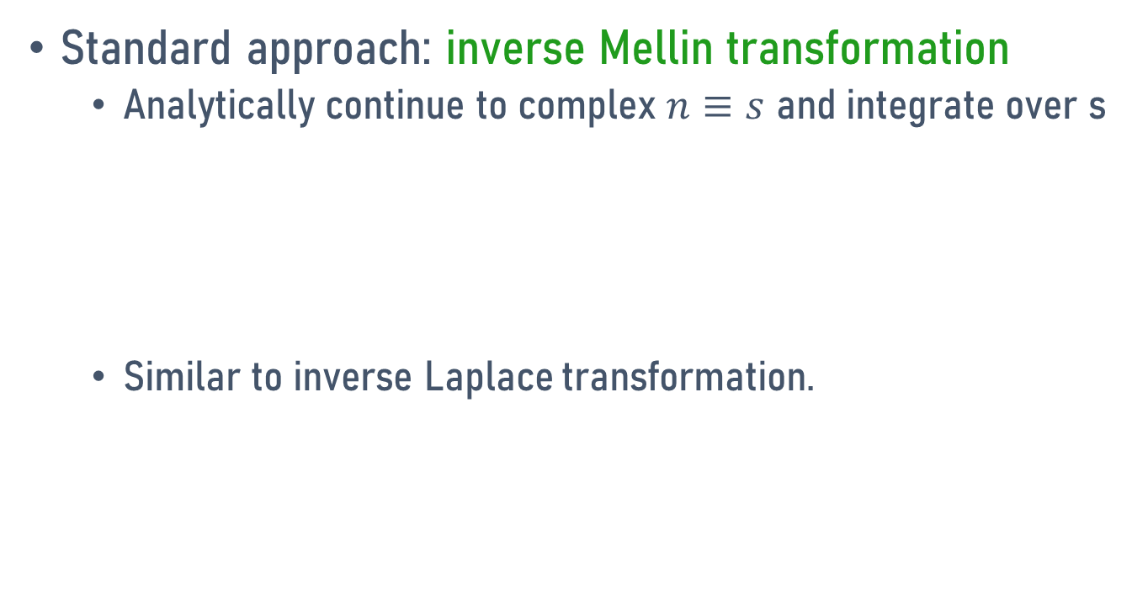
Reconstructing PDF from moments
Standard approach: inverse Mellin transformation
  Analytically continue to complex $n≡s$ and integrate over s
  Similar to inverse Laplace transformation.
Notes:
n

Slide 12
Alternative approach
Integral expansion
it formally recover the moments.
It is NOT a convergent expansion! One needs find way to do the sum.
Summing over singular functions (delta function and its derivatives) is not easy. One needs to introduce regulator for them.

Slide 13
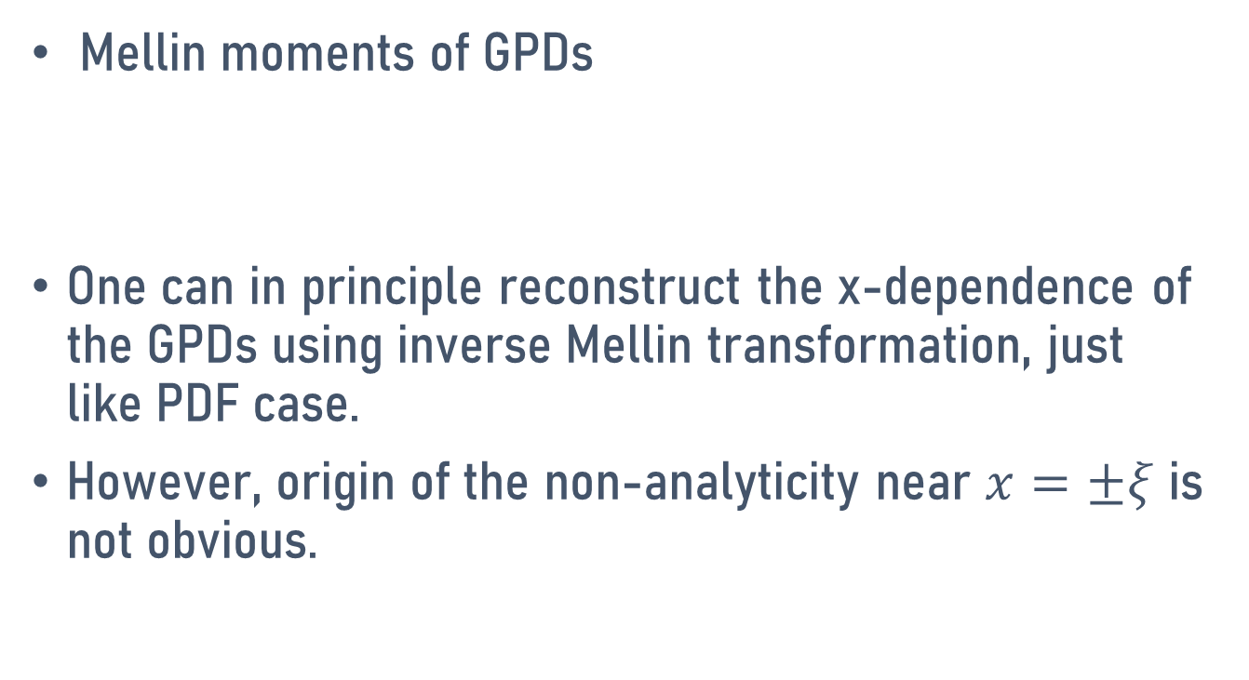
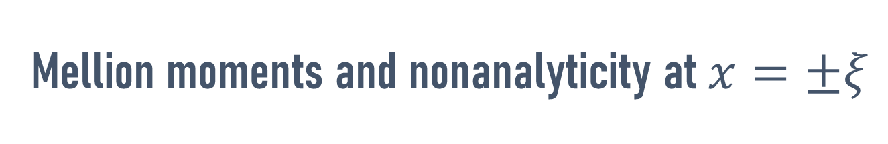
Mellion moments and nonanalyticity at $x=±ξ$
Mellin moments of GPDs
One can in principle reconstruct the x-dependence of the GPDs using inverse Mellin transformation, just like PDF case.
However, origin of the non-analyticity near $x=±ξ$ is not obvious.

Slide 14
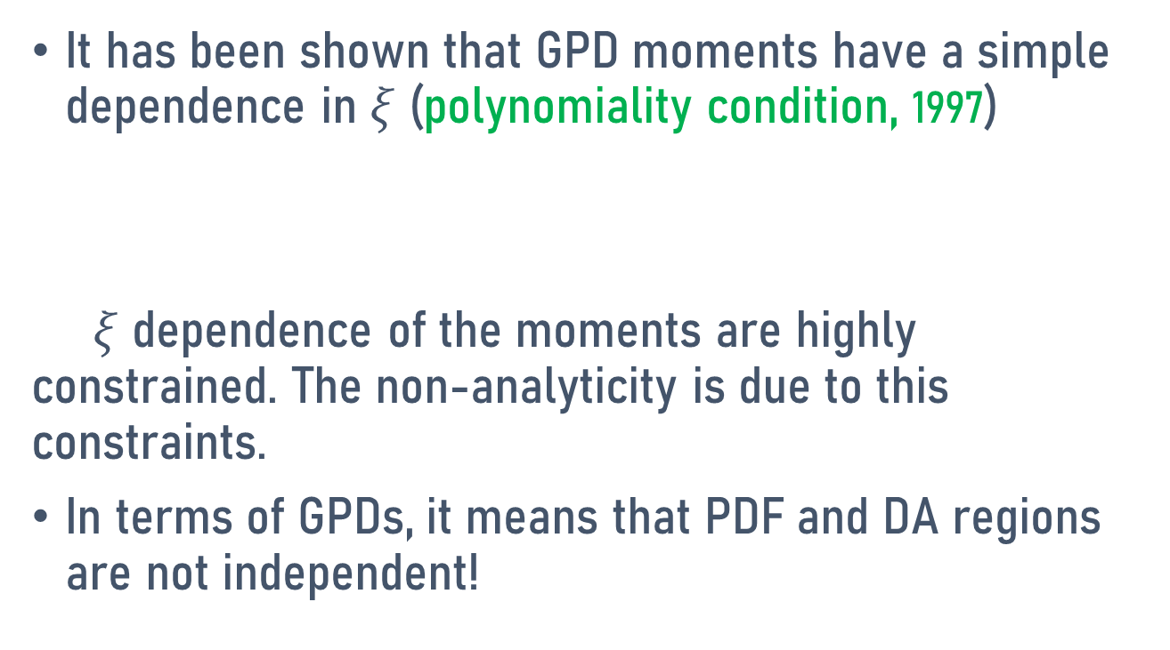
Polynomiality condition
It has been shown that GPD moments have a simple dependence in $ξ$ (polynomiality condition, 1997)
$ξ$ dependence of the moments are highly constrained. The non-analyticity is due to this constraints.
In terms of GPDs, it means that PDF and DA regions are not independent!

Slide 15
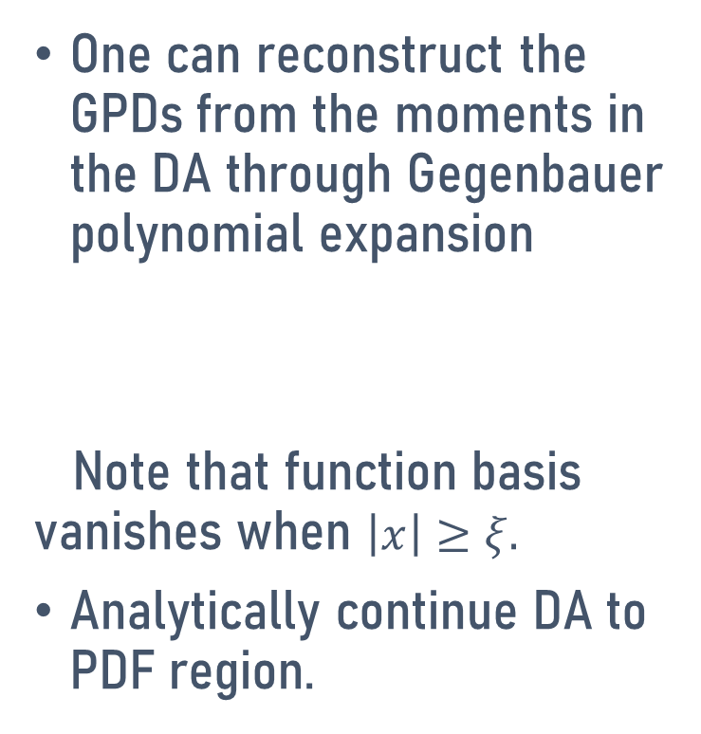
Reconstructing GPDs in the DA region
(Muller & Schaefer, 2005)
One can reconstruct the GPDs from the moments in the DA through Gegenbauer polynomial expansion
Note that function basis vanishes when $\left|x\right|≥ξ.$
Analytically continue DA to PDF region.

Slide 16
Conformal moments
Using orthogonality condition on G-Polynomials, one can found the coefficients of the expansion is
which is called conformal moments.
CM are linear combinations of Mellin moments.

Slide 17
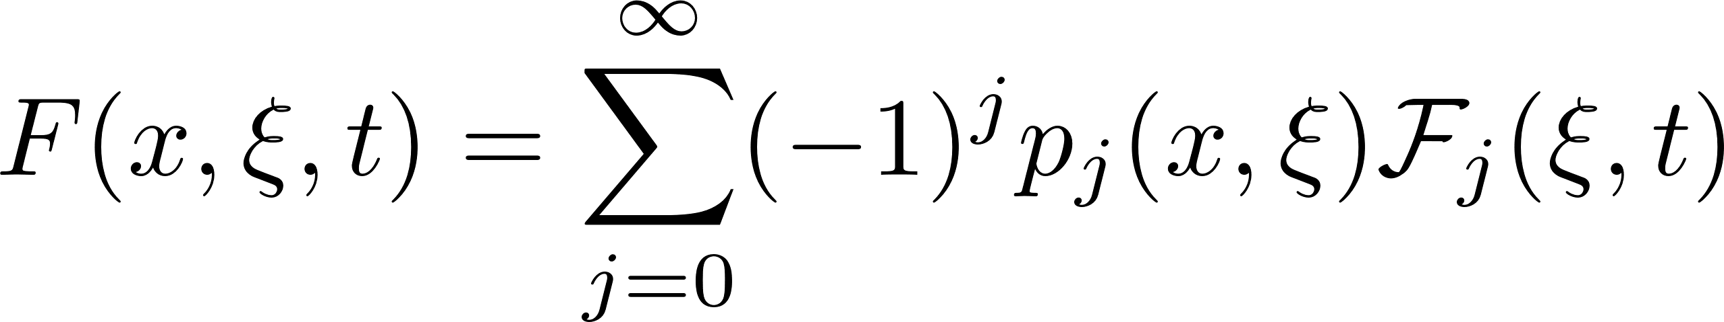

GPD from conformal moments
Using the integral form (Mellin-Barnes integral )
Analytically continuation in $j$and |$x|>ξ$

Slide 18

Testing the PDF limit $(ξ→0)$
In the forward limit,
the expansion becomes
However, the MB integral is hard to carry out.
The forward limit can be taken after the MB integral.

Slide 19
Mellin-Barnes integral

Slide 20
Parametrizing GPD (conformal) moments and test fitting
(Guo et al, 2022, 2023)

Slide 21
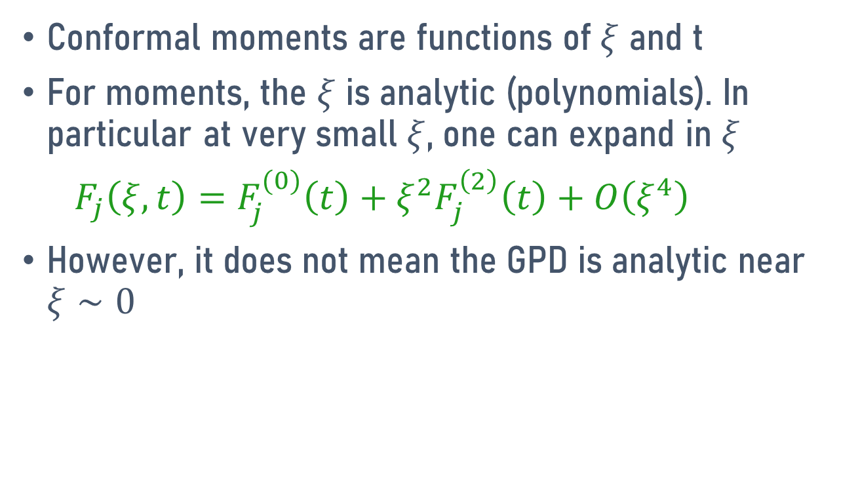
How to parametrize the moments
Conformal moments are functions of $ξ$ and t
For moments, the $ξ$ is analytic (polynomials). In particular at very small $ξ$, one can expand in $ξ$
$F_{j}\left(ξ, t\right)=F_{j}^{(0)}\left(t\right)+ξ^{2}F_{j}^{\left(2\right)}\left(t\right)+O\left(ξ^{4}\right)$
However, it does not mean the GPD is analytic near $ξ∼0$

Slide 22
t-dependence
Years of experience studying the form factors as a function of t
Meson dominance through dispersion analysis
Regge analysis

Slide 23
A possible parametrization
A possible form factor parametrization
This is a form of universal moment parametrization
It reduces to CTEQ type of parametrization in the forward limit.
However, other reasonable parametrizations can also be used so long it is universal

Slide 24
Global fit strategy
All possible constraints can be used
  Experimental data
  Forward limit
  Individual form factors
  GPDs from direct lattice calculations

Slide 27
An example of global analysis

Slide 28
GPDs to be fitted

Slide 29
UMP
Consider u, d, and gluon, H, E, H-tilde and, E-tilde

Slide 30
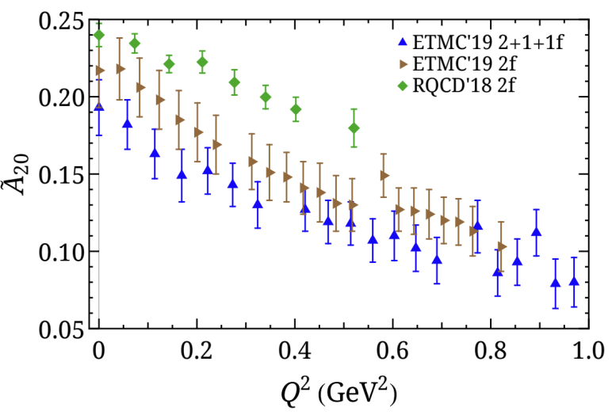
Inputs for the global analysis
Experiments
Lattice
PDFs from global analysis
  Polarized and unpolarized PDFs from JAM
Charge form factors from global analysis
  YAHL global analysis of EM form factors
  Flavor separation combing proton and neutron data
DVCS cross-section measurements
  Combined data from CLAS and Hall A (UU and LU)
  H1 experiments at HERA
Different setups used in lattice simulations induce systematical uncertainties and deviations.
JAM, Phys. Rev. D 106 3, L031502 (2022)
Z. Ye et. Al., Phys. Lett. B 777 8-15 (2018)
CLAS, Phys. Rev. Lett. 123 3, 032502 (2019)
JLab Hall A, PoS Hadron2017 170 (2018)
M. Constantinou et. al. Prog. Part. Nucl. Phys. 121 103908 (2021)
Lattice form factors and GPDs from a single group.
H1, Phys. Lett. B 681 391-399 (2009)
C. Alexandrou et. al. Phys. Rev. Lett. 125 26, 262001 (2020)
C. Alexandrou et. al. PoS LATTICE2021 250 (2022)

Slide 36
Tuning using non-universal moments

Slide 39
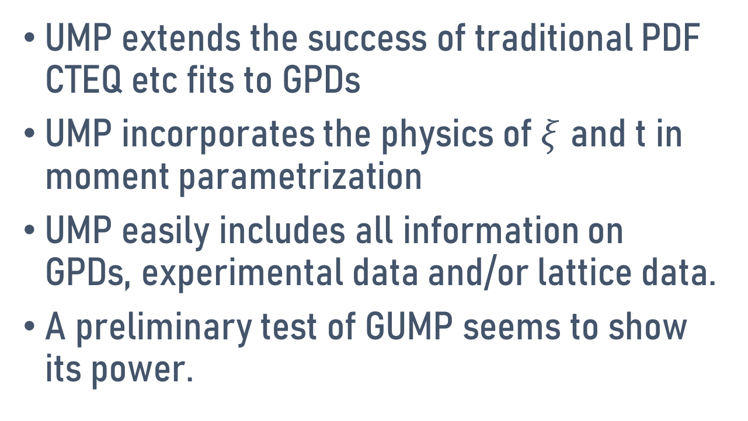
Conclusions
UMP extends the success of traditional PDF CTEQ etc fits to GPDs
UMP incorporates the physics of $ξ$ and t in moment parametrization
UMP easily includes all information on GPDs, experimental data and/or lattice data.
A preliminary test of GUMP seems to show its power.

