Slide 1
The electron-ion collider –
A world-wide unique collider to unravel the 3d structure of visible matter
Elke-Caroline Aschenauer (BNL)

Slide 2
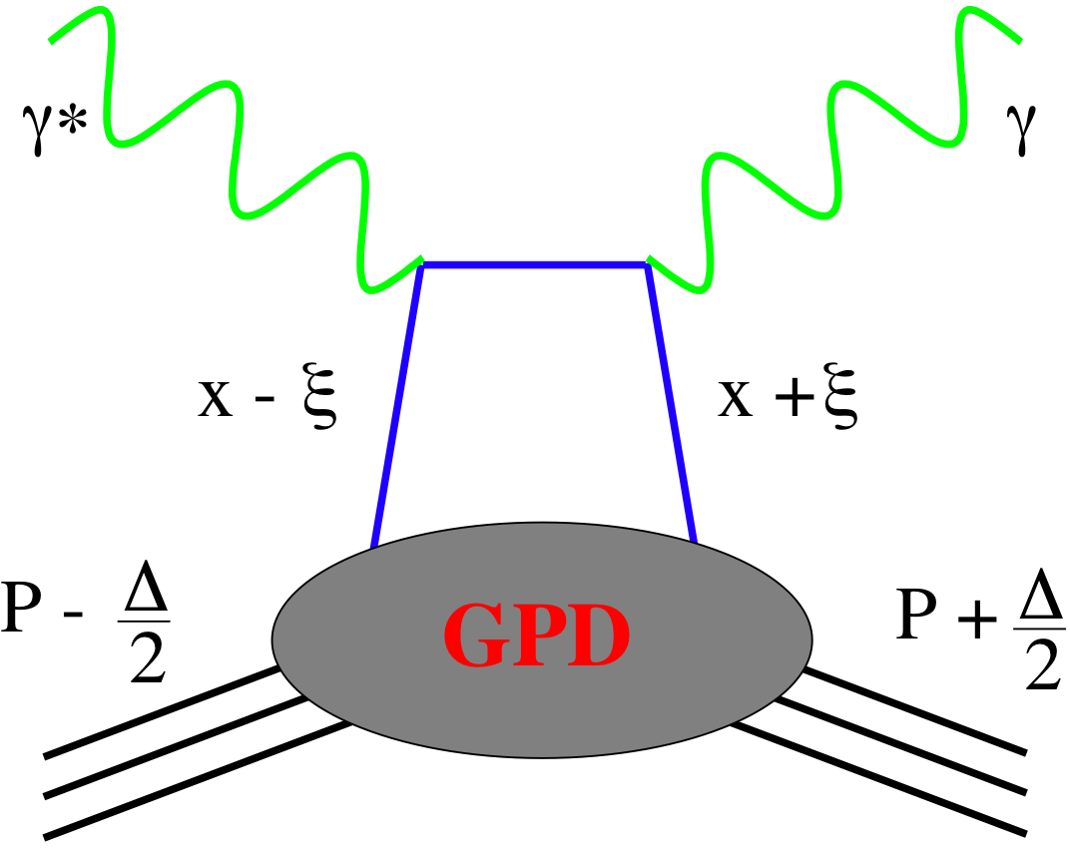
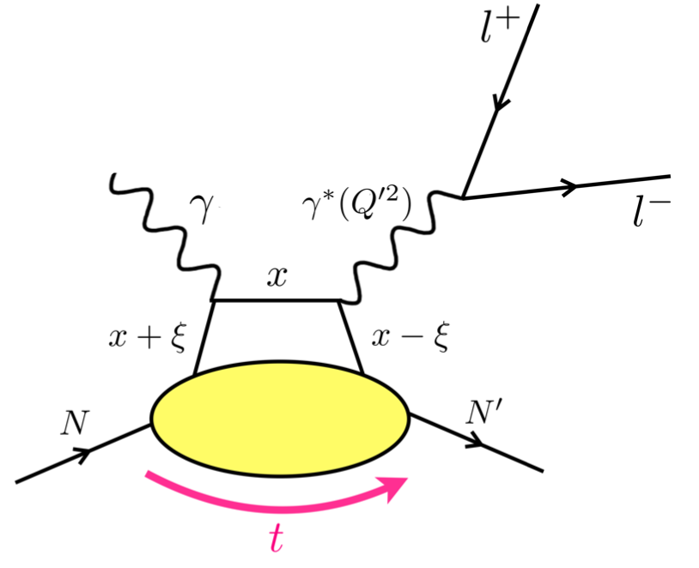
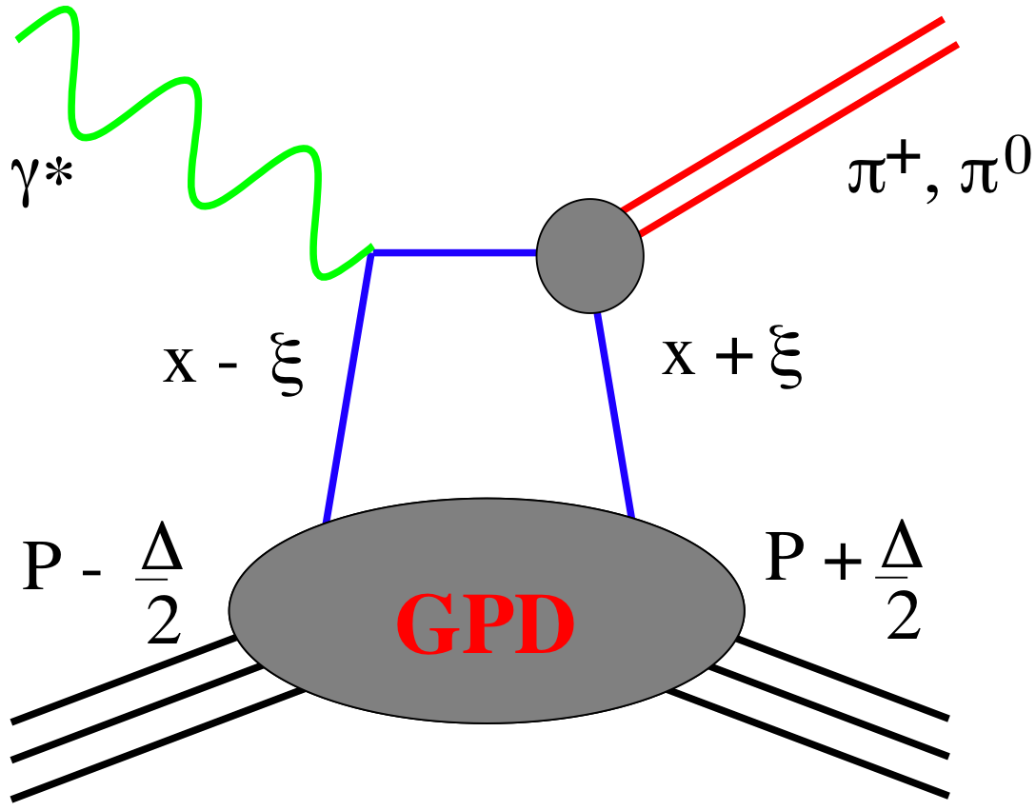
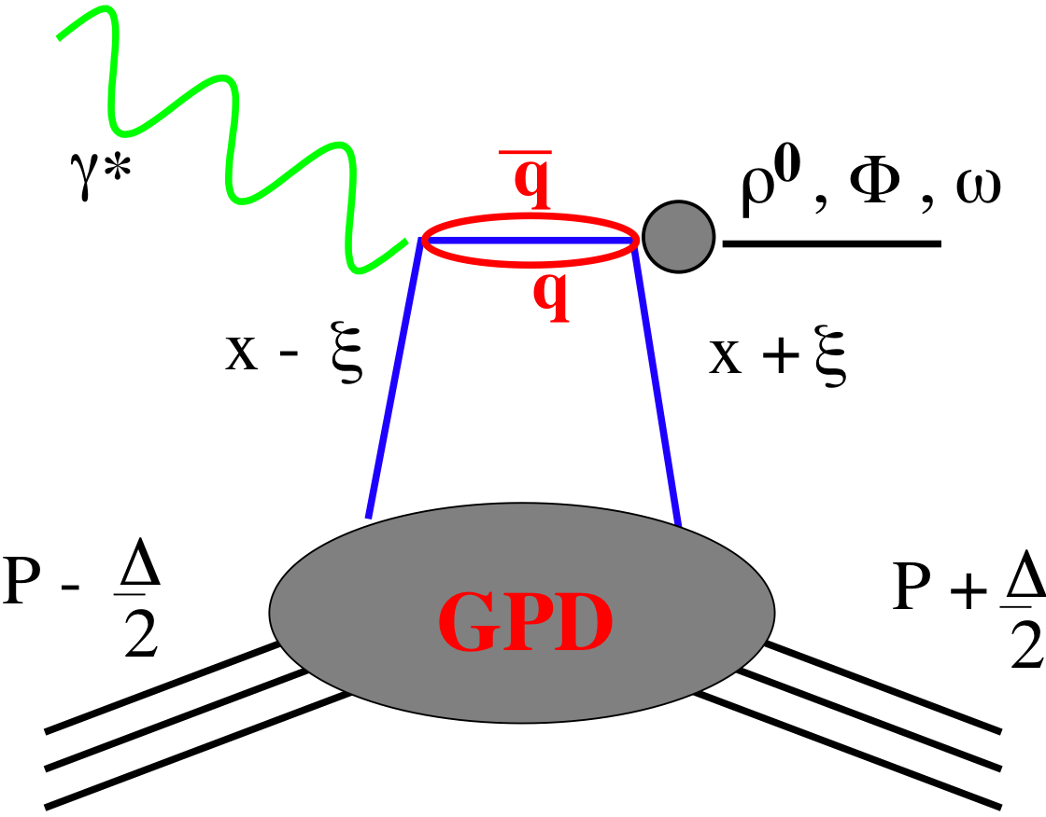
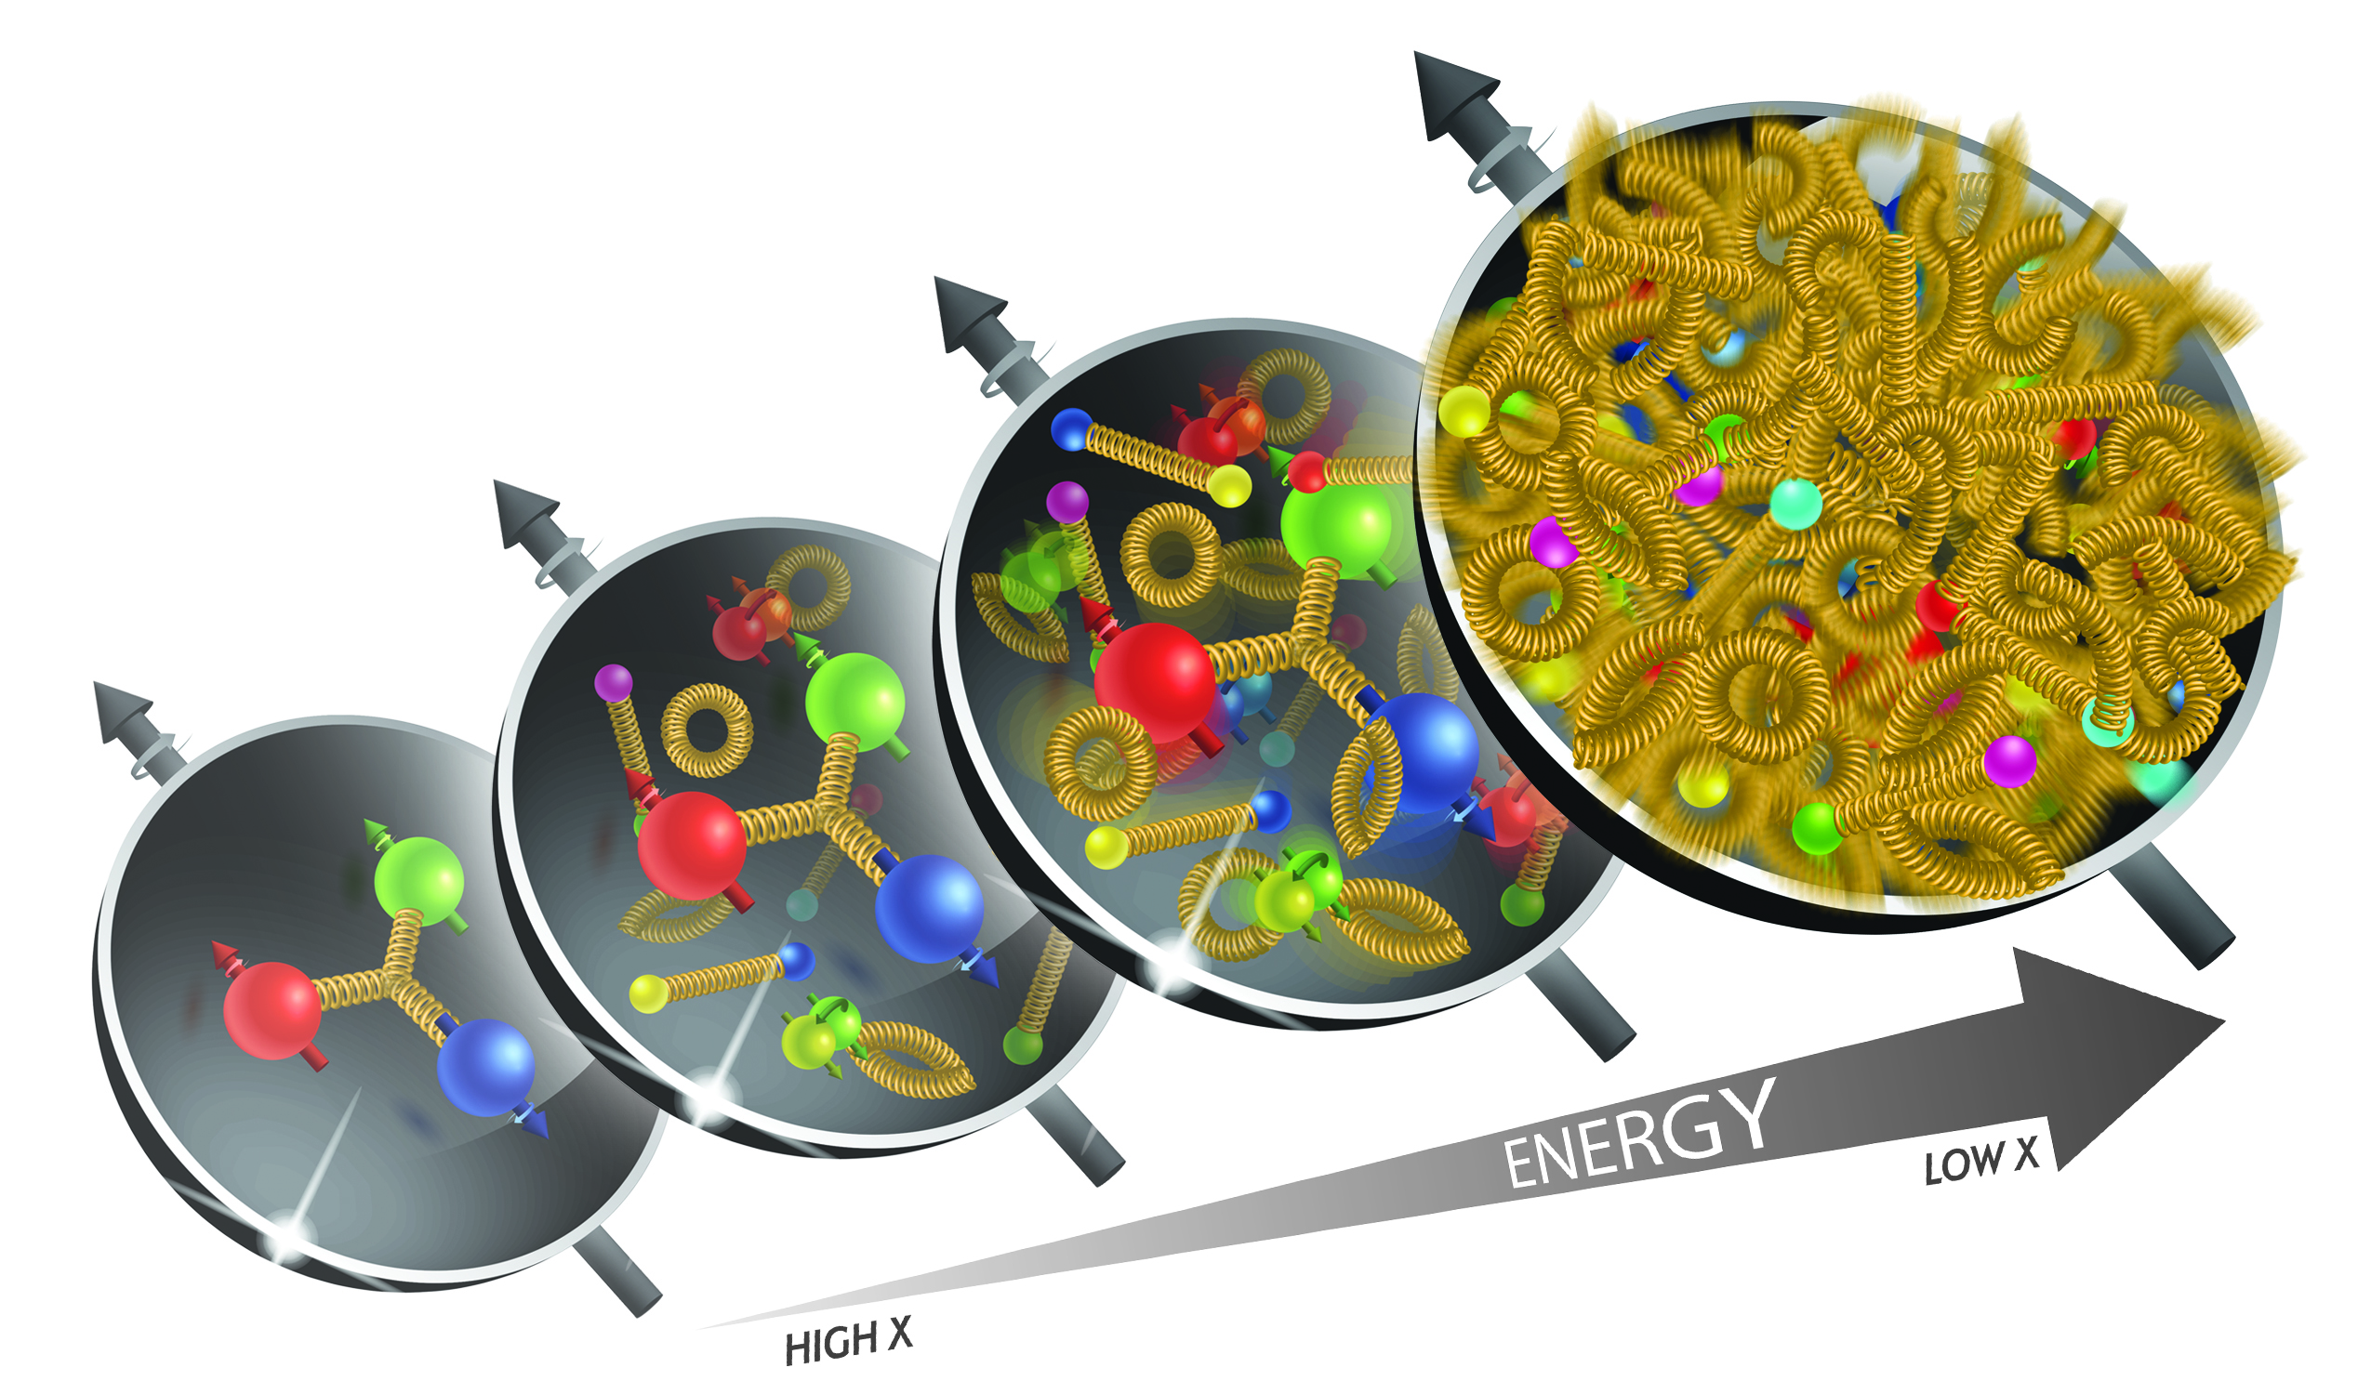
EIC Probes for 3d Spatial Imaging
vary quantum numbers of final state → access to q_{f} and gluons
DVCS
TCS
pseudo-scaler mesons
vector mesons
Observables: Asymmetries A_{UT}, A_{UL}, ALL, A_{LU}
cross sections

Slide 3
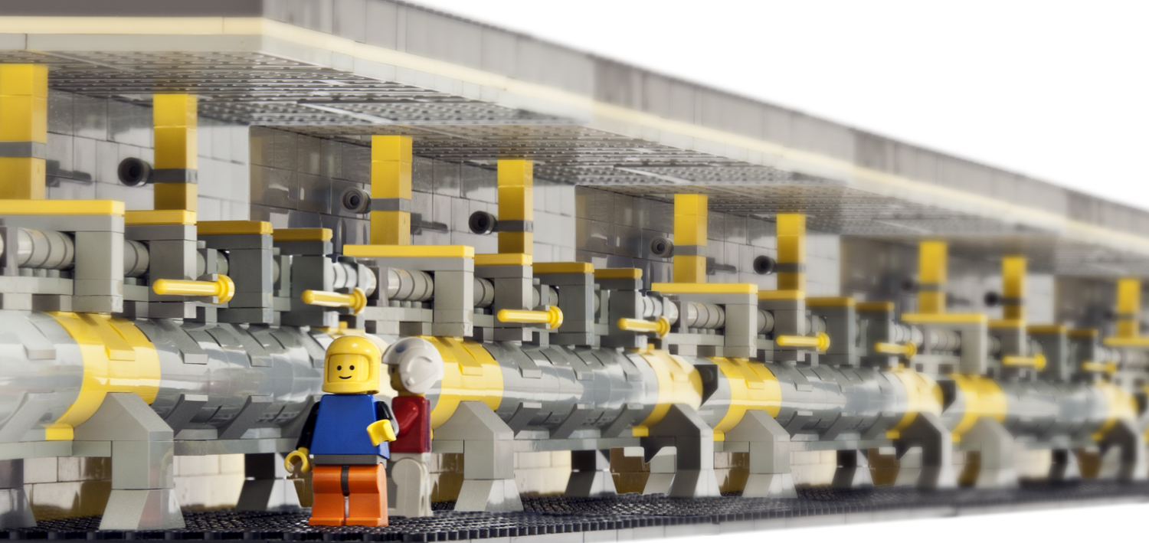
The EIC Accelerator

Slide 4
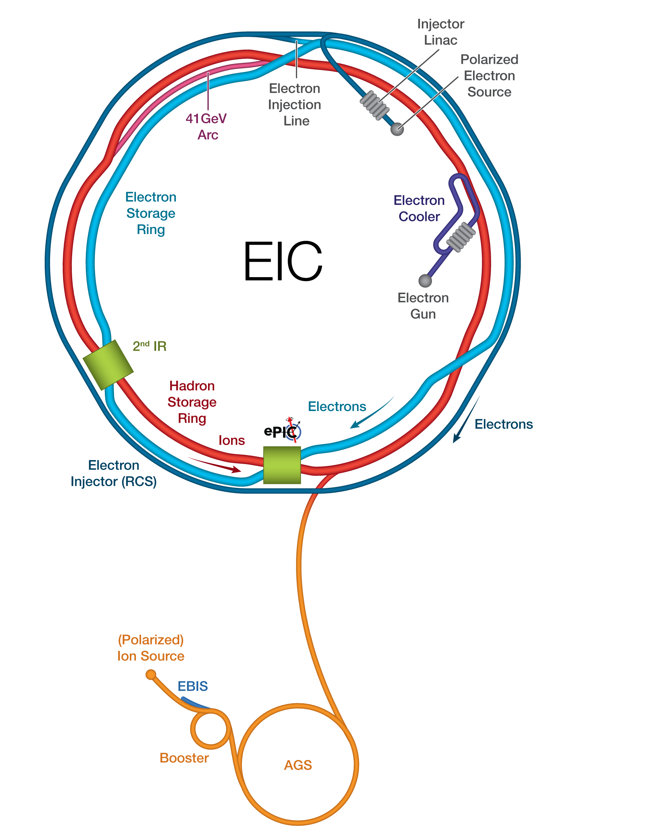
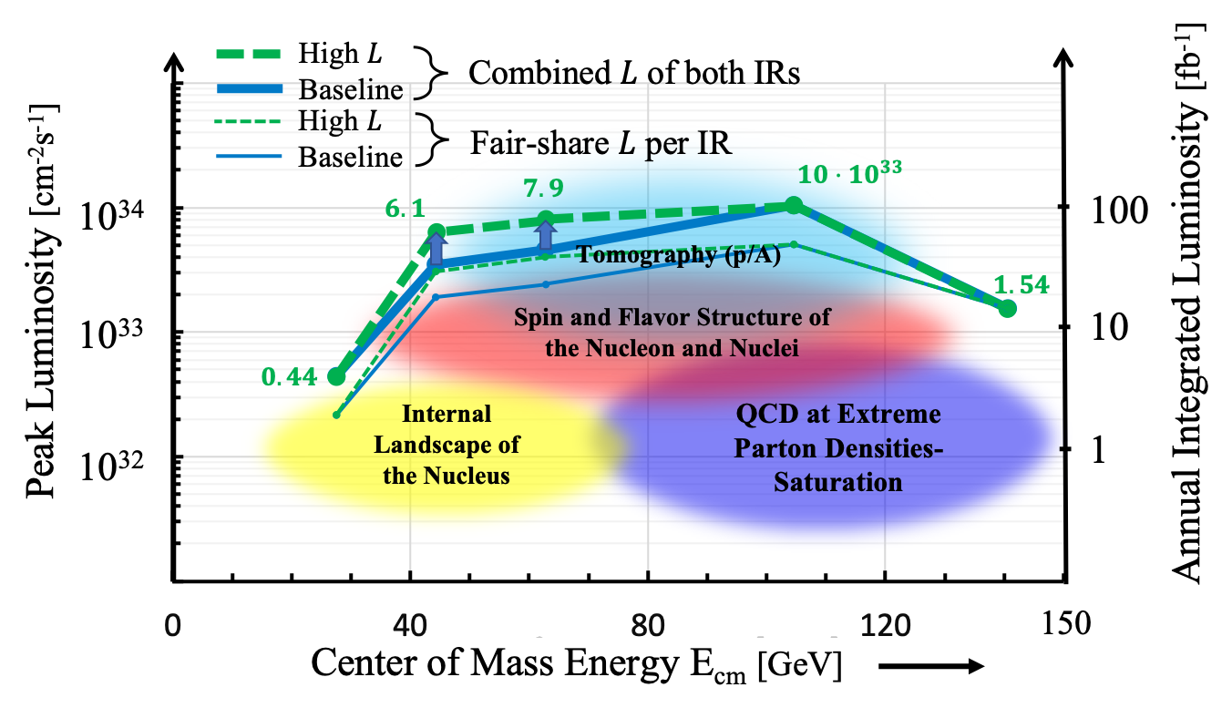
Facts about EIC
Luminosity:
Beam energies:
Leptons: 5, 10, 18 GeV
Protons: 41 GeV, 100 – 275 GeV
d,A: 41 GeV, 100 – 110 GeV
He-3: 41 GeV, 100 – 166 GeV
transverse and longitudinally polarized p, ³He, later d
longitudinally polarized electrons
Possibility for 2 IRs only one
part of the EIC Project
All requirements for 3d spatial imaging fulfilled

Slide 5

Complementarity for 1st-IR & 2nd-IR
1st IR (IP-6)
2nd IR (IP-8)
Globally:
same accelerator highlights and challenges
Geometry:
ring inside to outside
ring outside to inside
Crossing Angle:
25 mrad
35 mrad
→ more difficult to get acceptance at high η
different blind spots
different far-forward detector acceptances
Luminosity:
same luminosity at both IRs
same center-of-mass energy coverage
IR-Design:
0.2 GeV < p_{T} < 1.3 GeV
2nd Focus
→ improved low p_{T} acceptance at far-forward Roman Pots
x_{L} ~1 → p_{T} ~0
Experiment:
complementarity through
different subdetector technologies

Slide 6
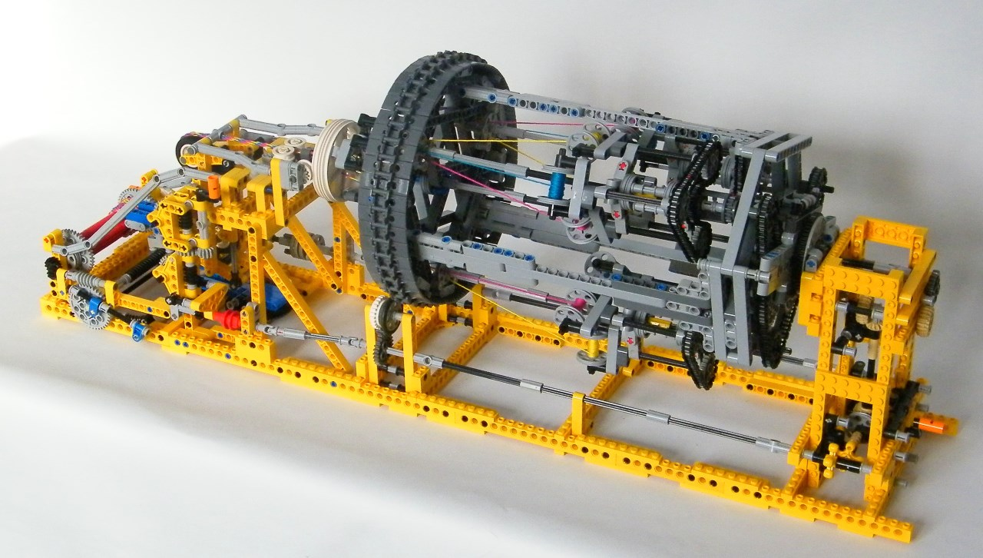
EIC Detector Concept

Slide 7
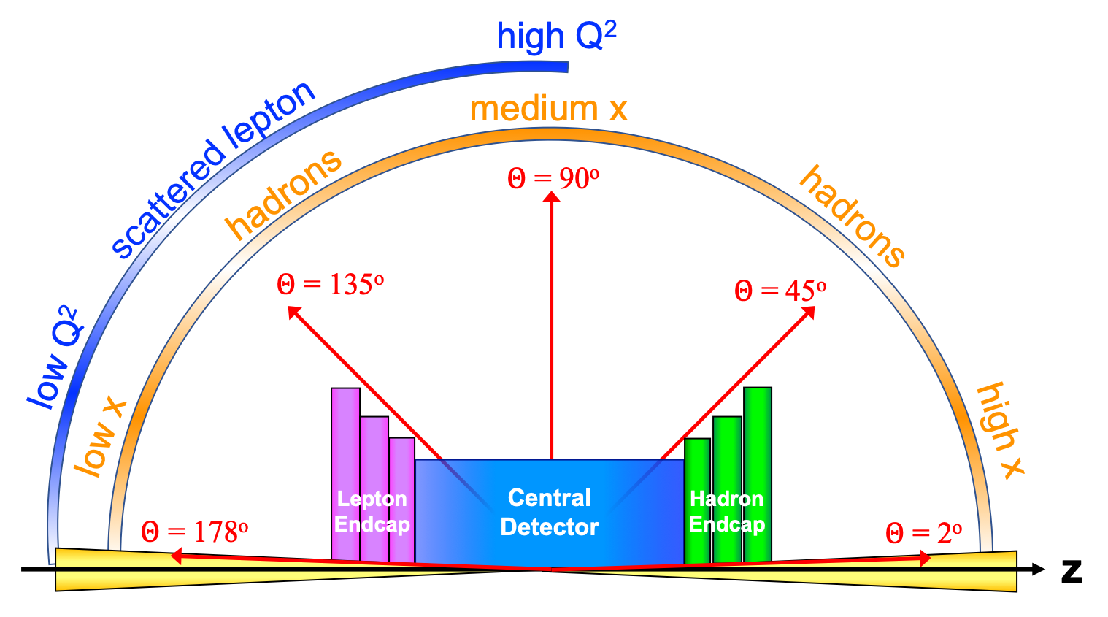
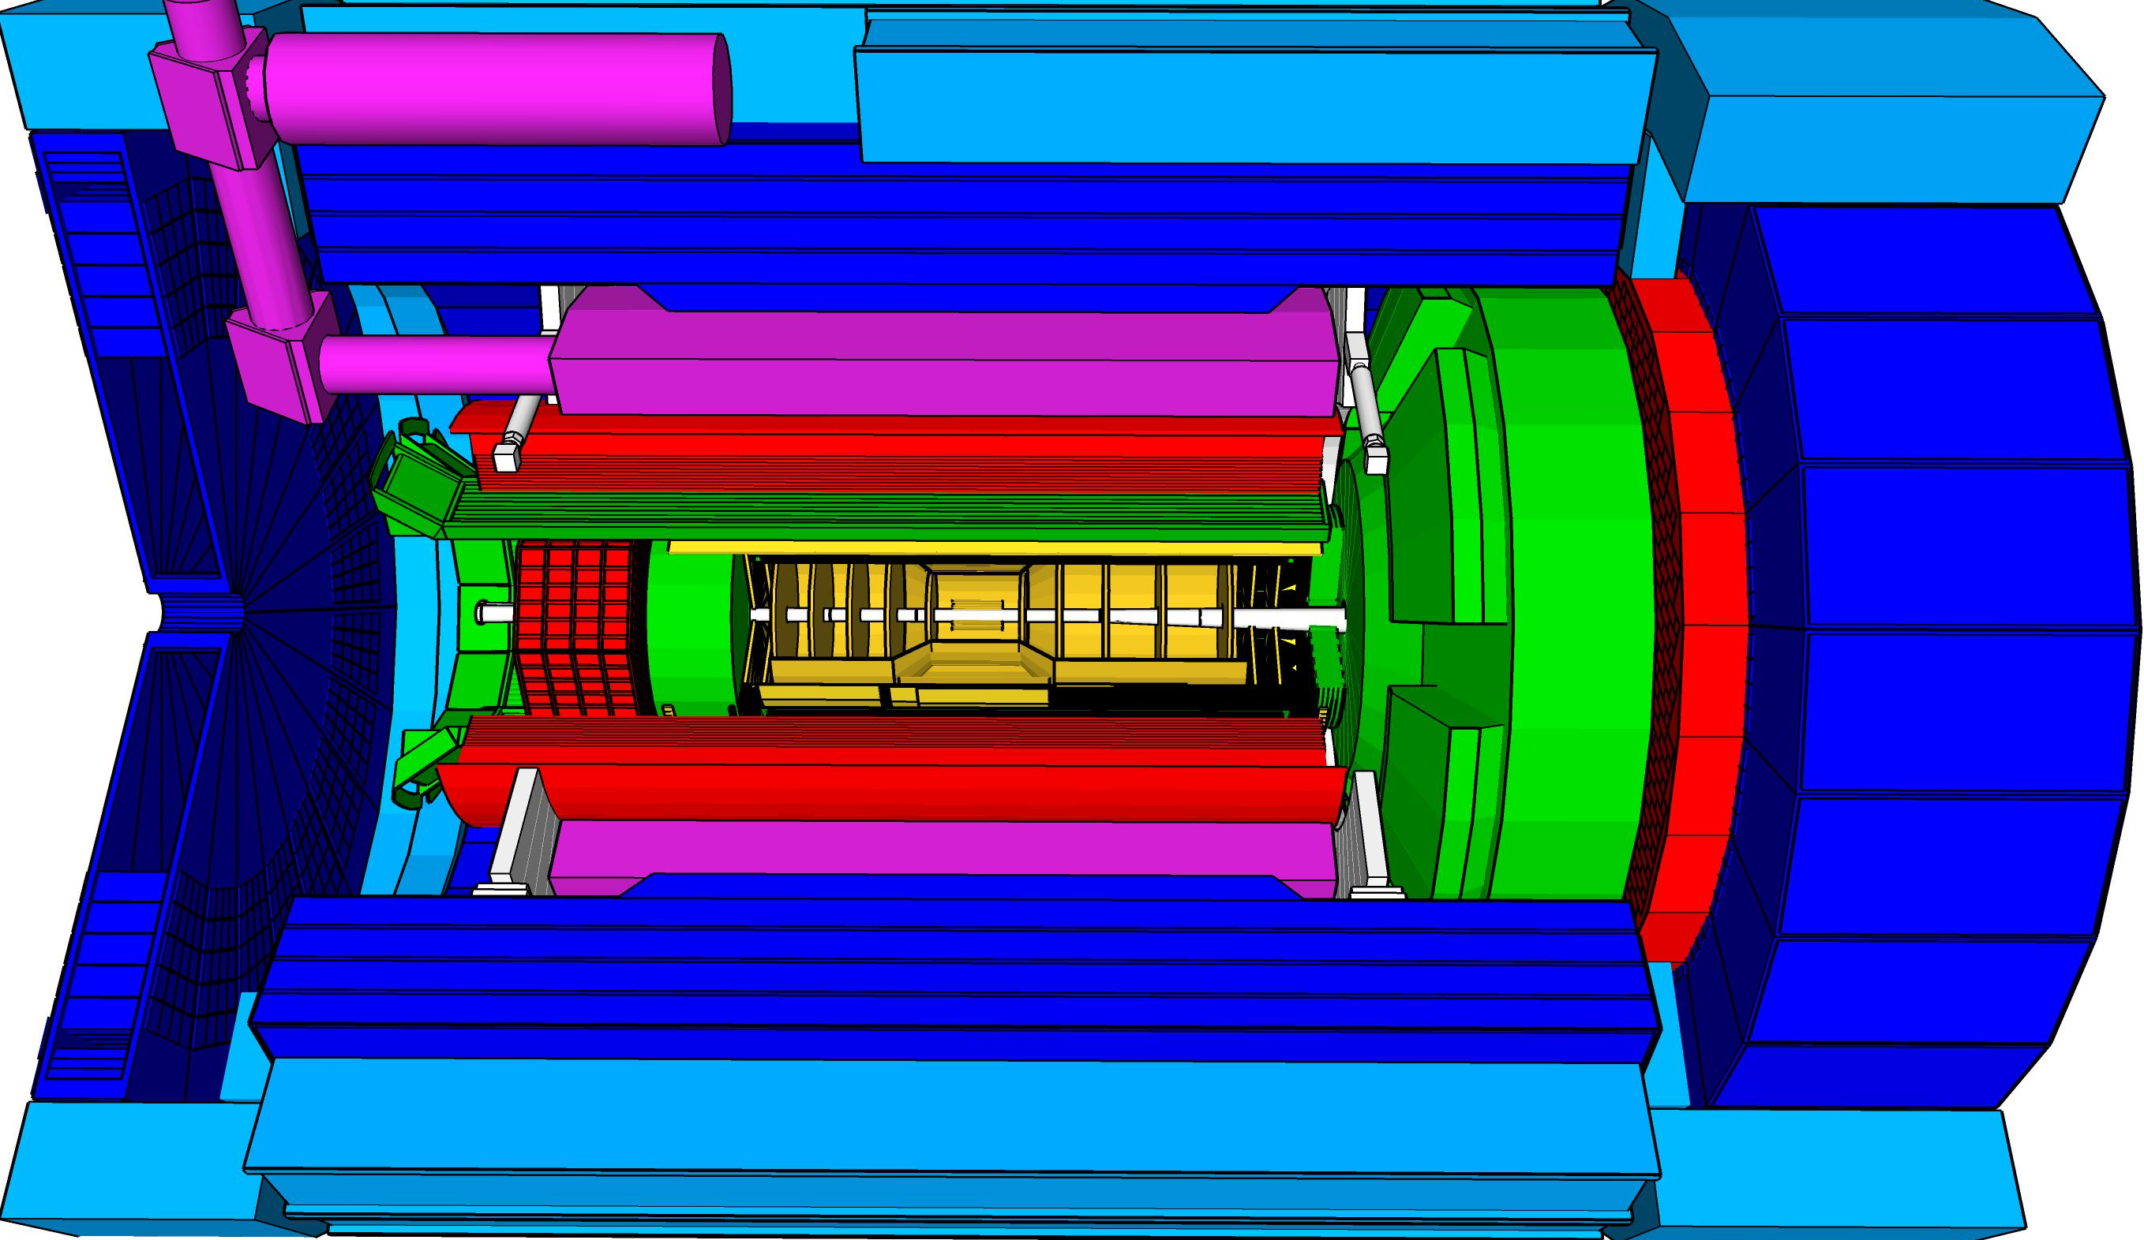
Experimental Equipment Scope
High Luminosity: L= 10³³ – 10³⁴cm⁻²sec⁻¹,
10 – 100 fb⁻¹/year
Highly Polarized Beams: 70%
→ requires high precision electron and hadron polarimetry
Large Center of Mass Energy Range:
E_{cm} = 29 – 140 GeV
→ Large Detector Acceptance
Asymmetric beam energies
→ require an asymmetric detector Barrel
with electron and hadron endcap → 9.5 m
→ equal coverage (-4 < η < 4) Tracking, particle dentification,
electromagnetic and hadronic calorimetry
  High precision low mass tracking
  good e/h separation critical for scattered electron identification
  separate e, p, K, p on track level
Science program required momentum resolution
→ requires a large bore 2T magnet
(1.7 T magnet operation point, stretch goal 2T)
with a bore radius of 1.2 m.
Imaging science program → Large Ion Species Range: protons – Uranium
→ requires specialized detectors integrated in
the Interaction Region over 80 m
Streaming readout electronics model
→ highest scientific flexibility
very compact Detector → Integration is key
Good Background Conditions
25 different Subsystems incl. Polarimetry
local hadron polarimeter
hadronic calorimeters
Time.of.Flight,
DIRC,
RICH detectors
MPGD trackers
Solenoidal Magnet
MAPS tracker
e/m calorimeters
Luminosity
Monitor
low Q² electron-tagger
off-Momentum
taggers
Roman
Pots
Zero-Degree
Calorimeter
p: 41 GeV, 100 to 275 GeV
p/A beam
e beam
e: 5 GeV to 18 GeV
lepton and hadron polarimeters not shown

Slide 8
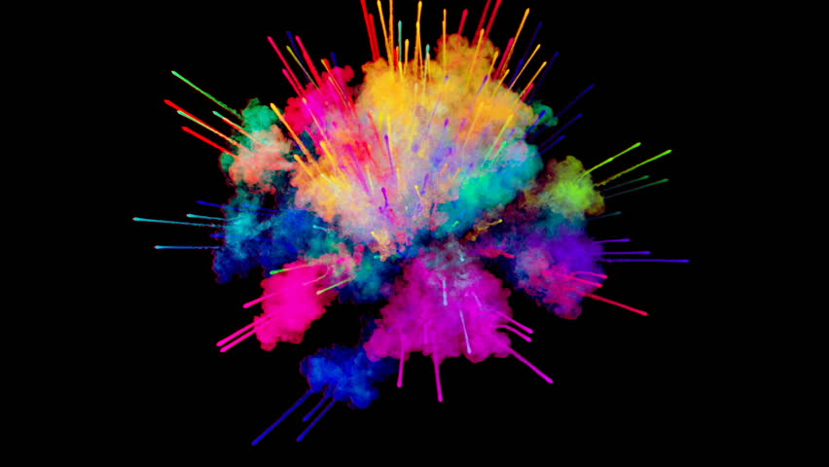


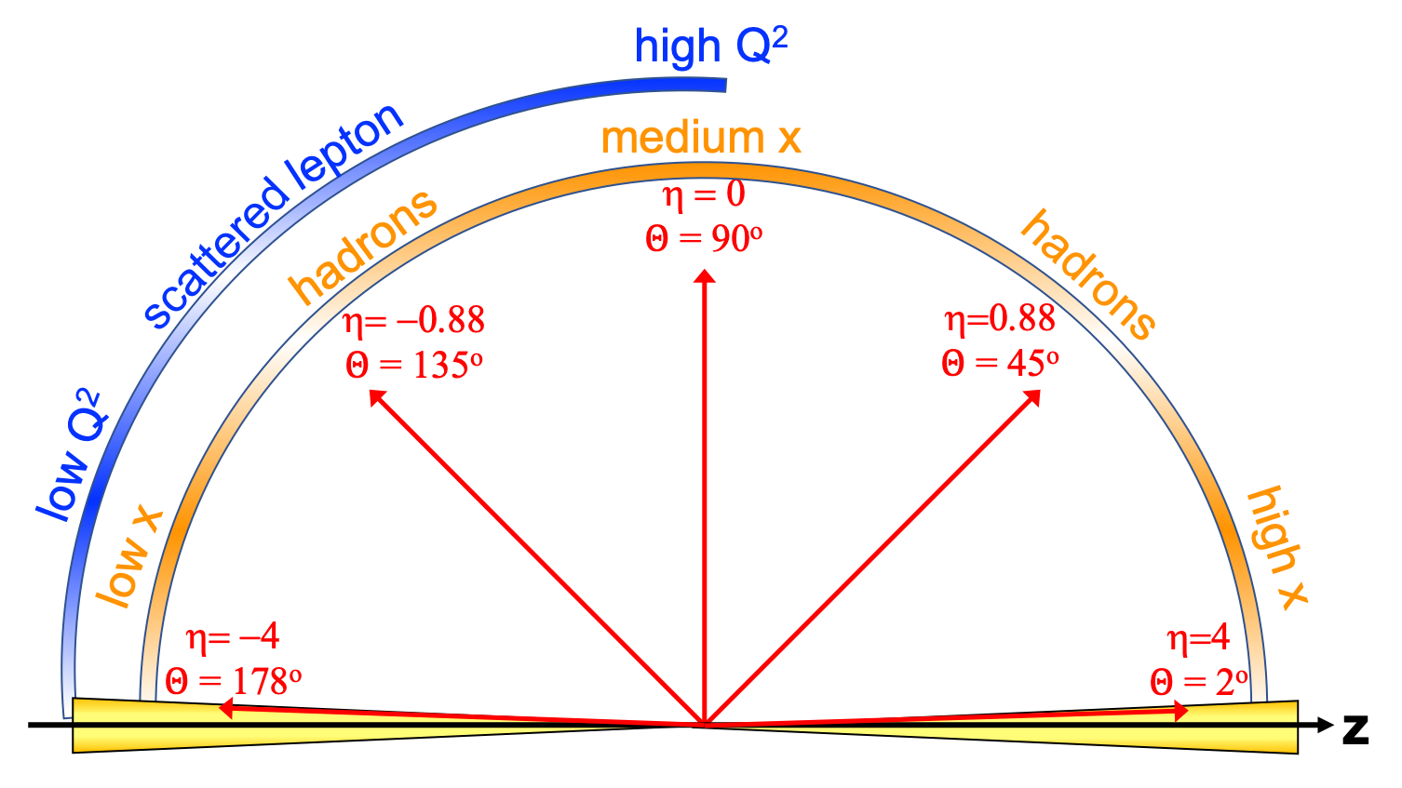
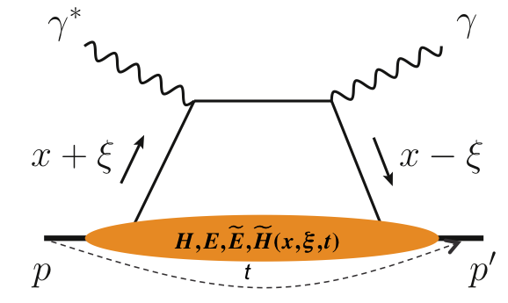
ePIC - General Purpose Detector
p/A beam
electron beam
inclusive DIS:
semi-inclusive DIS
Backward-η
Forward-η
Central
Detector
HCAL
Lepton
Endcap
Magnet
Hadron
Endcap
HCAL
ECAL
HCAL
ECAL
ECAL
Tracking
PID
PID
PID
Tracking
very low Q²
scattered lepton
Bethe-Heitler photons
for luminosity
Tracking
particles from nuclear
breakup and
from diffractive reactions
exclusive DIS
ZDC
Luminosity Detector
Forward Tracking
Low Q²-Tagger

Slide 9
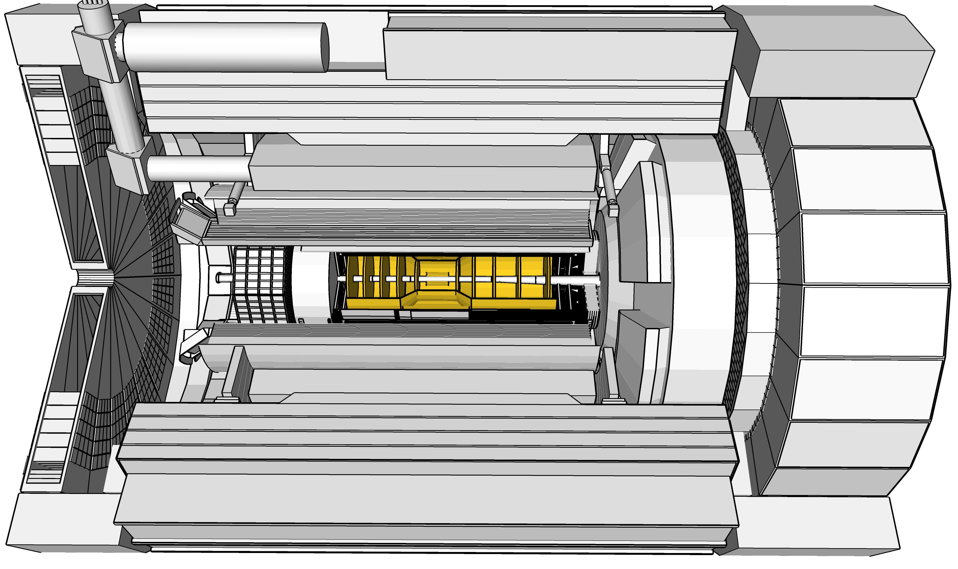

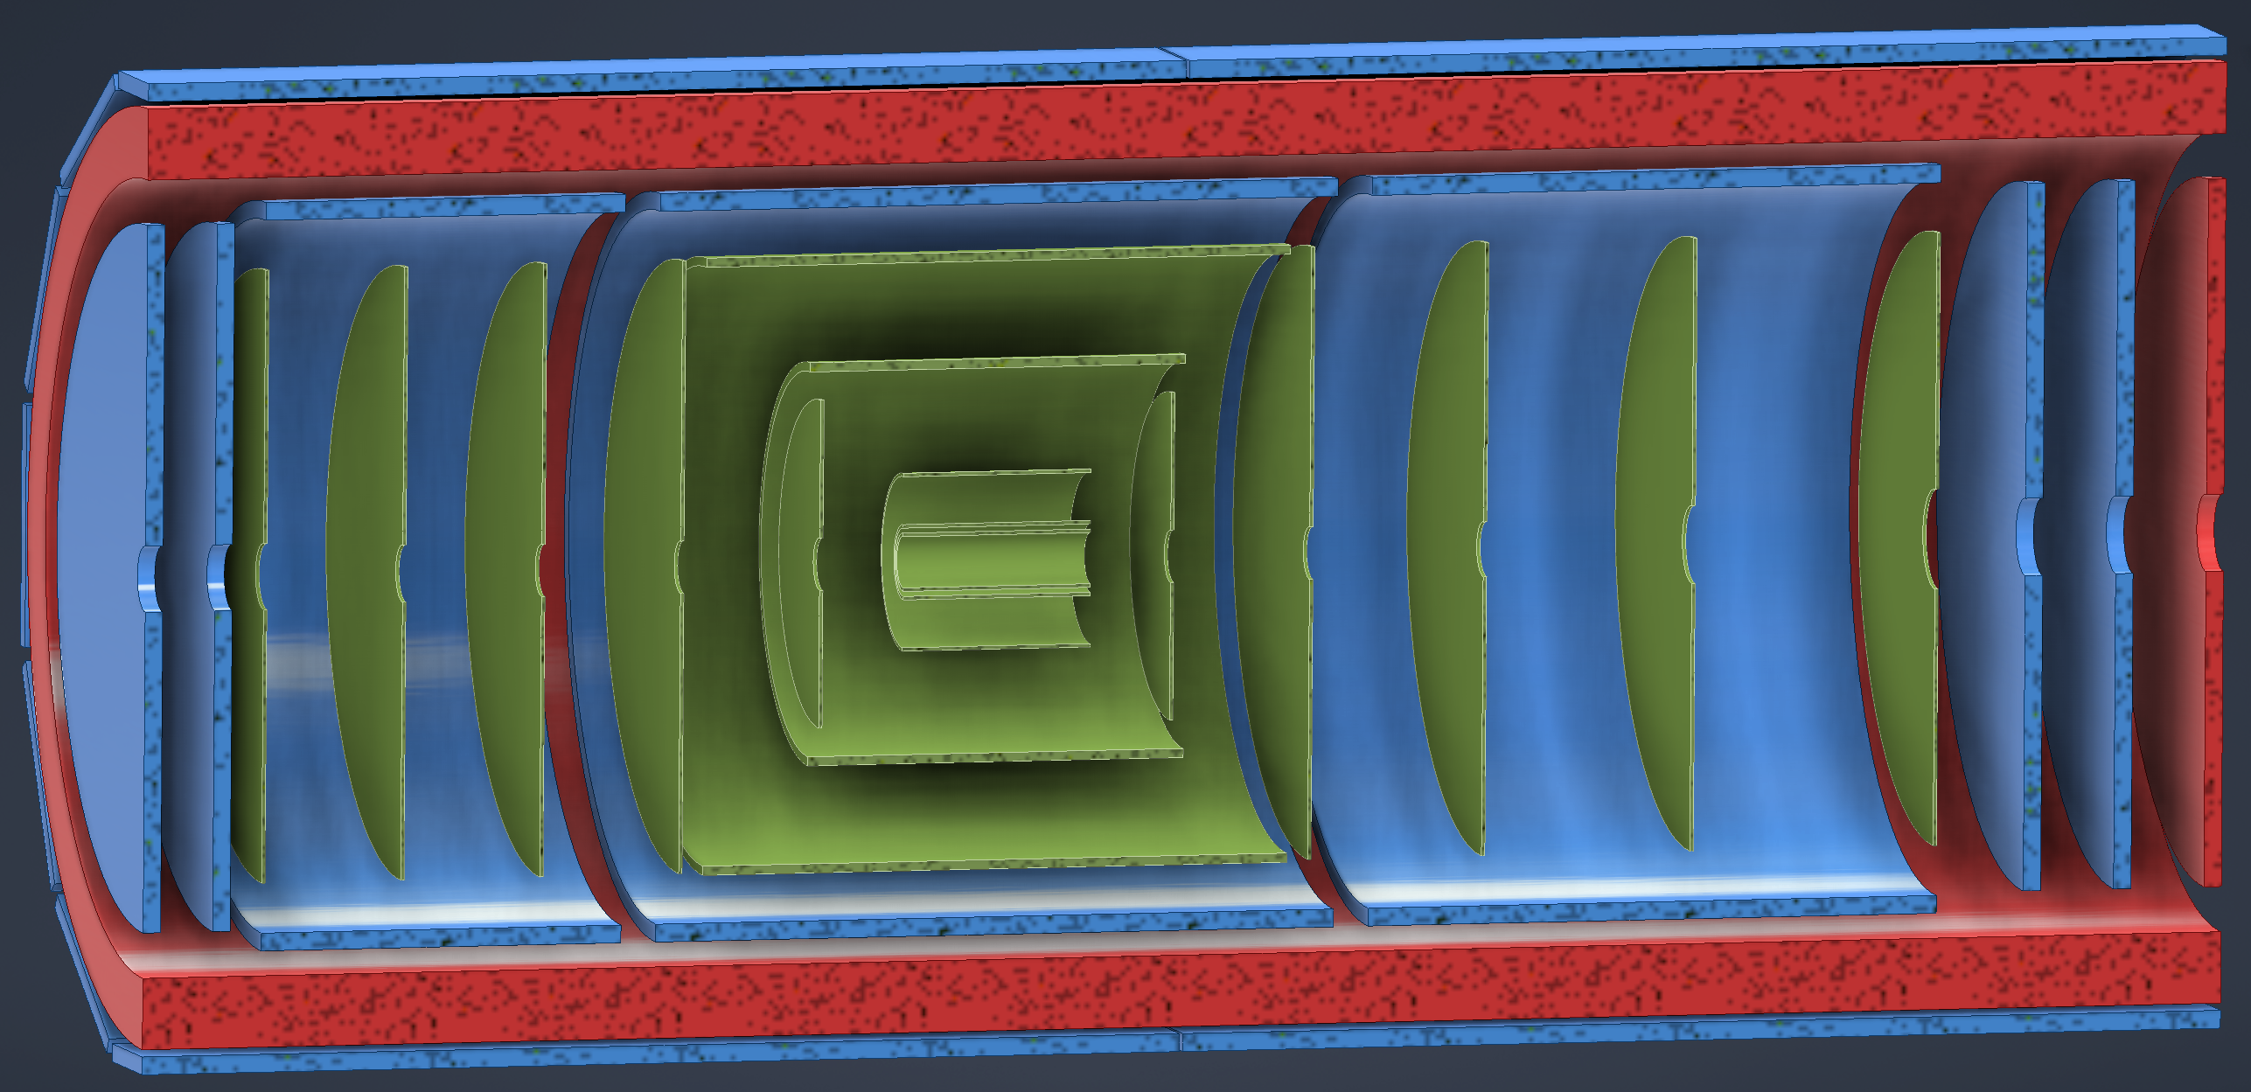
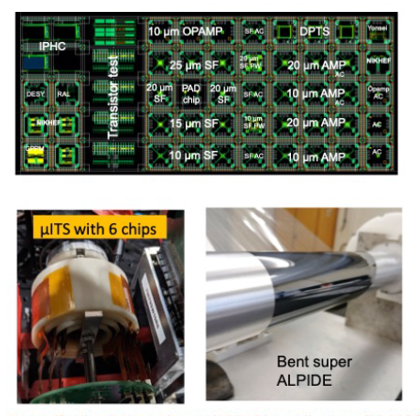
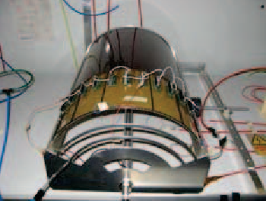
ePIC Tracking Detectors
Monolithic Active Pixel Silicon Tracker:
1 single technology: 65-nm MAPS
  small pixels (10 μm) and
  power consumption
  (<20 mW/cm²)
  low material budget
  (0.05% to 0.55% X/X₀ / layer)
  based on ALICE ITS3
  development
  MAPS Vertex layers
  MAPS Barrel, forward and
  backward disks
  → synergy with ALICE-3 especially
  with the R&D on fast MAPS
Multi Pattern Gas Detectors:
additional space points at large radii
Cylindrical microMEGAS
→ Additional space point for
pattern recognition / redundancy
→ Ongoing geometry
optimization
μRWELL planar layer
just before hpDIRC
→ Impact point and direction for the
ring seeding of hpDIRC
→ Additional space point for pattern
recognition / redundancy
Two MPGD disks each beyond Si disks in forward and backward direction
→ To provide sufficient hits under
large backgrounds to compensate
for large Si integration time frame
world’s first
at
world’s first
at
MAPS Barrel + Disks
MPGD Barrels + Disks
AC-LGAD based ToF

Slide 10
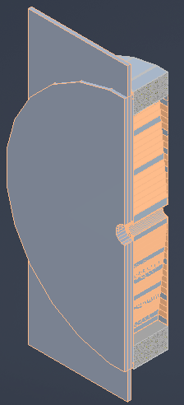
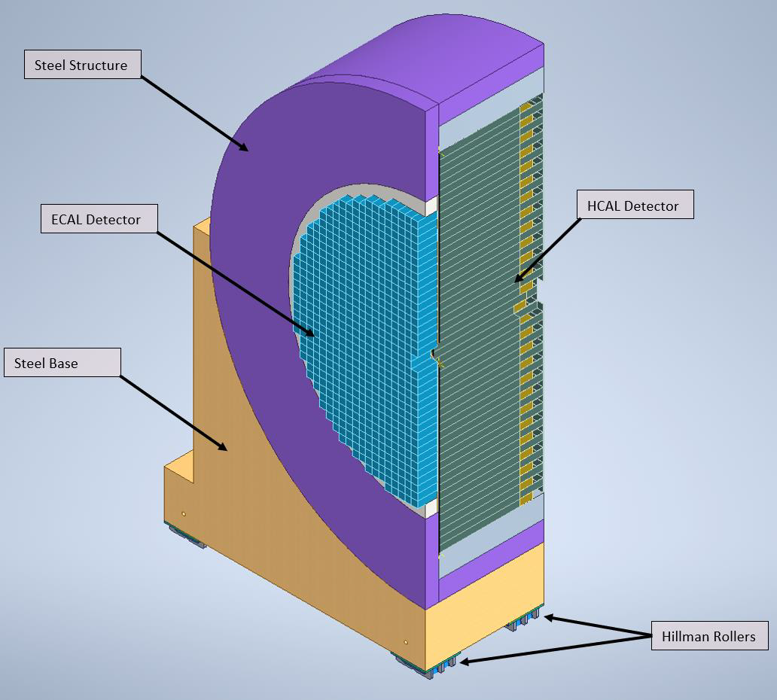
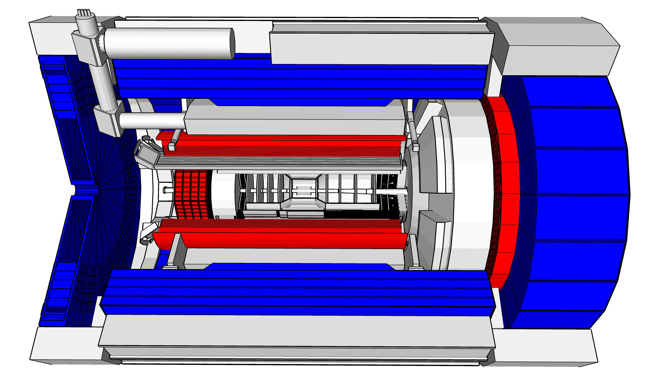
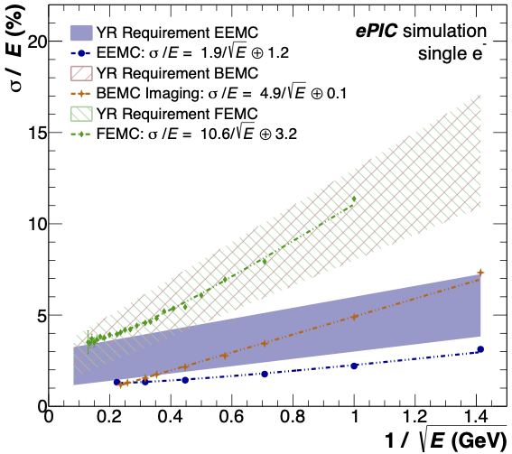
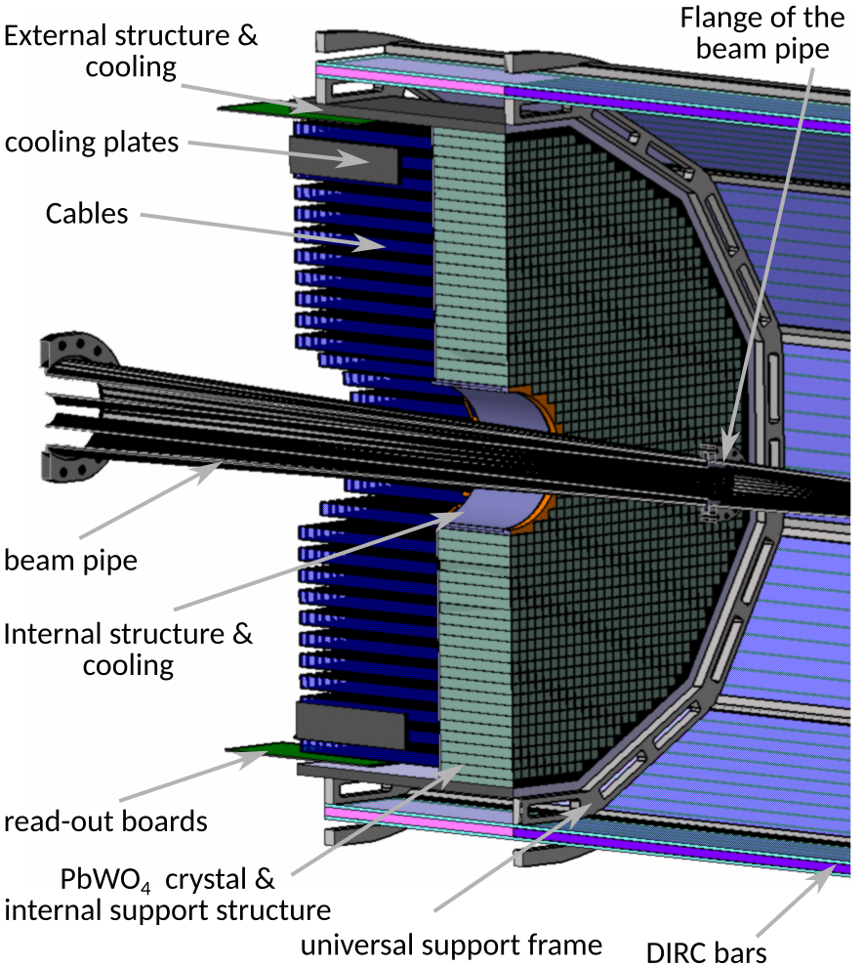
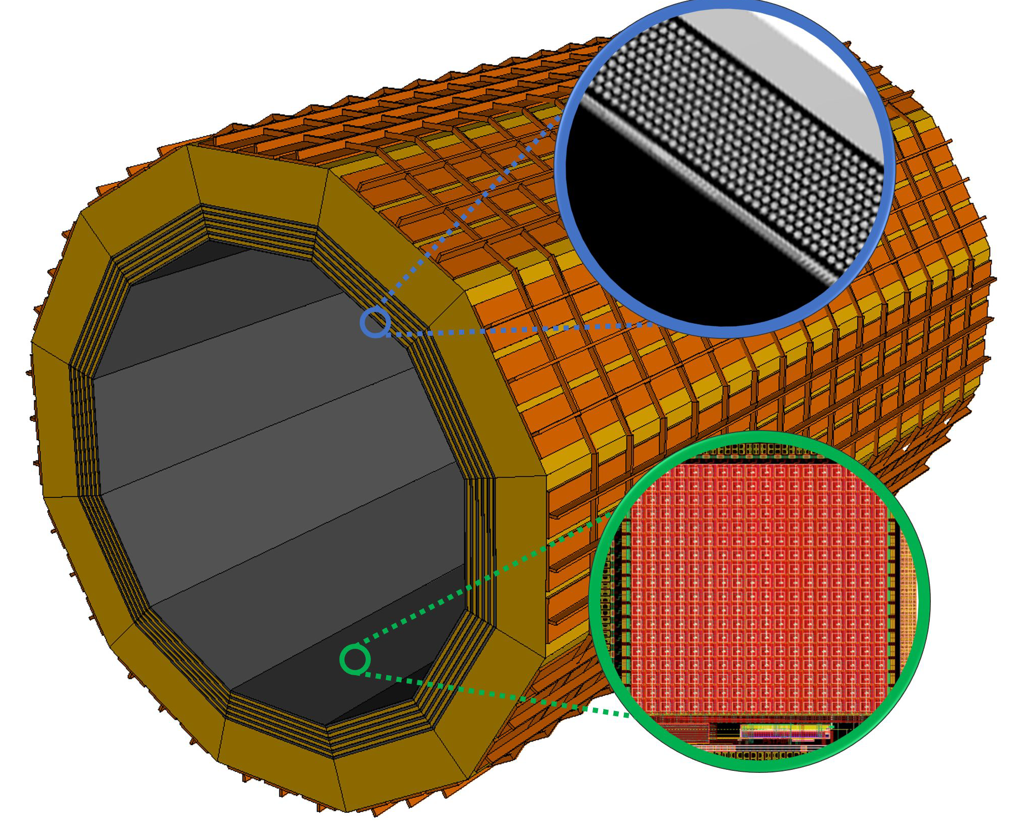
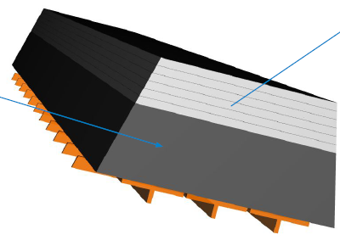
ePIC Calorimetry
Backwards HCal
Steel/Sc Sandwich
tail catcher
Barrel HCAL
(re-used from sPHENIX)
Excellent Energy Resolution
Forward ECal
High granularity
Tungsten/SciFi matrix
SiPMs as photonsensors
Forward HCAL
Longitudinally separated Steel/Sc & W/Sc sandwich
with SiPMs embedded in Scintillator
→ first large scale realization of a CALICE inspired design
world’s first
at
world’s first
at
Backward Ecal
High-precision, PbWO4
SiPMs as photonsensor
→ synergy with future crystal calorimeters
Pb/SciFi
world’s first
at
Barrel ECal: Pb/SciFi with a
hybrid imaging part (using 6 layers of ASTROPIX)
Recent Technology Choice
Review 03/14/23, ePIC Decision 04/21/23

Slide 11
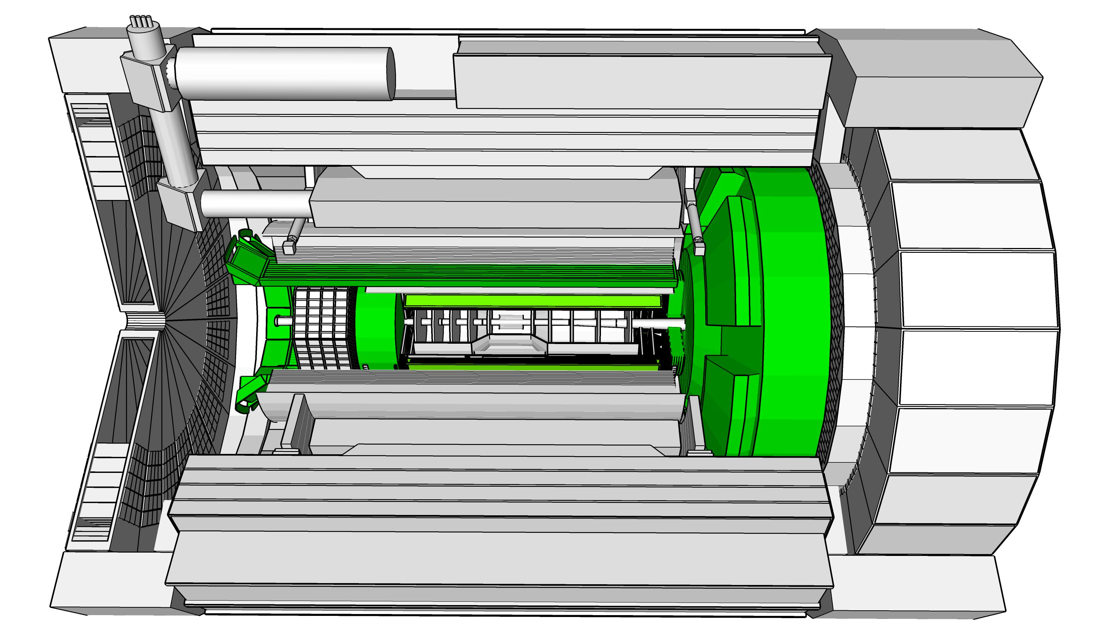

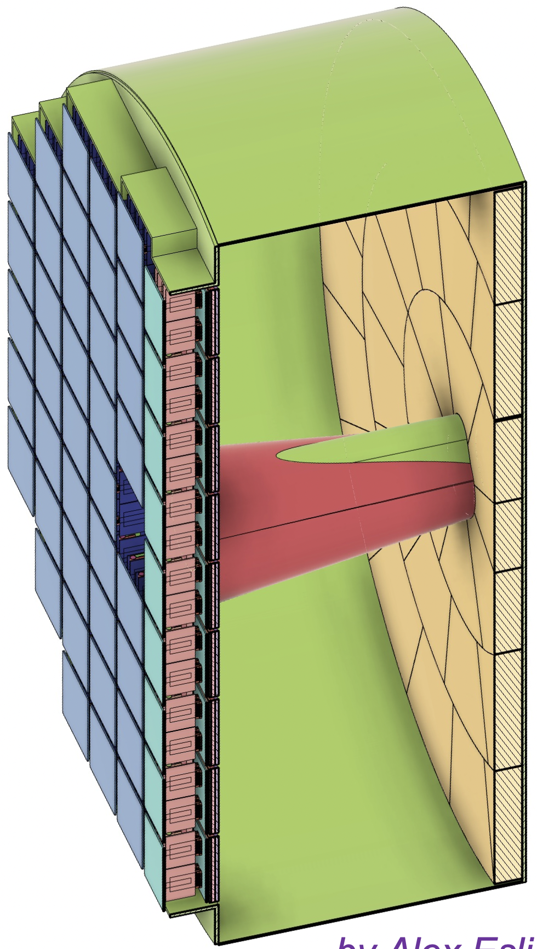
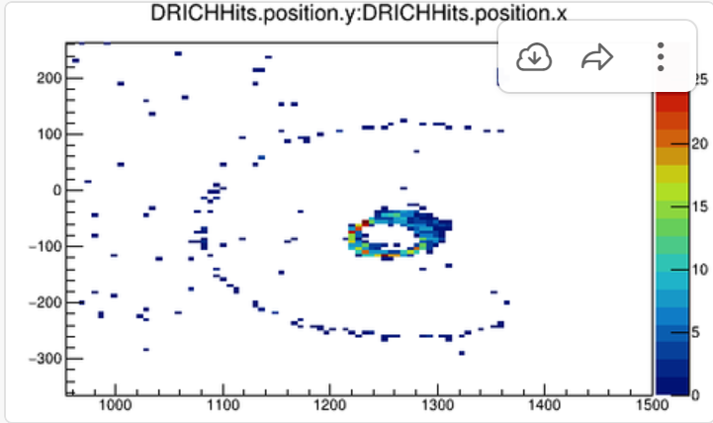
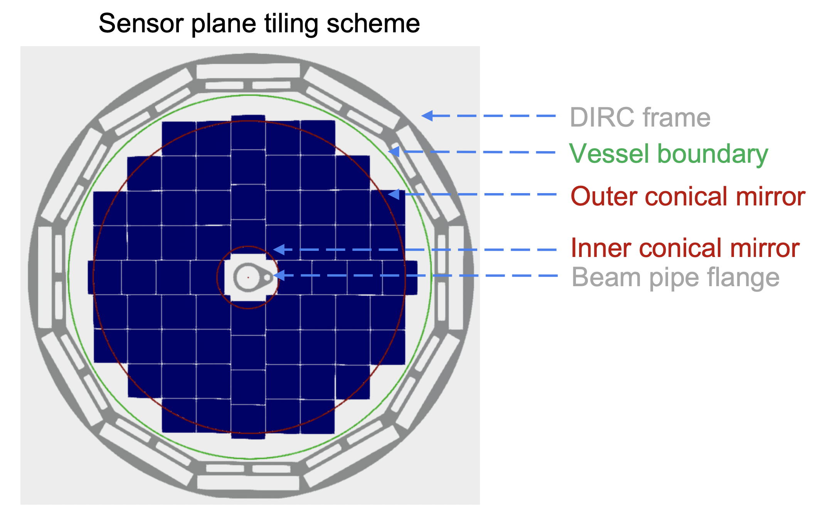
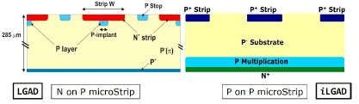
ePIC Particle Identification Detectors
Backward RICH:
Aerogel Cherenkov Det.
e, π, K, p separation
→ π/K 3σ sep. at 10 GeV/c
Photon-sensor:
LAPPDs to include TOF
hpDIRC (High Performance DIRC)
Quartz bar radiator → Reuse of BaBAR DIRC bars
light detection with MCP-PMTs
Fully focused
π/K 3σ sep. at 6 GeV/c
dual Radiator RICH
Aerogel
z: 4cm
radius: 110 cm
air gap
0.3 mm acrylic filter
Spherical Mirrors
6 Azimuthal Sectors
world’s first
at
Single volume proximity focusing aerogel RICH with long proximity gap (~30 cm)
C₂F₆ Gas Volume
120 cm length
radius: 185 cm
Tapered bore radius
Al vessel
Sensors tiled on spheres
→ SiPMs as Photonsensors
world’s first
at
π/K 3σ sep. at 50 GeV/c
AC-LGAD (Low Gain Avalanche Detector)
20-35 psec
Accurate space point for tracking
forward disk and central barrel
R&D and PED by International consortium HEP & NP
world’s first
at

Slide 12
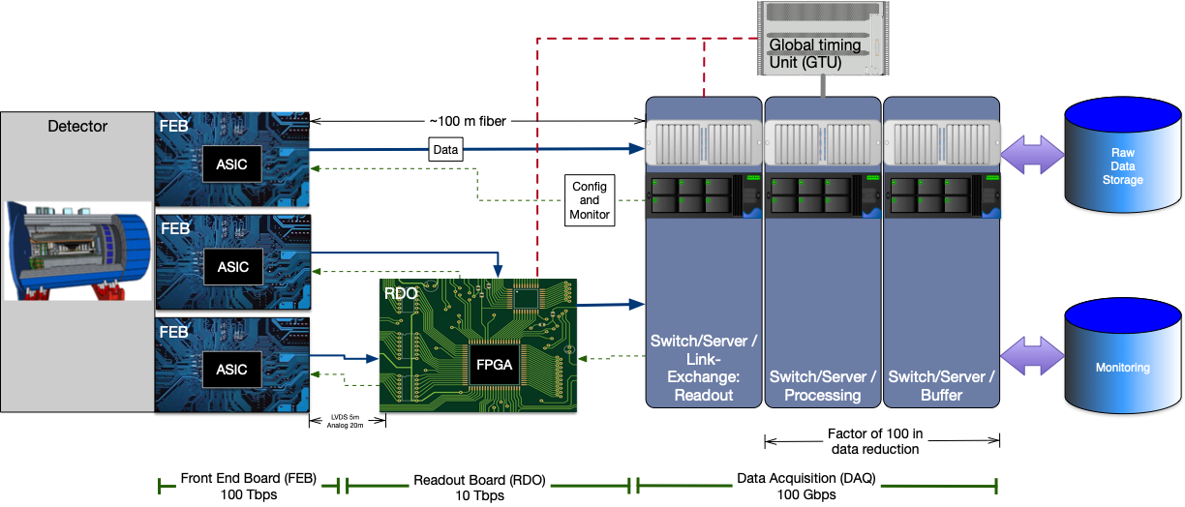
Streaming Readout Architecture
Triggerless streaming architecture gives much more flexibility to do physics
Rates quoted are at output of each stage
Integrate AI/ML as close as possible to subdetectors → cognizant Detector

Slide 13
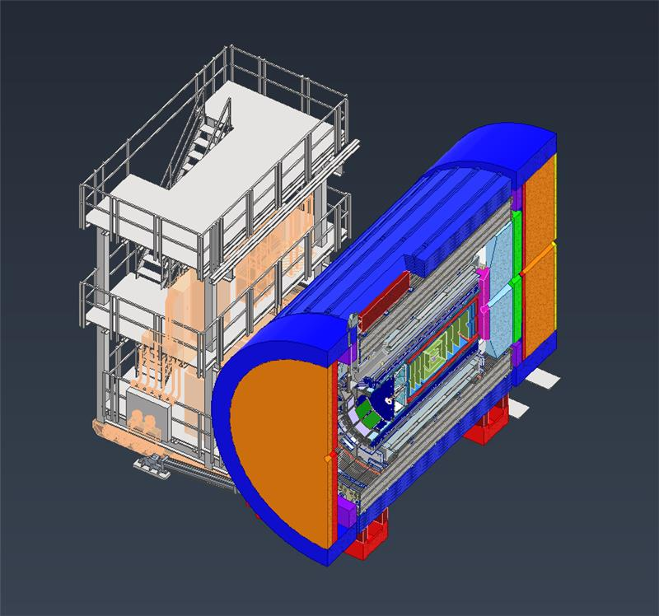
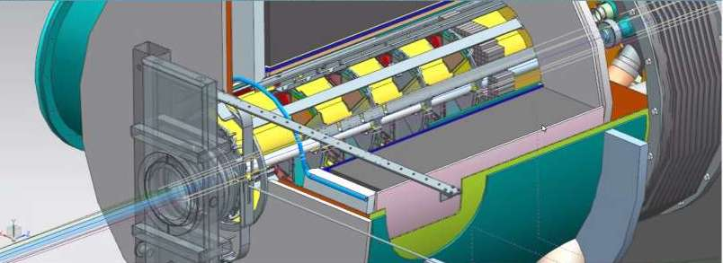
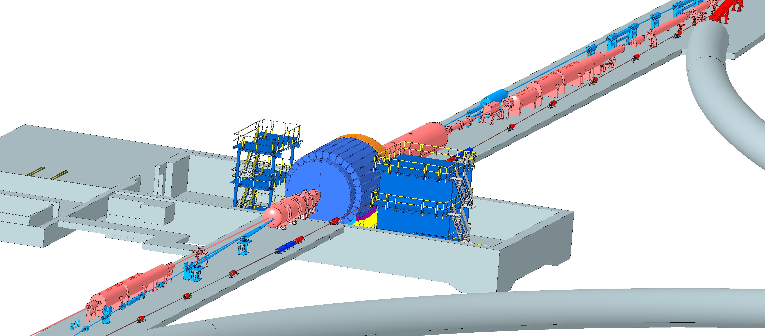
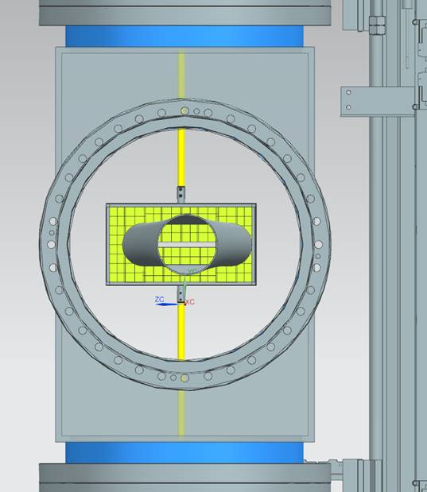
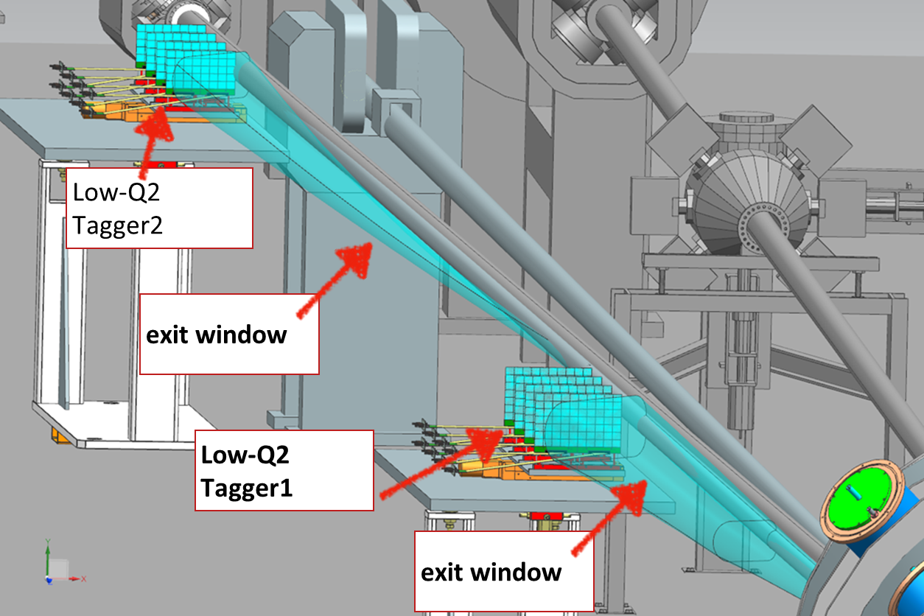
Interaction Region Layout
Central Detector
ESR Forward side
Detectors in B0 magnet
Roman Pots
Forward Side
SC Magnet Cryostat
HSR Injection Line
Central Detector
Rear Side
SC Magnet Cryostat
HSR Forward Side
HSR: Hadron Storage Ring
ESR: Electron Storage Ring
RCS: Rapid Cycling Synchrotron
SC: Superconducting
HSR
Rear Side
RCS
With Detector Bypass
Low-Q2 Detectors
ESR Rear side
every cm counts… → integration and communication with accelerator team is crucial

Slide 14
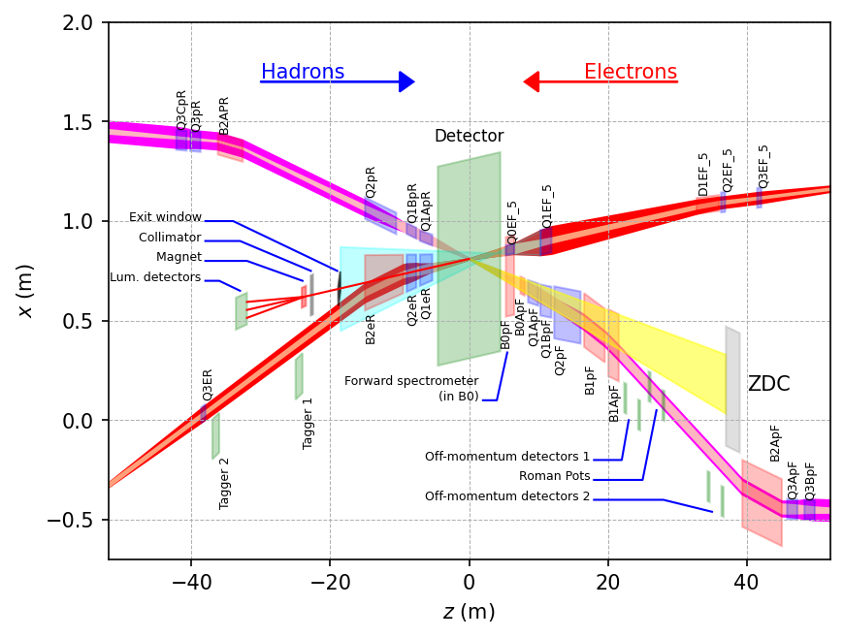
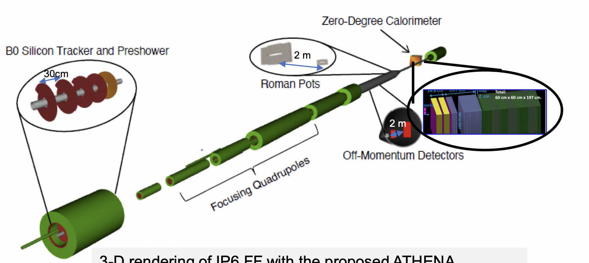
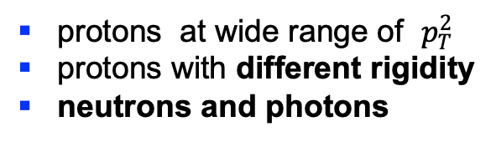
Far-Forward Detectors
Detection of forward particles critical for measuring t
exclusivity through missing mass does not work at collider → incoming beam Δp/p RMS ~ 10^{-4 to -5}
  protons at wide range of $p_{T}^{2}$
  protons with different rigidity
  neutrons and photons
IP
B0-dipole
 | Particles | Angle [mrad] |  | Distance from IP
B0-tracker | Charged particles Photons ( tagged) | 5.5 - 20 |  | ca 6-7 m
Off-momentum | Charged particles | 0-5.0 | 0.4< xL< 0.65 | ca 23-25 m
Roman Pots | Protons Light nuclei | 0*-5.0 | 0.6 < xL< 0.95 | ca 27-30 m
ZDC | Neutrons Photons | 0-4.0 (5.5) |  | ca 35 m

Slide 15

Measurements

Slide 16


DVCS at EIC
e’
γ
e
γ_{L}*
(Q²)
DVCS: Golden channel
theoretically clean
wide range of observables
(σ, A_{UT}, A_{LU}, A_{UL}, A_{C})
to constrain different GPDs through CFFs
x+ξ
x-ξ
~
~
p
H, H, E, E (x,ξ,t)
p’
t
DVCS data at end of HERA
D. Mueller, K. Kumericki
S. Fazio, and ECA
arXiv:1304.0077

Slide 17
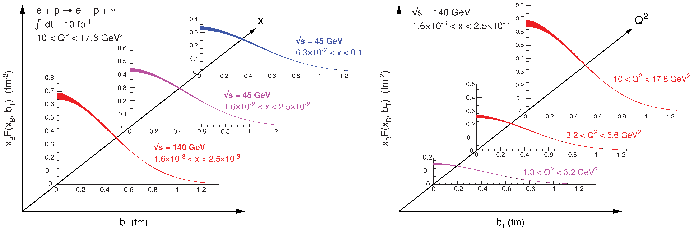

2+1d-Imaging in coordinate space
High precision
imaging at EIC
at low and high x
Golden channel:
DVCS
e’
e
γ_{L}*
γ
(Q²)
x+ξ
~
x-ξ
~
p
H, H, E, E (x,ξ,t)
p’
t
pion cloud
effects seen
at high b_{T}

Slide 18
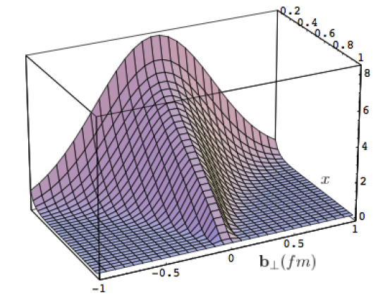
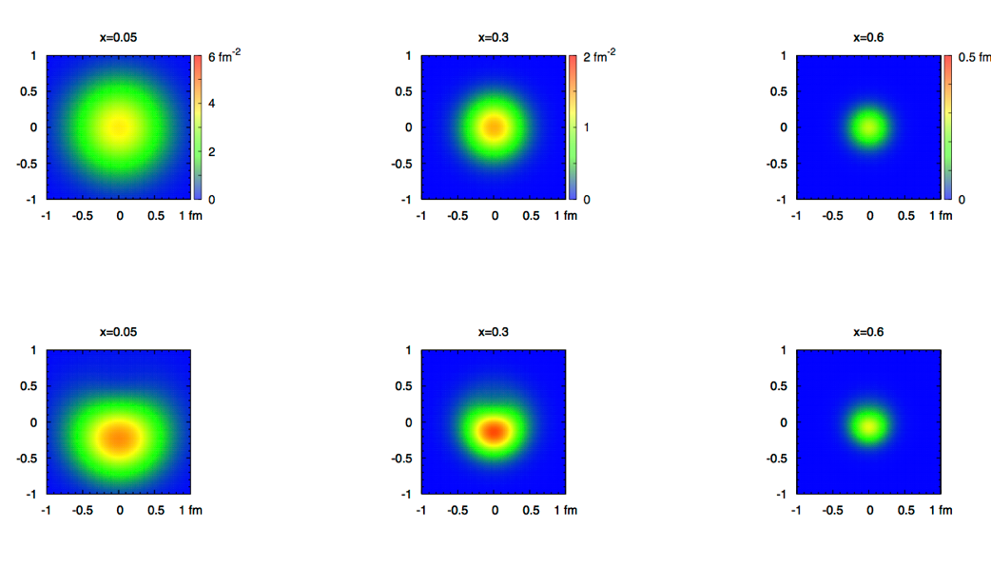
What can we learn
Model of a quark GPD
x
down valence quark
b_{T} (fm)
b_{T} decreasing as a function of x
x
EIC
Valence (high x) quarks at the center → small b_{T}
Sea (small x) quarks
at the périphérie → high b_{T} ?
GLUONS ???

Slide 19

Experimental

Slide 20

Experimental Reality
Precise Cross section measurements need precise corrections for BH
1
2
3
Milou:
Process 1, 2, 3, and 4
Process 5 is not:
→ not at all a problem
it can be easily rejected
or is not a problem
The magnitude of 2, 3 and 4 has been estimated, more details are shown in the next pages.
DVCS
BH -FSR
BH -ISR
4
5
q₃
q₃
All also included in new
EPIC generator
arXiv:2205.01762, Eur. Phys. J. C 82, 819 (2022)
DVCS
&
BH -ISR
DVCS
&
BH -FSR

Slide 21
BH Fraction
5 GeV x 100 GeV
BH subtraction will be important, at large y, depending on the x-Q² bin
BUT…
5 GeV x 100 GeV
and
5 GeV x 250 GeV
are overlapping:
x-sec. measurements at 5x250 at low-y can
crosscheck the BH
subtrac. made for 5x100
20 GeV x 250 GeV
BH subtraction will be not an issue for y<0.6

Slide 22
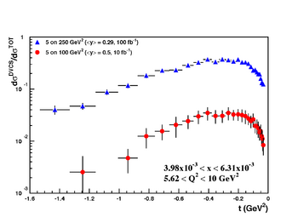
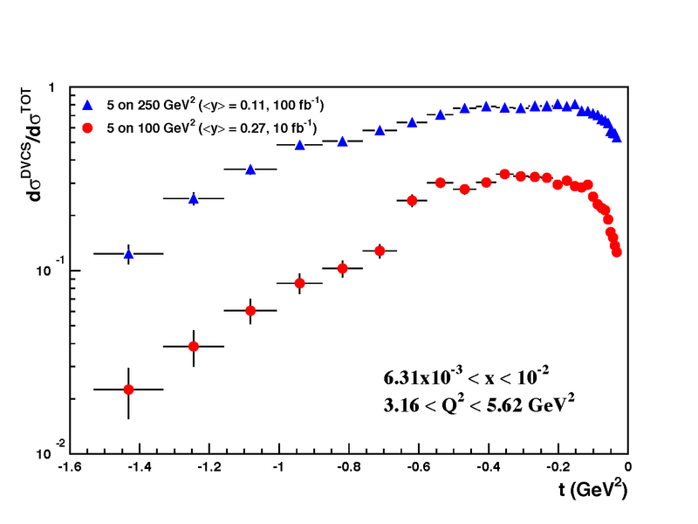
Rosenbluth Separation
Rosenbluth separation of the electroproduction cross section
→ verify MC based BH corrections
The statistical uncertainties include all the selection criteria to suppress the BH
exponential |t|-dependence assumed

Slide 23
Impact of reduced scattered proton acceptance
Measurement
Physics Obsevable
Plots from
EIC WP:
Requirement:
∫L_{int}=10fb⁻¹
0.18 < p_{t} (GeV) < 1.3
0.03 < |t| (GeV²)< 1.6
Fourier
Transform
Plots with
reduced
lower
p_{t}-acceptance
∫L_{int}=10fb⁻¹
0.44 < |p_{t}| (GeV) < 1.3
∫L_{int}=10fb⁻¹
0.18 < |p_{t}| (GeV) < 0.8
Plots with
reduced
high
p_{t}-acceptance

Slide 24
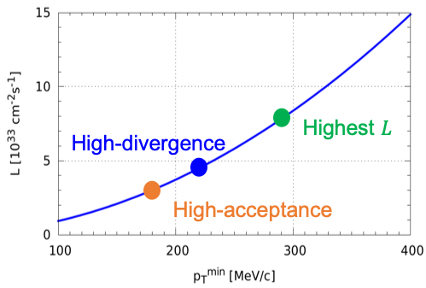

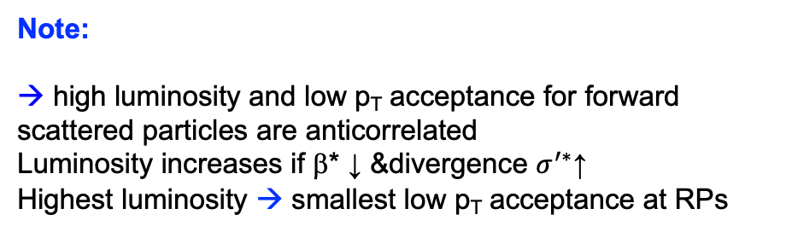
Far-Forward Detectors: Roman Pots
need two configurations:
high acceptance:
measure the low-t region
lowest t impacted by beam optics
high divergence
measure high-t tail
highest t reach driven by IR magnet
design → bore size
t= p_{T}²
HA
HD
$$\boxed{σ(z)=\sqrt{ε∙β(z))}}$$
Note:
→ high luminosity and low p_{T} acceptance for forward scattered particles are anticorrelated
Luminosity increases if β* ↓ &divergence $σ^{′∗}$↑
Highest luminosity → smallest low p_{T} acceptance at RPs

Slide 25
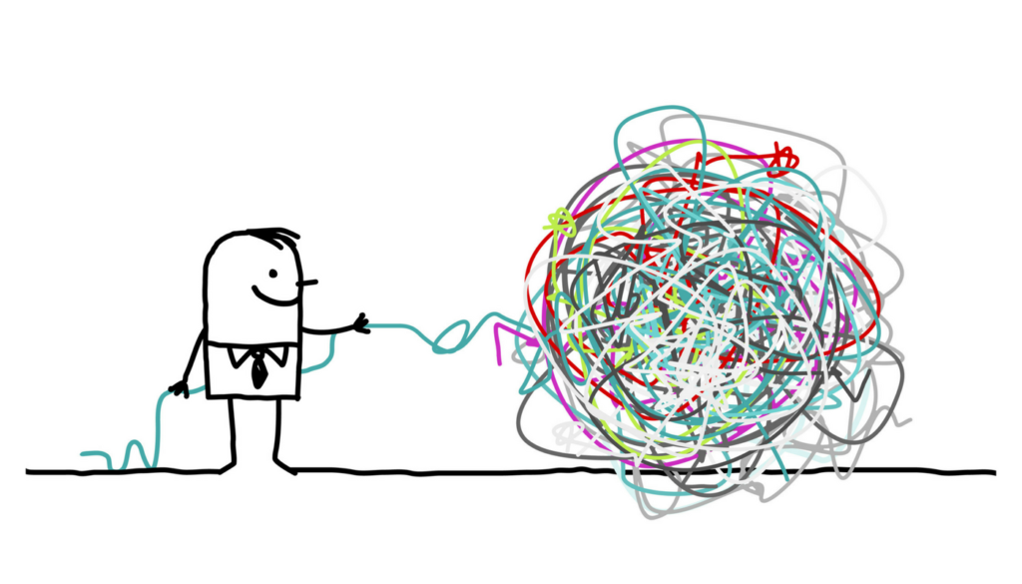
Disentangle Different CFFs and constrain GPDs

Slide 26
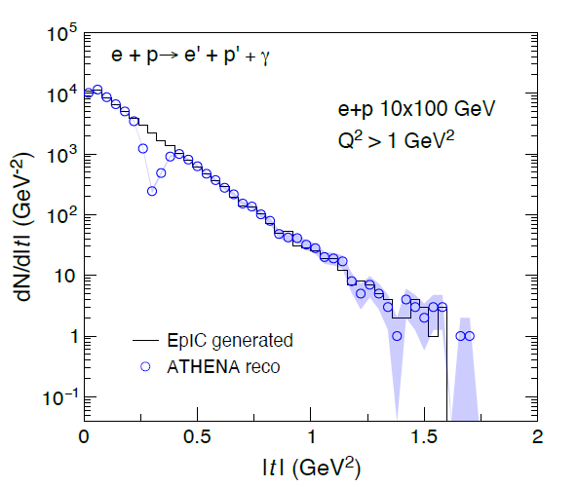
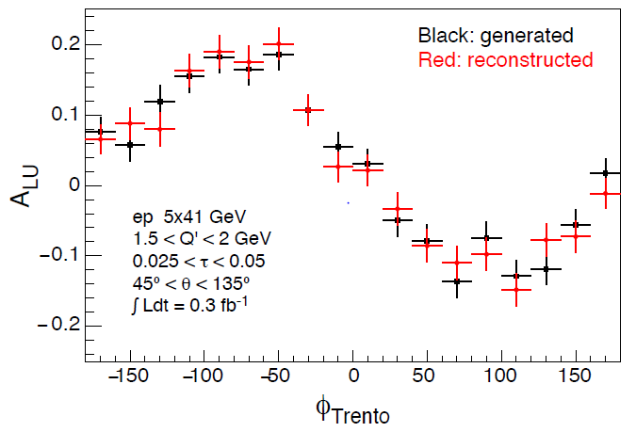
DVCS and TCS
assess to chiral-even GPDs and EMT
These exclusive channels challenge the detector
  DVCS: high energy γ
  TCS: di-lepton pair
  TCS scattered e at very small angles (not always detectable, in spite of FB)
  FB detectors key of the require measurement in large /t/-range (0.03-1.6 GeV²) → IMPACT PARAMETER by Fourier transformation
KEY:
Acceptance (including FF, possibly also FB)
fine resolution and good PID for γ, π⁰, e required for background suppression
Calorimetry (also HCal potentialities in the barrel)
at mid rapidity
FB gap intrinsic in
beam-line design
Q′ is the invariant mass of the lepton pair
τ = Q²=(s − m²_{p}) equivalent of x_{B}
θ angle between a produced lepton and the scattered proton
TCS and Bethe-Heitler (~100 more abundant !)
same kinematics,
their interference results in spin asymmetries

Slide 27
Disentangle different CFFs → GPDs
Vary electron and proton beam spin directions:
electron
beam
longitudinal
polarised
proton
beam
transverse
polarised
proton
beam
longitudinal
polarised
Δσ_{UT}
beam target

Slide 28
What will we learn about 2d+1 structure of the proton
GPD H and E as function of t, x and Q²
GPD H and E 1d+1
arXiv:1304.0077
A global fit over all pseudo data was done, based on the GPDs-based model:
[K. Kumerički, D Müller, K. Passek-Kumerički 2007]
Known values q(x), g(x) are assumed for H^{q}, H^{g}
(at x=0, t=0 forward limits E^{q}, E^{g} are unknown)
Excellent reconstruction of H^{sea}, H^{sea} and good reconstruction of H^{g} (from dσ/dt)
GPD H and E 2d+1 structure for sea-quarks and gluons

Slide 29
How to access Gluons in DIS
Several different complementary channels to access gluons
Scaling Violation
all x-Q² x_{g} = x_{Bj}
only limited by detector acceptance
Scaling Violation | F_{L}
all x-Q² x_{g} = x_{Bj} | only accessible if y is large x_{g} = x_{Bj}
only limited by detector acceptance | need several beam energies
 |  | Photon Gluon Fusion
Scaling Violation | F_{L} | Di-jets
all x-Q² x_{g} = x_{Bj} | only accessible if y is large x_{g} = x_{Bj} | wide coverage in x_{Bj}-Q² x_{g} =x_{Bj}(1+M²/Q²⁾ > x_{Bj}
only limited by detector acceptance | need several beam energies | need a wide acceptance detector
 |  | Photon Gluon Fusion
Scaling Violation | F_{L} | Di-jets | Charm
all x-Q² x_{g} = x_{Bj} | only accessible if y is large x_{g} = x_{Bj} | wide coverage in x_{Bj}-Q² x_{g} =x_{Bj}(1+M²/Q²) > x_{Bj} | same coverage in x_{Bj}-Q² as incl. F₂ x_{g} ≳x_{Bj}
only limited by detector acceptance | need several beam energies | need a wide acceptance detector | needs excellent m-vertex detector and particle ID

Slide 30
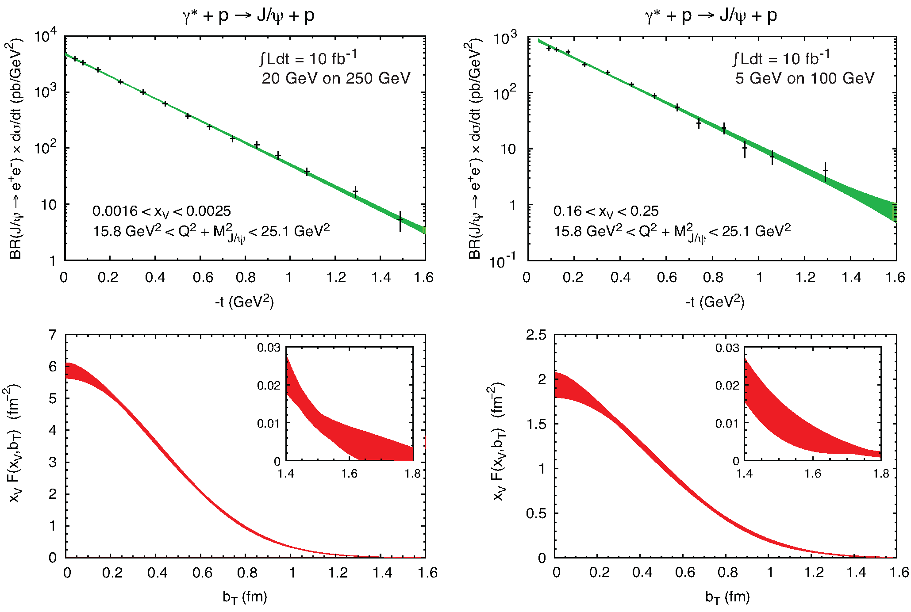

GPD H^{g}: J/ψ
To improve imaging on gluons
add J/ψ observables
cross section
A_{UT}
…..

Slide 31

Exclusive Upsilon Production
photo- and electro-production of heavy quarkonia near-threshold
t measured from:
Incoming and out-going proton four-momenta
Υ four-momenta
uncertainty of total and differential cross section of Υ(1S) near threshold for photo-production and electro-production (Q² < 1 GeV²) in e+p collisions via the di-electron decay channel
trace anomaly contribution to the proton mass in Ji’s decomposition;
green and red points are offset; band from a recent lattice QCD calculation; di-electron and di-muon decay channels
KEY:
good sensitivity over the entire rapidity range
good mass resolution to separate the three Υ states
good t resolution
e and μ PID

Slide 32
What about Nuclei?

Slide 33




Neutron GPDs
Possibility to study neutron structure
DVCS on neutron compared to proton can be used for flavor separation
𝛾
Using Deuteron is the simplest case:
DVCS on incoherent D (D breaks up) but coherent on the neutron, the “double tagging” method
Tag DIS on a neutron (by the ZDC)
Measure the recoil proton momentum
The recoil proton momentum cone is
  $α_{R}={\left(E_{R}+p_{R||}\right)}/{\left(E_{D}+p_{D||}\right)}$ and $p_{RT}$
Gives free neutron structure, not affected by final state interactions
He3 experimentally equally easy

Slide 34



Diffraction in DIS at Small x
e+p
t = (p-p’)²
β is the momentum fraction of the struck parton w.r.t. the Pomeron
x_{IP} = x/β: momentum fraction of the exchanged object (Pomeron) w.r.t. the hadron
M_{X}²: Squared mass is the diffractive final state
Diffraction in e+p:
  coherent ⇔ p intact
  incoherent ⇔ breakup of p
  HERA: 15% of all events are hard diffractive
Diffraction in e+A:
coherent diffraction (nuclei intact)
breakup into nucleons (nucleons intact)
incoherent diffraction
Predictions: σdiff/σtot in e+A ~25-40%

Slide 35

Spatial Gluon Distribution from dσ/dt
Diffractive vector meson production:
Momentum transfer t = |pAu-pAu′|² conjugate to bT
e + Au → e′ + Au′ + J/ψ, φ, ρ
Fourier Transform
PRC 87 (2013) 024913
Coherent cross-section sensitive to average geometry
Steepness and the position of first dip depends on density profile, non-linear effects and correlations
H.Mantysaari,B.Schenke PRC 101 (2020) 015203
Experimentally very challenging
Φ more sensitivity to saturation effects
BUT
Incoherent events are by themselves interesting
Different |t| regions of the spectrum sensitive to different sizes
Energy dependence of incoherent spectra with differential binning in |t| could tell us about growth of nuclei and evolution of fluctuations
Recent results from Mantysaari, et al. (arXiv:2303.04866) show different regions of spectrum to be sensitive to different kinds of shape deformations e.g Uranium
Notes:
spin-dependent gluon distribution

Slide 36
Vetoing Incoherent Events
Veto.1:
no neutron in ZDC
Veto.2:
Veto1 + no proton in Roman Pots
Veto.3:
Veto2 + no proton in off-momentum detector
Veto.4:
Veto3 + no proton in B0
Veto.5:
Veto4 + no anything in preshower
Veto.6:
Veto5 + no photon E>50MeV in ZDC
Veto.7:
Veto6 + no activities
($\left|η\right|<4.0 \& p_{T}>100{MeV}/c \& E>50 MeV$)
other than e- and $J/ψ$ in the main detector
With these requirements, the rejection power is found to be not enough to reach the three minimum positions.
Beam pipe design and material critical to vetoing power

Slide 37




More Exclusive Processes at EIC
e+d exclusive J/Psi
with p/n tagging
Short-Range Correlations
https://arxiv.org/abs/2108.08314
https://arxiv.org/pdf/2005.14706.pdf
Diffraction
Sullivan process
𝜋/K form factors and structure functions
https://arxiv.org/pdf/2102.11788.pdf
Saturation
Nucleon/Nuclei Structure
Rapidity
gap
https://arxiv.org/abs/2107.05737
u-channel backward exclusive electroproduction
Backward-angle colinear factorization
https://arxiv.org/pdf/2308.10478.pdf

Slide 38

The EIC Project

Slide 39


Timeline: What is Coming
    EIC Critical Decision Plan
    CD-0/Site Selection December 2019 ✓
    CD-1 June 2021 ✓
    CD-3A January 2024
    CD-3B October 2024
    CD-2/3 April 2025
    early CD-4 October 2032
    CD-4 October 2034
CD-3A:
Define Baseline:
technologies, Scope, Cost & Schedule
Long Lead Procurement (LLP) items
Design Maturity: ~90%
Plan is tracked through EVMS
& Change control process
Start of construction for LLPs
Construction Phase
Conclusion of
RHIC Operation
Science Phase
CD-2:
Approve preliminary design for all subdetectors
Design Maturity: >60%
Need “preliminary” TDR
Baseline project in scope, cost, schedule
The thinner bars indicate that R&D and design
can continue at a small level beyond CD-2 and CD-3
CD-3:
Approve final design for all subdetectors
Design Maturity: ~90%
Need full TDR

Slide 40

Let’s get to work
and built the EIC
Please join us

Slide 41


Slide 42


Different Processes
Hadron-Hadron:
Ultra-Peripheral Collisions:
probe has complex structure
no simple access to parton kinematics:
η → x; p_{t}² → Q² → x-Q²
strongly correlated
Gluons can be accessed directly → qg & gg
  gluon fragmentation
Electron-Hadron:
Photon induced process
no simple access to parton kinematics:
η → x; M²→ Q² can only be
varied by VM
access to initial state
Point-like probe → resolution
High precision & access to partonic kinematics through scattered lepton
→ x_{B}, Q²
    initial and final state effects can be cleanly disentangled
Notes:
details in backup
picture much more schematic / carton

Slide 43





UPC: Access to GPD E_{g}
UPC:
p’ detected in RPs
Forward rapidity gives access to the large asymmetry region
world wide only access to GPD E for gluons
→ J/Ψ production in p↑Au /p ↑ p UPC
2015 polarized pA data:

Slide 44
UPC in dAu
Coherent/incoherent separation not as obvious as for Au:
d not much larger than nucleon, p²_{T}-dist. not so different
Dipole model*: describe coherent/incoherent @ low p²_{T}
need fluctuations @ higher p²_{T} (like Au, Sartre ✓)
n-tag: suppresses coherent near p²_{T}~0; lose tagger acceptance higher p²_{T}
*H. Mäntysaari and B. Schenke, Phys.Rev.C 101 (2020) 1, 015203

Slide 45
What is needed experimentally?
experimental measurements categories to address EIC physics:
Parton Distributions in nucleons and nuclei
QCD at Extreme Parton Densities - Saturation
Spin and
Flavor structure of nucleons and nuclei
Tomography Transverse Momentum Dist.
QCD at Extreme Parton Densities - Saturation
Tomography
Spatial Imaging
inclusive DIS
semi-inclusive DIS
exclusive processes
measure scattered lepton
→ event kinematics
e-ID: e/h separation
reach to lowest x, Q² impacts
Interaction Region design
measure scattered lepton
and hadrons in coincidence
multi-dimensional binning:
x, Q², z, p_{T}, Θ
particle identification over entire kinematic region is critical
Jets: excellent E_{T}, jet-energy scale
measure all particles in event
multi-dimensional binning:
x, Q², t, Θ
proton p_{t}: 0.2 - 1.3 GeV
  cannot be detected in main detector
  strong impact on Interaction Region design
∫Ldt:
1 fb⁻¹
10 fb⁻¹
10 - 100 fb⁻¹
machine & detector requirements

Slide 46

2+1 dimensional Imaging of Quarks & Gluons
Wigner function
W(x,b_{T},k_{T})
→ QCD genetic map
Momentum
space
Coordinate
space
∫d²b_{T}
∫ d²k_{T}
f(x,k_{T})
f(x,b_{T})
Quarks
Quarks
down quark
x
Spin-dependent 3D momentum space
images from semi-inclusive scattering
Spin-dependent 2+1D coordinate space images from exclusive scattering

Slide 47
BH rejection: 20 GeV x 250 GeV
Cuts:
0.01 < y < 0.6
10⁻⁴ < x < 0.1 1.0 < Q² < 100 GeV²
0.01 < |t| < 1.0 GeV²
the upper y-cut cancels the shift
to the left in the BH peak.
0.01 < y < 0.85
BH electron has very low energy (often below 1 GeV)
→ with good scattered lepton ID
cut could be optimized
→ E_{el} > 5 GeV
Photon for BH (ISR) goes mostly forward (into the beam pipe)

Slide 48
What about DVCS-BH ISR
q₃
DVCS
&
BH -ISR
Fraction of ISR events for three Q²-bins as fct of x for two EIC beam energy combinations.
ONLY 15% of the events emit a photon with > 2% energy of the incoming electron
ISR photons with E_{γ} < 0.02 E_{e} do not result in a significant correction for the event kinematics.

Slide 49
Key Observables for Saturation
Diffraction:
Diffractive events are indicative of a color neutral exchange between the virtual photon and the proton or nucleus over several units in rapidity.
M_{X}²: Squared mass is the diffractive final state
x_{IP}: Momentum fraction of the “Pomeron” with respect to the hadron.
The rapidity gap between produced particles and the proton or
nucleus is Y ~ ln(1/x_{IP} )

Slide 50
Inclusive Diffraction
HERA observed: ~14% of all events are diffractive
Saturation models (CGC) predict up to σ_{diff}/σ_{tot} ~ 25% in eA
Ratio enhanced for small M_{X} and suppressed for large M_{X}
Standard QCD predicts no M_{X} dependence and a moderate suppression due to shadowing.
It would be nice to have equally
rigorous extraction of diffractive
PDF as the “std. PDFs”
→ both for proton and nuclei

Slide 51

IR Requirements from Physics
 | Hadron | Lepton
Machine element free region | High Luminosity → beam elements need to be close to IP EIC: +/- 4.5 m for main detector beam elements < 1.5º in main detector volume
Beam pipe | Low mass material i.e. Beryllium
Integration of Detectors | Local Polarimeter | Low Q²-tagger Acceptance: Q² < ~0.1 GeV
Zero Degree Calorimeter | 60cm x 60cm x 2m @ ~30 m
scattered proton/neutron acc. all energies for ep | Proton: 0.18 GeV < p_{t} < 1.3 GeV 0.5 < x_{L}< 1 (x_{L} = $E_{p}^{′}$/E_{Beam}) Neutron: p_{t} < 1.3 GeV
scattered proton/neutron acc. all energies for eA | Proton and Neutron: Θ < 6 mrad (√s=50 GeV) Θ < 4 mrad (√s=100 GeV)
Luminosity | Relative Luminosity: R = L^{++/--}/L^{+-/-+} < 10⁻⁴ Flexible spin patters for both beams 1: +-+--+-++-+- 2: -+-++-+--+-+ 3: ++--++--++-- 4: --++--++--++
 |  | γ acceptance: +/- 1 mrad → δL/L < 1%
most demanding

Slide 52








IR-Performance Highlights
Forward Direction
Backward Direction
Proton: 0.18 GeV < p_{t} < 1.3 GeV
Performance of low Q²-Tagger
5 x 41 GeV
10 x 100 GeV
18 x 275 GeV
Proton: 0.5 < x_{L}< 1
0.6 < x_{L}< 0.72
0.88 < x_{L}< 0.98
Reconstruction is feasible down to 10⁻³ GeV²
Beam angular divergence affects lower values of Q²
Performance of Luminosity-Tagger
Neutron: Θ < 4 mrad @ 100 GeV
Requirements fulfilled
Requirements fulfilled

