Slide 1

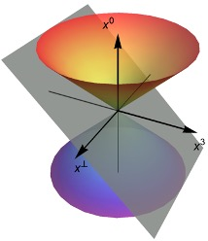
Nucleon GPDs
from
Basis Light-front Quantization
Xingbo Zhao
With
Chandan Mondal, Siqi Xu, Ziqi Zhang, Yiping Liu, Yang Li, James Vary
(BLFQ collaboration)
Workshop on Generalized Parton Distributions for Nucleon Tomography in the EIC Era
January 19, 2024

Slide 2
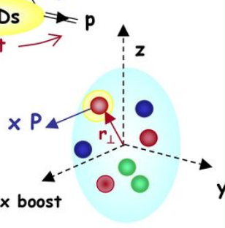
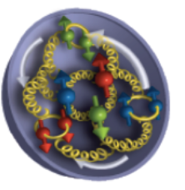
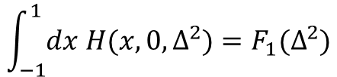






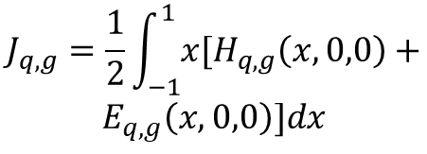



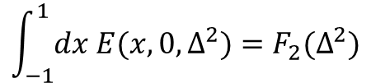











Generalized Parton Distribution Functions
GPDs encode 3D spatial information
$$Δ=P−P′$$
Contain information about spin and orbital angular momentum
Appear in DVCS / DVMP / TCS / DDVCS …
$$x=p^{+}/P^{+}$$
$$ξ=−Δ^{+}/2P^{+}$$
Deeply Virtual Compton Scattering (DVCS)
$$ξ−x$$
$$−ξ−x$$
$$x+ξ$$
$$ξ−x$$
$$x+ξ$$
$$x−ξ$$
DGLAP
ERBL
DGLAP
$$P′$$
$$P$$
$$P′$$
$$P$$
$$P′$$
$$P$$
$$−1<x<−ξ$$
$$−ξ<x<ξ$$
$$ξ<x<1$$
Parton distribution function
Form Factors
Total angular momentum
$$\int_{−1}^{1}{dx H(x,0,Δ^{2})}=F_{1}(Δ^{2})$$
$$H\left(x,0,0\right)=q(x)$$
$$J_{q,g}=\frac{1}{2}\int_{−1}^{1}{x[H_{q,g}\left(x,0,0\right)+}$$
$$E_{q,g}\left(x,0,0\right)]dx$$
$$\tilde{H}\left(x,0,0\right)=Δq(x)$$
$$\int_{−1}^{1}{dx E(x,0,Δ^{2})}=F_{2}(Δ^{2})$$
12/16

Slide 3
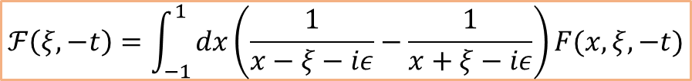

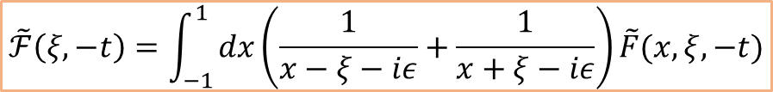
GPDs and Compton Form Factors
Cross sections to Compton form factors
$${\left|T\right|}^{2}={\left|T_{BH}+T_{DVCS}\right|}^{2}={\left|T_{BH}\right|}^{2}+{\left|T_{DVCS}\right|}^{2}+T_{BH}^{∗}T_{DVCS}+T_{DVCS}^{∗}T_{BH}$$
Cross-section
Structure functions
Compton form factors
GPDs to Compton form factors
$$ℱ\left(ξ,−t\right)=\int_{−1}^{1}{dx\left(\frac{1}{x−ξ−iε}−\frac{1}{x+ξ−iε}\right)F(x,ξ,−t)}$$
CFFs
GPDs
$$\tilde{ℱ}\left(ξ,−t\right)=\int_{−1}^{1}{dx\left(\frac{1}{x−ξ−iε}+\frac{1}{x+ξ−iε}\right)\tilde{F}(x,ξ,−t)}$$
Compton form factors are integrations of GPDs over $x$
It is challenging to extract GPDs from CFFs
Exploring GPDs from theory is interesting

Slide 4
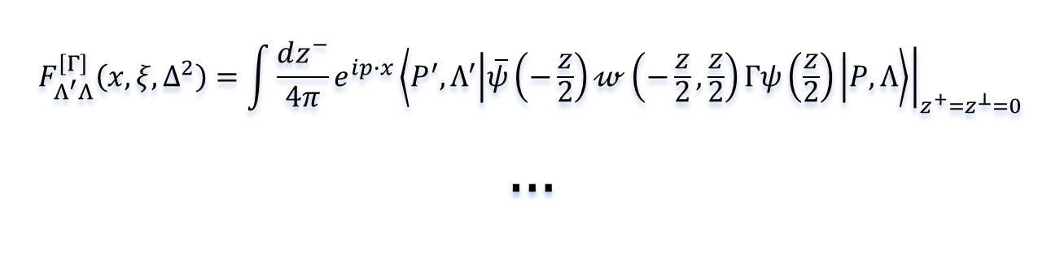
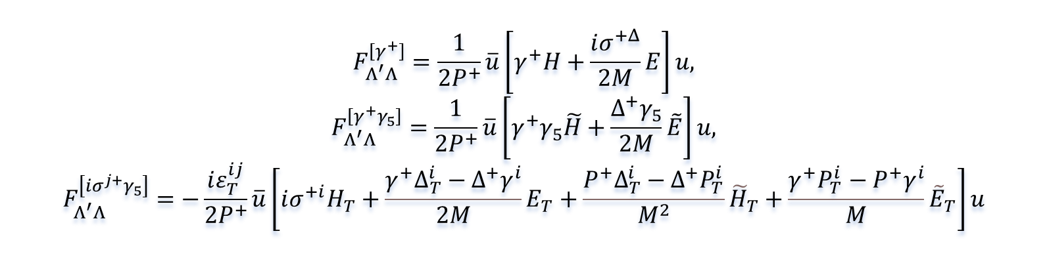
Definition of GPDs
GPDs are defined through the following bilocal operator:
[Stephan.M, 2009]
$$F_{Λ^{′}Λ}^{\left[Γ\right]}\left(x,ξ,Δ^{2}\right)=\int{\frac{dz^{−}}{4π}e^{ip∙x}}{\left.\left\langle P^{′},Λ^{′} | \overline{ψ}\left(−\frac{z}{2}\right)𝓌\left(−\frac{z}{2},\frac{z}{2}\right)Γψ\left(\frac{z}{2}\right) | P,Λ\right\rangle \right|}_{z^{+}=z^{⊥}=0}$$
$$…$$
GPDs are parameterized by taking different $Γ$ matrices:
$$F_{Λ^{′}Λ}^{\left[γ^{+}\right]}=\frac{1}{2P^{+}}\overline{u}\left[γ^{+}H+\frac{iσ^{+Δ}}{2M}E\right]u,$$
$$F_{Λ^{′}Λ}^{\left[γ^{+}γ_{5}\right]}=\frac{1}{2P^{+}}\overline{u}\left[γ^{+}γ_{5}\tilde{H}+\frac{Δ^{+}γ_{5}}{2M}\tilde{E}\right]u,$$
$$F_{Λ^{′}Λ}^{\left[iσ^{j+}γ_{5}\right]}=−\frac{iε_{T}^{ij}}{2P^{+}}\overline{u}\left[ⅈσ^{+i}H_{T}+\frac{γ^{+}Δ_{T}^{i}−Δ^{+}γ^{i}}{2M}E_{T}+\frac{P^{+}Δ_{T}^{i}−Δ^{+}P_{T}^{i}}{M^{2}}{\tilde{H}}_{T}+\frac{γ^{+}P_{T}^{i}−P^{+}γ^{i}}{M}{\tilde{E}}_{T}\right]u$$
We use symmetric frame

Slide 5
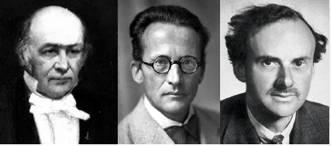

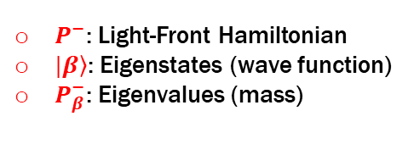



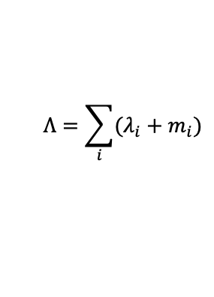

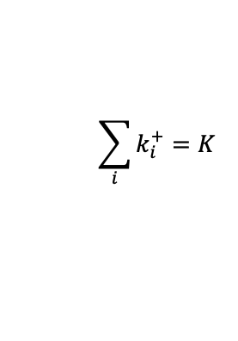
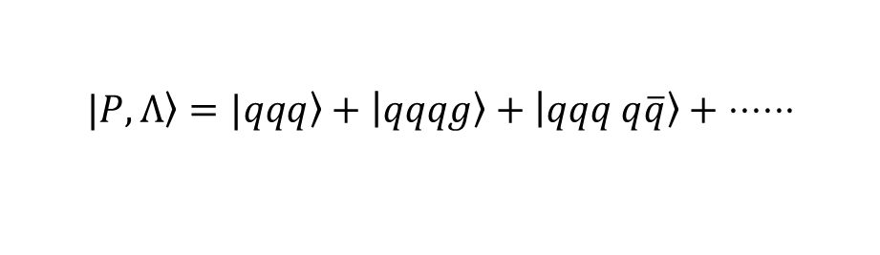
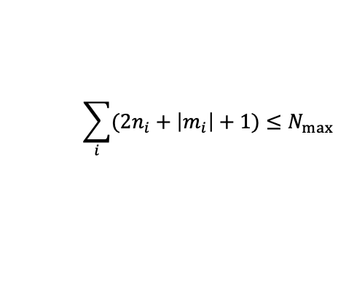
Basis Light-Front Quantization
Hamiltonian eigenvalue equation:
[Dirac, 1949]
[Vary, et.al, Phys.Rev.C ’10]
$$P^{−}\left|\left.β\right\rangle =P_{β}^{−}\right|\left.β\right\rangle$$
$P^{−}$: Light-Front Hamiltonian
$|\left.β\right\rangle$: Eigenstates (wave function)
$P_{β}^{−}$: Eigenvalues (mass)
Basis setup:
Fock sector expansion:
  $$|\left.P,Λ\right\rangle =|\left.qqq\right\rangle +\left|qqqg\right\rangle +\left|qqq q\overline{q}\right\rangle + ⋅⋅⋅⋅⋅⋅$$
Single particle basis
in $|qqq⟩$:
$$\left|α\right\rangle =|n_{1},m_{1},n_{2},m_{2},n_{3},m_{3}⟩$$
$$⨂ |k_{1}^{+}, k_{2}^{+},k_{3}^{+}⟩$$
$$⨂|λ_{1},λ_{2},λ_{3},C⟩$$
2D harmonic oscillator
Discretized longitudinal momentum
Helicity and color
$$\sum_{i}{(2n_{i}+\left|m_{i}\right|+1)}≤N_{max}$$
$$\sum_{i}{k_{i}^{+}}=K_{}$$
$$Λ=\sum_{i}{(λ_{i}+m_{i})}$$
Advantages:
1. Straightforward for calculating observables defined on the light cone
2. Exact factorization between center-of-mass motion and intrinsic motion
3. Harmonic oscillator basis supplies adequate infrared behavior for hadrons

Slide 6
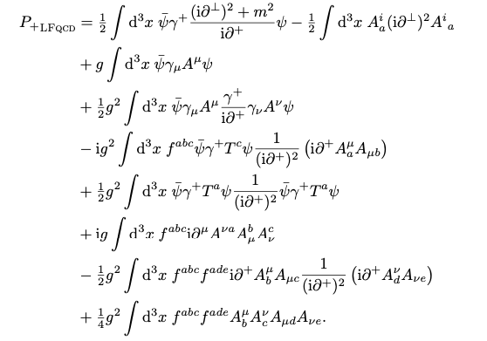
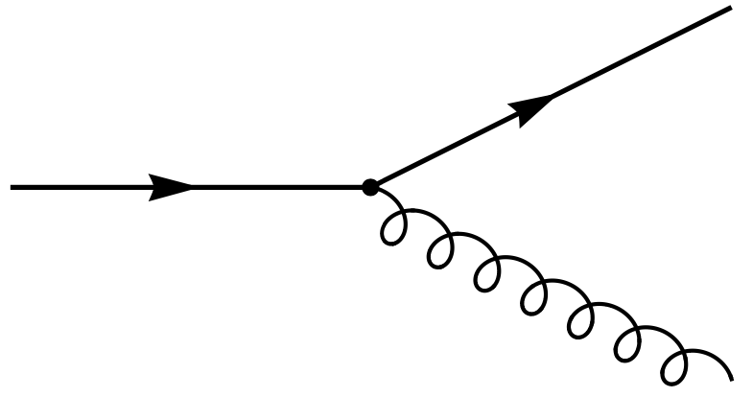
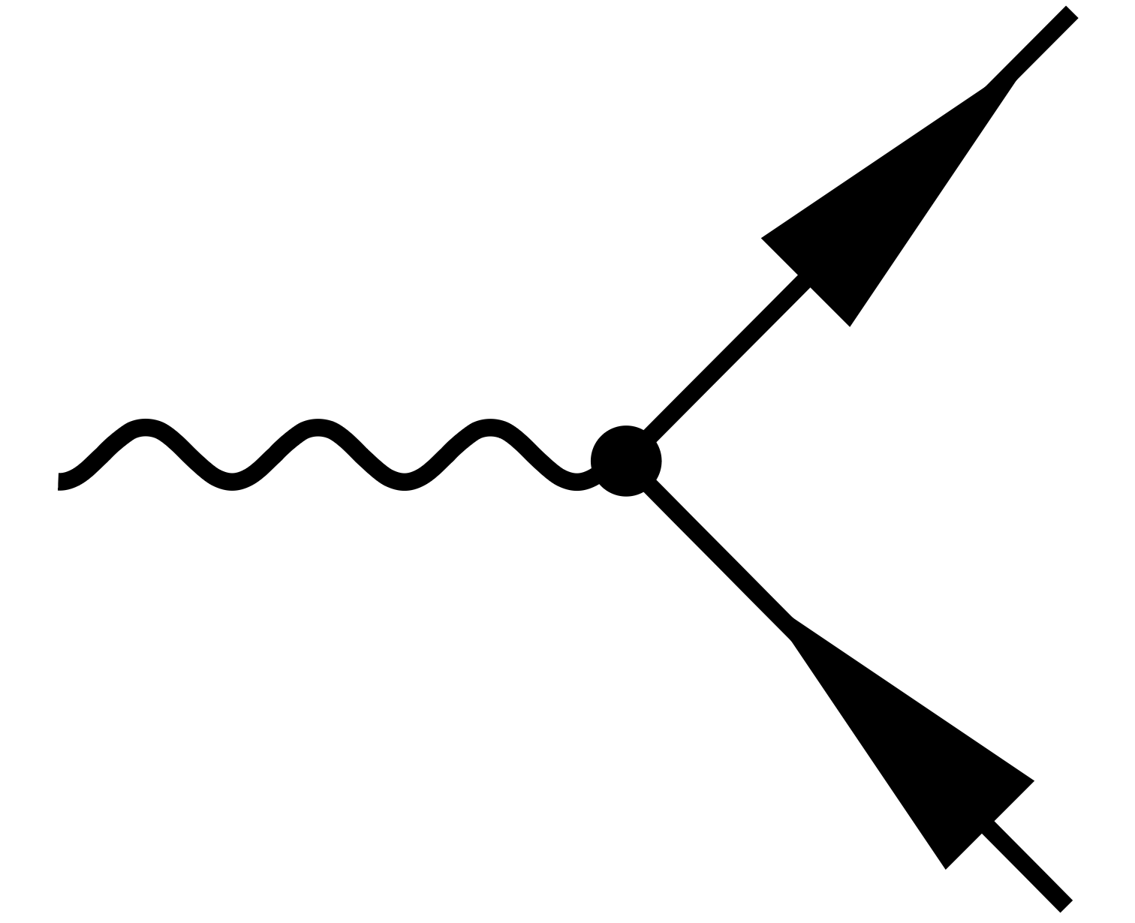
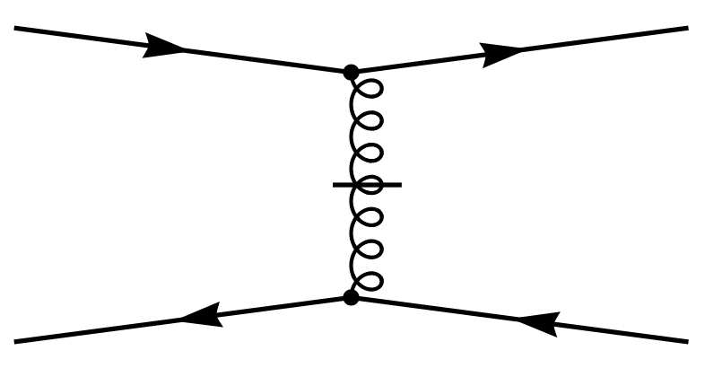
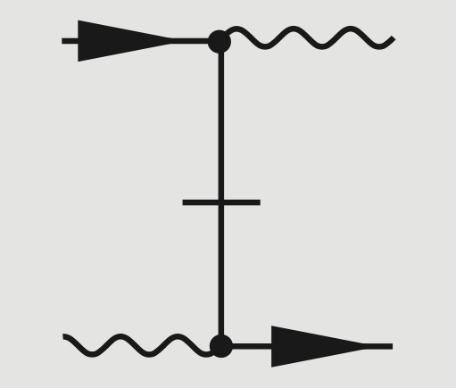
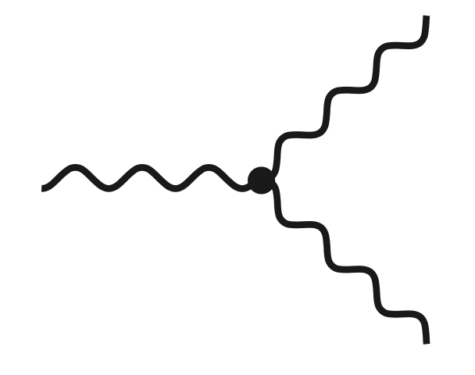
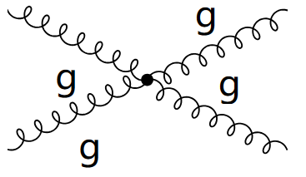
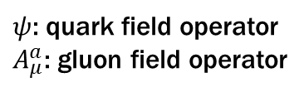



Light-Front Hamiltonian
QCD light-front Hamiltonian can be derived from QCD Lagrangian:
$$A^{+}=0$$
$$ℒ_{QCD}=\overline{ψ}\left(iD−m\right)ψ−\frac{1}{4}G_{μν}^{α}G_{α}^{μν}$$
/
$$P_{QCD}^{−}=$$
$ψ$: quark field operator
$A_{μ}^{a}$: gluon field operator

Slide 7
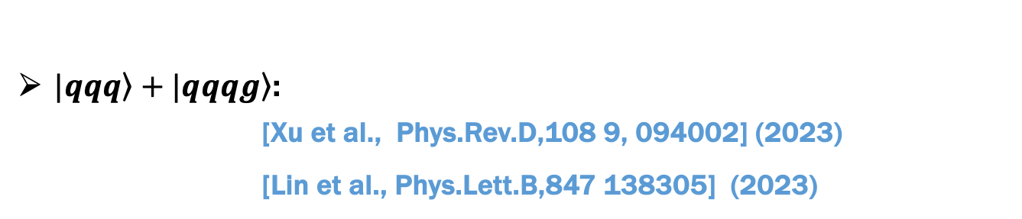
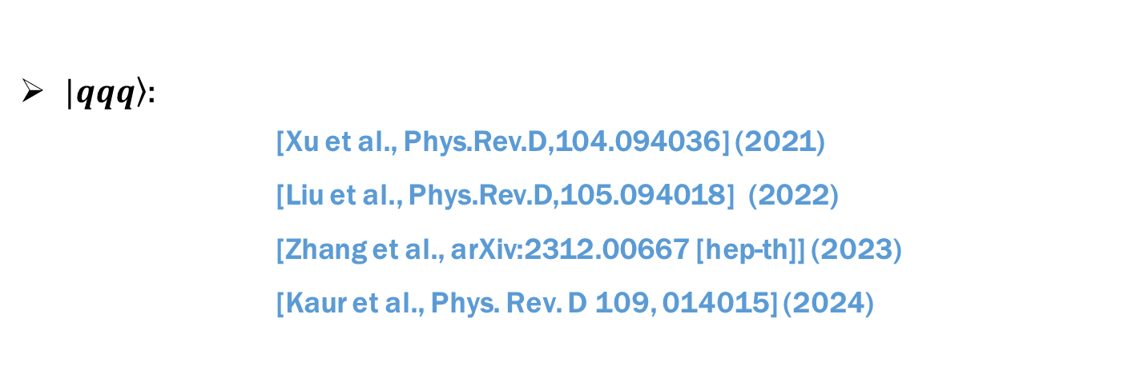
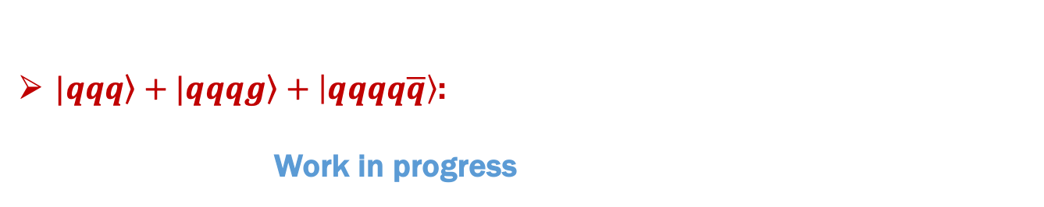
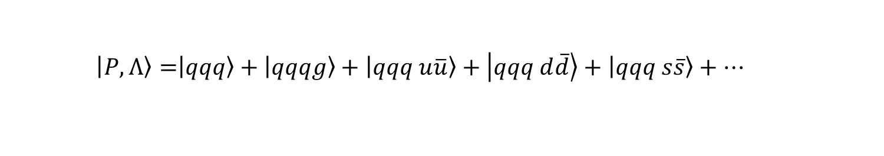
Publications on Nucleon GPDs
  $$\left|\left.P,Λ\right\rangle =\right|\left.qqq\right\rangle +\left|qqqg\right\rangle +\left|qqq u\overline{u}\right\rangle +\left|qqq d\overline{d}\right\rangle +\left|qqq s\overline{s}\right\rangle +…$$
$|\left.qqq\right\rangle$:
    [Xu et al., Phys.Rev.D,104.094036] (2021)
    [Liu et al., Phys.Rev.D,105.094018] (2022)
    [Zhang et al., arXiv:2312.00667 [hep-th]] (2023)
    [Kaur et al., Phys. Rev. D 109, 014015] (2024)
$\left.|qqq\right\rangle +\left.|qqqg\right\rangle$:
    [Xu et al., Phys.Rev.D,108 9, 094002] (2023)
    [Lin et al., Phys.Lett.B,847 138305] (2023)
$\left.|qqq\right\rangle +\left.|qqqg\right\rangle +\left|qqqq\overline{q}\right\rangle$:
    Work in progress

Slide 8
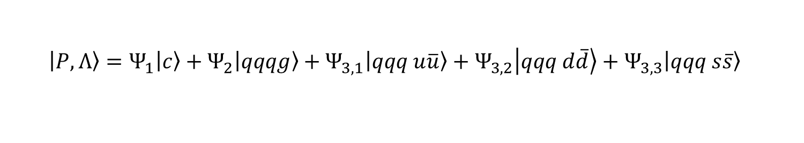
Truncated Light-Front Hamiltonian
  $$\left|\left.P,Λ\right\rangle =Ψ_{1}\right|\left.c\right\rangle +Ψ_{2}\left|qqqg\right\rangle +Ψ_{3,1}\left|qqq u\overline{u}\right\rangle +Ψ_{3,2}\left|qqq d\overline{d}\right\rangle +Ψ_{3,3}\left|qqq s\overline{s}\right\rangle$$
$$A^{+}=0$$
$$ℒ_{QCD}=\overline{ψ}\left(iD−m\right)ψ−\frac{1}{4}G_{μν}^{α}G_{α}^{μν}$$
/
$$P_{QCD}^{−}=$$
:
:
$ψ$: quark field operator
$A_{μ}^{a}$: gluon field operator

Slide 9
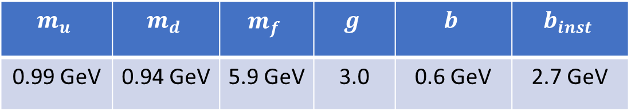
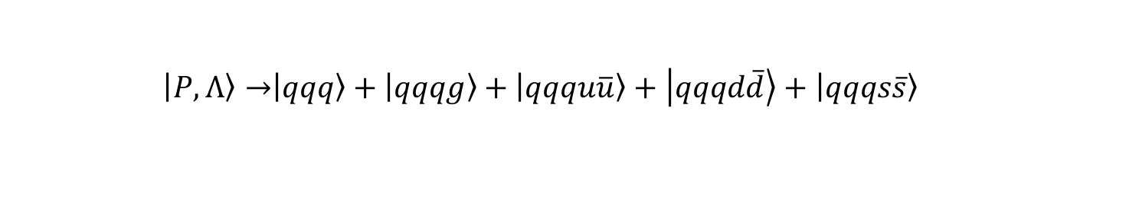
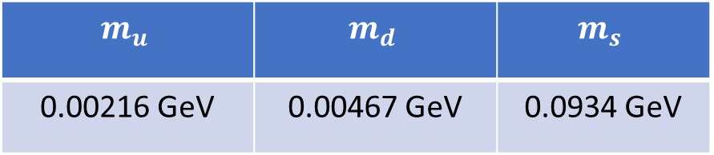
Parameters
  $$\left|\left.P,Λ\right\rangle →\right|\left.qqq\right\rangle +\left|qqqg\right\rangle +\left|qqqu\overline{u}\right\rangle +\left|qqqd\overline{d}\right\rangle +\left|qqqs\overline{s}\right\rangle$$
We use following observables to fix the parameters in the first two Fock sectors
Nucleon mass
Nucleon electromagnetic form factors
$$m_{u}$$ | $$m_{d}$$ | $$m_{f}$$ | $$g$$ | $$b$$ | $$b_{inst}$$
0.99 GeV | 0.94 GeV | 5.9 GeV | 3.0 | 0.6 GeV | 2.7 GeV
The parameters effectively parameterize certain non-perturbative dynamics
In five-quark Fock component, the quark masses are equal to current quark masses
$$m_{u}$$ | $$m_{d}$$ | $$m_{s}$$
0.00216 GeV | 0.00467 GeV | 0.0934 GeV
Truncation parameters: $N_{max}=7$ and $K_{}=16.5$

Slide 10





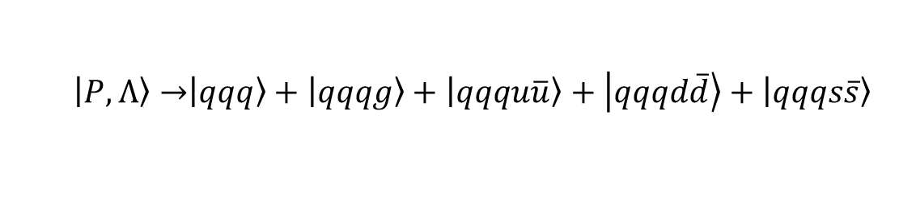







Fock Sector Decomposition
  $$\left|\left.P,Λ\right\rangle →\right|\left.qqq\right\rangle +\left|qqqg\right\rangle +\left|qqqu\overline{u}\right\rangle +\left|qqqd\overline{d}\right\rangle +\left|qqqs\overline{s}\right\rangle$$
$N_{max}=7$ and $K=16.5$
$$\left|qqqg\right\rangle$$
$$\left|qqq u\overline{u}\right\rangle$$
$$\left|qqq d\overline{d}\right\rangle$$
$$\left|qqq\right\rangle$$
$$\left|qqq s\overline{s}\right\rangle$$
$\left|qqq q\overline{q}\right\rangle \sim 3$ color singlet states
1 singlet $⨂$ singlet
2 octet $⨂$ octet
$\left|qqq g\right\rangle \sim 2$ color singlet states
2 octet $⨂$ octet
$\left|qqq\right\rangle \sim 1$ color singlet state

Slide 11
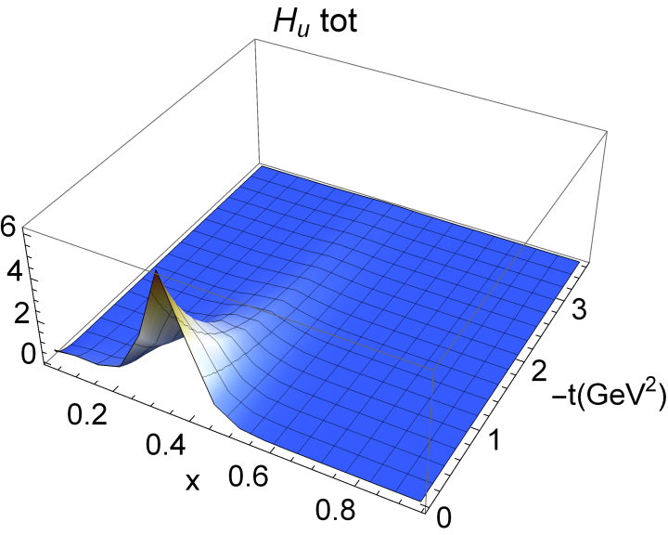
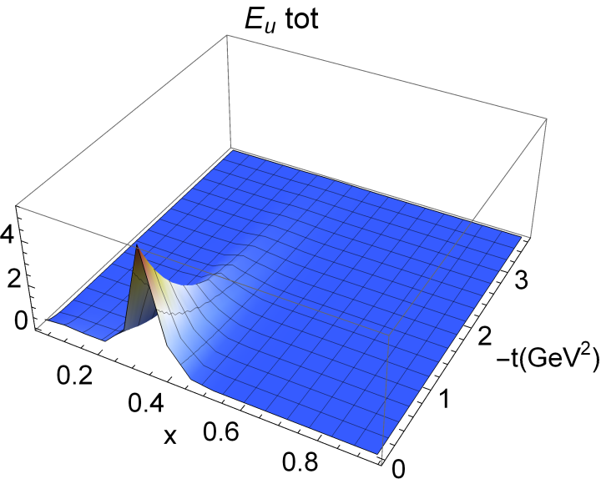
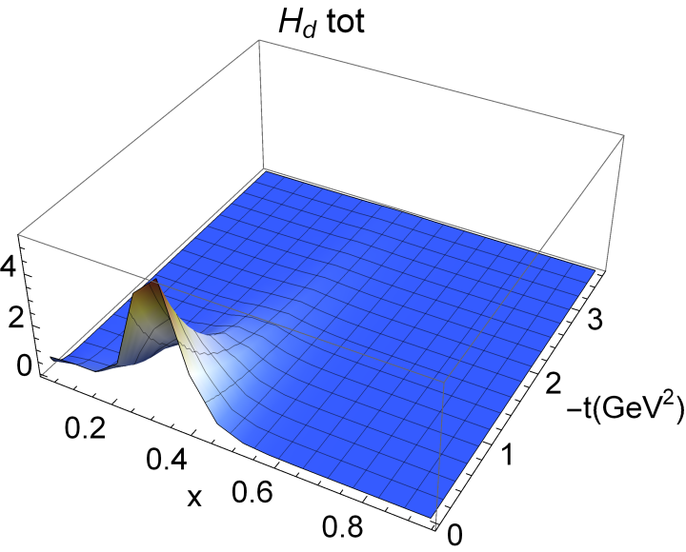
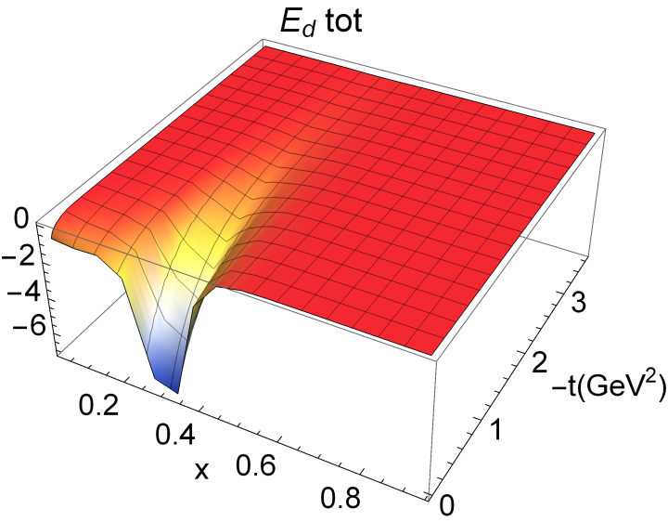

GPDs at $ξ=0$
Preliminary
$u$ and $d$ quark GPDs (contributions from all Fock sectors)
$E_{u}$ has positive distribution while $E_{d}$ is negative, consistent with FF data

Slide 12
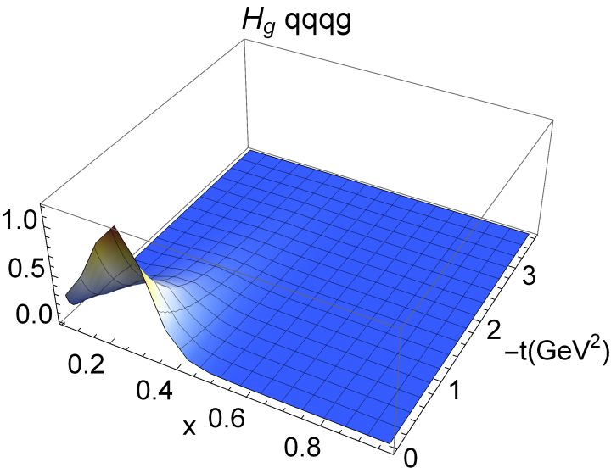
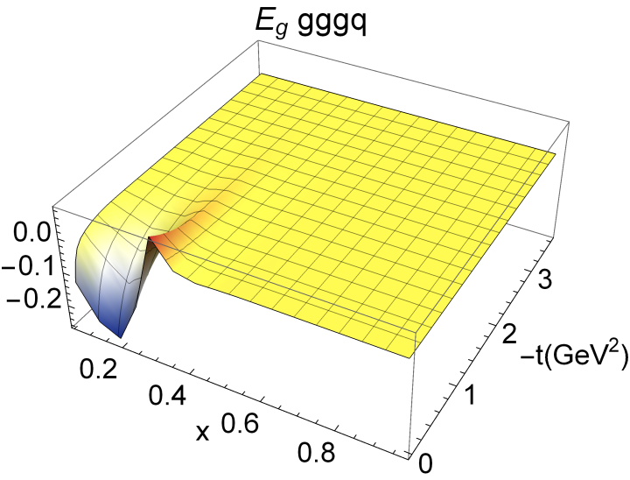
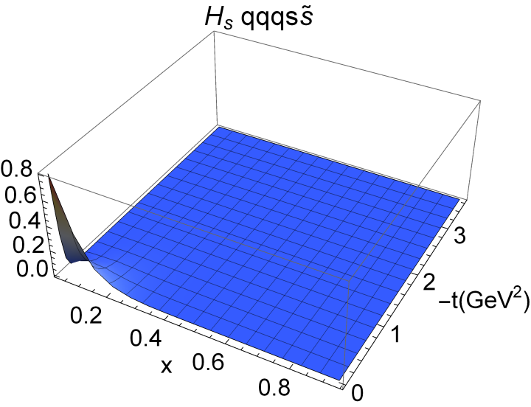
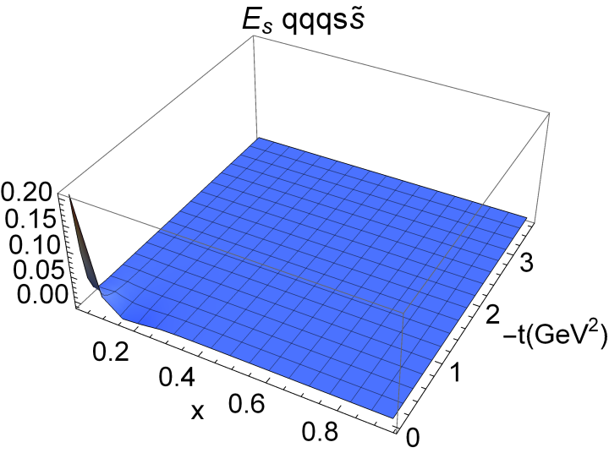
GPDs at $ξ=0$
Preliminary
Gluon and $s$ quark GPDs
$E_{s}$ mainly contributes at small $x$ region

Slide 13
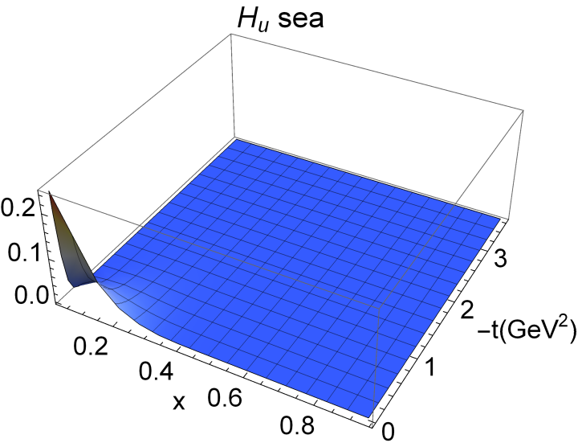







GPDs at $ξ=0$
$$H_{\overline{u}}$$
$$E_{\overline{u}}$$
Preliminary
$$H_{\overline{d}}$$
$$E_{\overline{d}}$$
$\overline{u}$ and $\overline{d}$ GPDs
$\overline{u}$ and $\overline{d}$ GPD $E$ have small negative region around $x\sim 0.2$

Slide 14
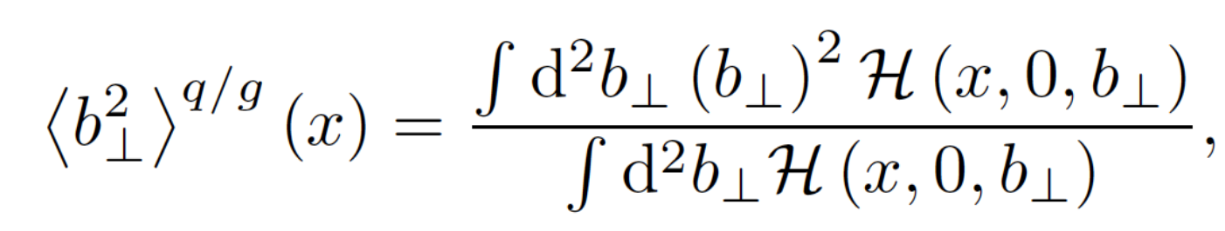
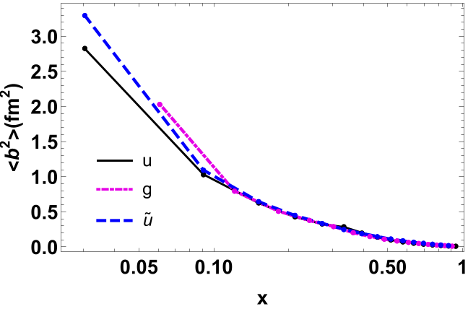
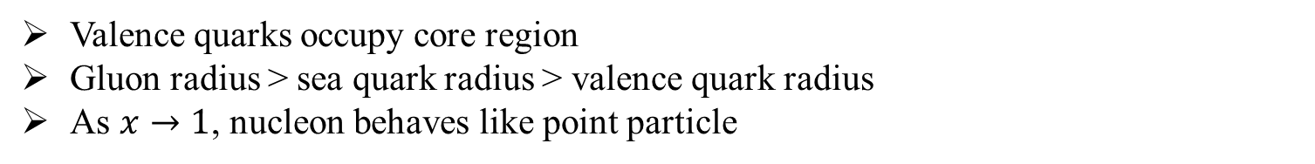
Squared Radius
Preliminary
Valence quarks occupy core region
Gluon radius > sea quark radius > valence quark radius
As $x→1$, nucleon behaves like point particle

Slide 15
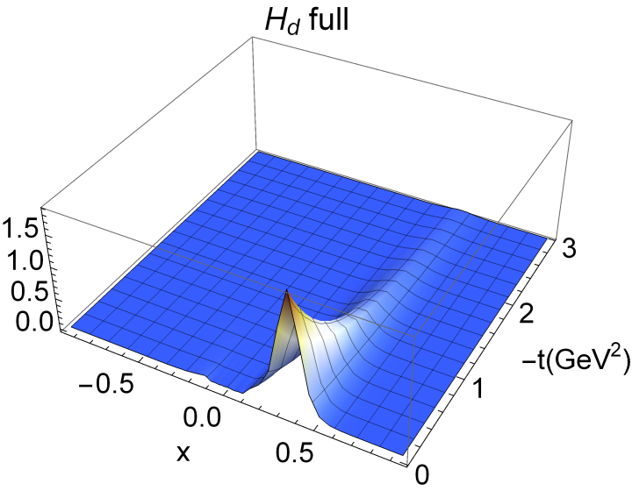
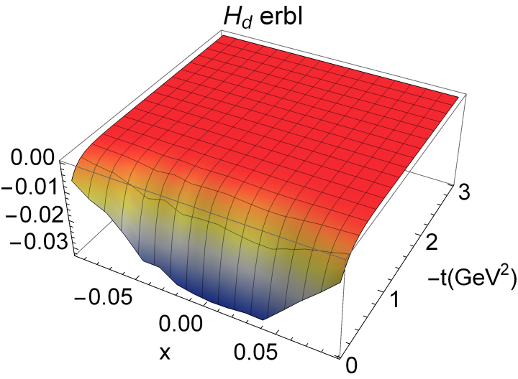
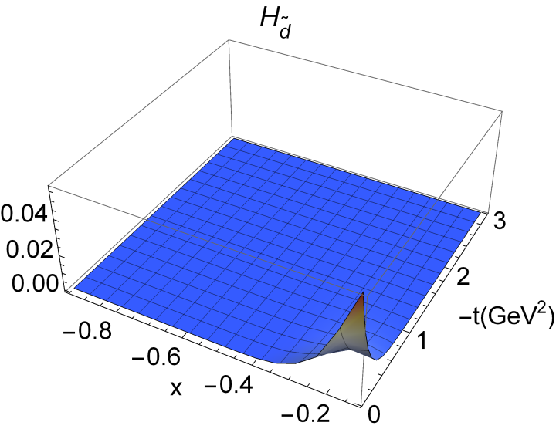

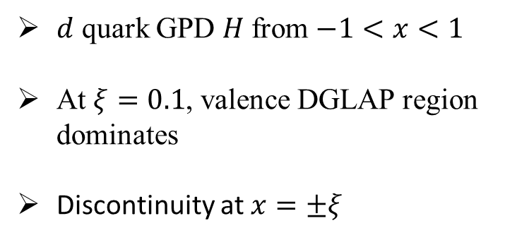


GPDs at $ξ=0.1$
Preliminary
$$H_{\overline{d}}$$
$$[−1,−ξ]$$
We use symmetric frame
$d$ quark GPD $H$ from $−1<x<1$
At $ξ=0.1$, valence DGLAP region dominates
Discontinuity at $x=±ξ$

Slide 16
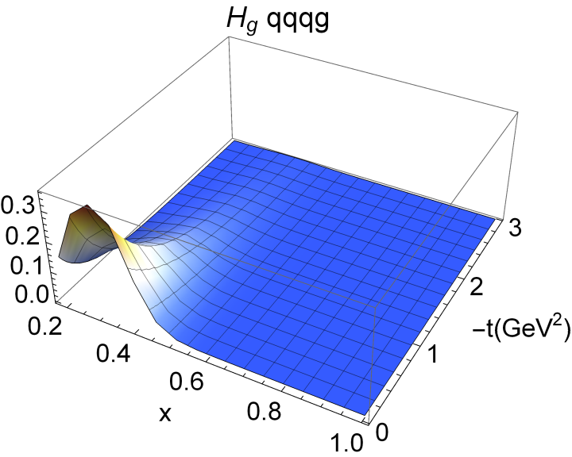




GPDs at $ξ=0.1$
Preliminary
Gluon and $s$ quark GPDs in DGLAP region at $ξ=0.1$
For non-zero skewness, $E_{s}$ changes sign

Slide 17










Compton Form Factors at $ξ=0.1$
$$ℱ\left(ξ,−t\right)=\int_{−1}^{1}{dx\left(\frac{1}{x−ξ−iε}−\frac{1}{x+ξ−iε}\right)F(x,ξ,−t)}$$
Preliminary
$$Re ℋ_{u}$$
${Im ℋ}_{u}$
$Re ℋ_{d}$
$Im ℋ_{d}$
Real part of $ℋ_{d}$ falls faster than $ℋ_{u}$
Imaginary part of $ℋ$ falls faster than real part

Slide 18









Compton Form Factors at $ξ=0.1$
$$ℱ\left(ξ,−t\right)=\int_{−1}^{1}{dx\left(\frac{1}{x−ξ−iε}−\frac{1}{x+ξ−iε}\right)F(x,ξ,−t)}$$
Preliminary
$$Re ℰ_{u}$$
${Im ℰ}_{u}$
$Re ℰ_{d}$
$Im ℰ_{d}$
Real part of $ℰ$ follows the trend of electromagnetic form factors
Imaginary part of $ℰ$ falls faster than real part

Slide 19

Conclusion
Basis light-front quantization: a non-perturbative approach based on light-front QCD Hamiltonian
Considered $|\left.qqq\right\rangle +\left|qqqg\right\rangle +\left|qqq q\overline{q}\right\rangle$ Fock sectors and relevant QCD interactions
Probability of each Fock sector: 53.03% ($|\left.qqq\right\rangle$), 26.39% ($\left|qqqg\right\rangle$), 20.58% ($\left|qqq q\overline{q}\right\rangle$)
Explored the GPDs of valence and sea quarks and gluon
Explored skewness-dependent GPDs including both DGLAP and ERBL regions
Investigated the Compton form factors
Thank you!

Slide 20


Parton Distribution Function
Preliminary
$$μ_{0}^{2}=0.22 GeV^{2}$$
$$μ^{2}=5.00 GeV^{2}$$
Fit the initial scale by evolving the PDF to experimental scale and comparing with the second moment of $u$ and $d$ quark

Slide 21





GPDs at $ξ=0$
$$μ_{0}^{2}=0.22 GeV^{2}$$
Total contribution of $u$ quark GPDs
Fock sectors $|qqq>, |qqqg>$

Slide 22



GPDs at $ξ=0$
Contribution of $u$ quark GPD $H$
Fock sectors $|qqqq\overline{q}>$

Slide 23



GPDs at $ξ=0$
Contribution of $u$ quark GPD $E$
Fock sectors $|qqqq\overline{q}>$

Slide 24





































Deeply Virtual Compton Scattering
The deeply virtual Compton scattering describes the process:
$$e+p →e+p+ γ$$
$$k′$$
$$k$$
$$k′$$
$$k$$
Hard part:
Perturbative description
$$γ^{∗}$$
$$Q^{2}$$
$$q′$$
$$γ^{∗}$$
$$Q^{2}$$
$$q′$$
$$x+ξ$$
GPDs
$$x−ξ$$
$$x+ξ$$
$$x−ξ$$
Soft part:
Non-perturbative description
GPDs
$$P′$$
$$P$$
$$P$$
$$P′$$
The DVCS cross-section is distinguishable with BH process:
$$q′$$
$$k$$
$$k$$
$$q′$$
$$q′$$
$$k$$
$$γ^{∗}$$
$$γ^{∗}$$
$$k′$$
$$k′$$
$$γ^{∗}$$
$$k′$$
$$p′$$
$$p$$
$$p′$$
$$p$$
$$p′$$
$$p$$
DVCS
Bethe-Heitler

Slide 25

Twist-3 generalized parton distribution
The twist-3 GPDs are parameterized by taking different Dirac gamma matrices:
[Stephan.M 2009]
$$F_{Λ^{′}Λ}^{\left[1\right]}=\frac{M}{{2\left(P^{+}\right)}^{2}}\overline{u}\left[γ^{+}H_{2}+\frac{iσ^{+Δ}}{2M}E_{2}\right]u,$$
$$F_{Λ^{′}Λ}^{\left[γ_{5}\right]}=\frac{M}{{2\left(P^{+}\right)}^{2}}\overline{u}\left[γ^{+}γ_{5}{\tilde{H}}_{2}+\frac{P^{+}γ_{5}}{M}{\tilde{E}}_{2}\right]u,$$
$$F_{Λ^{′}Λ}^{\left[γ^{j}\right]}=\frac{M}{{2\left(P^{+}\right)}^{2}}\overline{u}\left[ⅈσ^{+j}H_{2T}+\frac{γ^{+}Δ_{T}^{j}−Δ^{+}γ^{j}}{2M}E_{2T}+\frac{P^{+}Δ_{T}^{j}−Δ^{+}P_{T}^{j}}{M^{2}}{\tilde{H}}_{2T}+\frac{γ^{+}P_{T}^{j}−P^{+}γ^{j}}{M}{\tilde{E}}_{2T}\right]u,$$
$$F_{Λ^{′}Λ}^{\left[γ^{j}γ_{5}\right]}=\frac{−iε_{T}^{ij}M}{{2\left(P^{+}\right)}^{2}}\overline{u}\left[ⅈσ^{+i}H_{2T}^{′}+\frac{γ^{+}Δ_{T}^{i}−Δ^{+}γ^{i}}{2M}E_{2T}^{′}+\frac{P^{+}Δ_{T}^{j}−Δ^{+}P_{T}^{j}}{M^{2}}{\tilde{H}}_{2T}^{′}+\frac{γ^{+}P_{T}^{j}−P^{+}γ^{j}}{M}{\tilde{E}}_{2T}^{′}\right]u,$$
$$F_{Λ^{′}Λ}^{\left[iσ^{ij}γ_{5}\right]}=\frac{−iε_{T}^{ij}M}{{2\left(P^{+}\right)}^{2}}\overline{u}\left[γ^{+}{H′}_{2}+\frac{iσ^{+Δ}}{2M}{E′}_{2}\right]u$$
$$F_{Λ^{′}Λ}^{\left[iσ^{+−}γ_{5}\right]}=\frac{M}{{2\left(P^{+}\right)}^{2}}\overline{u}\left[γ^{+}γ_{5}{\tilde{H}′}_{2}+\frac{P^{+}γ_{5}}{M}{\tilde{E}′}_{2}\right]u$$

Slide 26












Twist-3 generalized parton distribution
We calculated these twist-3 GPDs based on the LFWFs obtained by applying BLFQ framework, and results are given:
$$Γ=γ^{i}$$
$$H_{2T},E_{2T},{\tilde{H}}_{2T},{\tilde{E}}_{2T}$$
$$Γ=γ^{i}γ_{5}$$
$${H′}_{2T},{E′}_{2T},{\tilde{H}′}_{2T},{\tilde{E}′}_{2T}$$

Slide 27
















Twist-3 generalized parton distribution
$$H_{2},E_{2}$$
$$Γ=1$$
$${H′}_{2},{E′}_{2}$$
$$Γ=iσ^{ij}γ_{5}$$
$${\tilde{H}}_{2},{\tilde{E}}_{2}$$
$$Γ=γ_{5}$$
$${\tilde{H}′}_{2},{\tilde{E}′}_{2}$$
$$Γ=iσ^{+−}γ_{5}$$

