Slide 1
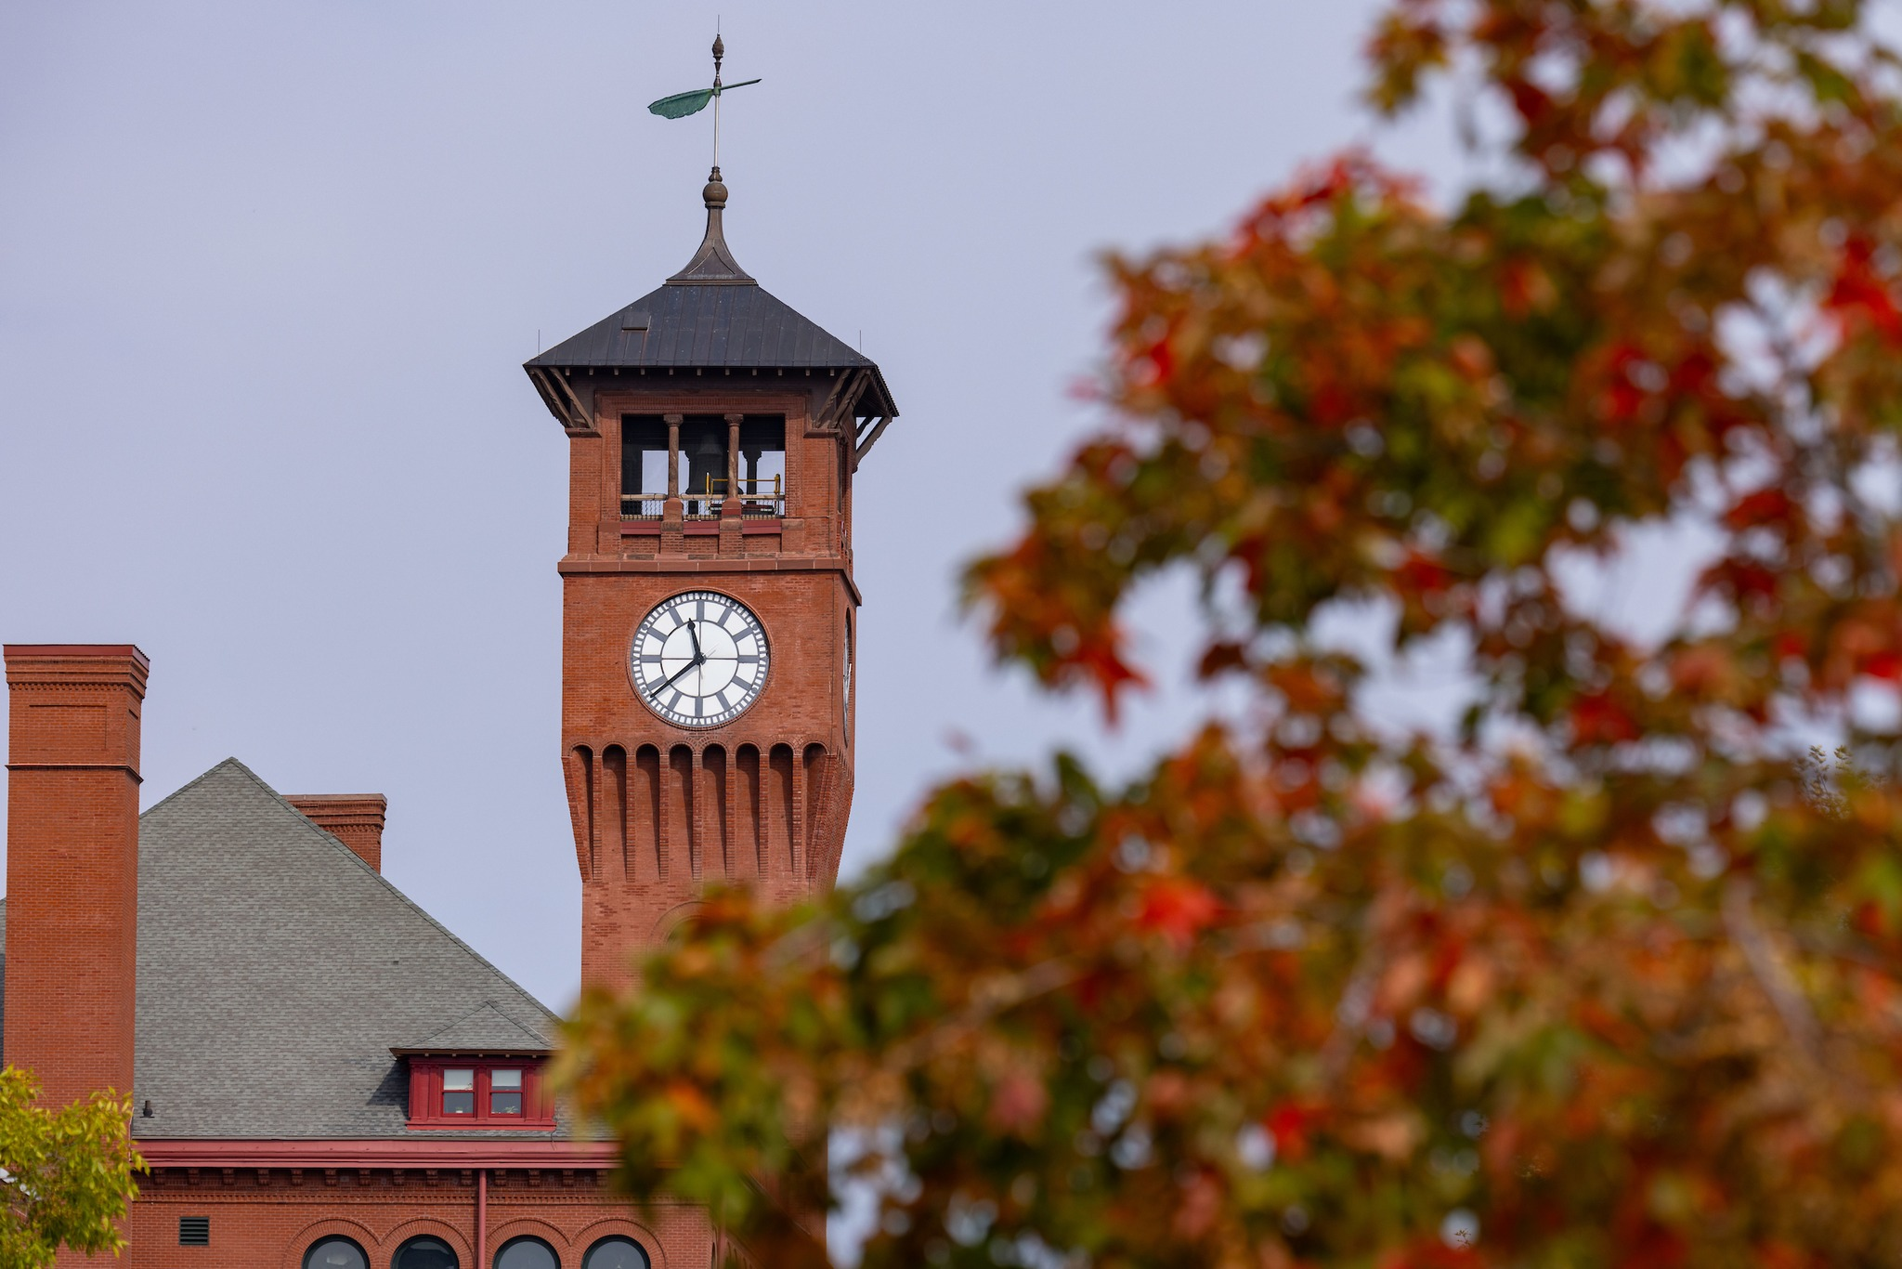
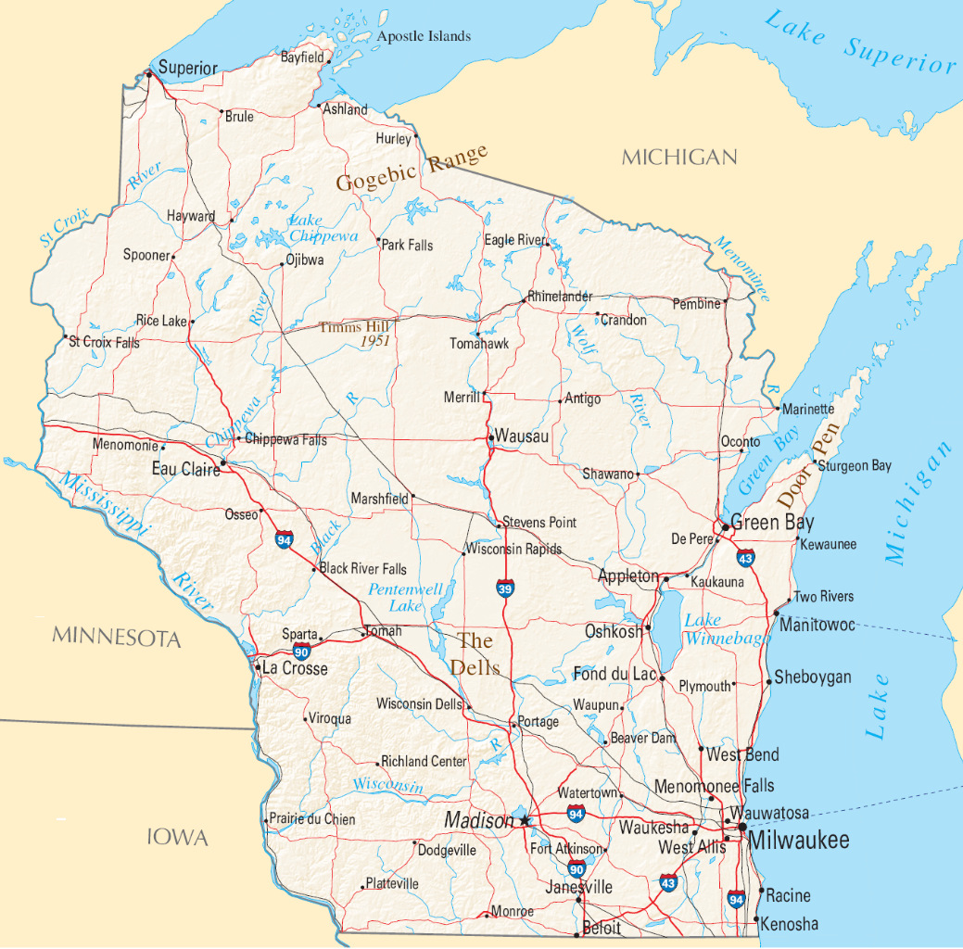
Perspectives of Scientists Involved in World War II
Introduction
Axis, Allies
Future
Alan Scott
UW-Stout Wisconsin’s Polytechnic University

Slide 2
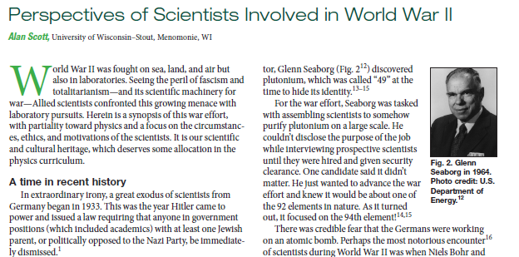
The Physics Teacher, December 2023

Slide 4
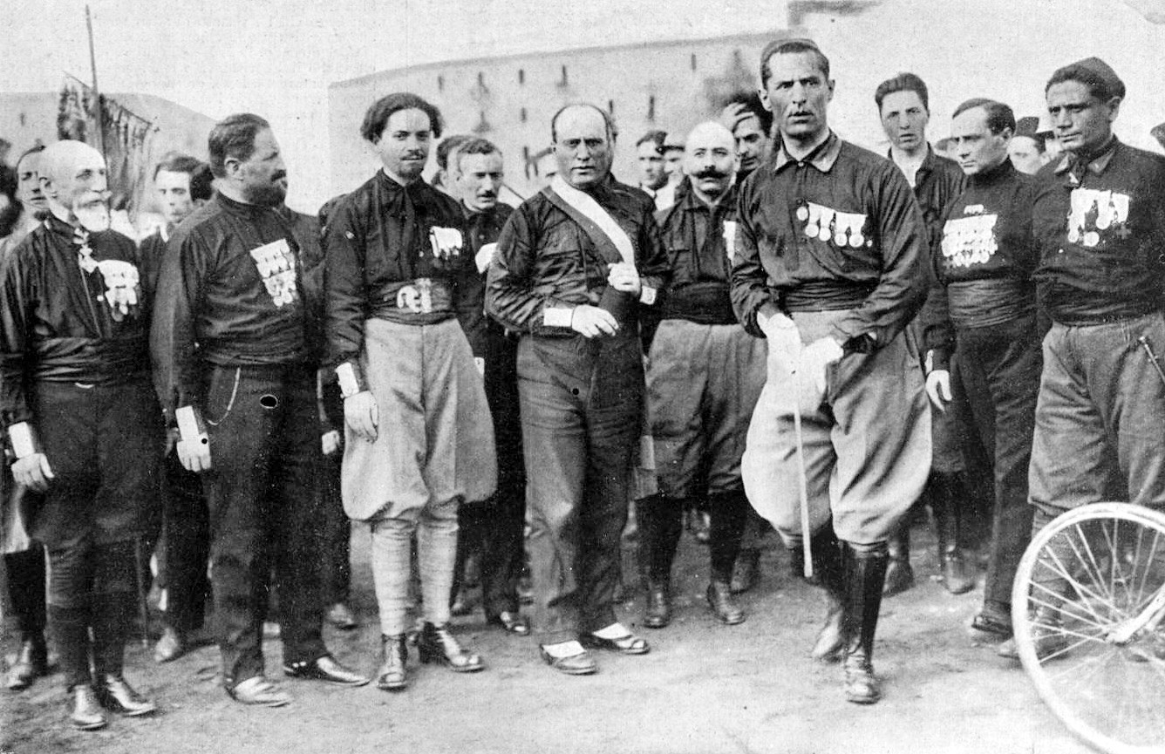
1922
Berlin
https://en.wikipedia.org/wiki/March_on_Rome

Slide 5
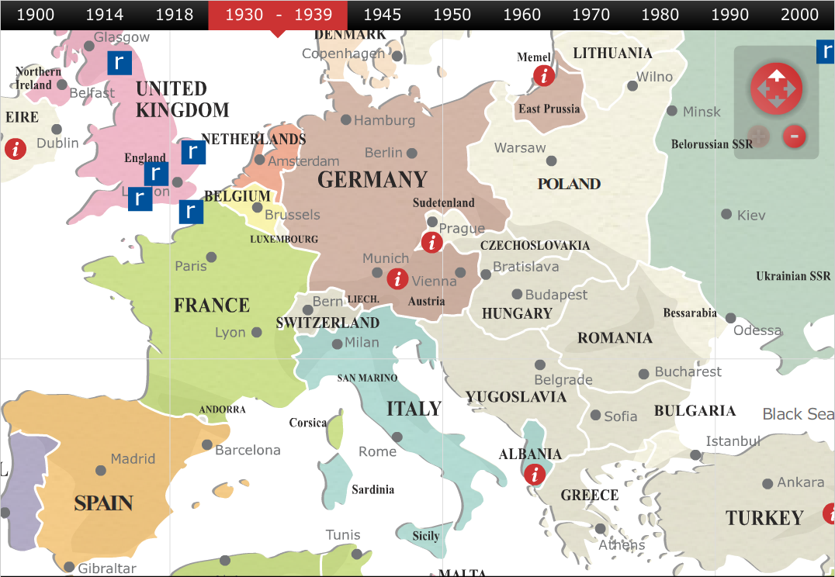
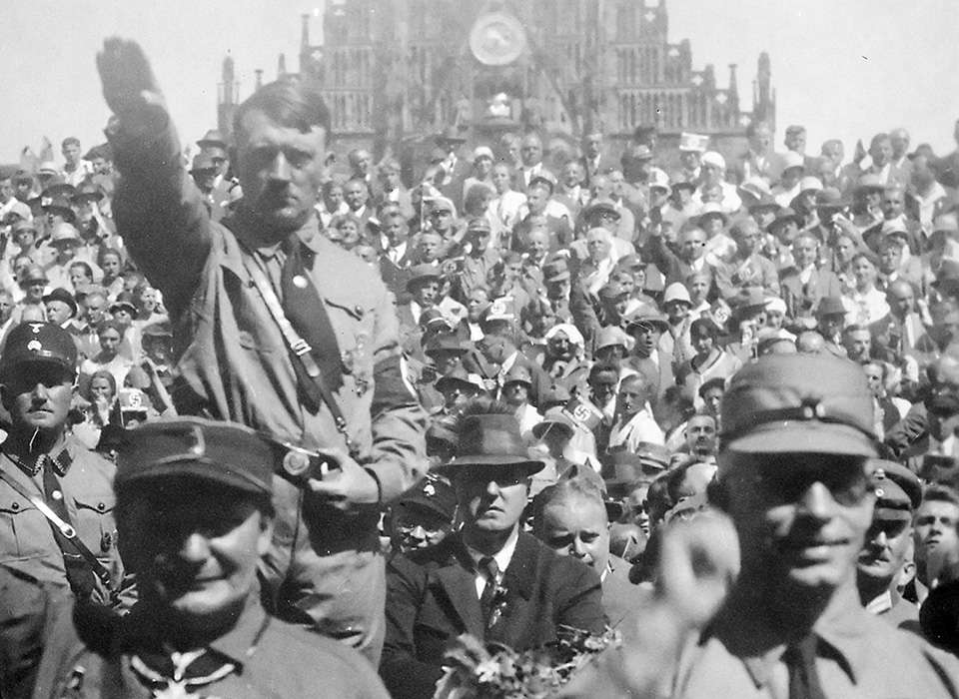
Berlin
https://www.nationalww2museum.org/war/articles/how-did-adolf-hitler-happen
1933

Slide 6
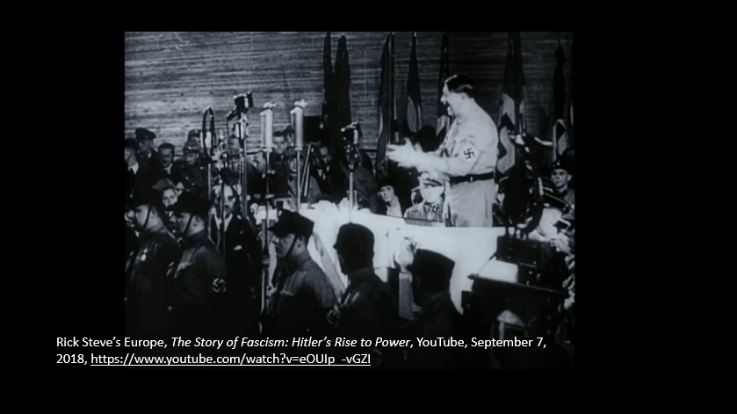

Slide 9
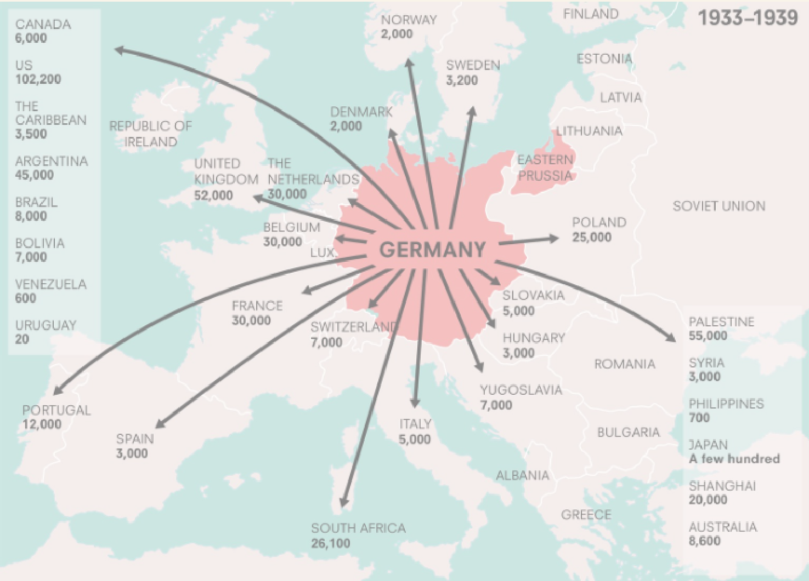
1933
https://www.annefrank.org/en/anne-frank/go-in-depth/impossibilities-escaping-1933-1942/

Slide 10
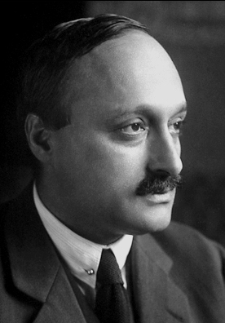
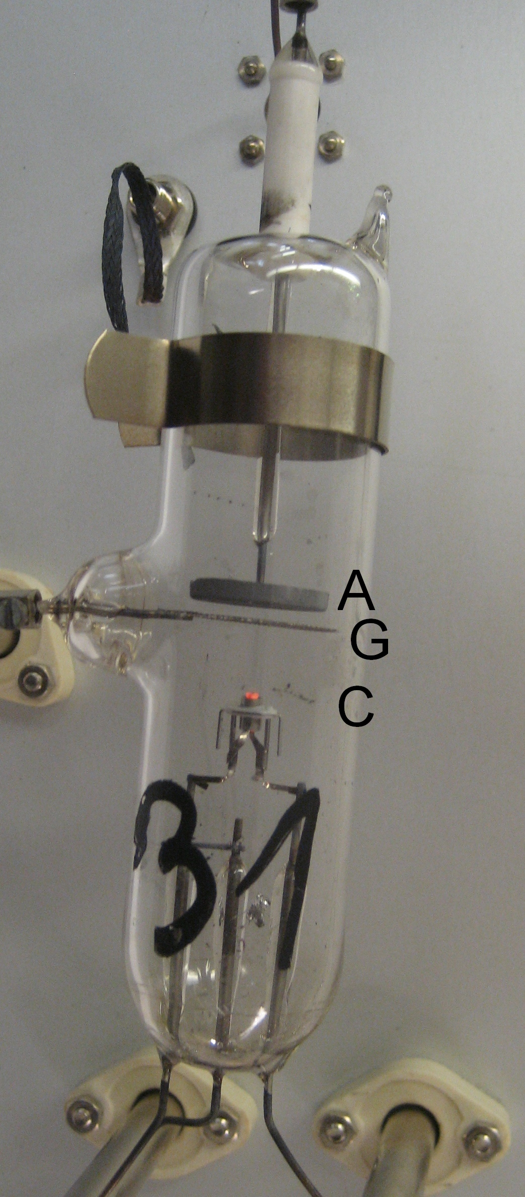
James Franck in 1925
https://en.wikipedia.org/wiki/Franck%E2%80%93Hertz_experiment#/media/File:FranckHertzHgTube.jpg

Slide 11
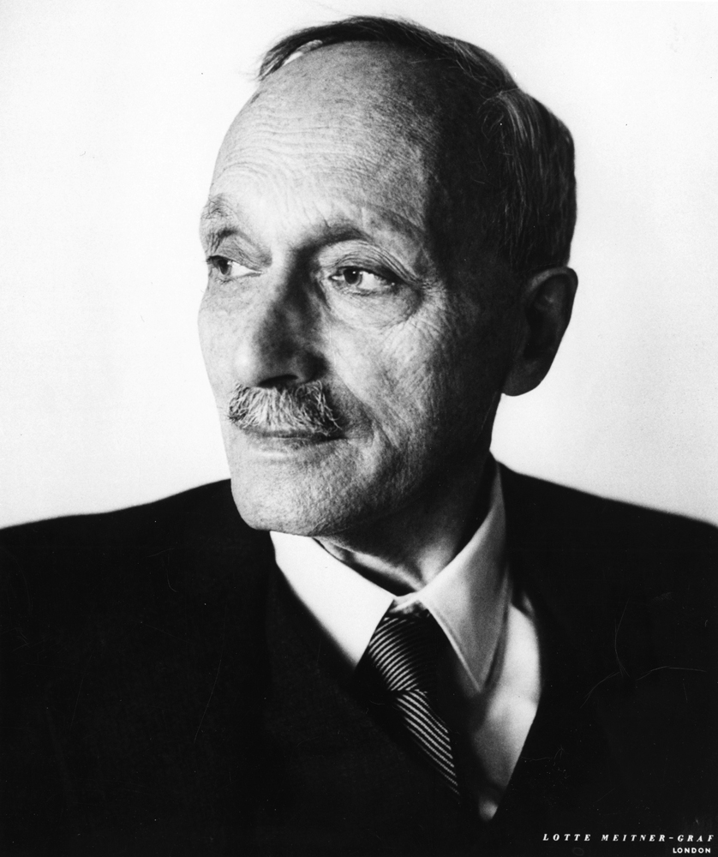
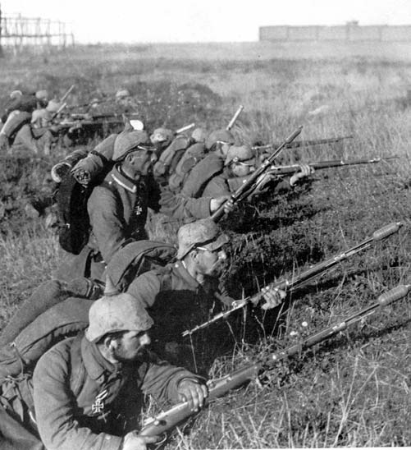
James Franck in 1925
https://storage.lib.uchicago.edu/ucpa/series1/derivatives_series1/apf1-06144r.jpg
https://en.wikipedia.org/wiki/First_Battle_of_the_Marne

Slide 12
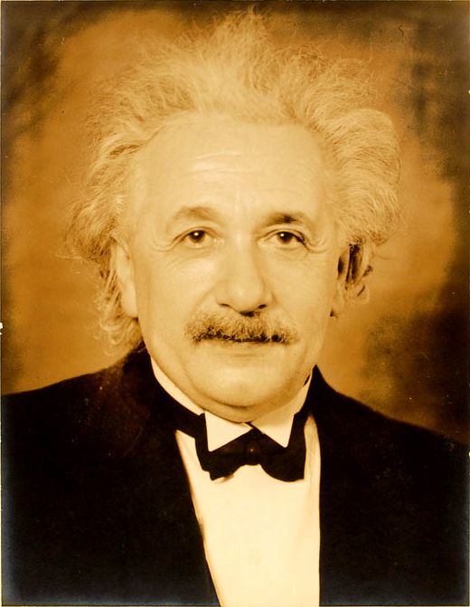
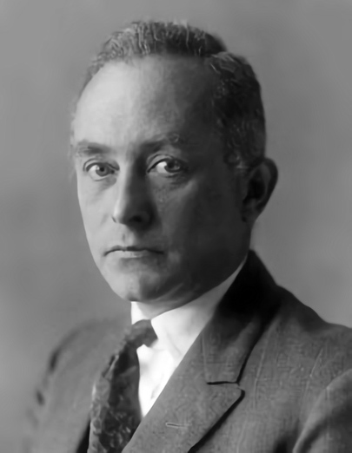
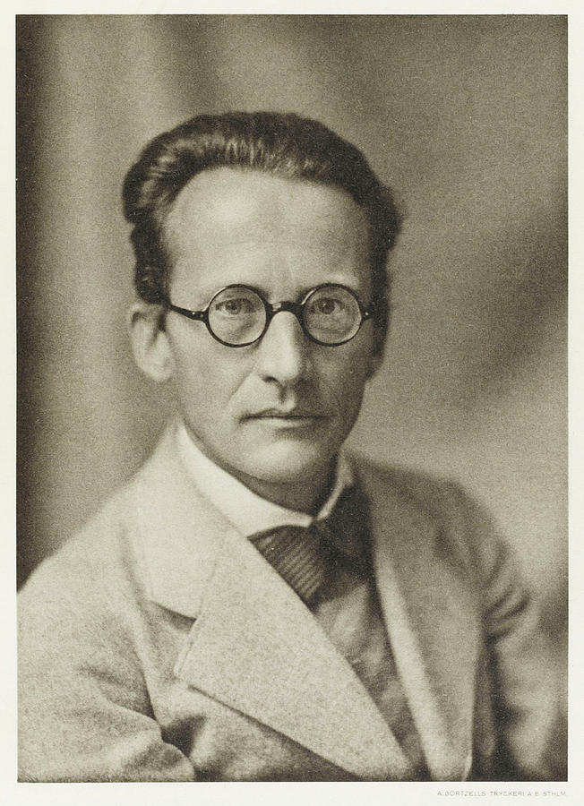
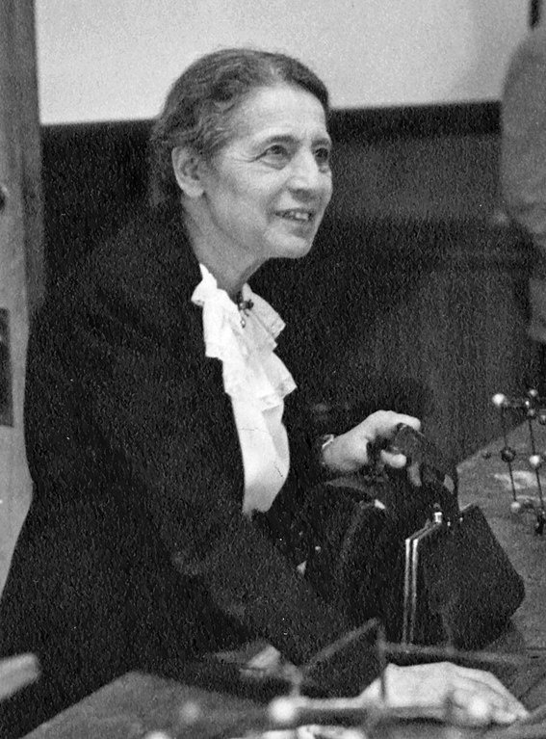
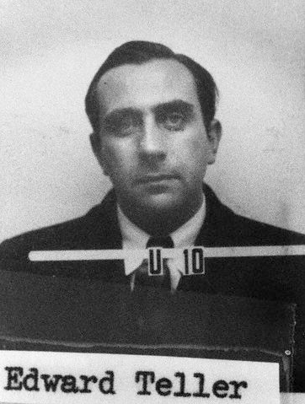
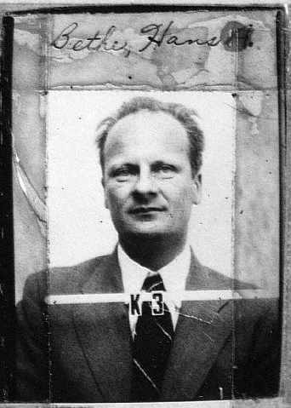
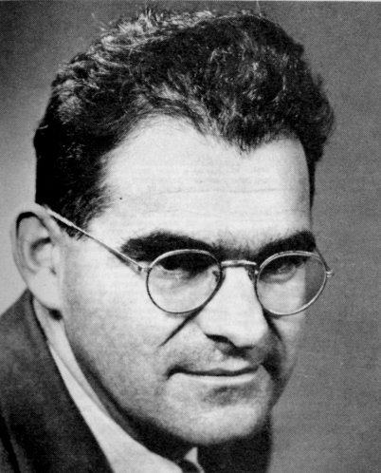
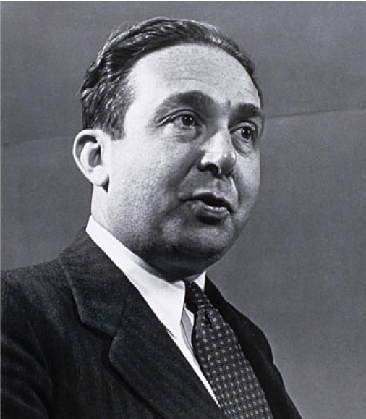
1935
1930s
1933
https://www.annefrank.org/en/anne-frank/go-in-depth/impossibilities-escaping-1933-1942/
1946
1942
1941
1940s

Slide 13
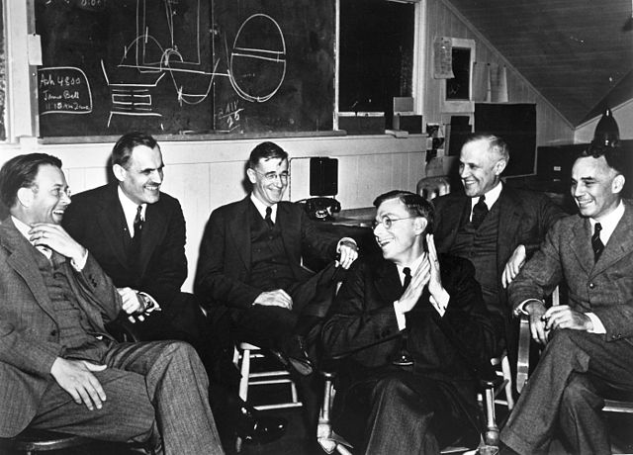
National Defense Research Committee (NDRC), June 1940
Office of Scientific Research and Development (OSRD), June 1941
Vannevar Bush
March 1940

Slide 14
Aeronautical Research, a Vital Link in Our National Defense, May 1940,…
Science and National Defense, October 1941,…

Slide 15
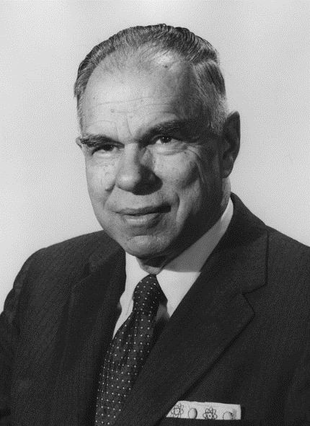
Before Pearl Harbor, December 1940…
https://www2.lbl.gov/Publications/Seaborg/bio.htm

Slide 16
Following Pearl Harbor…
https://www2.lbl.gov/Publications/Seaborg/bio.htm

Slide 17
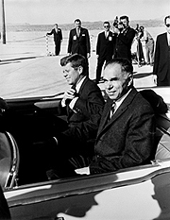
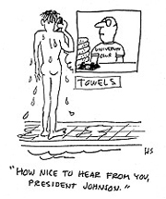
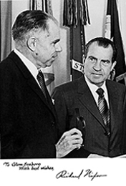
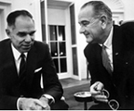
https://www2.lbl.gov/Publications/Seaborg/bio.htm

Slide 18
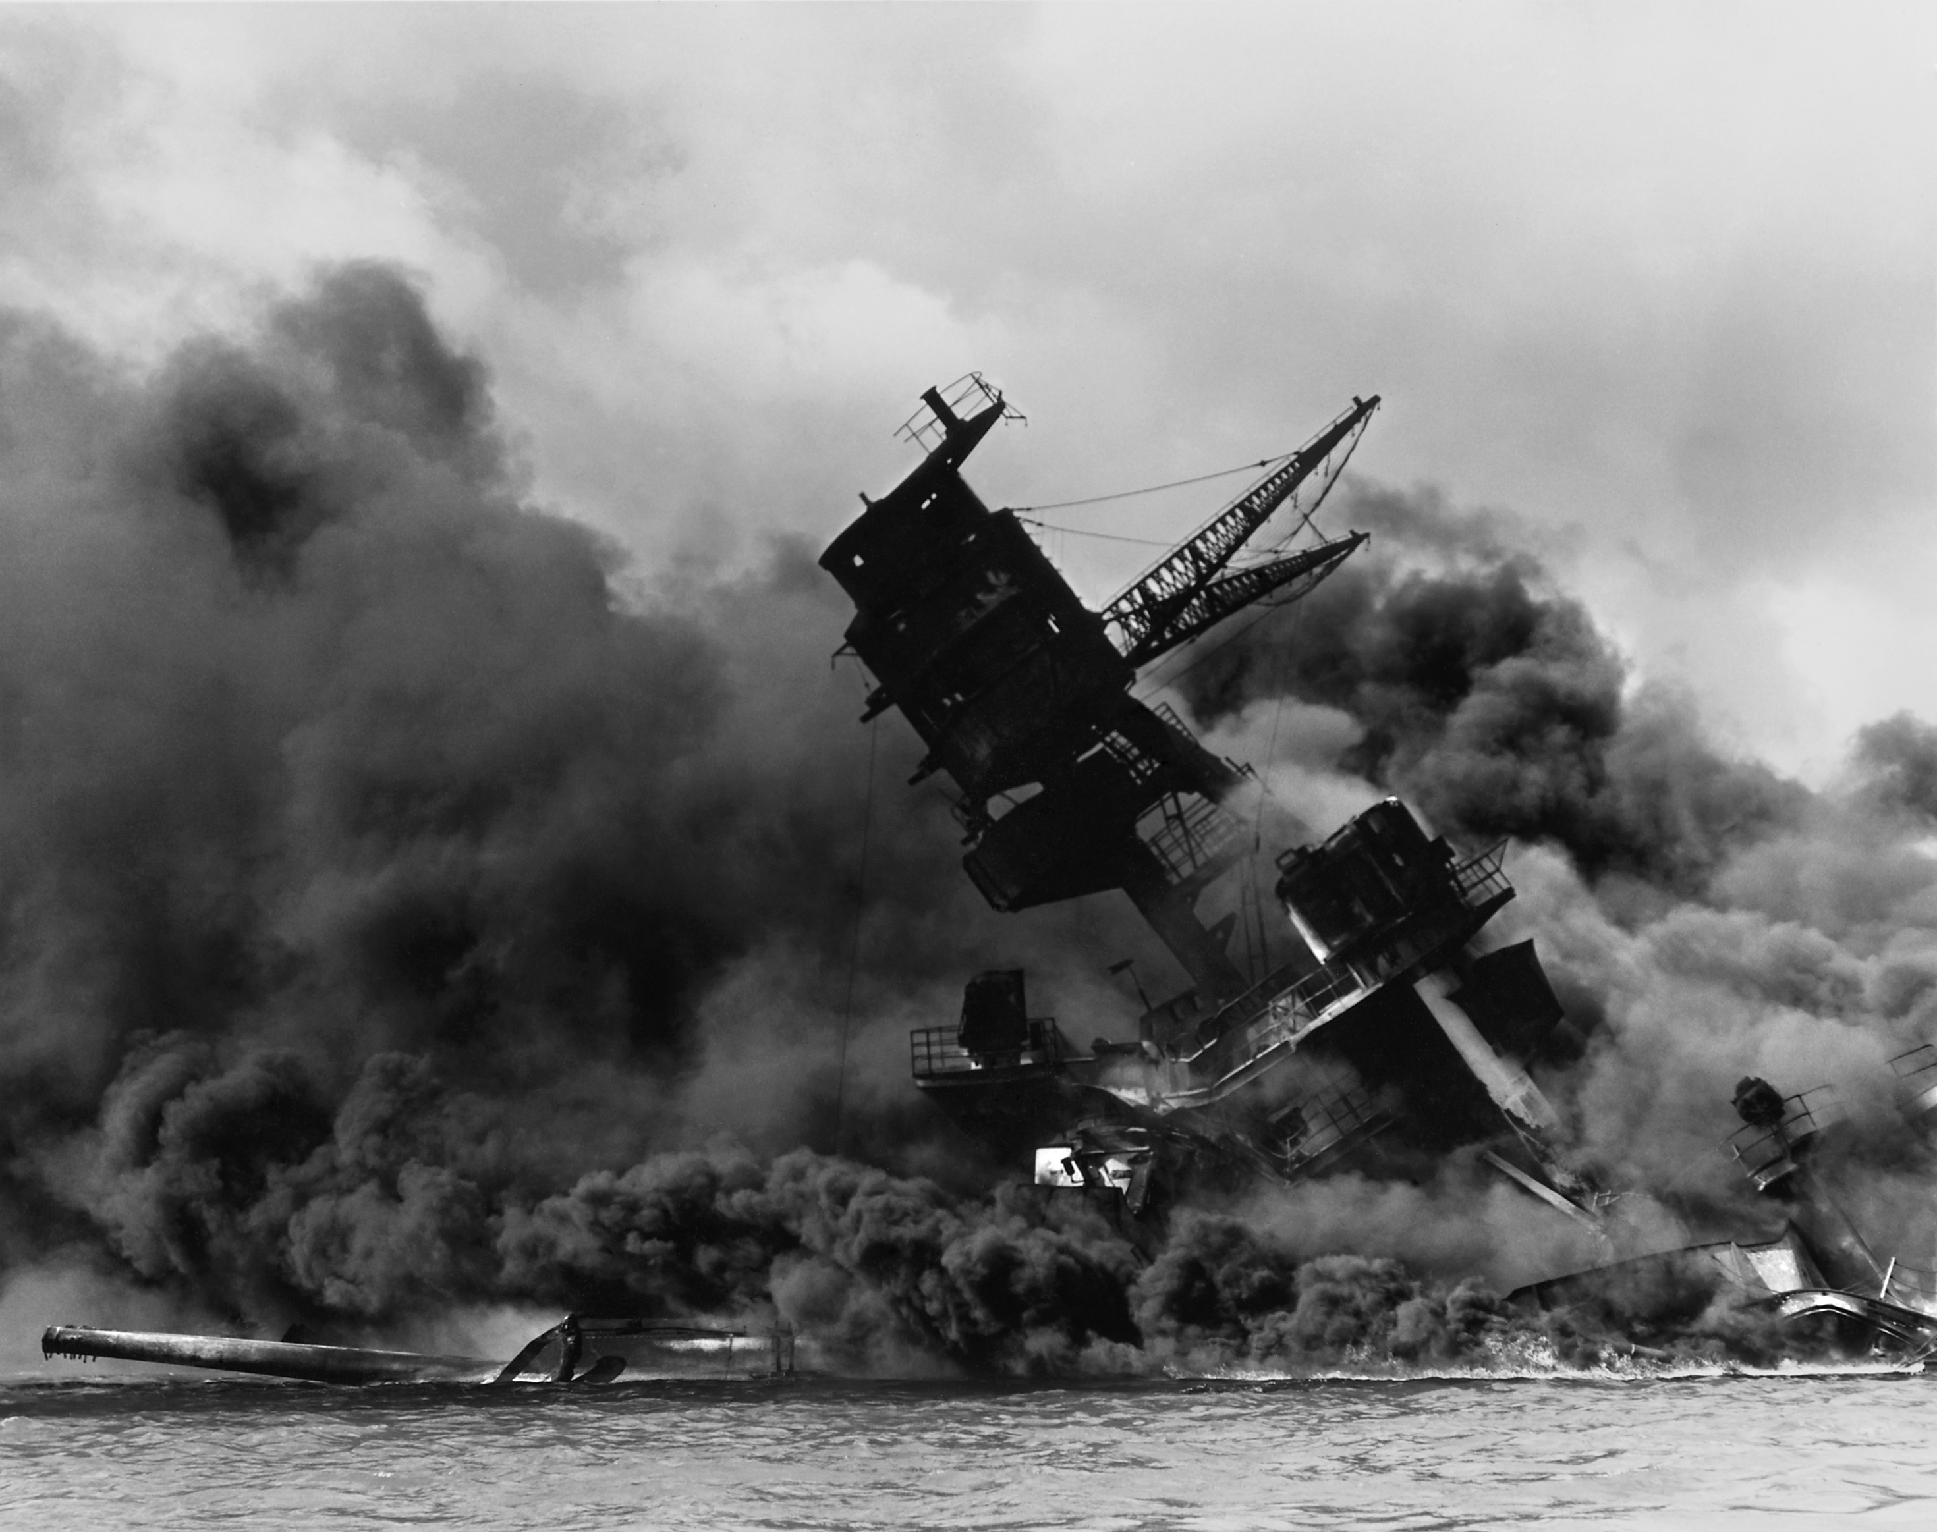
https://en.wikipedia.org/wiki/Attack_on_Pearl_Harbor#/media/File:The_USS_Arizona_(BB-39)_burning_after_the_Japanese_attack_on_Pearl_Harbor_-_NARA_195617_-_Edit.jpg

Slide 19
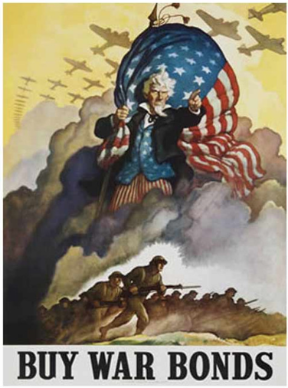
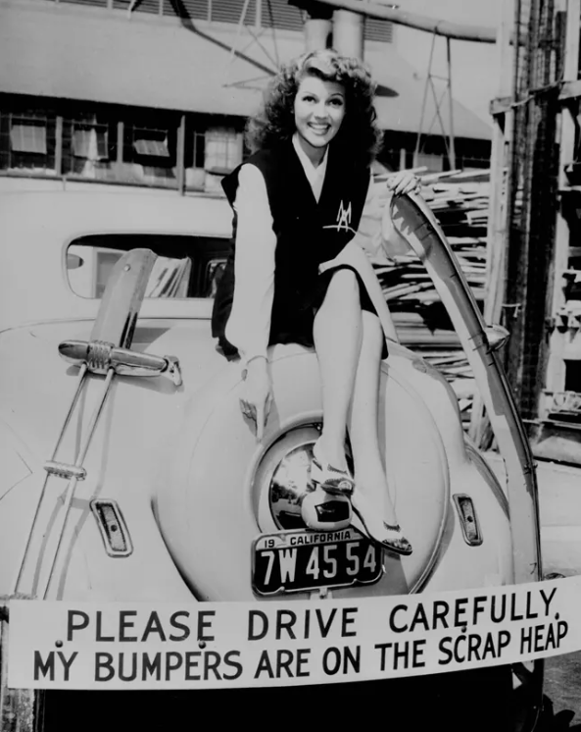
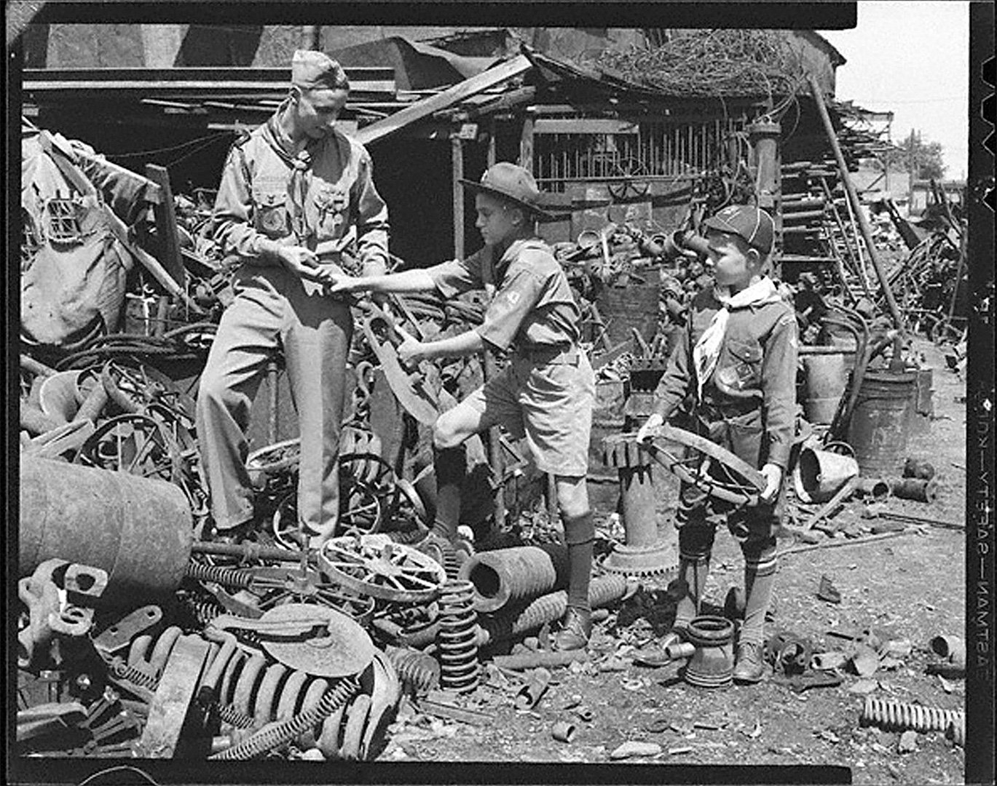
https://www.nps.gov/articles/wwiihomefront.htm
1943
https://www.nebraskastudies.org/en/1925-1949/on-the-home-front/scrap-metal/
https://store.nationalww2museum.org/buy-war-bonds-replica-wwii-propaganda-poster/

Slide 20
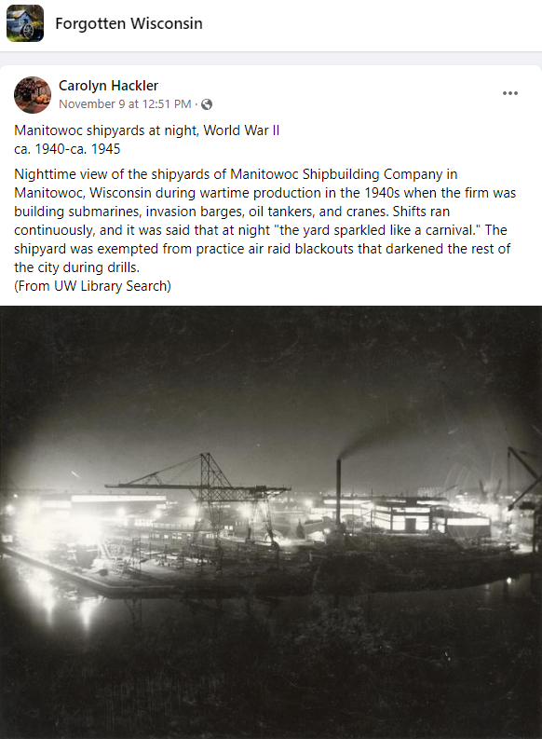

Slide 21
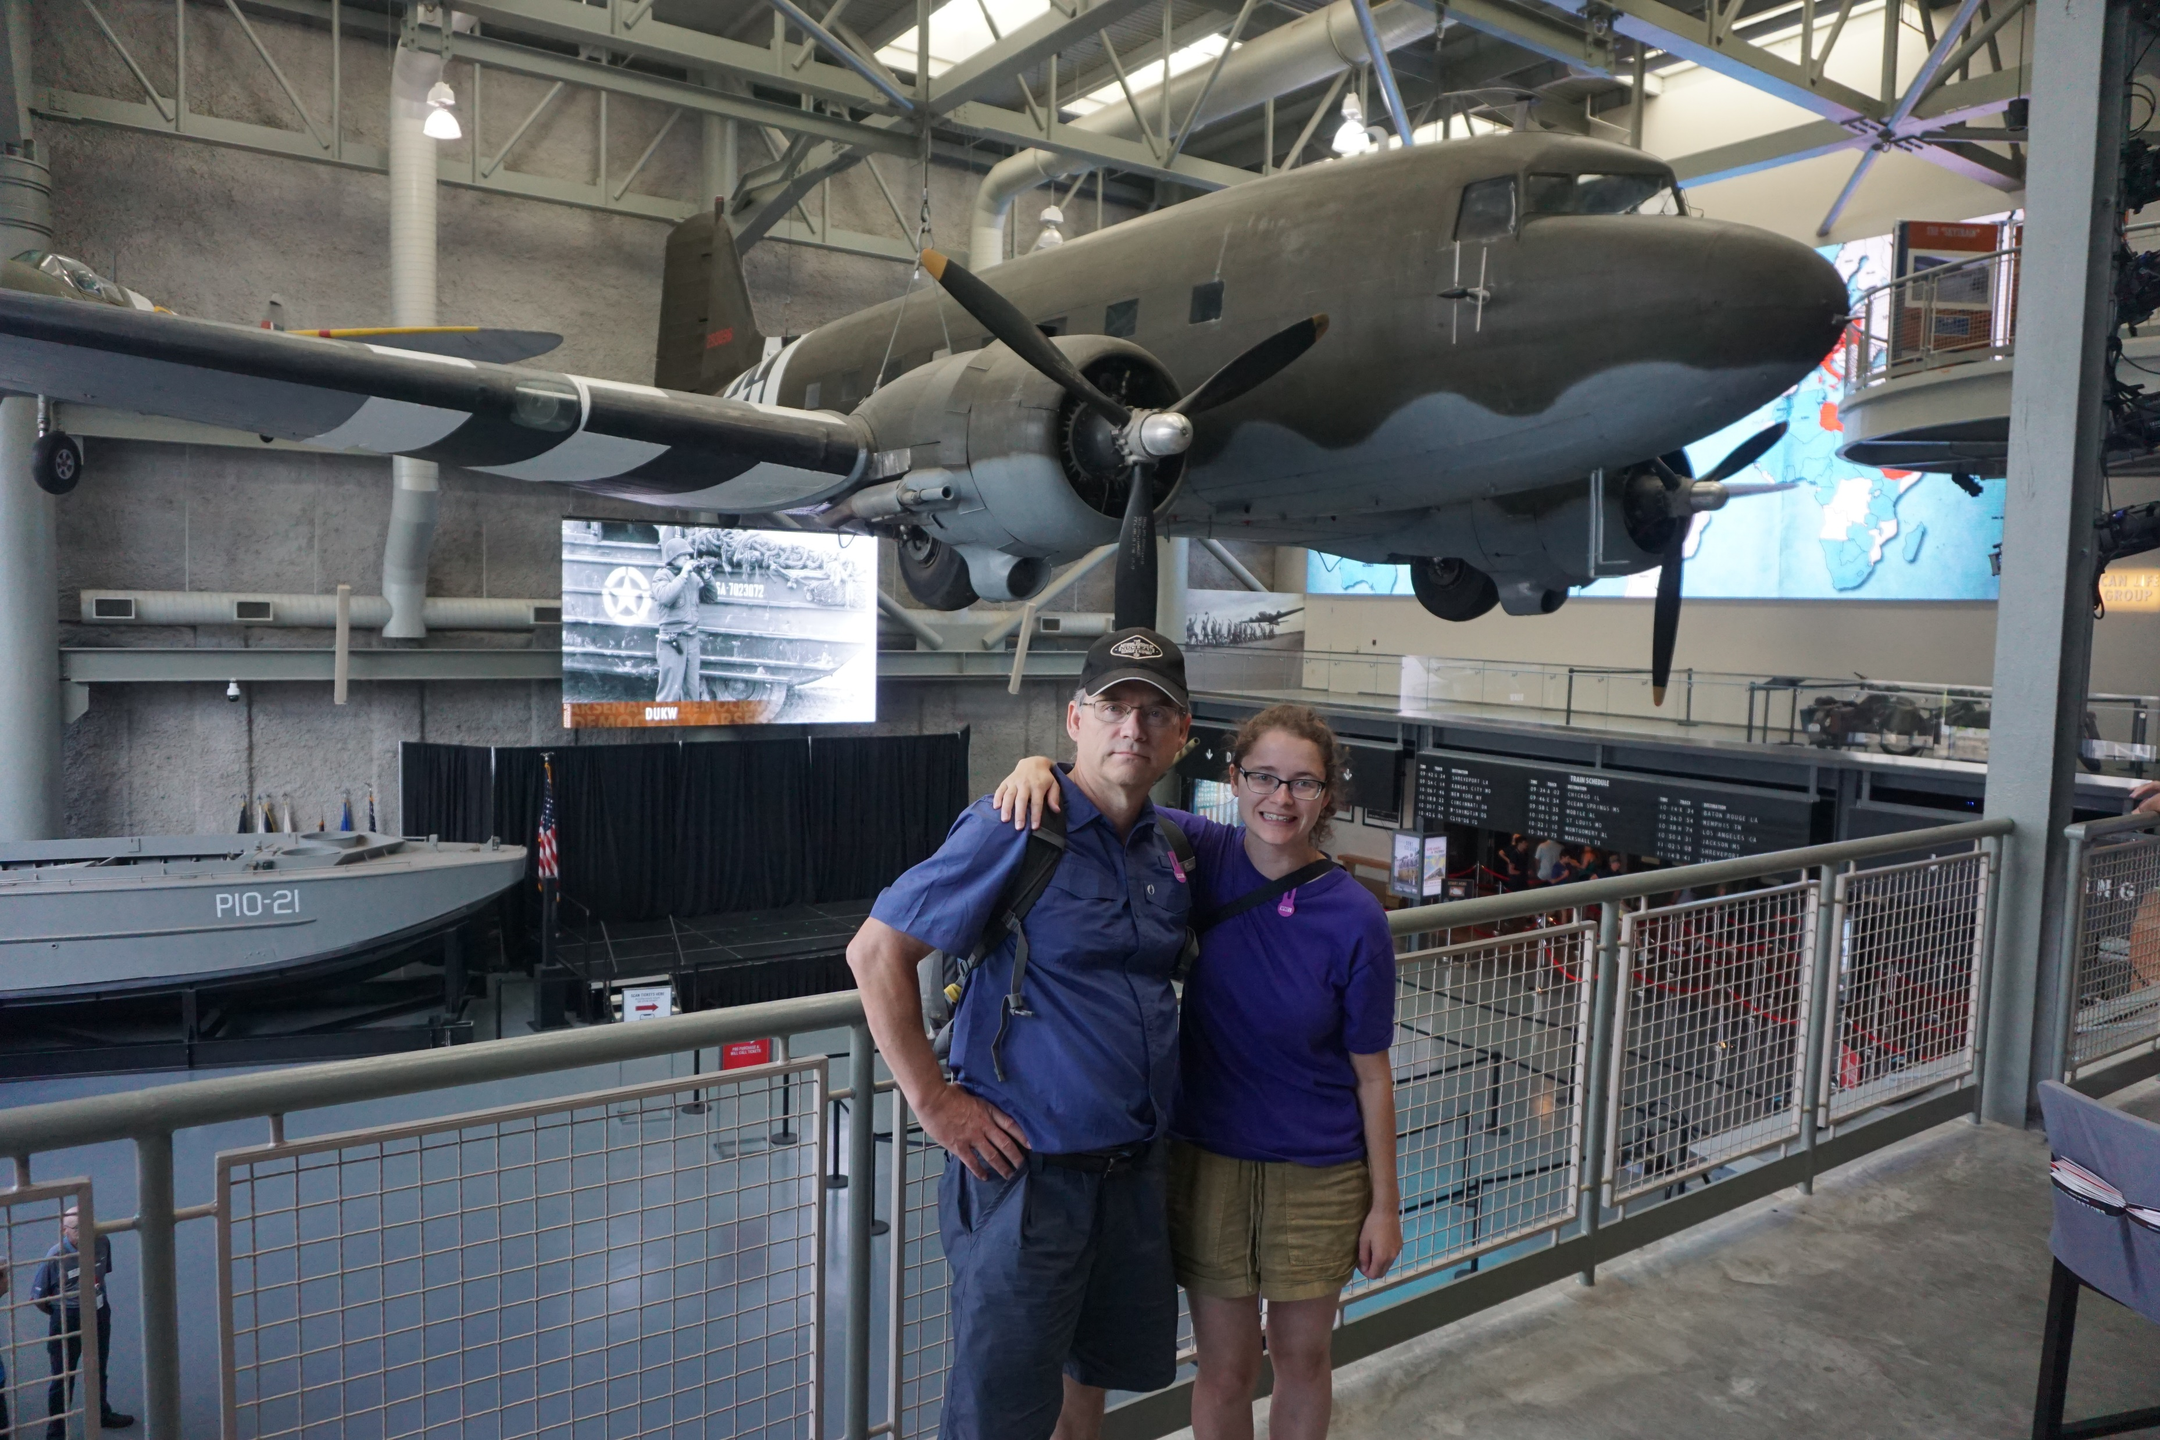
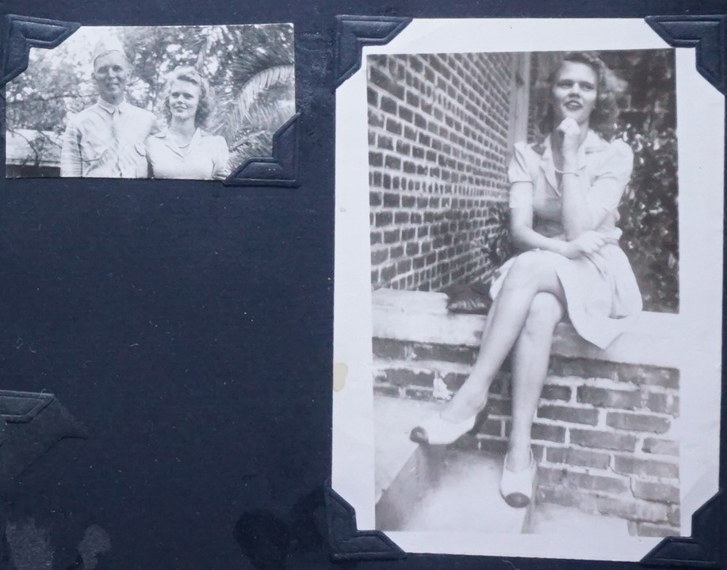

Slide 22
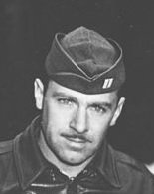
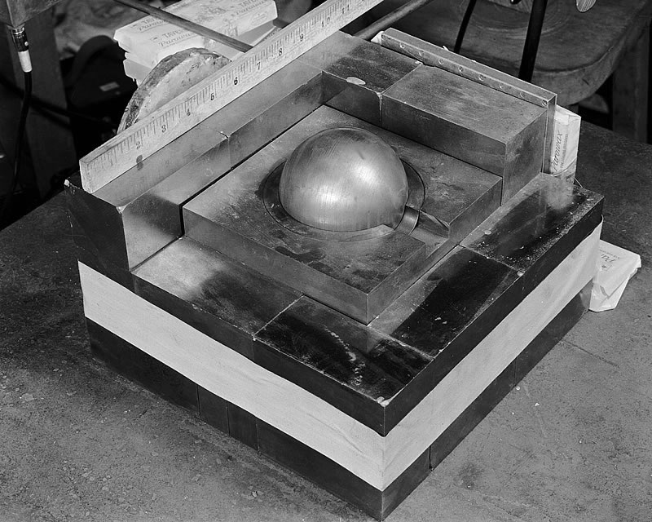
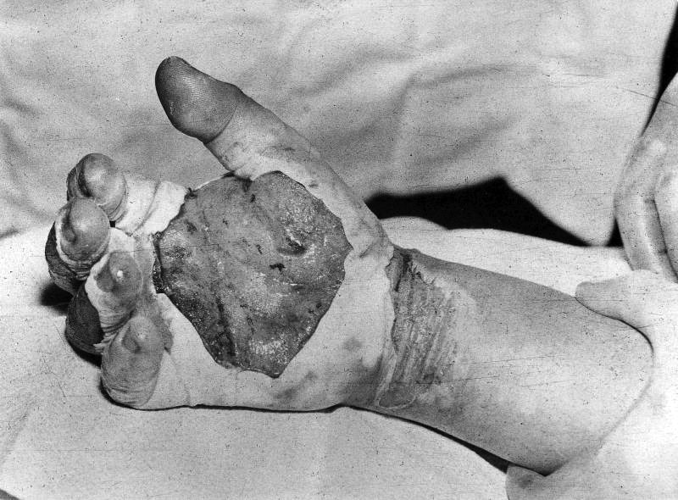
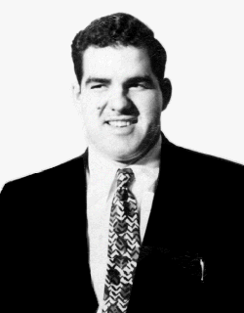
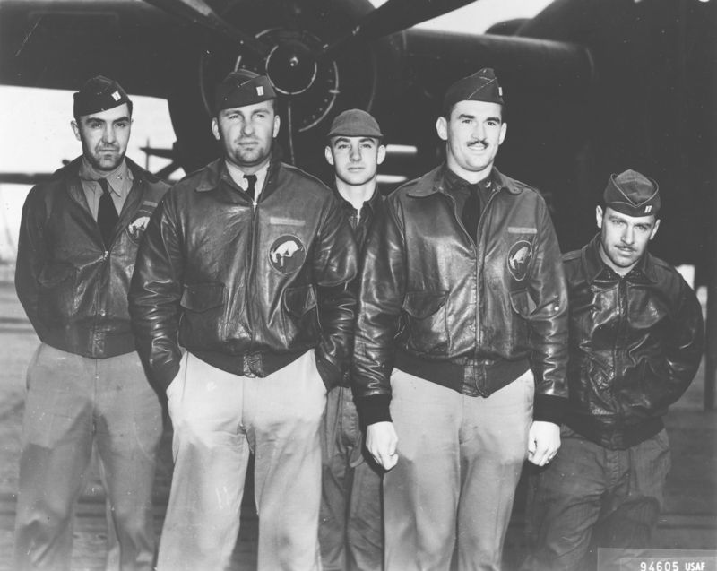
Sargent William Dieter
https://en.wikipedia.org/wiki/William_John_Dieter
Physicist Harry Daghlian
https://en.wikipedia.org/wiki/Harry_Daghlian

Slide 23
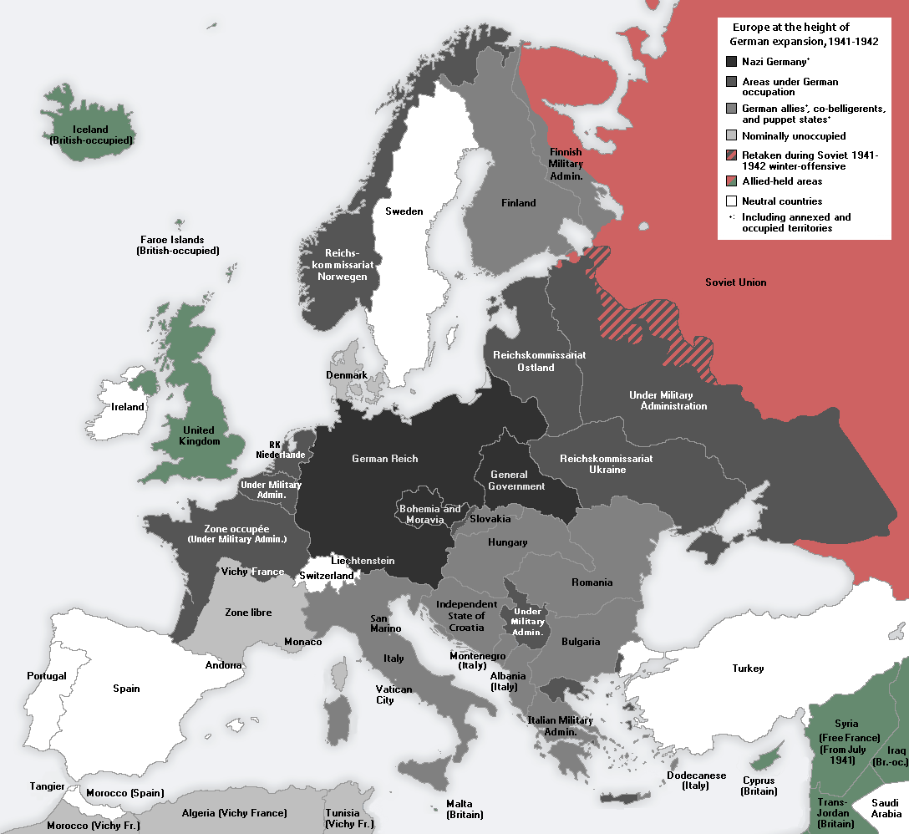
Axis Powers
https://en.wikipedia.org/wiki/German-occupied_Europe

Slide 24
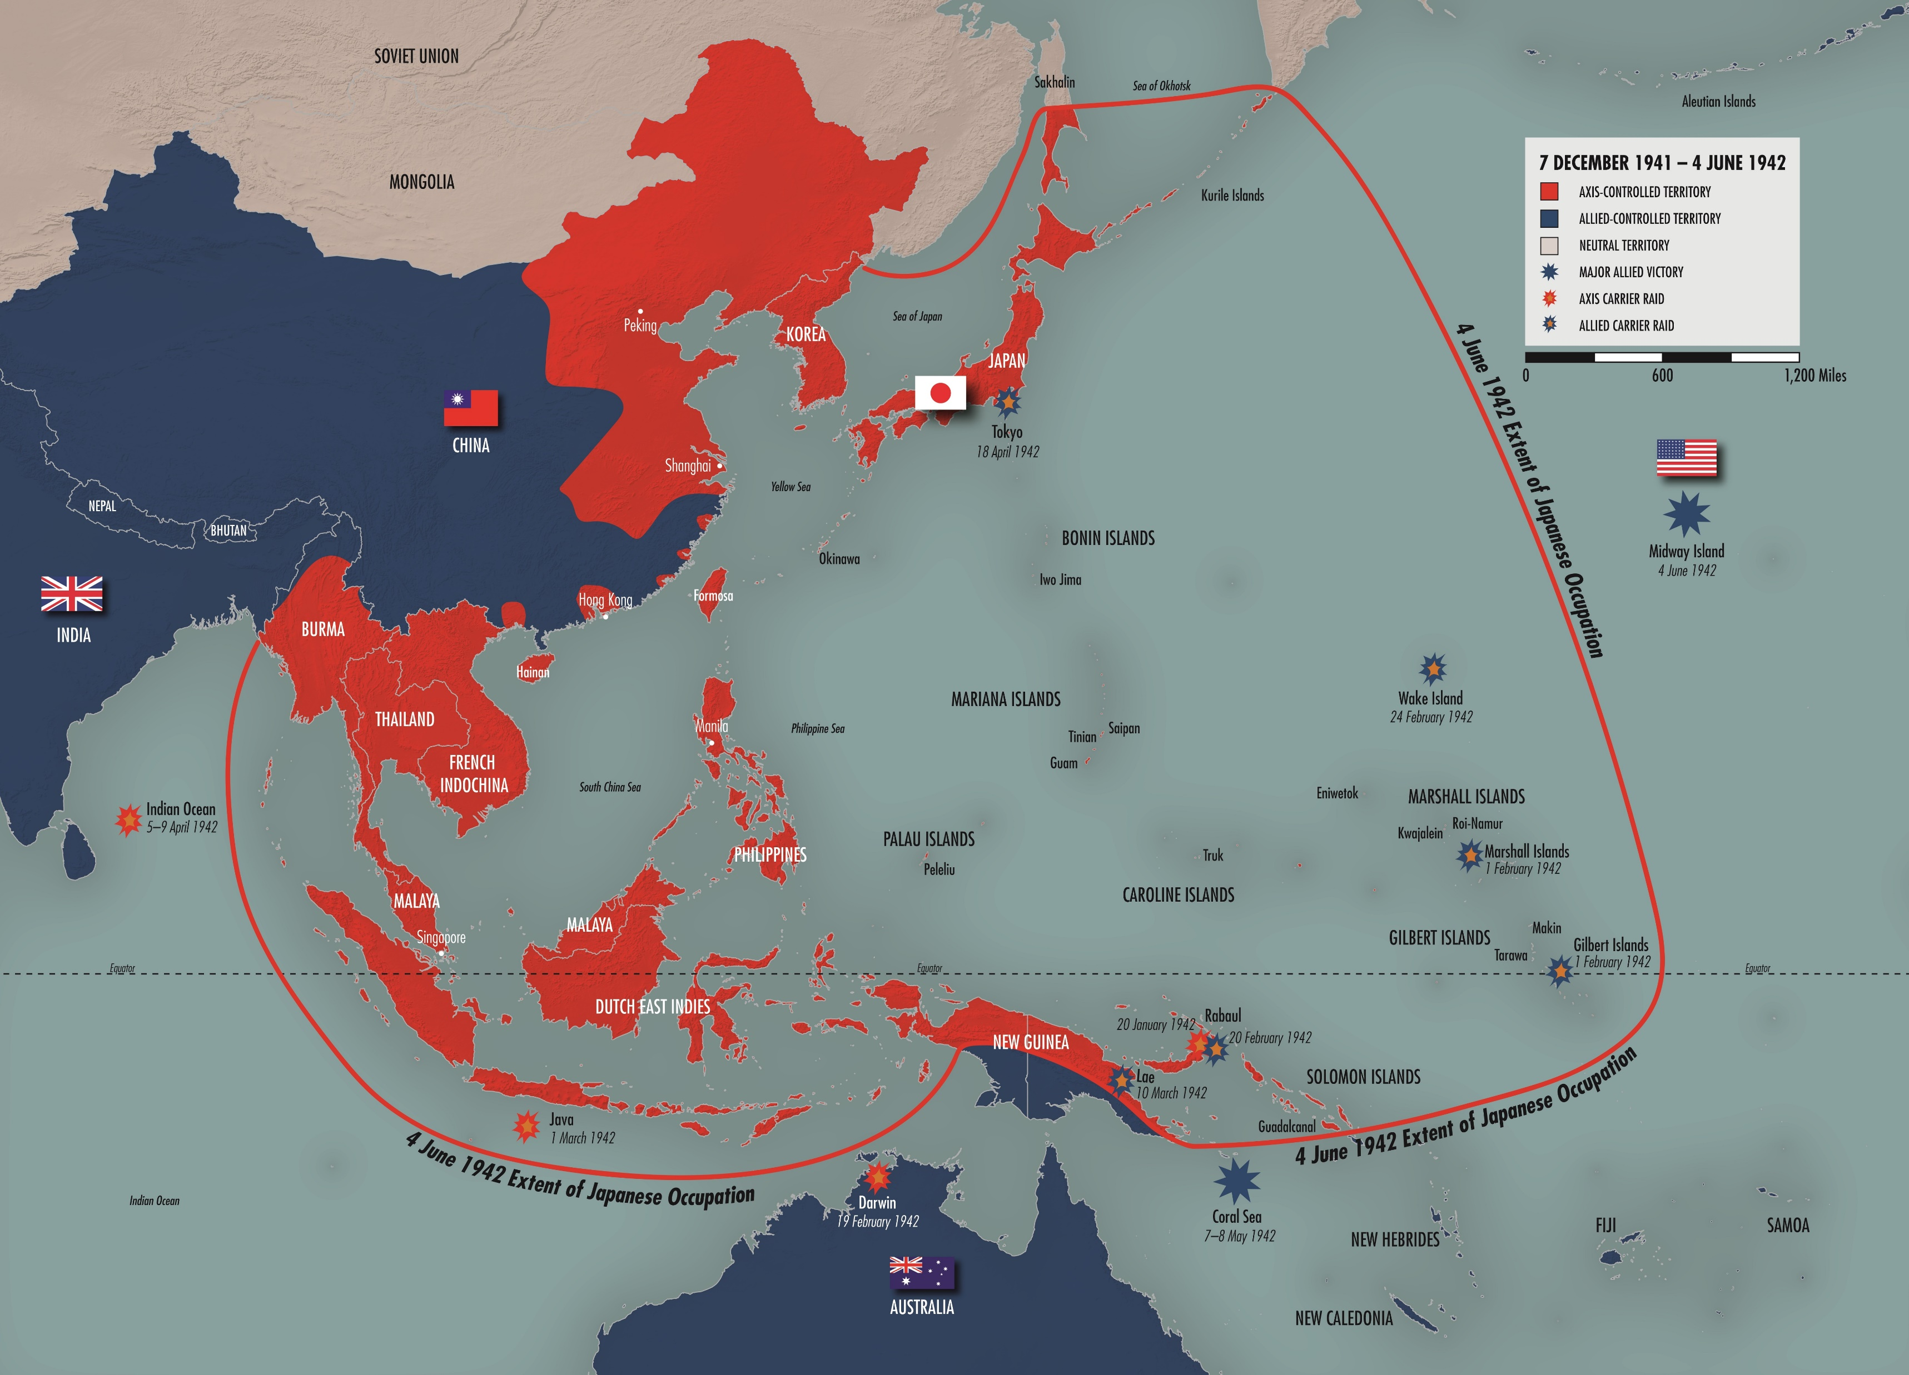
Axis Powers
https://www.ww2classroom.org/node/148
https://www.ww2classroom.org/node/148

Slide 25
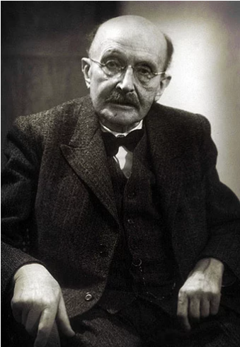
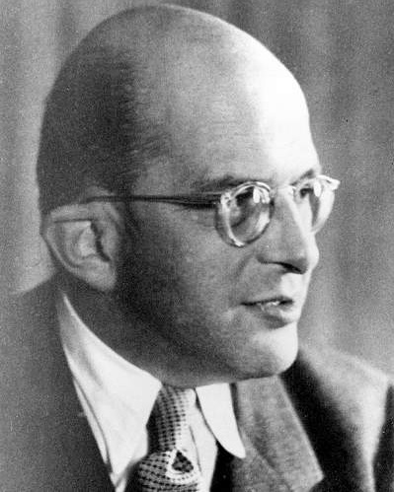
https://www.mpg.de/955542/3_event1-1945
https://en.wikipedia.org/wiki/Erwin_Planck

Slide 26
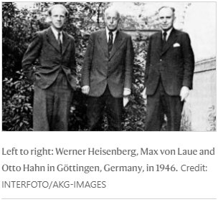
https://www.nature.com/articles/503466a

Slide 27
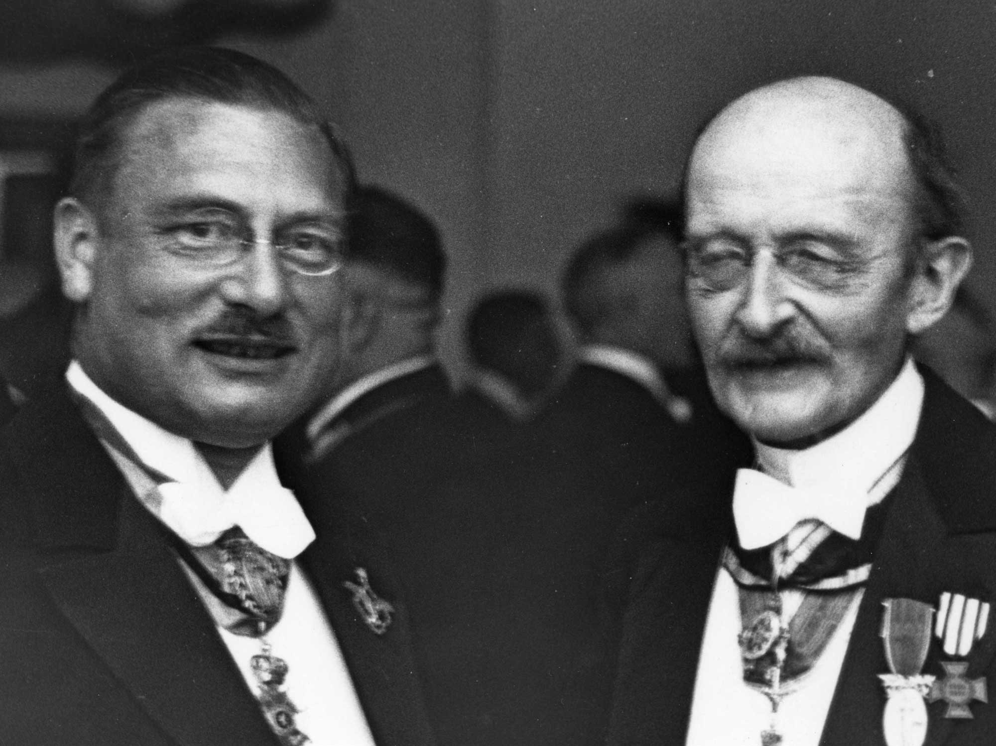
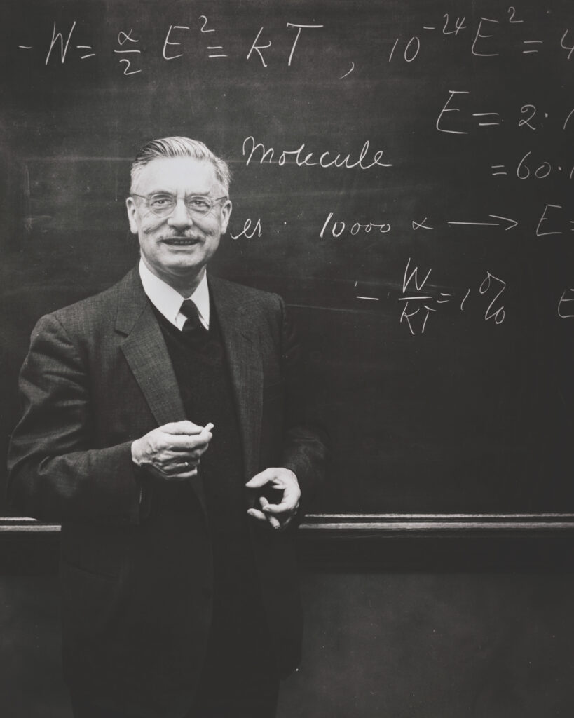
Peter Debye, 1930s
https://www.nobel.mpg.de/en/node/14
Peter Debye, 1940’s
https://alumni.cornell.edu/cornellians/nobel-prize/
https://cen.acs.org/articles/84/web/2006/03/Nobel-Laureate-Accused-Nazi-Collaboration.html

Slide 28
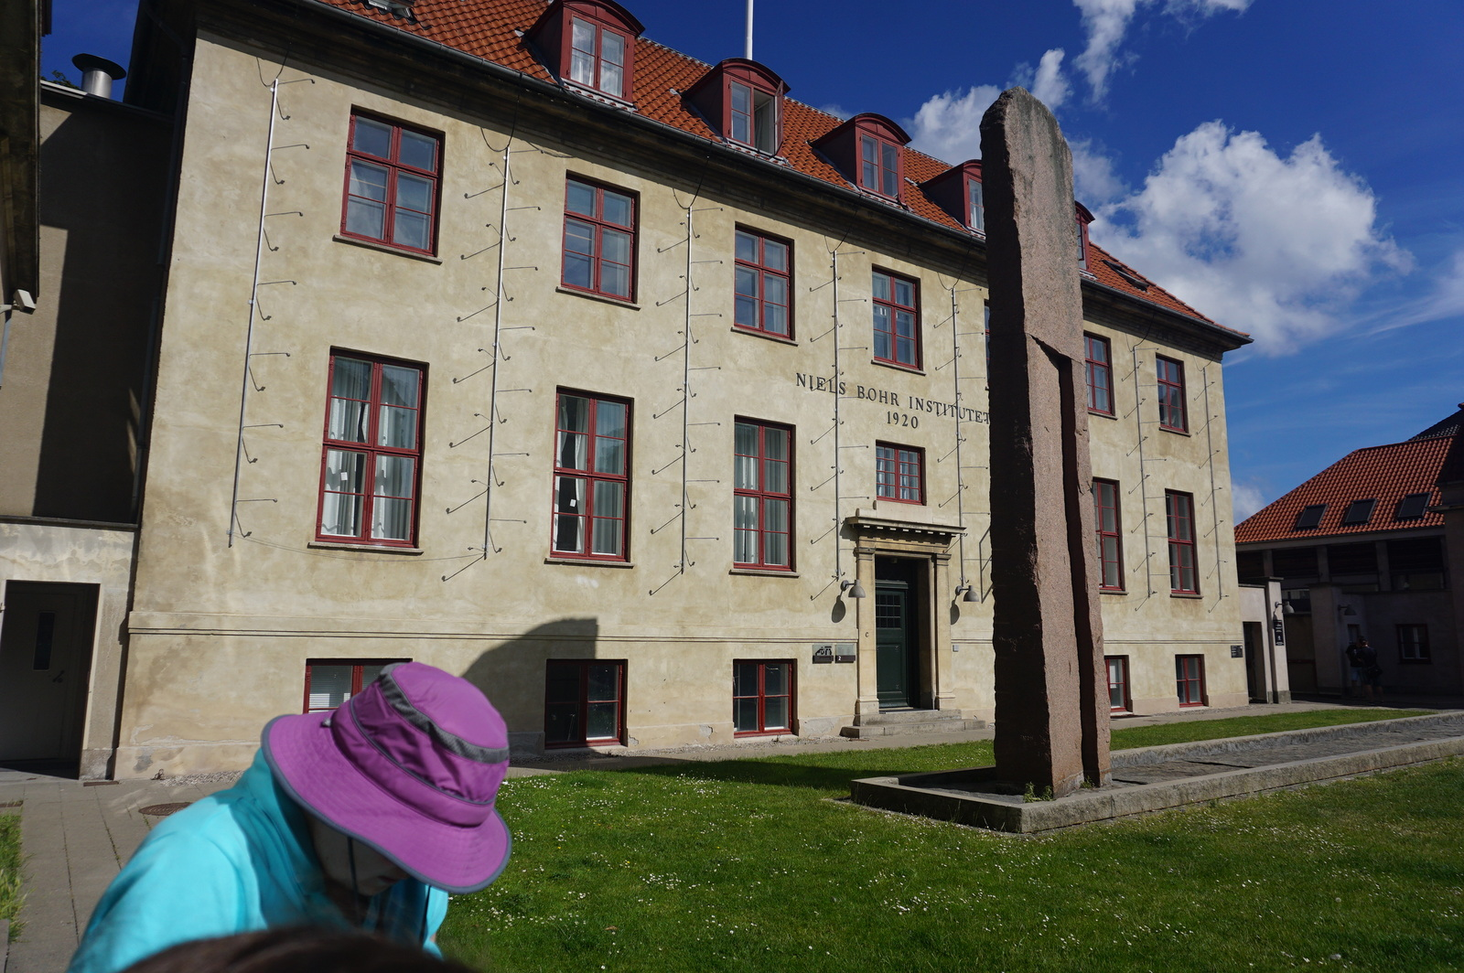
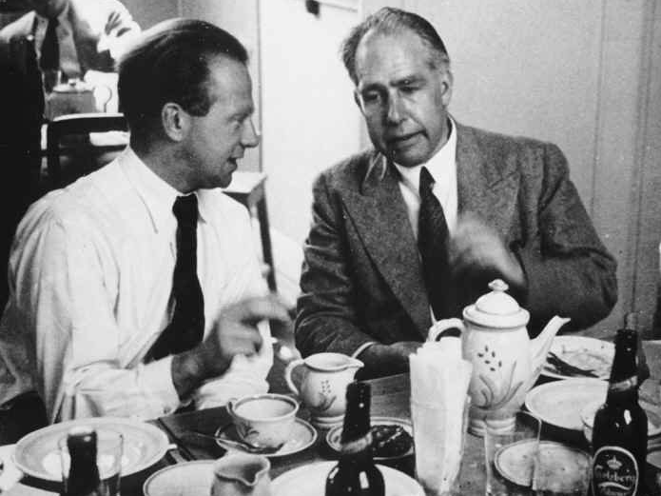
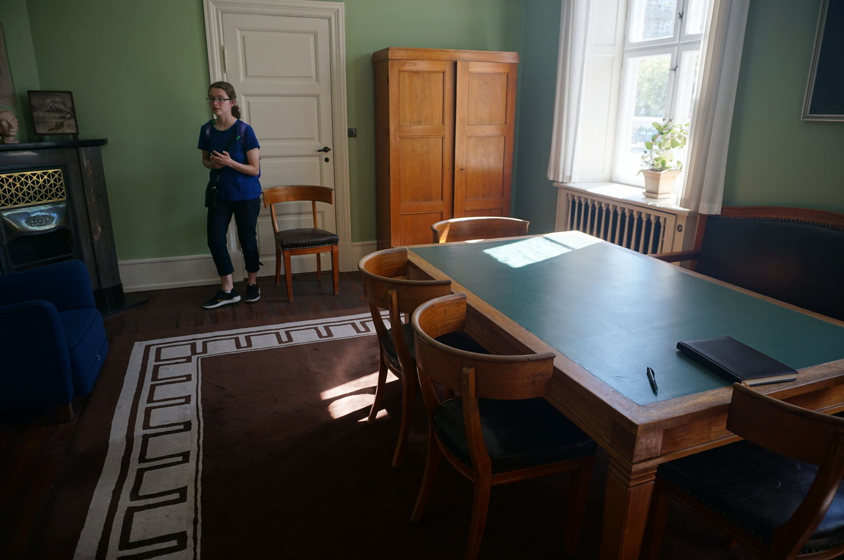
1934

Slide 29
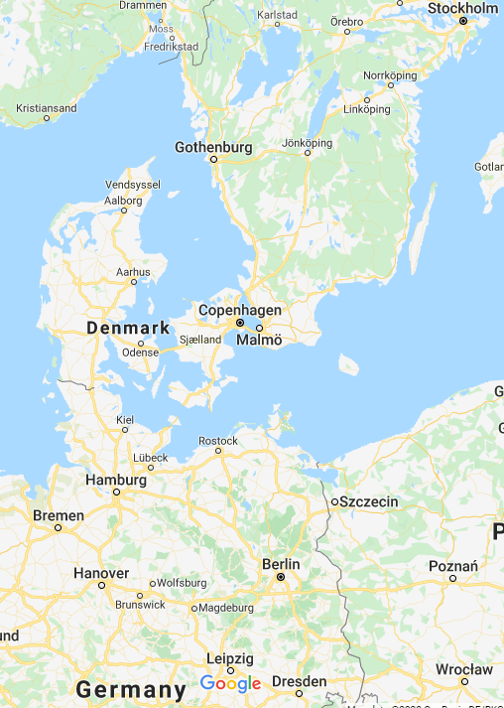
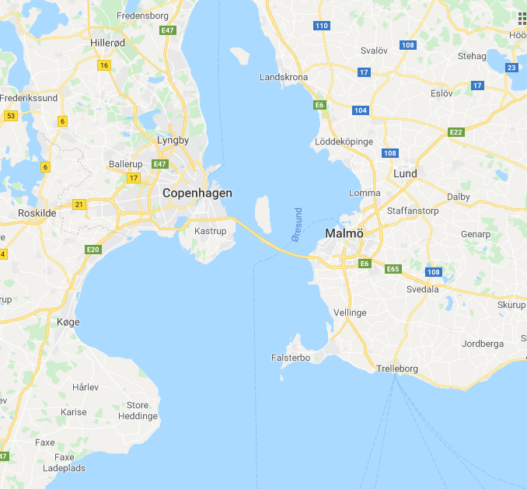

Slide 31
Fritz Houtermans

Slide 32
1933
1934

Slide 33
German reactor in Haigerloch, Germany.
https://thebulletin.org/2019/07/scientific-blinders/

Slide 34
“…rather than definitively proving German atomic complicity or resistance, the Farm Hall transcripts illustrate how trauma and guilt are rarely, if ever, processed linearly or rationally.”
Ryan Dahn, The elusive truth of Farm Hall, Physics Today, May 19, 2022
Farm Hall Estate in England
https://thebulletin.org/2019/07/scientific-blinders/

Slide 35
1940
1976
Philip Morrison

Slide 36
Judgment at Tokyo
Came out in October 2023.

Slide 38
Allied Powers

Slide 39
“SCIENTISTS WANTED, Thousands of scientists are wanted by the government for war work…In these days no one man, whatever his genius, can cover more than a fraction of the immense field of science in war…We are engaged in a death struggle with an enemy who boasts with justification of his achievements in the field of science…”
https://blog.nationalarchives.gov.uk/sir-maurice-hankey-birth-modern-government/

Slide 40
Physics Conference
Washington DC, 1939
Enrico Fermi, 1940s
“the cat was not entirely out of the bag, but its tail was sticking out.”

Slide 41
https://www.aps.org/programs/honors/history/historicsites/summer.cfm
1939 Summer Symposium in Theoretical Physics
U of Michigan
Enrico Fermi, 1940s
“These people [the Fascist] have no principles; they will kill anybody who might be a threat – and they won’t think twice about it. You have only the influence they grant you.”
Schwartz, D.N. 2017. The Last Man Who Knew Everything. Basic Books, p. 175

Slide 42
Metallurgical Group 1946
https://en.wikipedia.org/wiki/Leo_Szilard#/media/File:ChicagoPileTeam.png

Slide 43
December 2, 1942

Slide 44
https://www.osti.gov/opennet/manhattan-project-history/images/cp1_printout_image.htm

Slide 45
“…[Bohr] showed vigorous interest in both theory and design, and acted as a scientific father confessor to the younger men…Bohr at Los Alamos was marvelous.” -Oppenheimer
December 2, 1942
http://faculty.polytechnic.org/gfeldmeth/1314138a.html
Manhattan Project Heritage Preservation Association

Slide 46
https://www.defense.gov/News/Feature-Stories/Story/Article/3464967/army-general-and-physicist-helped-usher-in-the-atomic-age/

Slide 47
https://commons.wikimedia.org/wiki/File:Agnew_on_Tinian.jpg
Luis Alvarez, 1945

Slide 48
https://commons.wikimedia.org/wiki/File:Agnew_on_Tinian.jpg
Luis Alvarez, 1945
1968
https://upload.wikimedia.org/wikipedia/commons/thumb/2/2f/Luis_Alvarez_-_Flak_Jacket.JPG/640px-Luis_Alvarez_-_Flak_Jacket.JPG

Slide 49
Andrei Sakharov
1943

Slide 50
Stimson Advisory Group
(Henry Stimson, Secretary of War )
Szilard and Franck Group

Slide 51
https://upload.wikimedia.org/wikipedia/commons/6/69/Jimmy_Carter_Library_and_Museum_145.JPG
International Day of Peace organization

Slide 52
“We are all citizens of a world community sharing a common peril. Is it inevitable that because of our passions and our inherited customs we should be condemned to destroy ourselves?”
Bulletin of Atomic Scientists June 1948

Slide 54
The End

