Slide 1


A Tale of Two Labs
It was the best of times, it was even better than that….for acronyms
MPT @ CERN; OPMD @ Oxford
Todd Huffman

Slide 2
Micro Pattern Technologies Workshop
@CERN
Rui De Oliveira

Slide 3
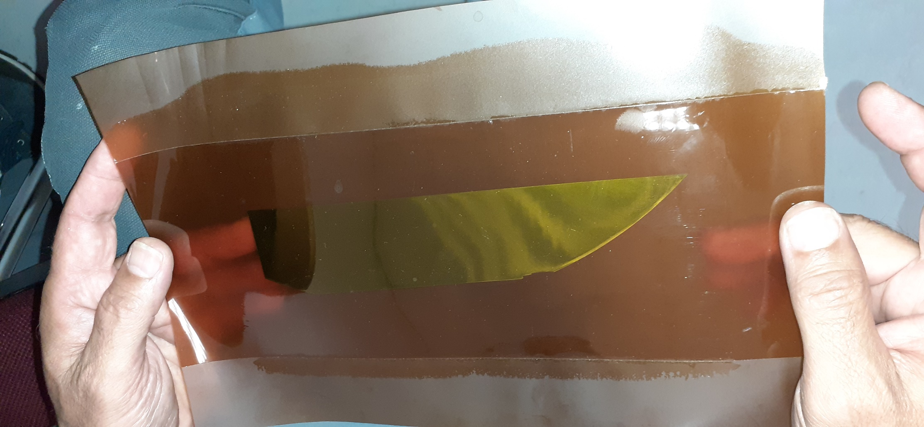
Example of 25um Si
Silicon thinned to 25um and vacuum encapsulated in Kapton.
Adds Bending strength and improves reliability on bend.

Slide 4
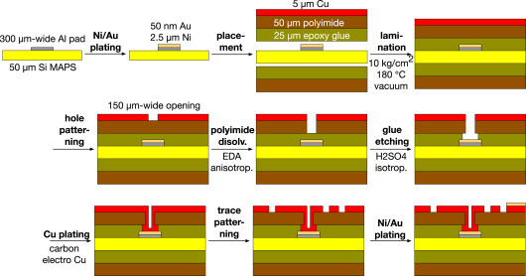
The MAPS connection Process
Process
Glues are films
  Material and thickness control
General process is shown (Cu)
Al Technique was developed first
  Via’s – vacuum plating directly
Ref: NIM V1046, 11 Jan 2023, 167673

Slide 5
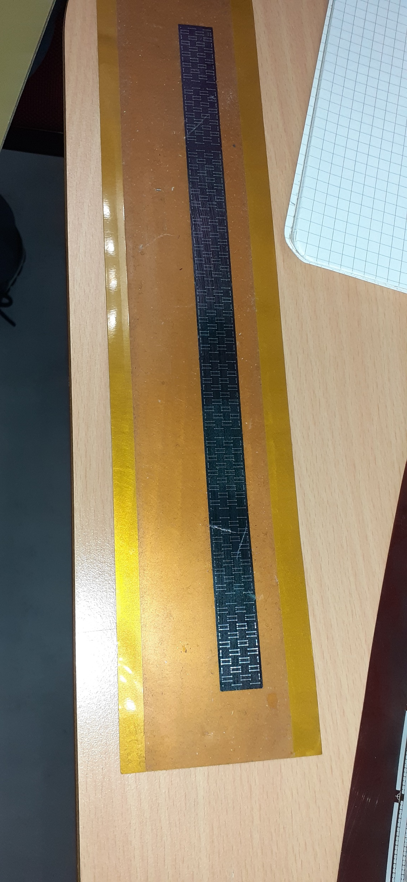
The Process
Start with stave substrate material – Peek, Carbon fibre, etc
  This one is Aluminium
Glue Kapton on substrate sticky side up. (glue film)
Pick and place chips with precision (~20um in this case)
Place tape over top and etch holes and plate
Remove substrate (or leave for rigidity).

Slide 6
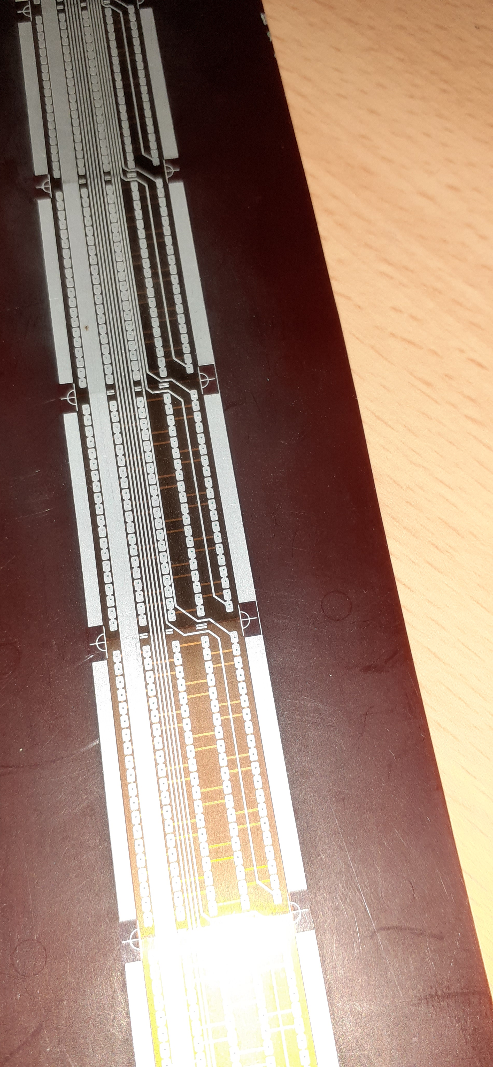
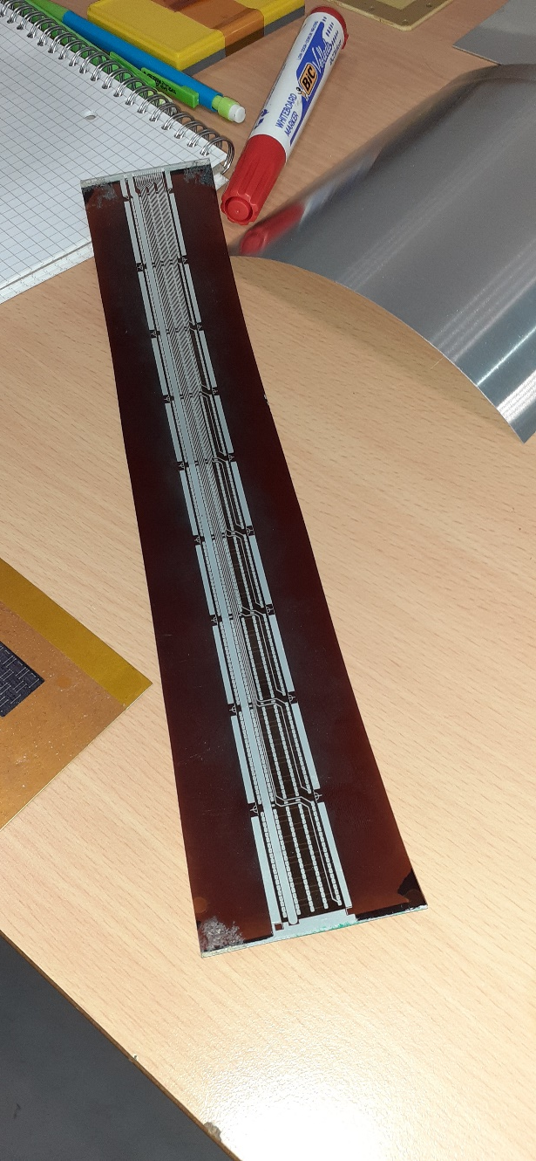
9 chip result
Critical step:
Must remove Al-Oxide
from chip pads.
Done with plasma beam
At low pressure.
Then Al deposited to
Plate the holes.
One section showing through-holes.
All 9 chips

Slide 7
Plated through Holes
Holes plated through to the MAPS sensors below.
Via – 200 um dia
Pads are large in this case ~1.2 mm on long end.
Pads could be 400 um and round as minimum size.

Slide 8
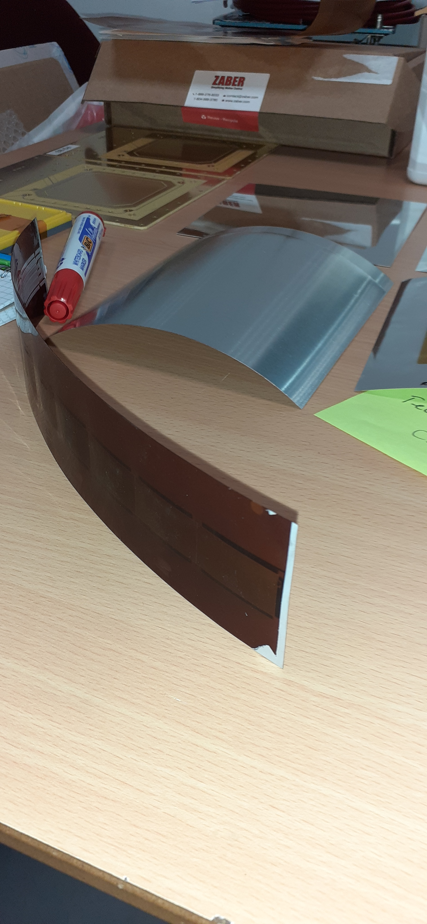
Fully completed sensor
Individual MAPS chips aligned and encapsulated inside Kapton.
Si chips Thinned to 25 um
(thinning effects yield)
Top surface has full connectivity across the whole sensor
No structure needed for cooling if air-flow is sufficient. Consider using tension to hold in place rather than a substrate.

Slide 9
Oxford Physics Microstructure Detector Lab.
(OPMD)
Richard Plackett

Slide 10
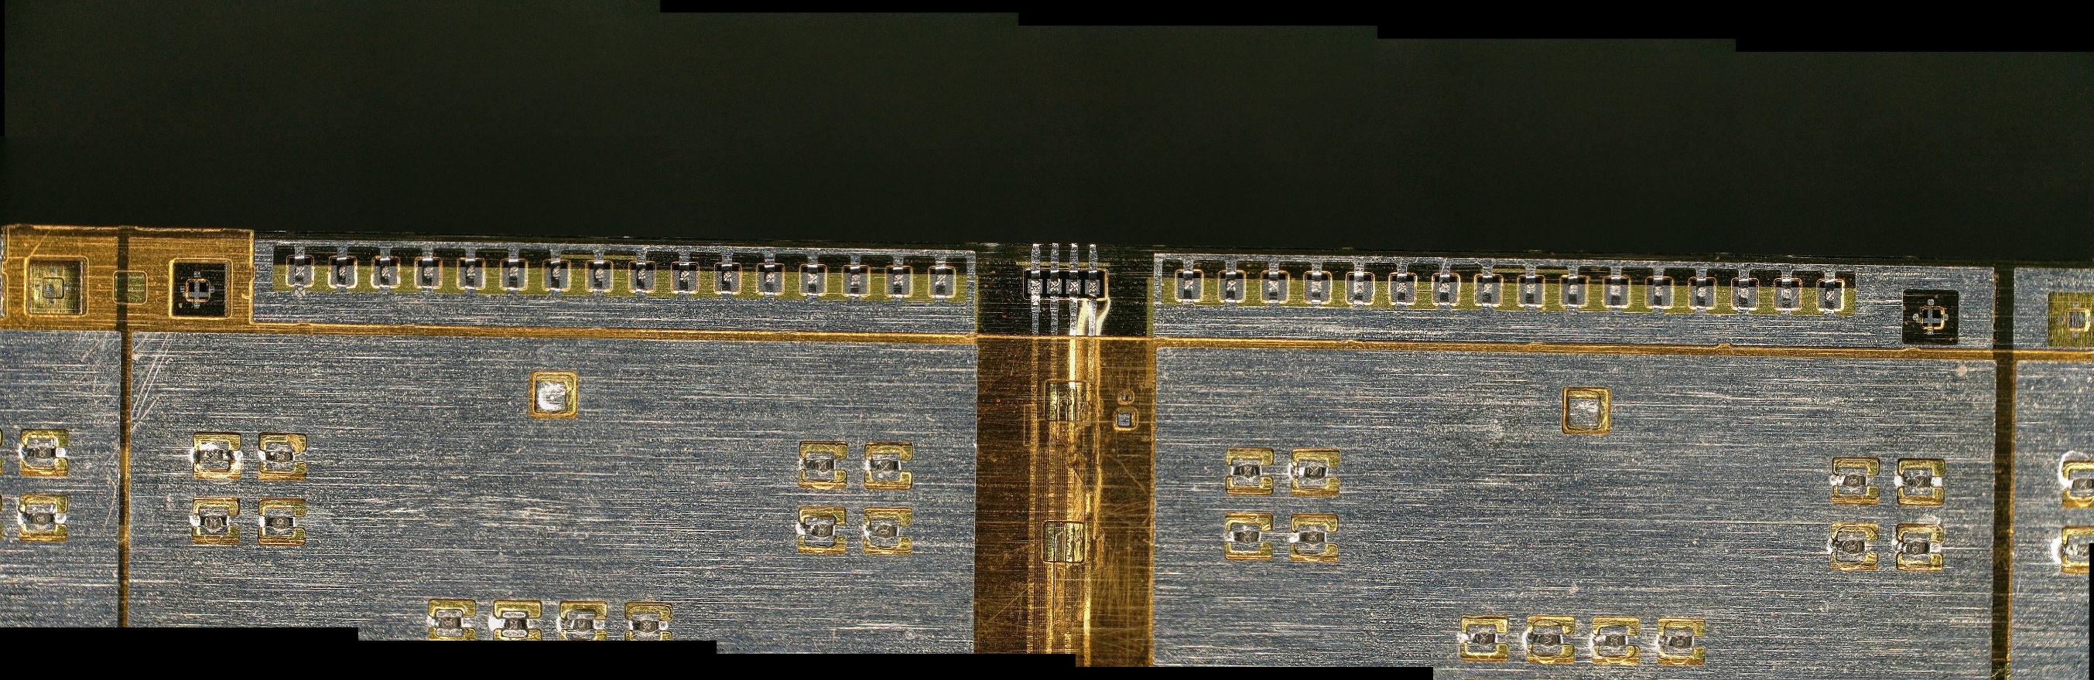
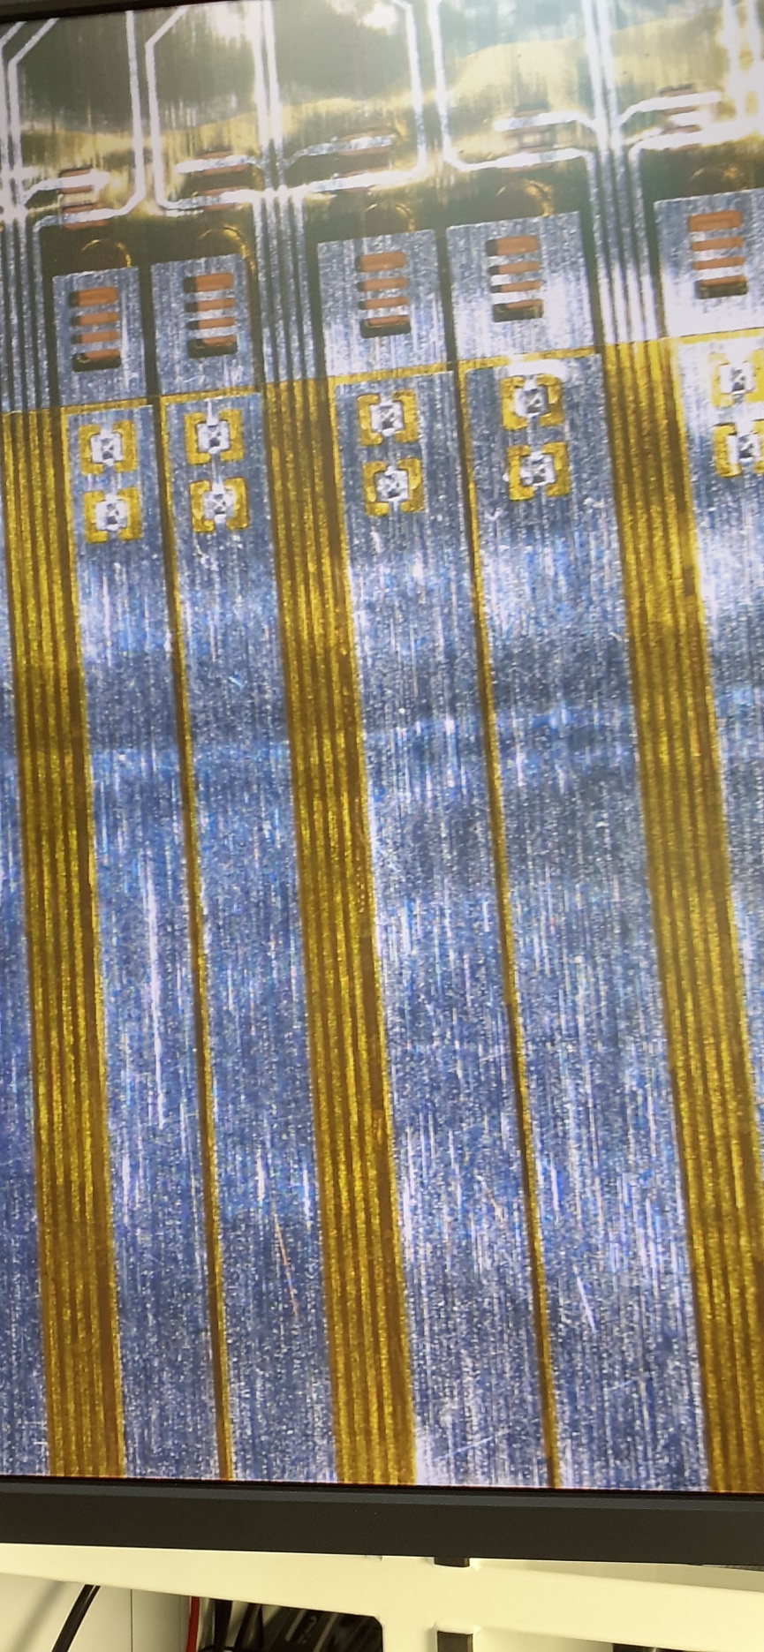
MU3e cable examples @ OPMD

Slide 11
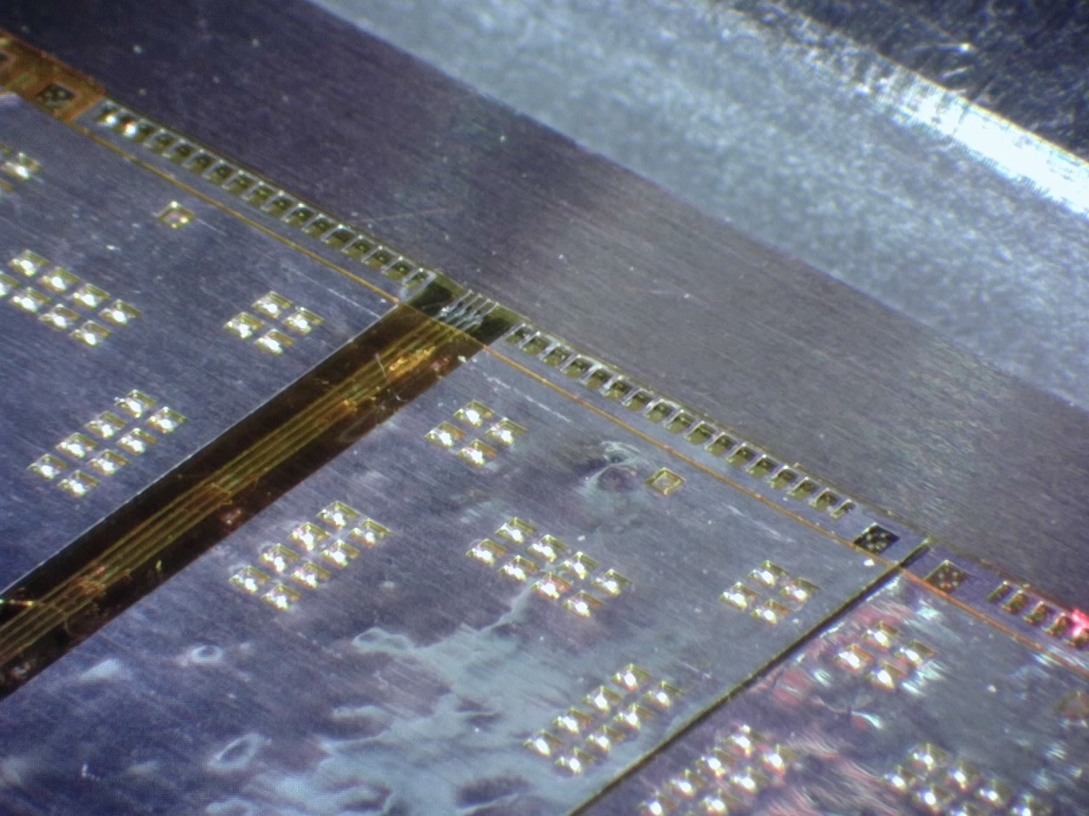
Tab-bonding: The movie
Aluminium flex circuits → Ukraine (LTU)
Same people that gave the presentation
Last week.

Slide 12
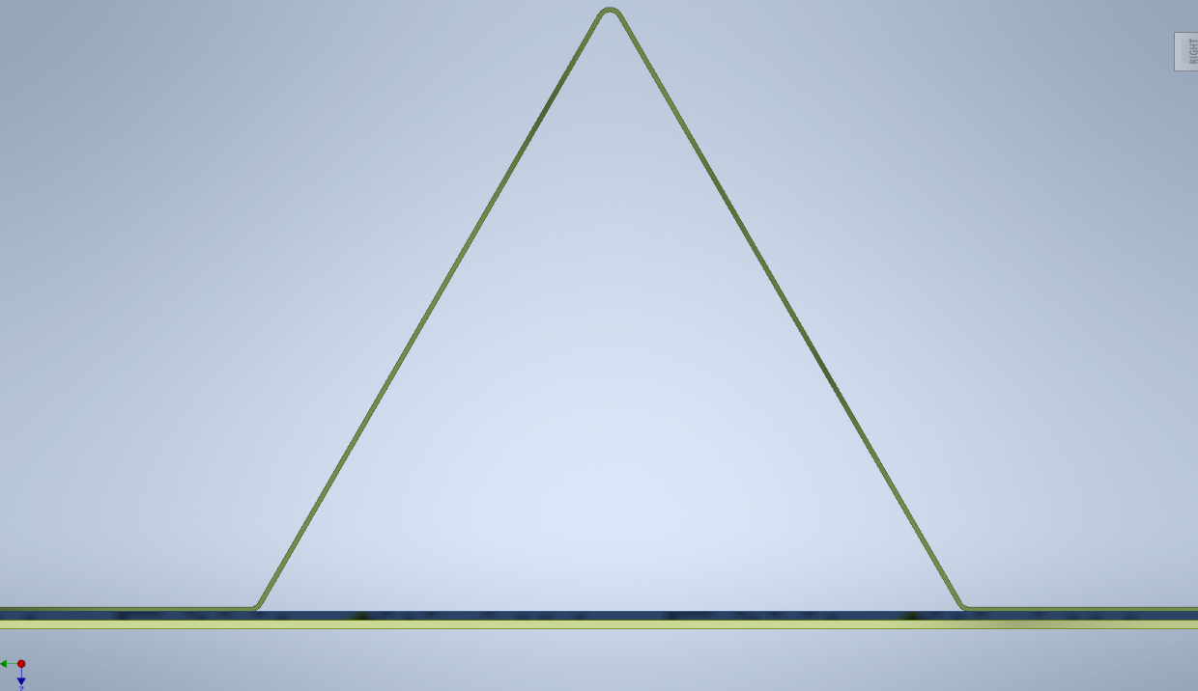
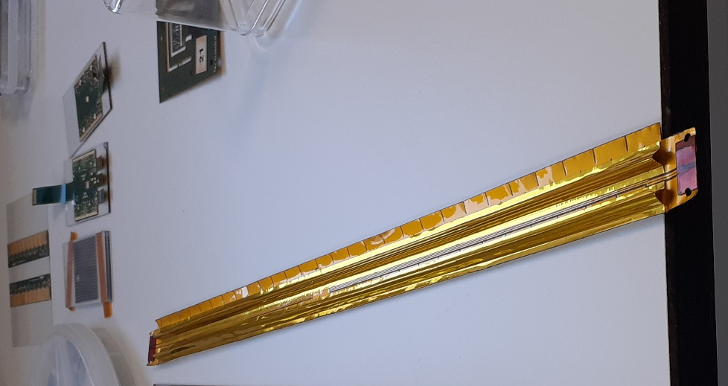
‘v’ – shaped channel for stiffness and cooling
MAPS sensors ~2x2 cm
Shown is Kapton example
Final version will be carbon fibre
Full 18-sensor long stave mass = 2 g

Slide 13
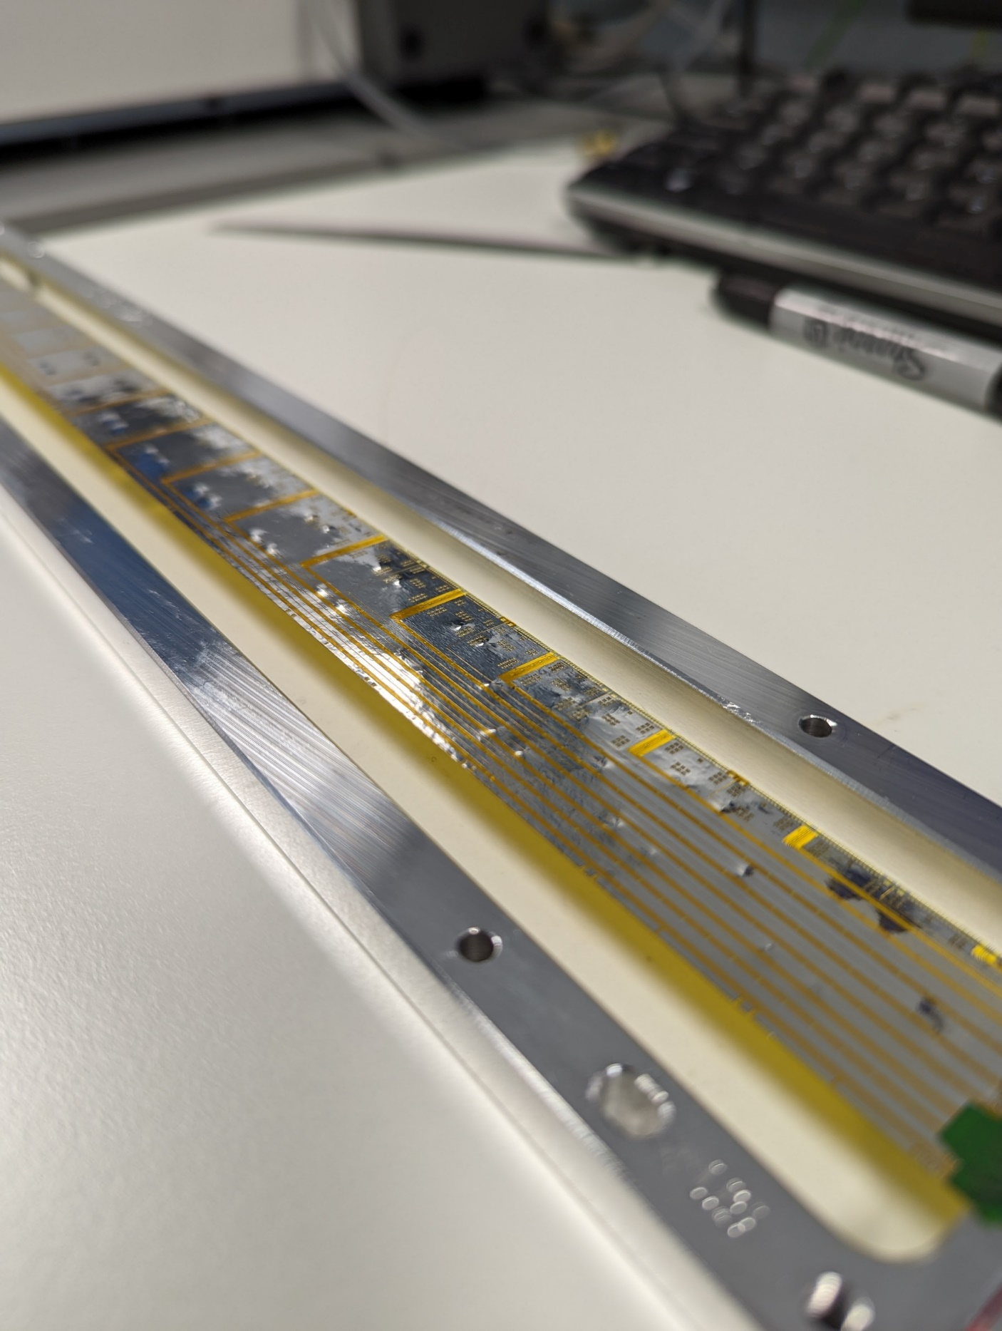
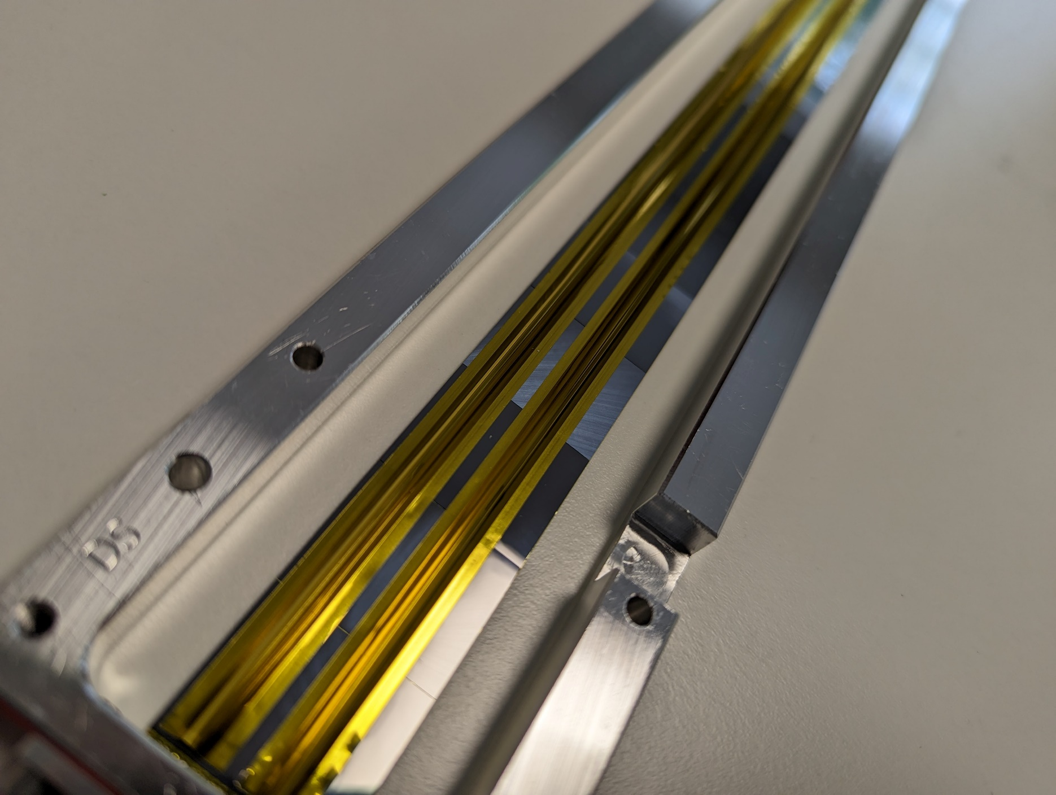
Mu3E – MAPS sensors at Oxford

Slide 14
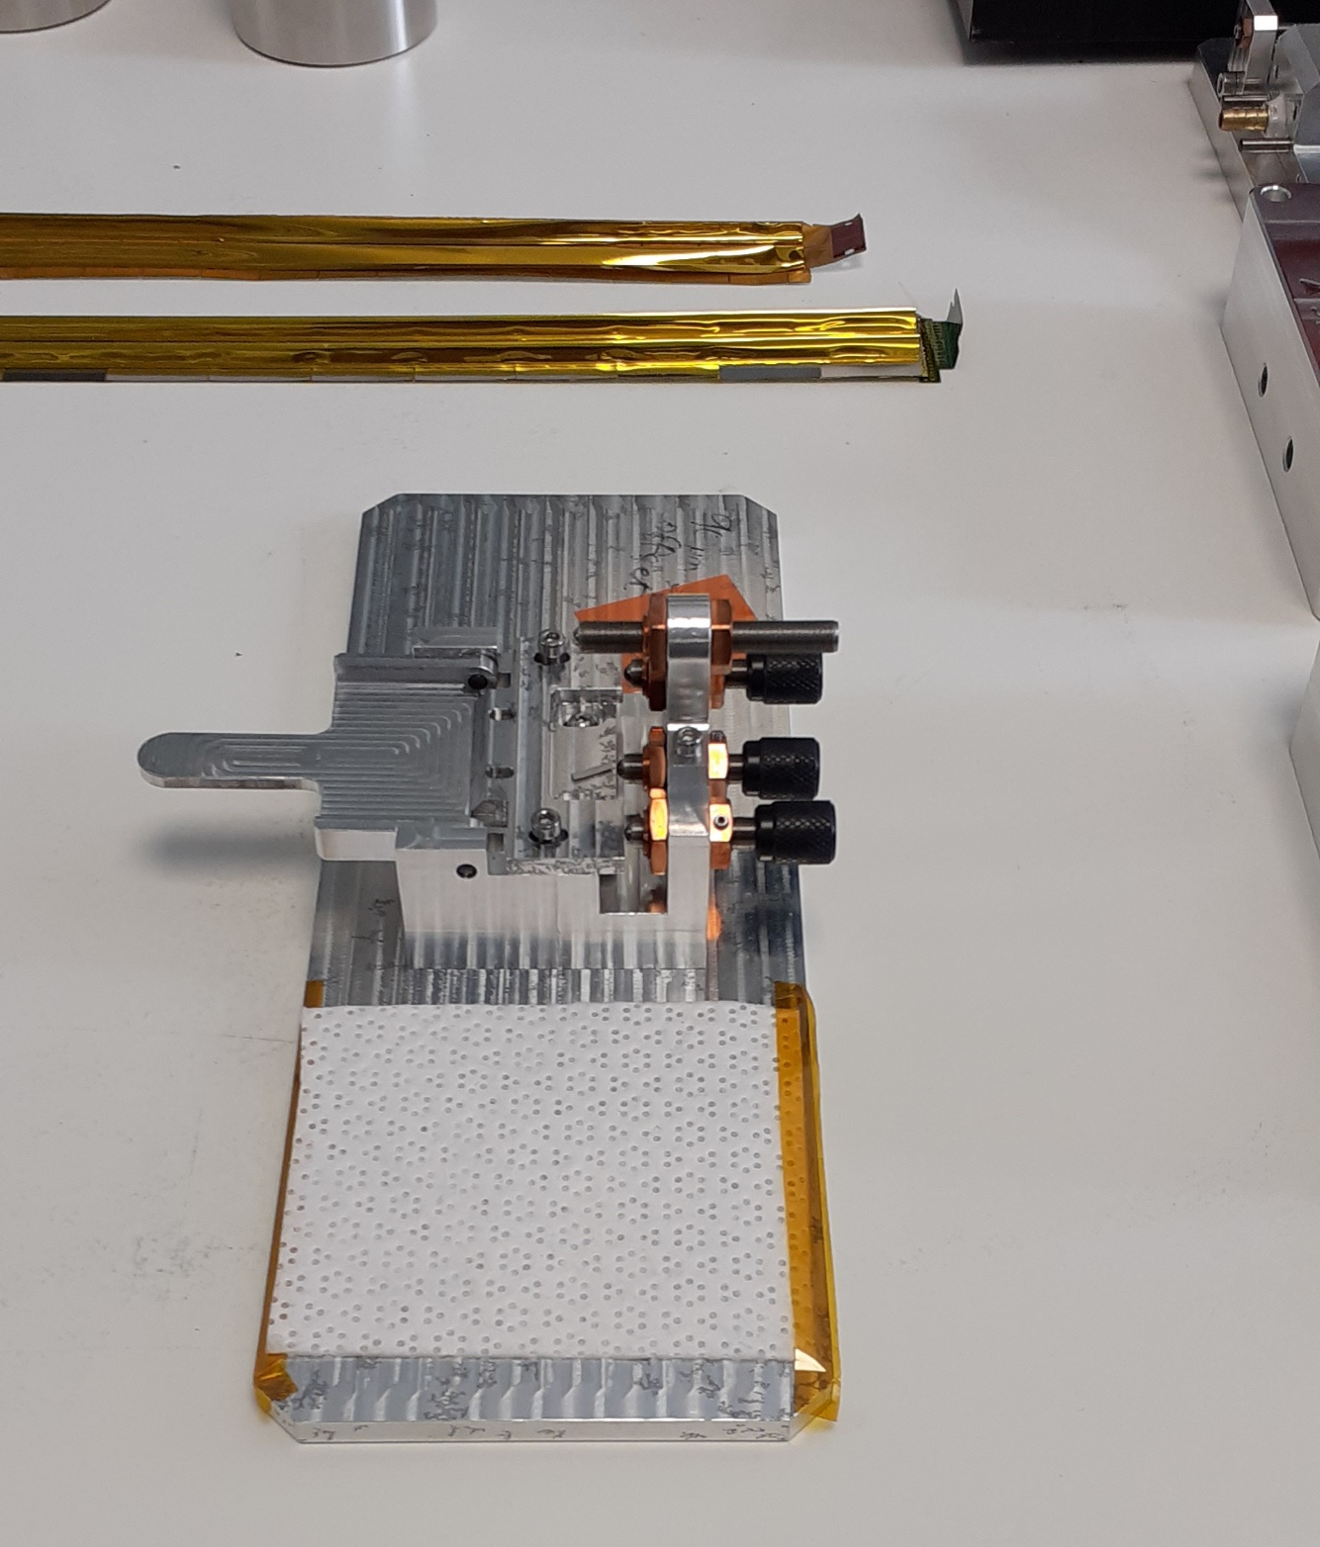
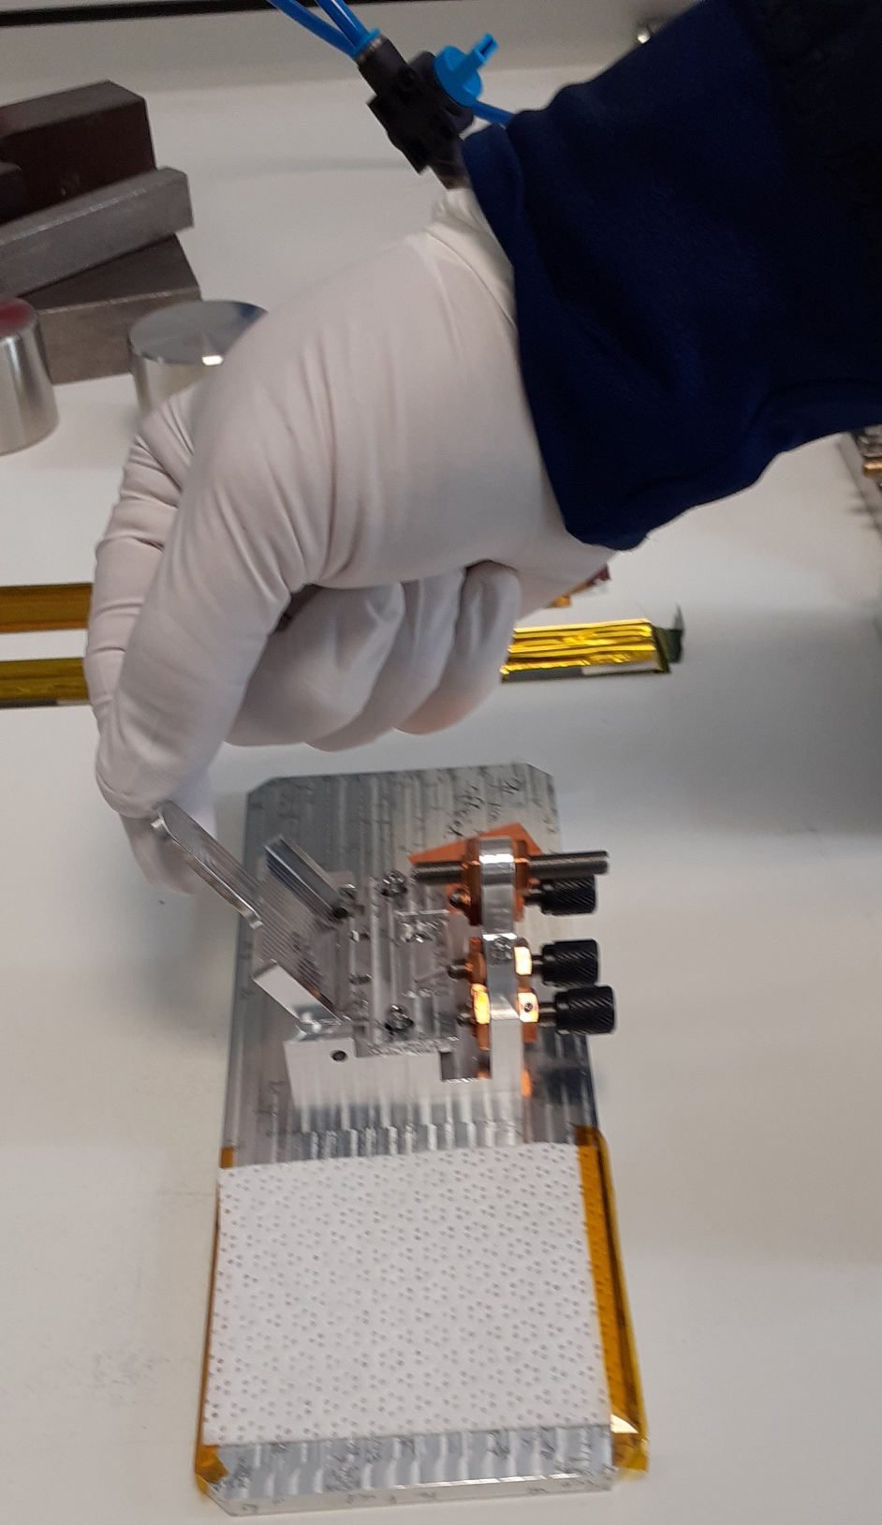
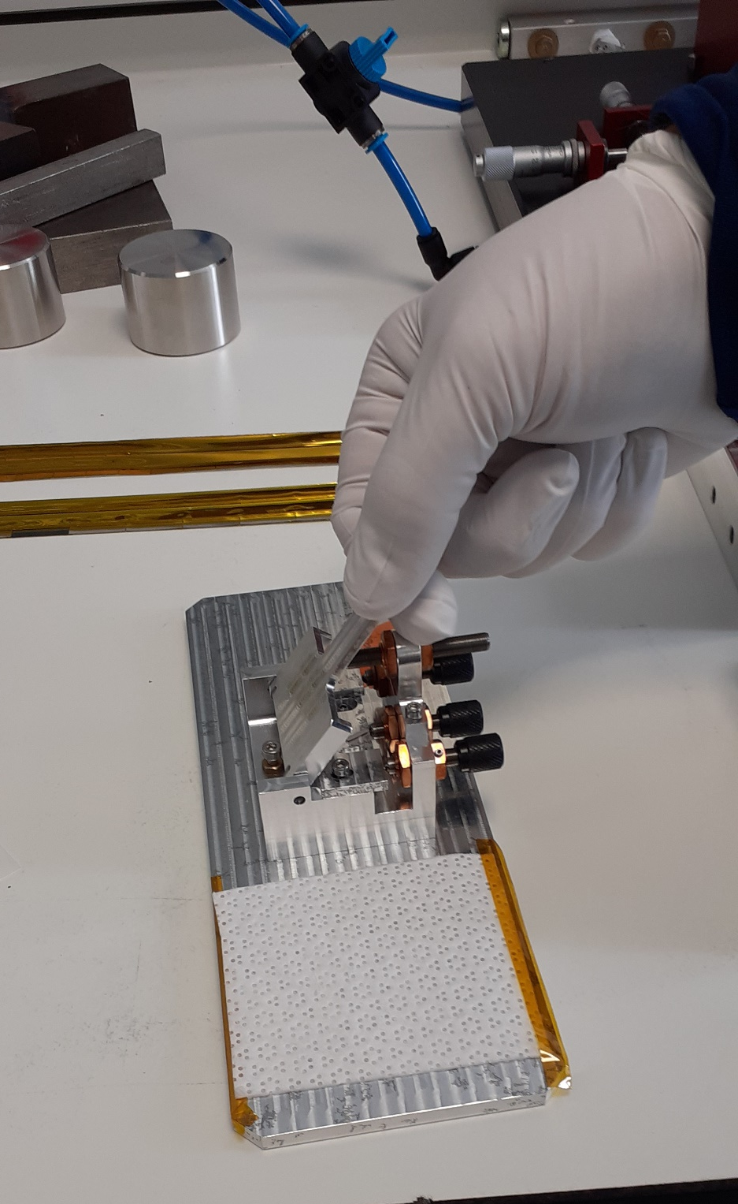
The Smallest Sheet metal bender in the world

Slide 15

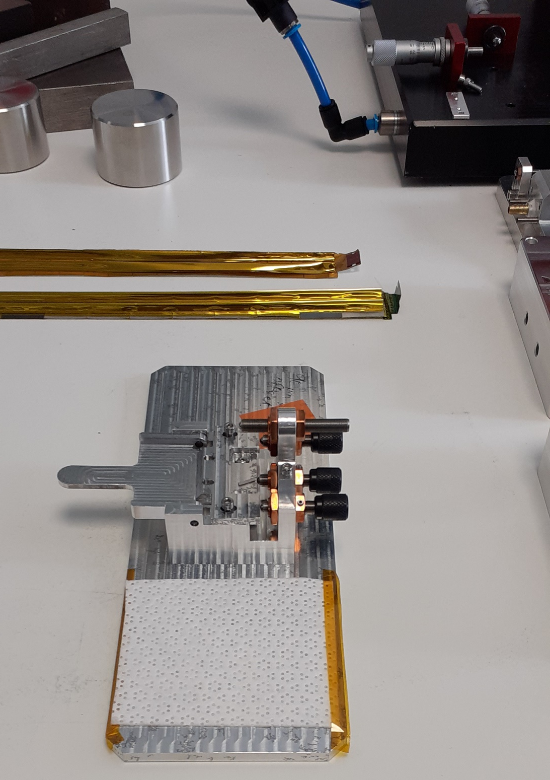
What’s it do?
Cu flex bent to right angle
Al can only bend once…unreliable

Slide 16
One worry - Yield issues
Imagine we can spend on twice as many wafers as strictly needed.
What is required yield for a 9 RSU sensor?
  Require a per-wafer yield of 50%
  Entire sensor thrown away if one RSU is defective.
Individual RSU yield needed = 92.6% (89% for 6 RSU-long sensor)
MU3e Experience so far – 70% yield after thinning (70 um), per RSU
  Anyone know how Alice will mitigate this problem?
  Back to individual RSU’s mounted on stave structure.
But then – ALICE has to solve this problem too?

Slide 17
Separate MAPS - Potential advantages
Yield improvements are obvious, only use the MAPS sensors that work on the wafer
More efficient wafer area usage – no stitching required
  Fill the wafer with chips (need about ½ the wavers if yield is the same)
Fewer (maybe no) wire bonds and the stress introduced by wire bonding.
Do we even need a substrate? Use tension to hold sensors in place.
Now - Let’s be provocative!

Slide 18
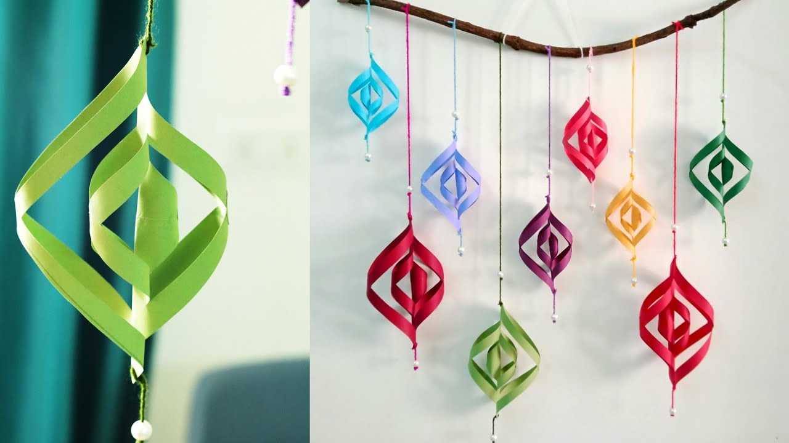
The kinds of Sensors we could make with air cooling and flex sensors
Why constrained by flat structures?
Use tension to maintain shapes
Concentric spheres might not be insane.

Slide 19
Stiched MAPS metal traces - Questions
144 Data lines alone
Longest running 2 running full length of sensor
~100 um pitch would do it
  50 um traces of metal layers on stitched RSU’s
  How are simulations/tests of 160 Mbps going, driving a 30cm Al line that is 50 um wide?

