Slide 1
EIC Project Update
Elke Aschenauer and Rolf Ent
Co-Associate Directors for the Experimental Program
ePIC General Meeting
October 5th 2023

Slide 2
Recent Detector-Related Project Meetings
April 3 + 4: 1st Resource Review Board meeting @ SBU & BNL
July 5 + 6: Particle Id Detectors Interim Design Review
Reviewers: Peter Krizan (U Ljubljana), Floris Keizer (CERN), Ana Amelia Machado (UniCamp), Koji Nakumura (KEK),
Justin Stevens (W&M)
July 21: Final Design Review of the PbWO4 Crystals for the ePIC Backward EM Calorimeter
Reviewers: Eugene Chudakov (JLab), Dipangkar Dutta (MSU)
August 28 + August 31: DAC Review of Detector R&D
FY23 progress and FY24 continuation requests
Expect report late September/early October
Preparing to start R&D contracts with lab procurements in October
August 29 + 30: DOE CD-3A Design Review by DAC
final closeout report received
September 13: Final Design Review of the SciFi for bECal & fECal
Reviewers: Pierluigi Campana (LNF), Caroline Riedl (UIUC)
September 14: Final Design Review of SiPMs for ECals, HCals & dRICH
Reviewers: Elton Smith (retired), Stepan Stepanyan (JLab)

Slide 3
Upcoming Detector-Related Project Meetings
September 25: Final Design Review of the forward HCal W & Steel
Reviewers: Jim Mills (BNL), Felix Sefkow (DESY)
October 5 + 6: Final Design Review of Magnet (MARCO)
Reviewers: Gianluca Sabbi (LBNL), Ruben Fair (JLab),
Vladimir Kashikin (FNAL), Bill Schneider (retired JLab)
October 10-12: DOE CD-3A Director’s Review
Folds in Design Review reports of DAC, MAC, Infrastructure Committee; Concentrates on CD-3A Long Lead Procurement Items
Detector Reviewers: Rik Yoshida (ANL), Gabriella Carini (BNL),
Luciano Musa (CERN), Tim Whitlatch (JLab)
November 14-16: DOE CD-3A Independent Project Review
December 7 + 8: 2nd Resource Review Board meeting @ CUA, Washington
December/January: Preliminary Design Review of Far-Forward/Far- Backward Detectors
All 2023 PDR and FDR and design review closeout reports are posted here
Closeout Reports from Reviews

Slide 4
Outcome of recent FDRs of LLPs
PbWO₄ - crystals:
No recommendation for LLP
Recommendation on Charge Q#2: Are the plans for achieving detector performance and construction sufficiently developed and documented for the present phase of the project?
A) Calculations of the impact of the thermal gradients on detector performance caused by shower fluctuations should be performed.
B) The carbon-fiber mesh (or something similar to the final design) should be used in the prototype being tested for temperature stabilization.
SciFi for bECal & fECal :
None of the recommendations should delay the fiber procurement plans. Some of the recommendations are beyond the scope of this review and they are kept to guide future follow-up work.
● Q2: We strongly recommend exposing one minimal slice / element of the EPIC barrel EMCal into a testbeam to study its performance and test as a slice of the full system latest before the second purchase order of the scintillating fibers.
● Q6: We continue to recommend the beamtest of engineered structures (see also Q2).
● Q7: We recommend parallelizing the QA efforts, for example, make use of ways to measure attenuation length developed at one lab also at the other site.
● Q7: We recommend making a clear evaluation of the needed margin in fiber length to compensate for bad fibers and production training / losses / accidents.
● Q7: We recommend ordering fibers in canes if possible, to avoid the issue of elastic memory.
● Q8: We recommend considering pre-production of a small amount from both companies to evaluate the different sets of parameters.
SiPMs for ECals, HCals & dRICH:
No recommendations at all

Slide 5
Outcome of recent FDRs of LLPs
forward HCal W & Steel:
LLP: The committee recommends that the project expeditiously move to procure the LFHCAL absorber and casing steel as detailed in the Final Design Review held on Monday, September 25, 2023.
Recommendations on charge
1. Are the LFHCAL technical performance requirements complete, documented, and understood?
Use the power of the now existing full simulation for the further understanding of detailed requirements ​
Uniformity within segments ​
Tungsten vs stainless steel​
Dynamic range ​
Cast and molded scintillator, small and large SiPMs.​
Use LFHCAL simulation as integrated in overall ePIC simulation and study physics sensitivity to technical performance. ​
2. Are the plans for achieving detector performance and construction sufficiently developed and documented for the present phase of the project? Specifically, are they commensurate with the initiation of the LFHCAL absorber and casing steel procurement?
Implement software compensation as soon as possible and re-assess the benefits of the tungsten section.

Slide 6
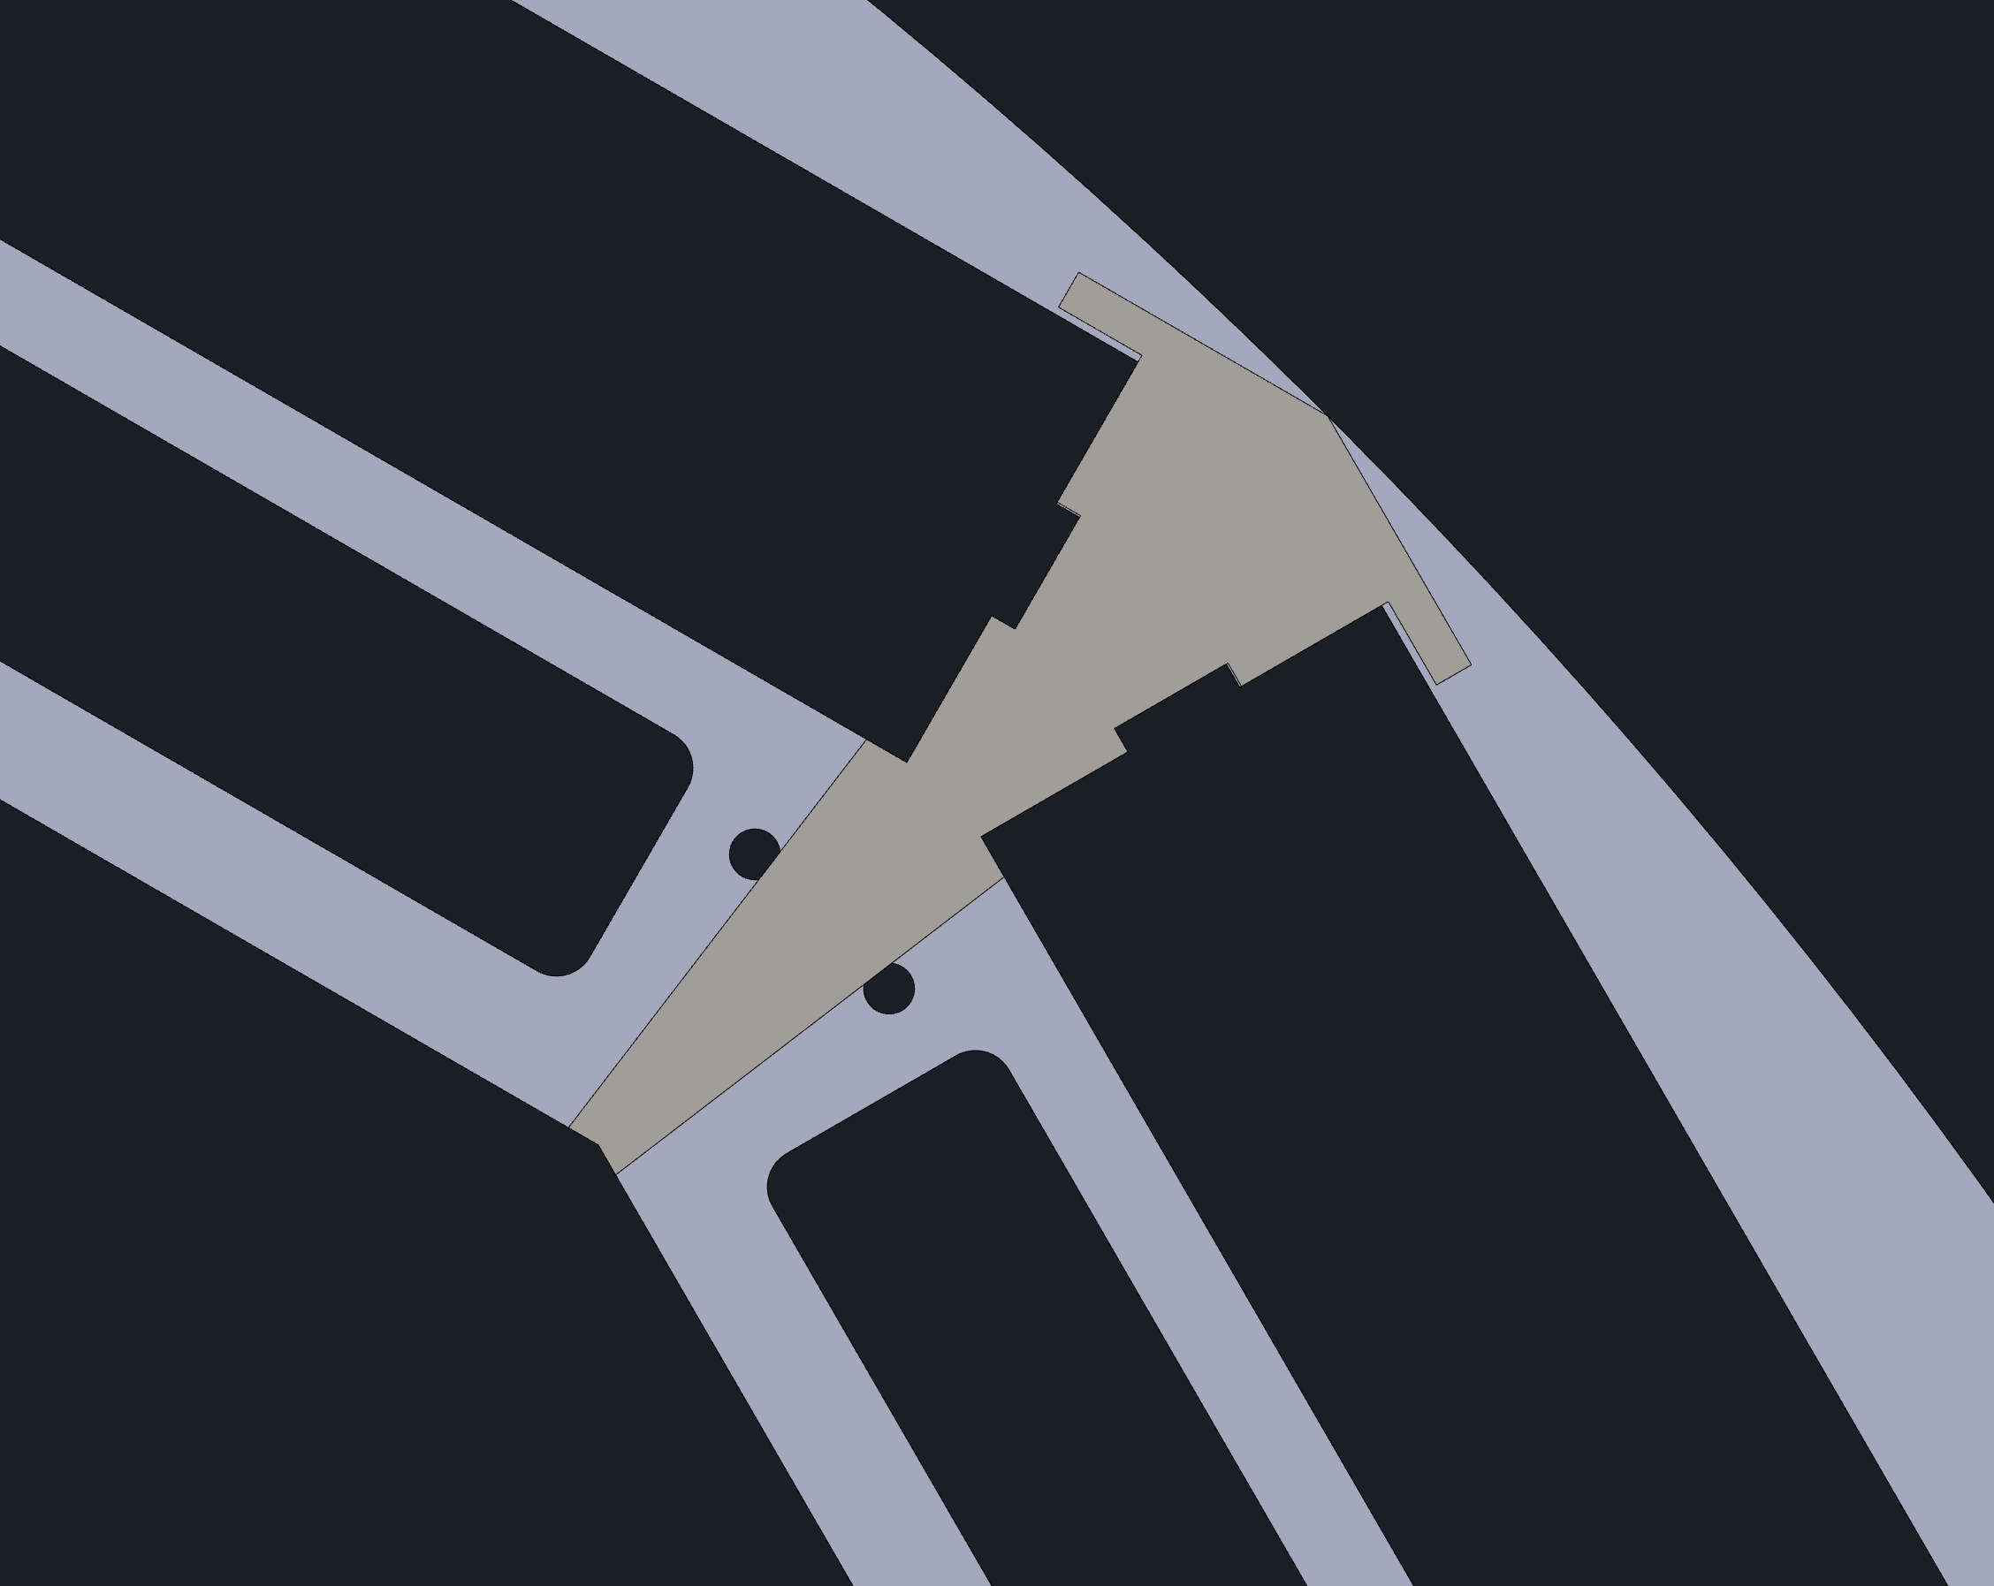
News from the Design Front
Barrel ECal independent DIRC support structure – Old solution
Stainless steel bars and plates, aluminum “skins”.
Total thickness including clearances: 175mm → needs more space bECal needs to be moved out in radius → increased cost and weight
Structure includes cable openings for inner detectors requiring them to be pre-attached to the structure → complicates installation procedure enormously
Slots inadequate for cables.
Structure deflects too much for DIRC bars → hpDIRC group studies (thanks!) pointed to small deflection allowance → structure would need to become more massive → material budget impact
In this scenario, DIRC would need to move out in radius by ~3 cm
Too many negatives need new solution

Slide 7
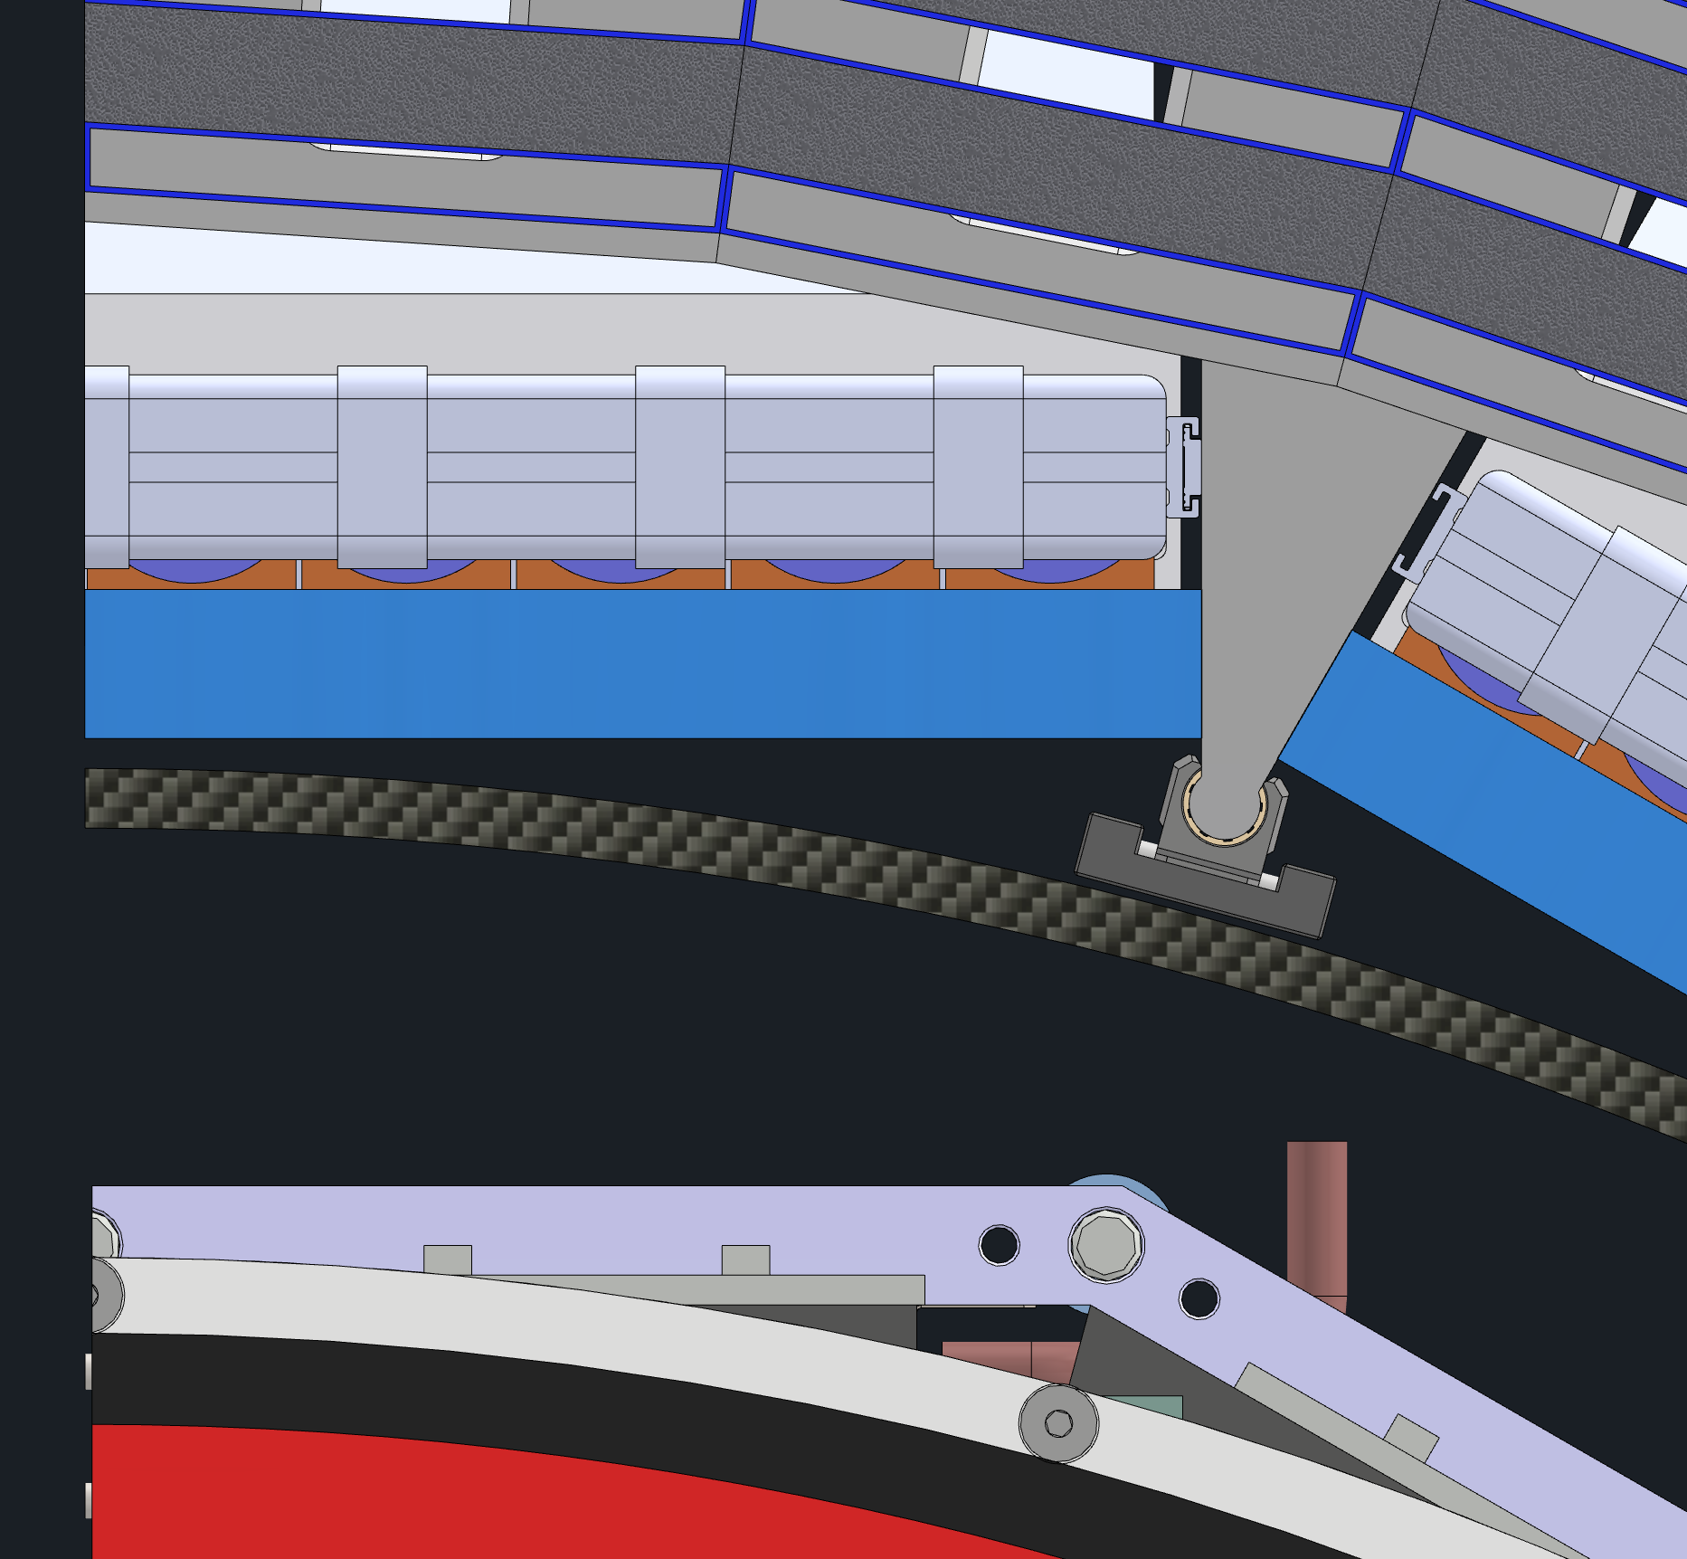
News from the Design Front
Updated geometry database released:
https://eic.jlab.org/Geometry/Detector/Detector-20230929162408.html includes also an updated sketchup model
fully consistent with EPIC Envelope - 07-21-2023.pdf
Based on recent optimized design of of Barrel ECal and DIRC support structure
Aluminum bars and “skins”, no plates.
Total thickness including clearances: 100 mm.
Structure completely independent from inner detectors → critical for installation sequence and ease of installation
Clearance adequate for cables.
Structure deflection fulfills requirements for DIRC bars
DIRC moved out in radius by 3.5 cm
Component | Radius
bEMCal | 810
Gap | 790
DIRC | 785
Gap | 755
MPGD | 750
Gap | 725
CFS | 720
Services | 710
Gap | 660
eeEMCal | 650
No change was made here to the inner detector radii

Slide 8
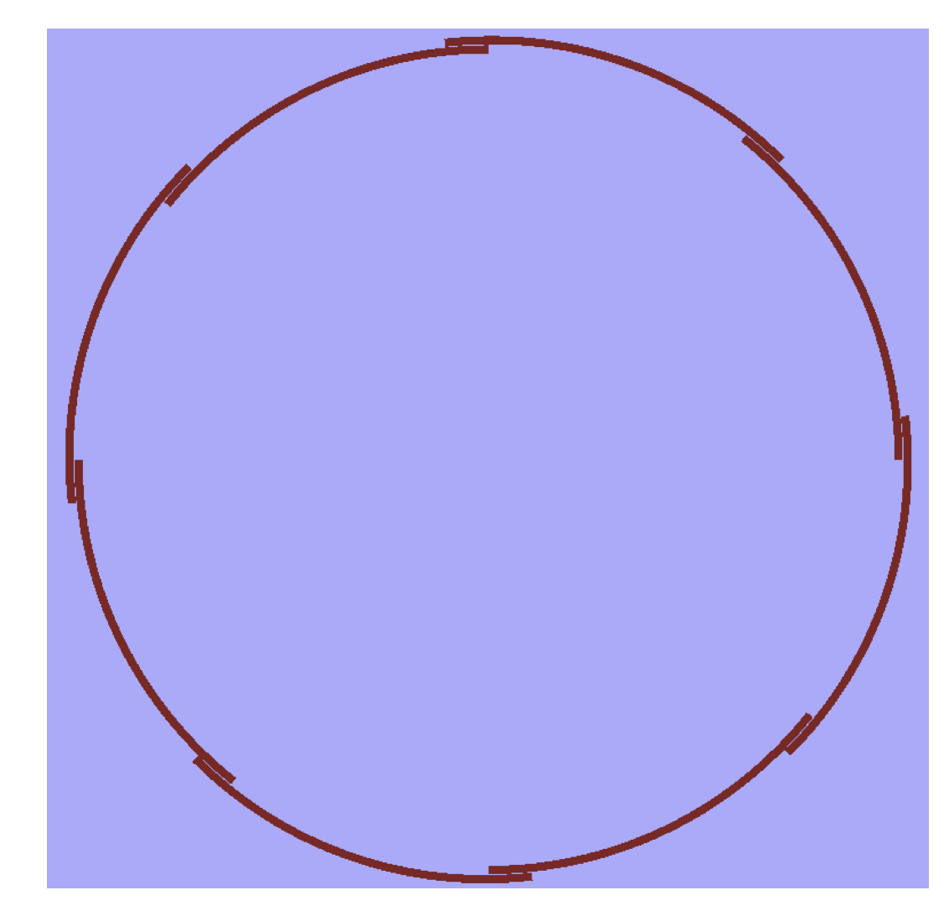
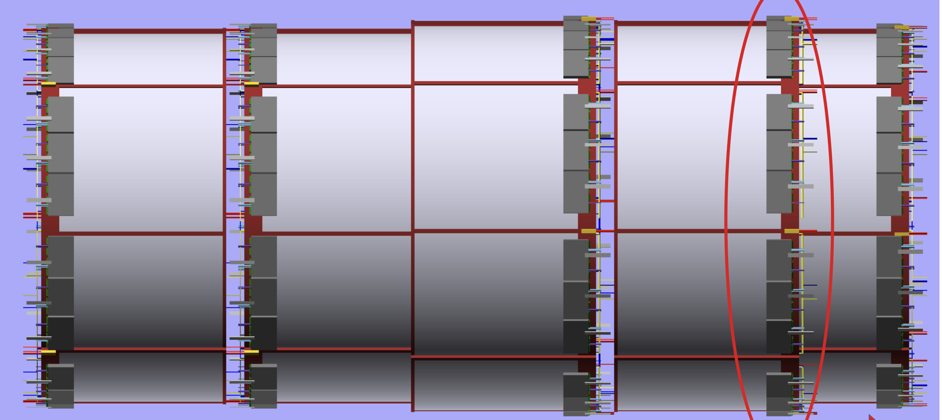
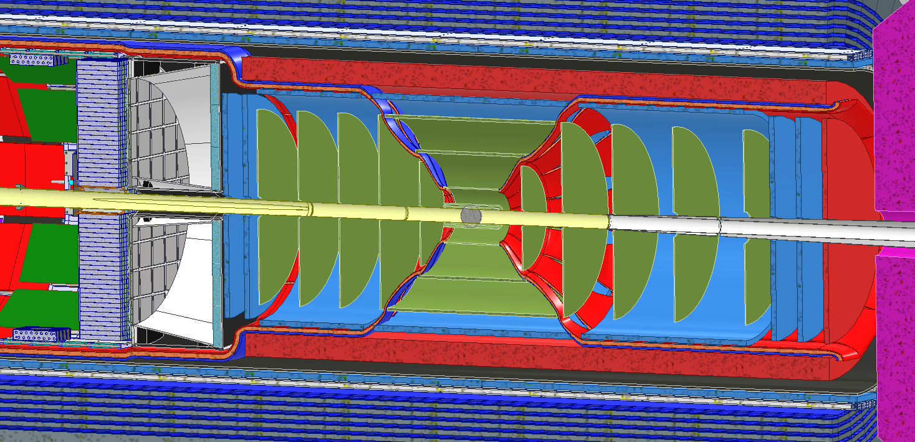
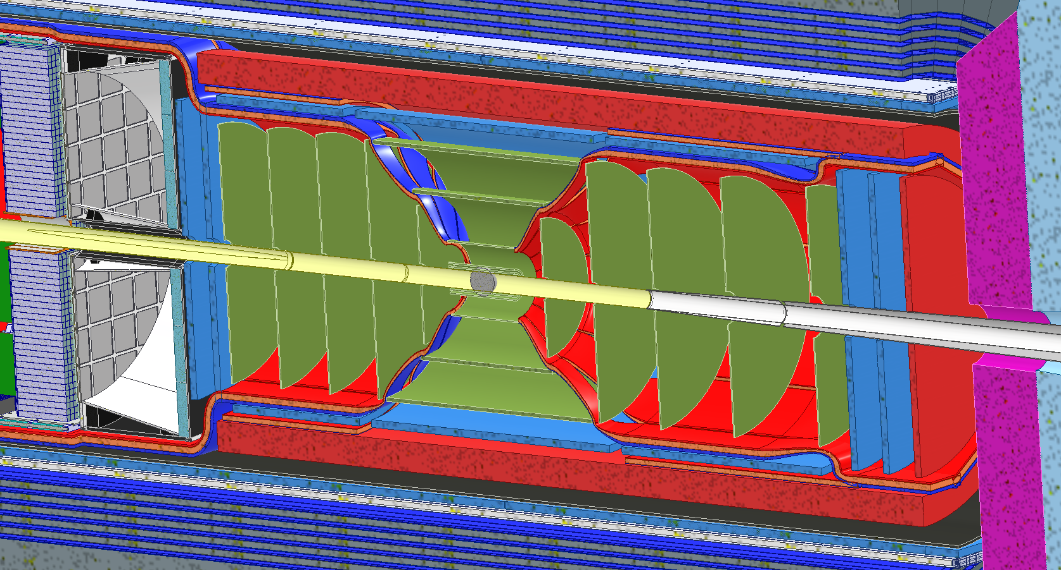
News from the Design Front
TIC meeting focused on MPGD – trackers on 09/25/2023 https://indico.bnl.gov/event/20385/
triggered several follow up meetings
MICROMEGAS – Layout:
Asked MICROMEGAS team to go with their
“alternate” detector arrangement as this
makes a clamp-shell design much easier
Requested and found we can provide the 5 cm radial space for MICROMEGAS → some last checks to be done
MICROMEGAS services block space to pull cables from inner trackers through
→ Change of plan: move all services and cables from inner trackers and disks to run in front of the MICROMEGAS tracker
→ increased material budget in front of tracker → impact on tracking? - NEEDS QUANTITATIVE STUDY
→ Allows better choice/minimization of the size/number of modules in z within max size per module of 70 cm —> 1 module left and right and 2 in the middle? → FEBs should be on the module like shown
modified layout
Disentangles inner trackers from outer trackers!

Slide 9
News from the Design Front
TIC meeting focused on MPGD – trackers on 09/25/2023 https://indico.bnl.gov/event/20385/
triggered several follow up meetings
Follow up meeting with μRWell DSC (and eRD108 proponents)
established that remaining R&D is minimal (but all versions need 2-2.5 years of PED)
will move forward with engineering design of a full-size engineering test article
(== the rest of the world calls it a prototype). It will always need to accommodate a standard
μRWell (with variable gap size) to have a viable backup option. We are investigating if the
mechanical structure can be developed to allow a standard μRWell but also thin-gap μRWell and a hybrid μRWell to answer questions of stability and efficiency for both options.
To support these pragmatic decisions to move forward in the μRWell and MICROMEGAS design and not loose time towards CD-2/3 → it is extremely critical that we can answer the following questions through simulations asap
Which μRWell design comes closest to the angular resolution needed for the DIRC
What do the Astropix, Micro-Mega and AC-LGAD help to obtain the required angular resolution
What impact has the cable material in front of the Micro-Megas on its performance
Is the low number of hits in certain rapidity ranges fully mitigated
Is the impact of the 5 (2) μs MAPS frame accumulation time resolved → Do we have enough hits from fast detectors to form a tracklet with a good pointing resolution → background suppression
Answers can have large impact on design

Slide 10
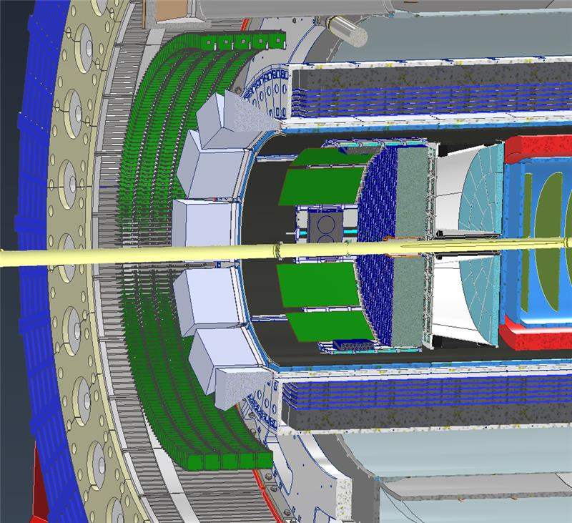
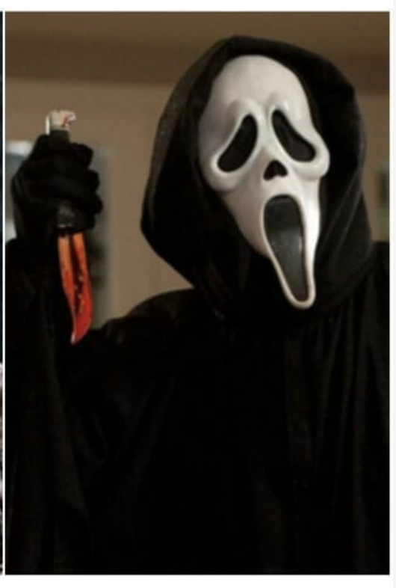
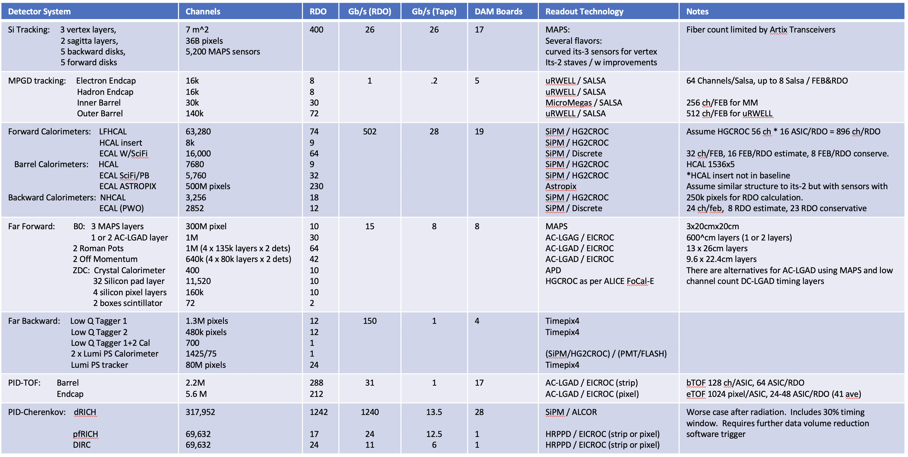
News from the Electronics Front
Thanks to ePIC DAQ-Electronics WG conveners and CAMs improvements in numbers and definition of location
Same group is working with DSCs to define how much VTRx+ are needed
Rolf and I will evaluate how to make things work
through the project → can be easy or hard
depending on # VTRx+ and process to get the, from
CERN
Need to finalize specifications for HGCROC for ECals and HCals
→ Norbert in contact with DSCs to finalize specs before
his visit to France
→ would like to have one more Calo or TIC meeting to
have everybody sign off on specs
September: Needed to get realistic numbers of RDOs per subsystem (@present ~2800 → 1400 each side)
1000 RDOs for illustration.
Not realistic: need space for support, cables, …
At best can fit few 100
This is “easy” side…

Slide 11
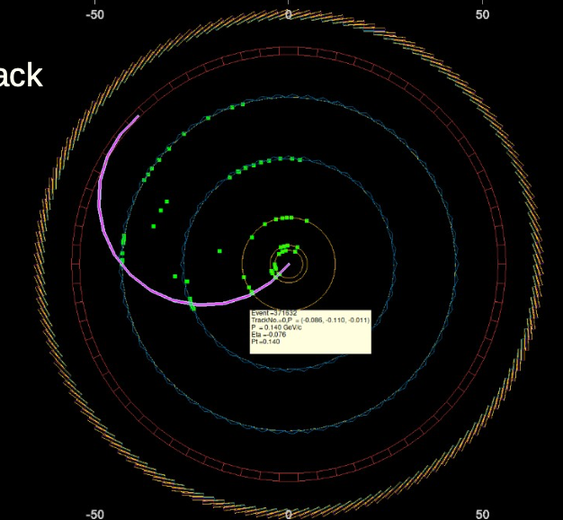
Next Steps in Background Simulations
slide thanks to Kolja
Thank to all who provided info, but we need more
Re-translation ADC → physical value
CalorimeterHitDigi
Summed energy
Time and cellId from most energetic hit
Track Reco
*RecHits
Vertex, Tracker, Barrel, Endcap, …
Jet Finding
SiliconTrackerDigi
Mostly 1-1
Rare multiple hits in a cell are summed
*RecHits
HCal, Ecal,
Barrel, Endcap, …
Clustering
From Geant4:
Simulated Hits
Location
Energy deposition
Time
Particle Flow
PhotoMultiplierHitDigi
…
PID Hypothesis
…
Is “HitDigi == Readout channel” correctly mirrored?
HitDigi == HitRaw, the terms are used interchangeably
Here, “digitization” means translation to ADC and positioning in the sensor center. Needs from DAQ regarding ASICs details etc.?
We use pedestal σ and nσ threshold
Need to be consistent! The threshold by default should be 0 and anything sharper a deliberate choice on top of Digi
From here on, there is (should be) no differentiation between data and simulation

Slide 12
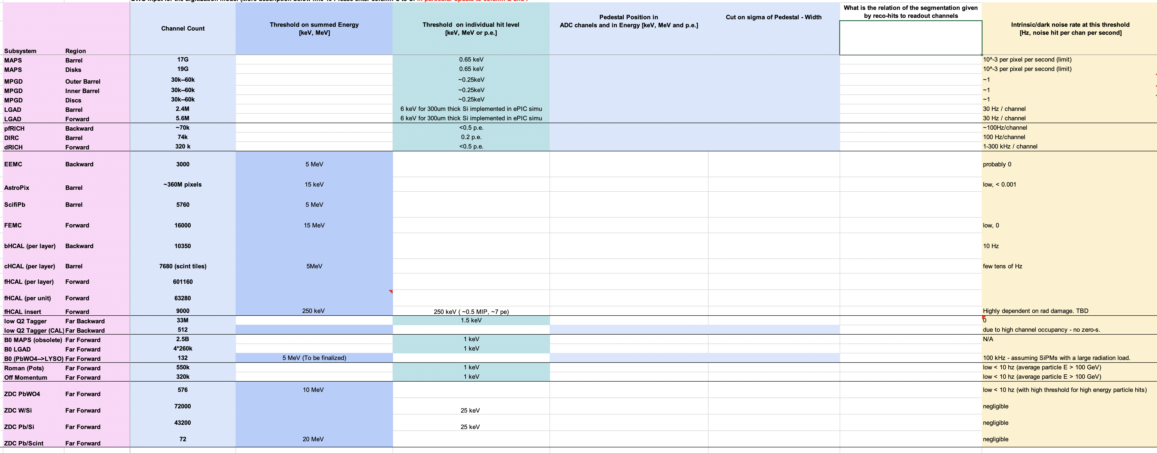
Next Steps in Background Simulations
Thank to all who provided info, but we need more
please fill in EPIC Detector Digitization Model.10.2023.xlsx
Pedestal position
cut on sigma of Pedestal width
relation between Hit-digi to readout channels
please check numbers on noise
missing
This info will be absolutely critical to re-evaluate background rates and provide DAQ group rates per channel → impact on ASICs and number of FEBs / RDO

