Slide 1
Consistency check : Fun4All based decoder
I made EventBased tree using Chris’s workflow (Fun4All_Intt_Conbiner.C)
  I made Fun4All module to make event-based tree based on InttCombinedRawDataConverter.C
Compare an event from this event-base tree with that from my decoder
  Nhit is different although BCO_FULL is the same.
  Fun4All decoder always have smaller Nhits. I suspect that Fun4All decoder lose some hits.

Slide 2
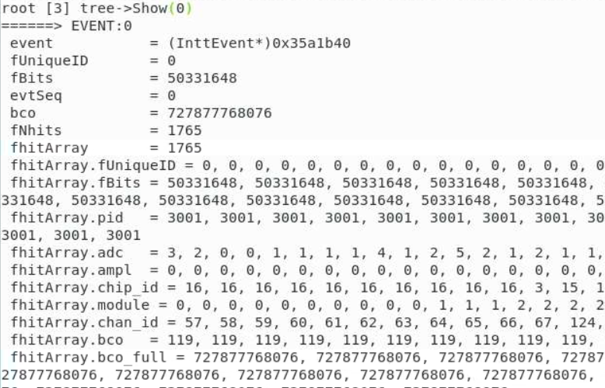
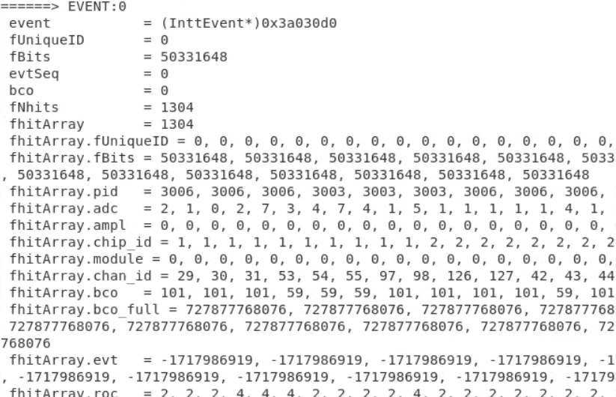
My decoder & Fun4All decoder comparison
My decoder
Fun4All decoder
BCO_FULL is the same for both but Nhits are different and Fun4All has smaller hits

Slide 3
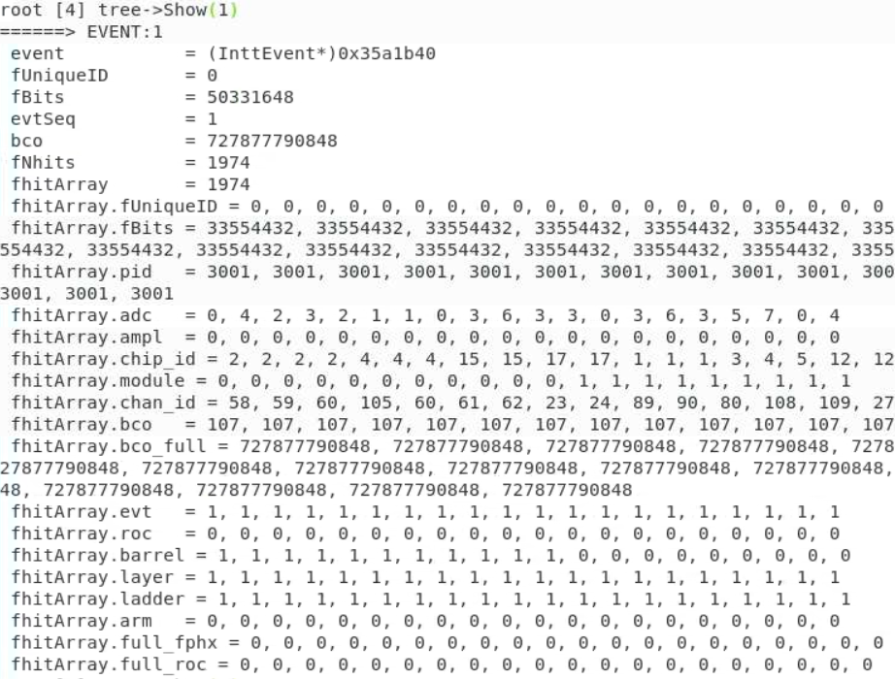
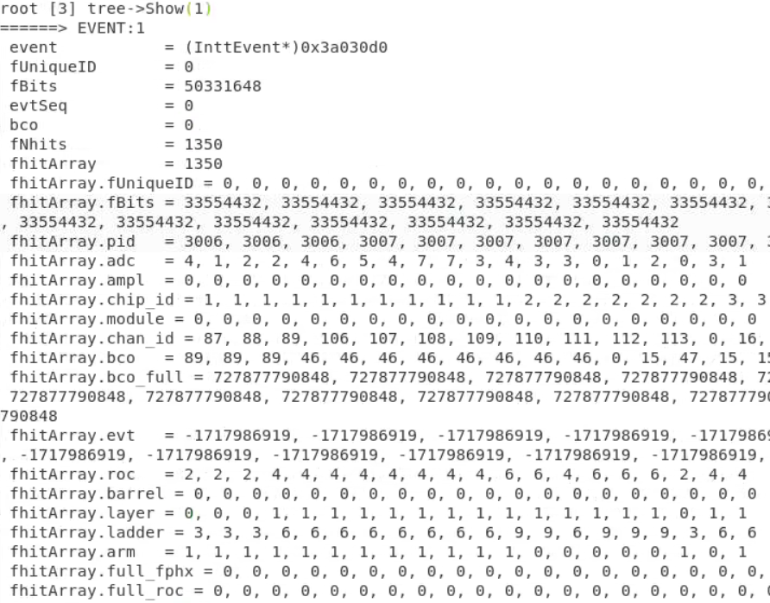
My decoder & Fun4All decoder comparison
My decoder
Fun4All decoder
BCO_FULL is the same for both but Nhits are different and Fun4All has smaller hits

Slide 4
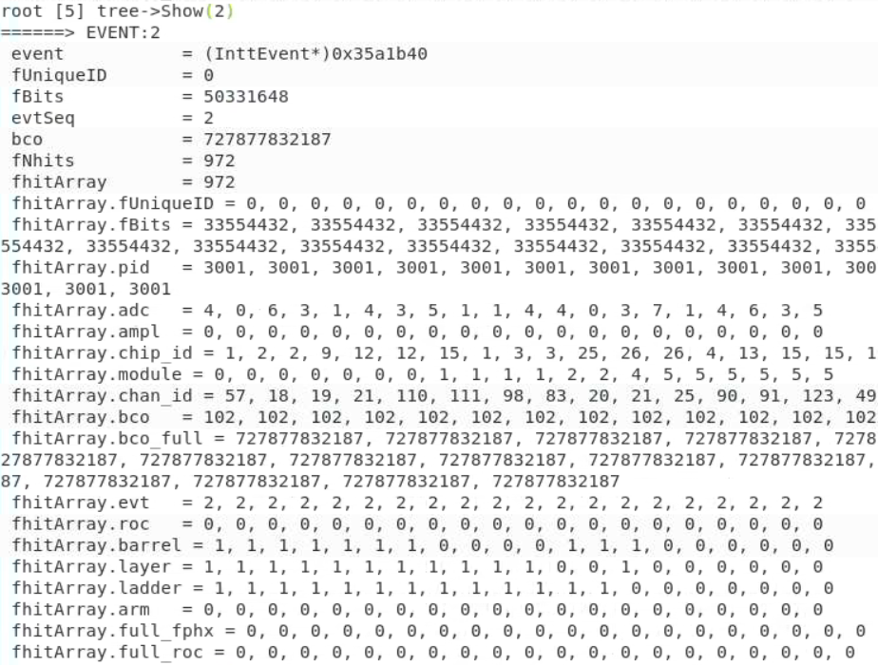
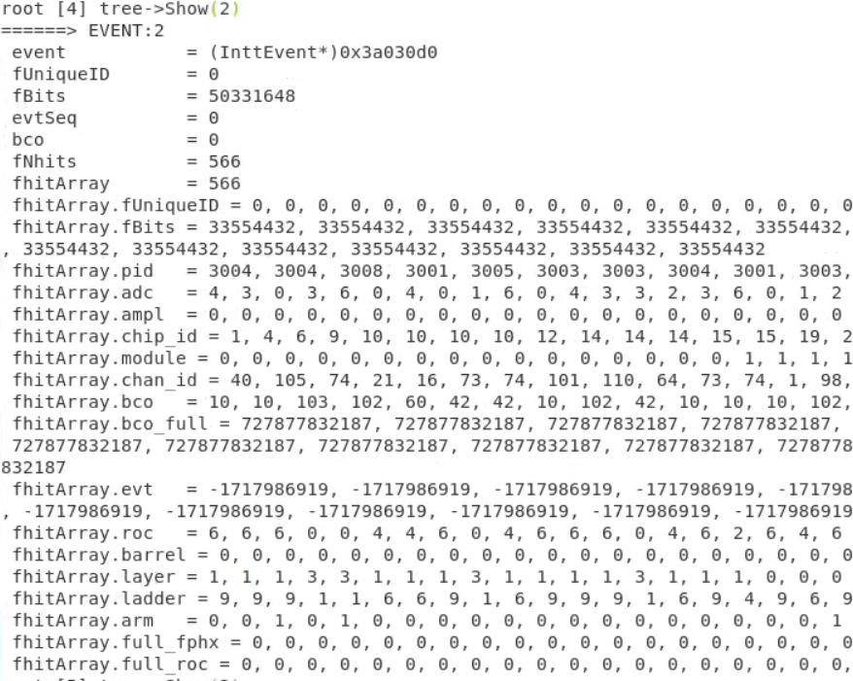
My decoder & Fun4All decoder comparison
My decoder
Fun4All decoder
BCO_FULL is the same for both but Nhits are different and Fun4All has smaller hits

