Slide 1
sPHENIX Status Update
Kin Yip
RHIC Coordination Meeting, Jan. 30, 2024

Slide 2
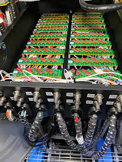
sPHENIX Status (TPC repair/upgrade and other detectors):
We have completed the pink sheet (interlocks tests) for all racks in 1008-IR
Transfer/generator test (for ODH) successful (Jan. 23, 2024)
AESRC review happened on Jan. 24 and received 7 action items.
We have assembled/installed/tested the Contingency Boxes for TPC
We are now turning on all the 72 GEM’s (of TPC) at the operating
voltage, … and cosmic run (as in our schedule)
We have also been improving/re-implementing cooling in 1008 for
TPC, EMCAL...
We’re doing the 2nd week of calorimeter readout & DAQ tests (utilizing the new ADC’s and partition modules)
Collider User Training is needed for new shifters by Feb. 20, 2024, either in-person or online.

