Slide 1
sPHENIX Status Update
Kin Yip
RHIC Coordination Meeting, Feb. 6, 2024

Slide 2
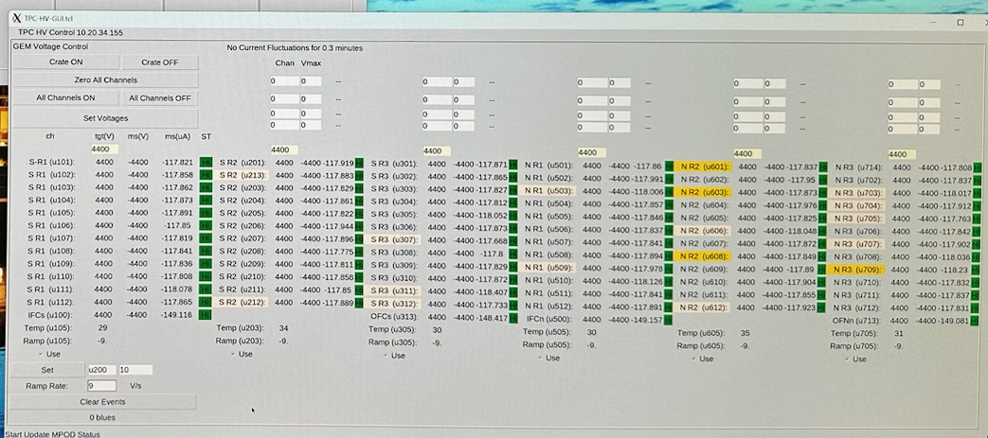
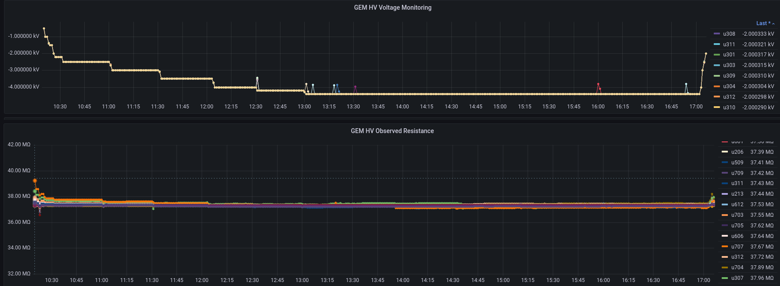
sPHENIX Detector Status Update
After months of disassembly and assembly/installation/testings, we were finally able to run 72 GEM’s of TPC to the operating voltage on Jan. 31, 2024 for ~4 hours.
After achieving stable cooling environment, we turn on and test FEE’s (front-end electronics) while we closely watch any temperature variation
⇒ when ready, we’ll test with cosmic rays to find tracks, before we start installing line laser instrument.

Slide 3
sPHENIX Detector Status Update (cont.)
We’ve had 2 weeks of calorimeter readout & DAQ tests (utilizing the new ADC’s and partition modules) ⇒ Success running GL1/HCal/EMCal with zero suppression tuned for a specific occupancy, running at > 15 kHz with clock triggers.
We have completed grounding improvement task for all the ROC’s (ReadOut Cards) of INTT (Inner Tracker).
Drawing/Statement of Work for Absorber (for reducing MVTX background) is ready and we just submitted the requisition yesterday.
We’ll start our “watch shifts” (2-person) on Feb. 20, 2024. TPOT operating gas can start to flow.

