Slide 1
sPHENIX Status Update
Kin Yip
RHIC Coordination Meeting, Feb. 13, 2024

Slide 2
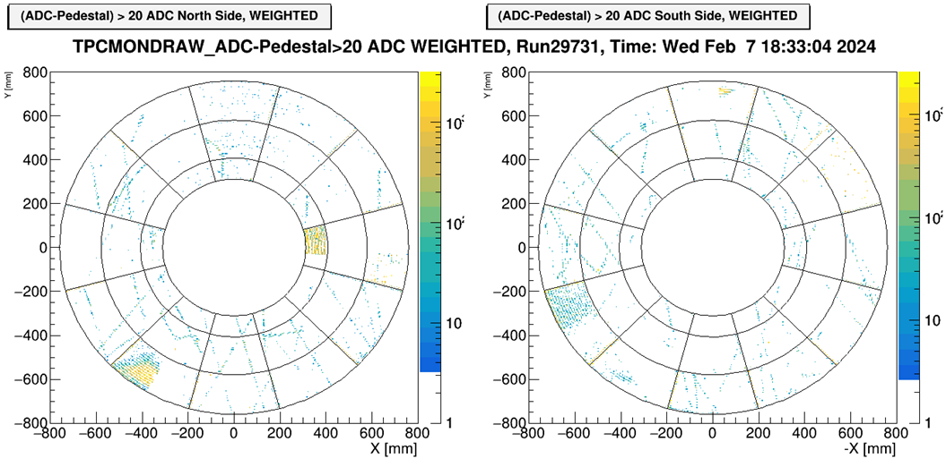
sPHENIX Detector Status Update
Feb. 7 (78 days after we did the cosmic ray test to determine that our repair on a couple sectors worked), we did the cosmic ray test for the entire TPC. We were able to see tracks throughout TPC though there are some noise problem to tackle with before we install other detectors.

Slide 3
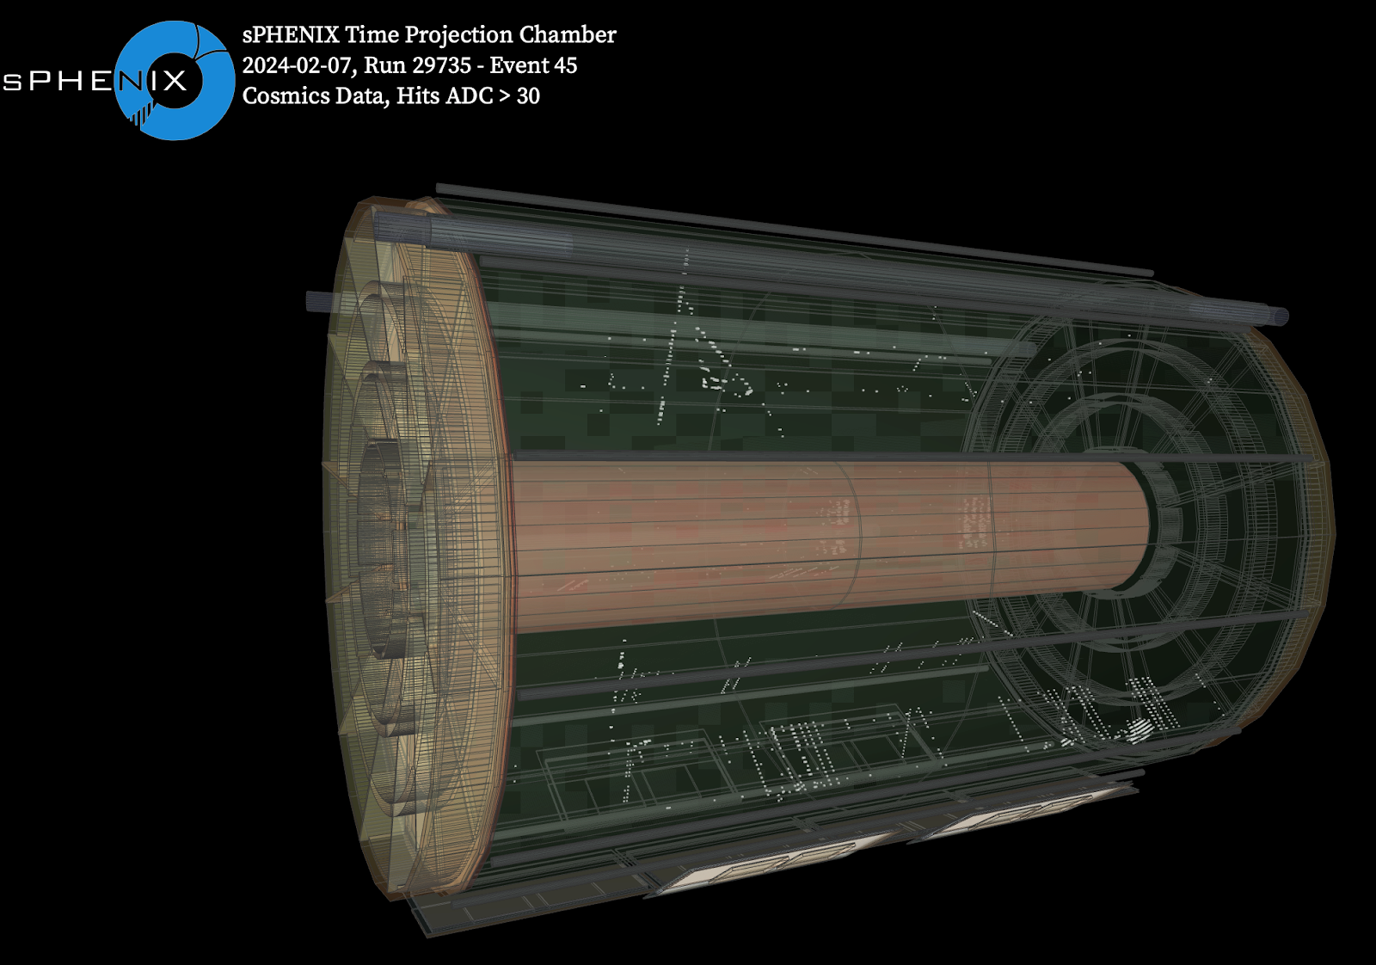
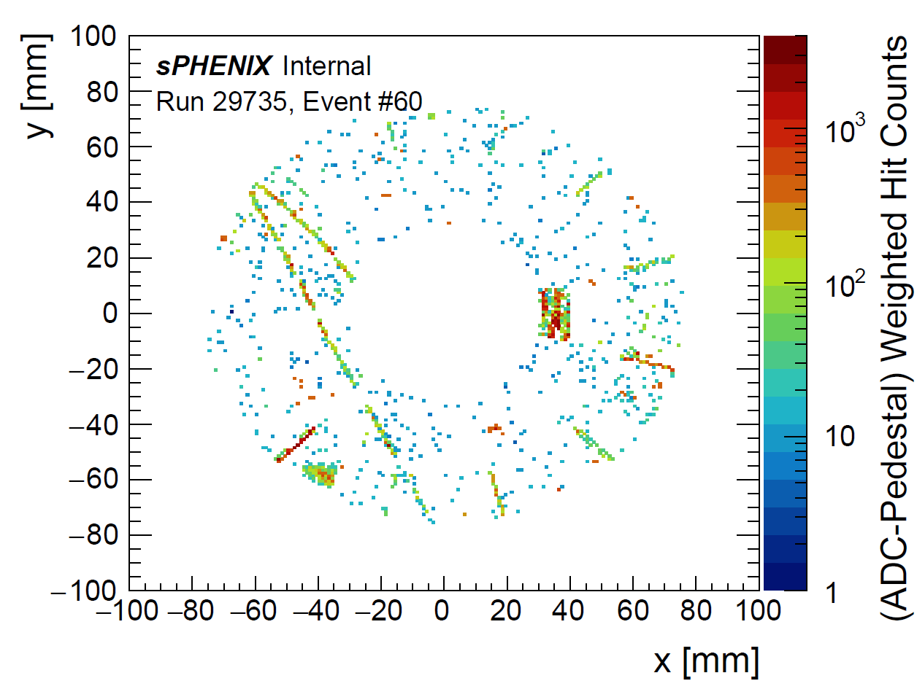
More event displays
TPC FEE’s (front-end electronics) maintenance
~ done.
There is a reasonable-sounding hypothesis for the localized noise seen in the TPC cosmic check-out and we are investigating.

Slide 4
sPHENIX Detector Status Update
If the noise issue is resolved, we will install the laser benches for the TPC line laser calibration system later this week .
We're preparing for the INTT ROC reinstall next week (starting from the South).
There was an internal review of the MVTX reinstallation plan -- which will include new cables of shortened (optimized) lengths and a redesigned piece (with a screw instead of a pin) to positively secure the proper gap between the two halves.
Progress continues on localizing and fixing tiny leaks in the negative pressure cooling system for the TPC -- even so, the achieved flow rate is much higher than last year.

