Slide 1
sPHENIX status
Kin Yip
sPHENIX Operations Director
Shutdown Time meeting & RHIC Coordination Meeting
February 20, 2024

Slide 2
TPC status
Braided grounding strap added to each FEE card per GEM module (36 per side) reduced localized noise
Repositioning of the cables near the mirror cards (at the outermost radii of TPC) removed a more rare but sharp noise
Improved cooling system for TPC has stabilized nicely
TPC line lasers have been installed
Excellent TPC cooling cools TPC lasers too much! Implementing solution before installing INTT ROCs

Slide 3
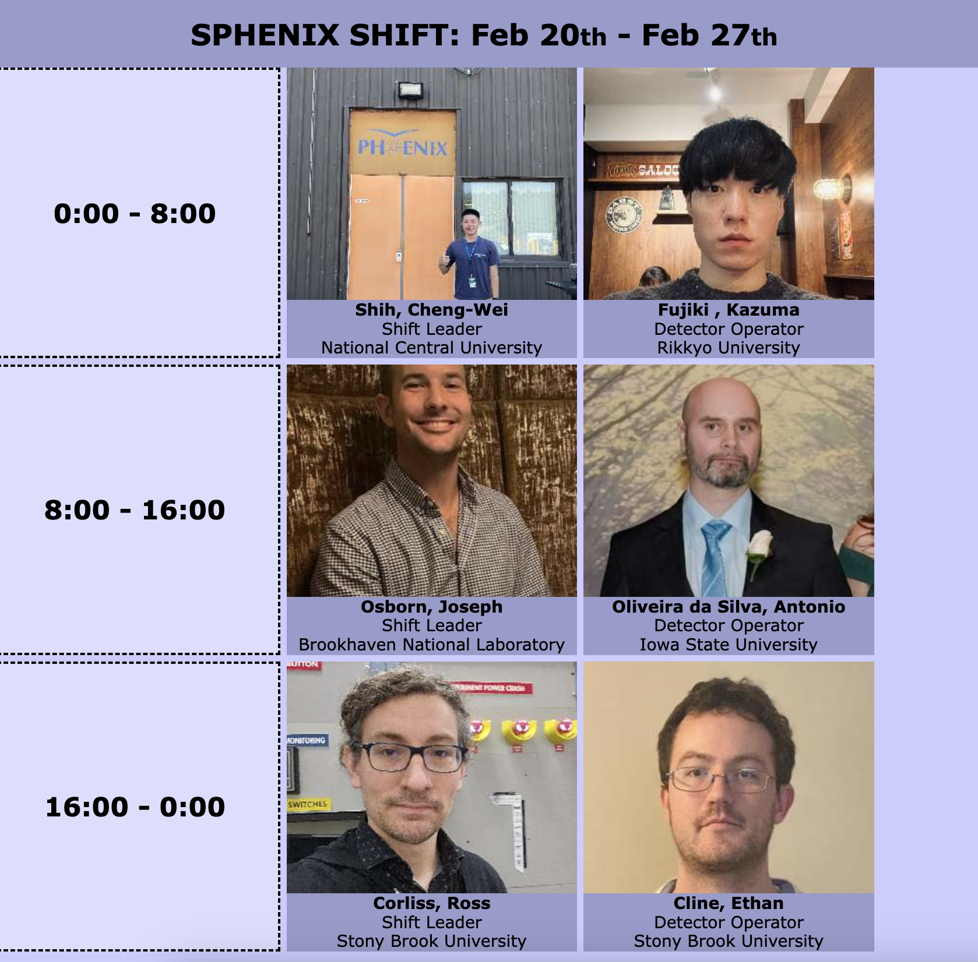
sPHENIX shifts
Two person round-the-clock shifts started today at 8 am

Slide 4
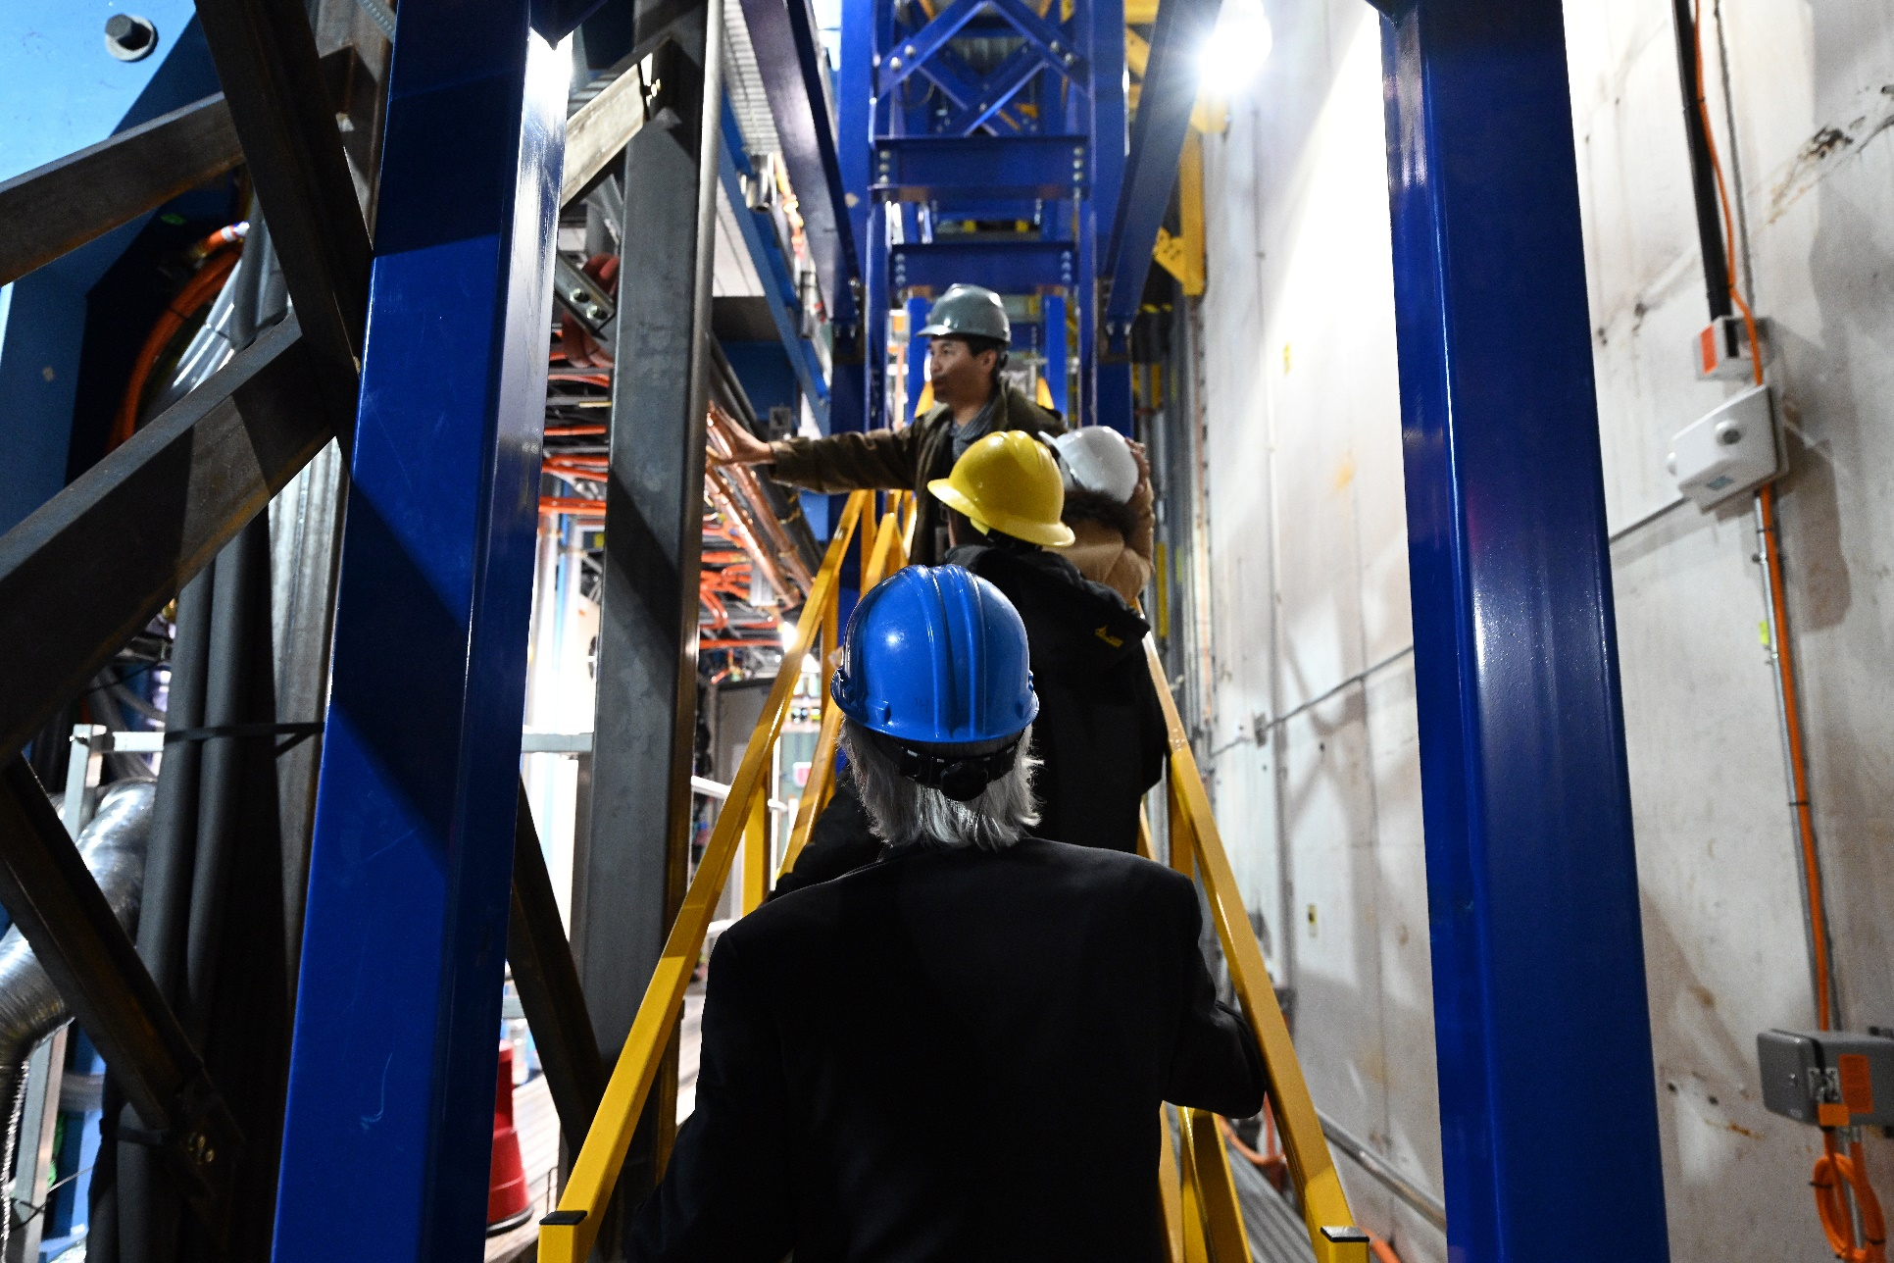
MSI Tour last Thursday in 1008 MSI = Minority Serving Institutions

