Slide 1
sPHENIX status
Kin Yip
sPHENIX Operations Director
Shutdown Time meeting & RHIC Coordination Meeting
February 27, 2024

Slide 2
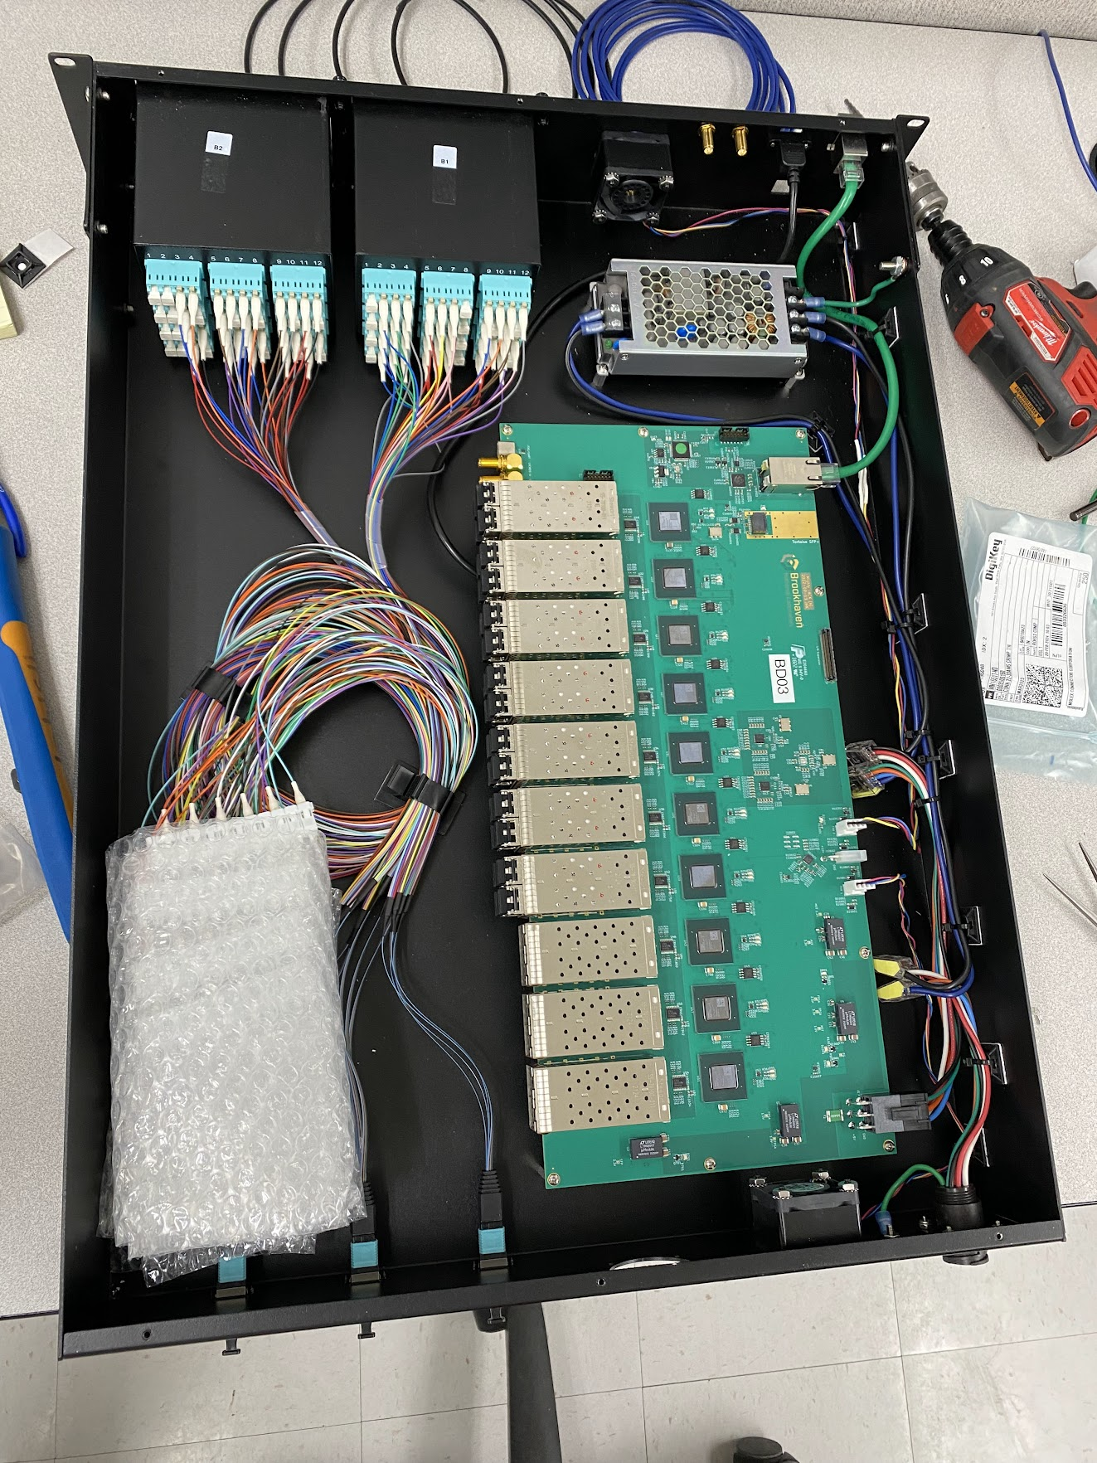
Detector status
All TPC line lasers have been installed on both sides and alignment in the South has been completed. We are working on the lasers in the North to get them aligned.
All (8) ReadOut Cards (ROC) of INTT in the South have been installed (including cooling). We are now adding cables and testing ROC one by one and expect this to be done by Fri.
First article of Sort-out-Box/MJACK (for TPC firmware reloading) has been made and we are testing it before making the other 23 ones.
The plan is to start to prepare for installing MVTX
(X-Wing) next week.

Slide 3
1008 in general
The start-up, calibration and commissioning of the IR/GMH flammable
detection systems were successfully completed ~ Feb. 22.
All (7) action items from the AESRC (Jan. 24) have been completed.
The backup chiller ~ 1008C has been fixed (Feb. 26), tested and run
by “Carrier” ⇒ operational ! Conveniently, they also did a yearly
preventive maintenance for our primary chiller.

