Slide 1
sPHENIX status
Kin Yip
sPHENIX Operations Director
Shutdown Time meeting & RHIC Coordination Meeting
Mar. 5, 2024

Slide 2
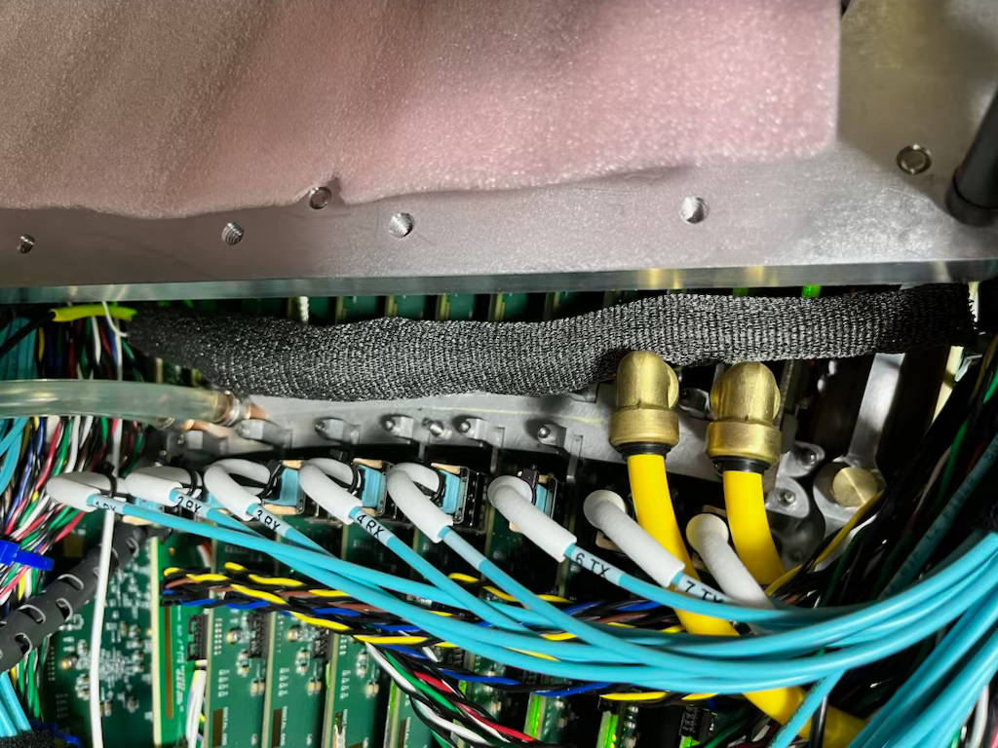
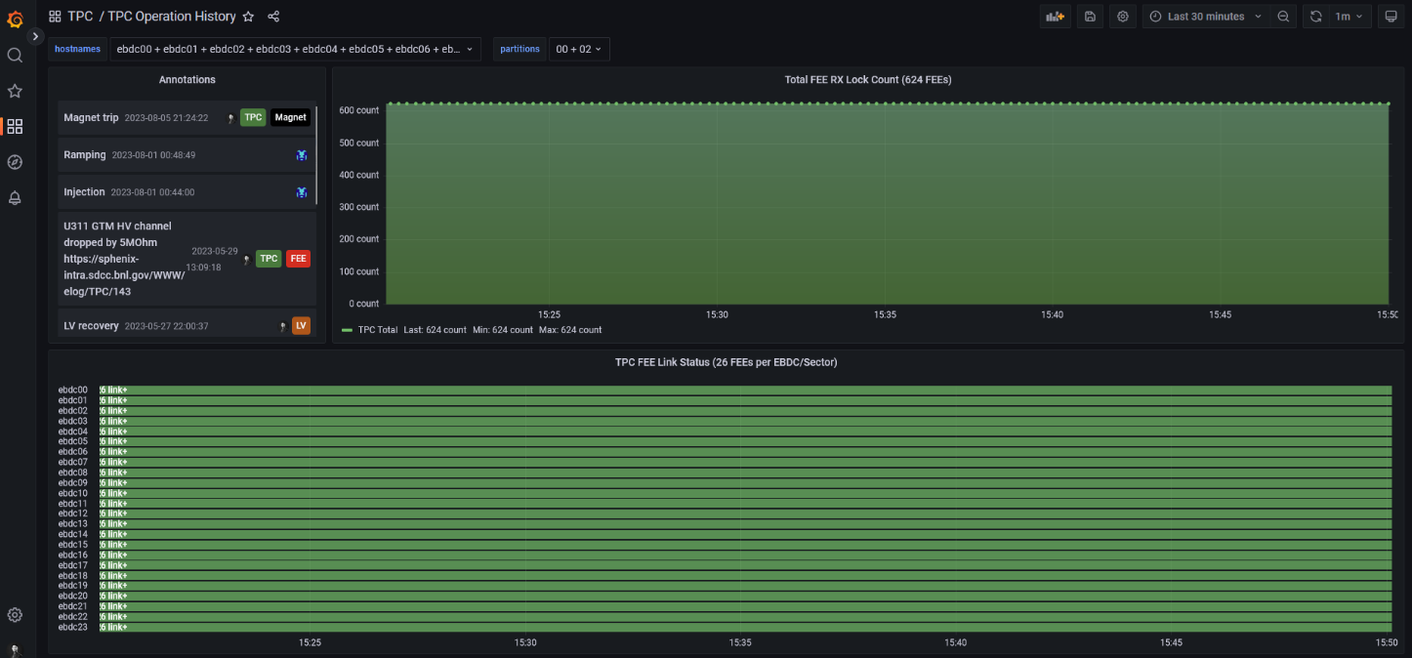
sPHENIX Detector status
After ~10 days of work, all (8) ReadOut Cards of INTT in the South have been tested, as good as they were in the 2023 run. They start to install in the North side.
Installation effort for the MVTX (X-Wing) starts this week/today.
TPC team has been taking cosmic data from time to time to further understand and improve their system.
HCAL and TPOT have been taking cosmic data.
We are also building a tent to cover the chillers to
prevent condensation esp. in summer.
Ground shielding
(TPC)
All FEE linked and all sectors taken data well …

Slide 3
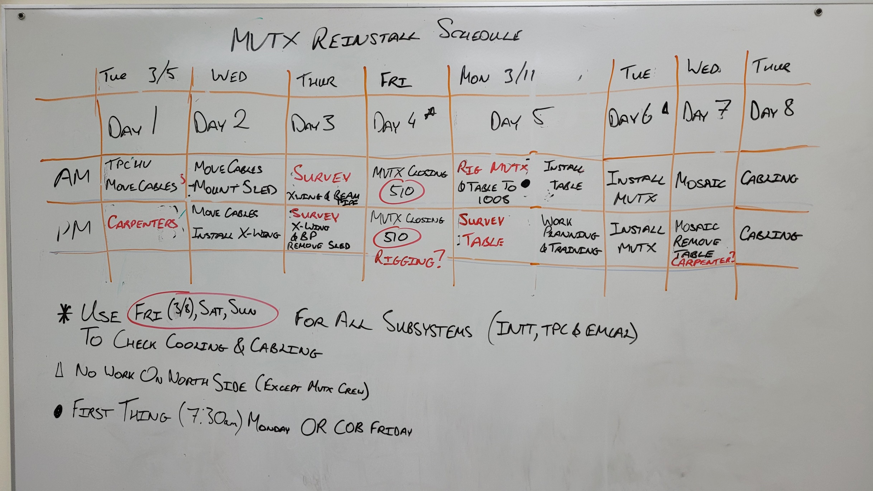
A peek at our MVTX scheduling

