Slide 1
sPHENIX status
Kin Yip
sPHENIX Director of Operations
Shutdown Time meeting & RHIC Coordination Meeting
Mar. 12, 2024

Slide 2
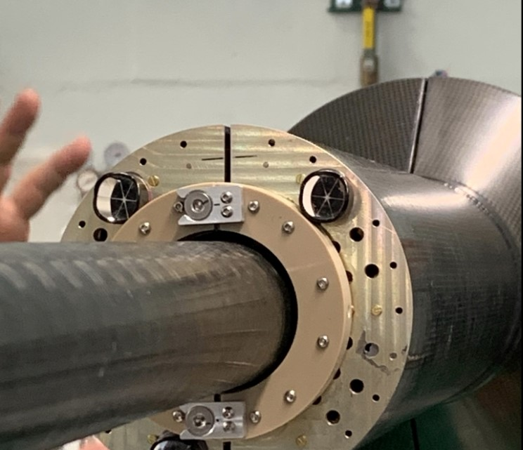
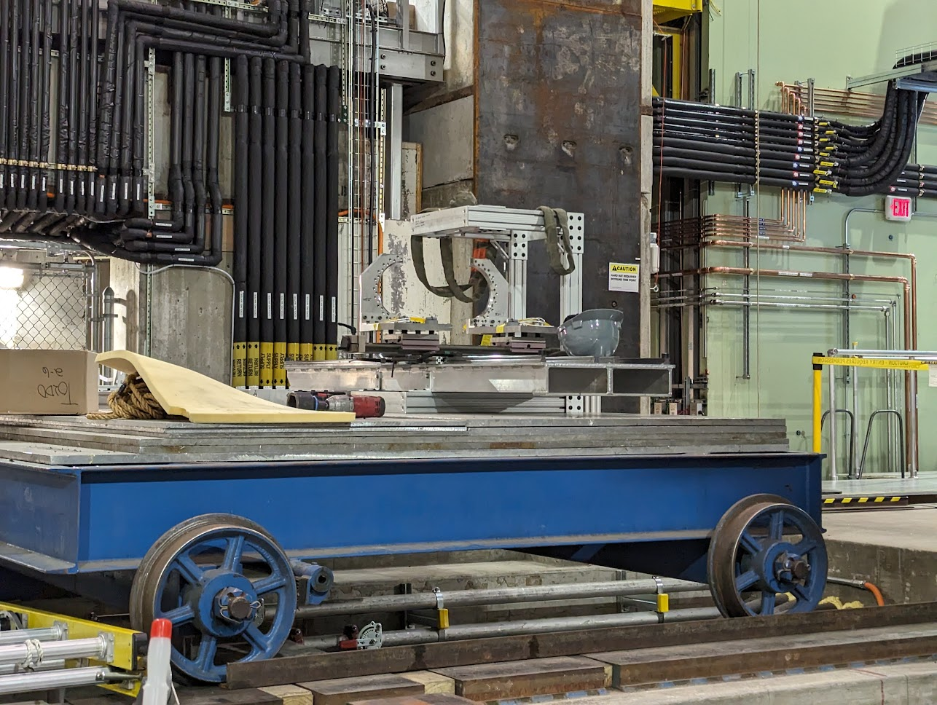
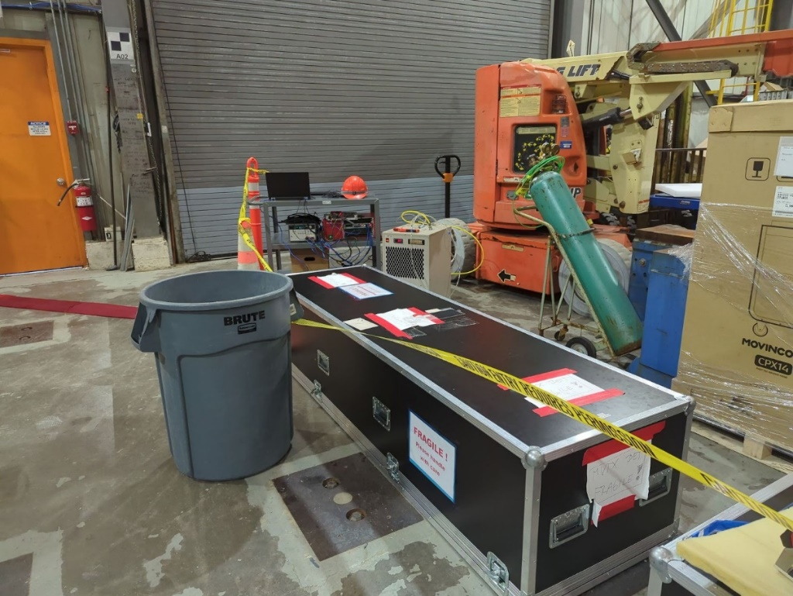
sPHENIX Detector status
X-Wing of MVTX was installed last Wed., followed by
survey. Closing of 2 halves of MVTX involved some
adjustments ⇒ more survey on Monday
⇒ Install and “survey table” (Tue.) ⇒ Install MVTX on Wed.

Slide 3
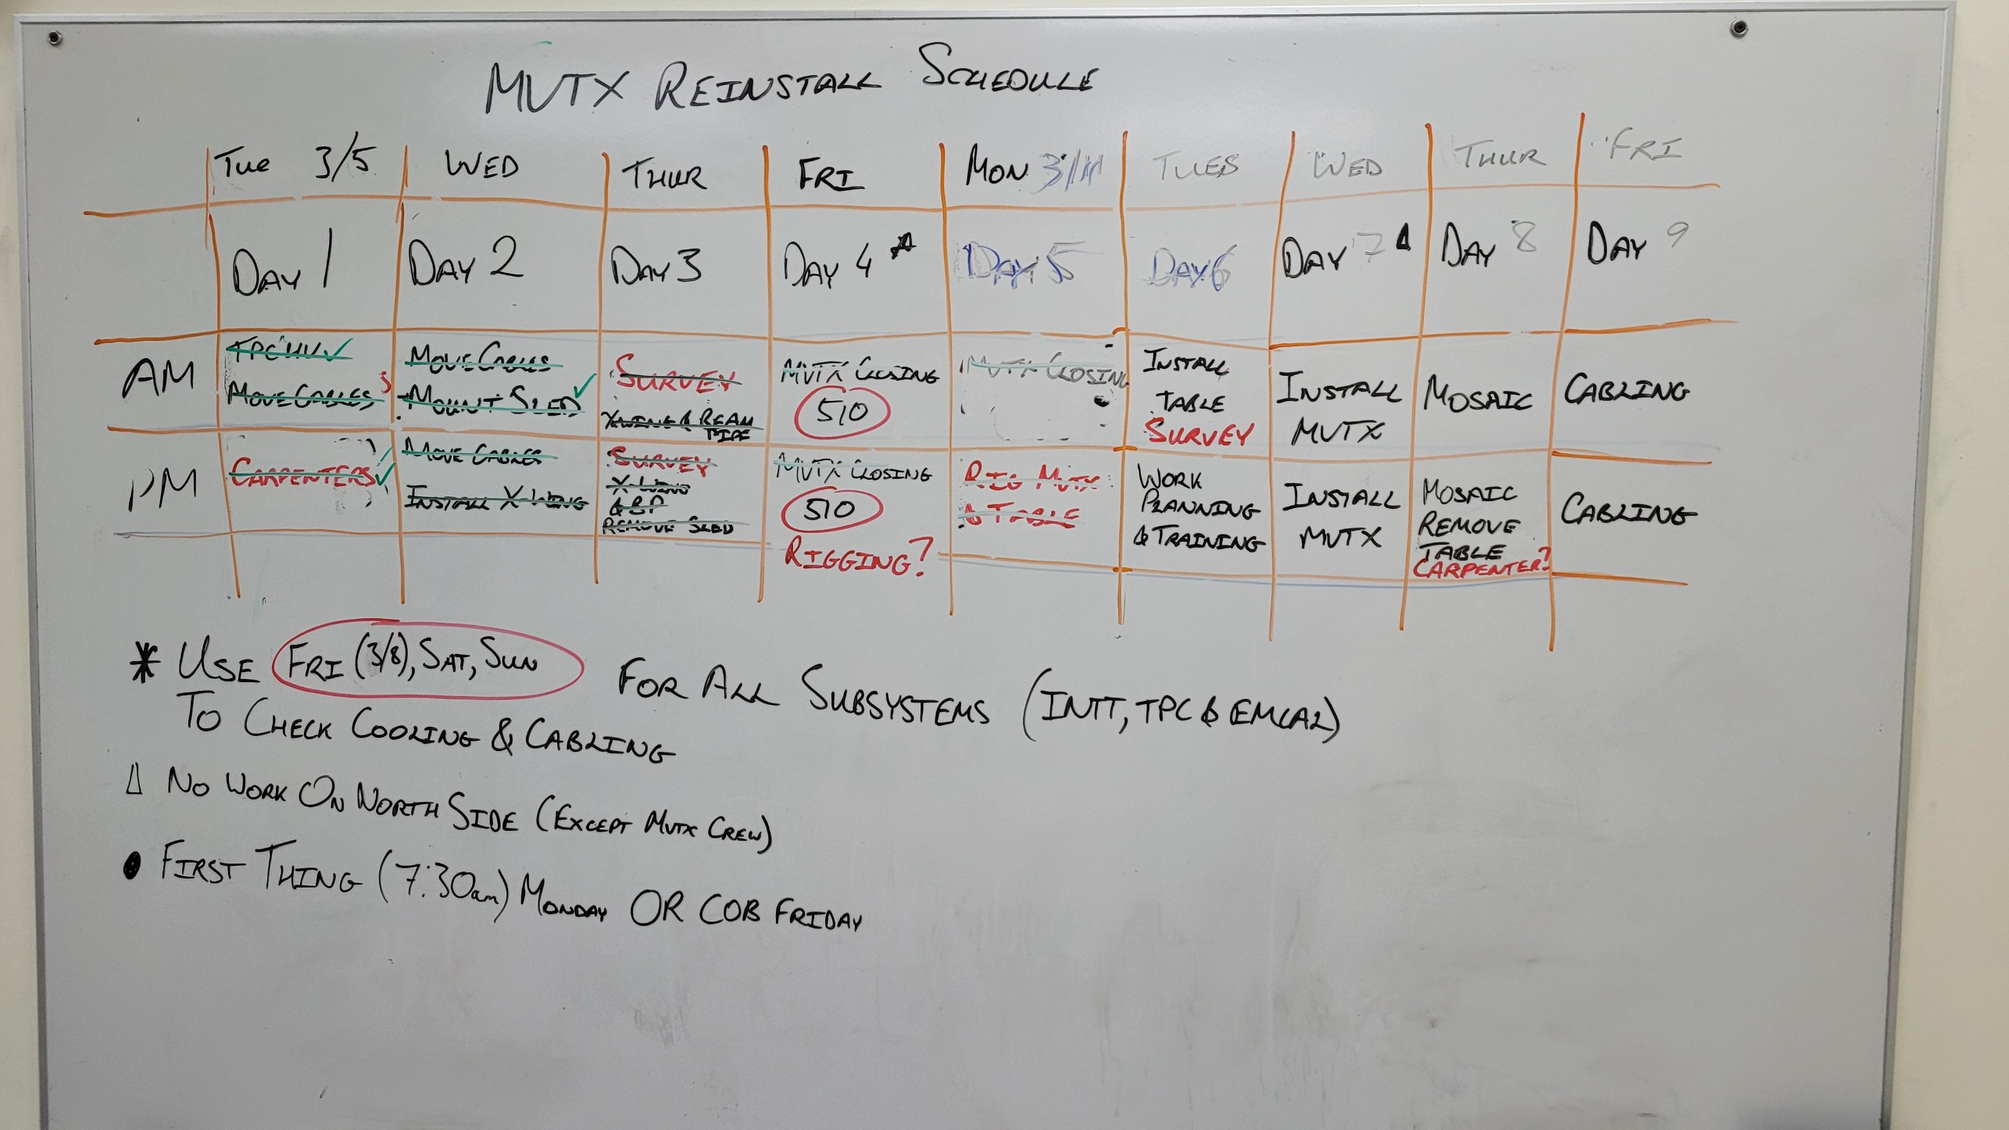
Dynamically updated MVTX schedule

Slide 4
sPHENIX Detector status (cont.)
All ReadOut Cards of INTT are installed, tested and ~calibrated.
Still seek minor improvement here and there.
TPC was run at operating HV for 16 hours Sunday night/Monday morning with HCAL cosmic trigger data
5 trips / 16 hours (no new damage)
5 (out of 24) Sort-out-boxes/Mighty-Jack needed for firmware downloading (to Front-End-Electronic
cards) have been installed.
Scheduled to be done by about Mar. 25.

