Slide 1
sPHENIX status
Kin Yip
sPHENIX Director of Operations
Shutdown Time meeting & RHIC Coordination Meeting
Mar. 19, 2024

Slide 2
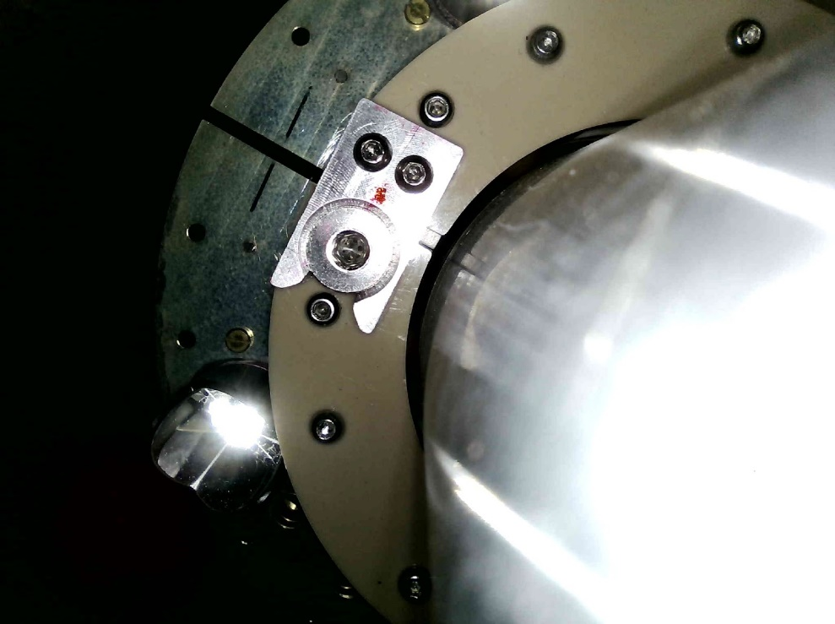
sPHENIX Detector status ⎯ on schedule for Apr. 15
MVTX was installed last week, followed by electronic test on all the chips and surveys, and then
cable connections, and then another round of test.
Alignment is not as perfect as last year (though we still have
> 6σ clearance from the beampipe). Tomorrow, we’re going to try
to reduce the misalignment a little.
INTT has been restored to identical status of 2023.
So far, 9 Sort-Out-Boxes have been installed (for downloading
firmware to Front-End-Electronics cards).
Monday (Mar. 18): power dip stopped the pump for the Electronic
Cooling Water, and we needed to take time to turn back on our racks and chillers one by one.
sEPD full-channel mapping has also been completed.
We just closed the shield wall this morning to help stabilize humidity (etc.) in the IR and will install MBD next week.

Slide 3
