Slide 1
sPHENIX status
Kin Yip
sPHENIX Director of Operations
Shutdown Time meeting & RHIC Coordination Meeting
Apr. 2, 2024

Slide 2
sPHENIX Detector status ⎯ on schedule for Apr. 15
All Sort-Out-Boxes have been installed and are now being tested/used (firmware transmission) together with the rest of TPC electronics.
In the tunnel, we have done maintenance/repair work on background counters.
  To match the crossing-angle in Run 2024, we’ll move the ZDC/SMD 1.8 cm horizontally.
We have spent some time in dealing with the cooling systems for TPC/MVTX/INTT.
  INTT and MVTX switched back to the algaecide that we used previously.
Continue to optimize the DAQ with HCAL, EMCAL, TPC, TPOT … + Global Level 1.
Magnet is waiting to be cooled to 45 K … right now, it’s still ~80 K.
  We’ve surveyed the pole-tip door to prepare for the installation of MVTX absorber later in the run.
  We have also installed some Hall-probes to monitor magnetic field.
In the last few weeks, we have noticed multiple instances that “RA” in 1008 (8GE1) changed to “A≠B” error. ACG has tried to fix this problem but it’s still lingering (as I noticed it Monday/Apr. 1 morning). If this is not completely fixed , RHIC beam may be aborted during the run due to this error.

Slide 3
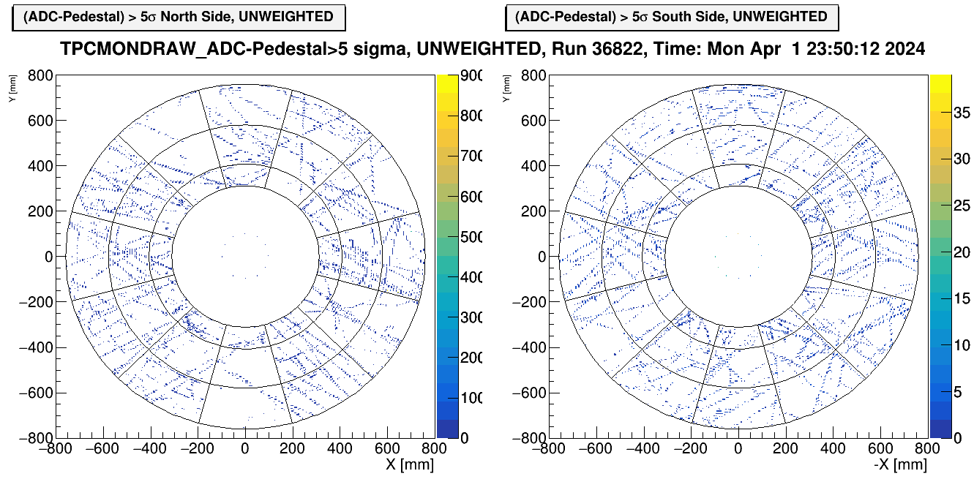
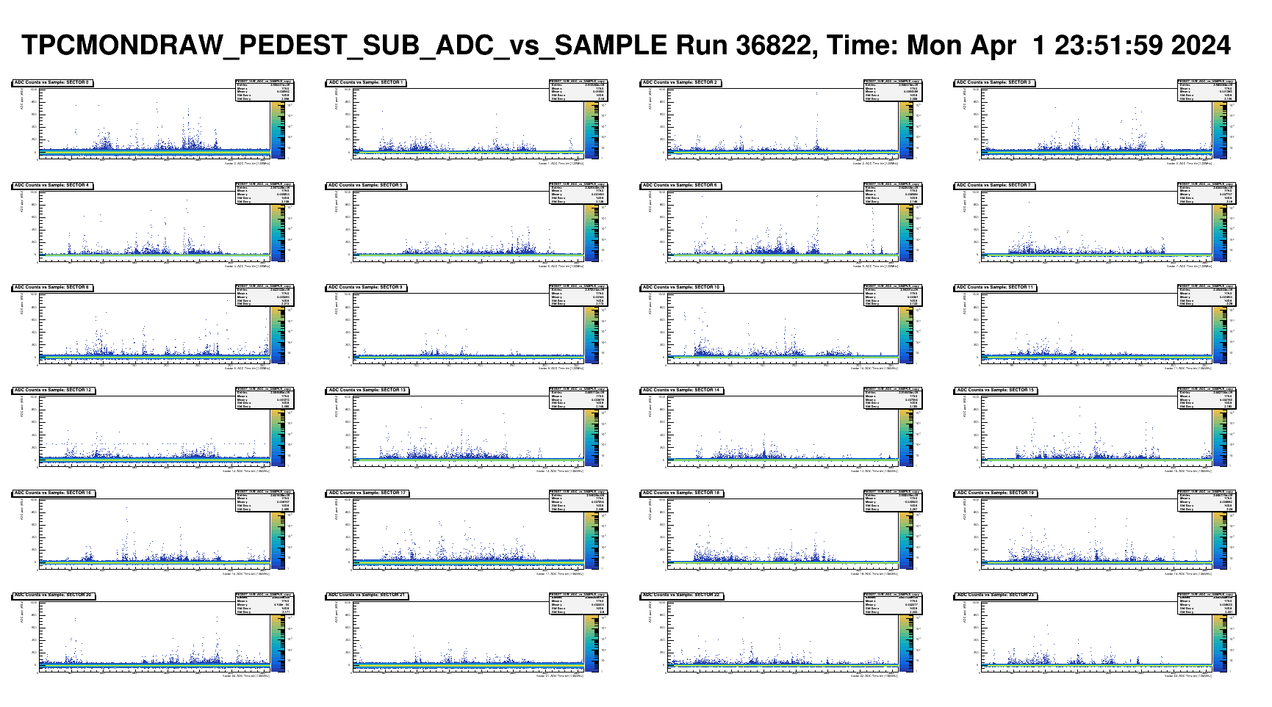
Triggered by “horizontal tracks”
(in HCAL)

Slide 4
BACKUP

