Slide 1
sPHENIX status
Kin Yip
sPHENIX Director of Operations
Shutdown Time meeting & RHIC Coordination Meeting
Apr. 9, 2024

Slide 2
sPHENIX Detector status ⎯ on schedule for Apr. 15
We continue to optimize and debug the DAQ and trigger with as many detectors as possible and do “speed test” etc.
It’s a dress rehearsal (~ dry run) for data taking this week in 1008.
Firmware development also continues for running TPC at higher rates.
The last detector, sEPD’s, have been installed on both North and South sides of sPHENIX.
ZDC/SMD in the tunnels have been moved (to match the crossing-angle) and they have been surveyed by the end of last week.
A leak was discovered in the water-cooled-bus (Magnet) in 1008 IR ~2 weeks ago and was fixed last week after a couple attempts by the C-AD Facility & Expt. Support Group.
Magnet temperature has finally gone below 80 K and I was told that it’d probably reach 60 K by the end of the “45 K” cooldown.
Hole drilling on the pole-tip doors was also completed last week.
Magnetic Safety Inspection was done this morning and “White Sheet” for the Magnet Power Supply is ongoing to the next week.

Slide 3
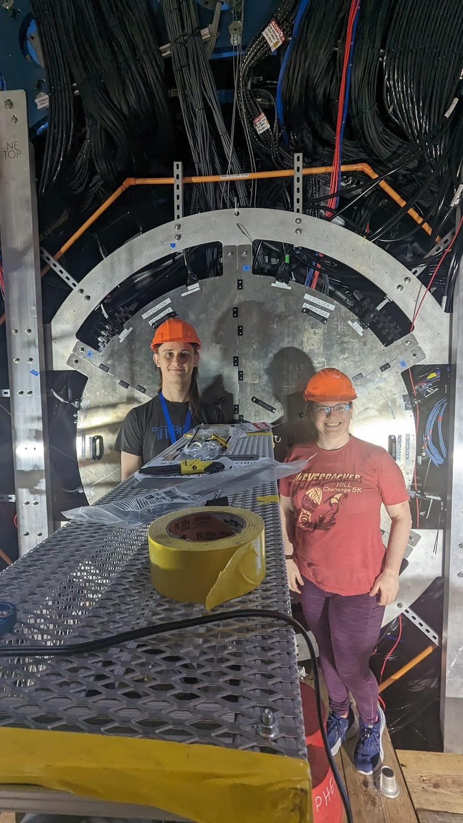
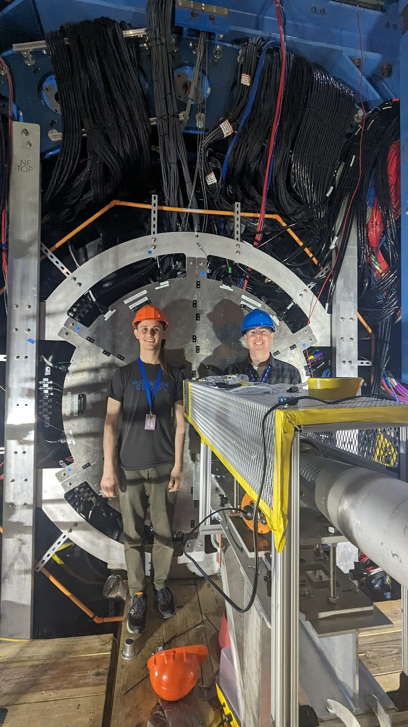
Happy sEPD Installers ⎯ on schedule for Apr. 15

