Slide 1
RHIC Time Meeting
Guillaume Robert-Demolaize, on behalf of Kiel Hock
April 15, 2024 – October 7, 2024

Slide 2
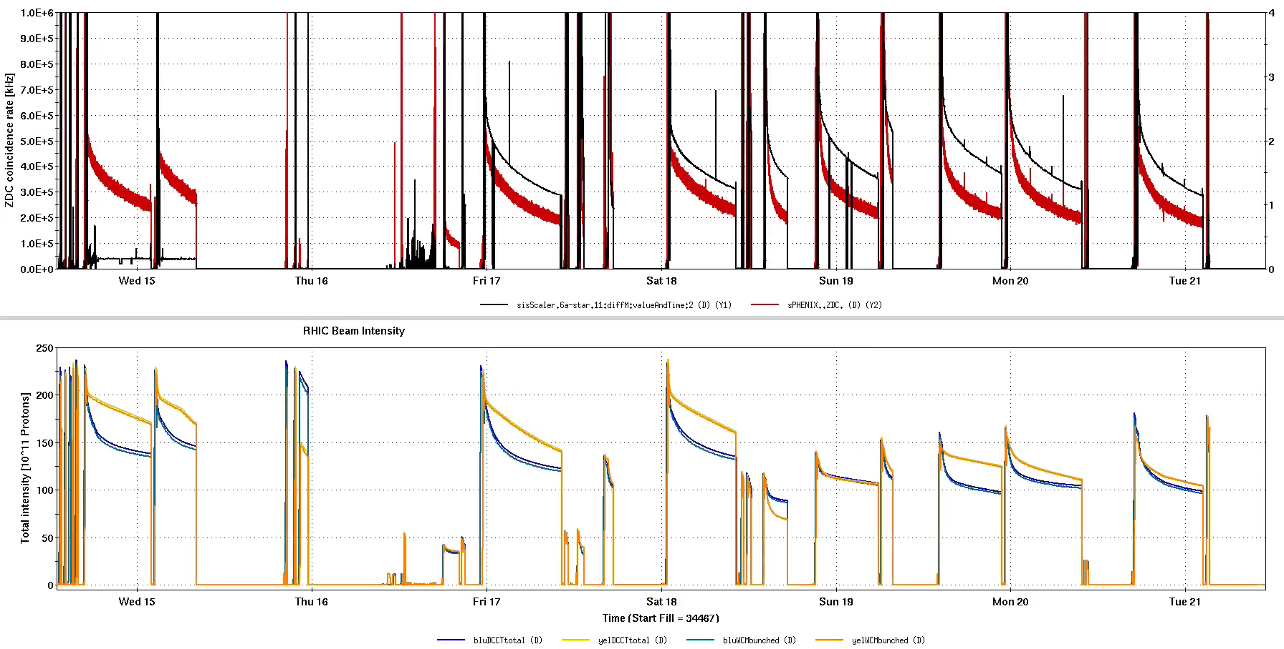
May 14-21, 2024
#34472
111x110
#34473
111x111
#34480
110x73
#34485
111x111
#34492
111x111
#34503
74x74
#34509
74x74
#34500
74x74
#34496
56x55
#34504
74x74
#34499
68x68

Slide 3
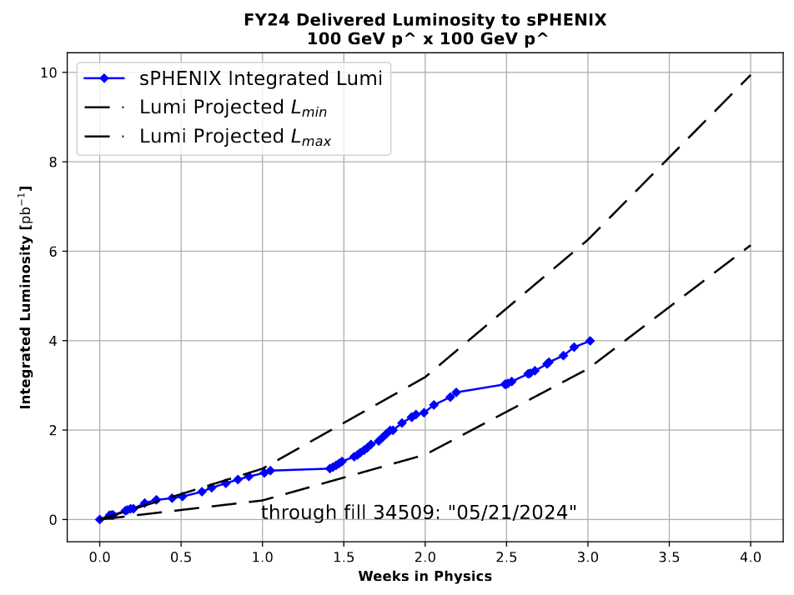
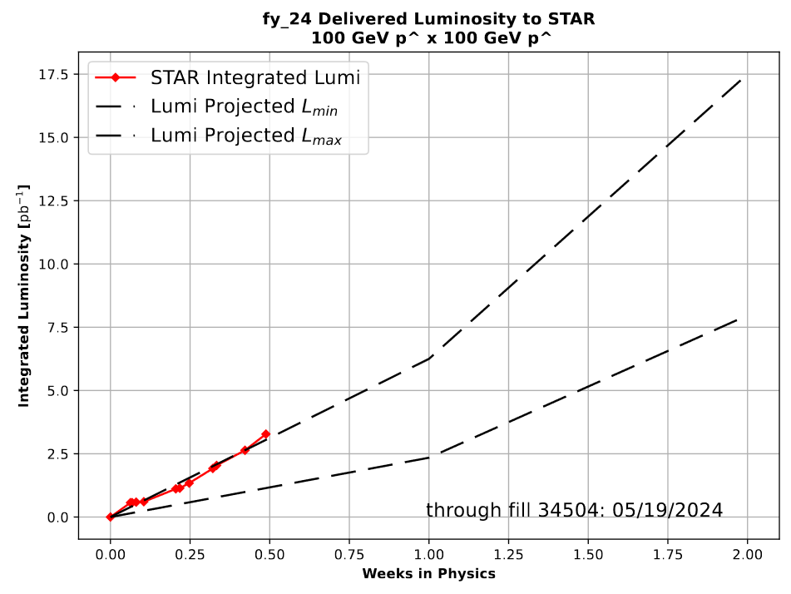
Luminosities projections
Pushing intensity from fill to fill, highest is 2.4e11/bunch on a 74x74 ramp. Increasing bunch number is still an option.
STAR low lumi run completed; moved to head-on (0 mrad crossing angle) collisions on 5/15 and rotator ramps on 5/17.

Slide 4
Outlook for the week
QPA issues in IR12 are causing an extended downtime, despite repairs/replacements over the weekend. Work is currently ongoing (now replacing the DX power supply), also need to look into related quench link questions.
Tune the IR6 rotators currents during physics fills to adjust the spin direction.
Keep pushing for max intensity with limited emittance blowup.
Maintenance tomorrow 5/22.

