Slide 1
fTOF Sensor and bonding and ASIC planning
Mathieu Benoit, Wei Li

Slide 2
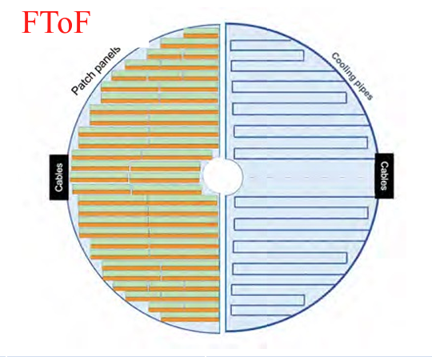
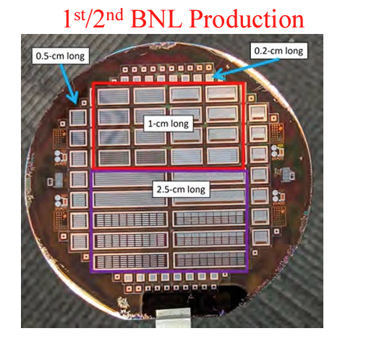
Forward TOF geometry and implications
Covering R = ~ 6 to 60 cm
  ~ 2.2 m² of sensor/ASIC
  5000-6000 sensors, bonding to be produced/performed
Service Hybrid location still in discussion
  Placement in acceptance or at periphery
  Need to be optimized for material budget
Sensor ASIC hybridation method could make use of low-cost bonding technique (500 µm pitch)
  Need to quickly investigate possible cost reduction via low-cost bonding

Slide 3
Forward TOF work packages
Sensor and sensor-ASIC integration
  Sensor (500x500µm² pixels , 30µm, 25 ps resolution)
  Sensor-ASIC integration (hybridization to ASIC)
Front-end Electronics
  ASIC (Design, prototyping,production, probing and dicing(?))
  Flex module PCB (Design, prototyping and production)
  Service hybrid (Design, prototyping and production)
Detector Module
  Module mechanical structure
  Module assembly
Schedule is very preliminary and in development. All elements need to be logically tied.

Slide 4
Schedule development
3 phases for sensors, ASIC, ASIC-Sensor integration
  Prototyping and site preparation
    Design, production and testing of prototypes for final design
    Elaboration, procurement and commissioning of test benches for production
    Documentation of production procedure
    Procurement of (pre)-production sensor/ASIC/bonding
  Final Design Review (FDR)
  Pre-production (10% of needed output (spares) )
    Reception of sensor/ASIC/bonded assembly
    QA/QC, cataloging of sensor/ASIC/bonded assembly
    Packaging and shipping to bonding vendor/Module assembly sites
  Production Readiness Review (PRR)
  Production (90% of needed output)
    Reception of sensor/ASIC/bonded assembly
    QA/QC, cataloging of sensor/ASIC/bonded assembly
    Packaging and shipping to bonding vendor/Module assembly sites

Slide 5
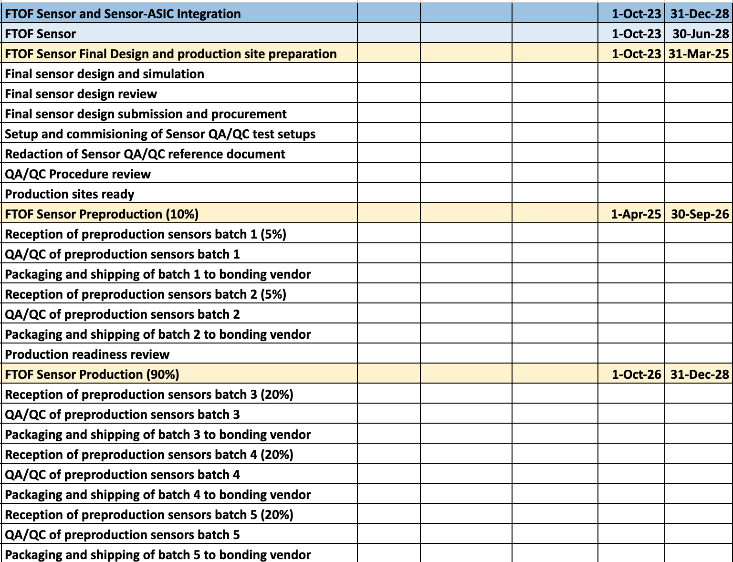
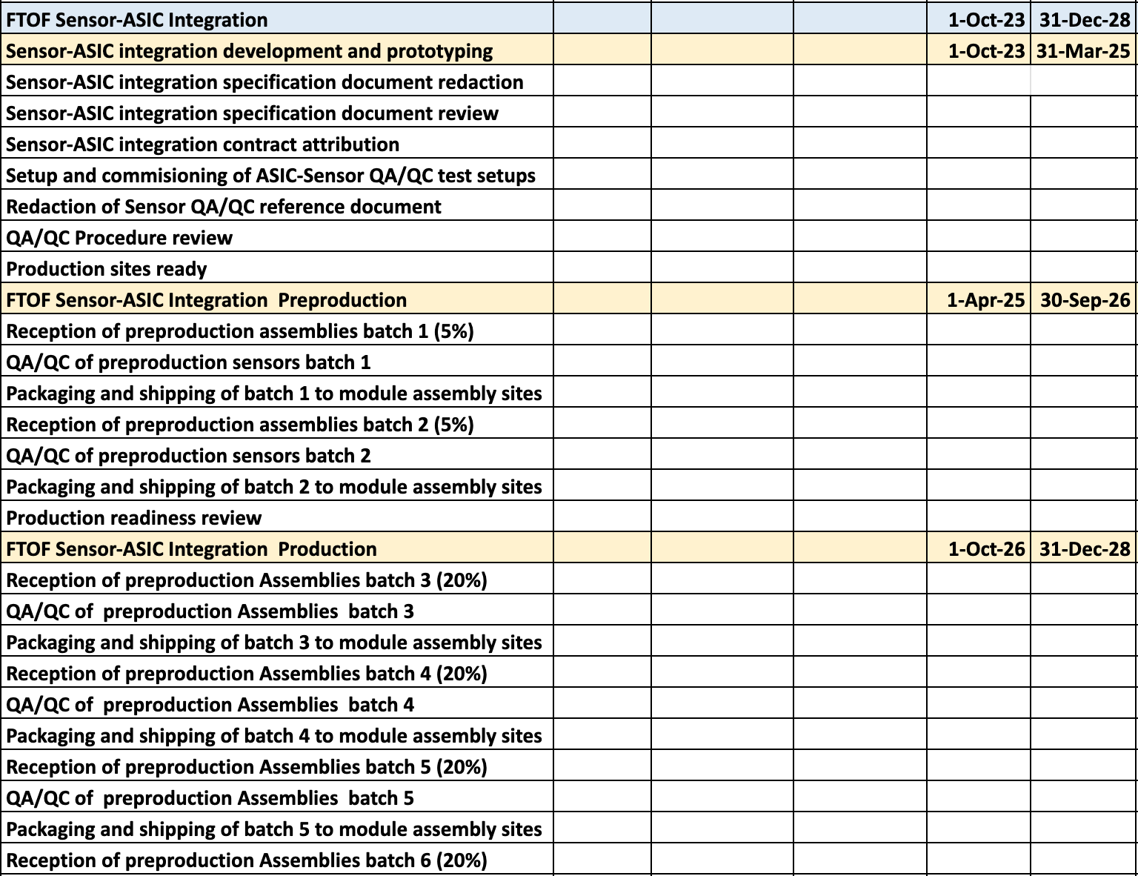
Schedule WP breakdown (Sensor + bonding)
(...)
(...)

Slide 6
QA/QC procedure for sensor and bump bonding testing
The main deliverable for the sensor part of the scope is known good sensors , tested to meet the market survey requirements at the vendors
  If vendor cannot provide known good sensors (diced), need to plan IV/CV measurement for each unit
  Dicing and UBM need to be handled at vendor, or added to schedule after wafer reception
  Sensor probably need testing after dicing
The testing done on sites covers the test not doable but the vendors
  Visual inspection of the sensors after transport to the lab
  DC Characterization (IV/CV) of a subset of sensors ( ~2.5% selected at random + marginal samples )
  Transient analysis with Laser test setup to extract timing, CCE (1% selected at random + marginal samples )
  Repeat test after irradiation to verify compliance with market survey parameters

Slide 7
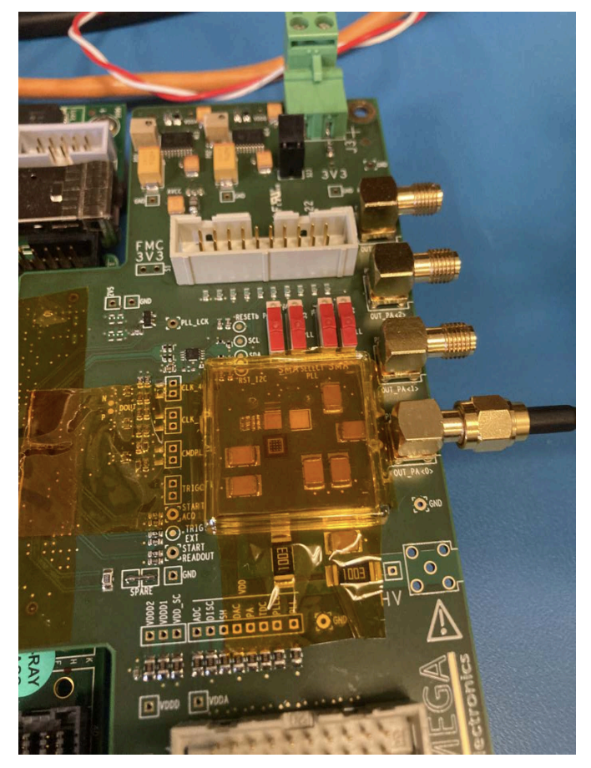
Frontend Electronics - ASICs (10/1/23-5/31/27)
EICROC0 (4x4) testing at BNL
3 steps of design and prototyping:
  EICROC1 (intermediate size, TBD)
  EICROC2 (full size)
  EICROC3 (full size)
Wafer probing development and test
  Set up probe station
  Probe card development and programming
  Probe tests
Preproduction (10%)
Production and QA/QC (90%)
Packaging and shipment for bump-bonding

Slide 8
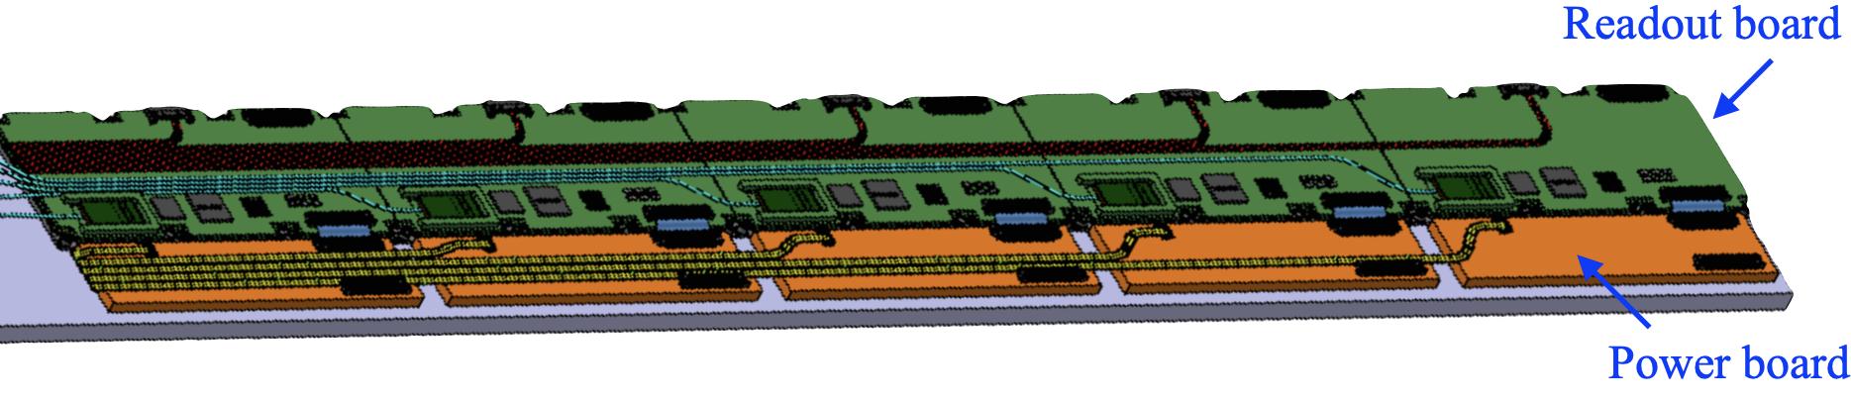
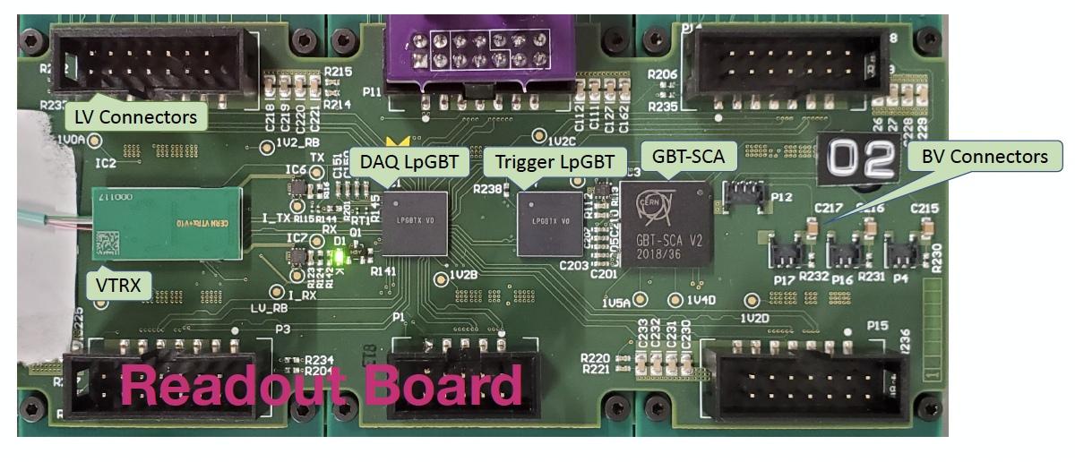
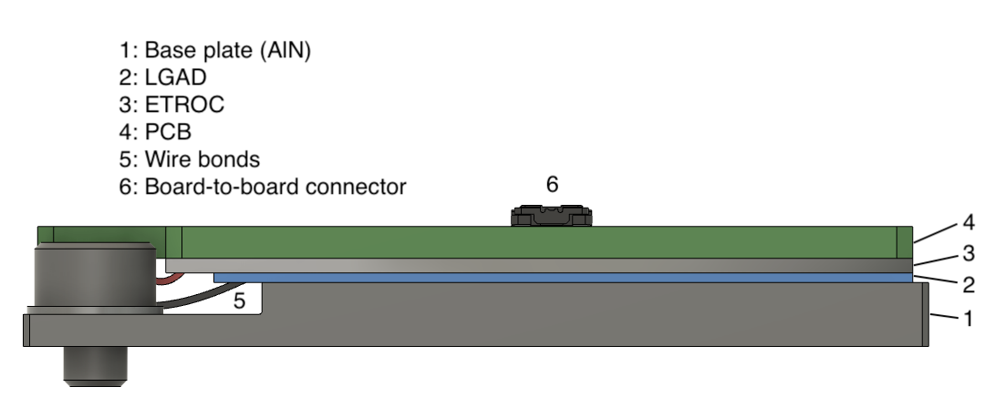
Frontend Electronics - Service Hybrids and Module PCB
Design (10/1/23-9/30/24)
  Readout Board
  Power Board
  Module PCB
Prototyping (10/1/24-3/31/26)
  Initial Prototype (RB, PB, MPCB)
  Final Prototype (RB, PB, MPCB)
Preproduction (4/1/26-3/31/27)
  10% fabrication and assembly
  Electronics component procurements
  QA/QC procedure development
Production and QA/QC (4/1/27-2/29/28)
  90% fabrication and assembly
  Production QA/QC
  Packaging and shipment for module assembly
Module PCB

Slide 9
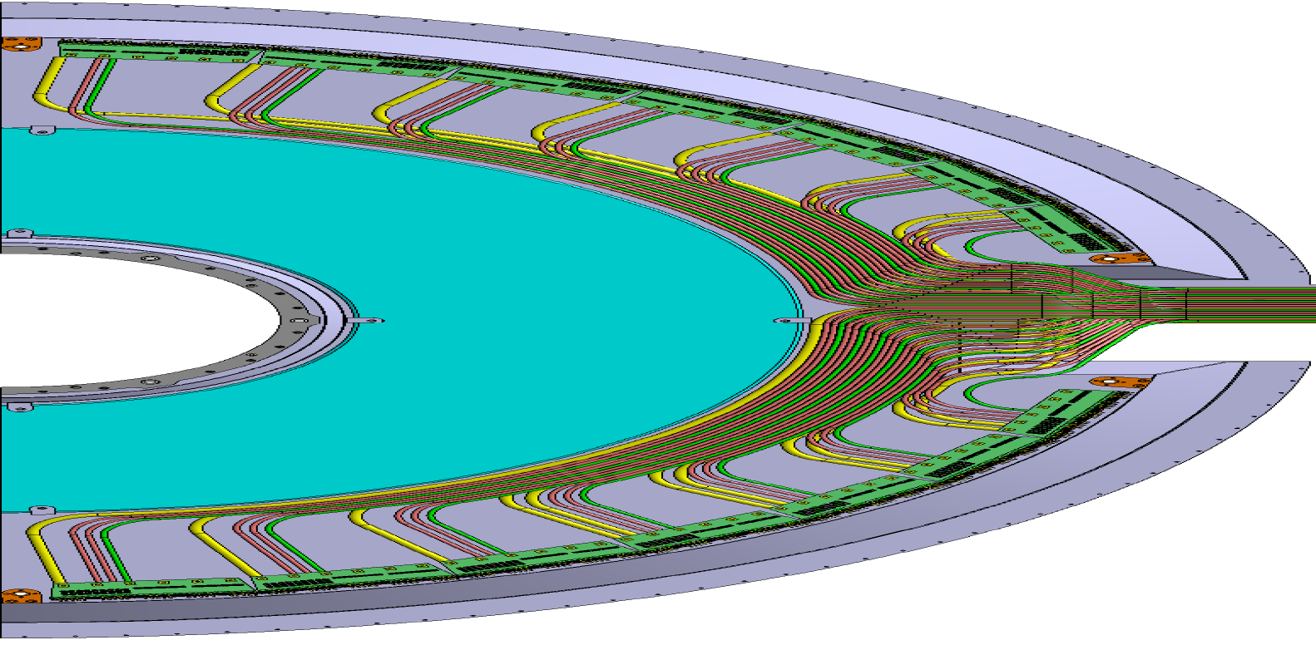
Frontend Electronics - Patch Panels and Cables (10/1/23-9/30/27)
PP
PP Design (10/1/23-5/31/25)
  Electrical Design
  Mechanical Design
PP Prototyping (6/1/25-9/30/26)
  Electrical Materials Prototyping and Testing
  Mechanical Prototyping and Testing
PP Production (10/1/26-9/30/27)
Cable Prototyping (10/1/25-9/30/26)
Cable Production (10/1/26-9/30/27)

Slide 10
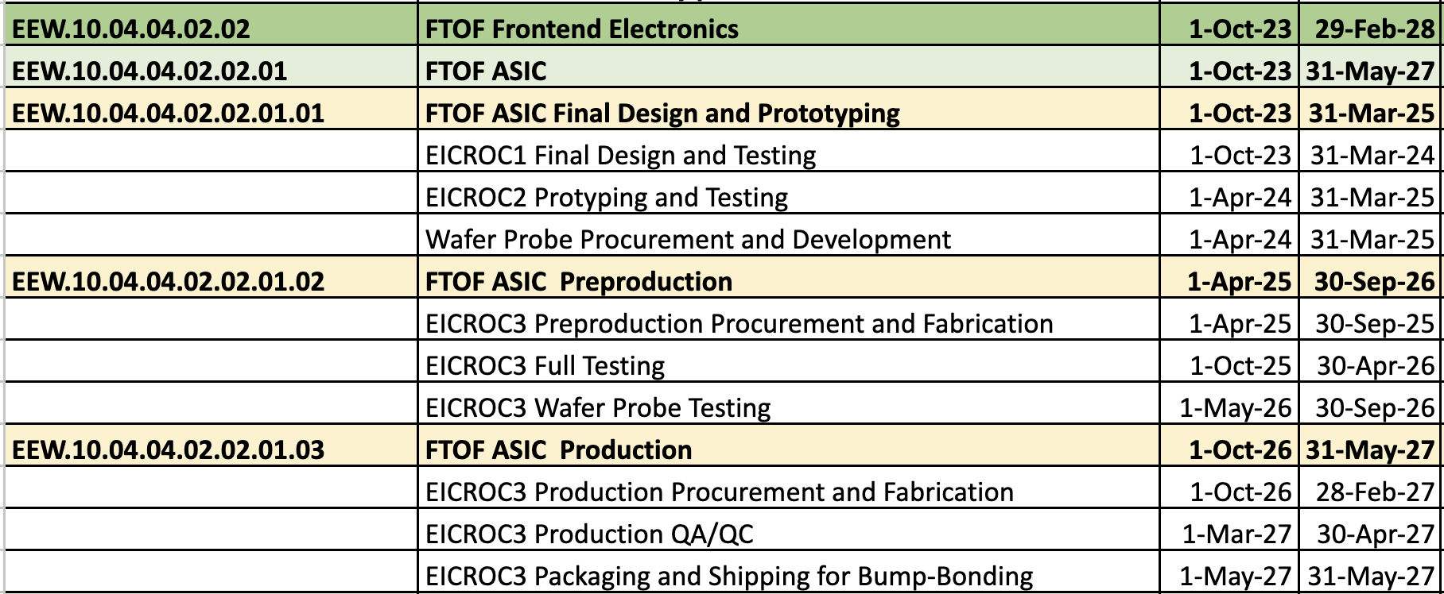
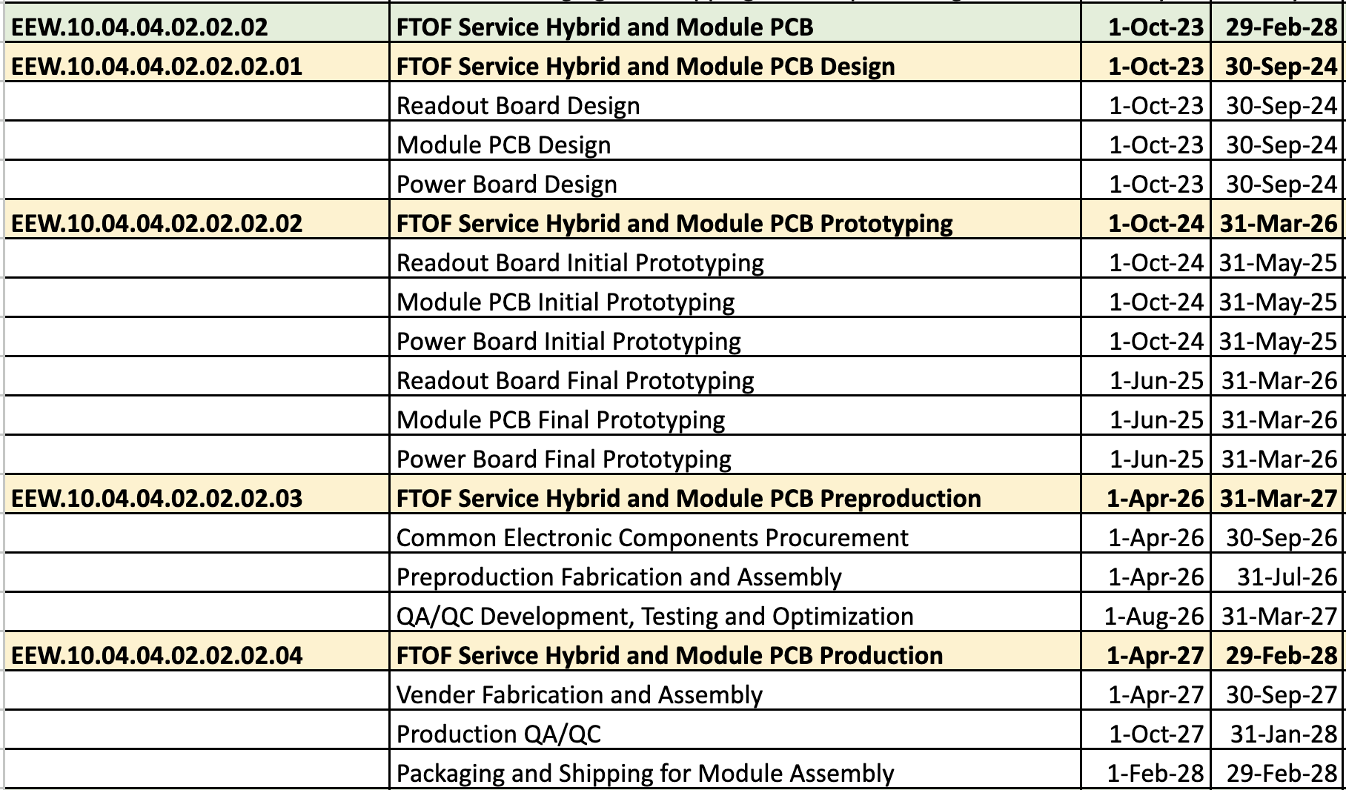
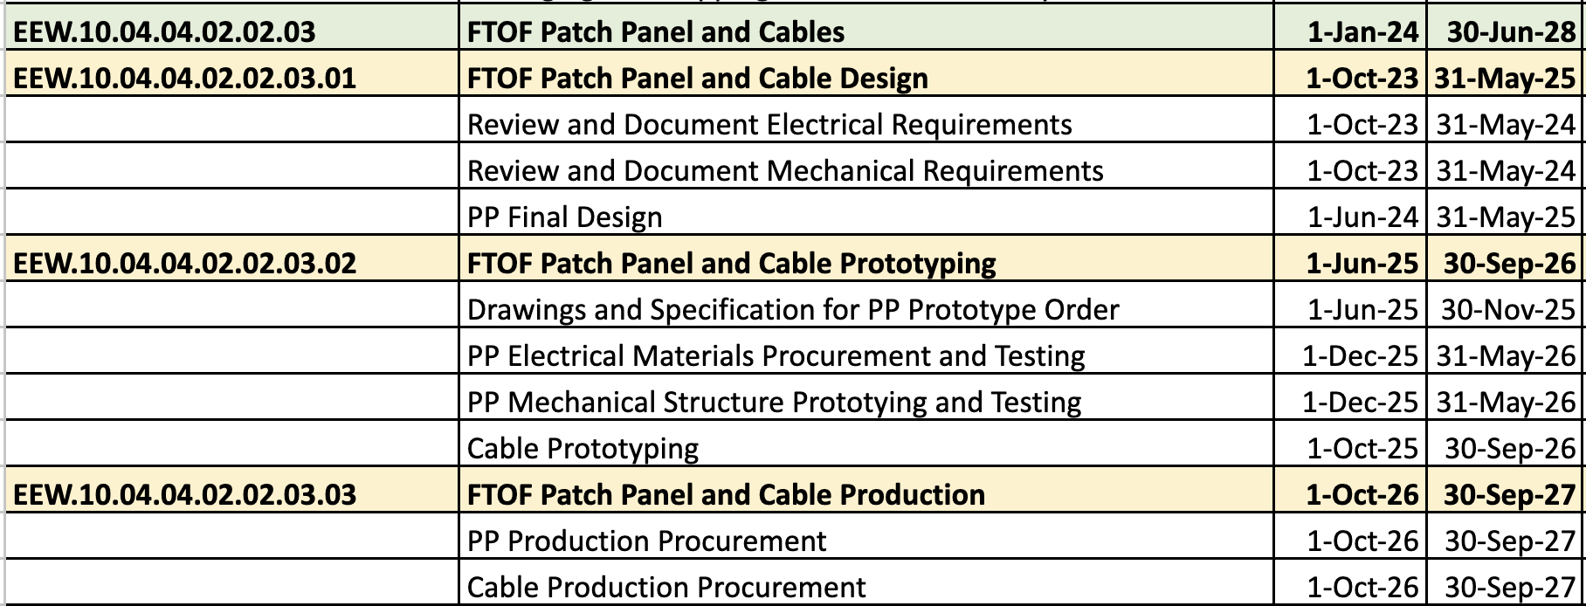
Frontend Electronics - Schedule Development and WP

Slide 11
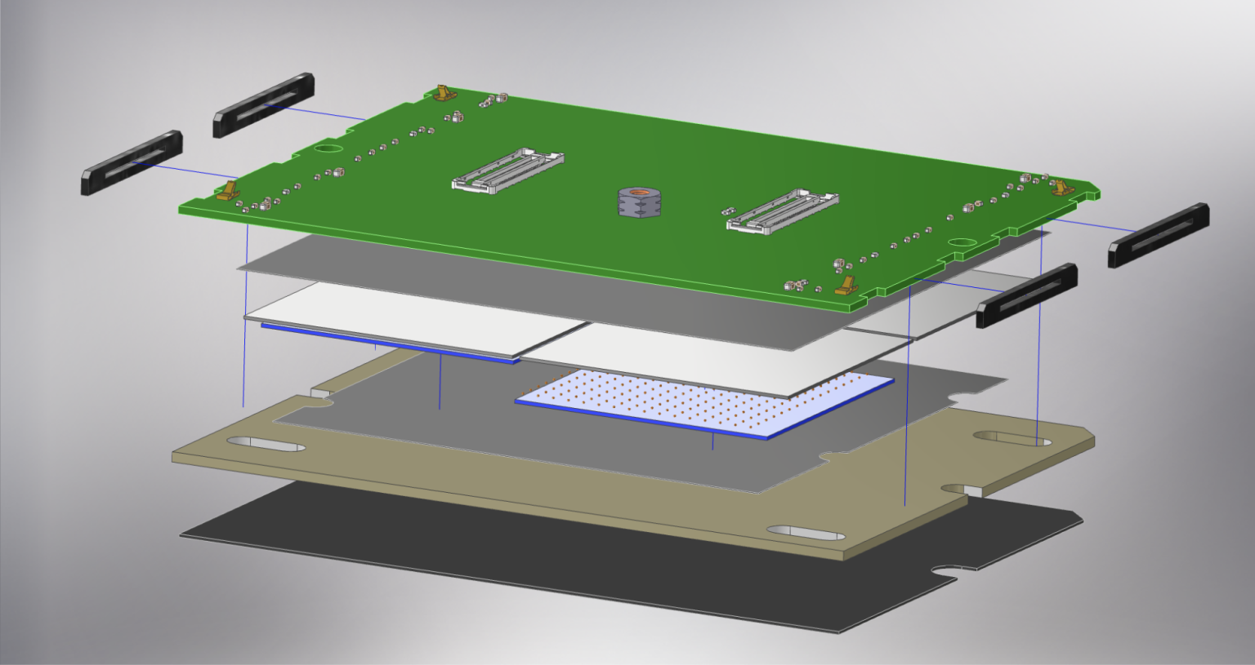
Module Assembly

Slide 12
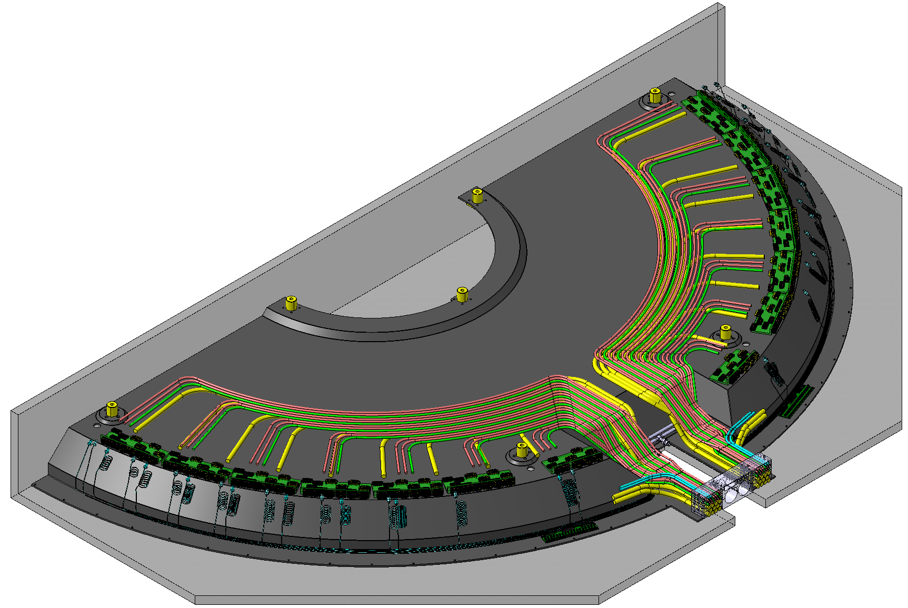
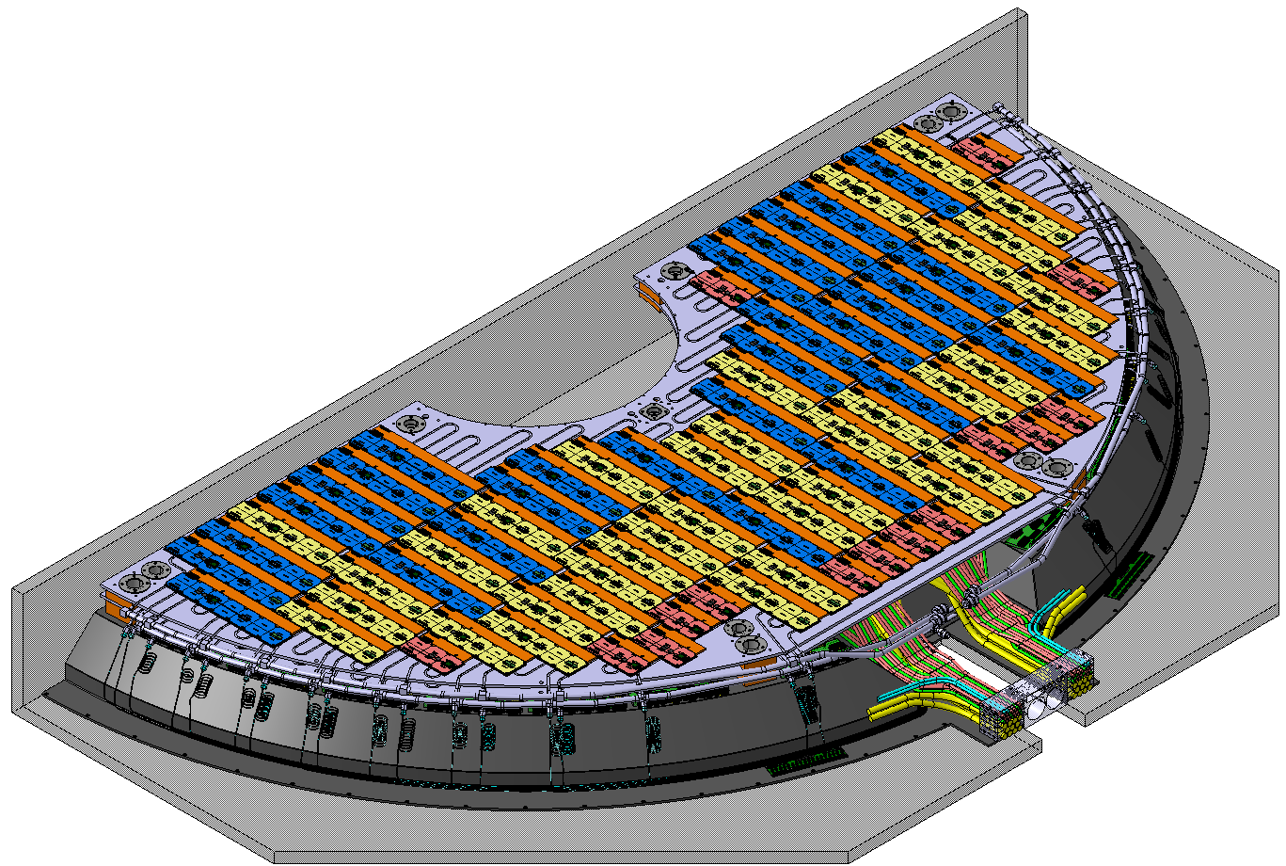
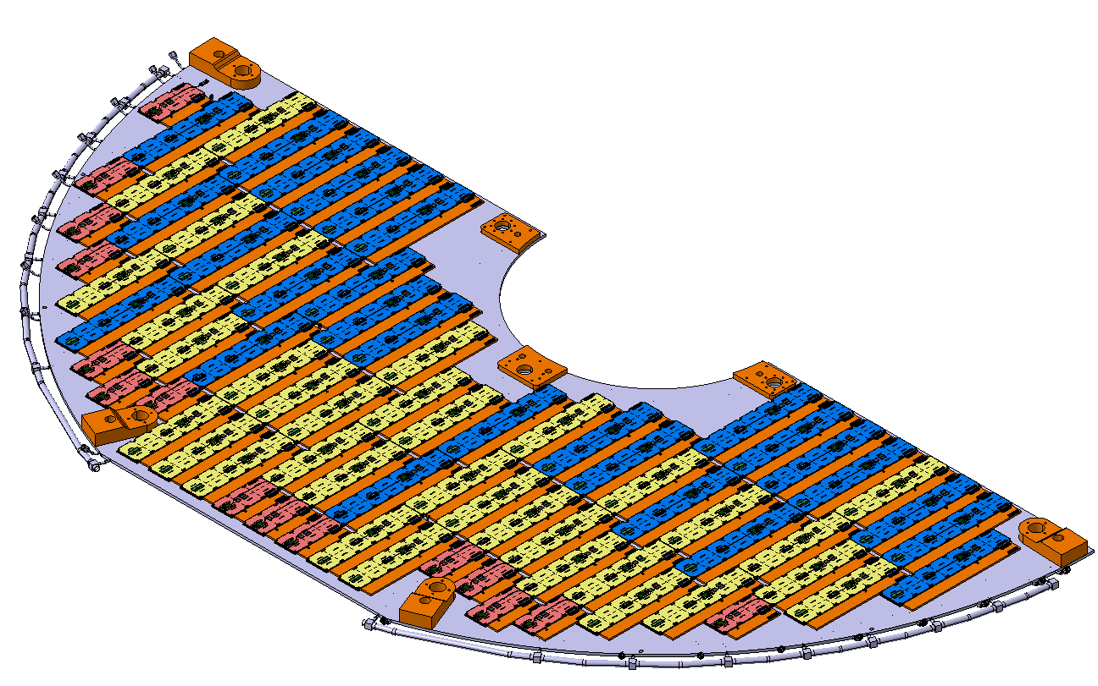
Integration and Installation (work in progress)
Mounting patch panels, cables, cooling manifold etc.
Final installation to ePIC
Integration of modules onto the cooling and support structure

