Slide 1
Software Development
Takashi Hachiya
Nara Women’s University

Slide 2
Current status of S/W development
Development are on going in various places. But not well organized. I would like to summarize current status so far
Task list is in the web
  https://docs.google.com/spreadsheets/d/19oZJ2UAu-wwczQBbfpat8sEreKFuLpSZrDDzt1xYgPA/edit#gid=0

Slide 3
<Simulation>
Original Plan： Workflow for data production
May 11th
Event-Gen
RCDAQ
physics
calib
<test bench>
Python raw data
Ghit (PHG4Hit)
evt (32 bit word)
converter
Martin, Joseph
Unpacker
Python dictionary
converter
DST-sim
Amp is to be dropped
Trkrhit (hits in local coordinate)
Online->offline Conversion map
Amp, Hit Ch, ADC, Chip, Ladder-ID, bco, bcofull
Joseph
Root Raw Data Format*
check_felix →calib_monitor
TrkrCluster
Online Monitor
Hot/dead channel map
…
Event Display
Hit rates, time-in, DAC0, DAC scan, event multiplicity, etc..
Manami
Fun4All framework
* Long int -> long-long int
Non Fun4all framework
*Raw Data Format file in physics mode is only for commissioning
Plots

Slide 4
Current status：Work flow for the producton
<Simulation>
RCDAQ
physics
calib
Event-Gen
evt (32 bit word)
Ghit (PHG4Hit)
Martin, Joseph
Fun4AllDecoder
(SingleInttInput)
Unpacker
Two different mod.？
DST-sim
Trkrhit (hits in local coordinate)
Amp is to be dropped
Remove
Badhit
InttCombined
RawDataDecoder
InttCombined
RawDataConverter
Online->offline Conversion map
Remove
HotDead
Joseph
Geometry
alignment
New format？
EventBaseTree(or HitBaseTree)
TrkrCluster
Online Monitor
Hot/dead channel map
OutputTree（Raw Data）
Amp, Hit Ch, ADC, Chip, Ladder-ID, bco, bcofull
Cut cls w smallerE
…
Event Display
Manami
Root Raw Data Format*

Slide 5
Decoder
  Martin’s pool method still have an issue. Some hits are lost during the decoding process. See next page
Converter Workflow
  There are two modules -> I think it is good to merge them to one
  Output format: New format (vector based) is implemented now but I think the output format should be an existing one (Event base or Hit base) because we developed the code to do raw data analysis.
Bad Channel removal
  Genki is working how the bad hit should be removed
    Copy hit 1: Ladder, Chip, Chan, ADC, BCO are all same
    Copy hit 2: ADC is different. Genki found its fraction is small
  Off-Timing hits
    Away from BCO-BCO_FULL peak
  Mix-up
    No way to remove hit in the analysis. Mai is studying how much it happens.
Hot Channel removal
  Jaein, Joseph, Yuka are working to develop the algorithm and determine the hot channel run by run
  DB is necessary to manage the parameter

Slide 6
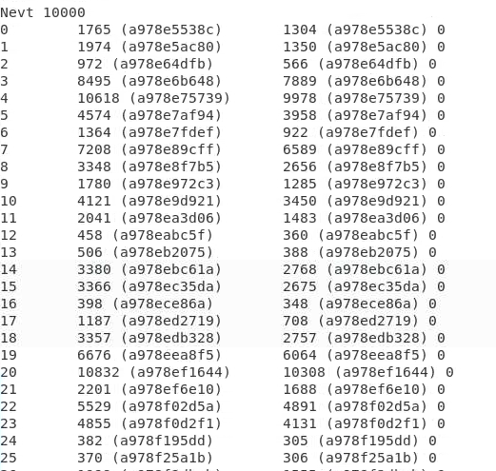
Event comparison
My decoder
Nhits (BCO_FULL)
F4A decoder
Nhits (BCO_FULL) BCO_DIFF
BCO_FULL is the same for both but Nhits are different
Fun4All has always smaller hits

Slide 7
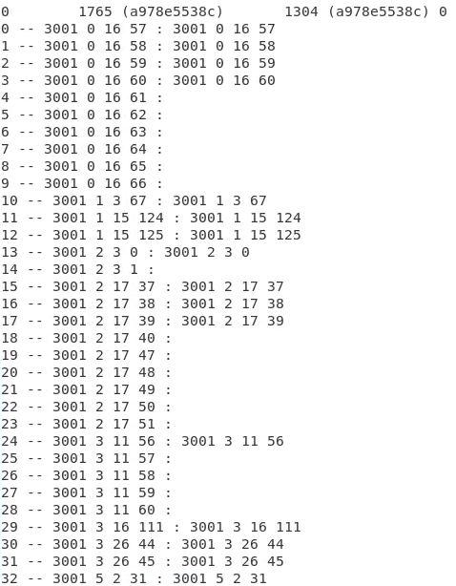
Hit comparison
My decoder
F4A decoder
pid ladder chip channel
Missing hits happen from all felix, ladder, chips

Slide 8
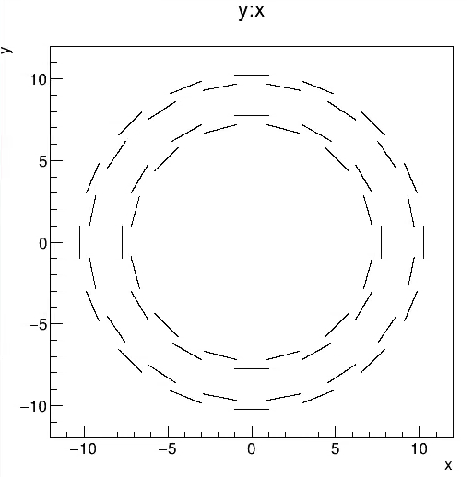
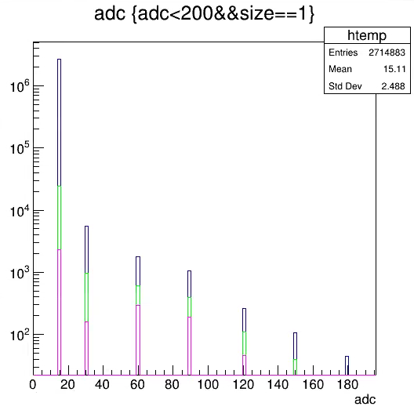
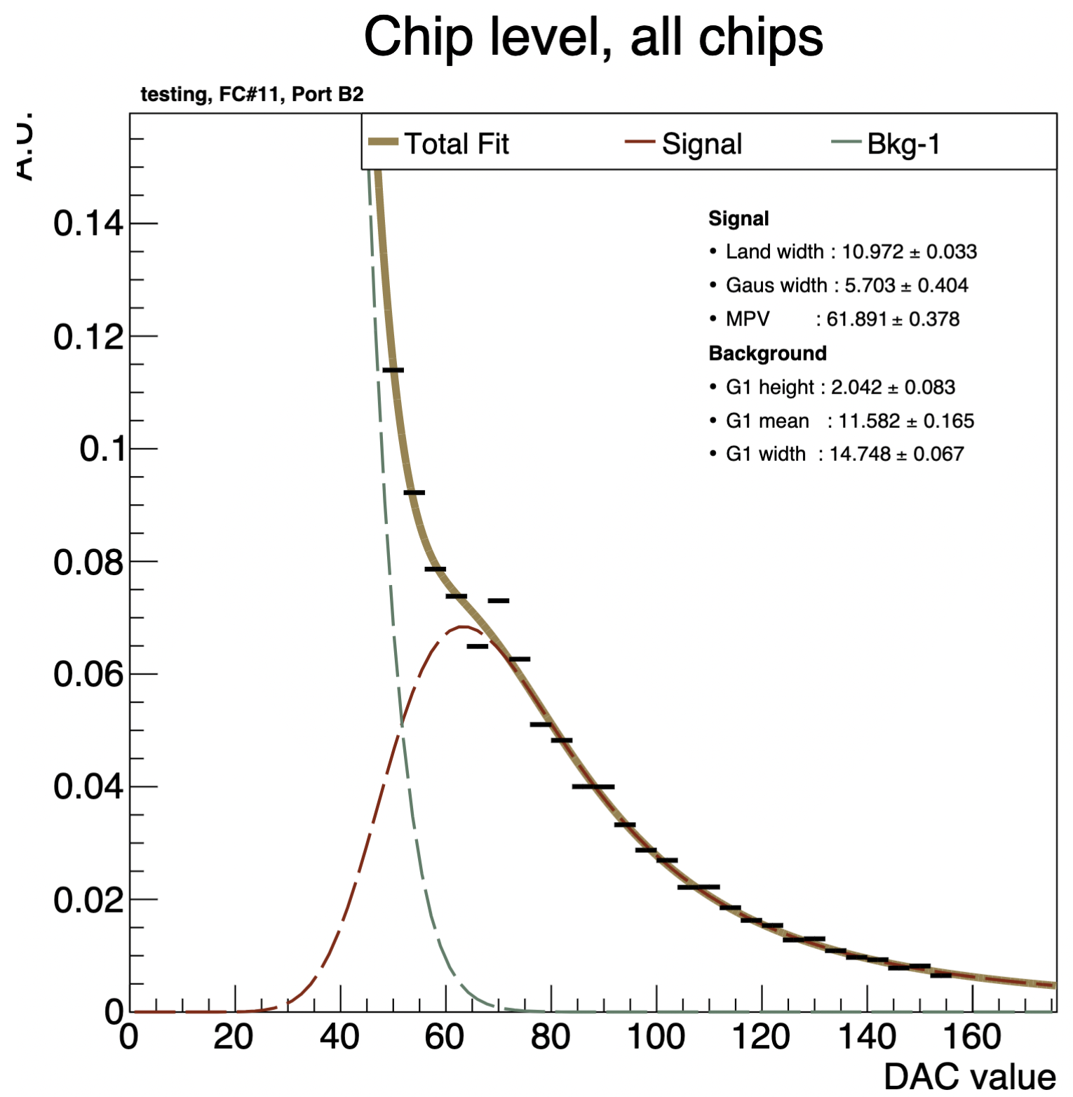
MIP peak finding
  ADC value of the cluster is used to check if the cluster is made by MIP particle
  No clear peak is found in DAC scan
  Cosmic data is also useful
    I found peak-like structure in cosmic data
CosmicRay ADC distribution
  Size==1
  2<nclus<6 single track in the event
  -3<X<3cm track goes top to bottom

Slide 9
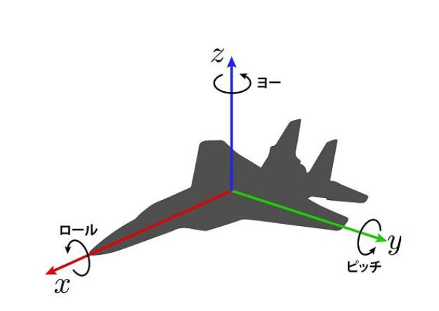
Alignment
Yaw
Alignment parameter definition
  Parameter defines the sensor position (X, Y, Z) and its rotation (Roll, Pitch, Yaw)
  sPHENIX Tracking(ACTS) take the difference from the ideal geometry
  Database format is not yet defined
Survey parameter
  Joseph made the survey parameter.
Further tuning beyond the survey position
  B-OFF A＋A data
  B-OFF Cosmic Ray
Software
  MILLIPEDE method is implemented in sPHENIX
  Need INTT-tracket as input to adjust INTT position with INTT alone
  Ask Software/MIT people how to use sPHENIX MILLIPEDE
Roll
Pitch

Slide 10
Summary
Current status of the tasks are summarized
I will update repeatedly

