Slide 1
ACTS update in EICrecon
Dmitry Romanov
10/12/2023

Slide 2
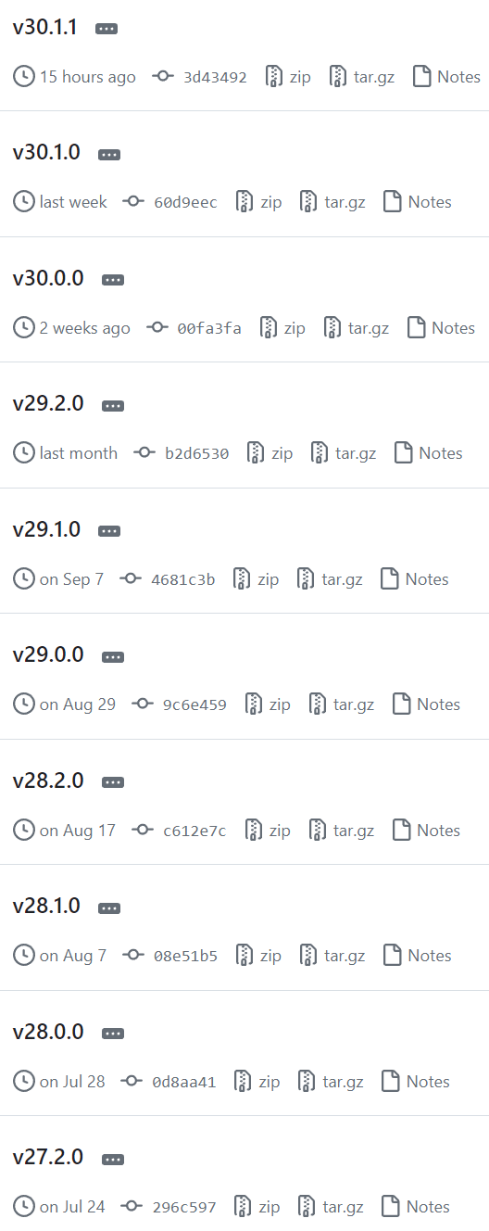
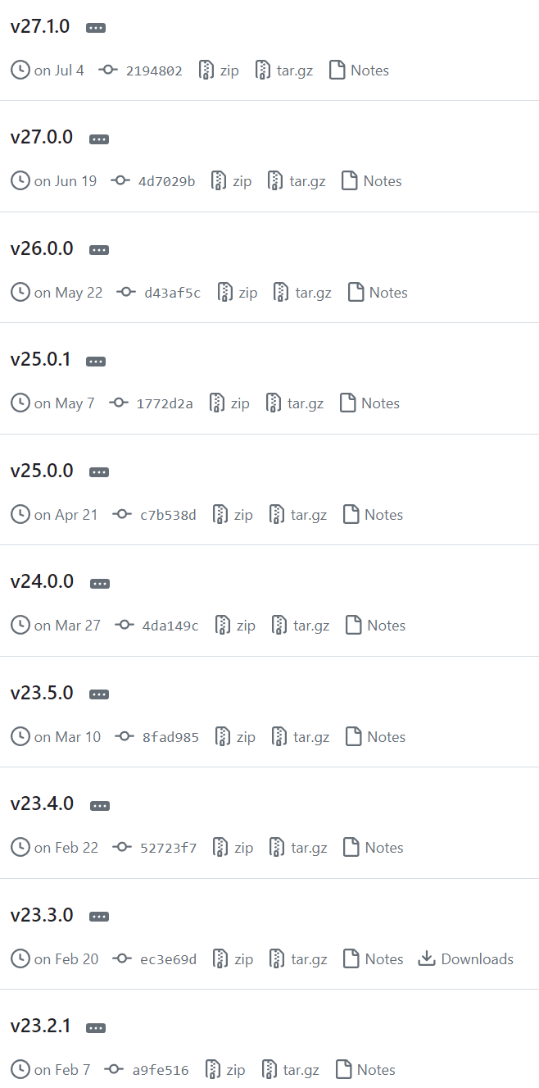
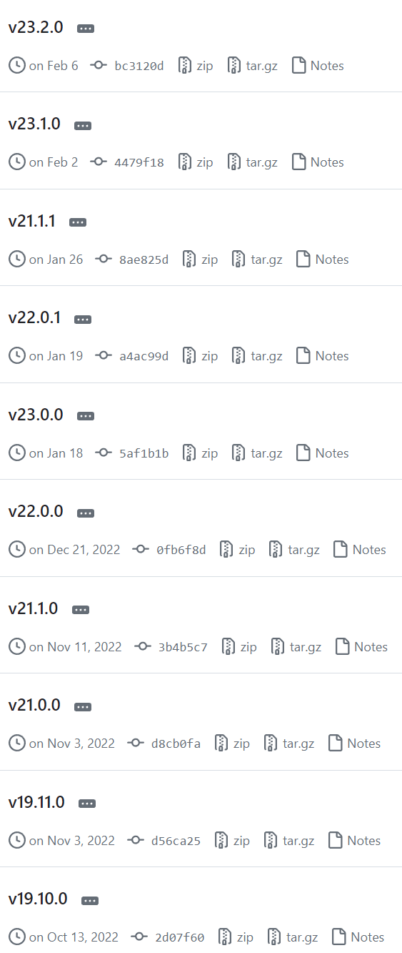
Acts versions

Slide 3
Acts versions where we are
Jan 26 2023
main
Branch is here
No API change
Nov 3 2022

Slide 4
Acts versions what we want
Jan 26 2023
main
Branch is here
No API change
Nov 11 2022

Slide 5
Acts versions what we want
Jan 26 2023
main
Branch is here
No API change
Nov 11 2022

Slide 6
Acts versions what we want
Jan 26 2023
main
Branch is here
No API change
Nov 11 2022

Slide 7
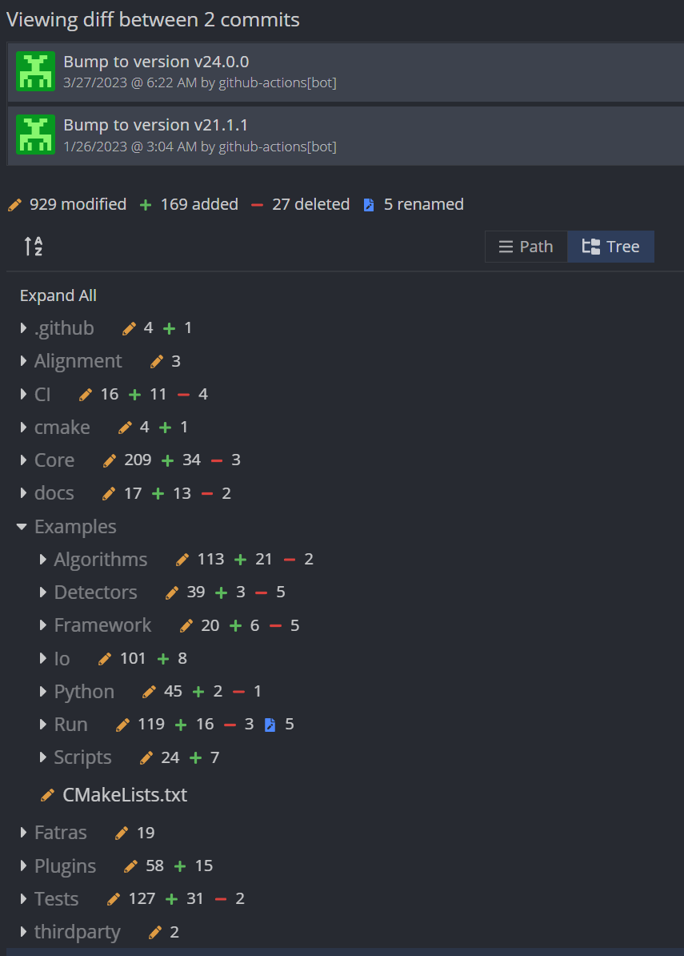
Changes
Initial attempt was done to move incrementally e.g. from 21-22-23
Changes in ACTS Event model makes you to change the same EICrecon code again and again if you go incrementally
Jumping from 21-24 needs more careful approach in changes and validation

Slide 8
What is changing in EICrecon tracking
Algorithms (how things are invoked, iterated)
ACTS data model (How data objects are organized)
Infrastructure (e.g. Logging)
Validation?

Slide 9
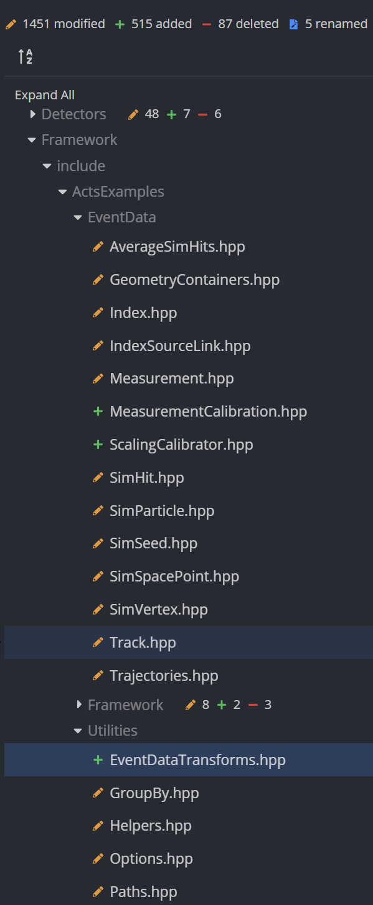
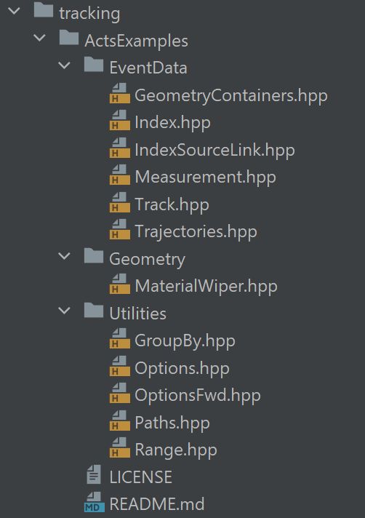
Changes in ACTS event model
ACTS destination version
EICrecon now

Slide 10
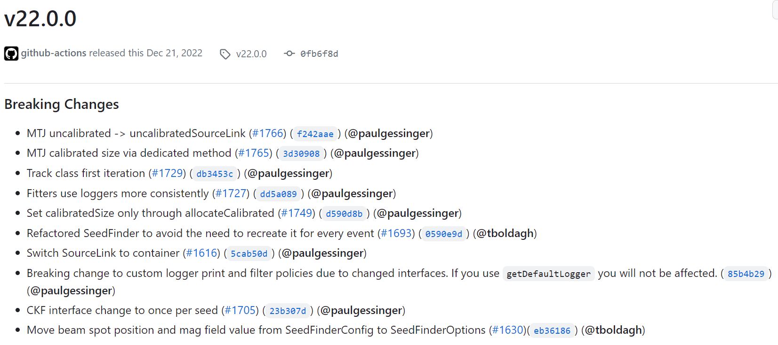
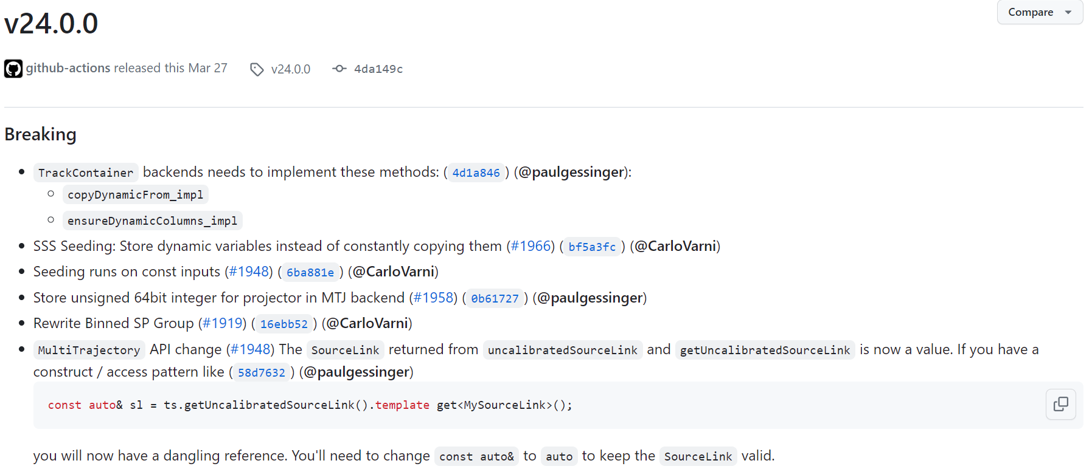
21-24

Slide 11
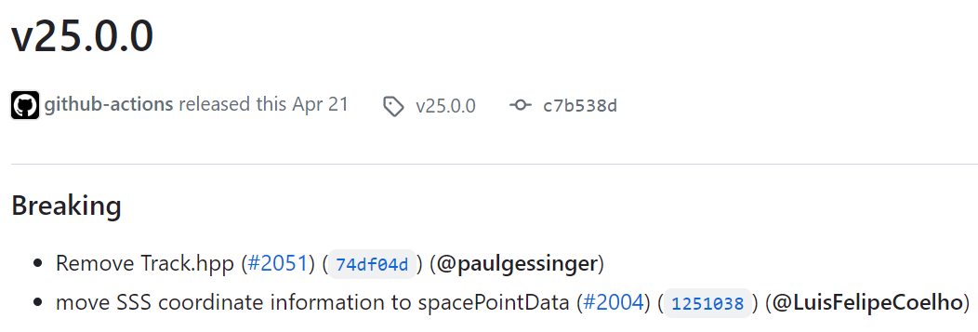
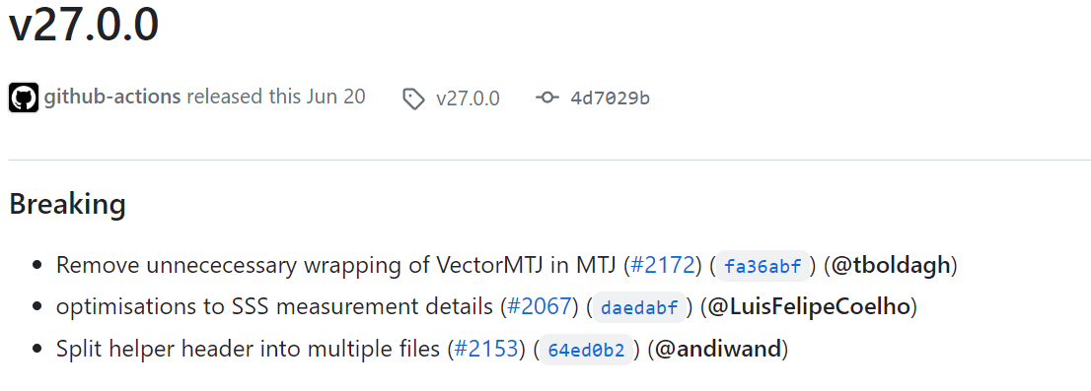
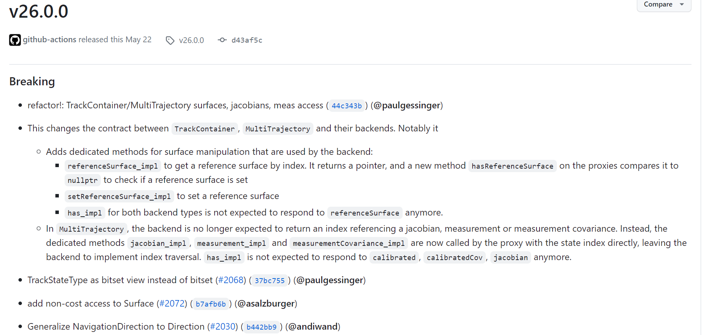
24-28

Slide 12
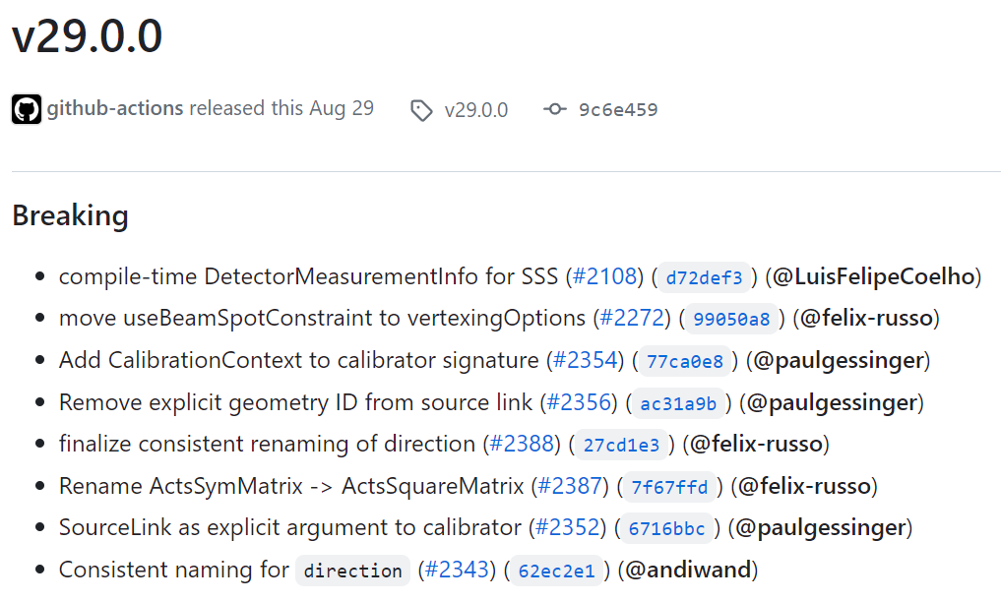
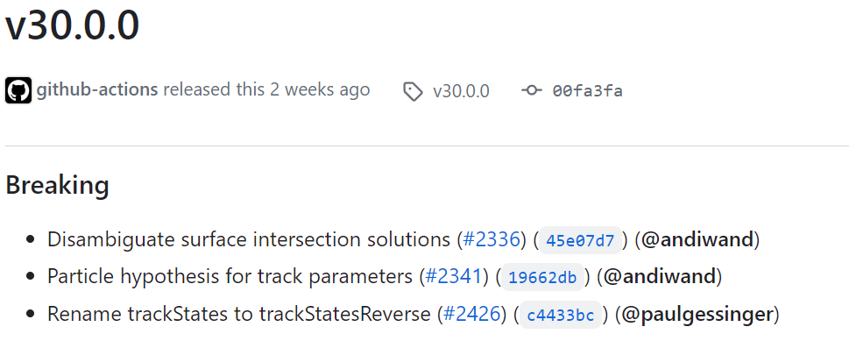
29-30

Slide 13
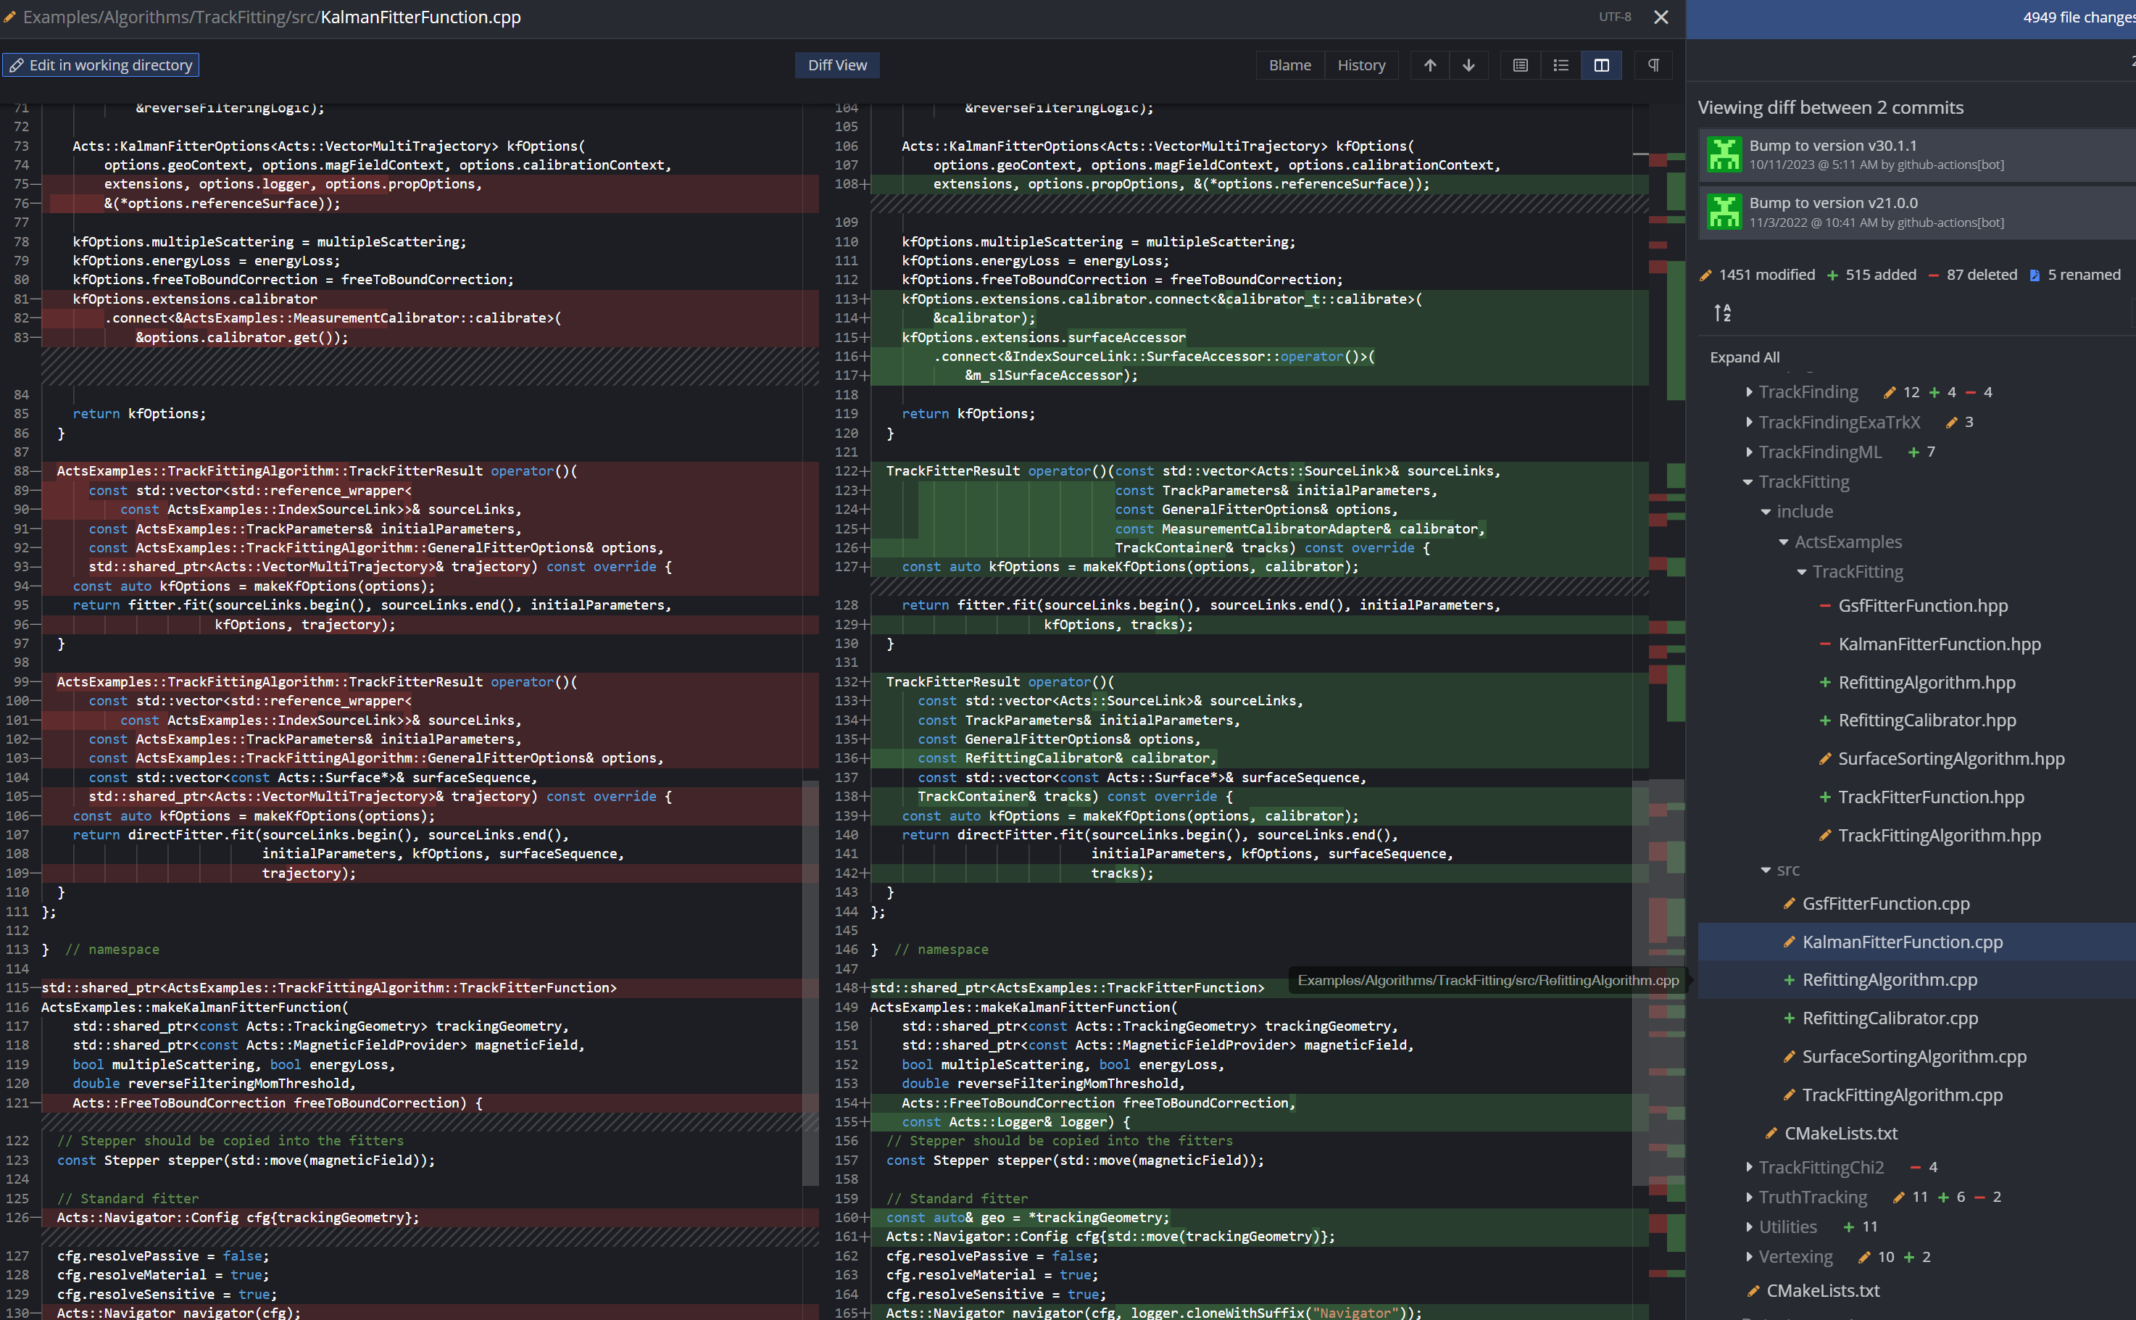
“Long jump” update

Slide 14
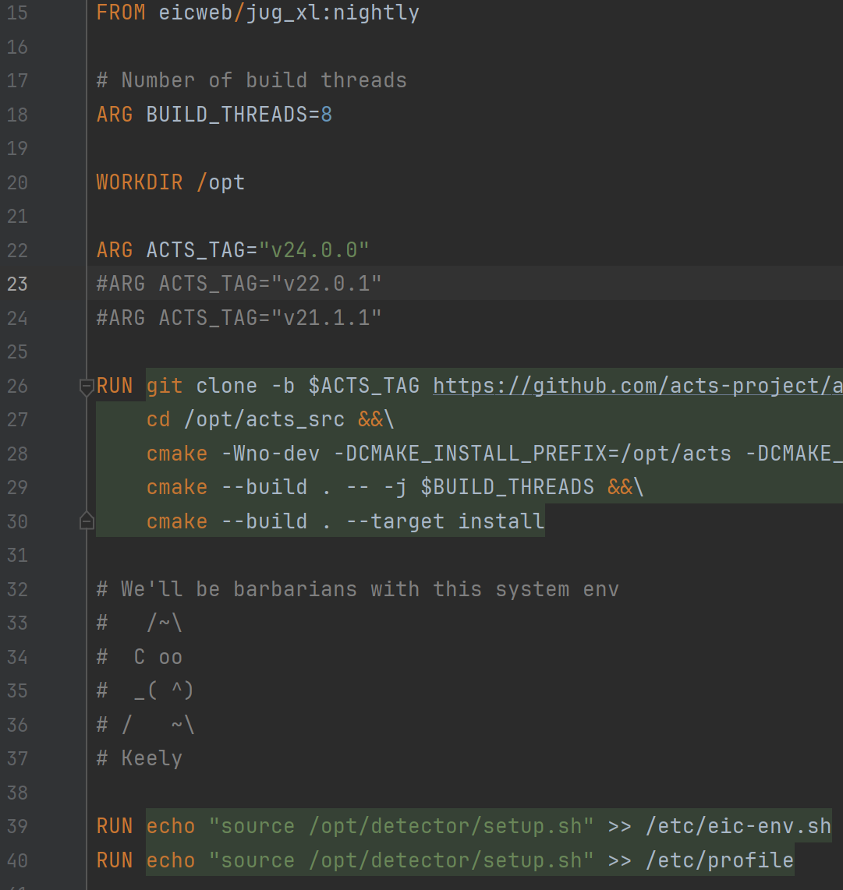
Switching versions
Task: be able to run with different ACTS versions
Current CI breaks if EICrecon changes to new ACTS version
Inherited docker images to easy switch and validate
eic_tracking_acts22
eicweb/jug_xl (eic_shell)
eic_tracking_acts24
…
https://github.com/DraTeots/eic_tracking

Slide 15
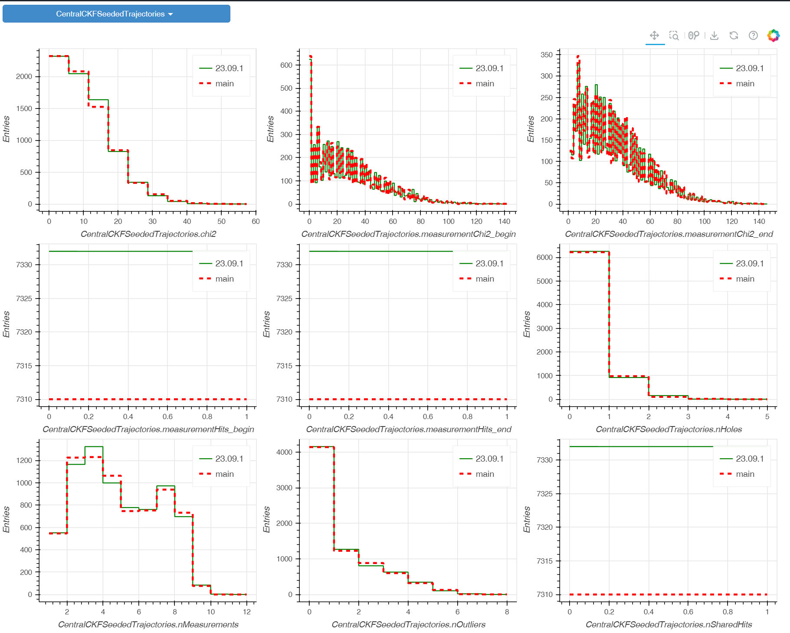
Validation
Using capi-bara idea?

Slide 16
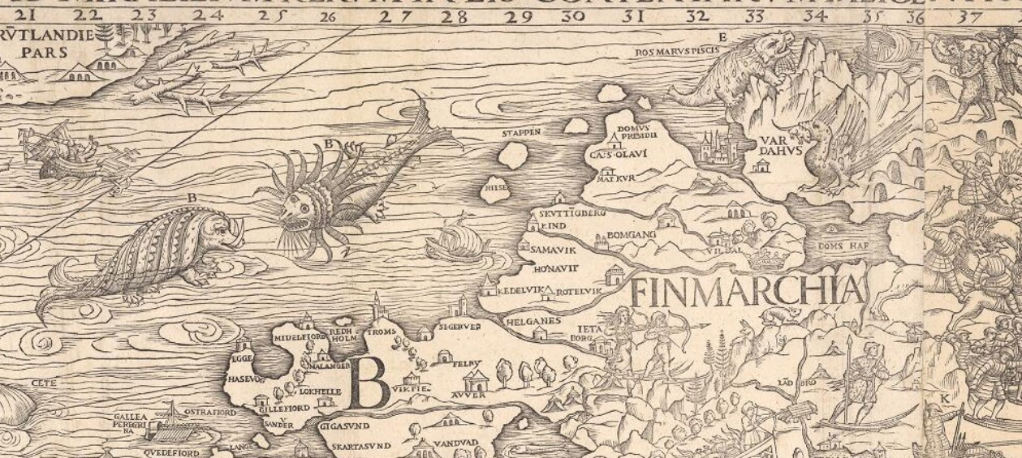
“Here be dragons” conclusion
Unknown (unpredictable)
Known (predictable)
"Carta Marina" of Scandinavia (1539)
ACTS update

