Slide 1
Some Key points of Physics
Y. Akiba (RIKEN/RBRC)
2023/11/07

Slide 2
Purpose of Physics
１）To find the fundamental laws of the nature
Fundamental laws: mathematical and quantitative model
２）To quantitatively explain all of the physical phenomena in the
nature
In other words
１）Discover the fundamental Lagrangian
Physics today has almost achieved this.
Standard Model (SM) and General Relativity
２）Predict all phenomena of the nature from the fundamental Lagrangian.
Old fashioned way
Solving the Lagrangian by analytical method
Modern approach
Solving the Lagrangian by numerical method as well as analytical
method

Slide 3
"Approximate Laws" and the "Fundamental Laws"
There are two types of natural laws
１） Approximate Laws
Laws that are know to be approximately “correct” e.g. by experience
Most of natural laws belongs to this category
They can be derived from the fundamental laws in (2).
２）Absolute fundamental law (aka principle)
The laws that are accepted/believed to be absolutely correct.
Examples:
Principle of invariant light speed: $c$ is invariant Theory of Relativity
Uncertainty principle $ΔpΔq ≥ℏ$ Quantum Theory
２A) Theories that are considered as fundamental
General Theory of Relativity
Standard Model of Particle Physics
Principle → Theory → Phenomenology, Models

Slide 4
Hierarchy and effective/valid range of laws
Most laws of physics are approximations of more fundamental laws
Each law have its valid range, and there is a hierarchy of the laws based on their validity ranges
The absolute law is the greatest and has the widest validity range, i.e., infinite
An approximate law has a narrower validity range.
Example: General Theory of Relativity
Special Theory of Relativity
Non-relativistic theory
General Theory of Relativity: The speed of light c is invariant
Spacetime curvature can be non-zero
Special Theory of Relativity: c is invariant. Spacetime curvature is zero (approximation)
Non relativistic model: speed of light is infinite. This is approximation of 1/c=0
In the everyday world, the approximation that the speed of light is infinite is sufficiently just.So non-relativity is "just" in the everyday world.However, when the speed becomes close to the speed of light, this approximation loses its validity.

Slide 5
Why we want to discover the fundamental laws?
Purpose of Physics
１）Discover the fundamental laws of the Nature
２）Explain every phenomena quantitatively from the fundamental laws.
A1: It is intellectually very satisfactory
A2: It is very useful!
From a practical point of view, the reason why "finding a theory" is so useful is that one can "explain natural phenomena quantitatively”.
If you know the correct theory, you can predict what will happen quantitatively based on that theory.The ability to predict what will happen is the usefulness of the theory.
Because we can predict natural phenomena, we have an understanding of nature, and thus we can control nature.The ability to "predict natural phenomena quantitatively and accurately" is a great advantage.
From this viewpoint, even an approximate model can be useful in the sense that It can make (reasonably) accurate predictions within its effective range

Slide 6
Usefulness and Limitations of Empirical Laws
Most of models of natural phenomena were initially discovered empirically. Experience shows that "this is always the case", and empirical laws were obtained based on this knowledge.
Empirical laws are "correct" in the sense that they are valid in the everyday world.
Example: Non-relativistic additive law of velocity (Galilean relativity)
$$v=v_{1}+v_{2}$$
This is "correct" if the velocity is negligibly small relative to the speed of light. Since the deviation from the relativistic formula is ${\left(v/c\right)}^{2}$, the magnitude of the deviation is ${10}^{−13}$ when $v=100 m/s$ or 360km/h.
However, it becomes incorrect when v is close to the speed of light. Particle velocities in accelerator experiments are almost always the speed of light, so the calculation must always be done using the special relativity equation
The empirical laws are "right". But they have effective limits.

Slide 7
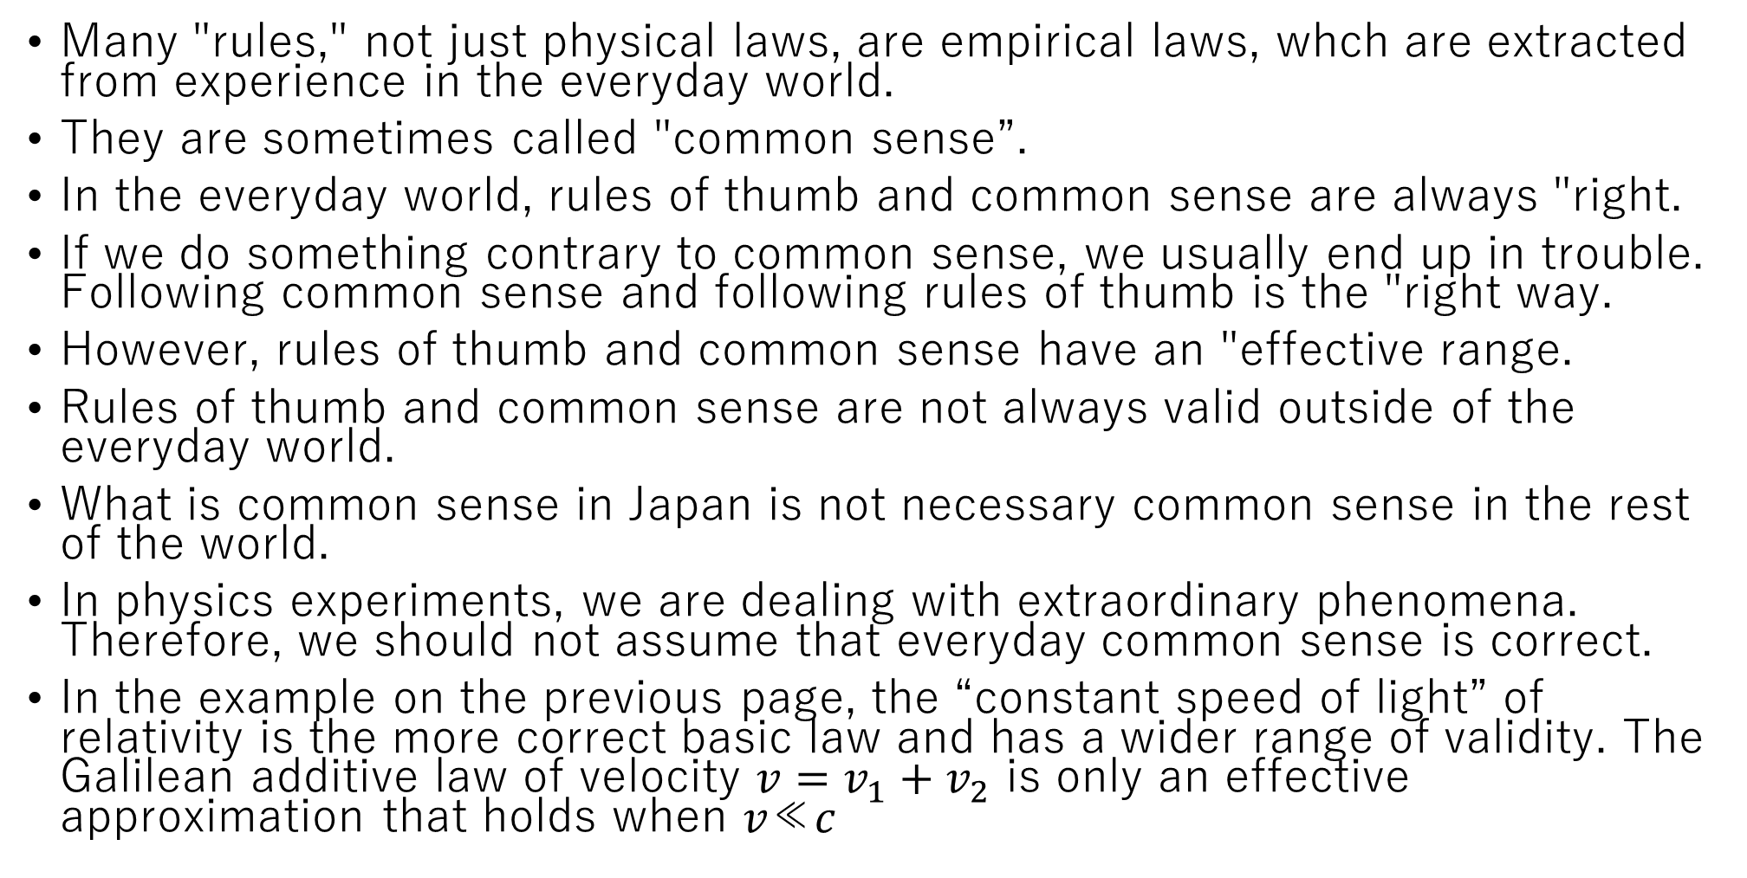
Experience and common sense are not always right.
Many "rules," not just physical laws, are empirical laws, whch are extracted from experience in the everyday world.
They are sometimes called "common sense”.
In the everyday world, rules of thumb and common sense are always "right.
If we do something contrary to common sense, we usually end up in trouble. Following common sense and following rules of thumb is the "right way.
However, rules of thumb and common sense have an "effective range.
Rules of thumb and common sense are not always valid outside of the everyday world.
What is common sense in Japan is not necessary common sense in the rest of the world.
In physics experiments, we are dealing with extraordinary phenomena. Therefore, we should not assume that everyday common sense is correct.
In the example on the previous page, the “constant speed of light” of relativity is the more correct basic law and has a wider range of validity. The Galilean additive law of velocity $v=v_{1}+v_{2}$ is only an effective approximation that holds when 𝑣≪𝑐

Slide 8
The purpose of an experiment is to demonstrate that a model or theory is INCORRECT
You cannot prove that a model or a theory to be correct
But you can demonstrate that it is incorrect
The most basic rule of Natural Science
Theories that do not fit experimental results are incorrect
They should be dismissed or corrected
Historically, it was only with the establishment of these basic rules that “natural science” was established and “progress” started in it.
For thousands of years until then, philosophers had been thinking about "truth". But no progress was made because there was no way to establish that a theory was wrong!
Only by showing through experimentation that a mistaken theory was "wrong" and then dismissing and correcting it, did natural science begin to make progress

Slide 9
Why it is meaningful to find a theory to be incorrect?
The purpose of physics experiment is to test the limitation of theories.
It is not possible to prove that a theory is absolutely correct. In this sense, all theories are effective theories with some (know or unknown) validity range.
The theory's predictions are tested by experiment. If the prediction does not meet the experiment, the theory is wrong. This means that the validity of the theory is determined by the experimental verification of the theory.
If the theoretical prediction does not match the experiment, the theory should be modified to match the experiment. In this way, a "more correct theory" or "more basic theory" with a wider range of validity is obtained.
The purpose of the experiment is to discover errors in the theory and to force a correction to the theory
Physics has made progress by repeatedly improving theory through tests by experiment,

Slide 10
Standard Model and General Relativity
One of the two purpose of Physics is to find the fundamental laws
If a theory cannot be rejected by any experiment, i.e., if the predictions of the theory are consistent with the experiment, then the theory is a fundamental theory of physics.
We now have two such theories, namely
General Relativity
Standard Model
So far, there is no firm experimental result that contradicts with General Relativity or Standard Model.
Particle physicists are looking for Beyond SM, i.e., phenomena that is forbidden by the SM, for four decades with no success.
Similarly, the search for breakdown of GR is not successful
SM and GR are close to the “fundamental theories” of physics
The correctness of the SM and GR are guaranteed by a very large number of experiments

Slide 11
Uncertainty in measurement is important
Any measurement has uncertainties
There is no measurement without uncertainty.
When we present the results of a measurement, we must present not only the central value of the measurement, but also the uncertainty of the measurement.
Measurement results without uncertainties are meaningless.
Error should be considered as important as the central value of measurement
The following results have the same central values
$$10±100$$
$$10±10$$
$$10±1$$
$$10.0±0.1$$
$$10.000±0.001$$
But they represent completely different results.

Slide 12
Physics is "problem simplification."
Natural phenomena are usually very complex and involve many factors.
Therefore, they cannot be understood as they are.
In physics, complex problems are broken down into simple problems, and the simpler problems are solved.
Complex problems are interpreted as combinations of simple factors.
Fundamental laws describe simple problems.
Problem Simplification - > Discovery of Fundamental Laws
Complex phenomena are described as combinations of simple problems that can be quantitatively understood by fundamental laws.
In experiments, we verify the fundamental laws by creating very simple conditions and conducting experiments.

Slide 13
Collider experiments are "simplification"
The reason we do beam collision experiments is to simplify the problem
In a collider experiment, we create the simplest situation, i.e., a reaction between two particles, and the reaction is examined.
The most advanced case of this simplification is the electron-positron collision experiment. The reaction between electrons and positrons, which are elementary particles, is investigated.
However, RHIC and LHC are slightly different. This is because quarks and gluons cannot be extracted by themselves (confinement)
So we do
Study interactions between quarks and gluons by making protons collide with each other.
Create QGPs in nuclear collisions and study the properties of QGPs.
Search for heavy new particles (LHC high-energy physics)
Experiments at RHIC and LHC are dealing with more complex situation than $e^{+}e^{−}$ collisions. However, it is the most simplified means of studying the desired physics.

Slide 14
Simulation is also for simplification and idealization
In the data analysis of a physics experiment, simulation is performed and used to analyze the data. Why?
This is because real experiments are not simple. Ideally, we conduct experiments so that only the reactions we want to examine occur, but in real experiments, there is an extra background or undesirable side reactions occurring at the same time.
Simulations are performed to investigate how these "extra effects" distort the "ideal experimental results" that we want to measure.
Example: Measurement of the energy distribution of a generated particle (e.g., photon)
Ideally, we can measure the energy of the generated photons with a calorimeter that has infinitely good energy resolution. The measured distribution is directly the "photon energy distribution" that we want to obtain. However, actual calorimeters have a resolution of about 1.0 GeV ± 0.1 GeV for a 1 GeV photon. In addition, the distribution of energy measurements is not always Gaussian.

Slide 15
Simulation is also for simplification (2)
Examine how the "measured energy distribution" shifts from the "original energy distribution (the correct answer)" due to the effect of energy resolution in a simulation.
If the effect due to the response of this measuring instrument is accurately investigated by simulation, the "original energy distribution" (the correct answer you want to measure) can be restored from the "measured energy distribution.
Actual experiment
True distribution→(instrument effect)→observed distribution
This is "convolution.
If the "instrument effect" is determined in the simulation, the reverse can be done
Observed distribution→ Inverse of (instrument effect)→ True distribution

Slide 16
Know what is more basic and correct
You probably think we have had a very abstract discussion, but what we have discussed so far is sometimes very useful
It is important to know "what is more correct.“
Sometimes there seem to be contradictions between the rules we have learned
Sometimes, when we are doing experiments, etc., we seem to get contradictory results. This is confusing because you don't know which one is correct.
At this time, identifying the "more correct one" among the contradictory results is the first step in solving the problem.

