Slide 1
To compere MC result to real data with clustering
Towards
[Tomoya Kato]
(Rikkyo Uni)
Check MC result and
Goal in this workshop: Check MC result and data with understanding PHoBOS
My To-Do List
trying cut adc0 before clustering
Compare the number of clusters in MC and real data (initially for 0-5%).
Verify the correctness of MC.
- Vary the collision points to observe the ratio of cluster numbers to tracking numbers for inner and outer regions.
- Research what MC is
- vary collision points with MC. (if possible)
・Confirm that the paper and MC match.
- Read the paper's clustering method.
I’d like to write document About Expert GUI (if possible)
A figure for an explanation if needed.

Slide 2
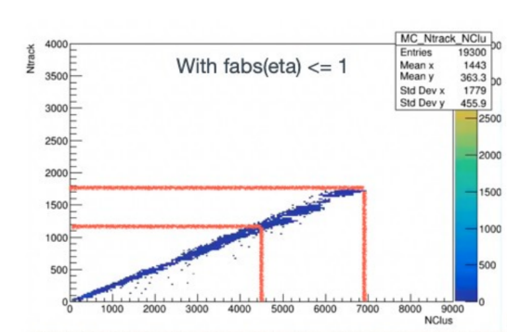
To compere MC result to real data with clustering
Towards
[Tomoya Kato]
(Rikkyo Uni)
Phobos result
To understand
Read the paper's clustering method
data
Montecarlo
・compare number of cluster
1st Remove adc0 before clustering
1st Plot multiplicity data and simlation
Verify the correctness of MC.
Vary the collision points to observe for inner and outer regions.
I’d like to write document About Expert GUI (if possible)

Slide 3
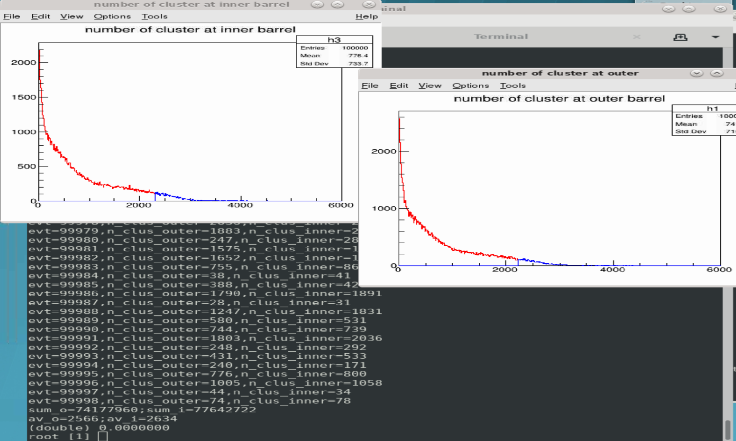
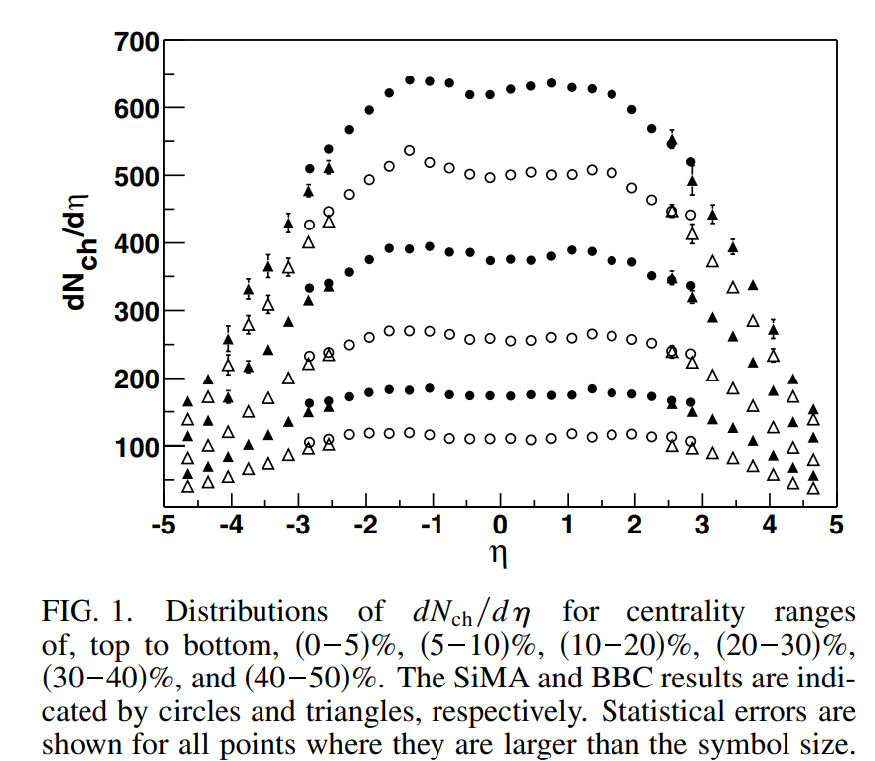
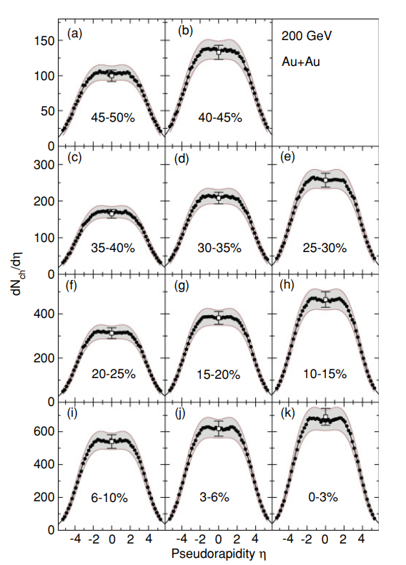
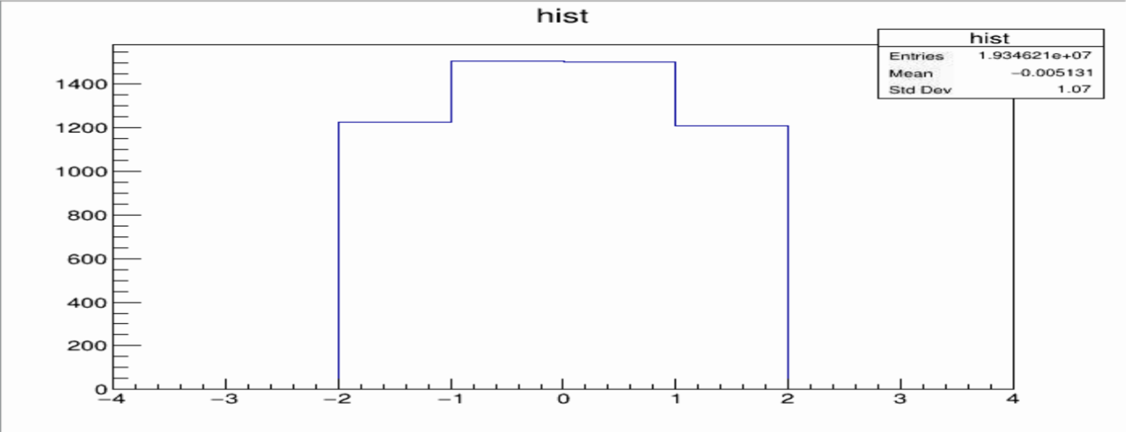
To compere MC result to real data with clustering
Towards
[Tomoya Kato]
(Rikkyo Uni)
BRAHMS
Phobos result
To understand
Read the paper's clustering method
data
Montecarlo
PHOBOS
・compare number of cluster
1st Remove adc0 before clustering
1st Plot multiplicity data and simlation
Verify the correctness of MC.
Vary the collision points to observe for inner and outer regions.
I’d like to write document About Expert GUI (if possible)

Slide 4
Compare(confirm) PHOBOS(BRAHMS) to Montecarlo
Paper result and Montecarlo are similar
BRAHMS
Montecarlo data
PHOBOS
Y axis :Ncluster
X axis :eta
Select top5%Ncluster(>4500) , include inner+outer layer
Now I try to separate at layer

Slide 5
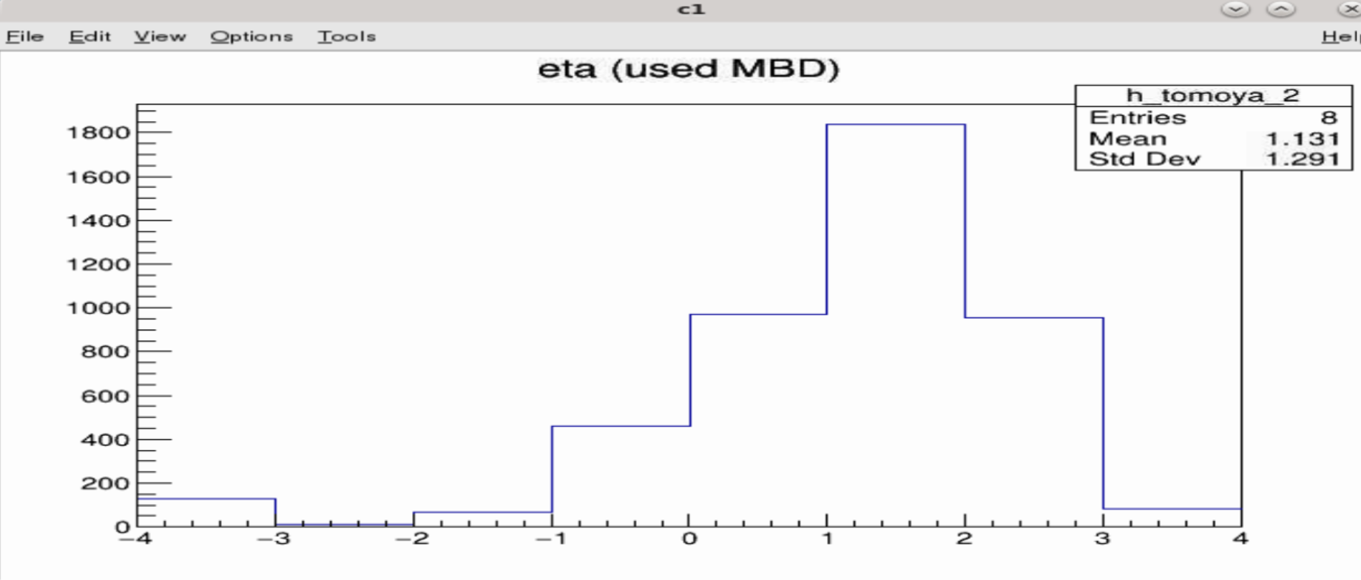
I borrow Misaki

Slide 6
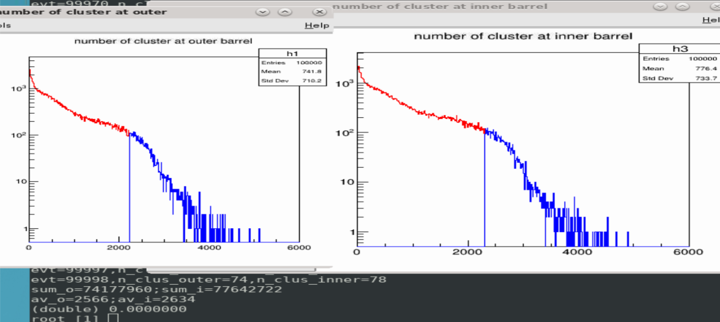
All adc0 was cuted.
I remove cluster that has adc<size*30

Slide 7
Detection efficiency using cosmic ray data
Towards
Genki Nukazuka
(RIKEN/RBRC)
Determination of detection efficiency of INTT using cosmic ray data as a function of half-ladder/chip/channel.
Goal in this workshop: Checking data, Migration to Fun4All framework, stability check of runs
My To-Do List
Checking whether all cosmic ray data was transferred to the SDCC storage
Processing all cosmic ray data with the latest decoder (DST production?)
Running a sample Fun4All macro
A very simple analysis within the Fun4All framework (with the input of the event-base TTree or DST?)
Giving INTT hits, clustering, converting clusters to hits (in the sPHENIX tracking framework?)
Applying a hot channel map
Applying the latest geometry correction from the survey data
Checking hit position distribution (x, y, z)
Checking ADC distribution
Event selections for finding cosmic track
A study using reconstructed cosmic tracks
Checking angle (both θ and φ) distributions
Checking cluster size distribution
EXAMPLE
A figure for an explanation if needed.

