Slide 1

Spokesperson’s Office Report
J. Lajoie, S. Dalla Torre
October 27, 2023

Slide 2
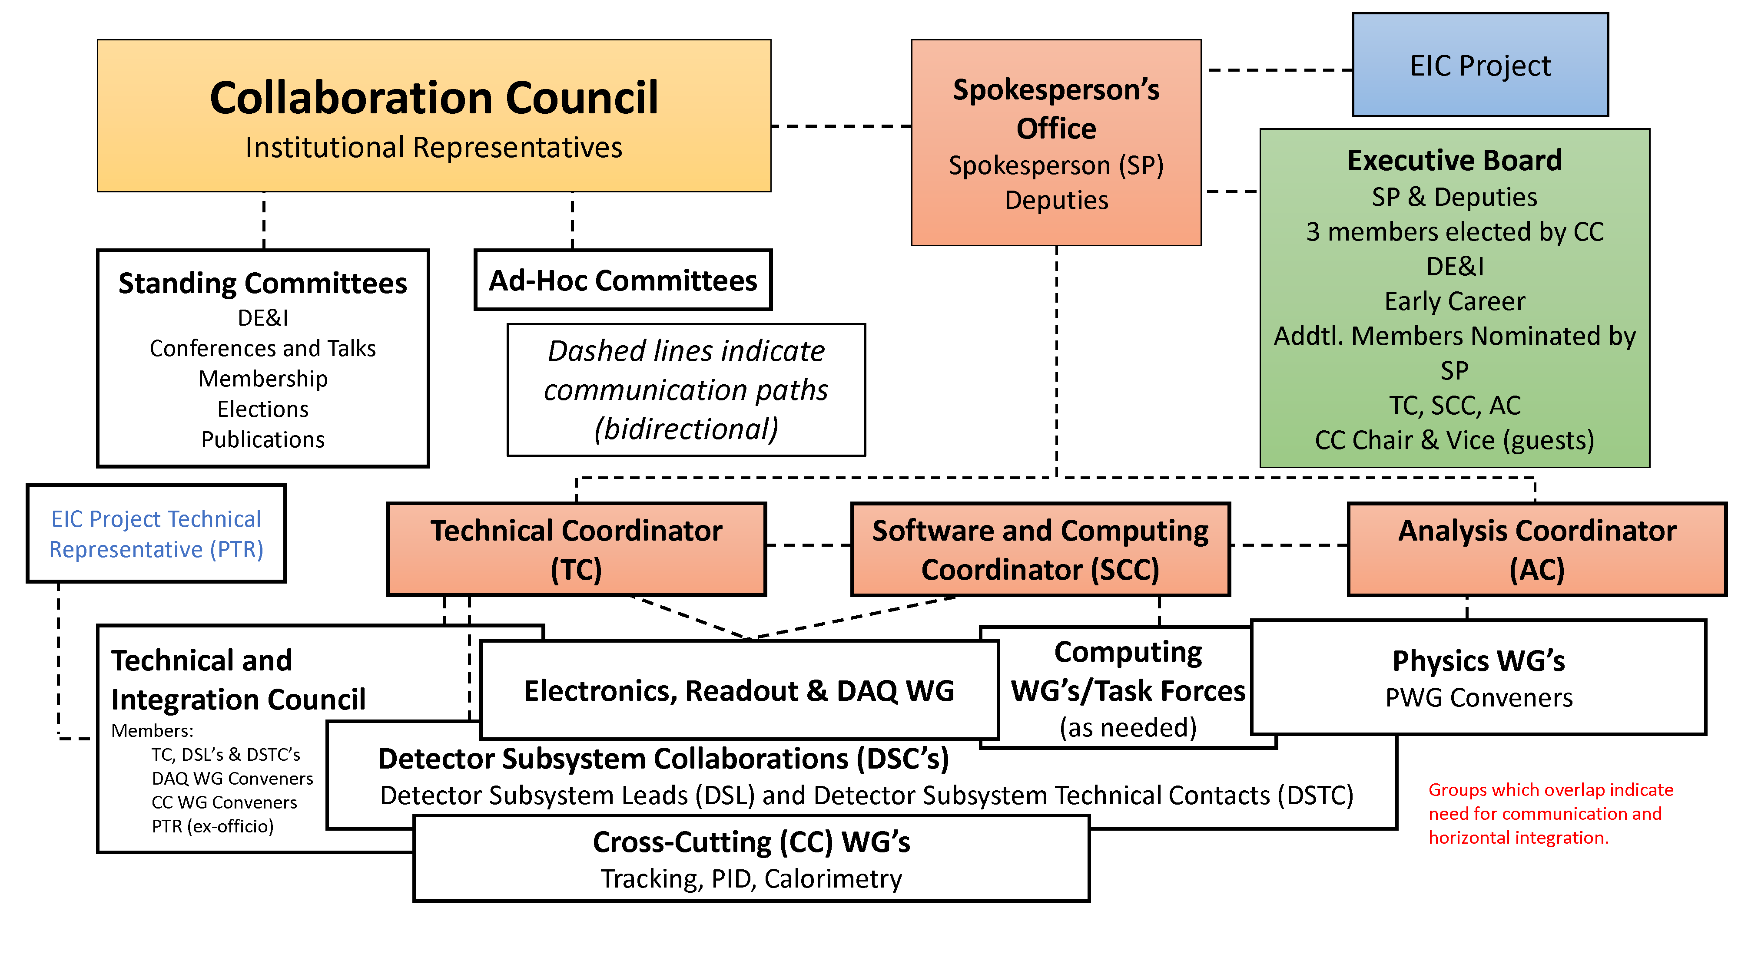
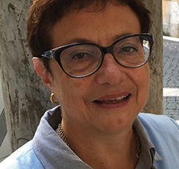
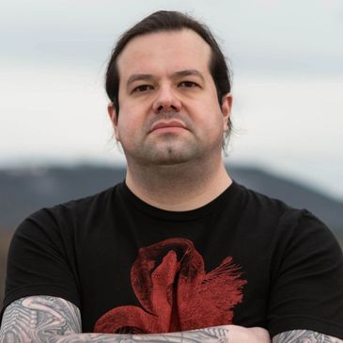
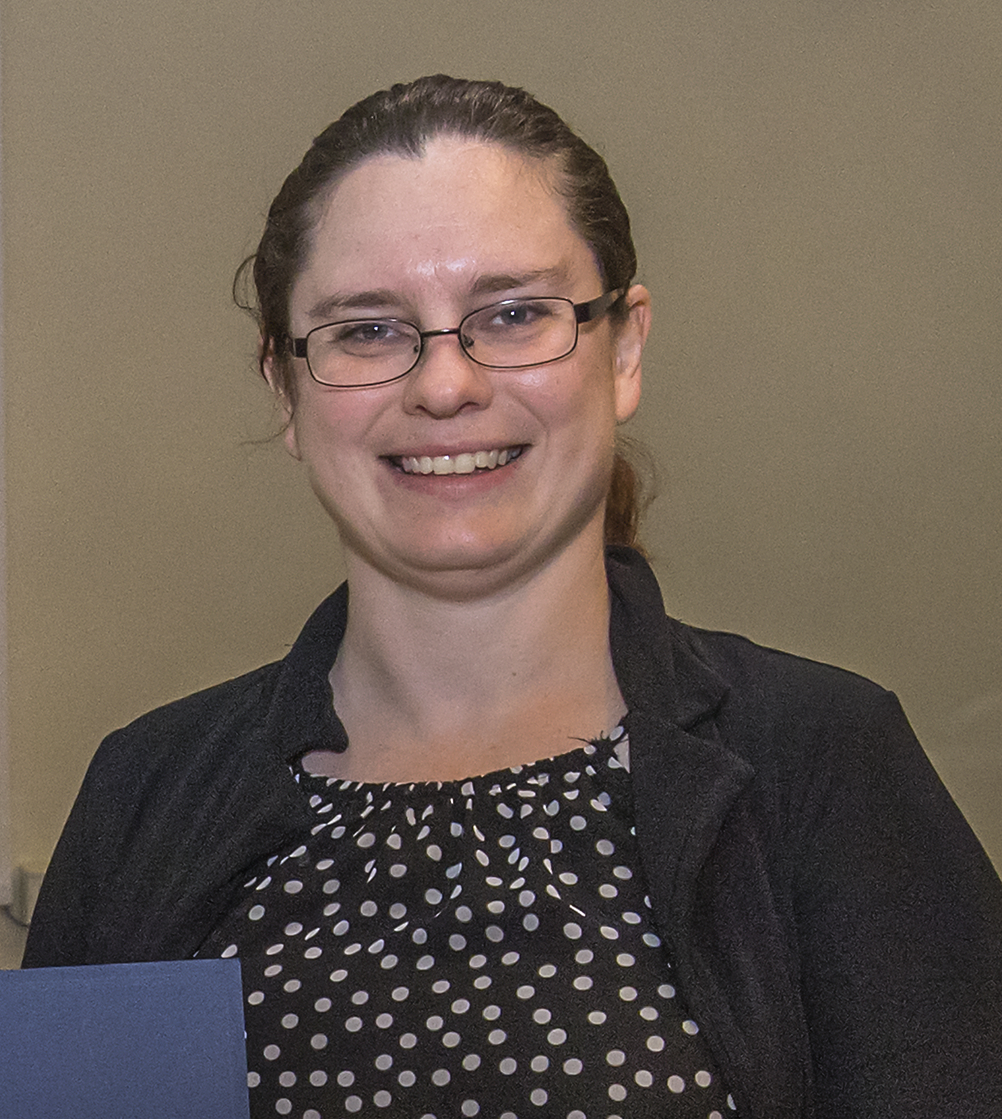
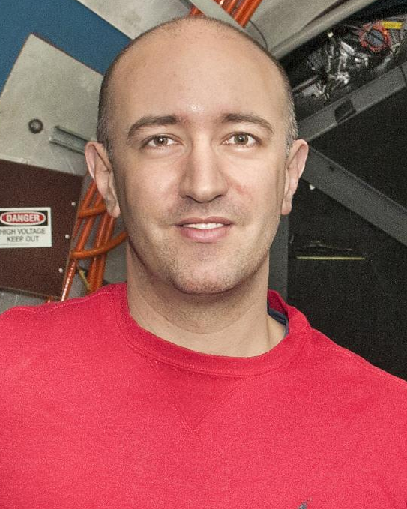
ePIC Collaboration Structure
Technical Coordinator (Acting)
• Silvia Dalla Torre (INFN)
SCC Coordinator
• Markus Diefenthaler (JLab)
• Wouter Deconinck
(U. of Manitoba,
Deputy SCC for Operations)
• Sylvester Joosten
(ANL, Deputy SCC for Development)
• Torre Wenaus
(BNL, Deputy SCC for Infrastructure)
Analysis Co-Coordinators
• Rosi Reed (Lehigh Univ.)
• Salvatore Fazio (Univ. Calabria)

Slide 3
ePIC Technical Coordination
We have encountered a number of difficulties in finding a permanent Technical Coordinator for ePIC:
  Our community is already heavily committed
    Can’t just shift the TC problem to somewhere else within ePIC!
    Groups have existing responsibilities, not just on ePIC but at JLab, RHIC, LHC, etc.
  Experienced people from outside ePIC are committed and unavailable
There are also issues associated with the nature of the position:
  It is not funded – asking for 80% of an experienced technical person is asking for a very substantial commitment
  This is a collaboration position and not directly
  connected to the EIC Project or the Host Labs - there is a
  lot of concern about the scope of the responsibilities
Technical Coordinator
Requirements:
Technical competence
Experience with DOE construction projects
Able to spend >80% of time on ePIC

Slide 4
The Path Forward for TC Office
Planning to appoint two Deputy TC’s in the next week or so
  Follow what works (Software and Computing model) – establish a small group of people who can work together to handle the workload
  Provide an opportunity for talented people to develop professionally
    Nurture talent within the collaboration - this is key to our ePIC management philosophy!
Silvia will continue as Acting Technical Coordinator
  We expect this will continue for the near-term (next few mos.) while we continue to try to identify a TC
  Very important to have stability now while we continue to establish the TC and keep it functioning as the ePIC technical design evolves
    Need to make progress towards TDR and CD-2/3

Slide 5
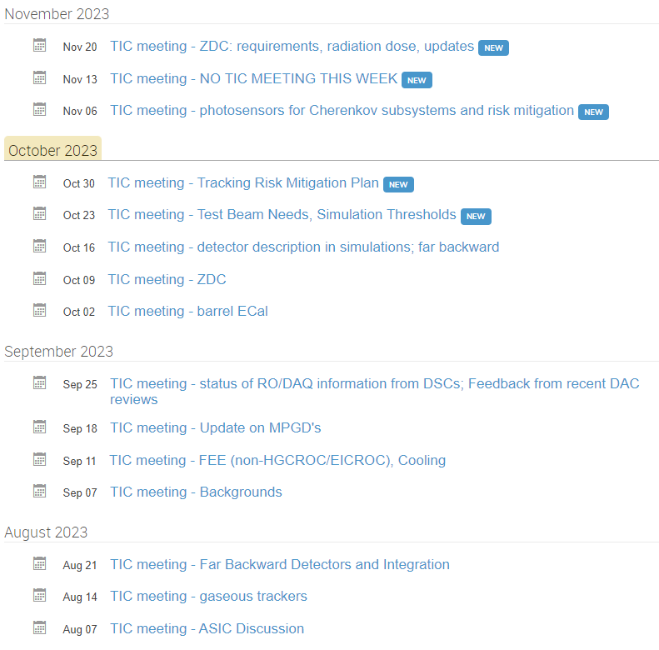
Recent Work of the
TC Office
TC Meetings organized in advance
  TC is proactive in setting agenda
  Speakers and expectations organized in advance
Closed discussion with PTR, CC WG conveners following open session
Notes on findings and decisions sent to TIC mailing list and posted to agenda
  Meeting recording also available

Slide 6
Summary
The SP Office has struggled to provide a TC nomination to replace Klaus Dehmelt
Nevertheless, we remain committed a TC Office within ePIC
Plan to go forward temporarily with an acting TC and supplement with two additional deputies
  Work with a model shown to be successful
  Critical that the work of the TC continues and increases
  Provide opportunities for talented people in ePIC
  Will continue search for a more permanent solution
We are very open to hearing concerns, comments and suggestions from the collaboration!

Slide 7


Slide 8

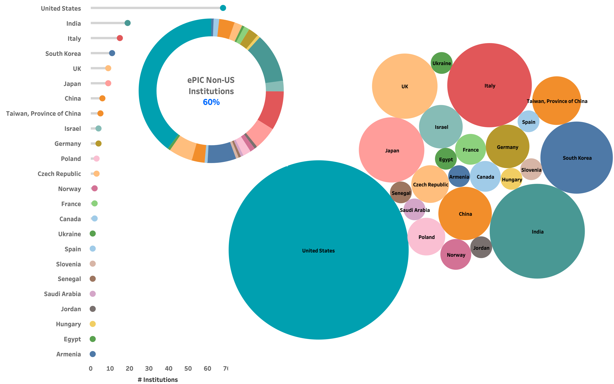
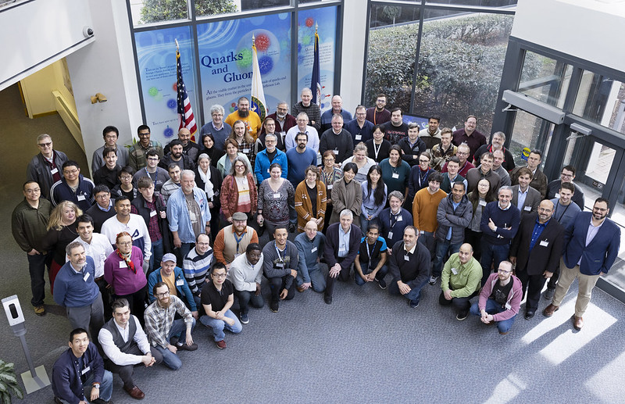
The ePIC Collaboration
171+ institutions
24 countries
500+ participants
A truly global pursuit for a new experiment at the EIC!
Notes:
24 countries total

Slide 9
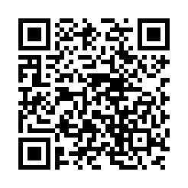
ePIC Resources – Get Connected!
Mailing Lists – https://lists.bnl.gov/mailman/listinfo
Indico Agenda - https://indico.bnl.gov/category/402/
Wiki - https://wiki.bnl.gov/EPIC
ePIC Software Training:
https://eic.github.io/tutorial-setting-up-environment/
https://eic.github.io/tutorial-geometry-development-using-dd4hep/
https://eic.github.io/tutorial-simulations-using-ddsim-and-geant4/
https://eic.github.io/tutorial-jana2/
Recordings: https://www.youtube.com/@eicusergroup1532
QR code for Mattermost channels:

Slide 10


Proposals for ePIC Membership
from the ePIC Charter:
After initial formation, new institutions are admitted to EPIC by a super-majority vote as described in Voting and Elections provisions of this Charter, after a proposal made to the Collaboration Spokesperson and Executive Board.
University of Debrecen
Nara Women’s University

Slide 11


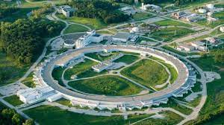
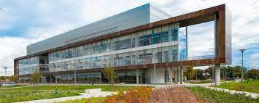
Next Collaboration Meeting – Jan 2024
Jan 9-13th, 2024 @ ANL
Three days of parallel workfests followed by two days of plenary sessions:
  https://indico.bnl.gov/event/20473/
  Send your students and postdocs!
  Student support available:
  https://indico.bnl.gov/event/20473/page/575-student-support
General registration coming early November
Make your travel plans now!!

