Slide 1
EIC Project Update
Elke Aschenauer and Rolf Ent
Co-Associate Directors for the Experimental Program
ePIC General Meeting
October 20th 2023

Slide 2
Upcoming Detector-Related Project Meetings
September 25: Final Design Review of the forward HCal W & Steel
Reviewers: Jim Mills (BNL), Felix Sefkow (DESY)
October 5 + 6: Final Design Review of Magnet (MARCO)
Reviewers: Gianluca Sabbi (LBNL), Ruben Fair (JLab),
Vladimir Kashikin (FNAL), Bill Schneider (retired JLab)
October 10-12: DOE CD-3A Director’s Review
Folds in Design Review reports of DAC, MAC, Infrastructure Committee; Concentrates on CD-3A Long Lead Procurement Items
Detector Reviewers: Rik Yoshida (ANL), Gabriella Carini (BNL),
Luciano Musa (CERN), Tim Whitlatch (JLab)
November 14-16: DOE CD-3A Independent Project Review
December 7 + 8: 2nd Resource Review Board meeting @ CUA, Washington
December/January: Preliminary Design Review of Far-Forward/Far- Backward Detectors
All 2023 PDR and FDR and design review closeout reports are posted here
Closeout Reports from Reviews

Slide 3
MARCO Magnet - FDR Recommendations
Recommendations
The review committee recommends proceeding to initiating long lead procurements as planned.
Complete and approve magnet design report, reference drawing package and SOW for the magnet procurement before the vendor solicitation process begins.
Apply a formal documentation and approval process for any requested design changes to the reference design before the vendor solicitation process begins.
Formalize the contracts for characterization of the cable samples and complete the test program by March 2024.
Consider possible additions to the long lead procurements that support the timely commissioning of the detector magnet to be included in a potential CD-3B
Proceed to LLP
2-4. Work to complete to initiate vendor solicitation
5. Concern about further magnet peripheral components, supply chains

Slide 4
Magnet - FDR Committee Conclusions
The collaboration between CEA-Saclay, JLab and BNL has continued to make excellent progress and the review committee strongly supports extending this collaboration into the procurement, fabrication and commissioning phases
Significant progress has been made since the 60% design review and the magnet reference design is now complete.
The design needs to be documented in a reference drawing package and change control processes should be applied from that point
Remaining interfaces that are directly relevant to the CD3A scope (conductor and magnet) need to be documented and formally approved prior to contract awards

Slide 5
CD-3A Director’s Review

Slide 6
CD-3A Director’s Review – SC-3 Detector System
Comments:
The detector group has made impressive progress since CD-1. A rather mature project management, for this stage, exists. International detector collaboration ePIC has been established and the project and the collaboration has good coordination.
The detector integration both within the detector and also with the accelerator is, as usual, a challenge. At this stage of the project, the detector team is addressing these issues in impressive detail.
Appropriateness of proposed CD-3A LLP items is central to these reviews. While we got the information from separate talks and questions, a sufficiently detailed summary of these items should be up front in the plenary presentation.
Presenting a summary of policies regarding ESH and Q for detectors (particularly for outside vendors, universities, and foreign entities) upfront in the plenary session would alleviate concerns from reviewers in a timely manner.
There are several possible in-kind contributions that could significantly, and positively impact the project, if successful. One is the NSF proposal which, if approved, will cover the costs of the backwards EM calorimeter including the PbWO4 purchase. There is also a possibility of in-kind contribution for the detector solenoid.
Upfront discussion of risks of R&D not coming to a favorable conclusion, and mitigation plans in this case, should be more clearly documented and presented. Where appropriate, for example for the tracking detector, more detailed plans should be developed.
Since Astropix production for the EM calorimeter is probably the largest silicon detector production for EIC, and one of the largest in the field, there should be more detail about its organization, planning and production in the subdetector presentation.

Slide 7
CD-3A Director’s Review – SC-3 Detector System
Comments - continued:
An overarching concern is the oversight of production yield and the distribution of key parameters for certain components over a large-scale production. These factors will need to be adequately accounted for in the project planning and management before CD-2.
Based on the presentations made during this review, it remains unclear whether the process of selecting components and transitioning from the research and development phase to production includes the validation of a substantial system prototype for all components. Full chain tests for subdetectors should encompass all final components, enabling an assessment of whether these components meet the requirements not only in isolation but also in terms of their integration and overall system performance.
The magnet LLP is ready to go forward. After CD-3A approval, before the solicitation, the recommendations of the Solenoid Magnet Final Design Review should be implemented.
The LLP items for the detectors are ready to go forward. Presentation can be improved as described elsewhere in these comments.
Recommendations:
Quantify (time, cost, performance) and document, before CD-2, mitigation plans for the possibility that some R&D components will not meet expectations.
Proceed to CD-3A.

Slide 8
CD-3A Director’s Review – SC-3 Detector System
We do need to urgently follow up on the following comment
“Upfront discussion of risks of R&D not coming to a favorable conclusion, and mitigation plans in this case, should be more clearly documented and presented. Where appropriate, for example for the tracking detector, more detailed plans should be developed.”
for the CD-3A review in November
→ We started discussion with ePIC tracking WG conveners & tracking DSCs
→ Remember that this is ONLY a mitigation plan (a what-if scenario)
→ There is NO change to the current baseline layout of the tracker
Further Timeline:
Thursday 26th Tracking WG meeting first discussion of a possible backup solution and timeline to possible branching points.
Monday 30th Discussion in TIC meeting
Follow up meetings as needed
This is not a new topic – remember the summary of the CERN visit in April 2023 by ePIC leadership, Si tracking proponents, and project leadership

Slide 9
Summary on ITS-3 ALICE –EIC SiC
Overall a very positive and successful meeting → clear goal to cooperate as much as possible in boundary conditions.
Main lessons learned and next steps
ITS3 open to sharing their sensor design with EIC → necessary agreements will need to be put in place in the next month.
ITS3 development made significant progress → received a lot of critical technical information to guide the next steps in R&D for both sensor and system design/integration of the ePIC SVT
but there remains still some risk in the ITS development → ALICE team will need to remain focused on their requirements and timeline challenges
→ ITS3 welcomes/seeks partnership in development with EIC designers contributing to ITS3
→ Received extremely valuable input to overall schedule and workforce needs for EIC SVT
Example: relation between schedule for ITS3 ER2/ER3 submission and evaluation and the
EIC/LAS development schedule → adjust our schedule to give more time for the sensor
modifications and the schedule and integrate lessons learnt from ITS3
→ ITS3 suggests we put in place a backup plan as our workforce is still growing, and the
overall EIC SVT schedule is aggressive
All the inputs are currently folded in an updated plan by the EIC SVT team
Updates will be presented in the respective ePIC meetings (TIC & TWG) by the SVT team
From ePIC general meeting of May 11

Slide 10
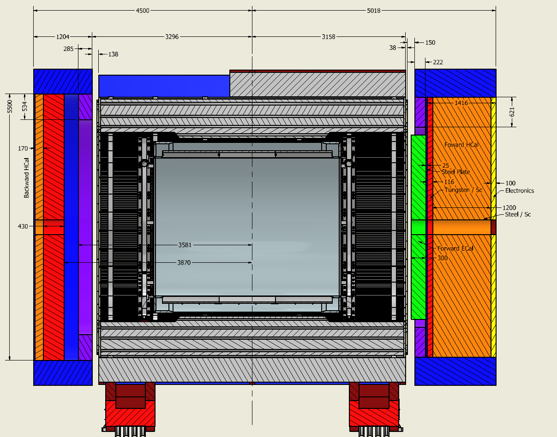
Final Layout of Flux Return and HCals
Note: detector is aligned with electron beam → 8 mrad rotation also for endcaps
From ePIC Collaboration Meeting July 2023
Stainless Steel
Steel
backward HCal was
further optimized to provide better overlap with barrel Hcal
→ separated the flux return from the backward HCal
→ need to use stainless steel as absorber
Steel

Slide 11
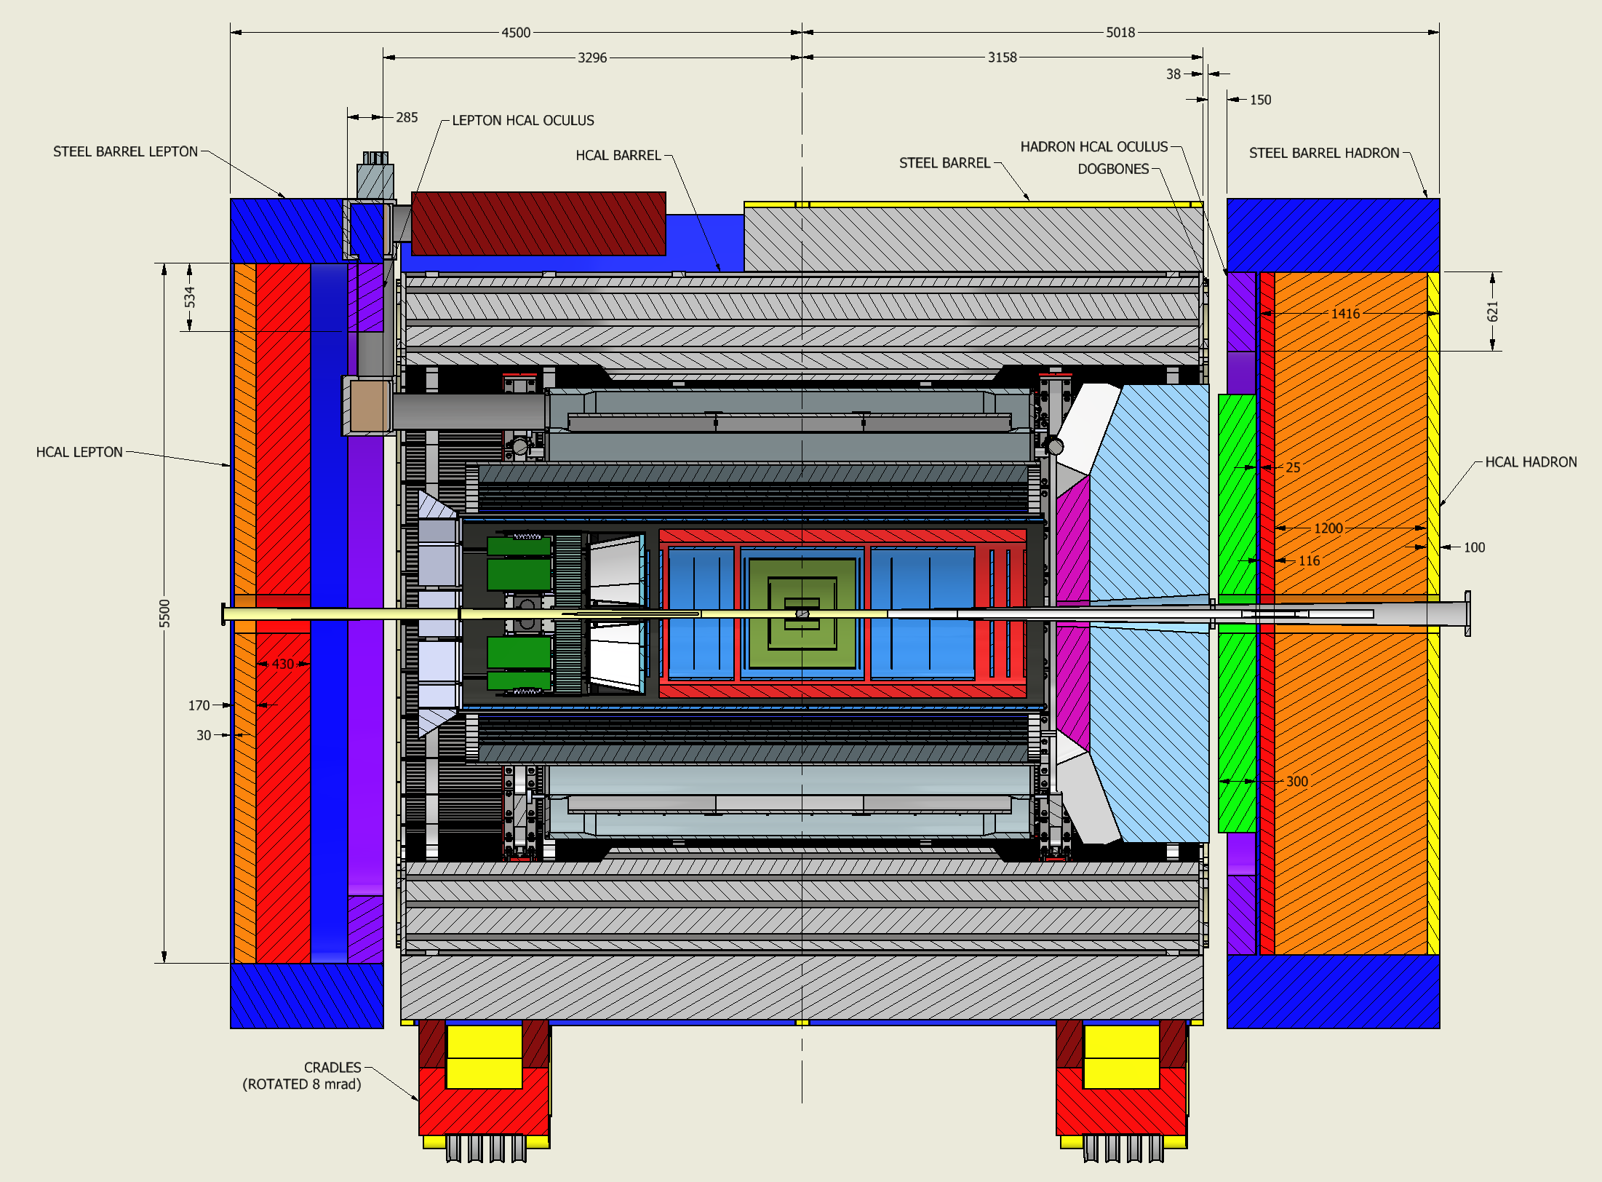
Final Layout of Flux Return and HCals
Note: detector is aligned with electron beam → 8mrad rotation also for endcaps
backward HCal
→ separated the flux
return from the backward HCal → move maybe closer towards IP
→ need to use stainless steel as absorber
Current Assumption:
re-use scintillator from STAR ECal
BUT
This causes a dependency on STAR removal. This makes the R&R process significantly more complicated and costly
→ not a realistic possibility
can use alternatives
E.g., build scintillator the same way as fHCal
Stainless Steel
Steel
Steel

Slide 12
Further Project Updates
All R&D response letters have been sent by Thomas yesterday
Same as FY22 and FY23, some contracts come through BNL, some come through Jefferson Lab
eRD102 dRICH Reduced to R&D only. Can not support software/simulations as R&D.
eRD103 hpDIRC Reduced to R&D only. We need to develop solid plan for further work.
[Note: separately planning to move remaining DIRC bar boxes from SLAC to JLab later this CY]
eRD107 fHCAL As requested
eRD108 MPGD Reduced to only MicroMegas part as ongoing R&D. Working with tracking WG to start E&D phase.
eRD109 ASICs As requested
eRD110 photosensors Reduced to R&D only in consultation with Pis. MC-PMTs done separate..
eRD112 AC-LGAD Reduced to R&D only and to only two separate sensors.
eRD114 pfRICH Does not qualify as R&D as requested, working with Pis to start E&D phase.
eRD115 bEMCAL As requested
eRD104 Si services As requesteI
eRD111 Si non-sensors As requested
eRD113 Si/ITS3 Reduced to R&D tasks only in consultation with PIs
Note I: CD-2 is anticipated 2Q/FY25 so non-ITS3/AC-LGAD/ASICs R&D is expected to complete in FY24
Note II: the above plan would draw on contingency for R&D. We will honor it but may need to be creative.
We are working on FY24 contracts next → all PIs please stay in close contact with us to provide further information as required, and at the later stage with your procurement offices to avoid delays.
Reminder: please provide us with the information asked previously → THANK YOU
EPIC Detector Digitization Model.10.2023.xlsx
ePIC Detector Information Request.xlsx

