Slide 1
Mechanics updates

Slide 2
Global developments
Good news: eRD111 has been fully awarded for FY24 – this means that Oxford has now 40k$ to start doing real work
Now need to set up the paperwork
(In parallel I have asked for ~20k£ from my college)
Nikki and I (for international WP4 – mechanics) and Andy Jung (for international WP6 – integration) met and updated WBS for our work packages (made sure nothing fell into the cracks)
International work package coordinators are supposed to work on requirements & specifications
I have started a draft for WP4 – sent to Nikki, she promised to look into it, but no reply yet

Slide 3
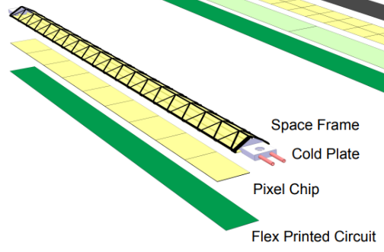
Mechanics meeting at DL
Good attendance
Several presentations to clarify knowns and unknowns
We noticed the tight schedule
To allow us get in prototypes before the TDR late next year we probably have to have identified by the end of the year one or two concepts we want to pursue in more detail
One (option) is to replicate the ALICE ITS2 concept (truss structure and water cooling)
This has been used to predict performance parameters used in the overall ePIC detector design
Challenges
Water cooling – not clear how air cooling would be possible
Is the cooling sufficient for our needs
Longer span
Overlaps in z and r (if needed)

Slide 4
Mechanics meeting II
The other option will be a foam-cored stave design, possibly with a thin UHM UD carbon fibre layer, and a Kapton surface to achieve a gas-tight channel for air cooling
This would be a new design, but it would be more in line with the expected IB design, so there is room for synergies, in particular for the gas cooling
Stephanie Yang (Oxford) will start some basic FEA to establish what materials/geometry could satisfy our needs
One thing we discussed is the relatively large dead are on a sensor (in particular the central spine, which cannot be covered by overlaps)
This raises the question whether complications in the mechanical desig to achieve overlaps are worth the effort
To understand this we agreed that we will build a more realistic geometry model (including the real sensitive area information)
The first step would be to do a simple hit count for as a function of η and φ
Later we can then study performance with more advanced track reconstruction
James and Sam will work on this

Slide 5
Next steps
I have arranged a meeting with Corrado to visit and discuss ALICE ITS2 IB and ITS3 mechanics on November 13th
This is ATLAS upgrade week, and I hope that Tim can join
Other people welcome
I plan to compile a list of foams people are/have been studying– contacted friends for input
Most interesting response from Joel Goldstein
He worked on LCFI and PLUME – they have worked on SiC and RVC foams down to 2% density
He also gave me a (very good) thesis about their work on RVC foams (FEA and measurements)
They worked with ERG (https://ergaerospace.com/) and were able to push them to these low densities, but he has lost his contact there, and the company web site does look more professional now, so not sure how much they are interested in R&D now
However, it turns out that the company is in the Bay area, 15 minutes from LBNL, so I asked Nikki. She was not aware of them, but said she would ask Eric Anderssen and Joe Silber (LBNL engineers) if they had a contact
In any case, we will make use of the fact that the LBNL people are next door and see whether they can start talking to them in person…

