Slide 1
RAL Update
24/10/23
Notes:
The abstract pattern can be removed or repositioned if required. Be careful to ‘Send to Back’ so that it does not obscure any important information.

Slide 2
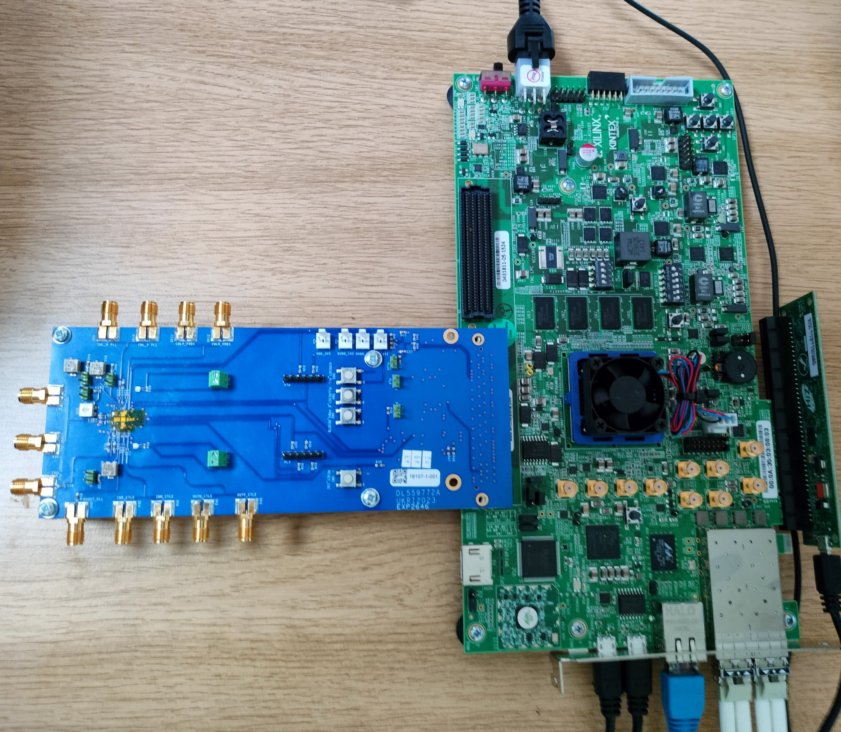
ER1 Tests
Update
Chips have arrived
Boards complete
All ship to UoB for bonding
Testing at DL?

Slide 3
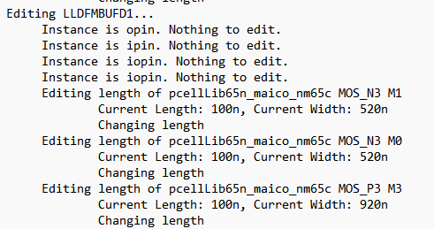
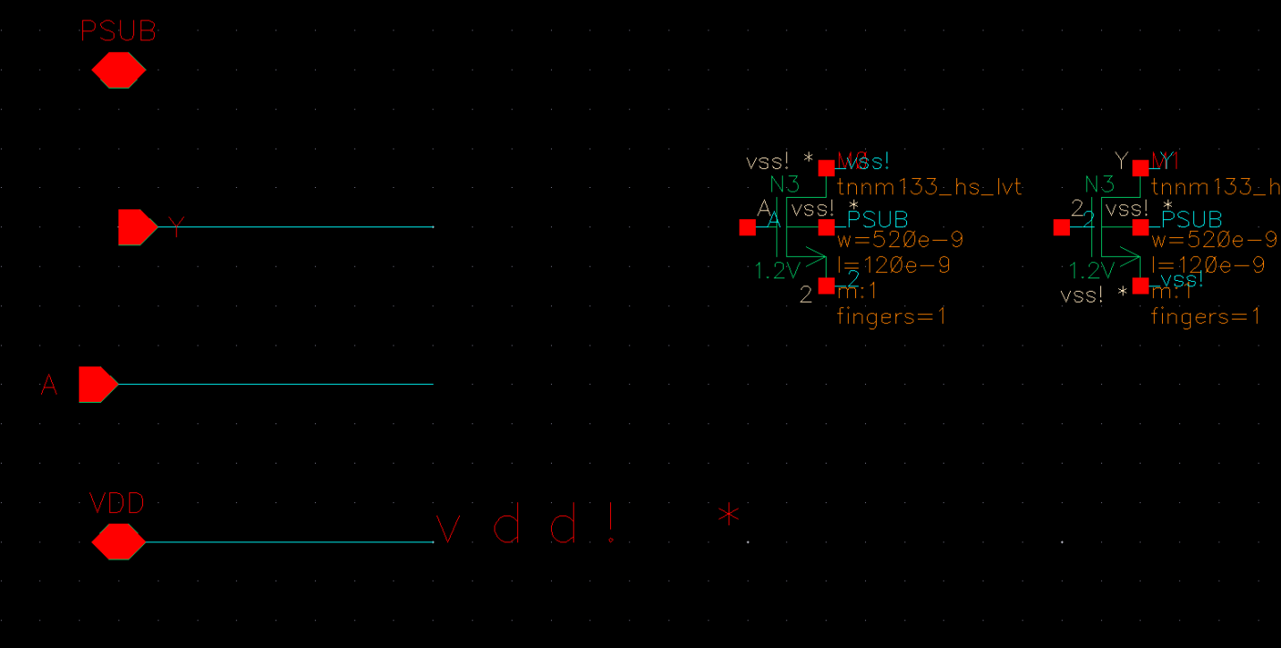
Design Work
Logic Libraries
Co-ordinating work on LLDFM cells for MOSAIX
Schematics complete
Working on layout distribution
SLDO
Arranging to have Roy Wastie as Visiting Scientist

Slide 4
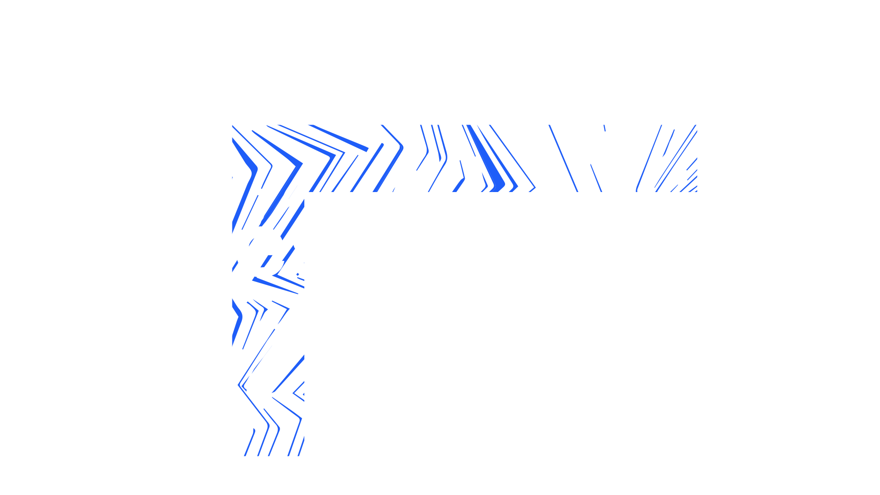
Notes:
The abstract pattern can be removed or repositioned if required. Be careful to ‘Send to Back’ so that it does not obscure any important information.

