Slide 1
Software Status updates
Takashi Hachiya
Nara Women’s University

Slide 2
Toward DST Production
Workflow of DST production
Rawdata DST(TrkrHitSet) is produced for each sub-system
Decoder issue will be fixed soon (Chris sent a message he updated the decoder yesterday)
Event synchronization among subsystems is also done at this production
Synchronization is done by BCOFull
Event Header
Each subsystem has their own event header in DST
Joseph made 1st version of INTT event header.
Chris mentioned that the data size is too much. (8 BCOFULL (40bits each))
Need to consider what information should be saved in the event header: Failure information, and so on
At GM, agreed that any results by the private decoder cannot be sPHENIX official result
Decoder issue
Last week, found that F4A decoder mistakenly produced multiple events which have the same BCOFULL value
Chris said it is fixed now (yesterday). I will check it again

Slide 3
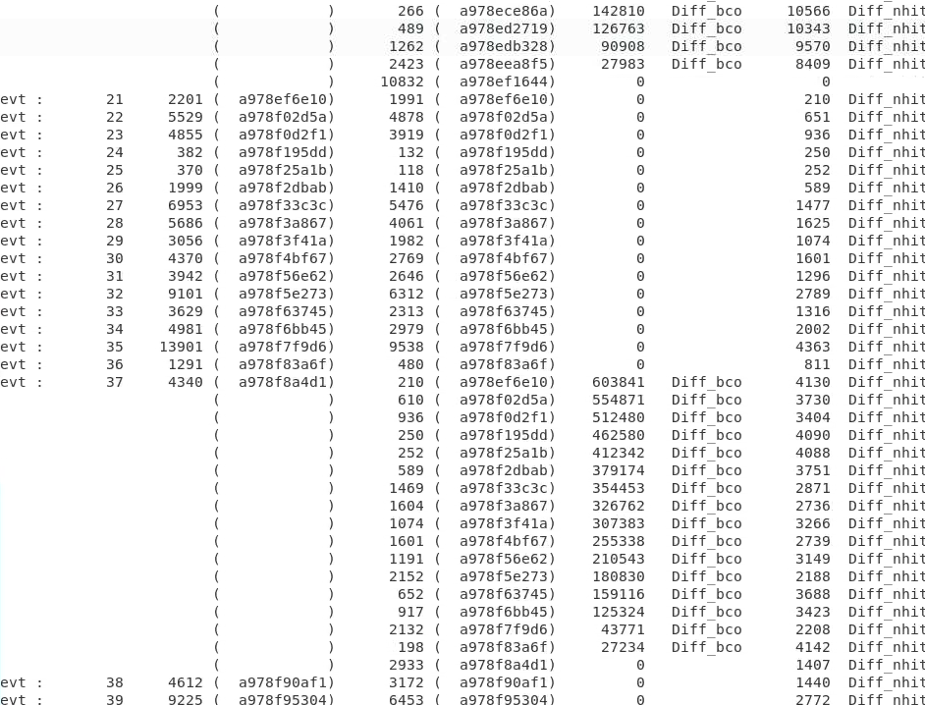
My decoder
FFA decoder
Nhit (BCO)
Nhit (BCO)
Nhit can be recovered by adding two events

Slide 4
Implementing HotDeadmap code
InttDeadMap.h/cc (simulation/g4simulation/g4intt)
To mask dead channels in simulation. Implemented a few years ago by Purdue group
I would like to use this as the v0 version for Hot/Dead map
Just for simulation but can be used for both data and sim with updates
In InttDeadMap, dead ch are managed by stl::set (key=64bit int)
Offline numbering is used
To update,
I would like to ask which online(hard) or offline numbering is good
I prefer online numbering because I want to use the same format to manage hot/dead channel map for both DST reconstruction and DAQ
Data structure needs to be updated to handle dead/hot (/ warm/ cold) statuses
Set -> map
63-56 | 55-40 | 39-32 | 31-16 | 15-0
Layer | Ladder_phi (ladder) | Ladder_z(sensor) | Strip_z (chip) | Strip_phi (channel)

Slide 5
Current status：Work flow for the production
<Simulation>
RCDAQ
physics
calib
Event-Gen
evt (32 bit word)
Ghit (PHG4Hit)
Martin, Joseph
Fun4AllDecoder
(SingleInttInput)
InttDeadMap
Unpacker
Two different mod.？
DST-sim
Trkrhit (hits in local coordinate)
Amp is to be dropped
Remove Badhit
InttCombined
RawDataDecoder
InttCombined
RawDataConverter
Online->offline Conversion map
Remove HotDead
Joseph
Geometry
alignment
New format？
EventBaseTree(or HitBaseTree)
TrkrCluster
Online Monitor
Hot/dead channel map
OutputTree（Raw Data）
Amp, Hit Ch, ADC, Chip, Ladder-ID, bco, bcofull
Cut cls w smallerE
…
Event Display
Manami
Root Raw Data Format*

Slide 6
(expected) workflow : Multi-stage approach
1st stage
HotDead
map
2nd stage
INTT (Fun4All_Intt_Conbiner.C)
Clustering and tracking
EVT file
Decoder
Raw data DST (HitSetContainer)
Remove HotDead
Intt
Clustering
Global Tracking
MVTX(Fun4All_Mvtx_Conbiner.C)
MVTX
Clustering
EVT file
Decoder
Raw data DST
TPC
Clustering
TPC
Raw data DST
CAL
Clustering
CAL
Raw data DST
Benefit: we scan the data to determine hot/dead/bad channel. These info can be applied in 2nd path

Slide 7
Alignment procedure
We expect : subsystem is responsible for local alignment, and tracking group is for Global alignment
This is not sure for now. Tracking group said that all the alignment will be done by tracking group with the cosmic ray data
But no time line, no framework, It will take huge amount of time
We need INTT local alignment for dN/deta
It is good to start the alignment by ourselves.
MVTX/MIT group knows how to use the alignment package based on Milliped.
I asked them to show their code

Slide 8
存在するDeadMapの構造
InttDeadMap.h (simulation/g4simulation/g4intt以下)
G4intt以下なのでSim専用という位置づけ
→ データでも使う場合、要変更。
STLのSetを使用した配列 ( mapのKeyだけ)
std::set<PHG4CellDefs::keytype> Map;
typedef uint64_t keytype;
Layer, ladder, sensor , chip, channel を含む64bit integer : OFFLINE_CHで定義
Hot, Deadなど(Warm, Coldも？) 、状態を分けたい場合、 setでは情報がたりない。
→MAPに変更したらよい。
DAQ用のHotChannel リスト
テキストファイルを直接読む形式： Hardware Chによって制御 (Jaeinのフォーマット？)
63-56 | 55-40 | 39-32 | 31-16 | 15-0
Layer | Ladder_phi (ladder) | Ladder_z (sensor) | Strip_z (chip) | Strip_phi (channel)

