Slide 1
Electronics & DAQ WG
Fernando Barbosa (JLab)
19 October 2023

Slide 2
Agenda
Welcome & News
  Report from CD-3A Director’s Review
  (extracts from Jeff’s presentation to ePIC Streaming Computing Model WG – 17 October 2023)
FY24 eRD109 Update
VTRX+ Update
Requests for Input updates:
  VTRX+ quantities
  Qmin/Qmax
  Institution/Group commitments
AOB

Slide 3
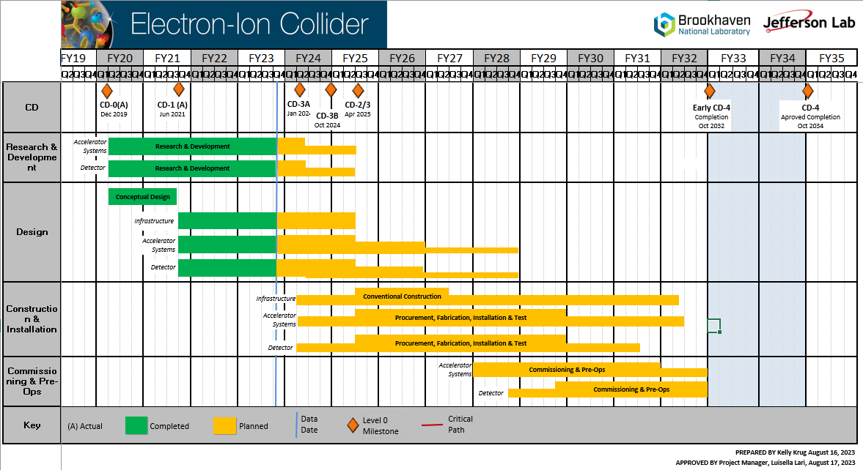
Report from CD-3A Director’s Review – Refer to Jeff’s slides
R&D – to April 2025 (CD-2/3, eRD109 until April 2027)
Design – to October 2028
Construction & Installation – to April 2031
Commissioning & Pre-Ops – to October 2032

Slide 4
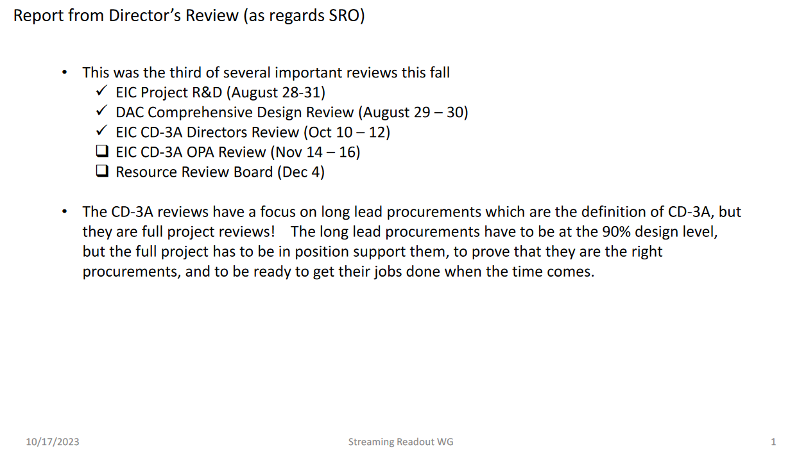
Report from CD-3A Director’s Review (cont.)

Slide 5
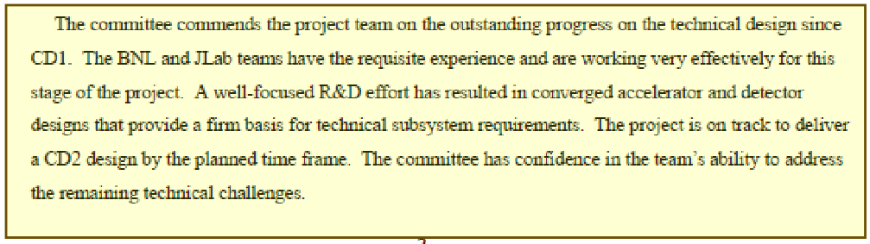
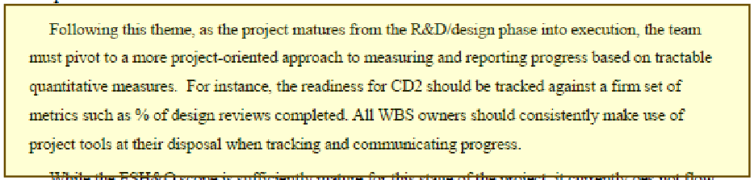
Report from CD-3A Director’s Review (cont.)
General Committee Remarks:
Outstanding progress
Well-focused R&D
On track
Confidence
Pivot to a project-oriented approach.

Slide 6


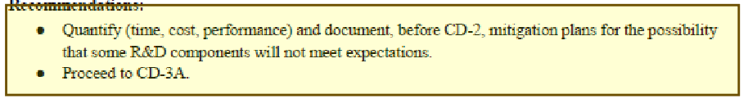
Report from CD-3A Director’s Review (cont.)
Detector Committee Remarks:
A credible plan.
Presentation of some materials early, plenary.
What if?

Slide 7
FY24 eRD109 Update
FY23 – All contracts have been awarded.
FY24 – Proposals, DAC reviewed 28-31 August 2023:
 | Detector/Technology | Discrete/ASIC | Group
A | Calorimeter | Discrete | IUCF
B | Calorimeter | HGCROC | ORNL
C | dRICH | ALCOR | INFN – BO, TO
D | AC-LGAD | EICROC | Omega/IN2P3/IJCLab/CEA/IRFU
 |  | FCFD | FNAL
 |  | Barrel L-M Serv. Hybrid | ORNL
 |  | High Precision Clock Distribution | BNL/Rice/UIC/ORNL
E | MPGD/µRWell | SALSA | CEA
 |  |  | USP
The synergies, commitments and responsibilities of the various groups working on the clock and GTU will be considered at an upcoming Electronics & DAQ WG meeting.
Present plan is to award eRD109 proposals as requested, unless there is a budget shortfall.
eRD109 initiatives should continue uninterrupted – High Priority.

Slide 8
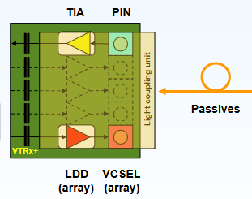
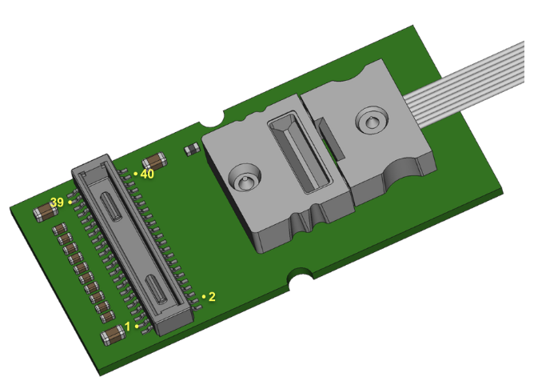
VTRX+ Update
VTRX+ - Versatile Link + Optical Link Module
TX: 5-10 Gbps
Rx: 2.5 – 5 Gbps
Pd ~ 320 mW
20 mm x 10 mm x 2.5 mm
~ $150.
1 RX
4 Tx
Multi-Mode Fiber
Rad Hard ASICs
COTs – Rad Tol screened
CERN-initiated production to start in early 2024.
Ken Wyllie is managing production requests for us on needed documentation to commit to production, to purchase, etc.
We need input from you regarding fit, needs and quantities.
Refer to latest VTRxPlus_spec.pdf here DAQ&Electronics

Slide 9
Requests for Input
1 – VTRX+ quantities – Plan to finalize this by 31 October 2023
2 – Qmin – Qmax – Plan to finalize this by 1 December 2023
We need to finalize the specifications/requirements for the ASICs:
  Minimum signal of interest
  Maximum expected signal
  Maximum rates per channel (Elke).
Sub-Detector groups to provide these specs (from simulations, tests, …).
These quantities need to be finalized this Fall 2023.
3 – Development Commitments – Plan to finalize this by 19 January 2024
We need to assess and establish responsibilities for development of the electronics & DAQ HW/FW/SW for all the sub-detectors:
  Adapter, FEB, RDO, GTU, DAM, cabling, tests, …
  Parts or full RO chain.
List of sub-detectors with institutions, groups, people, …
Enter values into ePIC Detector Information Request.xlsx here DAQ&Electronics

