Slide 1
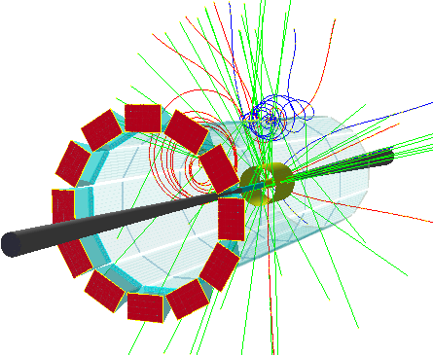
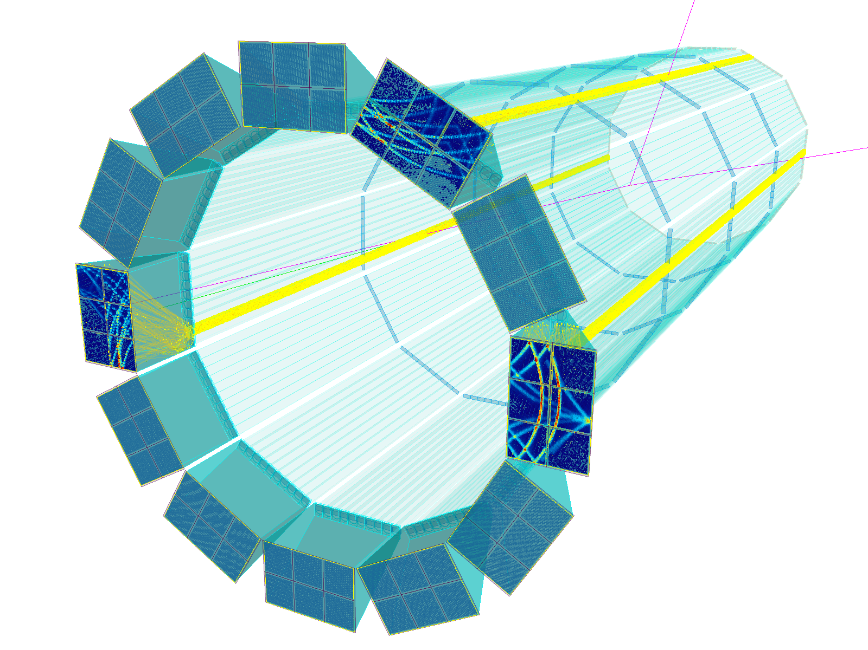
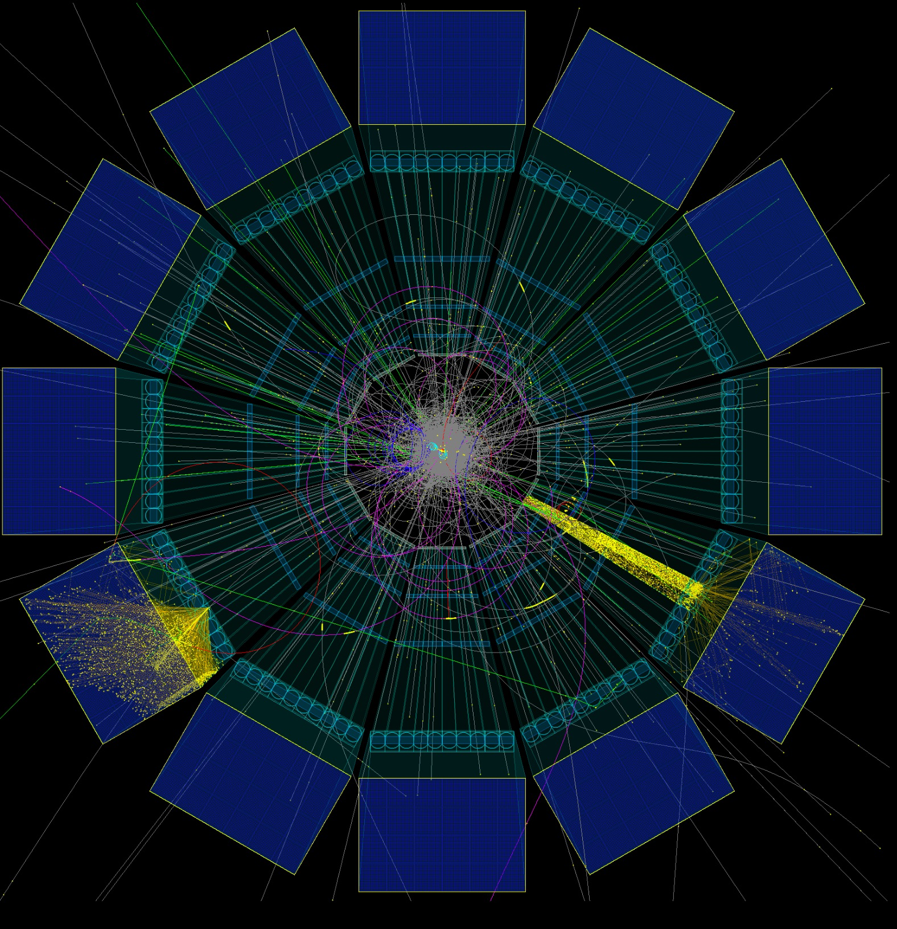
ePIC hpDIRC
Greg Kalicy

Slide 2
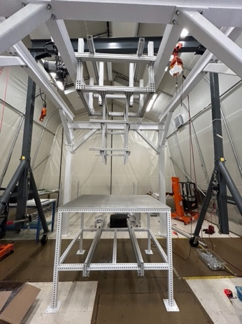
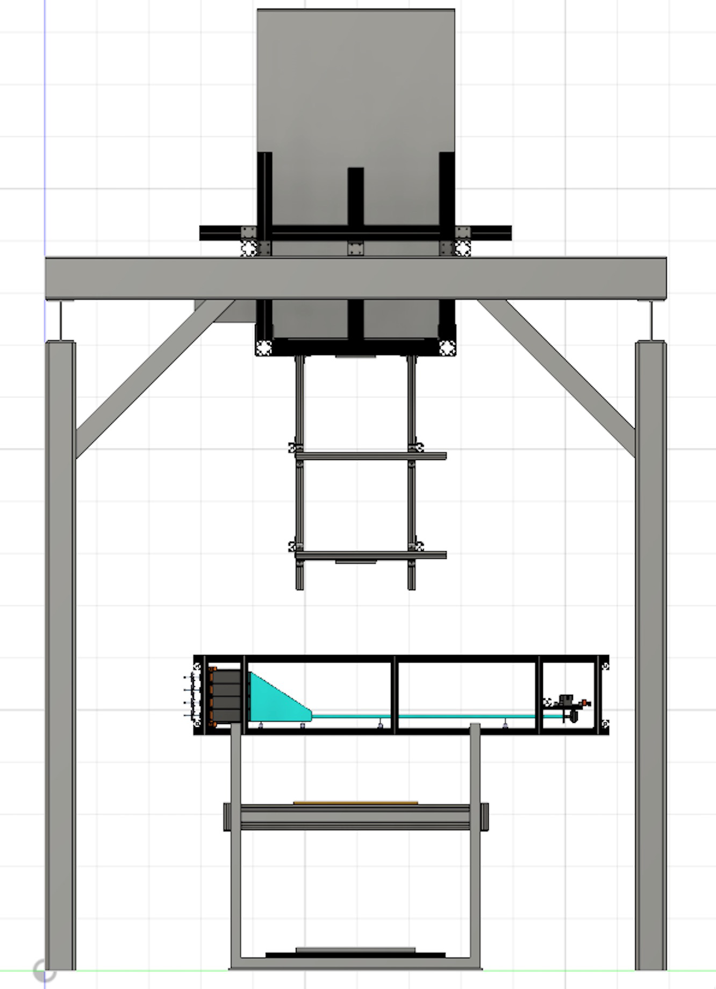
hpDIRC Prototype Plans
Current status of readout development and availability of small pixel sensors does not allow for meaningful test beam dedicated to hpDIRC in near future.
Panning to take part in pfRICH tests to gain experience with EICROC + HRPPDs combination
Initial prototype at SBU CRT with bar from PANDA Barrel DIRC
Disassembled BaBar DIRC bars will be tested in the prototype
Prototype with two bars simultaneously will allow to study additional aspects of performance, increase statistics
Two radiation-hard 3-layer lenses are in hand and will be tested for the first time in prototype
Ultimate CRT goal: test of fully assembled ePIC hpDIRC modules (gluing of bars and assembly of hpDIRC barboxes planned at SBU)
DIRC lab/CRT space at SBU
CRT setup schematic

Slide 3
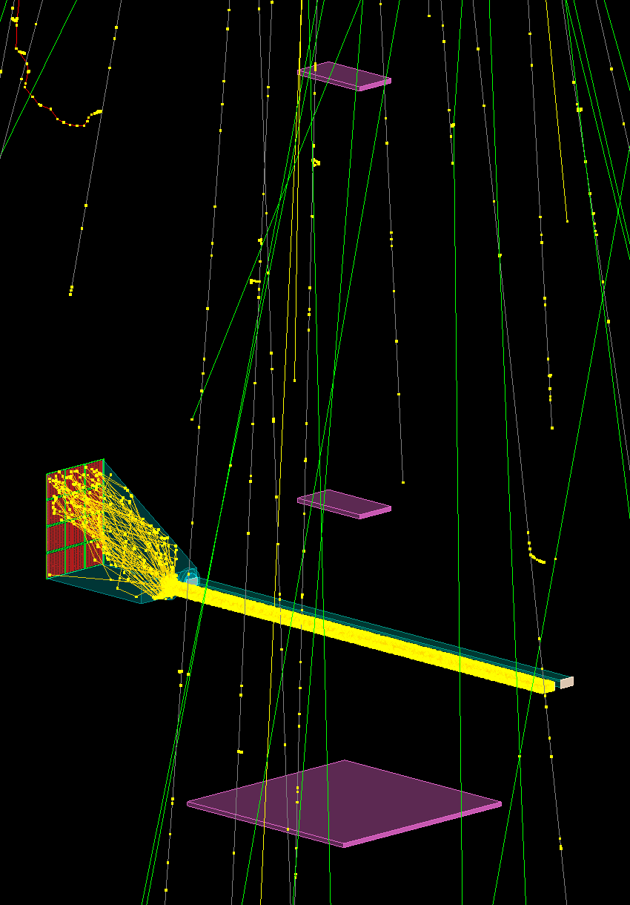
hpDIRC Prototype Plans
Current status of readout development and availability of small pixel sensors does not allow for meaningful test beam dedicated to hpDIRC in near future.
Panning to take part in pfRICH tests to gain experience with EICROC + HRPPDs combination
Initial prototype at SBU CRT with bar from PANDA Barrel DIRC
Disassembled BaBar DIRC bars will be tested in the prototype
Prototype with two bars simultaneously will allow to study additional aspects of performance, increase statistics
Two radiation-hard 3-layer lenses are in hand and will be tested for the first time in prototype
Ultimate CRT goal: test of fully assembled ePIC hpDIRC modules (gluing of bars and assembly of hpDIRC barboxes planned at SBU)
Simulation of hpDIRC Prototype with 2 bars in CRT

