Slide 1
BHCal Thresholds in EICrecon (ca. 10.23.2023)
Threshold on Summed Energy:
5 MeV
This is half-MIP, or about 20 SiPM pixels
Pedestal Mean/Position:
Set to 10 ADC counts in EICrecon
About 0.150 MeV (for 15 keV/count)
Expect MIP peak at ~10 MeV
About 40 SiPM pixels…
Pedestal Sigma:
Set to 2 ADC counts
Cut on Pedestal Sigma:
Set to 5
thresholdADC = (thresholdFactor x pedSigmaADC) + minADC
thresholdFactor = 5
pedSigmaADC = 2
minADC = 1
Clustering: threshold on minimum energy of tile to be added to cluster
5 MeV (or 30 MeV for central tile)
Note: ADC threshold given by:
threshold = (cutOnSigma x pedSigmaADC) + minADC
cutOnSigma = 5
pedSigmaADC = 2
minADC = 1
Note: keV/ADC count calculated via
perCount = dynamicRange / capADC
Dynamic range = 1 GeV
capADC = 65536

Slide 2
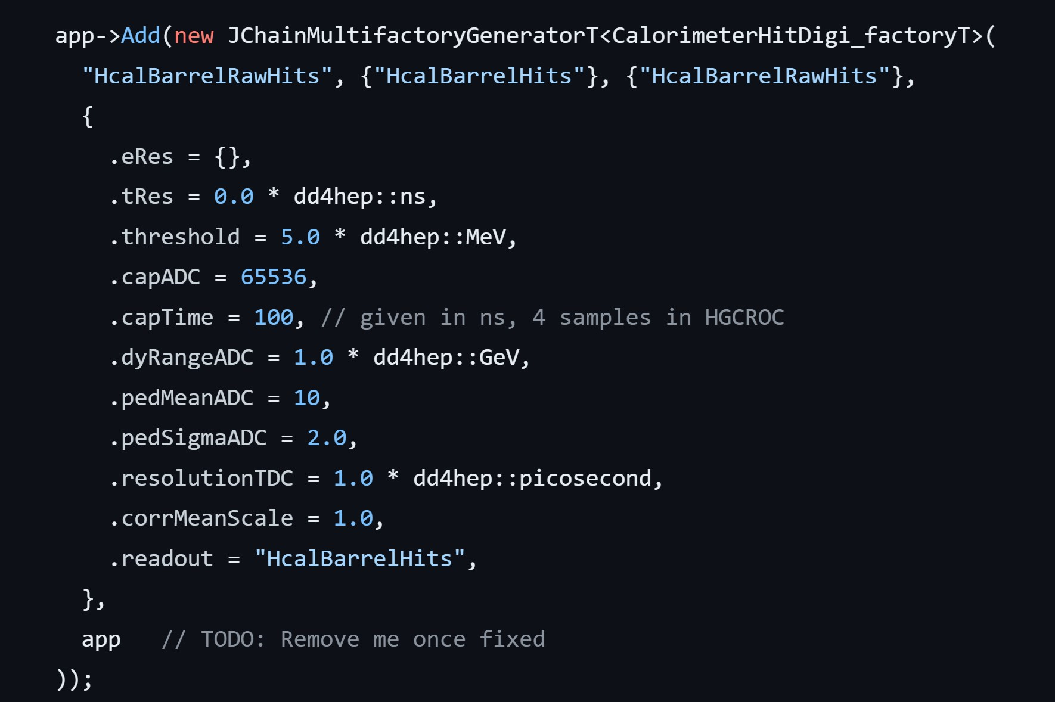
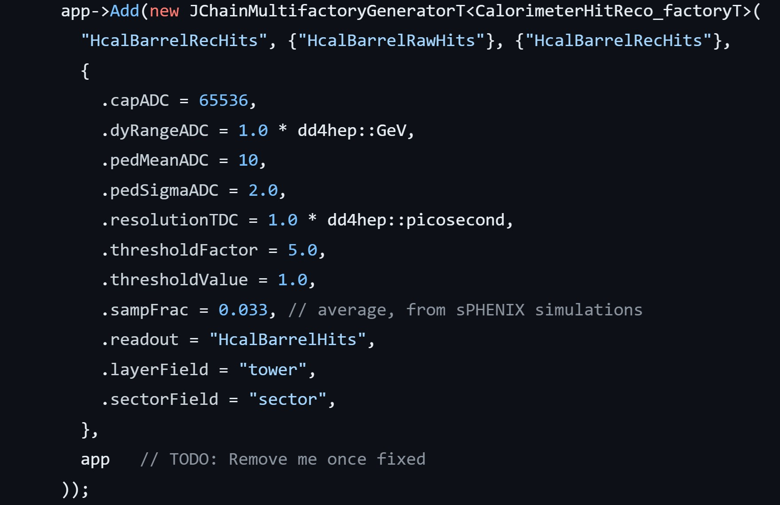
Backup | BHCal Reconstruction in EICrecon1.6.2
BHCal HitDigi Configuration
BHCal HitReco Configuration

Slide 3
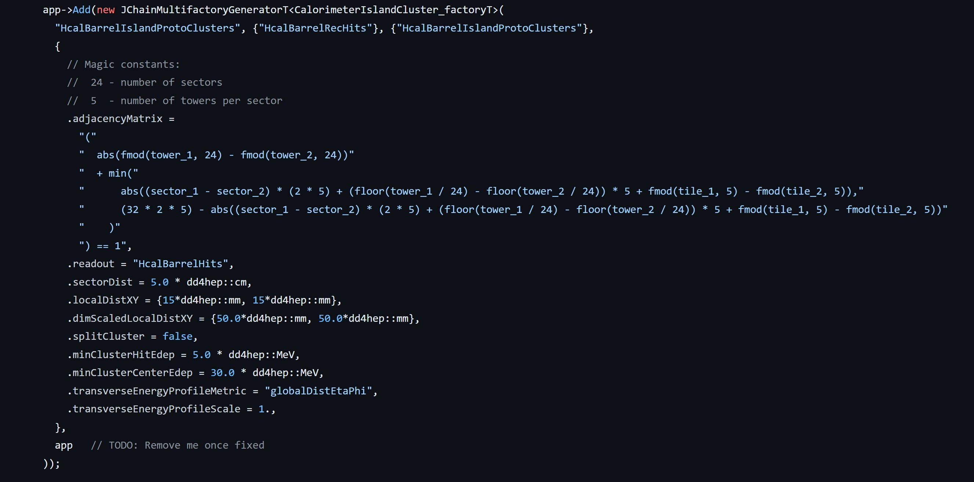
Backup | BHCal Reconstruction in EICrecon1.6.2
BHCal Clustering Configuration

