Slide 1
Barrel HCAL Test Beam Needs
The barrel HCAL is an existing detector, performance already measured a test beam and we will have sPHENIX experience to inform us as well.
The test beam needs for the barrel HCAL center on the new H2GCROC based electronics chain (reading single tiles).
  Equip sPHENIX test beam detector with new electronics
  Ideally measure performance for pions 2-40 GeV to match prior test beam results.
    FTBF is probably ideal for this.
    Muon studies can probably be done with cosmics
  Timing for this depends on electronics readiness (maybe 2024, certainly 2025)

Slide 2
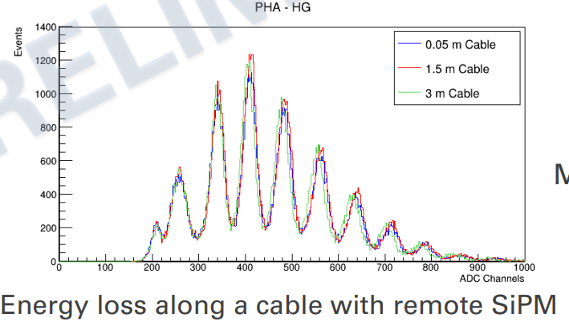
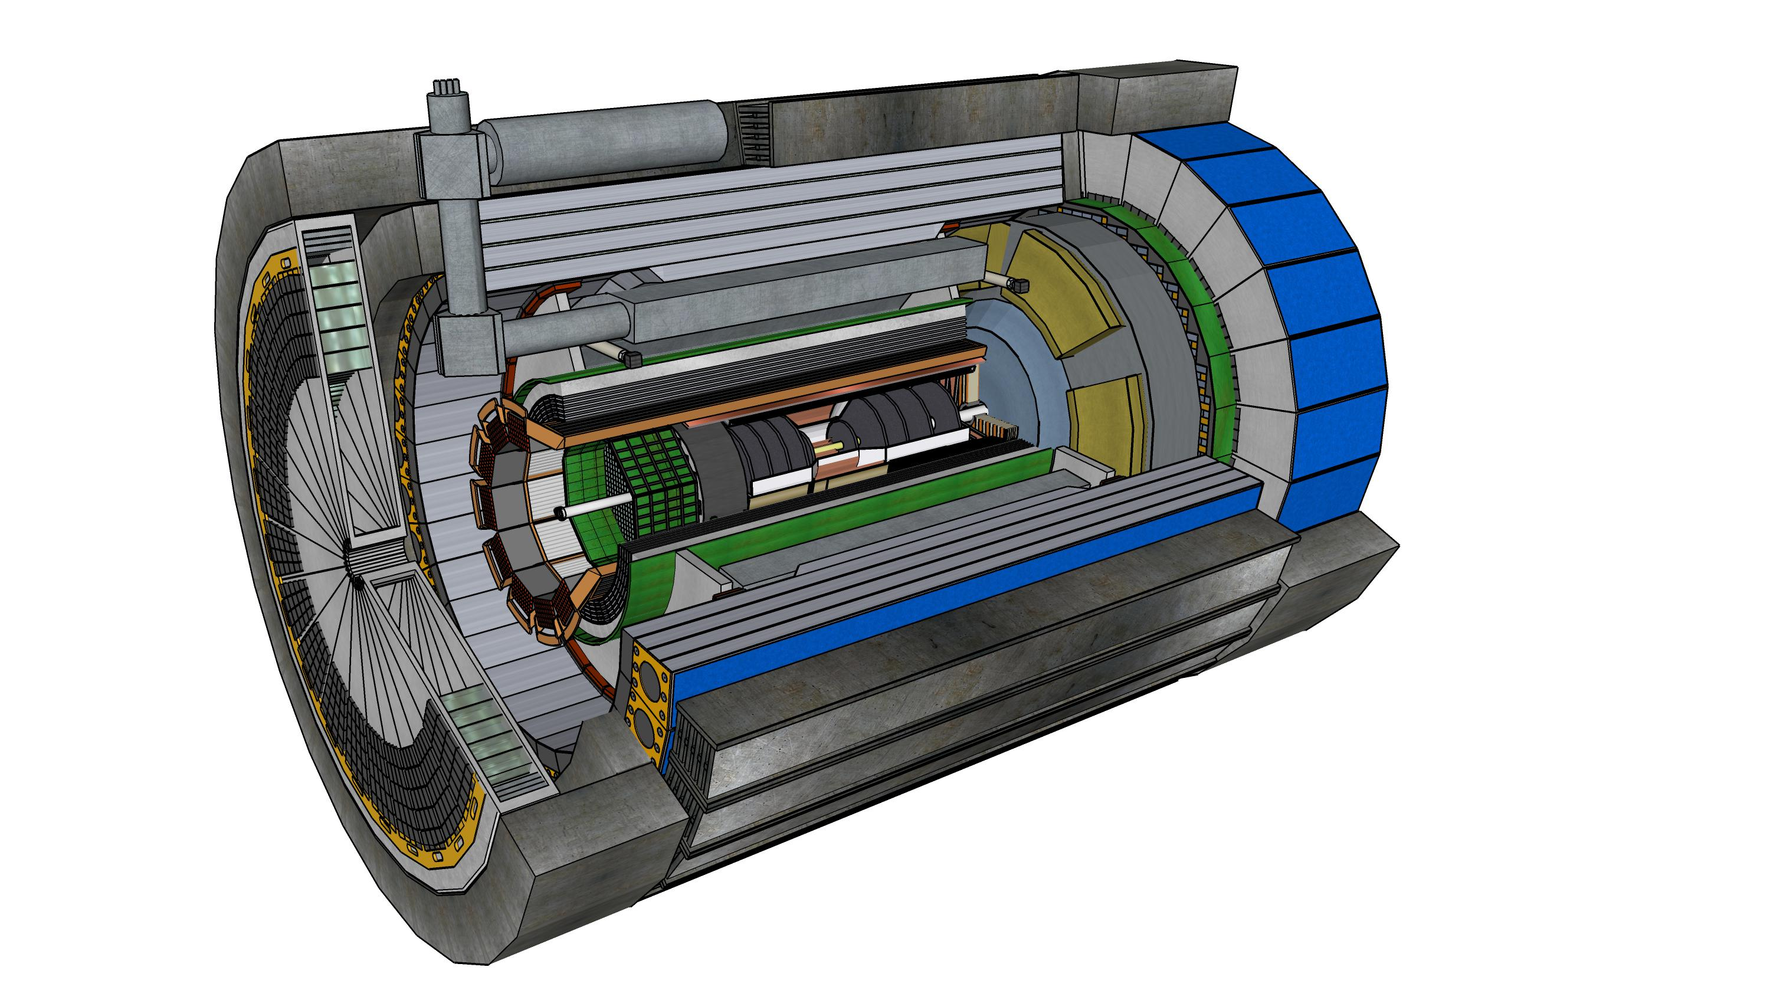
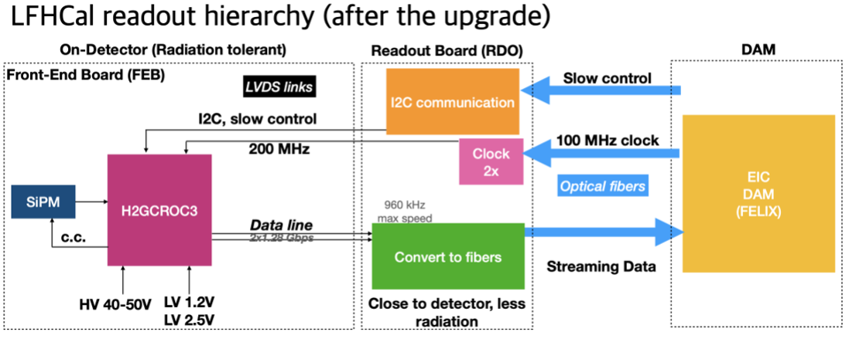
Readout Chain
Cable SiPM’s out to end of barrel HCAL to keep accessible for maintenance.
One half-sector -> 54 H2GCROC3 boards (72 channels each), collected into three RDO’s (up to 24 ASICS ea.)
~3m (μcoax)
120 cables/half-sector
H2GCROC3
(54 per half-barrel
+ LED driver boards
(LVDS Cu)
RDO’s
(3)
Fiber(s) to DAM
Combined with the dynamic range of fired pixels the collected charge range we will see is 1.0 – 213 pC. The H2GCROC3 expected range is 1-16pC (ADC), 16-320pC (TOT)

Slide 3
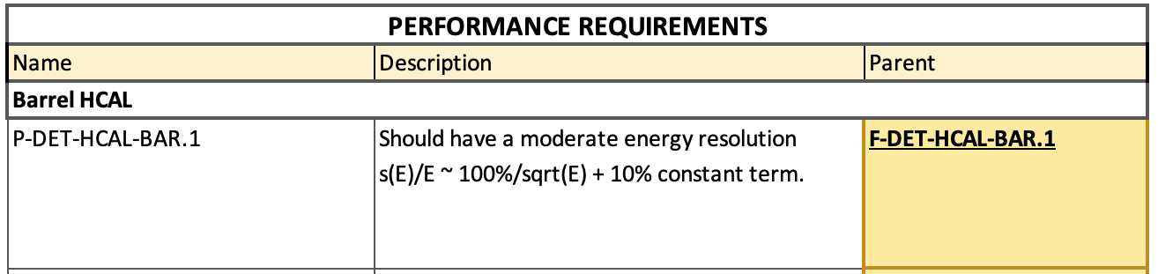
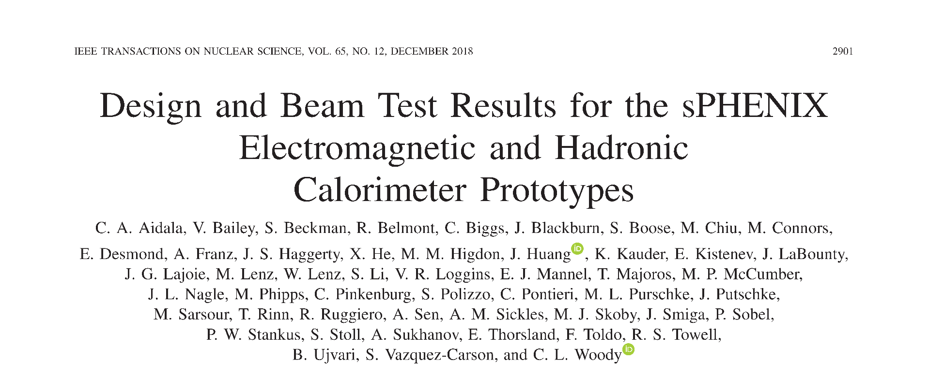
Prior Test Beam Results
Detailed studies of performance and comparison with simulations done in test beam (T-1044).
Performance of full device will be measured in sPHENIX. We should achieve a reduced constant term due to tighter control on the scintillator variation in a tower for production sectors.
Data vs. Monte-Carlo comparison

Slide 4


Slide 5
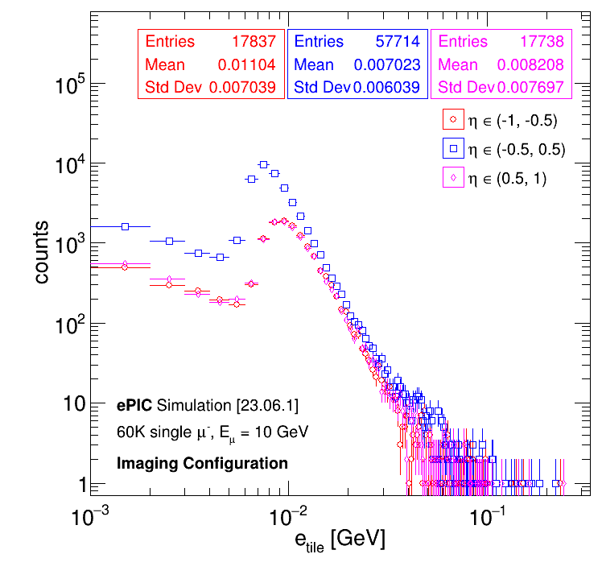
Muons in Simulation
Single muon peak in simulations is at 0.01 GeV/tile
This corresponds to:
0.01 GeV * 3200 pixels/GeV * (0.32/0.25) = 41 pixels
(The conversion comes from sPHENIX test beam results and a correction for the improved photon efficiency of the new SiPM.)
Will need to be careful with noise to make sure the MIP peak is not swamped. With a lower limit of 20 pixels (5MeV per tower) we should still be substantially above the SiPM noise.
(May be able to add additional incoherent noise mitigation by adding scintillators.)

Slide 6
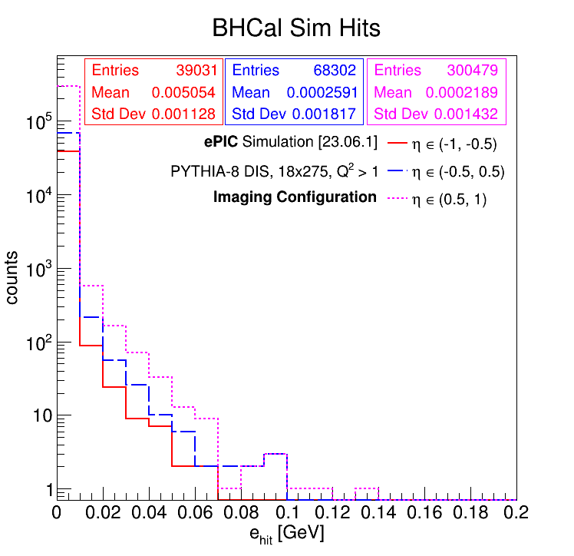
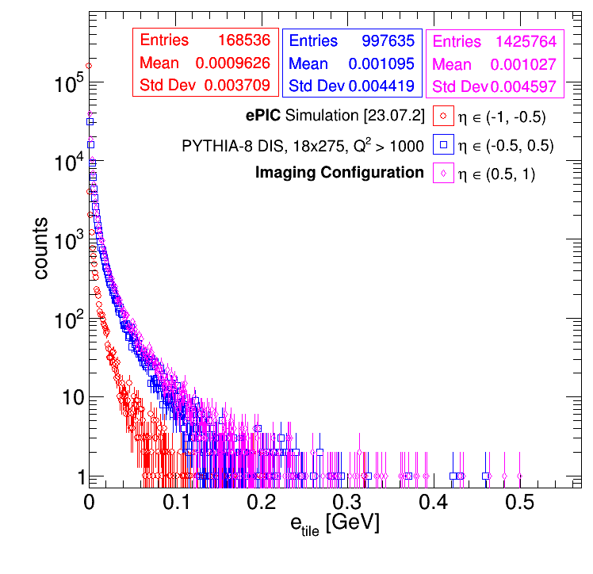
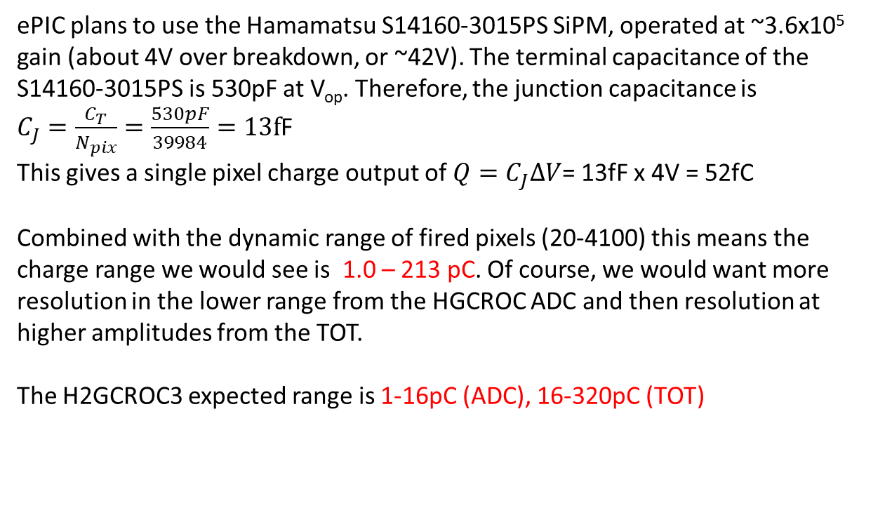
Readout Requirements – Dynamic Range
0.5 (1.0) GeV of energy deposited in the tile corresponds to ~2050 (4100) SiPM pixels firing. Single muon requirement sets lower limit at ~20 pixels
ePIC plans to use the Hamamatsu S14160-3015PS SiPM, operated at ~3.6x10⁵ gain (about 4V over breakdown, or ~42V). The terminal capacitance of the S14160-3015PS is 530pF at V_{op}. Therefore, the junction capacitance is
$C_{J}=\frac{C_{T}}{N_{pix}}=\frac{530pF}{39984}=13f$F
This gives a single pixel charge output of $Q=C_{J}ΔV$= 13fF x 4V = 52fC
Combined with the dynamic range of fired pixels (20-4100) this means the charge range we would see is 1.0 – 213 pC. Of course, we would want more resolution in the lower range from the HGCROC ADC and then resolution at higher amplitudes from the TOT.
The H2GCROC3 expected range is 1-16pC (ADC), 16-320pC (TOT)
The barrel HCAL will have sufficient dynamic range to cover MIPs up through
full energy jets.
This is the distribution of energy deposited in the scintillating tiles (*visible* energy) in an ePIC simulation of 18x275 GeV DIS events. The regions are split in rapidity, and the higher overall energy deposition at positive rapidity is visible.

