Slide 1
Collider-Accelerator Department Injector System Upgrades – 25-year plan to support EIC operation
Rob Michnoff C-AD Deputy Accelerator Division Head
2023 RHIC Machine Advisory Committee Meeting
December 2023
Notes:
20+10 min => ~20 slides

Slide 2
Outline
Injector complex overview
Accelerator Readiness Reviews (IRRs/ARRs)
25-year upgrade plan (Injector upgrades to support EIC)
Capital equipment funded upgrades
Accelerator Improvement Project (AIP) funded upgrades
Other priority upgrades
Need for funding

Slide 3
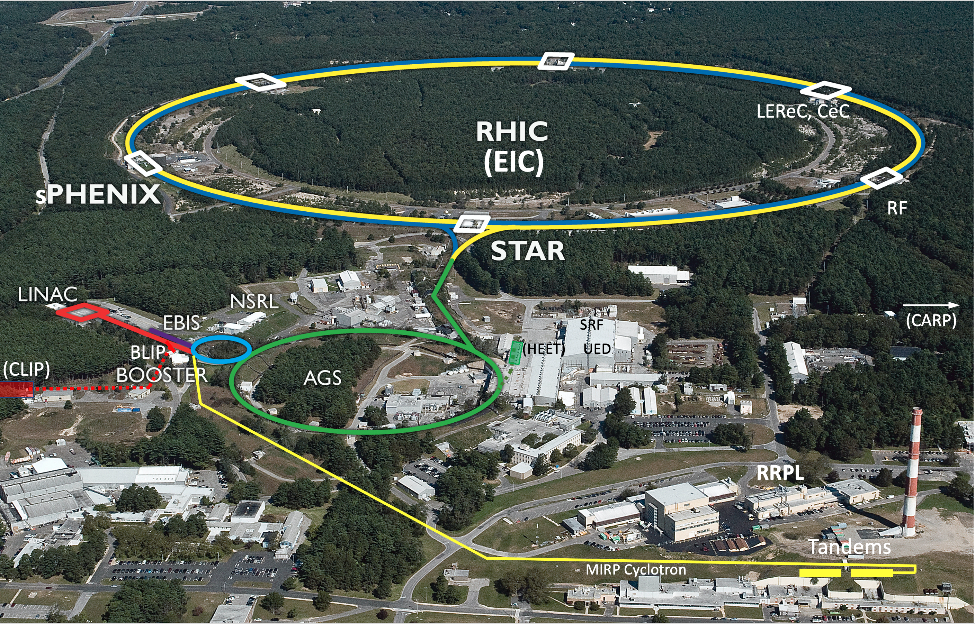
Collider-Accelerator Department facilities
Aside from RHIC, Injectors are also used for application programs: - Linac/BLIP for isotope production - Booster/NSRL for space radiation studies
- Tandem for industrial/academic users
R&D for future facilities and application sources, cooling, pol. beams, …

Slide 4
Collider-Accelerator Department facilities
Aside from RHIC, Injectors are also used for application programs: - Linac/BLIP for isotope production - Booster/NSRL for space radiation studies
- Tandem for industrial/academic users
R&D for future facilities and application sources, cooling, pol. beams, …
Injector complex

Slide 5
Upcoming Accelerator Readiness Reviews
IRRs (Internal Readiness Reviews) and ARRs (Accelerator Readiness Reviews) are planned for the following over the next few years:
Booster (2025)
Linac (2025)
AGS (2026)
Specific work required for successful ARRs is in the process of being identified

Slide 6
Readiness Review Preparations
Facility | IRR | ARR
Booster | July 2025 | September 2025
LINAC | July 2025 | September 2025
AGS | July 2026 | September 2026
Completed Items (Booster)
Cabling cleanup
Covers added to exposed bus
Lead bricks collected and moved to storage location
Underpass protection added
Legacy ACS equipment removed
Legacy BPM electronics boxes removed, and fiber optic cables removed
Items in Progress (Linac)
Sandbag cleanup
Addition of grates over penetrations with sandbags
Lead bricks to be collected / moved to storage
Safety covers to be added to exposed busses
Removal of legacy equipment (rough pumps, ACS equipment)
Signs and postings
Slide credit: Cindy Galdamez

Slide 7
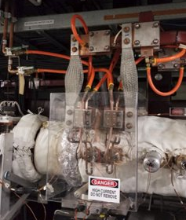
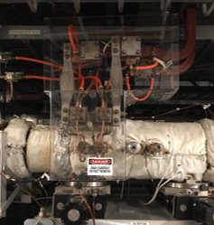
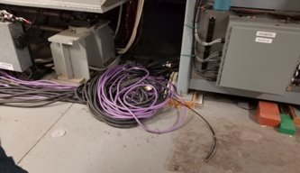
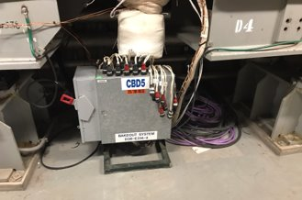
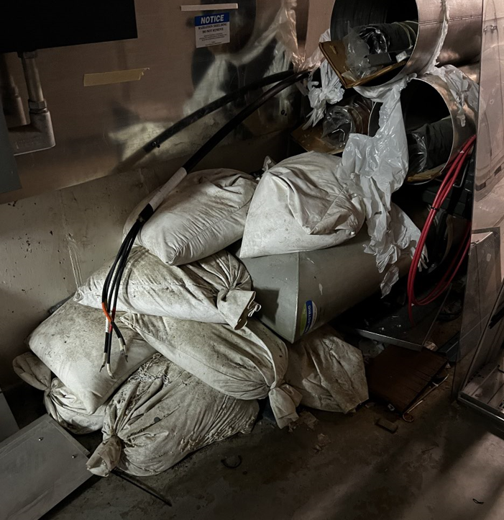
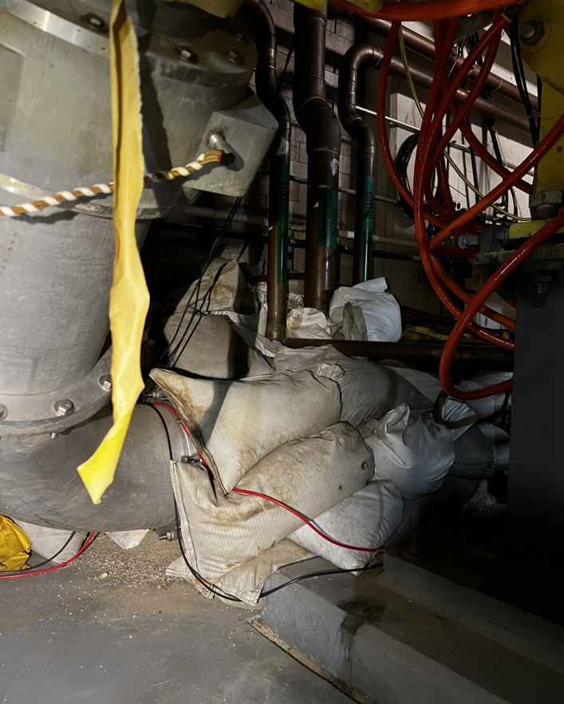
Photos – ARR prep
Booster - Exposed Bus Covers Installed (Before and After)
Booster - Cable and Lead Brick Cleanup (Before and After)
Linac – Sandbags to be addressed (multiple locations)
Slide credit:
Cindy Galdamez

Slide 8
AIP and CE Funding plan – Scenario 1 (FY2022-2029)
2 years without CE and AIP funding – suspension of orderly upgrade program
Availability goal raised from 82.5% to 85% 3 years ago
Majority of AIP funding needed for cryo upgrades, not sufficient for completion before EIC commissioning starts (cryo upgrades would continue beyond FY28)
CE completed before end of FY2025 and AGS Siemens cycloconverter upgrade may still benefit RHIC

Slide 9
AIP and CE Funding plan – Scenario 2 (FY2022-2029)
2 years without CE and AIP funding – suspension of orderly upgrade program
Availability goal raised from 82.5% to 85% 3 years ago
Almost same plan for Capital Equipment as for Scenario 1
Allows for completion of main cryo plant upgrade in time for EIC turn on
CE completed before end of FY2025 and AGS Siemens cycloconverter upgrade may still benefit RHIC

Slide 10
Potential upcoming C-AD projects
The following potential upcoming (unfunded) projects will not be addressed as part of this talk:
Clinical Alpha Radionuclide Producer (CARP) – DOE Isotope Program
Linac Intensity Upgrade Phase II (LIUP2) – DOE Isotope Program
70 MeV cyclotron – DOE Isotope Program
Clinical Linac Isotope Producer (CLIP) – DOE Isotope Program
High-Energy Effects Test Facility (HEET) – DoD

Slide 11
25+ year technical infrastructure upgrade plan
Initiated by Wolfram Fischer in 2018 for RHIC
Assessed periodically (1-2 years) based on need for
performance upgrades
upgrades of obsolete systems and components
Upgrade Plan Goals
Technical infrastructure maintained in good order
Hadron injector complex ready for EIC when commissioning starts while also running for external users (e.g. NSRL and BLIP)
As systems are upgraded, EIC requirements are considered so that new developments satisfy both injector EIC needs
Some new systems can be developed and tested with RHIC beam before the RHIC program ends

Slide 12
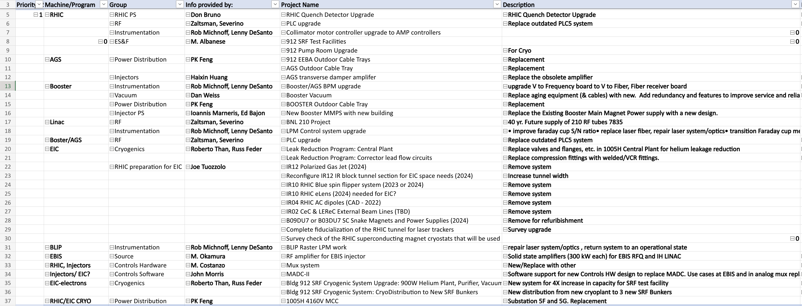
Spreadsheet of systems to upgrade has been developed (present list includes >420 items)

Slide 13
Capital equipment upgrades
AGS/booster beam position monitor upgrade (design in progress)
Front-end hardware will remain
System will be upgraded to transmit data via digital fiber optic serial link, replacing the existing voltage-to-frequency link
AGS skew quadrupole magnets and power supplies (in progress)
Required to preserve polarization
Chipmunks
These radiation monitors are old and difficult to maintain; and spares are very limited
Plan to research monitors used at other facilities to determine viability of using available system directly or if customization is needed
Water tower #7 replacement

Slide 14
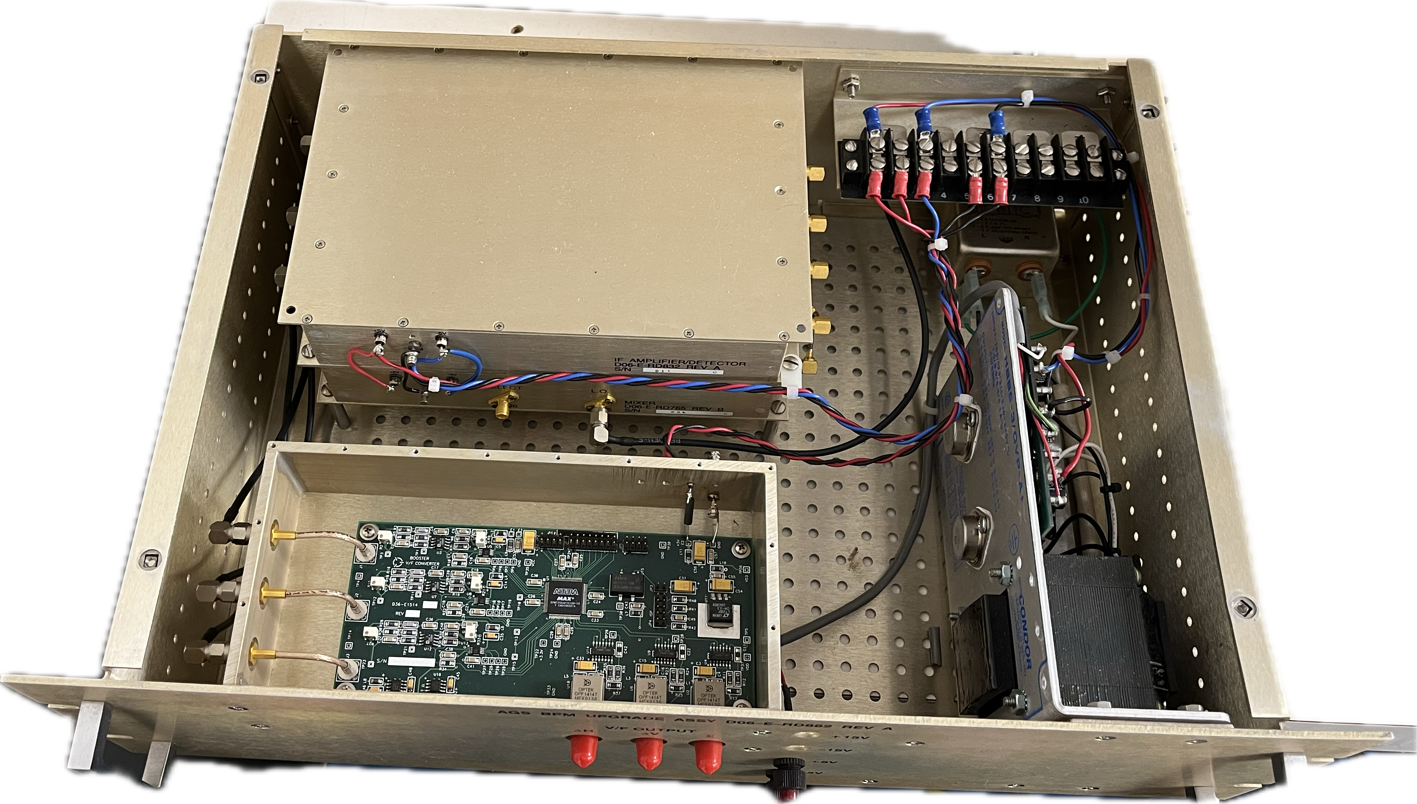
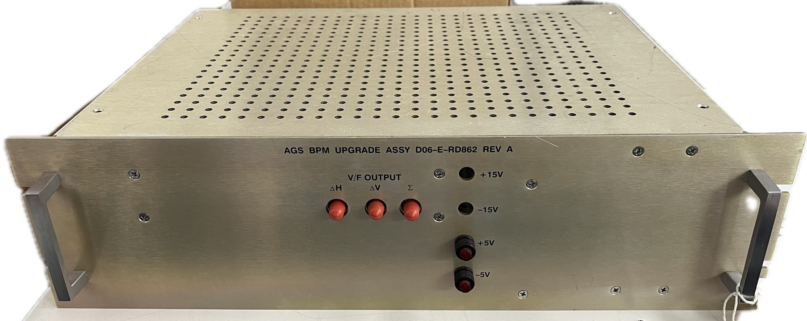
AGS and Booster BPM system upgrade
Existing analog to frequency fiber optic module will be upgraded with analog to digital serial fiber optic module
New processing module to be developed for receiving and processing fiber optic serial links from each BPM
This will also eliminate complicated downstream fiber to digital and scalar modules

Slide 15
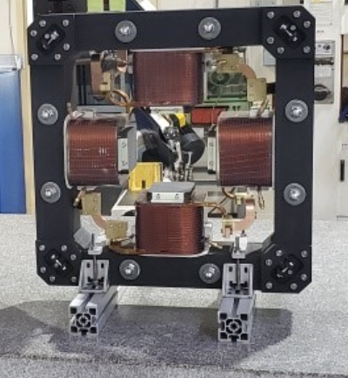
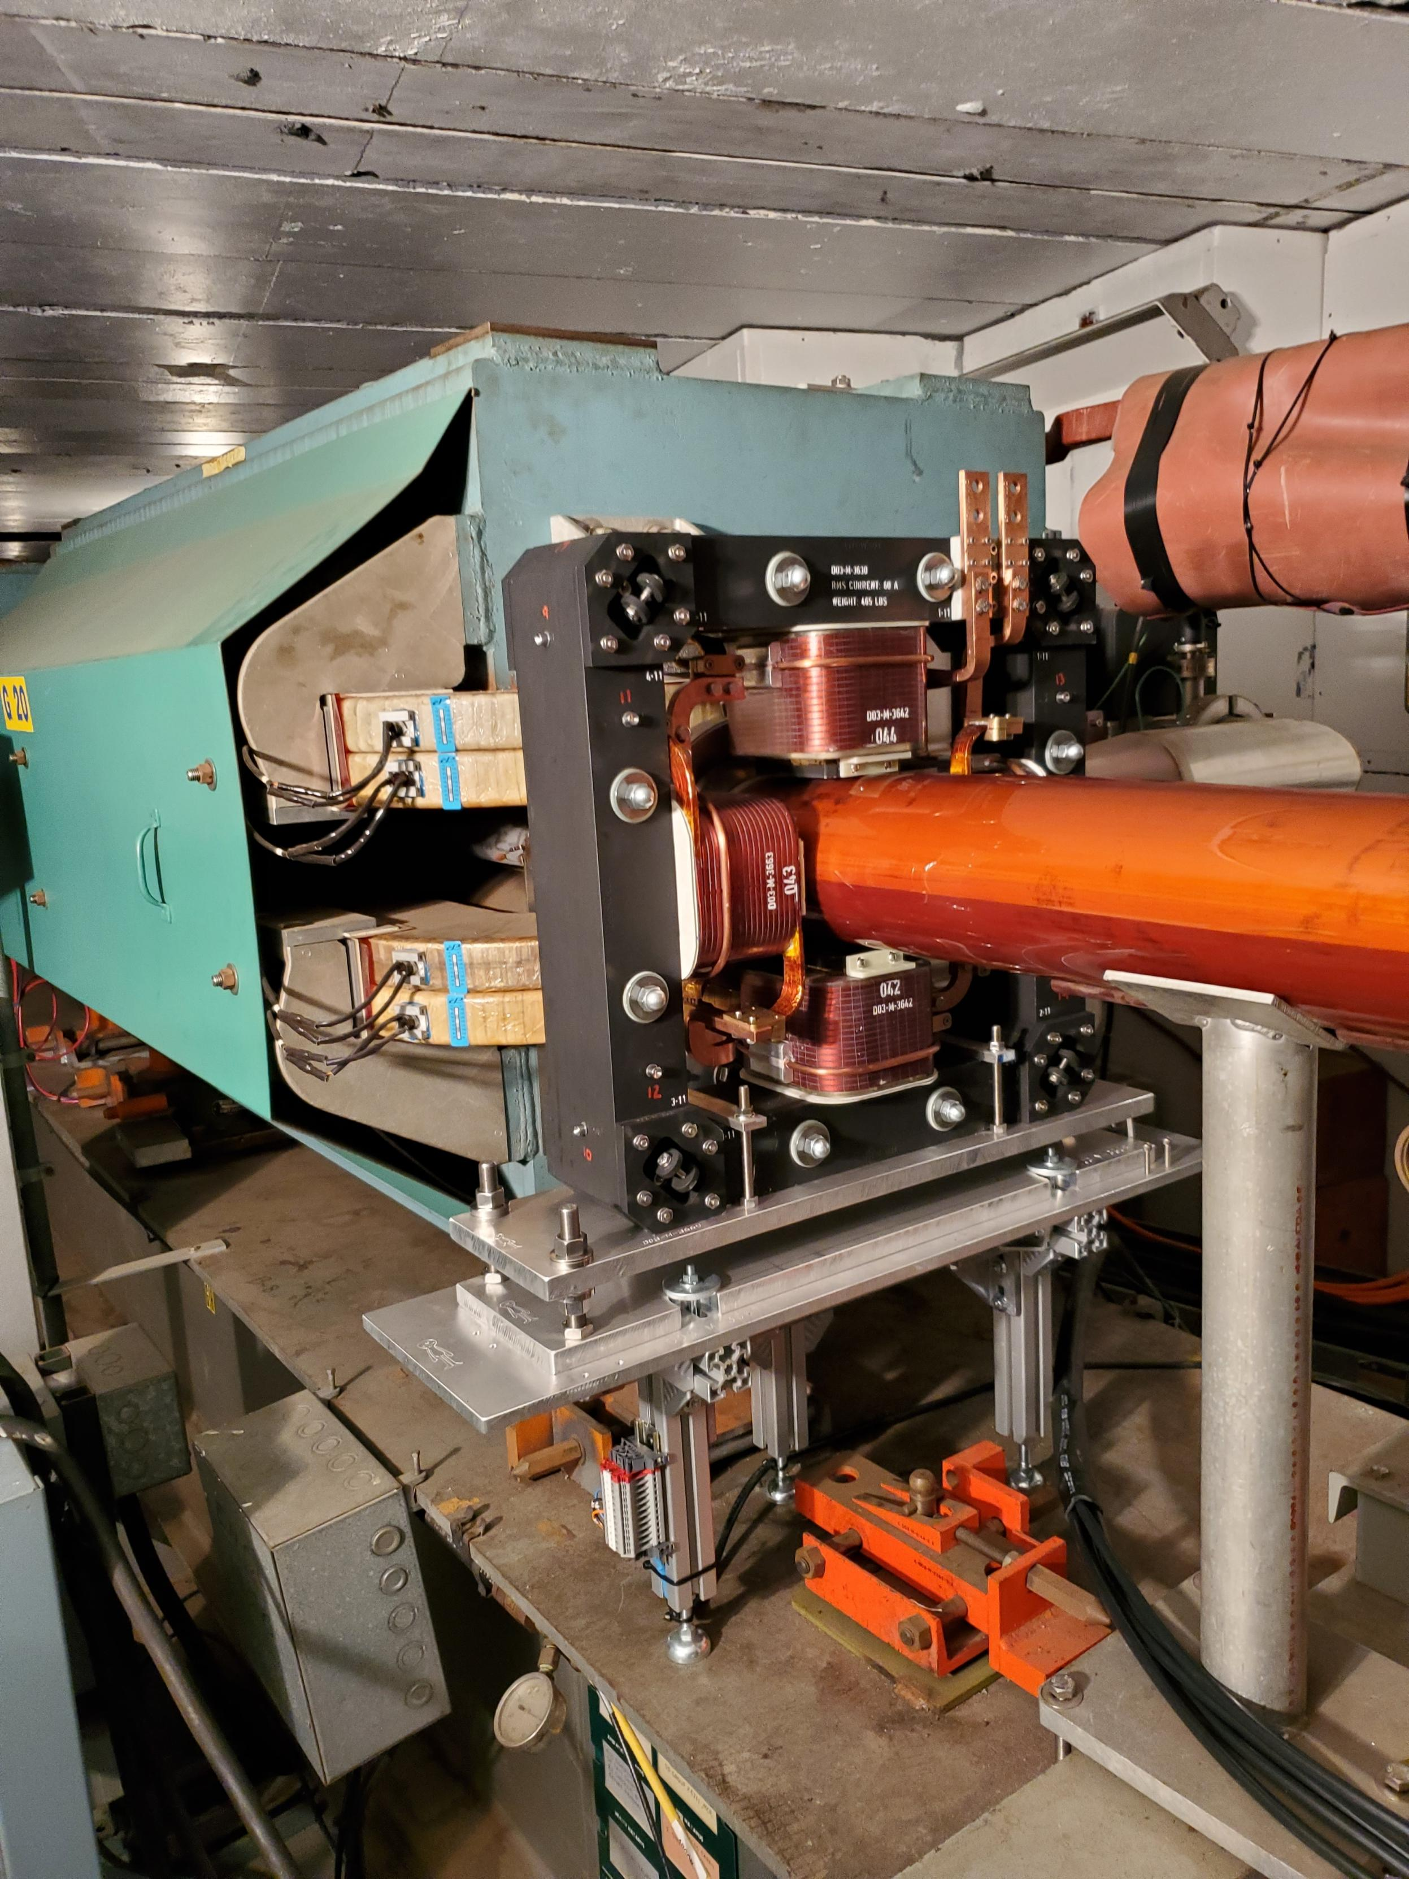
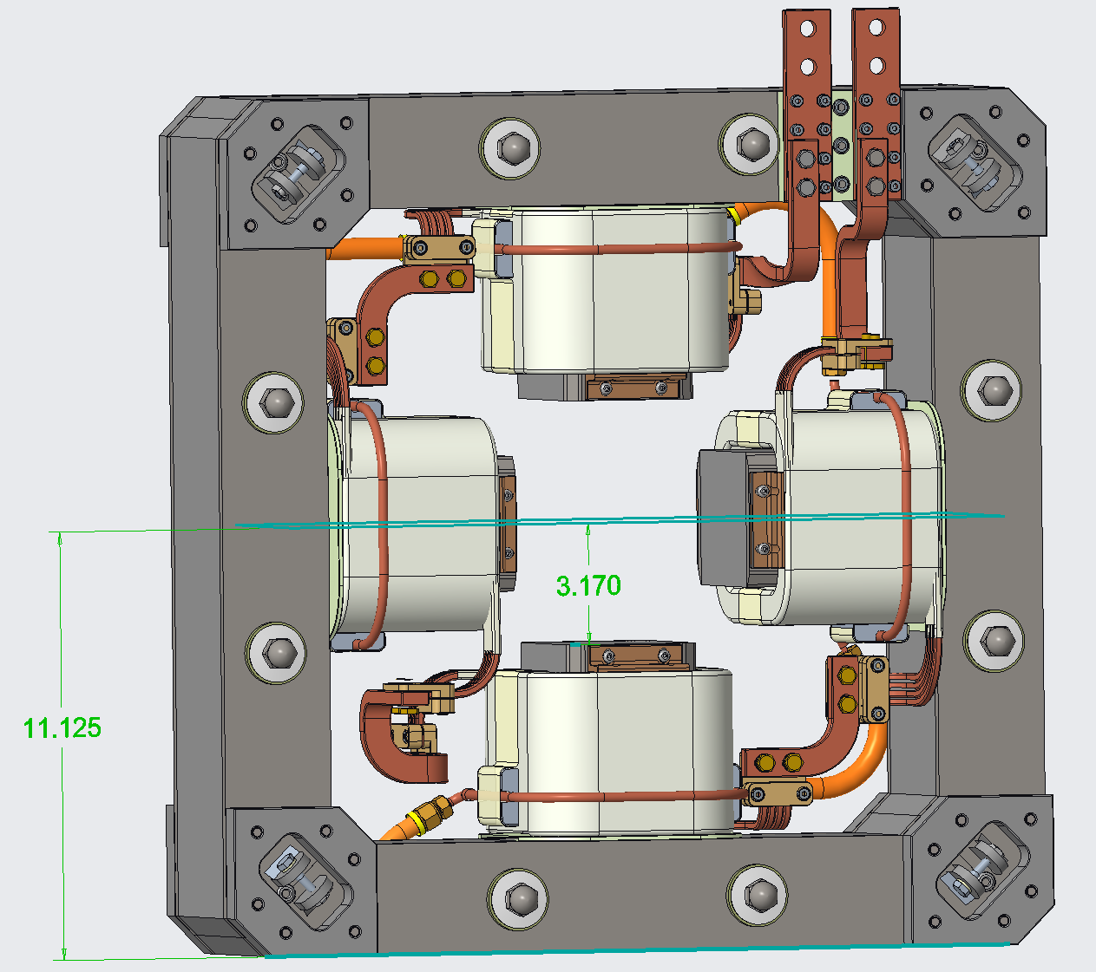
AGS Skew Quad Magnets and Power Supplies
14 of 15 magnets have been installed
Waiting for power supplies from vendor
Photos by Dan Lehn

Slide 16
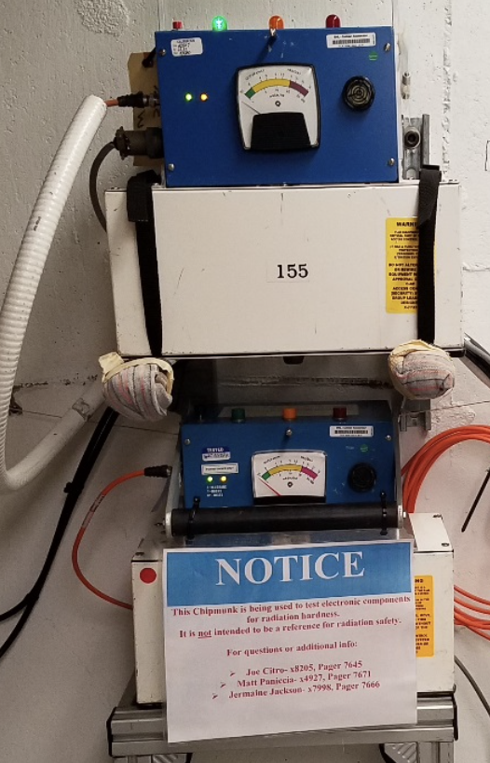
Chipmunk radiation monitor upgrade
These critical personnel protection devices are installed throughout the Collider-Accelerator complex to interlock beam when high radiation levels are detected in areas where personnel may be present.
Number of operational units installed: 104 (85 AC powered units, 19 DC powered units)
Number of functional spares: 20 (14 AC powered units, 6 DC powered units)
Note: DC units are powered by 24V from the access control system
Justification for upgrade:
The existing chipmunk radiation monitor design is 40+ years old
Spare availability is dwindling
Obsolete components are used in the present design
but a fair number of obsolete components are in-house to support repairs
Devices are challenging to maintain
Installation of devices in new locations can not easily be supported with existing spares
General upgrade plan
Review devices available in other facilities within and outside of BNL to determine viability for use in the Collider-Accelerator complex
Decide if available device can be used or if a new device must be designed in-house.
Status
This upgrade is in the very early conceptual phase
Plan to begin researching available devices within the next year
A new in-house design, if deemed necessary, will require several years to complete and certify
Chipmunks installed at NSRL

Slide 17
Accelerator Improvement Project (AIP) upgrades
All AIP funding for the next many years will be used for cryogenic central plant system upgrades

Slide 18
Cryo System Upgrades
912 Upgrade is most urgent.
Central Plant Upgrade scope is needed before EIC startup
Project | Sub-project | Estimate ($M) | Basis of estimate | Funded? | Funding Source
Central Plant Upgrades | Cryo C&I Upgrades | 1.5 - 2.0 | Actuals + EJ | Yes, 1.5$M | Capital Equipment
 | Cold End Upgrade | 5 – 6 | Past Projects | Planned allocation | AIP
 | Rotoflow Skids | 2.5 – 3.0 | Vendor Quotes | Planned allocation | AIP
 | Intercooler and Aftercooler HXs | 2.5 – 3.0 | Vendor Quotes | Planned allocation | AIP
 | Ambient Vaporizers + Piping | 0.8 | Past Projects | Planned allocation | AIP
Central Plant Total |  | 12-15 |  | 1.5
912 Technical Infrastructure upgrade | New helium liquefier plant and supporting eqpt and piping | 7 | Vendor Quotes | Yes, $7M | AIP
 | New cryo-distribution to SRF bunkers | 3 -3.5 | Past Projects | No | ?
 | New purifier, relocated sub-atmospheric equip | 1.5 | Vendor Quotes | No | ?
 | Infrastructure improvements | .5 | Past Projects | No | ?
912 Upgrade Total |  | 12 - 14 |  | 7
Significant additional funding required
Significant additional funding required
Slide credit: Roberto Than

Slide 19
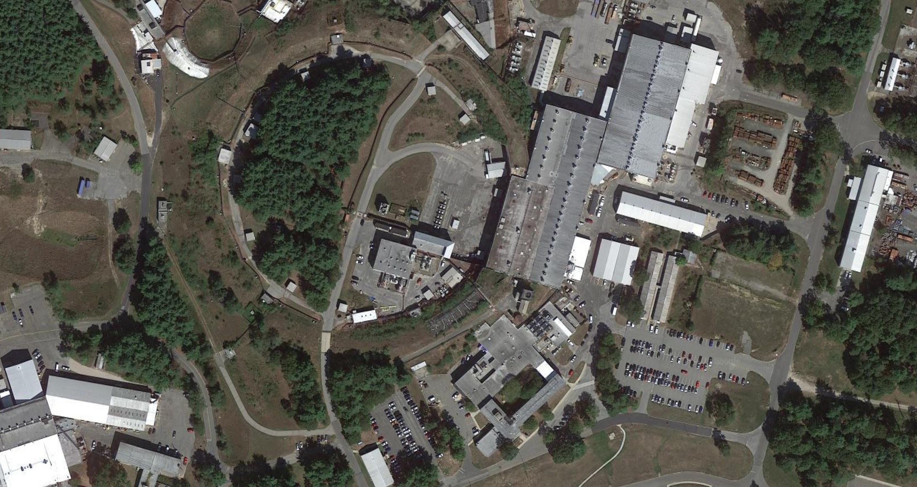
Technical infrastructure upgrades
Work supported mostly by off-EIC-project funding and strongly by BNL Modernization Project Office (MPO) and Facilities and Operations Directorate (F&O)
Bldg. 912 Existing SRF Infrastructure
(clean rooms, HPR, VTFs, RF test area)
Existing Laser development area
Cryo Upgrade in progress
Bldg. 924 Instrumentation
Upgrade complete
Bldg. 905 Vacuum
Upgrade nearly complete
Bldg. 911 Power Supplies
Upgrade complete

Slide 20
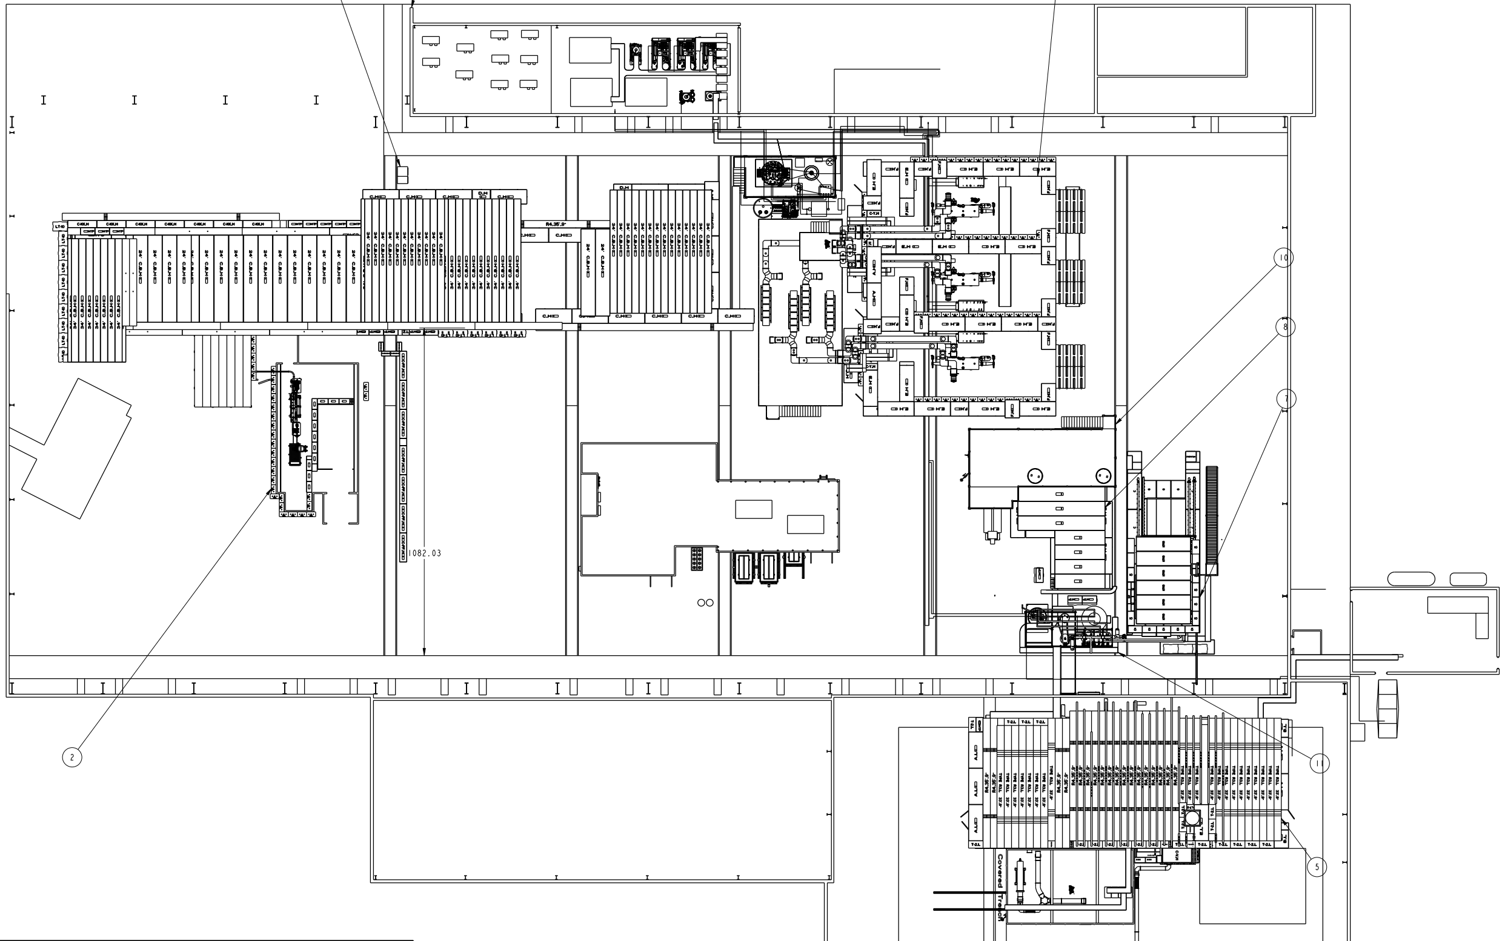
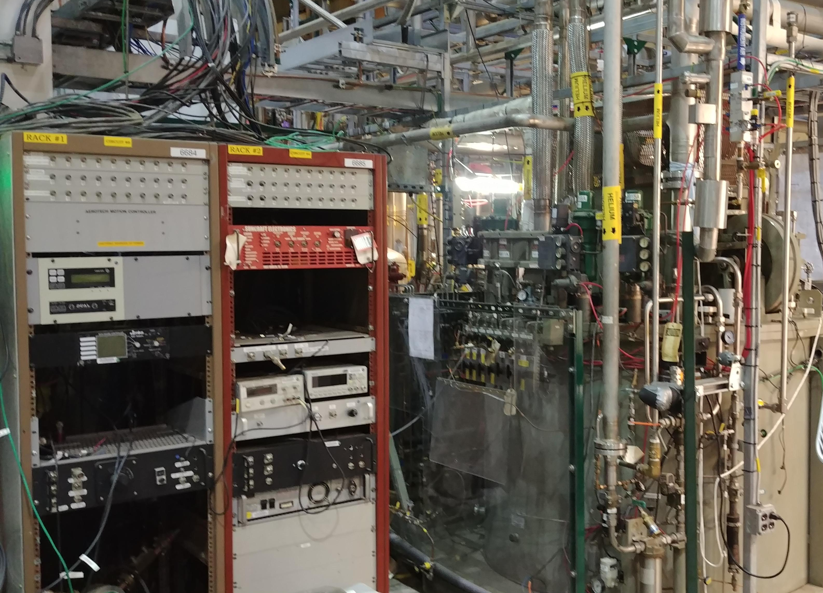
Building 912 – Technical Area for R&D and Testing
(SRF, laser, RF and magnet testing)
Planned
new SRF Area
Water systems
Cryo
Planned
new Cryo plant
RF Test area
Staging/
Loading
ATRO
RF Test area
RF Test area
VTF Cleanroom
VTF/SRF
Laser
R&D
Storage Cages
UED
Existing cryo pump/ compressor
Existing cryo plant
HPR + Cleanroom
RF Test area
Staging/Loading
Oven
SRF Control Room
(layout by Cliff Brutus)
HPR: High Pressure Rinse
VTF: Vertical Test Facility
UED: Ultrafast Electron Diffraction
ATRO: Accelerator Technology Research Office [includes Accelerator Test Facility (ATF)]
20

Slide 21
Other priority injector system upgrades
AGS RF Anode power supplies and electrical infrastructure (~ $3.5M)
11 power supplies ( ~ $2.5M)
Remove 13.8KV transformer and switchgear, replace with 480V feed
Booster main magnet power supply (~ $35M, 6 month shutdown rqd)
The existing system induces significant disturbances on the power line, and affects RHIC magnet power supplies resulting in beam perturbations
Cable tray replacement
Many cable trays are corroding and can no longer adequately support the required load
AGS transverse damper system upgrade
Power amplifiers and associated hardware are obsolete and difficult to maintain
Linac RF tube support
And MORE…
Several additional upgrades may be required for the Linac, booster and AGS ARRs planned over the next few years

Slide 22
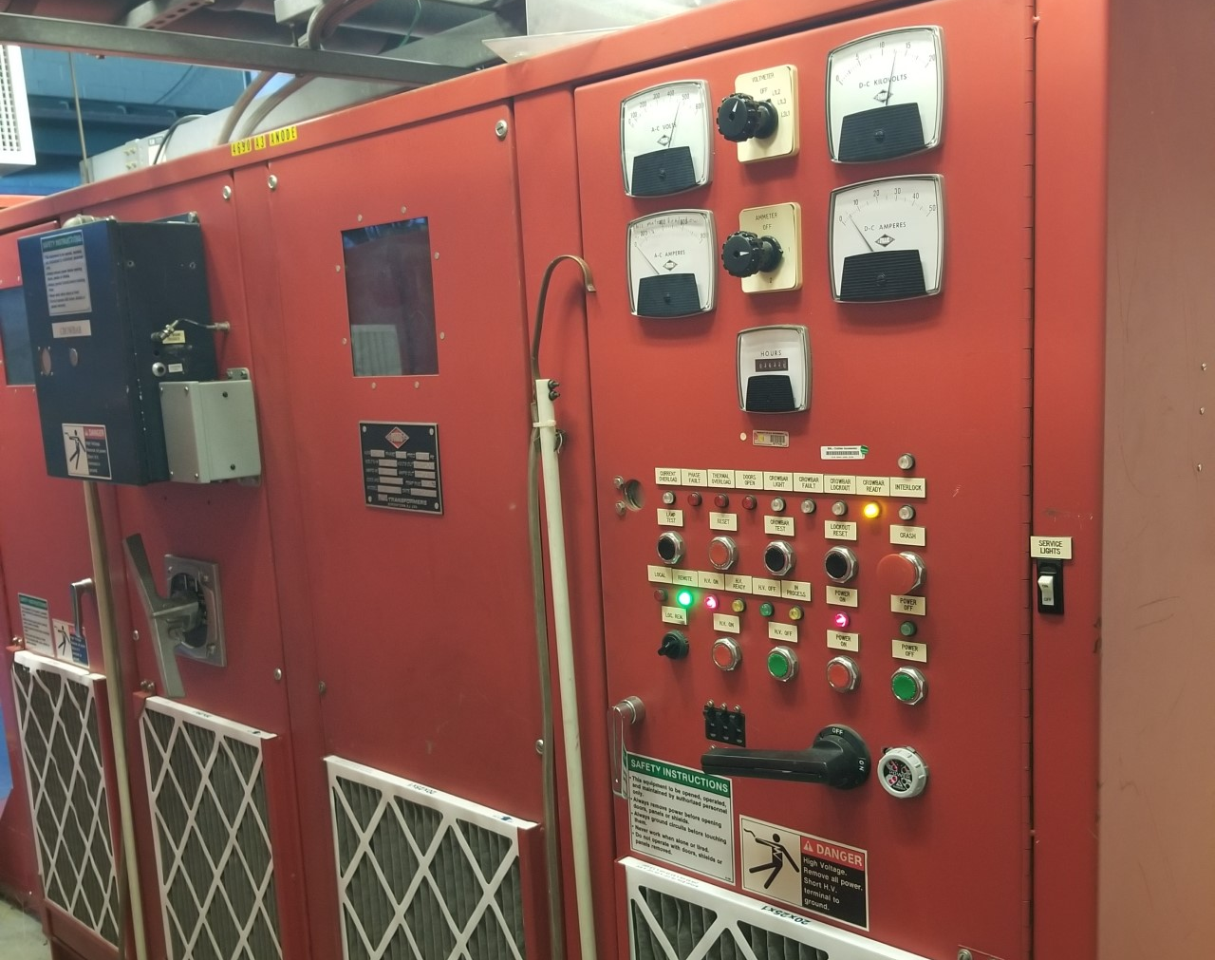
Booster RF Anode Power Supply Replacement for Bands 2 and 3
Cost: ~$1.4M
Status: Procurement in progress, expect to receive mid 2024
Slide credit: Ioannis Marneris, Ed Bajon

Slide 23
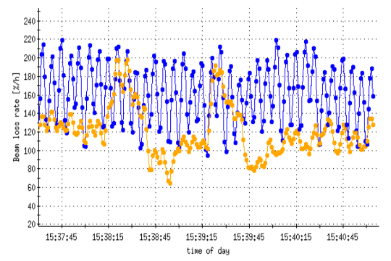
Funding not presently available for this important upgrade
Booster Main Magnet Power Supply
Booster Main Magnet Power Supply Upgrade would include capacitive energy storage (used for CERN PSB and PS, soon J-PARC MR)
Booster creates disturbances in the electrical grid due to the load changes
Utility company imposes restrictions on allowed cycles; Booster is turned off during RHIC ramps and sensitive operations since it creates noise (smaller EIC beams more susceptible to noise, also visible in NSLS-II)
New PS eliminates cycle restrictions, reduces RHIC/EIC noise, allows for more bunch merges or shorter AGS cycles
Estimated cost: $35M (including building)
Estimated schedule: 3+ years (need ~6 month shut-down)
RHIC loss rate variation in BES-II with Booster ON
[most prominent here in the blue ring (blue trace)]
23
Notes:
Blue Booster on, Yellow Booster off

Slide 24
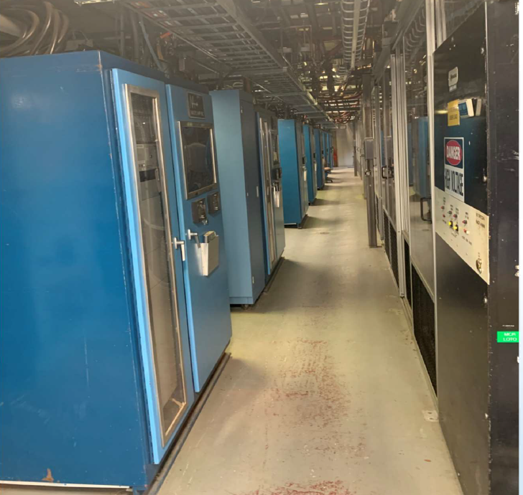
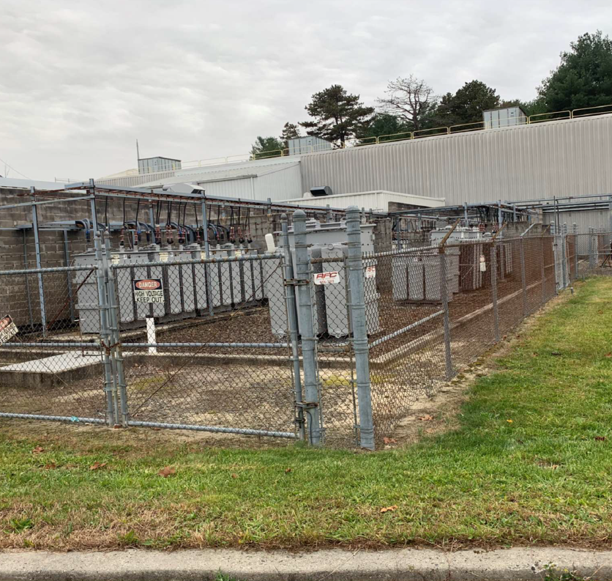
Booster Main Magnet Power Supply
Estimated Cost to Replace power supply and new building: $35Million
Slide credit: Ioannis Marneris, Ed Bajon
Booster MMPS Rectifier Modules
Booster MMPS Transformers

Slide 25
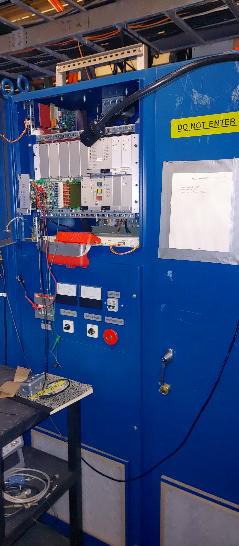
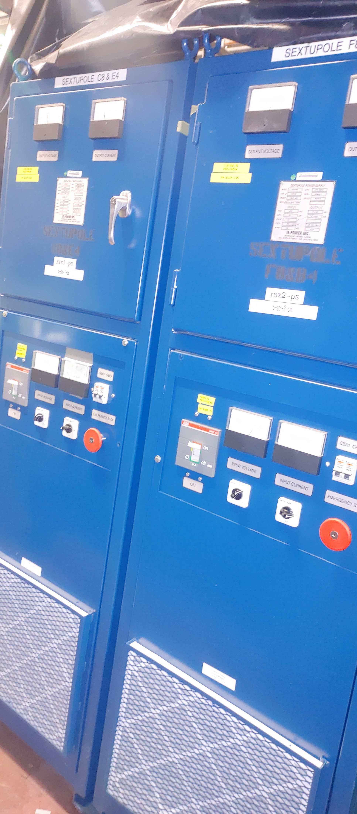
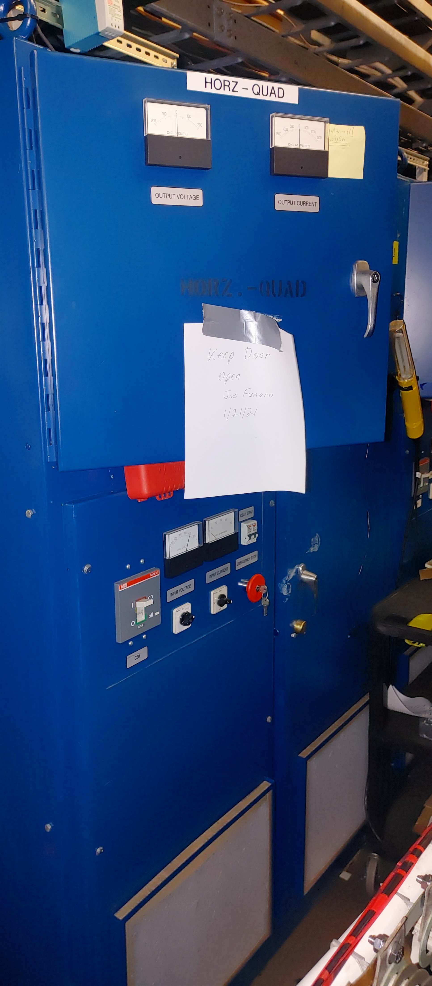
Booster Power Supply Upgrades Funding not presently available
Replace Booster Horizontal and Vertical Quad Power supplies in 930UEB, Estimated Cost: $500K
Replace Booster Horizontal and Vertical Sextupole Power Supplies in 930UEB,
Estimated Cost: $400K
Slide credit: Ioannis Marneris, Ed Bajon

Slide 26
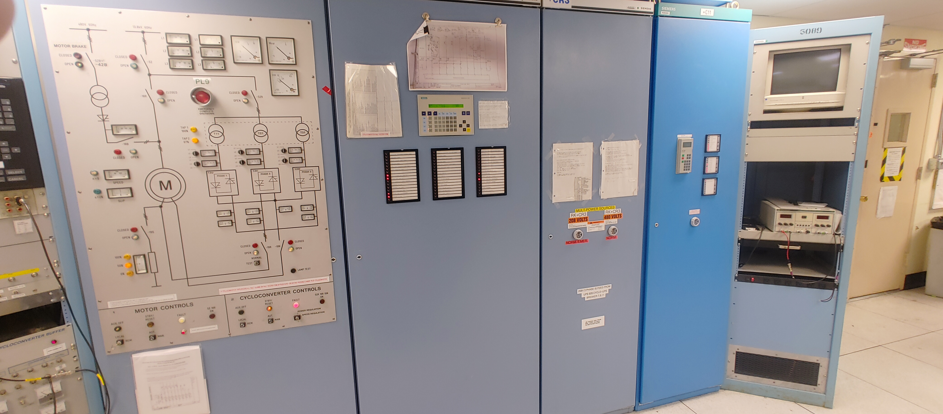
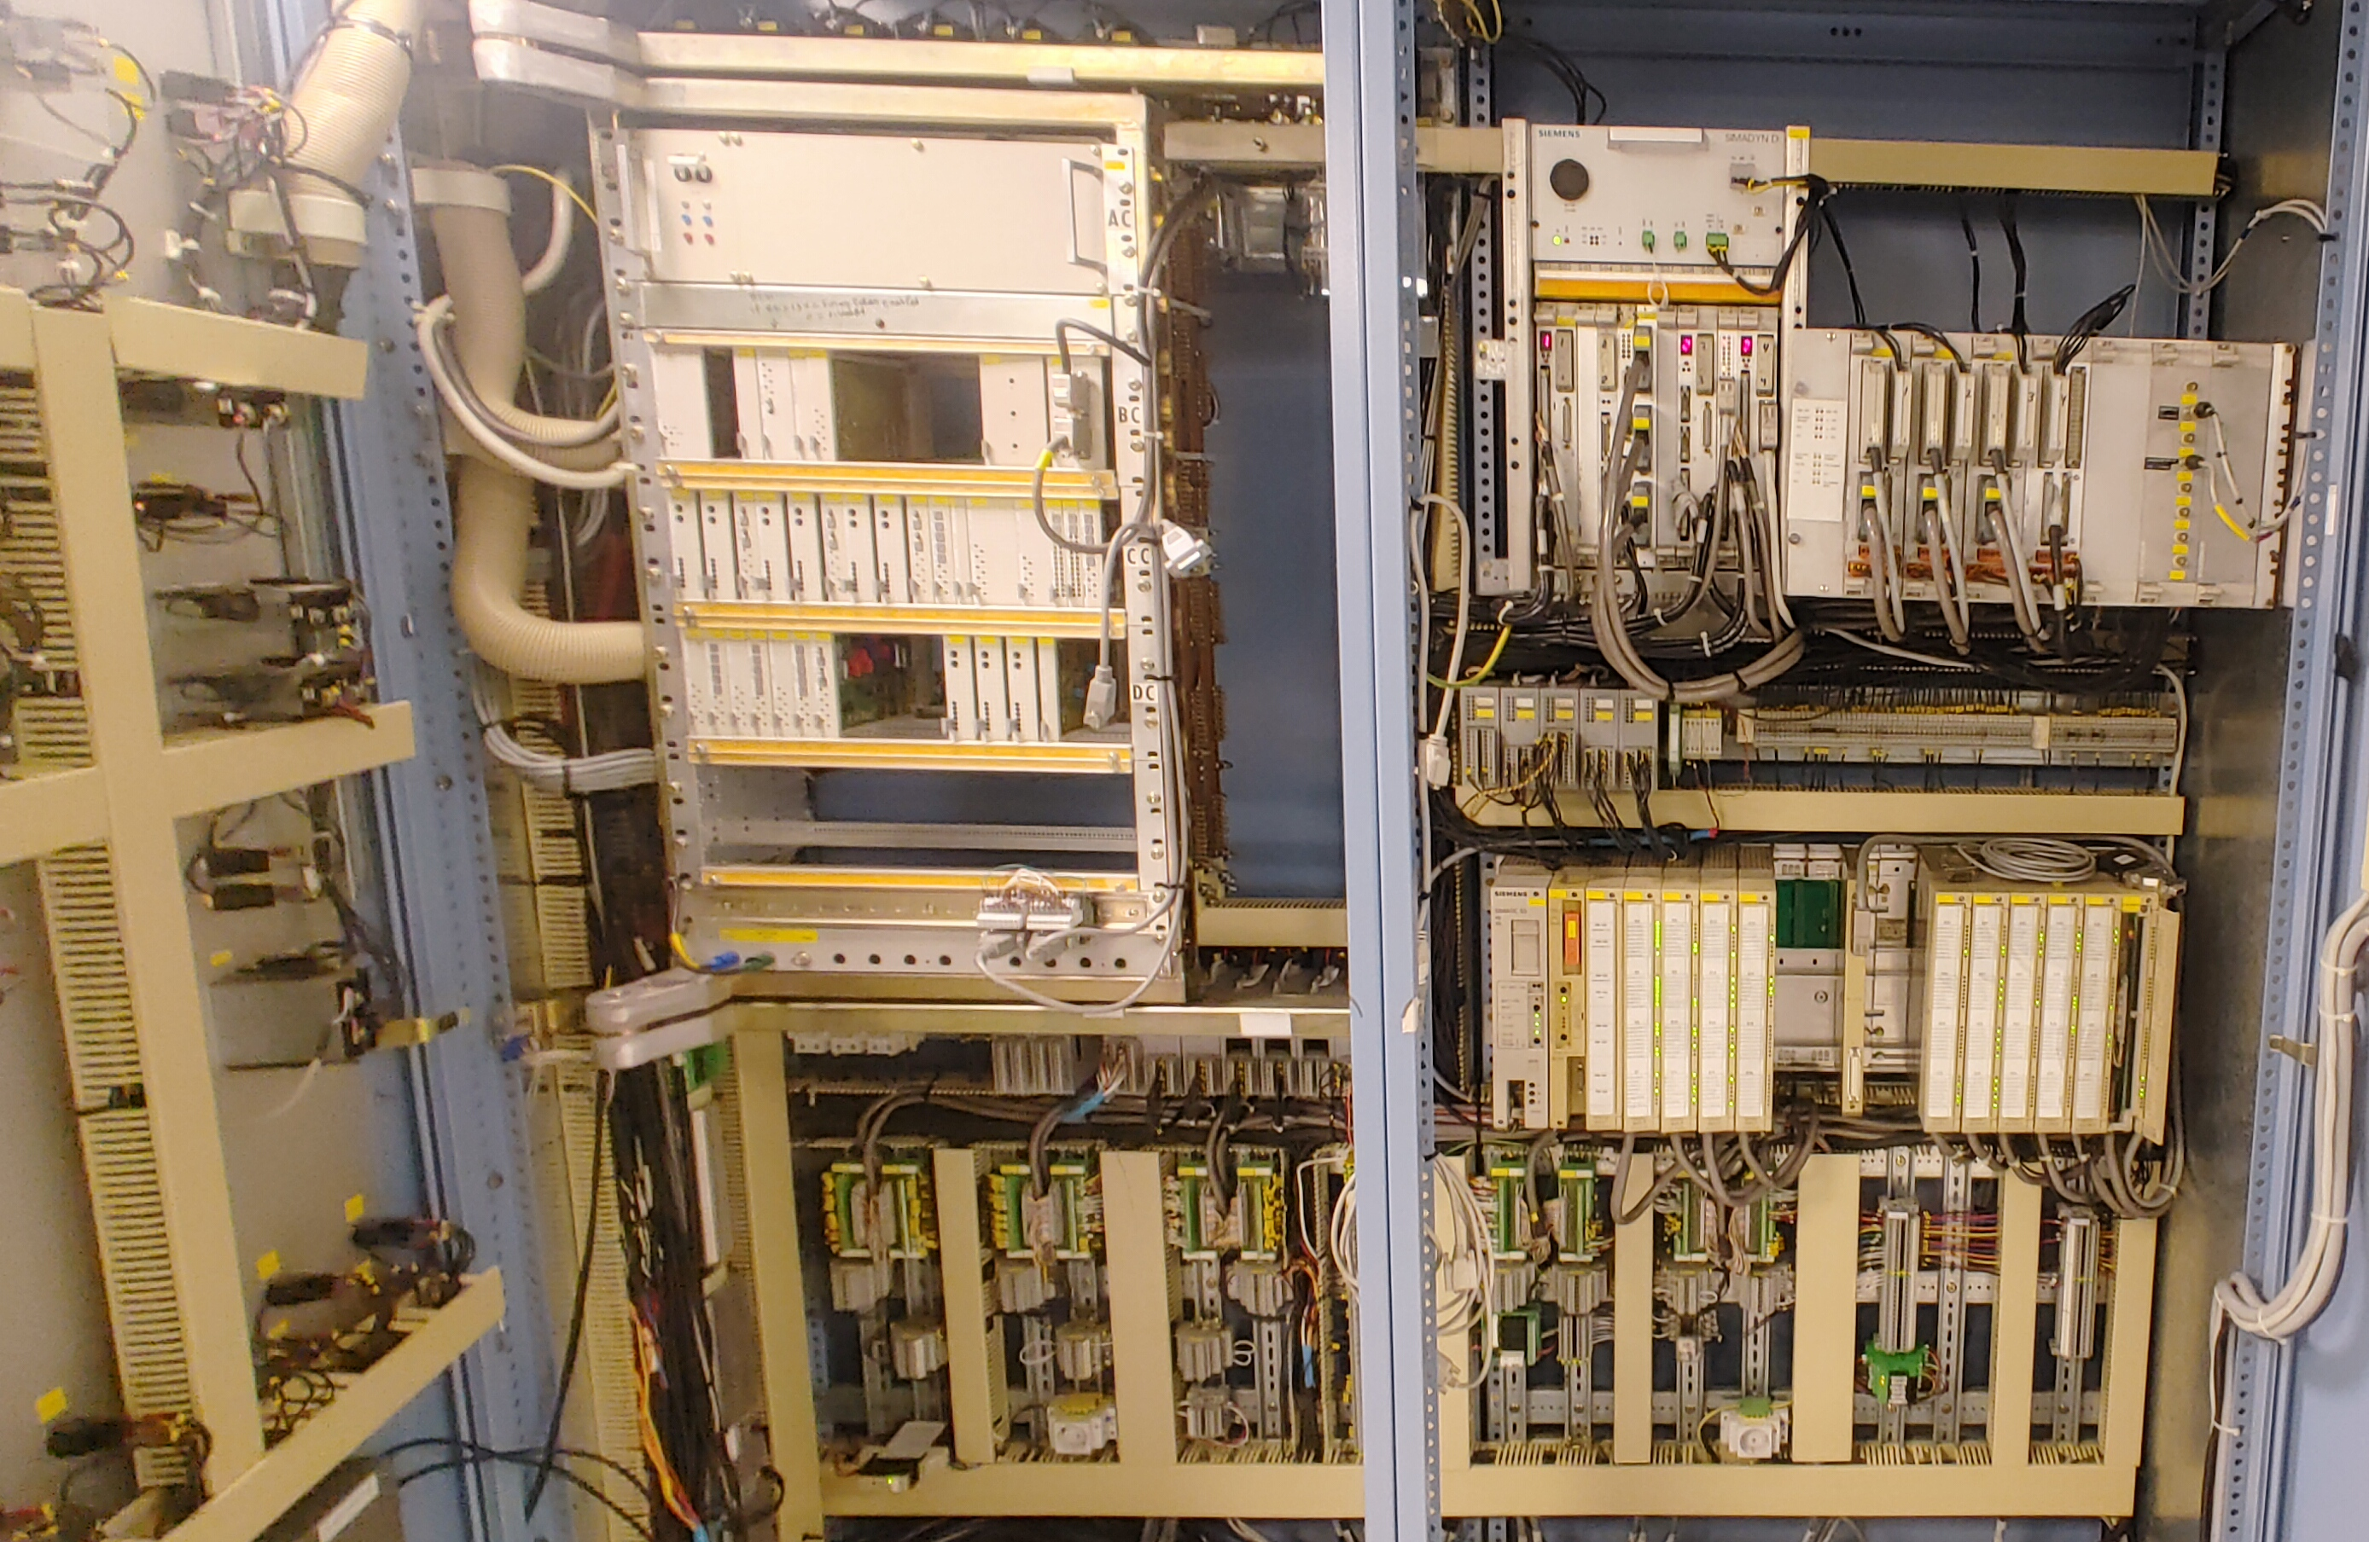
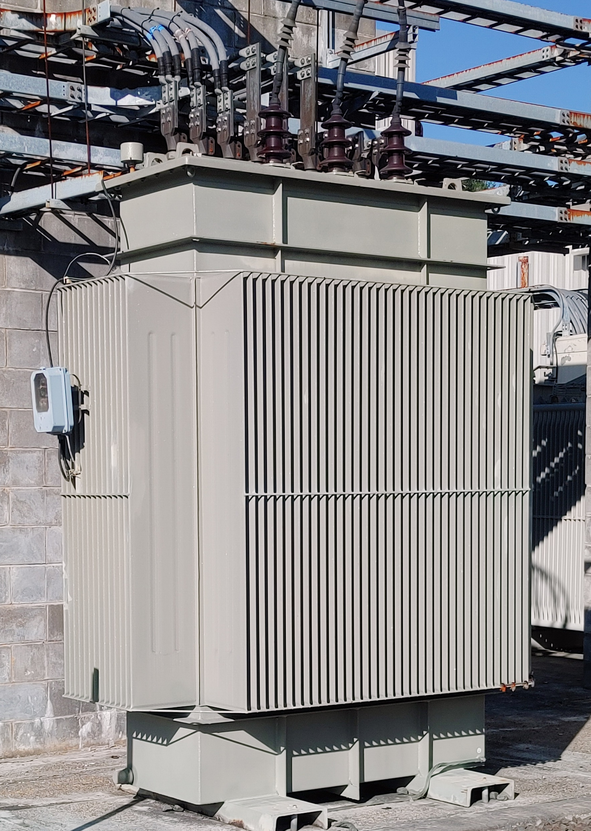
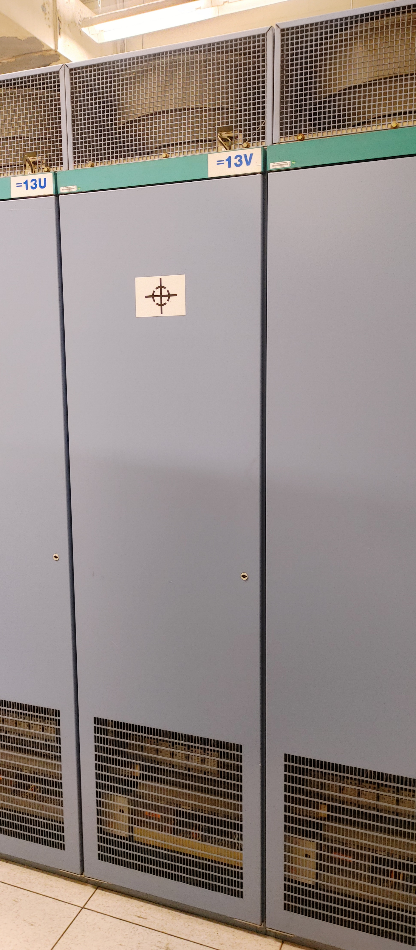
AGS – Siemens Main Magnet Power Supply Cycloconverter
Slide credit: Ioannis Marneris, Ed Bajon
Control Electronics
Manufacturer no longer supports the present system
Siemens Cycloconverter upgrade, Estimate cost to
Replace, $5 Million Total
Input Transformer
$2.5M AIP funding presently available, remaining is presently unfunded
Power Electronics

Slide 27
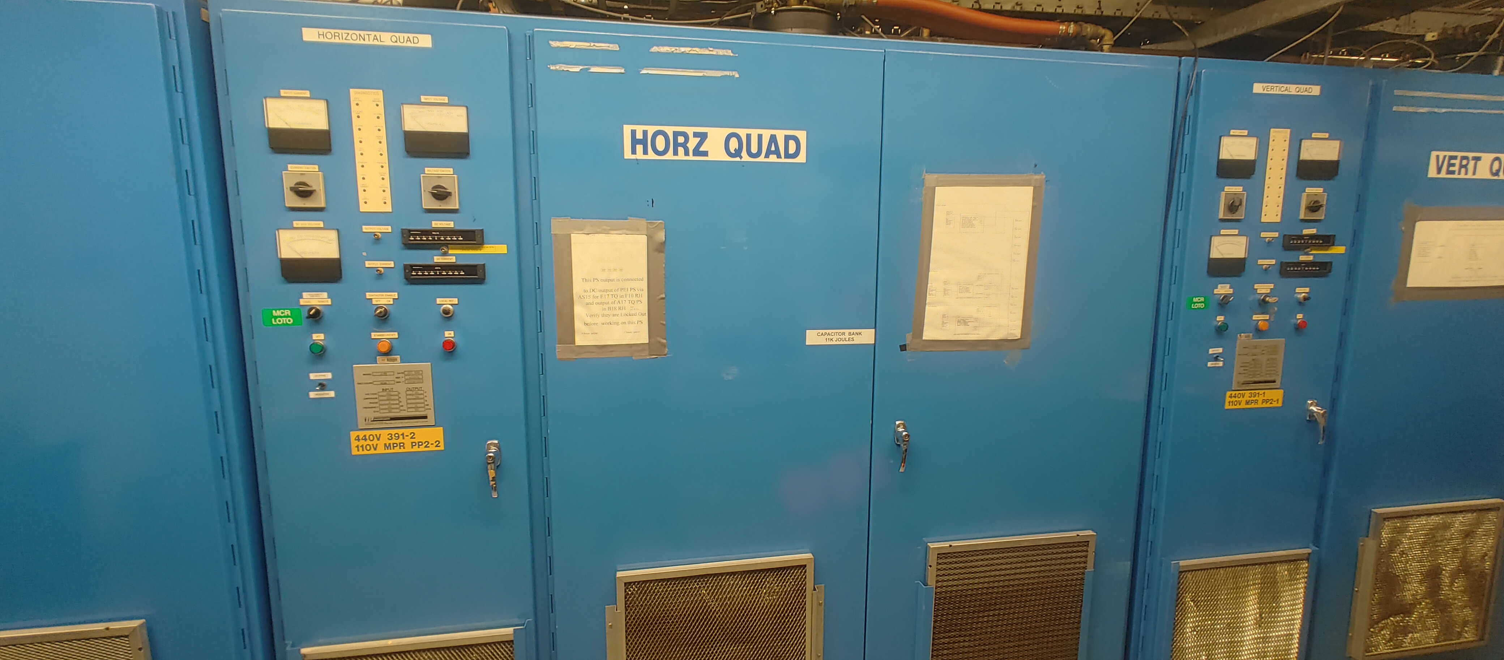
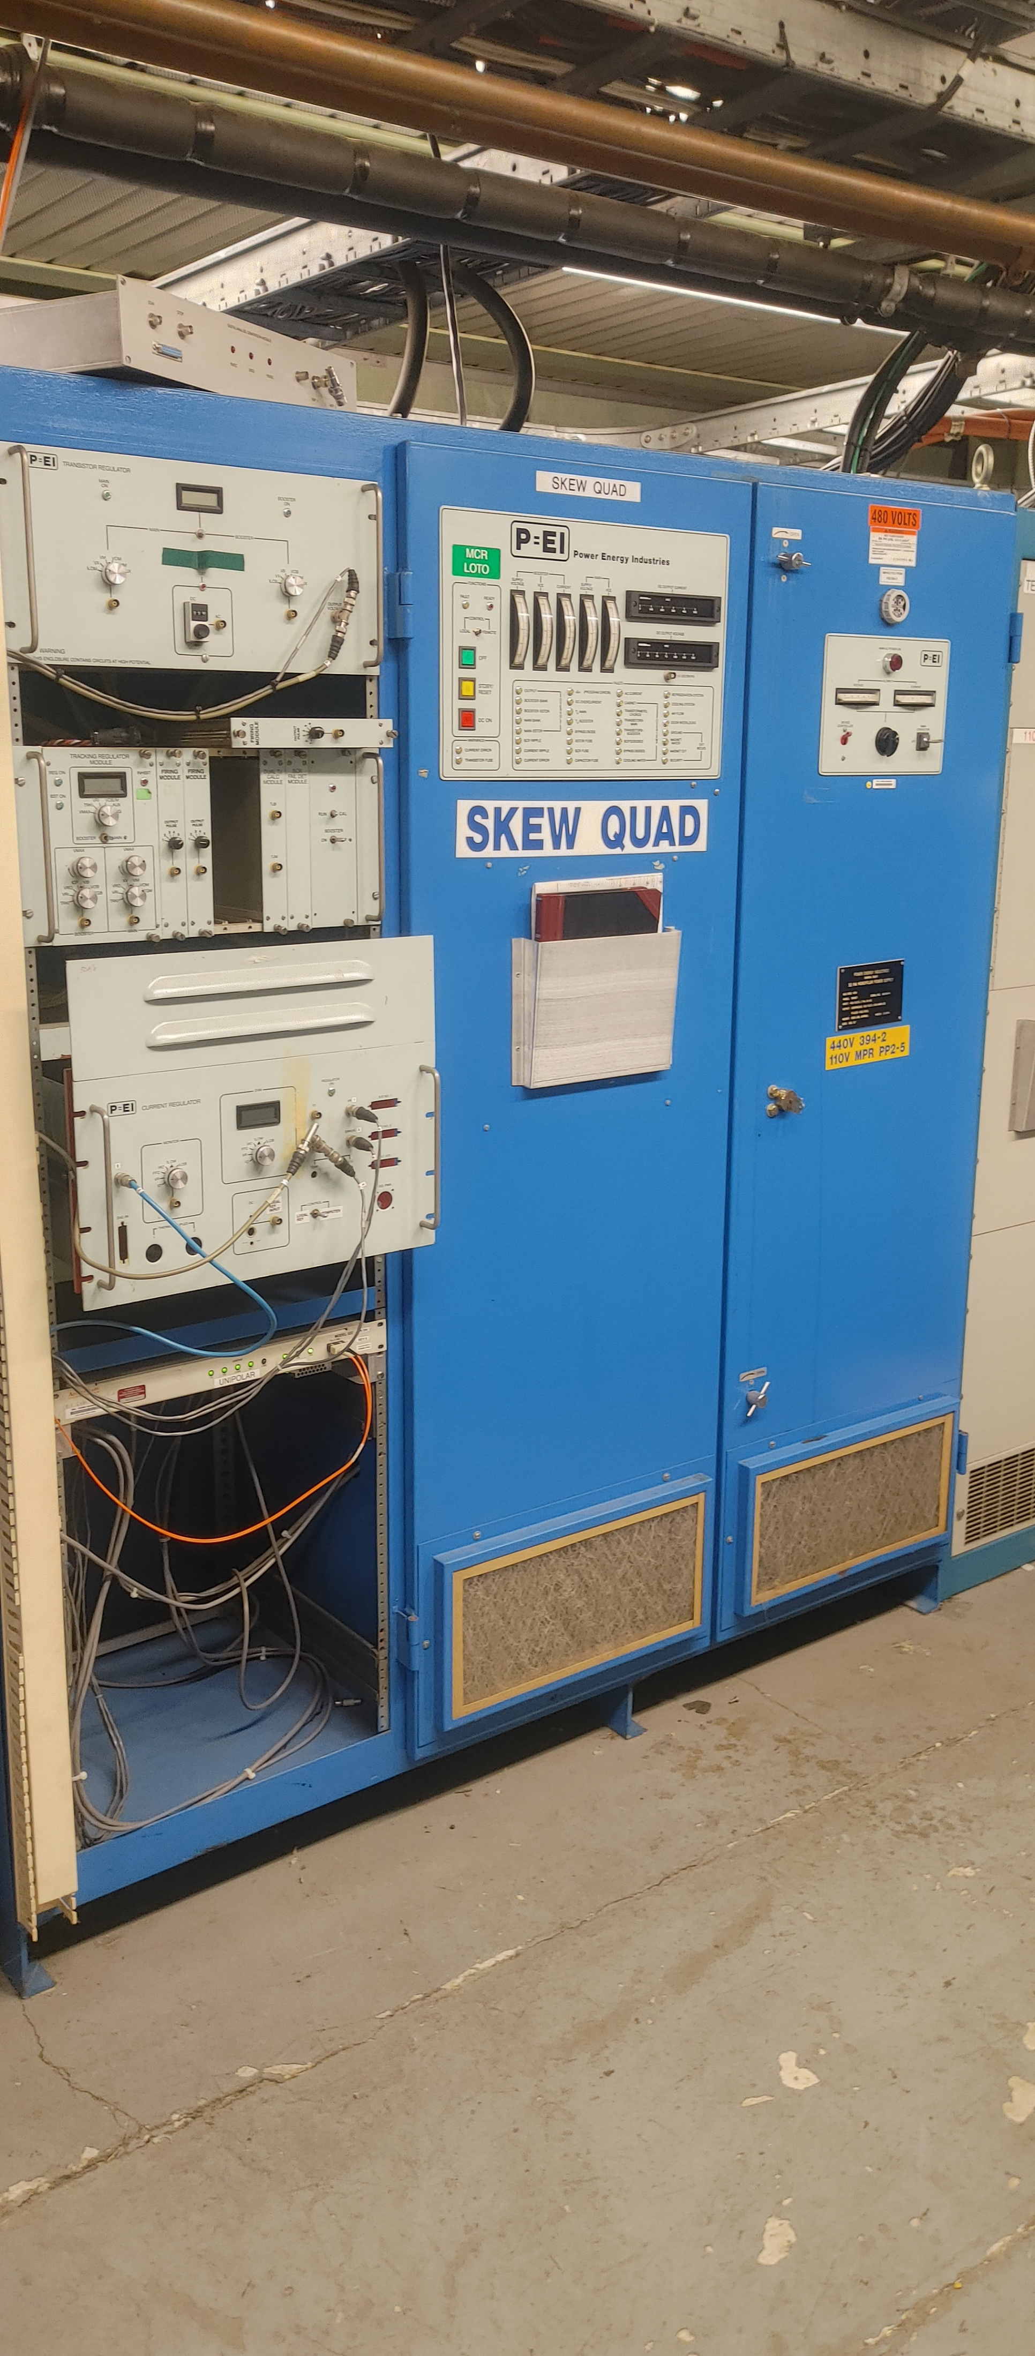
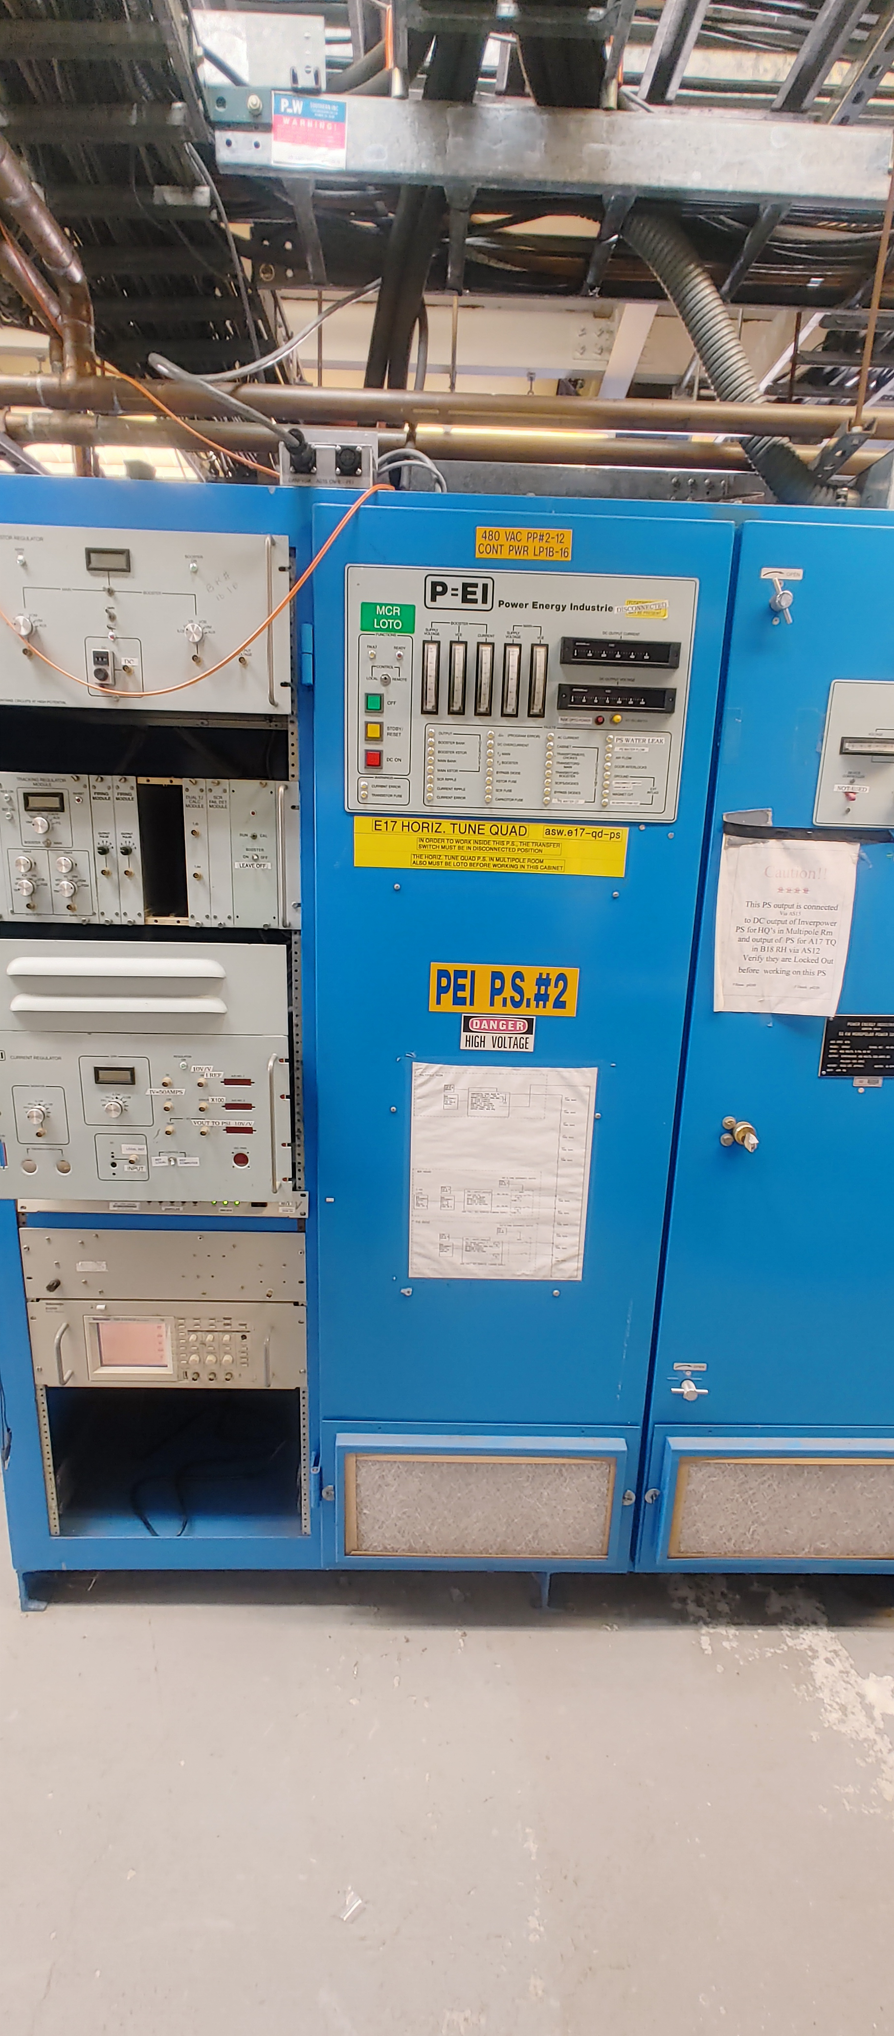
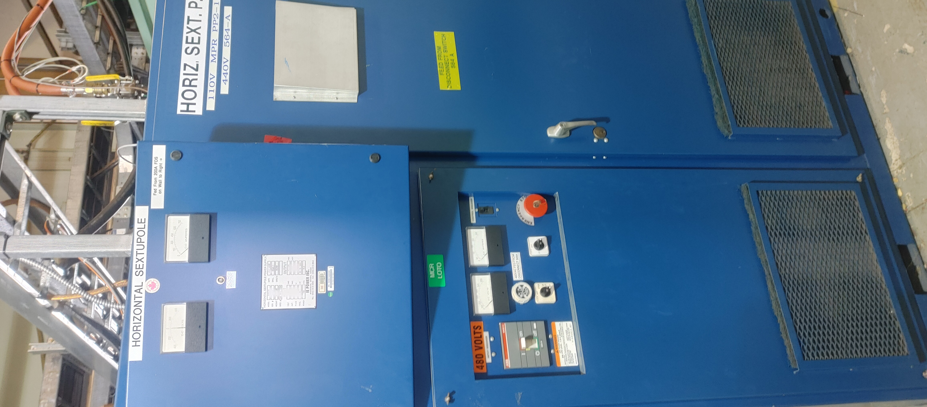
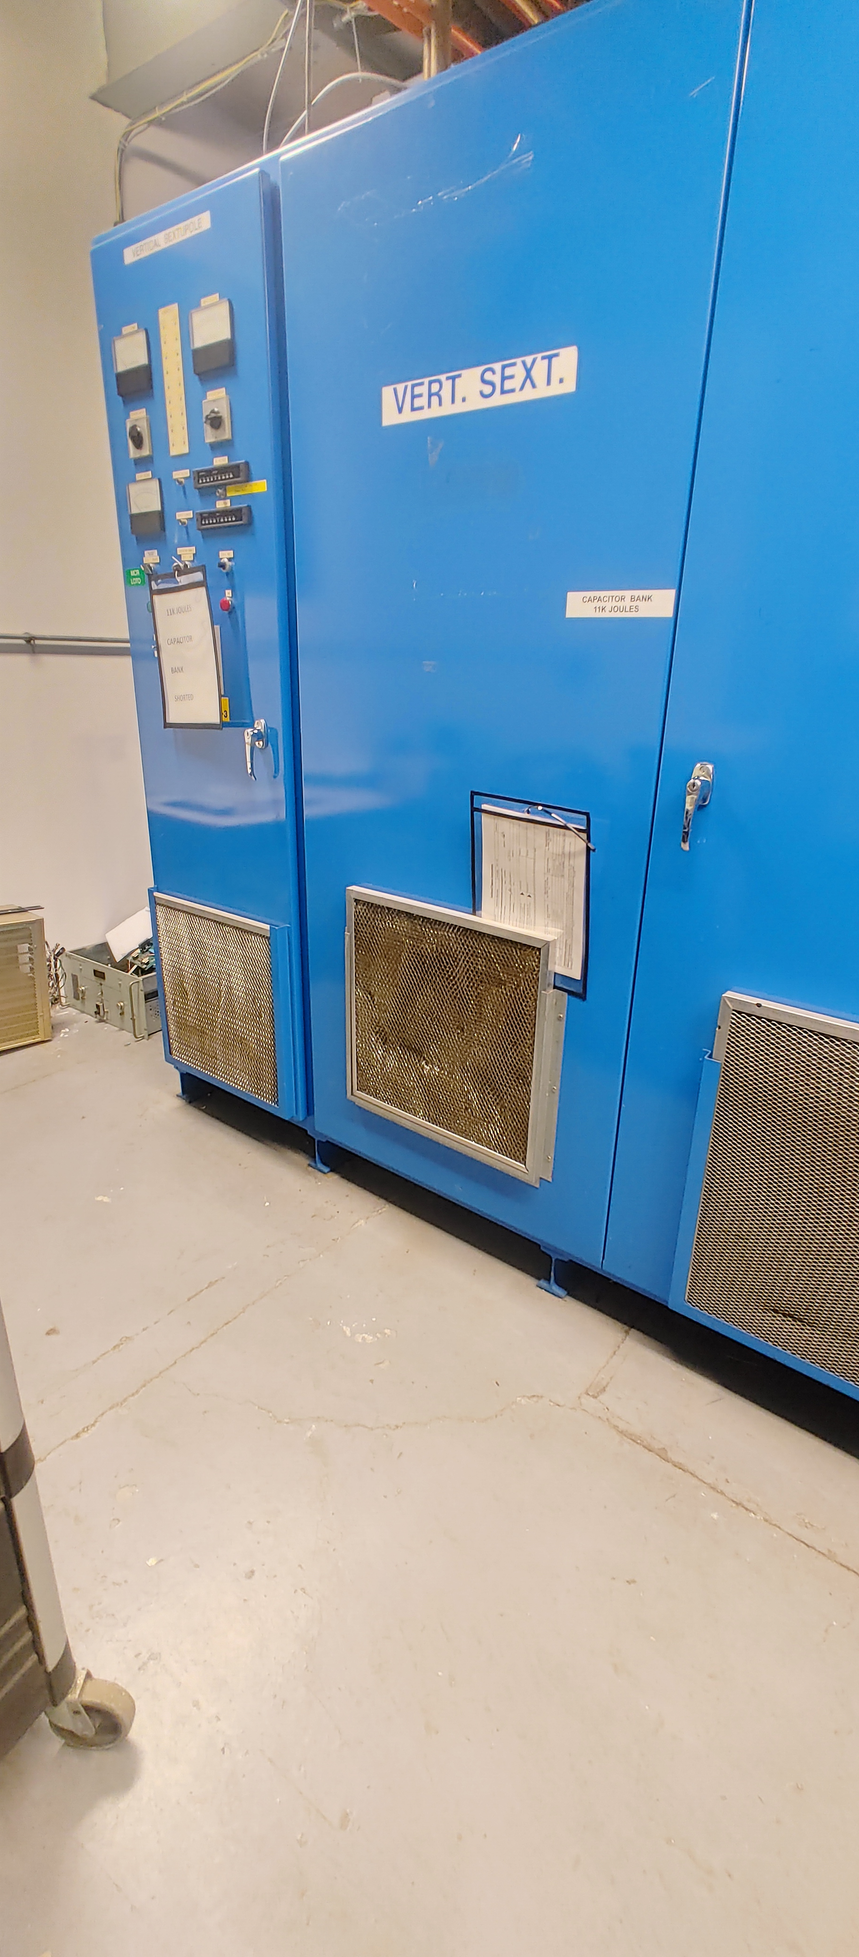
Replace two AGS PEI Power supplies Estimated cost: $200K
AGS Power Supply Upgrades
Funding not presently available
Replace one AGS Vertical and one Horizontal Quad Power Supply, Estimated cost: $300K
Multipole Room
F10 House
Replace one AGS Vertical and one AGS Horizontal Sextupole Power Supply, Estimated cost: $300K
Slide credit: Ioannis Marneris, Ed Bajon

Slide 28
Summary
Linac, booster and AGS IRR/ARR preparations are in progress, including identification of required upgrades/changes
A spreadsheet list is being maintained to identify and prioritize injector systems that need to be upgraded in order to support EIC for decades
Capital equipment funding is available now for some system upgrades
All AIP funding for the next many years to be allocated to cryo system upgrades
Significant additional funding is required to complete the bldg. 912 cryo plant upgrade required for EIC RF cavity testing
$35M funding is needed for the booster main magnet power supply upgrade. This is critically important for EIC in order to limit disturbances on the power line
Funding for upgrades is very limited
Funding sources for important upgrades need to be identified

