Slide 1
ML for Beam Polarization Increase Accepted ML / AI Proposal to DOE-NP FOA
Georg Hoffstaetter de Torquat
Collider-Accelerator Department, BNL and Cornell University
Georg.Hoffstaetter@cornell.edu
CAD MAC December 20, 2023

Slide 2
DE-FOA-0002875 : ARTIFICIAL INTELLIGENCE AND MACHINE LEARNING FOR AUTONOMOUS OPTIMIZATION AND CONTROL OF ACCELERATORS AND DETECTORS
Title: Higher RHIC polarization by Physics-informed Bayesian Learning
Budget: $1.5M, duration 2 years, start 09/01/2023 to BNL, Cornell, JLAB, SLAC, RPI
Funding through DOE-NP DE SC-0024287, contr.# 2023-BNL-AD060-FUND
Funding officer Manouchehr Farkhondeh
Requested topics:
Efficiently extract critical and strategic information from large complex data sets
Address the challenges of autonomous control and experimentation
Efficiency of operation of accelerators and scientific instruments
AI for data reduction of large experimental data

Slide 3
Desired result: higher proton polarization
What high-impact operational challenge can be addressed by MI/AI? ➔ Polarized protons.
From the source to high energy RHIC experiments, 20% polarization is lost.
Polarized luminosity for longitudinal collisions scales with P⁴, i.e., a factor of 2 reduction!
The proton polarization chain depends on a hose of delicate accelerator settings form Linac to the Booster, the AGS, and the RHIC ramp.
Even 5% more polarization would be a significant achievement.

Slide 4
Outline
Objective of proposed work: higher proton polarization in RHIC and the EIC.
Polarized-proton acceleration chain.
Potential avenues toward higher proton polarization.
(1) Emittance reduction
(2) More accurate timing of timed elements
(3) Reduction of resonance driving terms
Started Activities
Gaussian Process (GP) Bayesian Optimization (BO) and physics informed learning.
When is ML/AI better for accelerator operations than other feedbacks and optimizers?

Slide 5
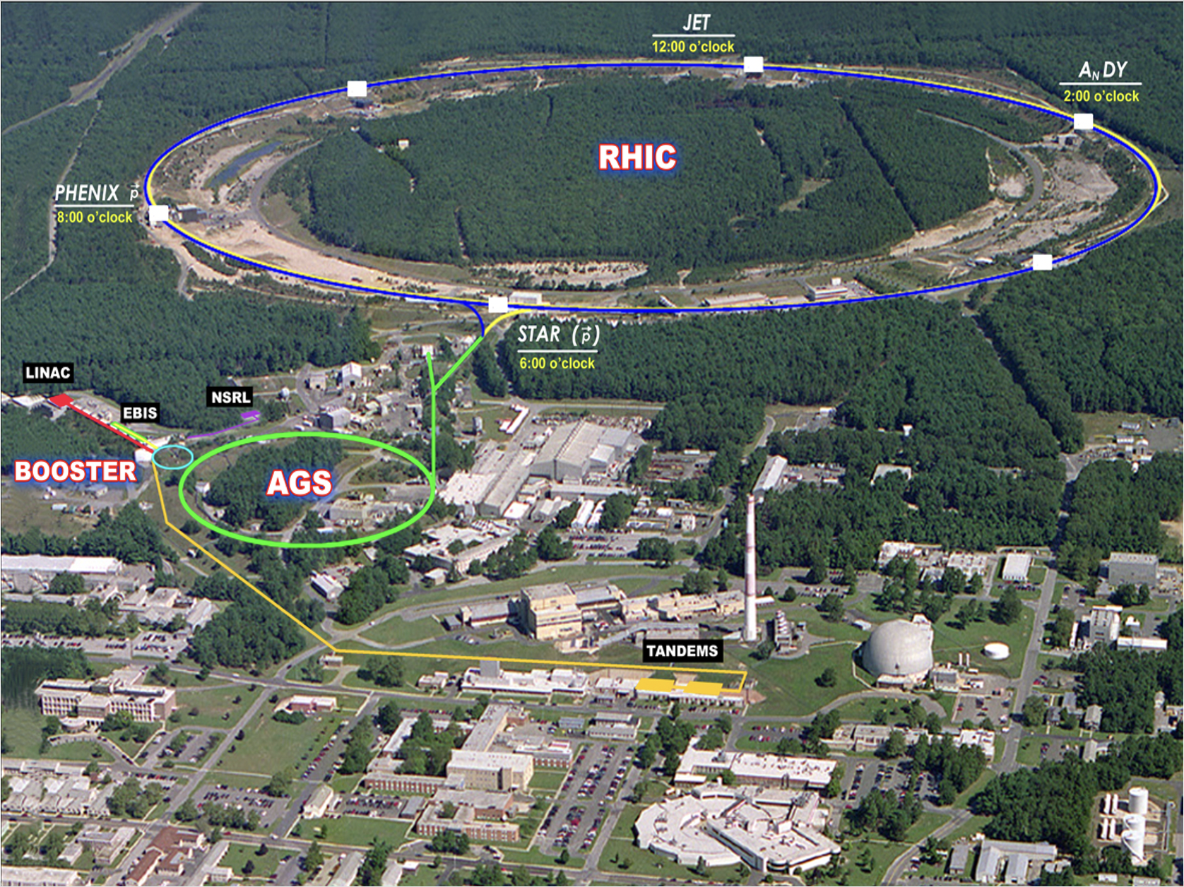
The polarized proton accelerator chain

Slide 6
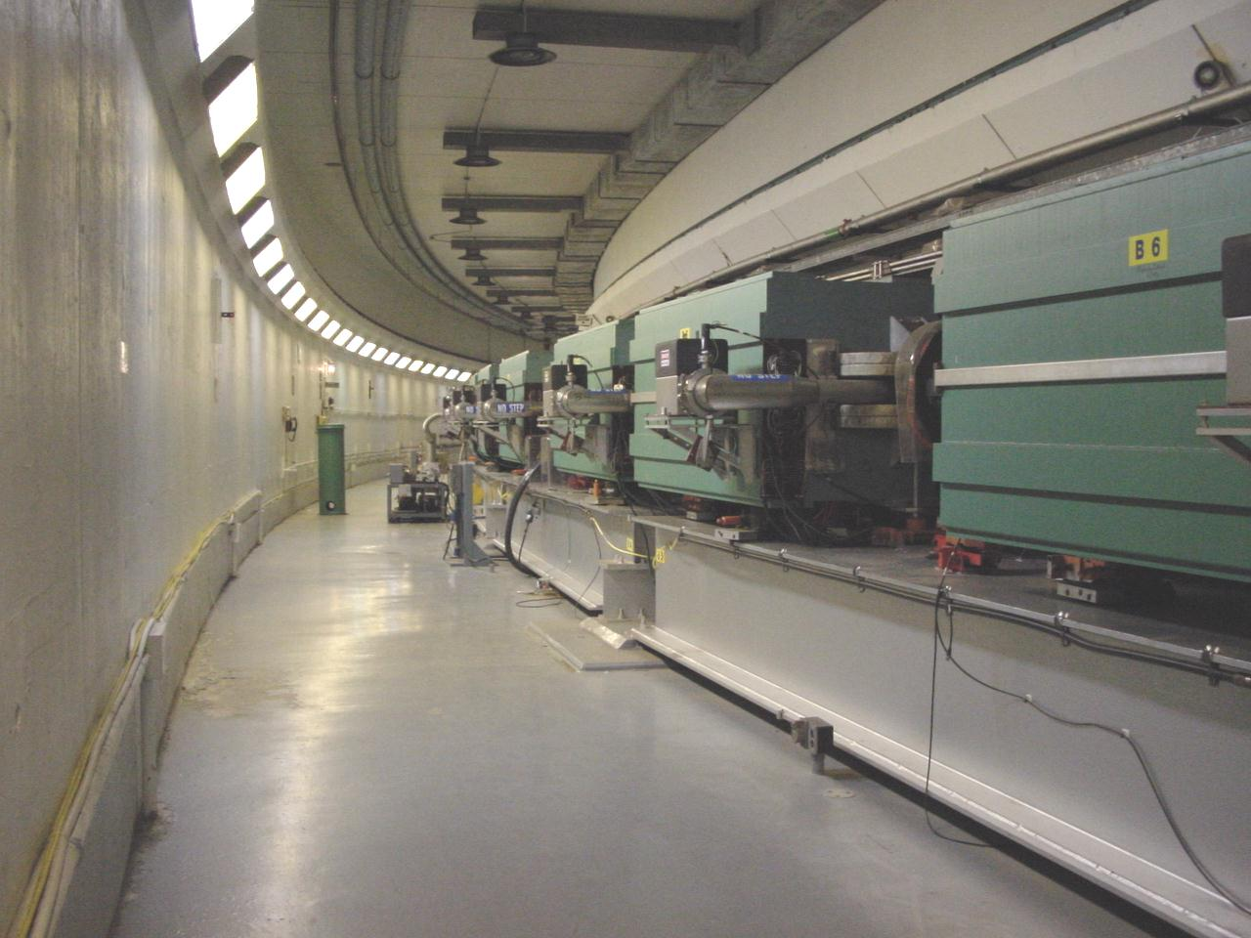
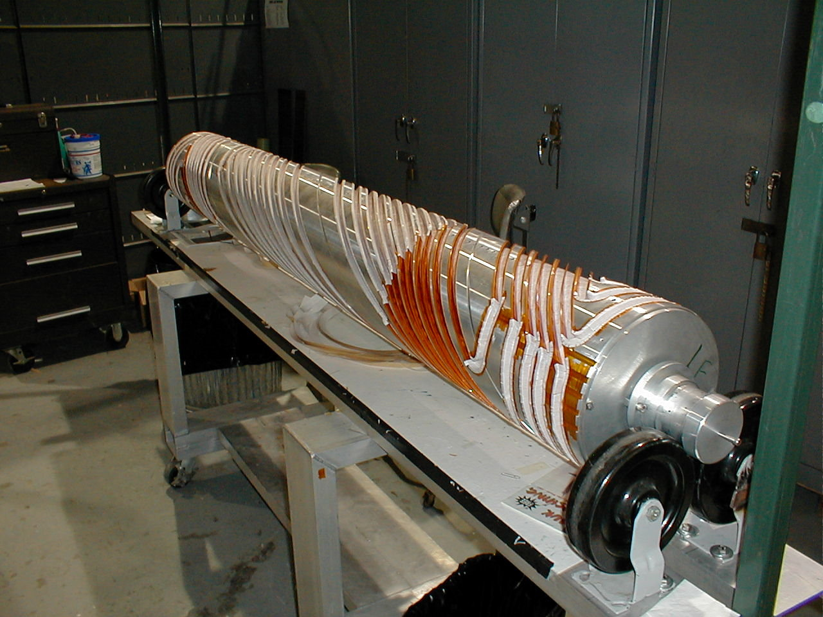
Linac – Booster – AGS Optimization
Readily available, large data flow possible
Spin flipper
Absolute Polarimeter (H jet)
RHIC pC Polarimeters
Siberian Snakes
PHENIX (p)
STAR (p)
Spin Rotators
(longitudinal polarization)
Spin Rotators
(longitudinal polarization)
LINAC
BOOSTER
Pol. H⁻ Source
Helical Partial
Siberian Snake
200 MeV Polarimeter
AGS
AGS Polarimeters
Strong AGS Snake

Slide 7
Topics that can improve polarization
(1) Emittance reduction
(2) More accurate timing of tune jumps
(3) Reduction of resonance driving terms

Slide 8
Emittance reduction ➔ less depolarization
Optimized Linac to Booster transfer
Optimized Booster to AGS transfer
Optics and orbit correction in Booster and AGS
Beam-based Quadrupole calibration from ORM in Booster and AGS.
Bunch splitting in the Booster for space charge reduction and bunch re-coalescing at AGS top energy.

Slide 9
Linac to Booster transfer
Parameters to vary:
Transfer line steers
Main Booster dipol90e field
Booster beta wave (stop-band quadrupoles) for tune toward ½ and minimum on the foil
Last two linac phases
Injection bump elements and their time profile
Scraper amplitudes
Observables to optimize:
Transfer efficiency linac ➔ Booster early ramp (2% absolute)
Emittance from multi wires of the AGS transfer line (5% relative)

Slide 10
Booster to AGS transfer
Parameters to vary:
Transfer line steerers
Main AGS dipole field
AGS RF phase
Amplitudes of two Injection bumps
Horizontal orbit in the snakes
Quadrupole corrections for the snakes
Injection to accelerator tune change
Observables to optimize:
Transfer efficiency Booster ➔ AGS early ramp (2% absolute)
Emittance from two IPMs (10% relative)

Slide 11
Response Error model for the ORM

Slide 12
Sensitivity studies: error sources
Sources or error and ranges come from past survey data
Criteria to quantify & visualize sensitivity:
RMS of ORM matrix
Beta-beating (vertical & horizontal)
$$\frac{∆β}{β}=\frac{β_{measured}−β_{model}}{β_{model}}$$
Name | Unit | Range
Main magnet roll error | mrad | [-0.5, 0.5]
Main magnet gradient error | m⁻² | $$± 0.1\%$$
Quadrupole gradient error | m⁻² | $$± 0.2\%$$
Sextupole offset error | mm | [-8, 8]
Snake magnet roll error | mrad | [-1.5, 1.5]

Slide 13
Where do we put AI/ML?
ORM will give us
BPM and Corrector Anomalies (Trust Analysis)
Gradient errors for given conditions
Beta-deviations from model
Dispersion measurements give us
BPM Consistency check for given dp/p (BPM Anomalies)
Coupling through longitudinal motion (very slow, typically)
Tune measurements
Betatron tune and coupling = destructive measurement in Booster/AGS
Tune, Chrom, coupling, emittance, dp/p from RHIC Schottky
Chromaticity measurements – need to change energy and measure tune
Orbit Measurements – parasitic = most are time averaged, some turn by turn
Linear model + small nonlinearities with NN model

Slide 14
Orbit & Optics correction in Booster / AGS
Parameters to vary:
Corrector coils (24 per Booster plane)
Corrector coils (48 per AGS plane)
Observables to optimize:
BPM readings (24 x&y in the Booster) (100um accuracy)
BPM readings (72 x&y in the AGS) (100um for 2mm size at 25GeV)

Slide 15
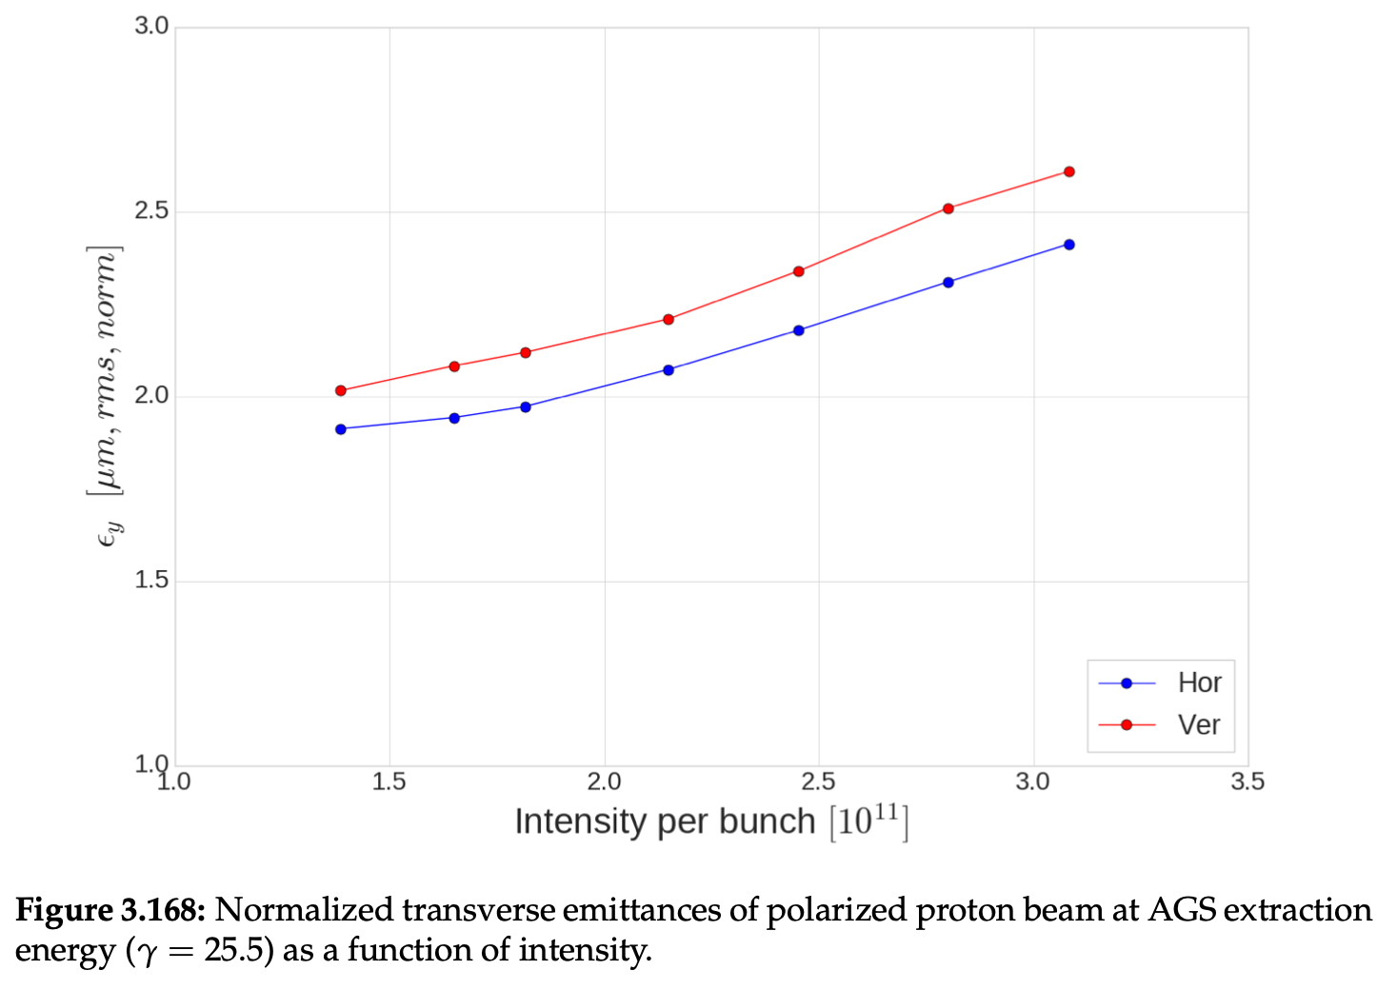
Space-charge emittance increase
➔ Splitting bunches before AGS acceleration can reduce the emittance.

Slide 16
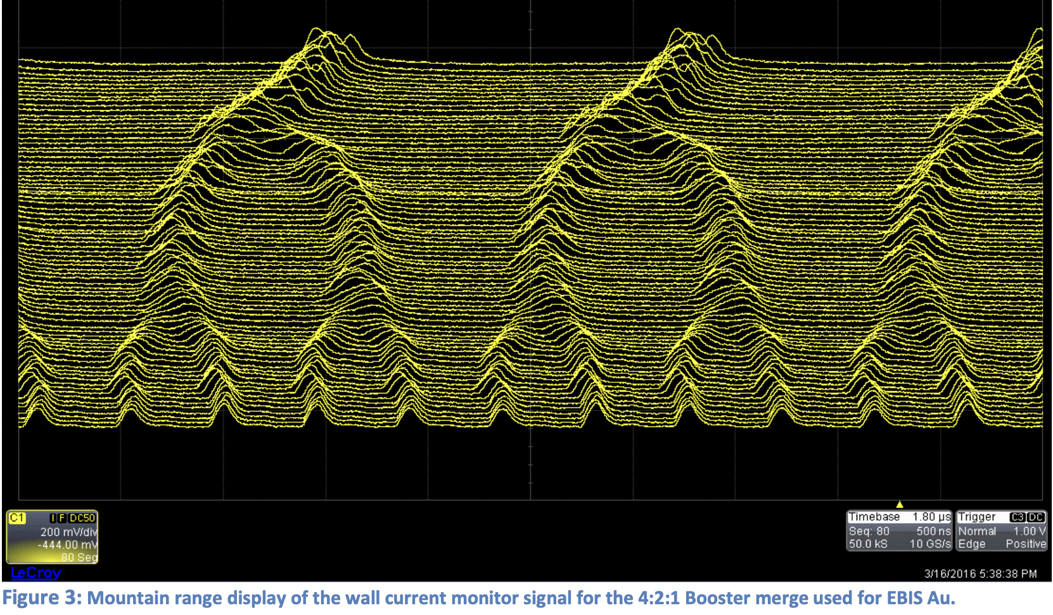
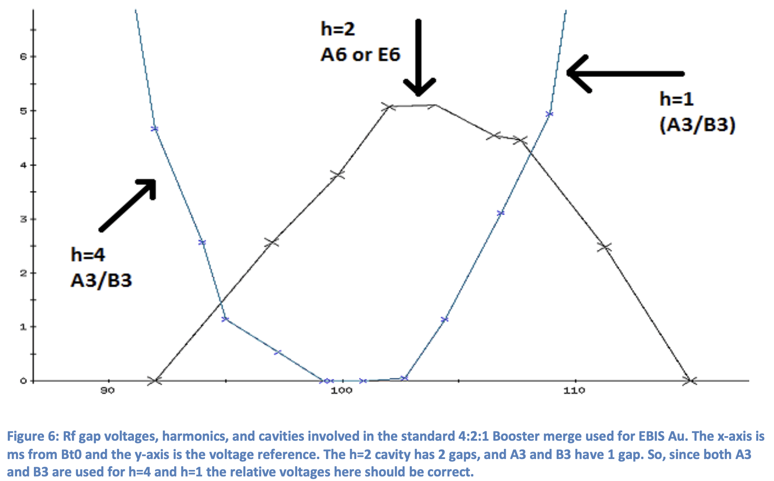
Bunch splitting / coalescing
Splitting in the booster and coalescing after AGS accelerator reduces space charge and emittance growth ➔ more polarization

Slide 17
Bunch splitting and coalescing
Parameters to vary:
3 RF amplitudes and phases, and their timing
Observables to optimize:
Mountain range width (5% relative)
Mountain range oscillations (10% of a sigma)
Baby-bunch currents (2%)
Emittance in the multi-wire to the AGS (5% relative)
Emittance from two IPMs (10% relative)

Slide 18
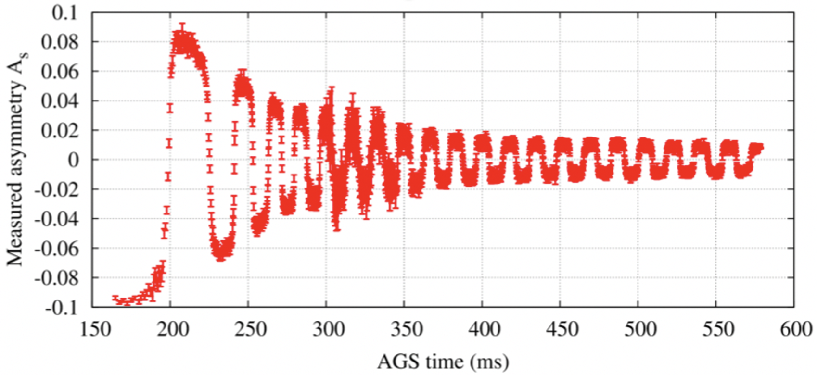
Timing of tune jumps
The G-gamma meter and accurate energy vs. time
Measure the energy by orbit + revolution frequency measurement
Measure of energy by field + revolution frequency measurement
Measure energy by spin flip at every integer spin tune
Combined optimization
better timing
➔ higher polarization

Slide 19
Improved energy timing
Parameters to vary:
Time profile of the time-jump quadrupoles
Observables to optimize:
Revolution frequency (1.E-6)
Radial offset from BPM readings (20mu average)
Main dipole fields Hall-probe at injection (0.1%) + integrating coil (2%)
E(t) by measure f(t), x(t), B(t), P(t)

Slide 20
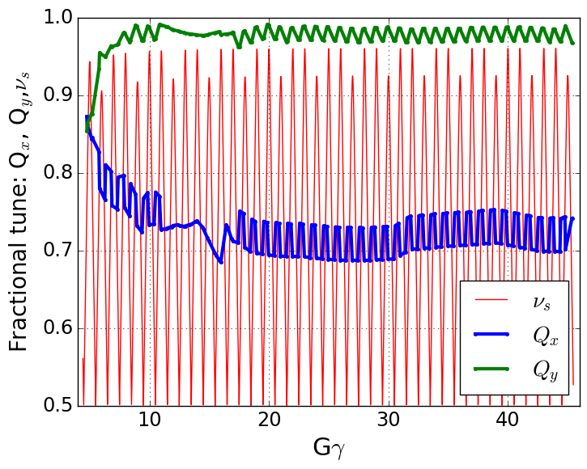
Reduction of AGS resonance driving terms
Spin tune gap
Polarization is preserved in the AGS with two partial helical dipole snakes (10% and 6% rotation)
Provides spin tune ‘gap’ where imperfection and vertical intrinsic resonance condition are never met
ν_{s} ≠ N (full spin flips)
ν_{s} ≠ N +/- Q_{y}
Horizontal resonance condition still met
ν_{s} = N +/- Q_{x}
Horizontal resonance are weak, but many (82 crossings)
Currently handled with fast tune jump
ΔQ_{x} = 0.04, 100 μs
Hor resonance crossings
Tune
jump
(pause tune jump near transition)
Partial snakes drive horizontal depolarizing resonances
➔ Compensate by other coupling elements, e.g., skew quads

Slide 21
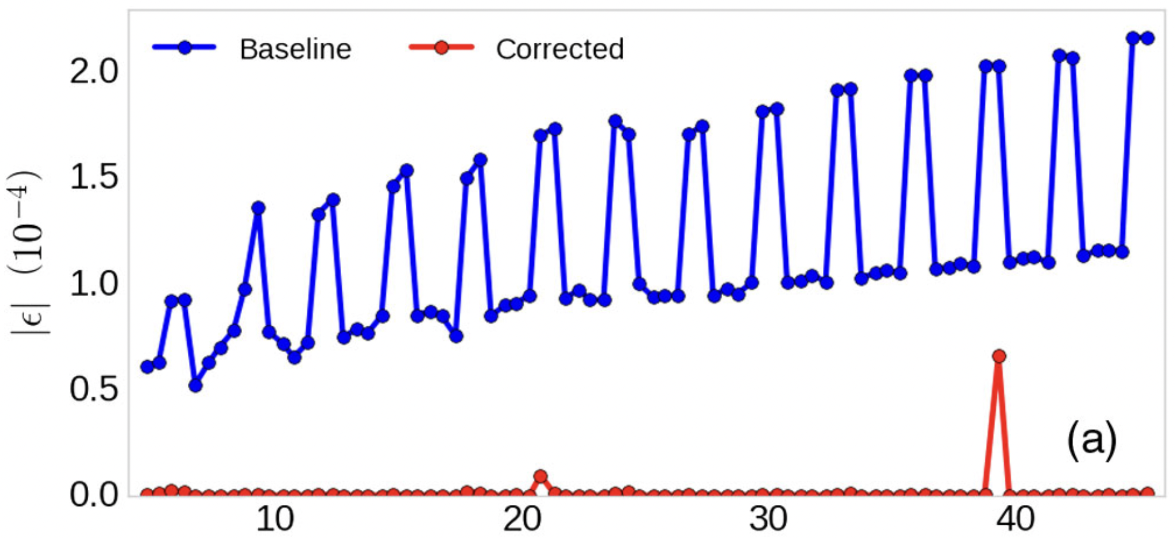
Reduction of AGS resonance driving terms
Two snakes, separated by 1/3 circumference
Modulated resonance amplitude highest near Gɣ = 3N (when snakes add constructively)
Horizontal resonances occur every 4-5 ms at the standard AGS acceleration rate
ML/AI:
Physics informed
Learning of the optimal
skew quad strength +
optimal timing.
Horizontal Resonance Amplitudes in AGS

Slide 22
Reduction of resonance strengths
Parameters to vary:
14 Skew quad amplitudes at each of 80 resonances
Timing of skew quad changes
Observables to optimize:
Polarization after the ramp (2% relative)
Polarization at intermediate energies (2% relative)

Slide 23
Activities
Kickoff Collaboration meeting @ Cornell, August 25, 2023 – successful in person
Weekly meetings Mondays 3:30pm of all collaborators
Interface with weekly meeting Wednesdays 11am on digital twins from Linac to AGS
Semi-weekly ML/AI software meeting Friday’s on beam & ML computer standards
To be addressed: Potential avenues toward higher proton polarization
(1) Emittance reduction
(2) More accurate timing of timed elements
(3) Reduction of resonance driving terms

Slide 24
Dominant Participants
Dominant participants:
BNL: Kevin Brown, Weinin Dai, Bhawin Dhital, Yuan Gao, Kiel Hock, Bohong Huang, Natalie Isenberg, Nguyen Linh, Chuyu Liu, Vincent Schoefer, Nathan Urban
Cornell: Georg Hoffstaetter de Torquat, Lucy Lin, Eiad Hamwi
SLAC: Auralee Edelen
JLAB: Malachi Schram
RPI: Yinan Wang
Radiasoft: Nathan Cook, Jon Edelen, Chris Hall
Teams: (1) Accelerator simulation – digital twins, (2) ML application – code development, (3) Experiment 2 simulation comparison.

Slide 25
Started Activities
Emittance reduction by linac 2 booster optimization:
Adjust the model to hardware and alignment data for the L2B line
Simulate scraping of beam in the Booster, including ionization foil with Bmad
Write Bmad function that produces loss rate vs. last two L2B correctors and bring to OpenAI Gym format.
Apply established ML codes to this function.
(2) Emittance reduction by booster optimization
Compare Bmad to established Zgoubi results and compare to BPM/alignment measurements
Establish booster-orbit response to corrector changes and produce function that gets minimized by optimizing system parameters, e.g. element alignments, bring into OpenAI gym format.
Apply established ML codes to this function.

Slide 26
Started Activities
(3) Emittance reduction by B2A transfer:
Adjust the Bmad model to hardware and alignment data for the B2A line
Simulate Booster phase space transfer through this line and compare to measured harp profiles
(4) Emittance reduction by re-bucketing
Adapt Bmad bunch-merging code for the EIC’s RCS to the Booster (bunch splitting) and AGS (bunch merging)
Compare Bmad to established Python re-bucketing code for Booster and AGS
Write a function that characterizes bunch splitting/merging efficiency from RF parameters for ML/AI optimization.

Slide 27
Started Activities
(5) Depolarization reduction by Skew-quad resonance minimization in the AGS:
Detailed Bmad model of the AGS at all energies overcoming:
Non-symplecticity of tracking through field maps of snakes
Introduce differentiable models of snake fields and match these to their field maps
Compensate the closed orbit, optics, coupling, and dispersion (esp. vertical) for these maps at all energies
Compute resonance strength of the Bmad model and compare to established results
Compare resonance strength to previous measurements
Define optimized skew-quad compensation schemes at all 82 resonances, minimizing vertical dispersion, coupling, optics errors, and speed of skew-quad changes
(6) Improved g-gamma meter by combining it’s 3 measurements
Technique discussed, Team being formed
(7) Combined and verified evaluation of existing emittance measurement techniques (through Radiasoft)
Technique discussed, Team is formed

Slide 28
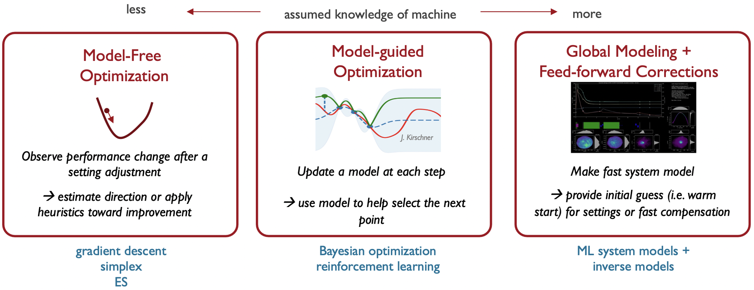
Optimizers for different applications
Courtesy Auralee Edelen

Slide 29
Characteristics of involved optimizations
Optimal parameter settings are hard to find, and the optimum is difficult to maintain.
The data to optimize on has significant uncertainties.
Models of the accelerator exist.
A history of much data is available and can be stored.
Is this type of problem suitable for Machine Learning?
Why would ML be better suited than other optimizers and feedbacks?

Slide 30
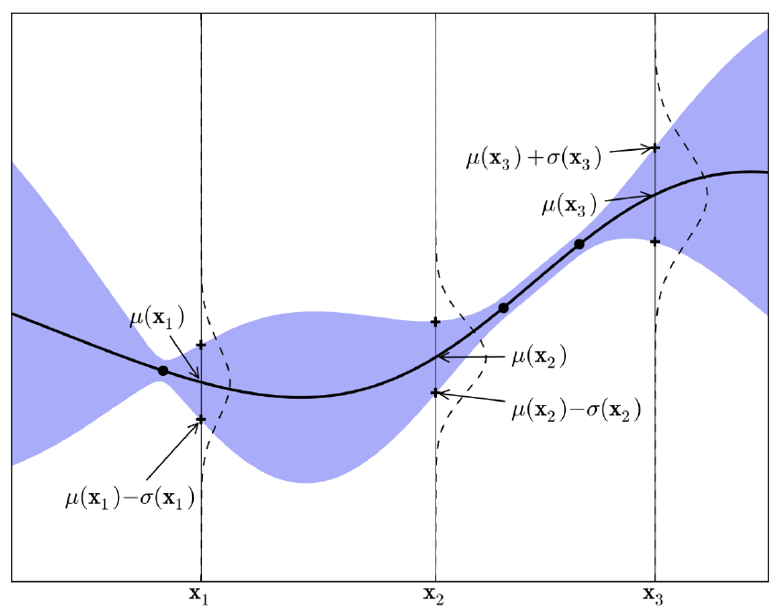
Gaussian Process
GP model built with scikit-learn library
A probability distribution over possible functions that fit a set of points
Mean function + Covariance function
Kernel: covariance function $k(x_{i},x_{j})$ of the input variables
Covariance matrix $K=k\left(X,X\right)=\left[\begin{matrix}k(x_{1},x_{1}) & ⋯ & k(x_{1},x_{t}) \\ ⋮ & ⋱ & ⋮ \\ k(x_{t},x_{1}) & ⋯ & k(x_{t},x_{t})\end{matrix}\right]$
At a sample point $x_{i}$, Gaussian process returns mean $μ\left(x_{i}|X\right)=m\left(x_{i}\right)+k\left(x_{i},X\right)K^{−1}\left(f(X)−m\left(X\right)\right)$ and variance $σ^{2}\left(x_{i}|X\right)=k\left(x_{i},x_{i}\right)−k(x_{i},X)K^{−1}k(X,x_{i})$

Slide 31
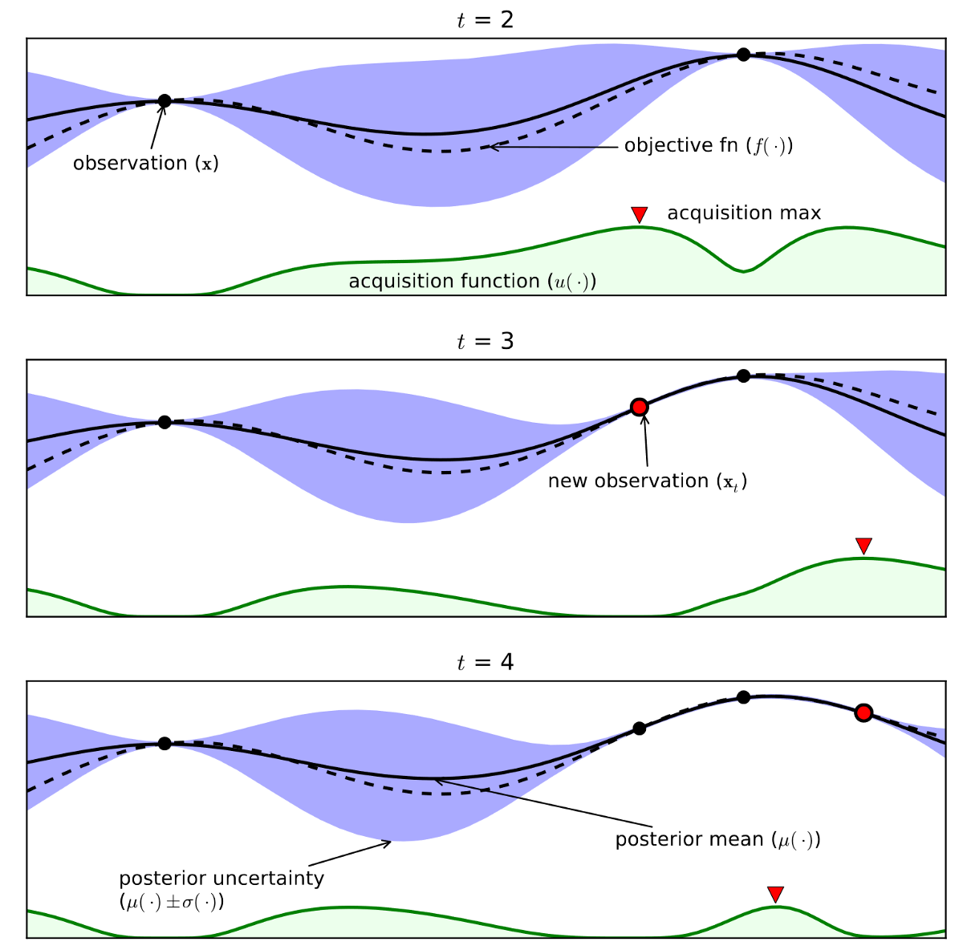
Acquisition Function
[2]
Guide how input space should be explored during optimization
Combine predicted mean and variance from Gaussian Process model
Probability Improvement (PI)
Expected Improvement (EI)
Upper Confidence Bound (UCB)
$$UCB\left(x\right)=μ\left(x\right)+κσ(x)$$

Slide 32
Merit of physics-informed optimization
Courtesy
Auralee Edelen

Slide 33
Unknown system parameters
Courtesy
Auralee Edelen

Slide 34
Advantages of Bayesian Optimization

Slide 35
Why is Bayesian Optimization suitable?
1. The data to optimize on has significant uncertainties
No derivatives have to be computed.
2. Models of the accelerator exist
the expected functional form can be included in the function search (Physics-informed learning)
3. A history of much data is available and can be stored
➔ All past data are included to model the function to be optimized.

Slide 36
Summary
A proposal to DOE-NP has been accepted for the enhancement of proton polarization using ML/AI. Goal: 5%.
Several accelerator optimizations can impact polarization.
These topics are of the type suitable for Bayesian Optimization
Excellent team has formed, items being addressed:
Emittance reduction (orbit, optics, bunch splitting)
More accurate timing of quadrupole jumps (G-gamma meter)
Reduction of resonance driving terms (Horizontal spin matching with skew quads)

Slide 37
Publications
ML/AI efforts at BNL/CAD
B. Huang, C. González-Zacarías, S. Sosa Güitrón, A. Aslam, S. G. Biedron, K. Brown, T. Bolin, Artificial Intelligence-Assisted Design and Virtual Diagnostic for the Initial Condition of a Storage-Ring-Based Quantum Information System, IEEE Access, Volume 10, 2022, pp.14350-14358
Y. Gao, W. Lin, K. A. Brown, X. Gu, G. H. Hoffstaetter, J. Morris, and S. Seletskiy, Bayesian optimization experiment for trajectory alignment at the low energy RHIC electron cooling system, Phys. Rev. Accel. Beams 25, 014601 – Published 7 January 2022
Y. Gao, J. Chen, T. Robertazzi, and K. A. Brown, Reinforcement learning based schemes to manage client activities in large distributed control systems, Phys. Rev. Accel. Beams 22, 014601 – Published 2 January 2019
W. Lin, M. A. Sampson, Y.C. Jing, K. Shih, G. H. Hoffstaetter, J. A. Crittenden, Simulation Studies and Machine Learning Applications at the Coherent Electron Cooling Experiment at RHIC, IPAC2022, Bangkok, Thailand
Y. Gao, K. A. Brown, X. Gu, J. Morris, S. Seletskiy, W. Lin, G. H. Hoffstaetter, J. A. Crittenden, Experiment Of Bayesian Optimization For Trajectory Alignment At Low Energy RHIC Electron Cooler, IPAC2022, Bangkok, Thailand
Y. Gao, K. A. Brown, P. Dyer, S. Seletskiy, H. Zhao, Applying Machine Learning to Optimization of Cooling Rate at Low Energy RHIC Electron Cooler, IPAC2021, Campinas, SP, Brazil
Polarized proton beams at BNL
K. Zeno, An overview of Booster and AGS Polarized Proton Operations during Run 17, BNL-114742-2017-TECH (10/2017)
K. Zeno, Run 16 Tandem gold performance in the injectors and possible improvement with AGS type 6:3:1 bunch merge in the Booster, C-A/AP/576, (10/2016)
V. H. Ranjbar, Approximations for crossing two nearby spin resonances, Phys. Rev. ST-AB 18, 014001 (2015)
Y. Dutheil, L. Ahrens, H. Huang, F. Méot, A. Poblaguev, V. Schoefer, K. Yip, Energy Calibration and Tune Jumps Efficiency in the PP APS, in Proc. PAC2014, Dresden/Germany (2014)
V. H. Ranjbar, M. Bai, H. Huang, A. Marusic, M. Minty, V. Ptitsyn, Experimental Effects of Orbit on Polarization Loss in RHIC, Proc. IPAC2012, New Orleans/LA (2012)
V. Schoefer, L. Ahrens, K.A. Brown, J.W. Glenn, H. Huang, Optics Error Measurements in the AGS for Polarized Proton Operation, Proc. PAC2011, New York/NY (2011)
V. Schoefer, Using betatron coupling to suppress horizontal intrinsic spin resonances driven by partial snakes, Phys. Rev. AB 24, 031001 (2021)
V. Schoefer, AGS Horizontal Resonance Compensation Overview, Presentation at BNL (2022)

Slide 38
Thank you and Questions?

